Slide 1
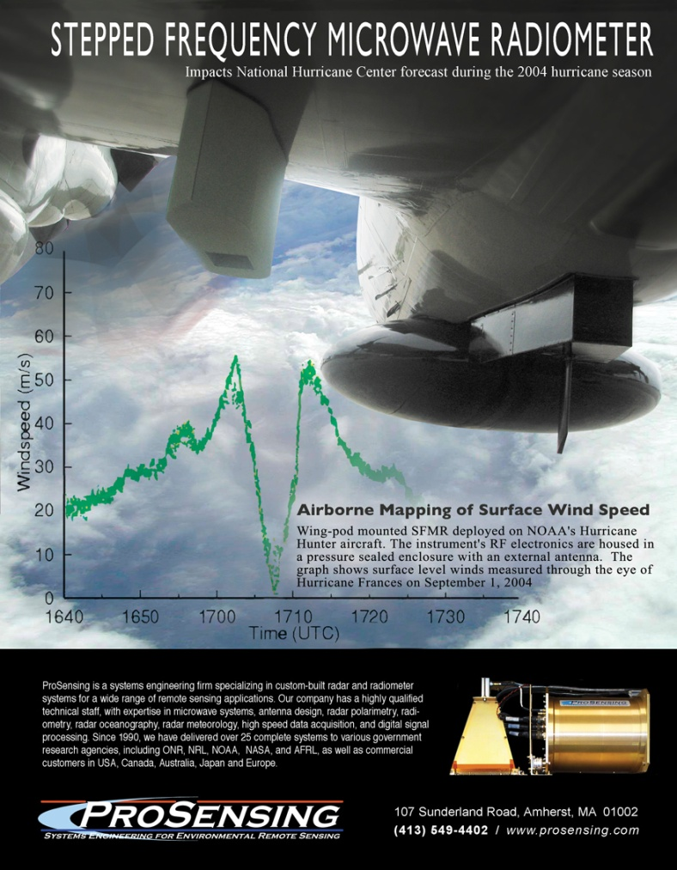
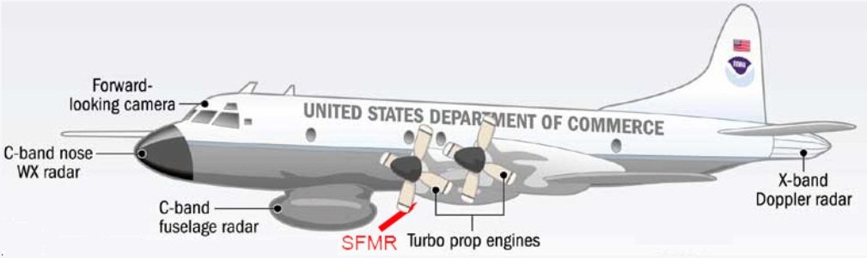
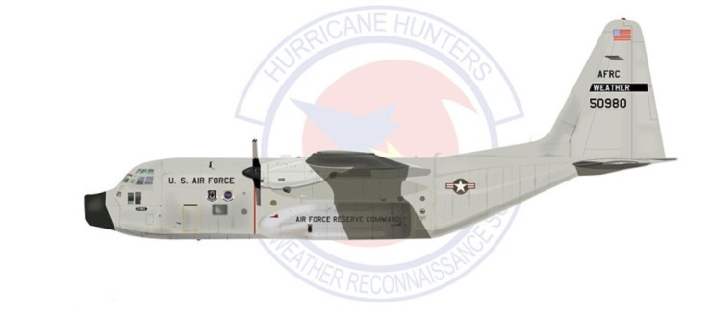
Retrievals of Wind and Rain Rate from Combined Measurements of Up-Looking and Down-Looking SFMRs
67th Interdepartmental Hurricane Conference
Mark Goodbarlet markg@prosenisng.com
Ivan PopStefanija
popstefanija@prosensing.com
ProSensing Inc.
107 Sunderland Road
Amherst, MA 01002 USA

Slide 2
SFMR Measures Microwave Emission by Ocean and Atmosphere
Microwave emission (brightness temperature), T_{BD}, measured by Down-Looking SFMR:
  where: = an upward-looking brightness temperature
  and T_{BK} is sky background emission =𝑇(ℎ_{R},∞)
Definitions:
atmosphere transmission between altitudes, h₁ and h₂
atmosphere emission between altitudes, h₁ and h₂
microwave reflection from ocean surface
ocean physical temperature (K)
Notes:
Real-time measurements in hurricanes are critical
- for providing the extent of12 foot seas (operational responsibility of NOAA)
- for improving hurricane forecasting and prediction of the
NOAA SENDs THE RECONISSANCE AIRCRAFT as a probe into the hurrican according to the NHC director there is other reporting of the sea hight

Slide 3
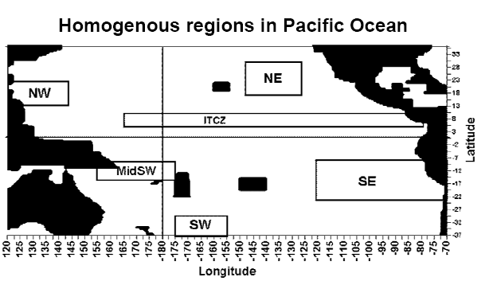
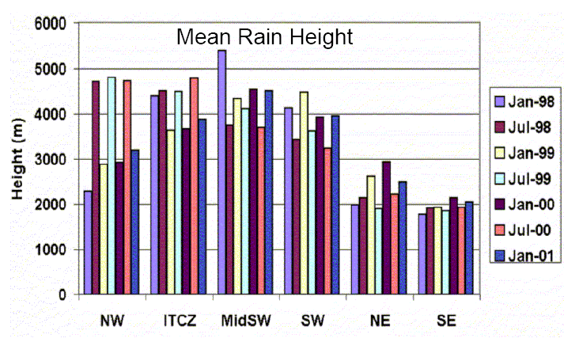
SFMR Retrieval Algorithm for Wind Speed and Rain Rate cannot retrieve Rain Height
Currently implemented SFMR retrieval algorithm calculates Wind Speed and Rain Rate with assumption that Rain Height has fixed value of 4000 meters
Actual rain height varies significantly from 4000m [Natarajakumar, 2004].

Slide 4
Combined measurements using
Up-Looking and Down-Looking SFMR
Up-Looking SFMR Measurement:
  => sky background
Down-Looking SFMR Measurement:
Only T_{BU} depends on the rain height, h_{R}
Direct measurement of T_{BU} with the up-looking SFMR eliminates SFMR retrieval algorithm’s dependency on rain height, h_{R}

Slide 5
Consequence of fixed Rain Height – Part 1
Rain Rate Retrieval Bias
Depends on rain height but not wind and rain
Example:
If actual rain height is 5000 m, then assuming 4000 m will bias the retrieved rain rate by 8% when flight altitude is 3000 m.
Calculated using the current SFMR measurement model
Notes:
If we know the rain height there would be no rain rate bias…

Slide 6
Consequence of Fixed Rain Height – Part 2
Low Wind Speed Rate Retrieval Bias
  Depends on wind, rain and rain height
Example:
If actual rain height is 5000 m, then assuming 4000 m will bias the retrieved wind by 7% when actual wind is 10 m/s, rain rate is 30 mm/hr, and flight altitude is 3000 m.

Slide 7
Consequence of Fixed Rain Height – Part 3
High Wind Speed Rate Retrieval Bias
      Depends on wind, rain and rain height
Fixed rain height:
causes negligible retrieval bias for in conditions of high winds
has minimal effect on the quality of the reported SFMR winds in hurricane conditions

Slide 8
In perspective
SFMR system error
SFMR measurement precision (NEDT) causes random error in retrieved winds. This error is high at low winds because SFMR has low sensitivity to changes in low wind speed

Slide 9
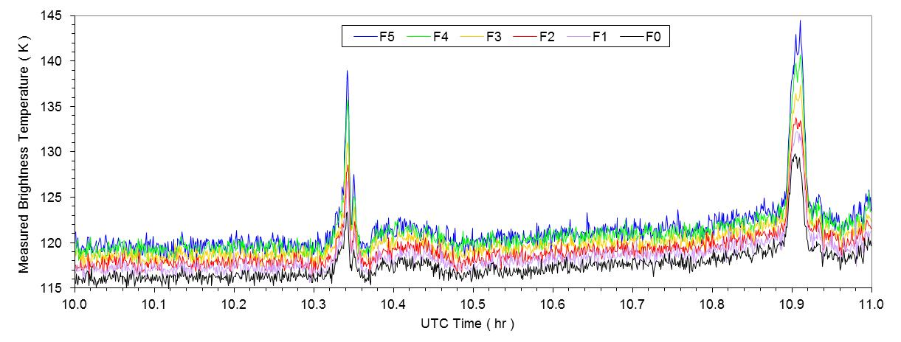
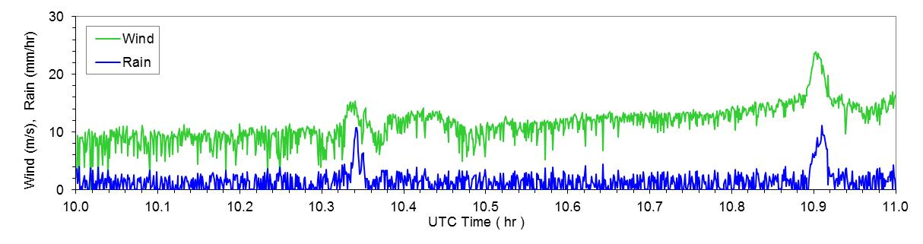
Rain Bias on SFMR Retrieved Winds Data Example
Down-looking SFMR, tropical storm Leslie, 07 Sep 2012

Slide 10
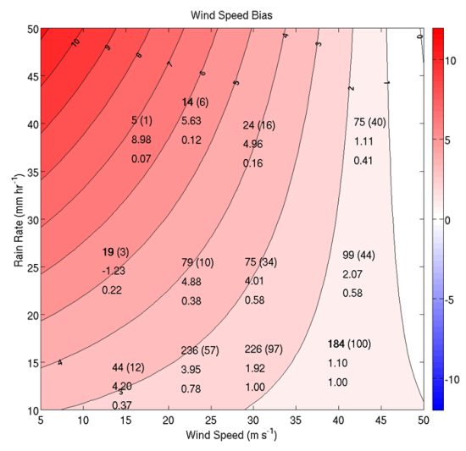
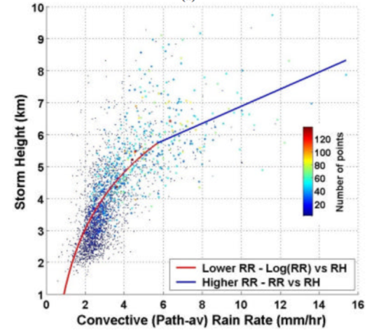
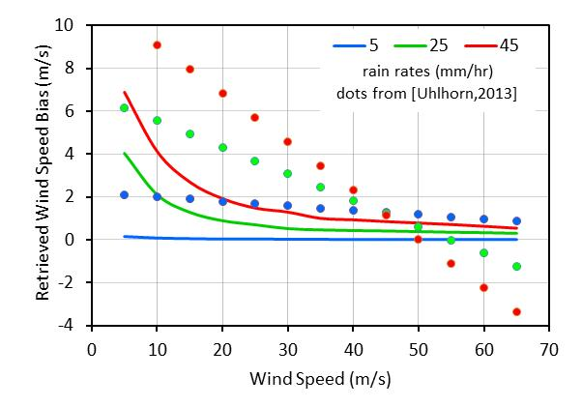
Rain Bias on SFMR Retrieved Winds
Simulation
← [Uhlhorn & Klotz, 2012] reported measurements of a rain-dependent bias on SFMR-retrieved winds
[Natarajakumar, 2004] reported measurements showing correlation between convective rain rate and rain height →
Simulation Experiment:
  Modify SFMR model to have variable rain height, computed from the [Natarajakumar, 2004] relationship with rain rate. Generate data using this model.
  Use current SFMR retrieval algorithm (with fixed rain height) to retrieve winds from the generated data. Biases on the retrieved winds resulting from rain-height differences are plotted at right along with biases reported by [Uhlhorn & Klotz, 2012].

Slide 11
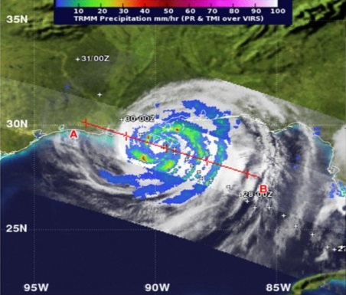
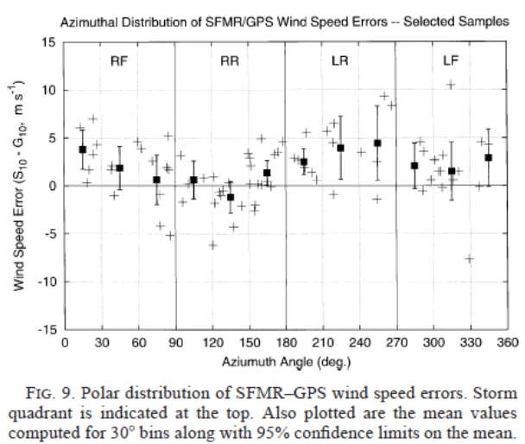
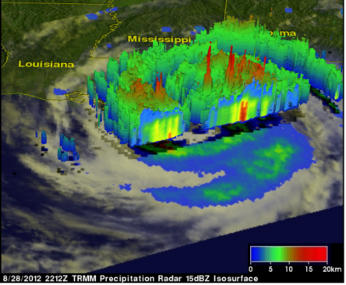
Hurricane Quadrant Bias on SFMR Retrieved Winds
Hurricane Quadrant bias could be (partially) explained to be a result of the higher rain height then the algorithm assumed fixed rain height of 4000 m in the LR and RF quadrants.
Higher rain rates generally correspond to higher rain heights [Natarajakumar, 2004]. The TRMM images show higher rain rate and cloud tops in the right-front(RF) and left-rear(LR) quadrants of hurricane Isaac, both of which suggest higher rain heights. If these rain heights exceed the 4000m assumed by the SFMR retrieval algorithm, then SFMR retrieved winds will be biased high as shown by our calculations plotted at left and by the measurements plotted above from [Uhlhorn & Black, 2003]
TOP: Hurricane Isaac on 29Aug12 tracking NW. TRMM derived rain rate (colors)
overlayed on VIRS infrared (black and white). BOTTOM: 15dBZ cloud heights. http://trmm.gsfc.nasa.gov/

Slide 12
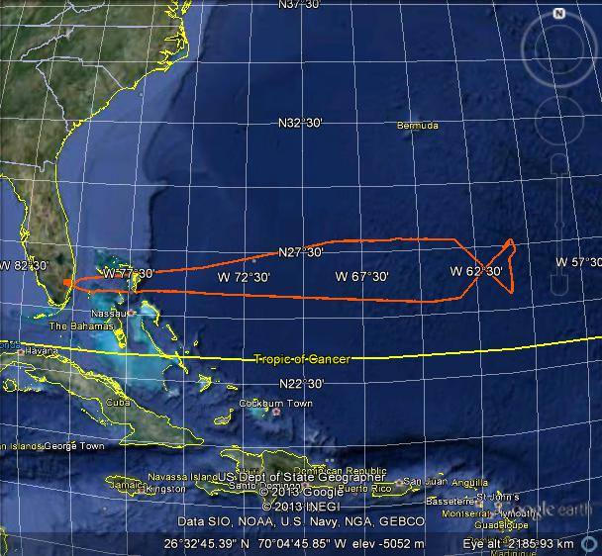
NOAA WP-3D Flight with both Up-Looking and Down-Looking SFMR
Tropical Storm Leslie, date: 07 Sep 2012

Slide 13
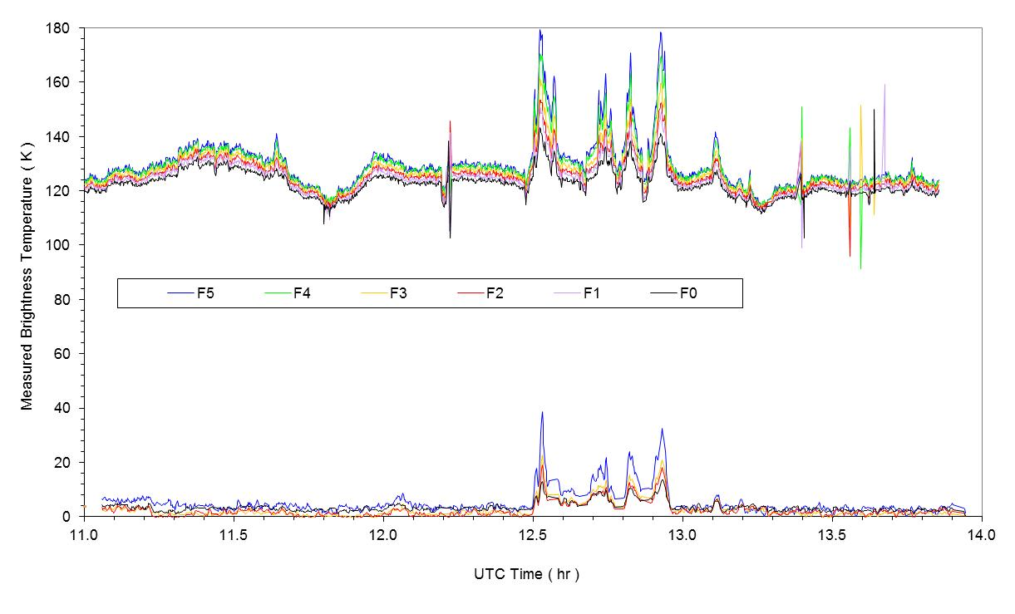
Measurements of Brightness Temperature with Down-Looking and Up-Looking SFMR

Slide 14
UP-Looking SFMR Measurement Brightness Temperature
Frequency channels F1 and F4 corrupted by RFI
measured by
up-looking SFMR >>
inferred by
down-looking SFMR >>

Slide 15
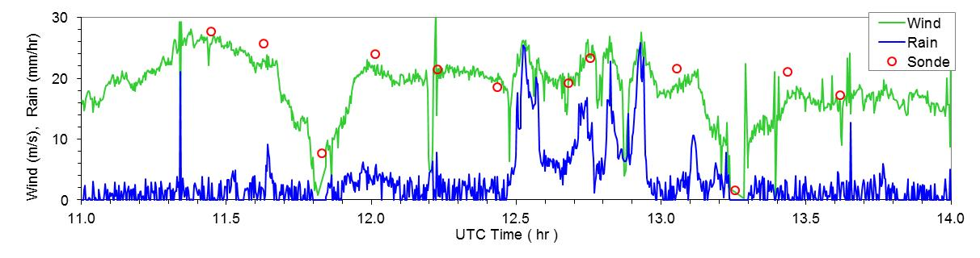
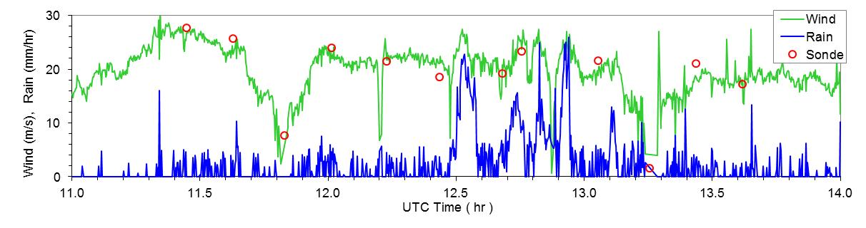
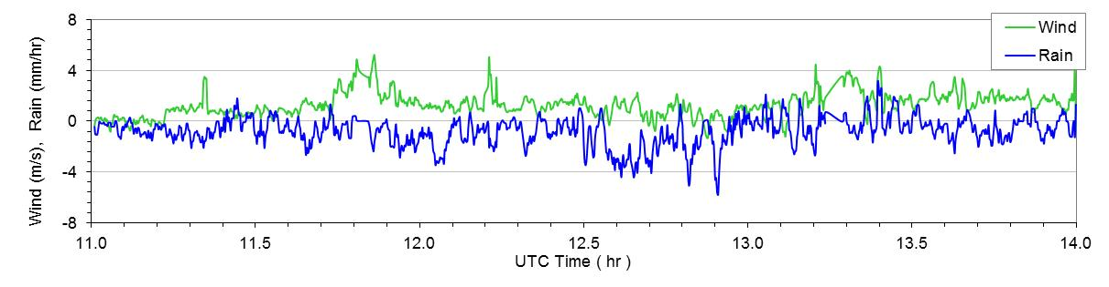
Retrievals of Wind and Rain from Combined Measurements of Up-Looking and Down-Looking SFMRs
Down Looking
Up & Down Looking
Difference (B-A)

Slide 16
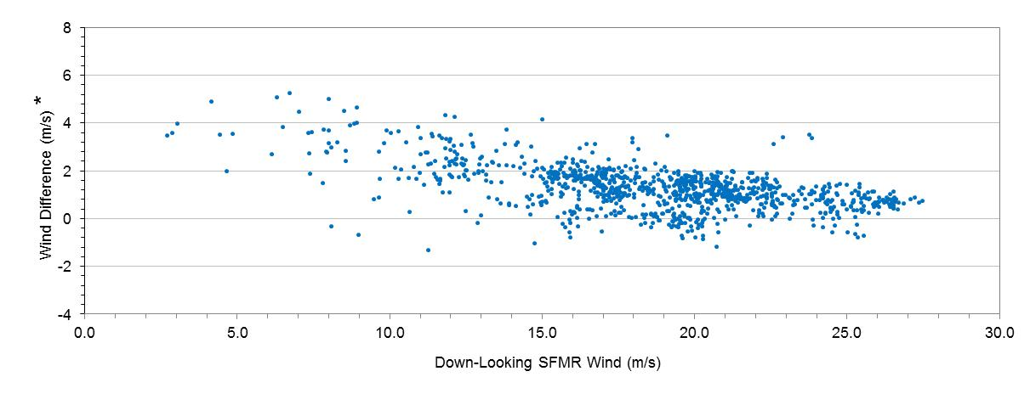
Retrievals of Wind and Rain from Combined Measurements of Up-Looking and Down-Looking SFMRs
Difference in wind speed measurement between current SFMR retrieval and Combined up & Doan SFMR retrieval

Slide 17
Calibration of Up-Looking SFMR
Flying above the clouds permits calibration of up-looking SFMR since the brightness temperature of the sky is accurately known

Slide 18
Closing Comments
The actual rain height can vary significantly from the fixed value of 4000 m as set in the SFMR retrieval algorithm, introducing biases in both the retrieved rain rate and the wind speed.
Theoretical analysis shows that rain rate bias can be on the order of 20% depending on the discrepancy of the actual rain height from the fixed value set in the SFMR retrieval algorithm.
Theoretical analysis also shows that the wind retrieval bias due to the fixed rain height can be on the order of 20% for low winds (< 15 m/s).
Direct measurement of T_{BU} with the up looking SFMR eliminates SFMR retrieval algorithm’s dependency on rain height, h_{R}
Need more testing of up-looking SFMR with flights at low altitude, in low winds, and in rain.

Slide 19
Acknowledgements
NOAA SBIR project WC133R-08-CN-0159 for funding development of the special (compact) version of the SFMR used for the up-looking instrument.
NOAA Aircraft Operation Centre (AOC) for the full support installing the up-looking SFMR.
NOAA’s Hurricane Research Division (HRD) for flying both the up-looking and down-looking SFMRs during the 2012 hurricane season.
Richard Henning of NOAA’s Aircraft Operations Center (AOC) for processing and providing dropsonde data from the HRD flights.

