Slide 1
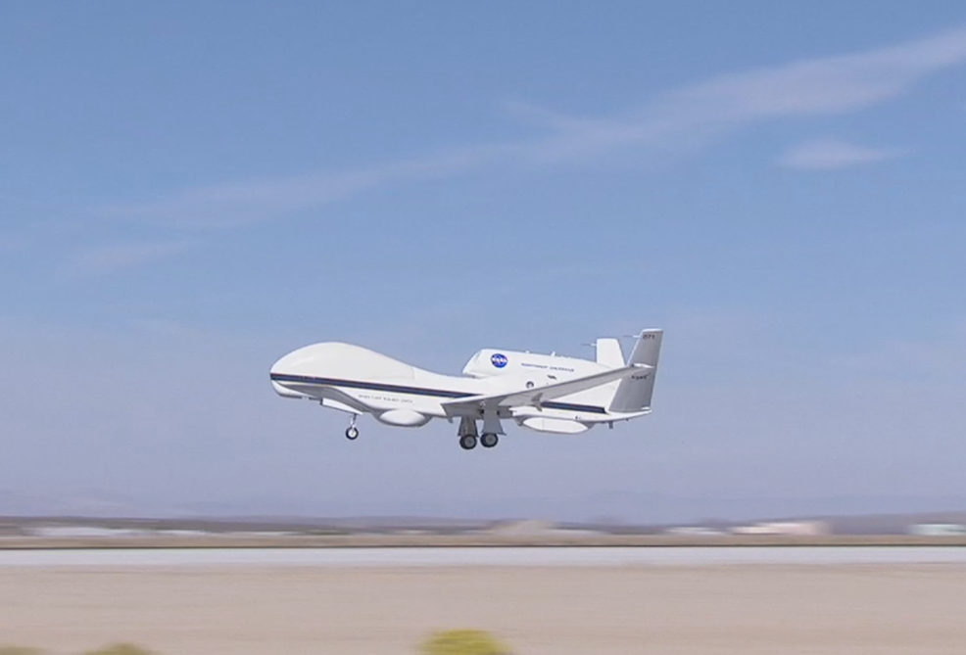




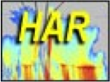
High-Altitude Imaging Wind and Rain Airborne Profiler (HIWRAP) Status and Future Plans
Gerry Heymsfield NASA/Goddard Space Flight Center
Lihua Li, Matt Mclinden NASA/Goddard Space Flight Center
Stephen Guimond U. MD/ESSIC
Lin Tian Morgan State Univ.
James Carswell Remote Sensing Solutions
HAMSR
HIWRAP
HIRAD
Picture of AV-1 Aircraft at Edwards AFB

Slide 2
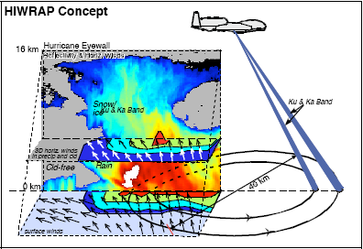
High-Altitude Imaging Wind and Rain Airborne Profiler (HIWRAP)
MEASUREMENTS GOALS:
Map the 3-dimensional winds and precipitation in precipitation regions associated with tropical storms.
Map ocean surface winds in clear to light rain regions using scatterometry.
HIWRAP Characteristics:
  Conically scanning.
  Simultaneous Ku/Ka-band & two beams @ 30 and 40 deg
  New technologies in radar: low power solid state transmitters with pulse compression, single antenna
  GPM radar frequencies.
Notes:
Increased sampling of storm temporally needed to capture RI and other events
Fills gaps in coverage from orbiting satellites.
Global Hawk new plane for science

Slide 3
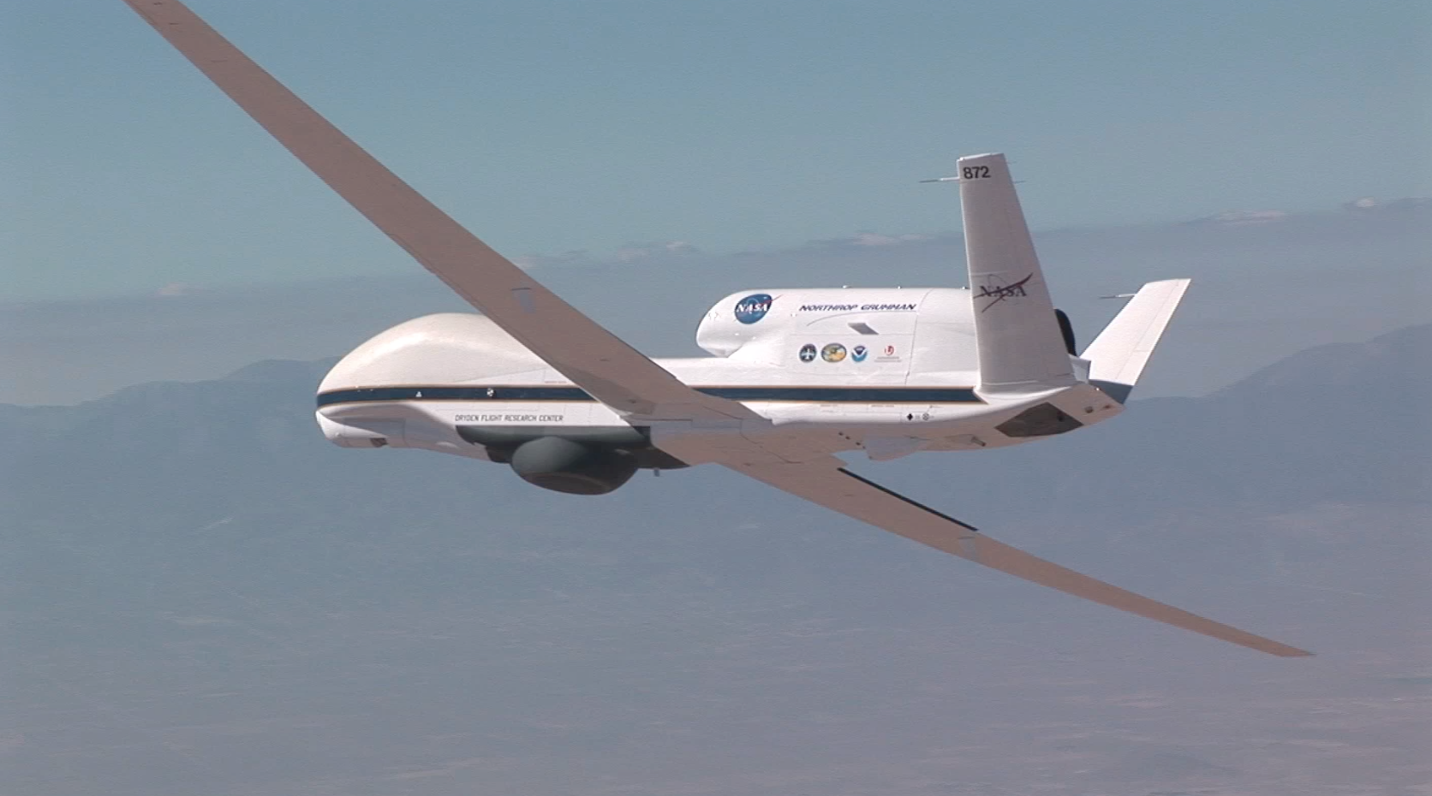
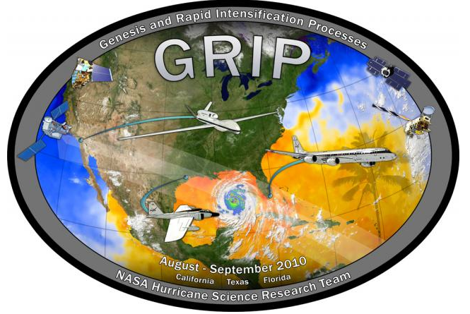


HIWRAP Development & Flights
Instrument development funded by NASA/ESTO Instrument Incubator Program (IIP) in 2006 as a new technology development.
GRIP AV-6 Global Hawk flights funded by NASA Weather Focus Area in Aug-Sept 2010.
Reconfigured for ER-2 non-scanning flights during MC3E (Oklahoma) for GPM validation in May 2011.
Funded for 5-years by HS3 (3 flight years) by with first AV-1 flights in Oct-Nov 2012.
AV-6
Notes:
3

Slide 4
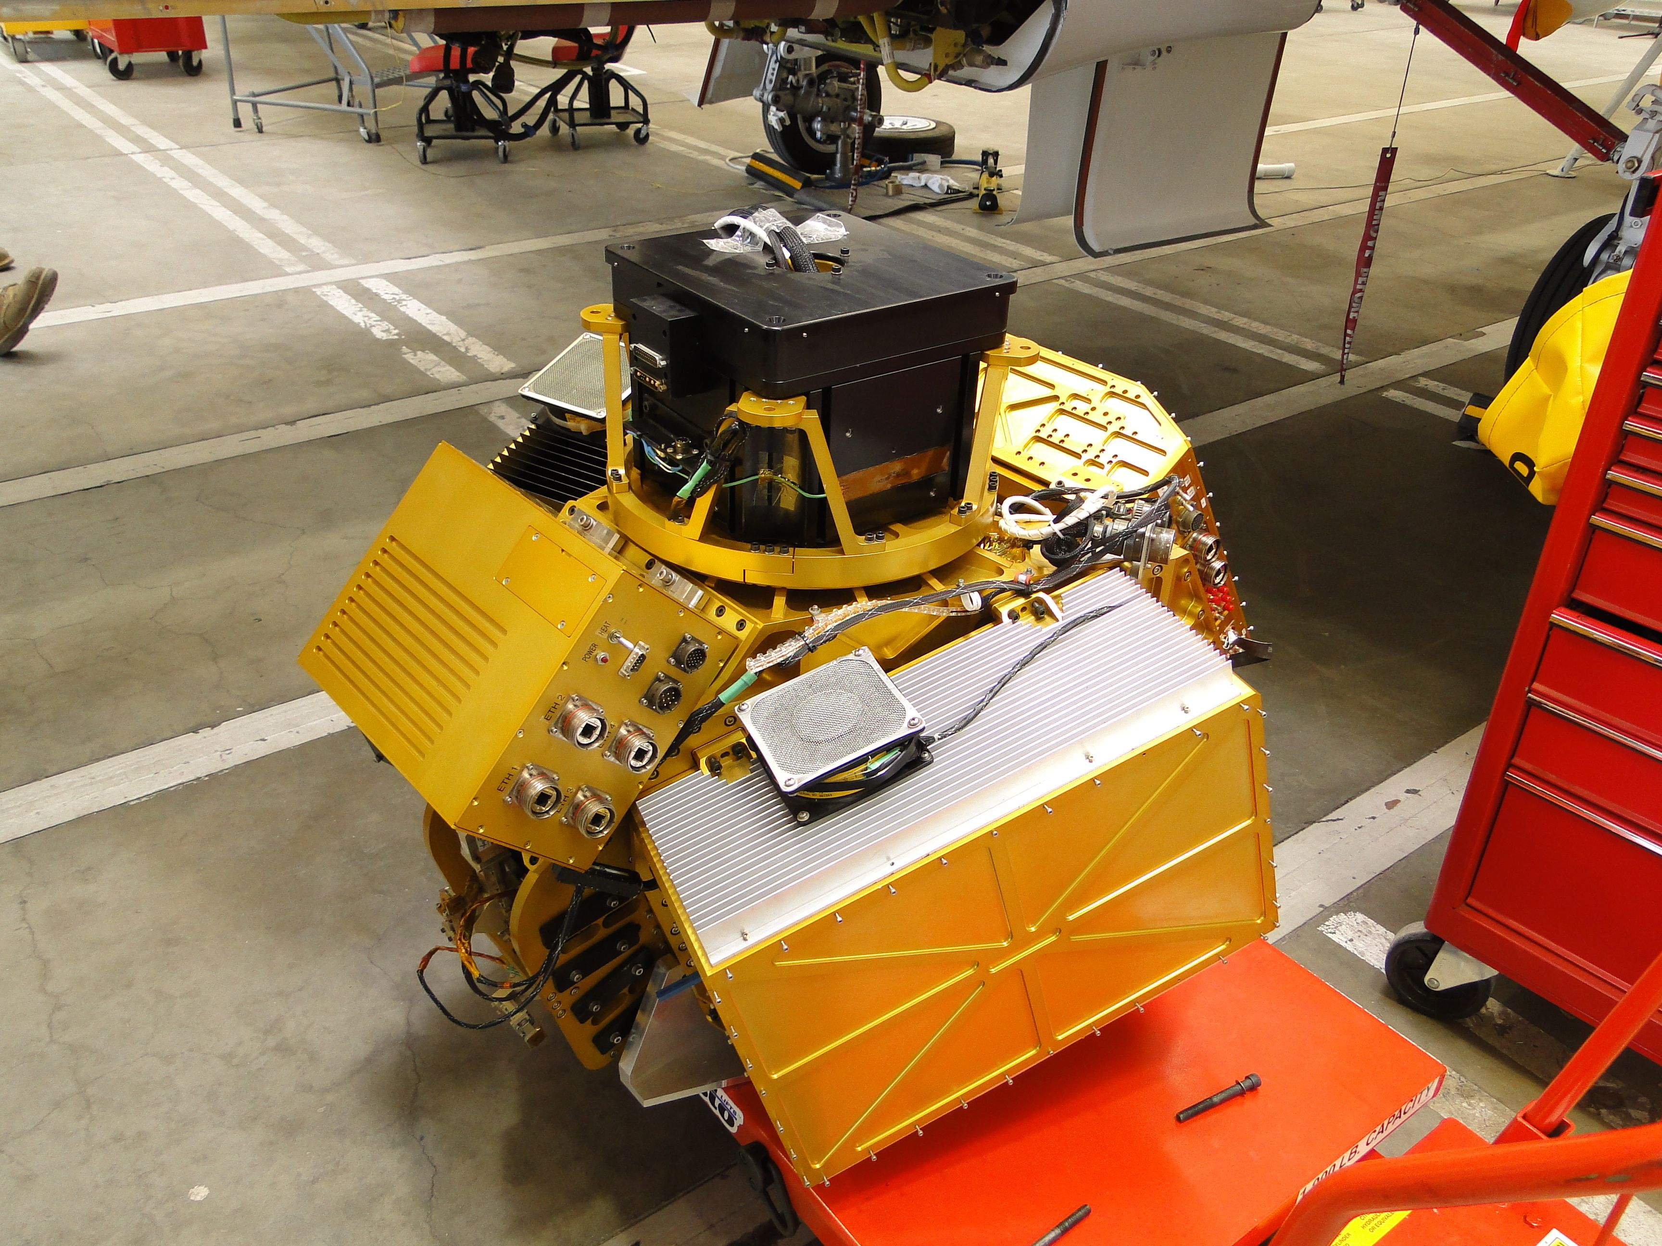
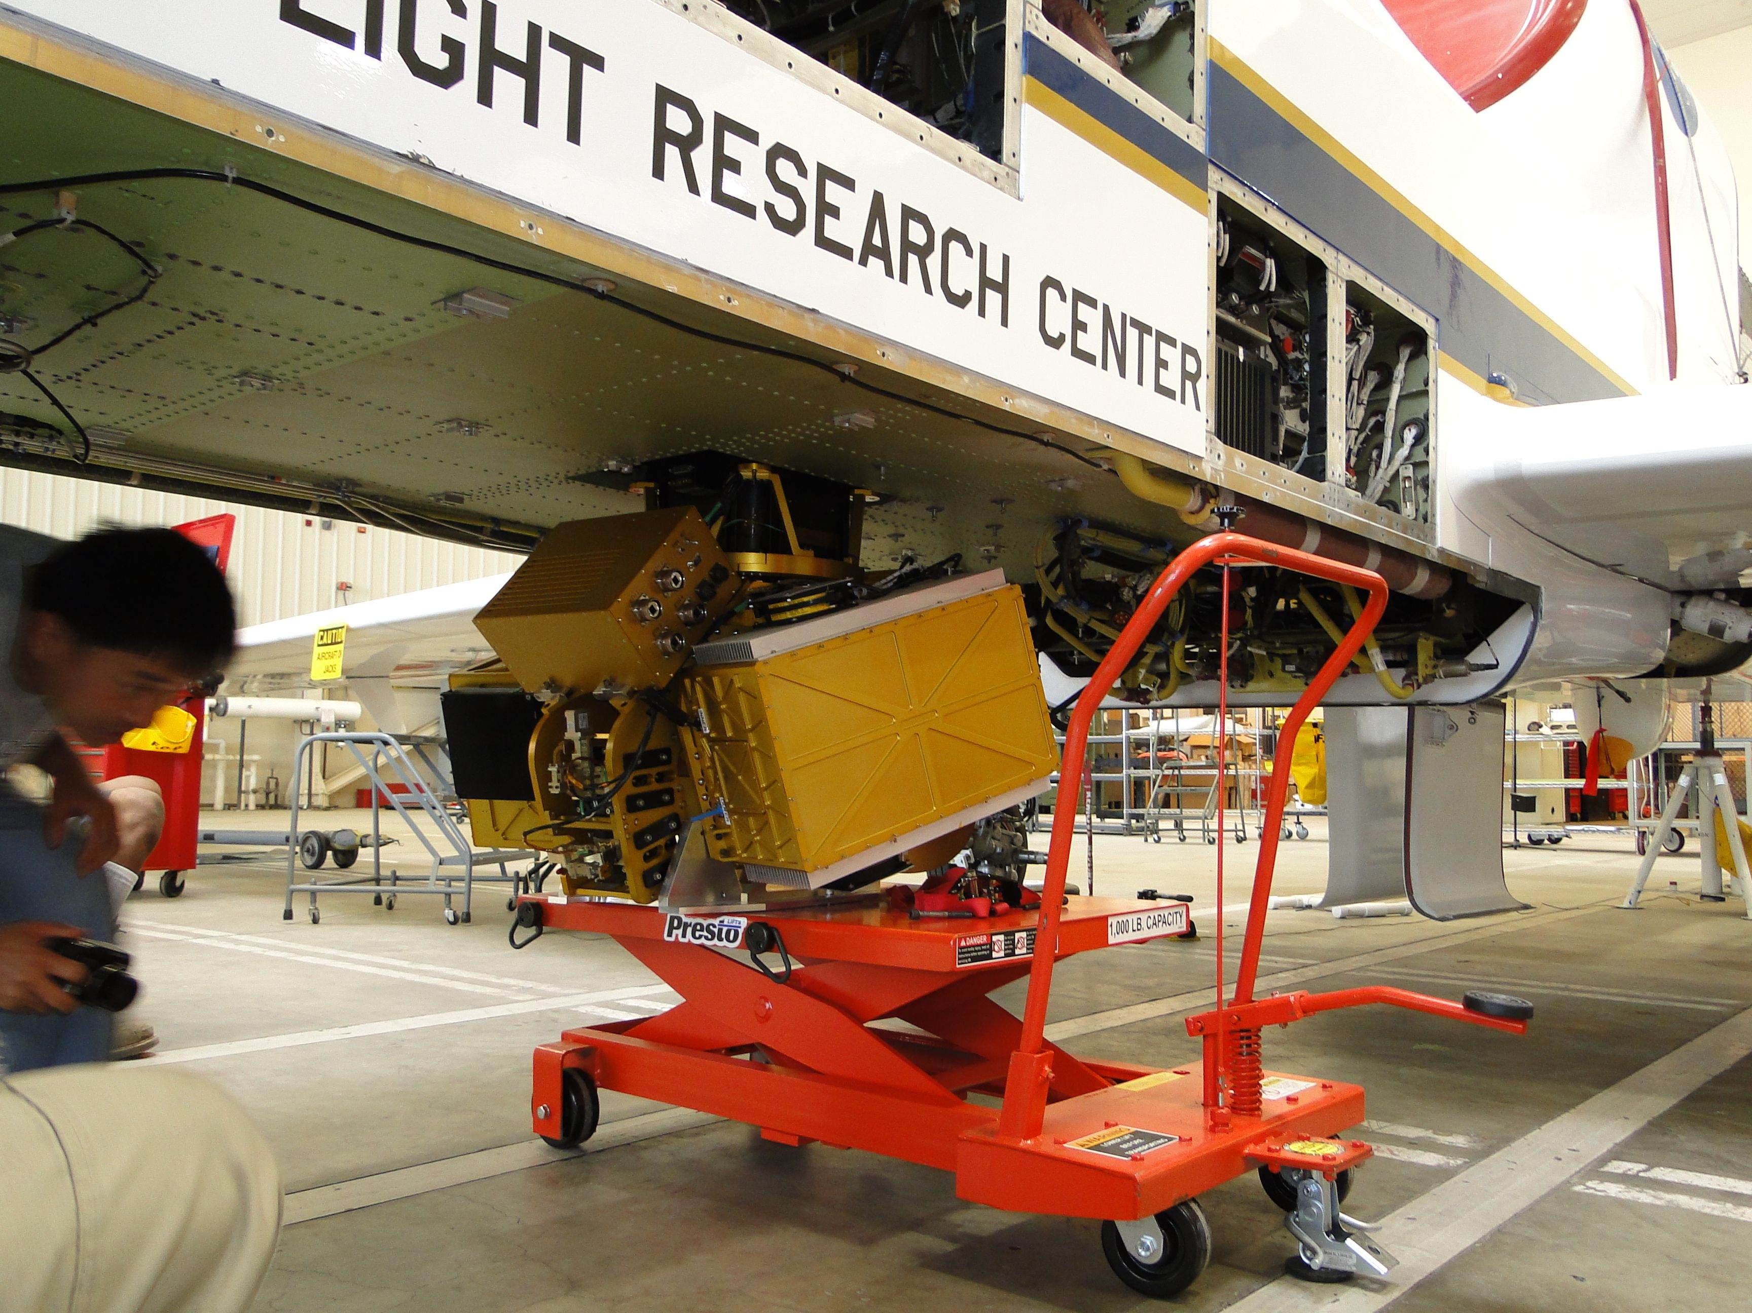
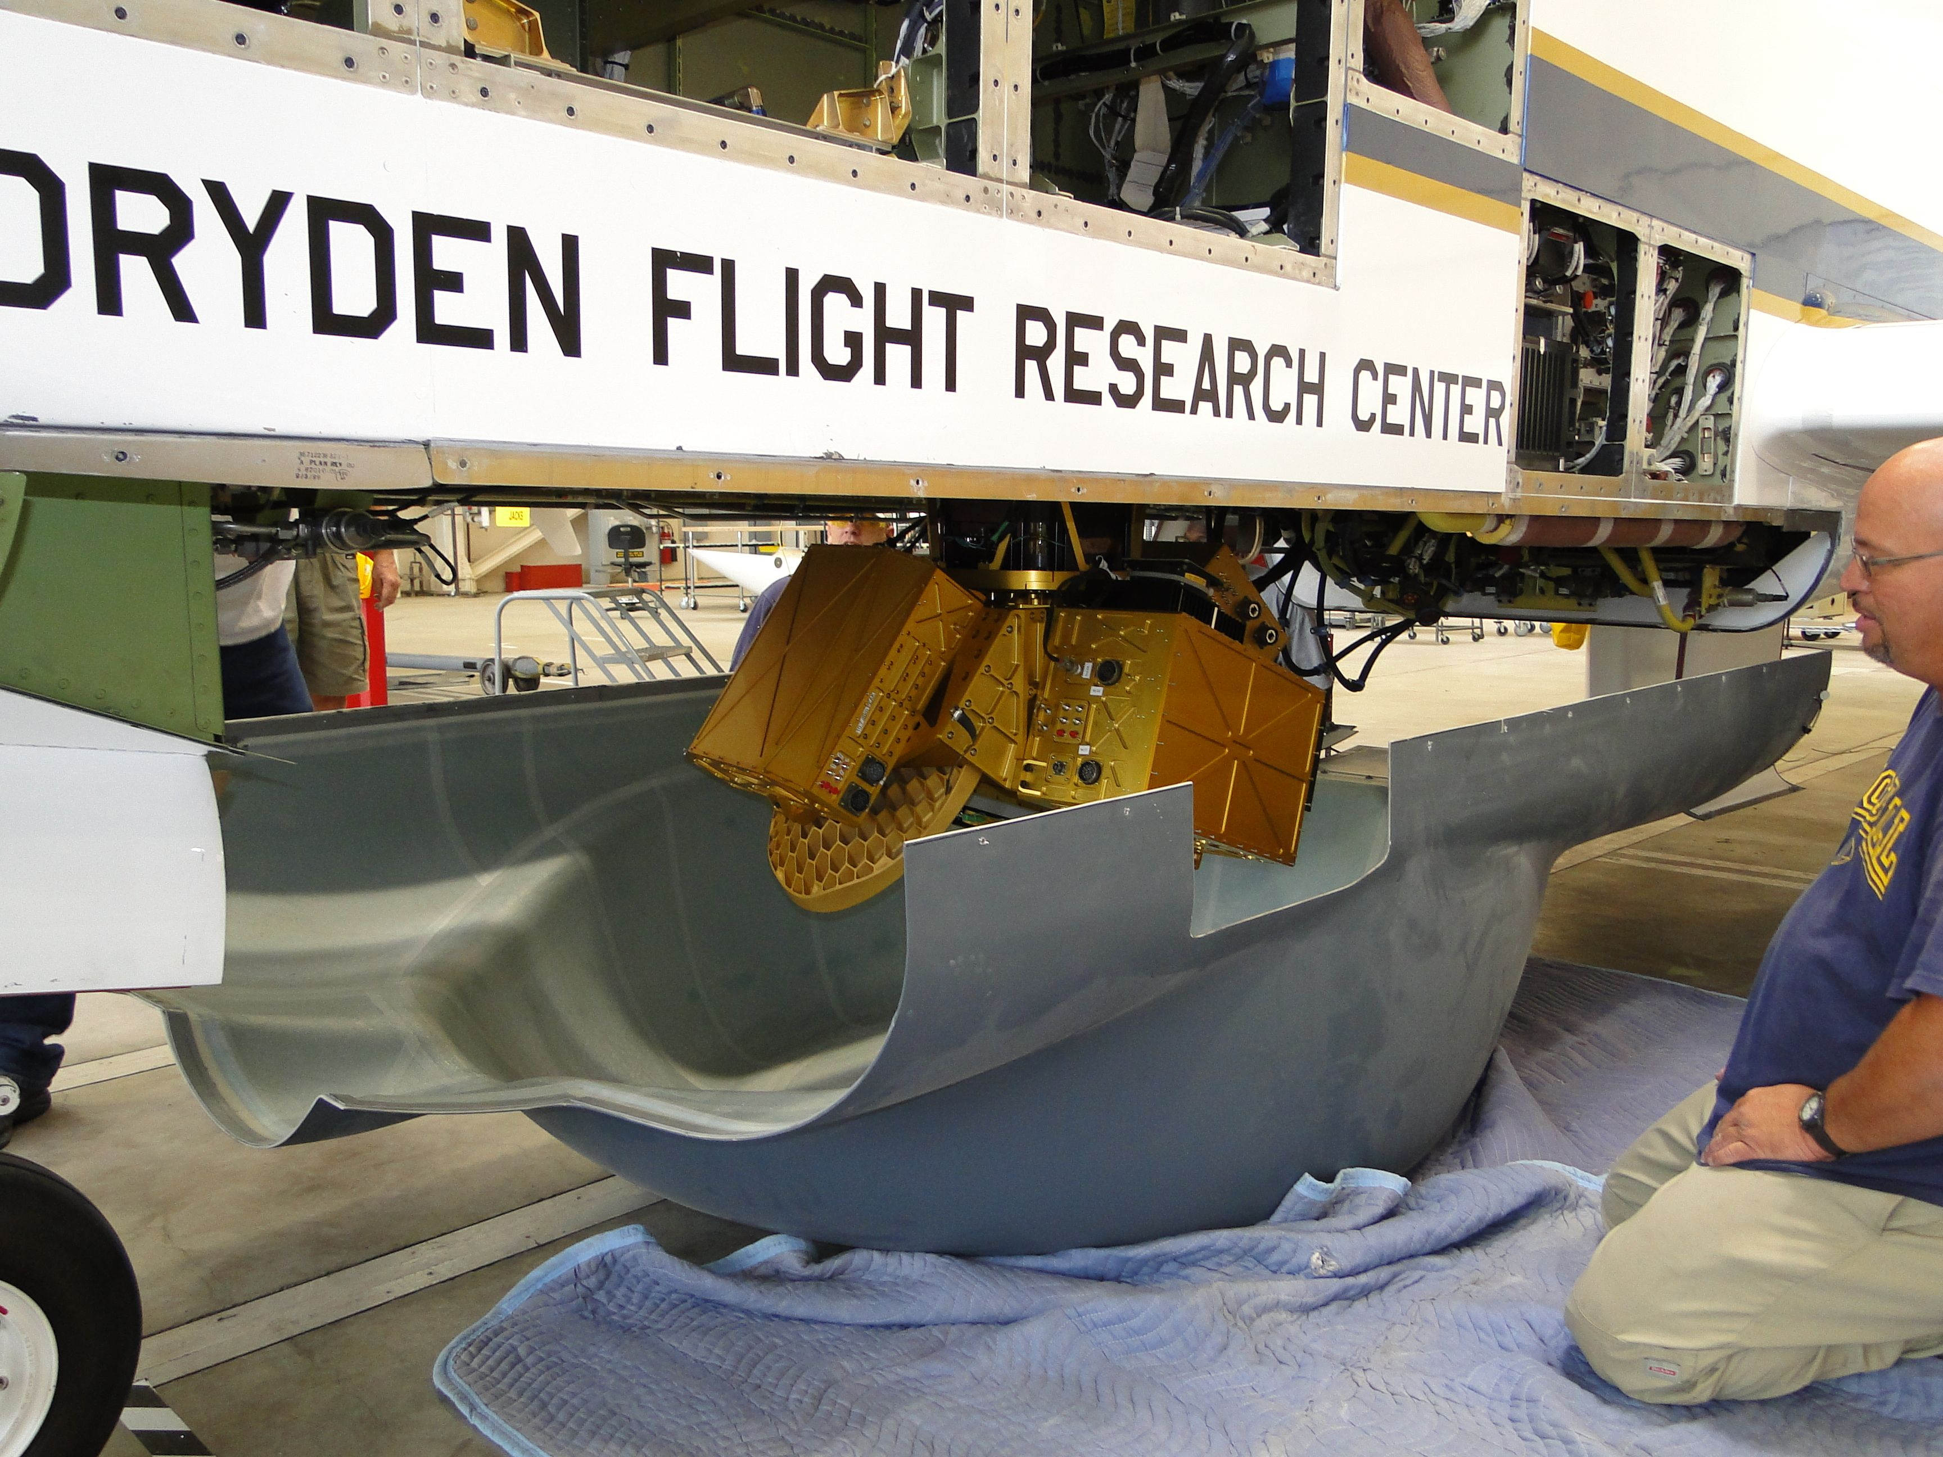
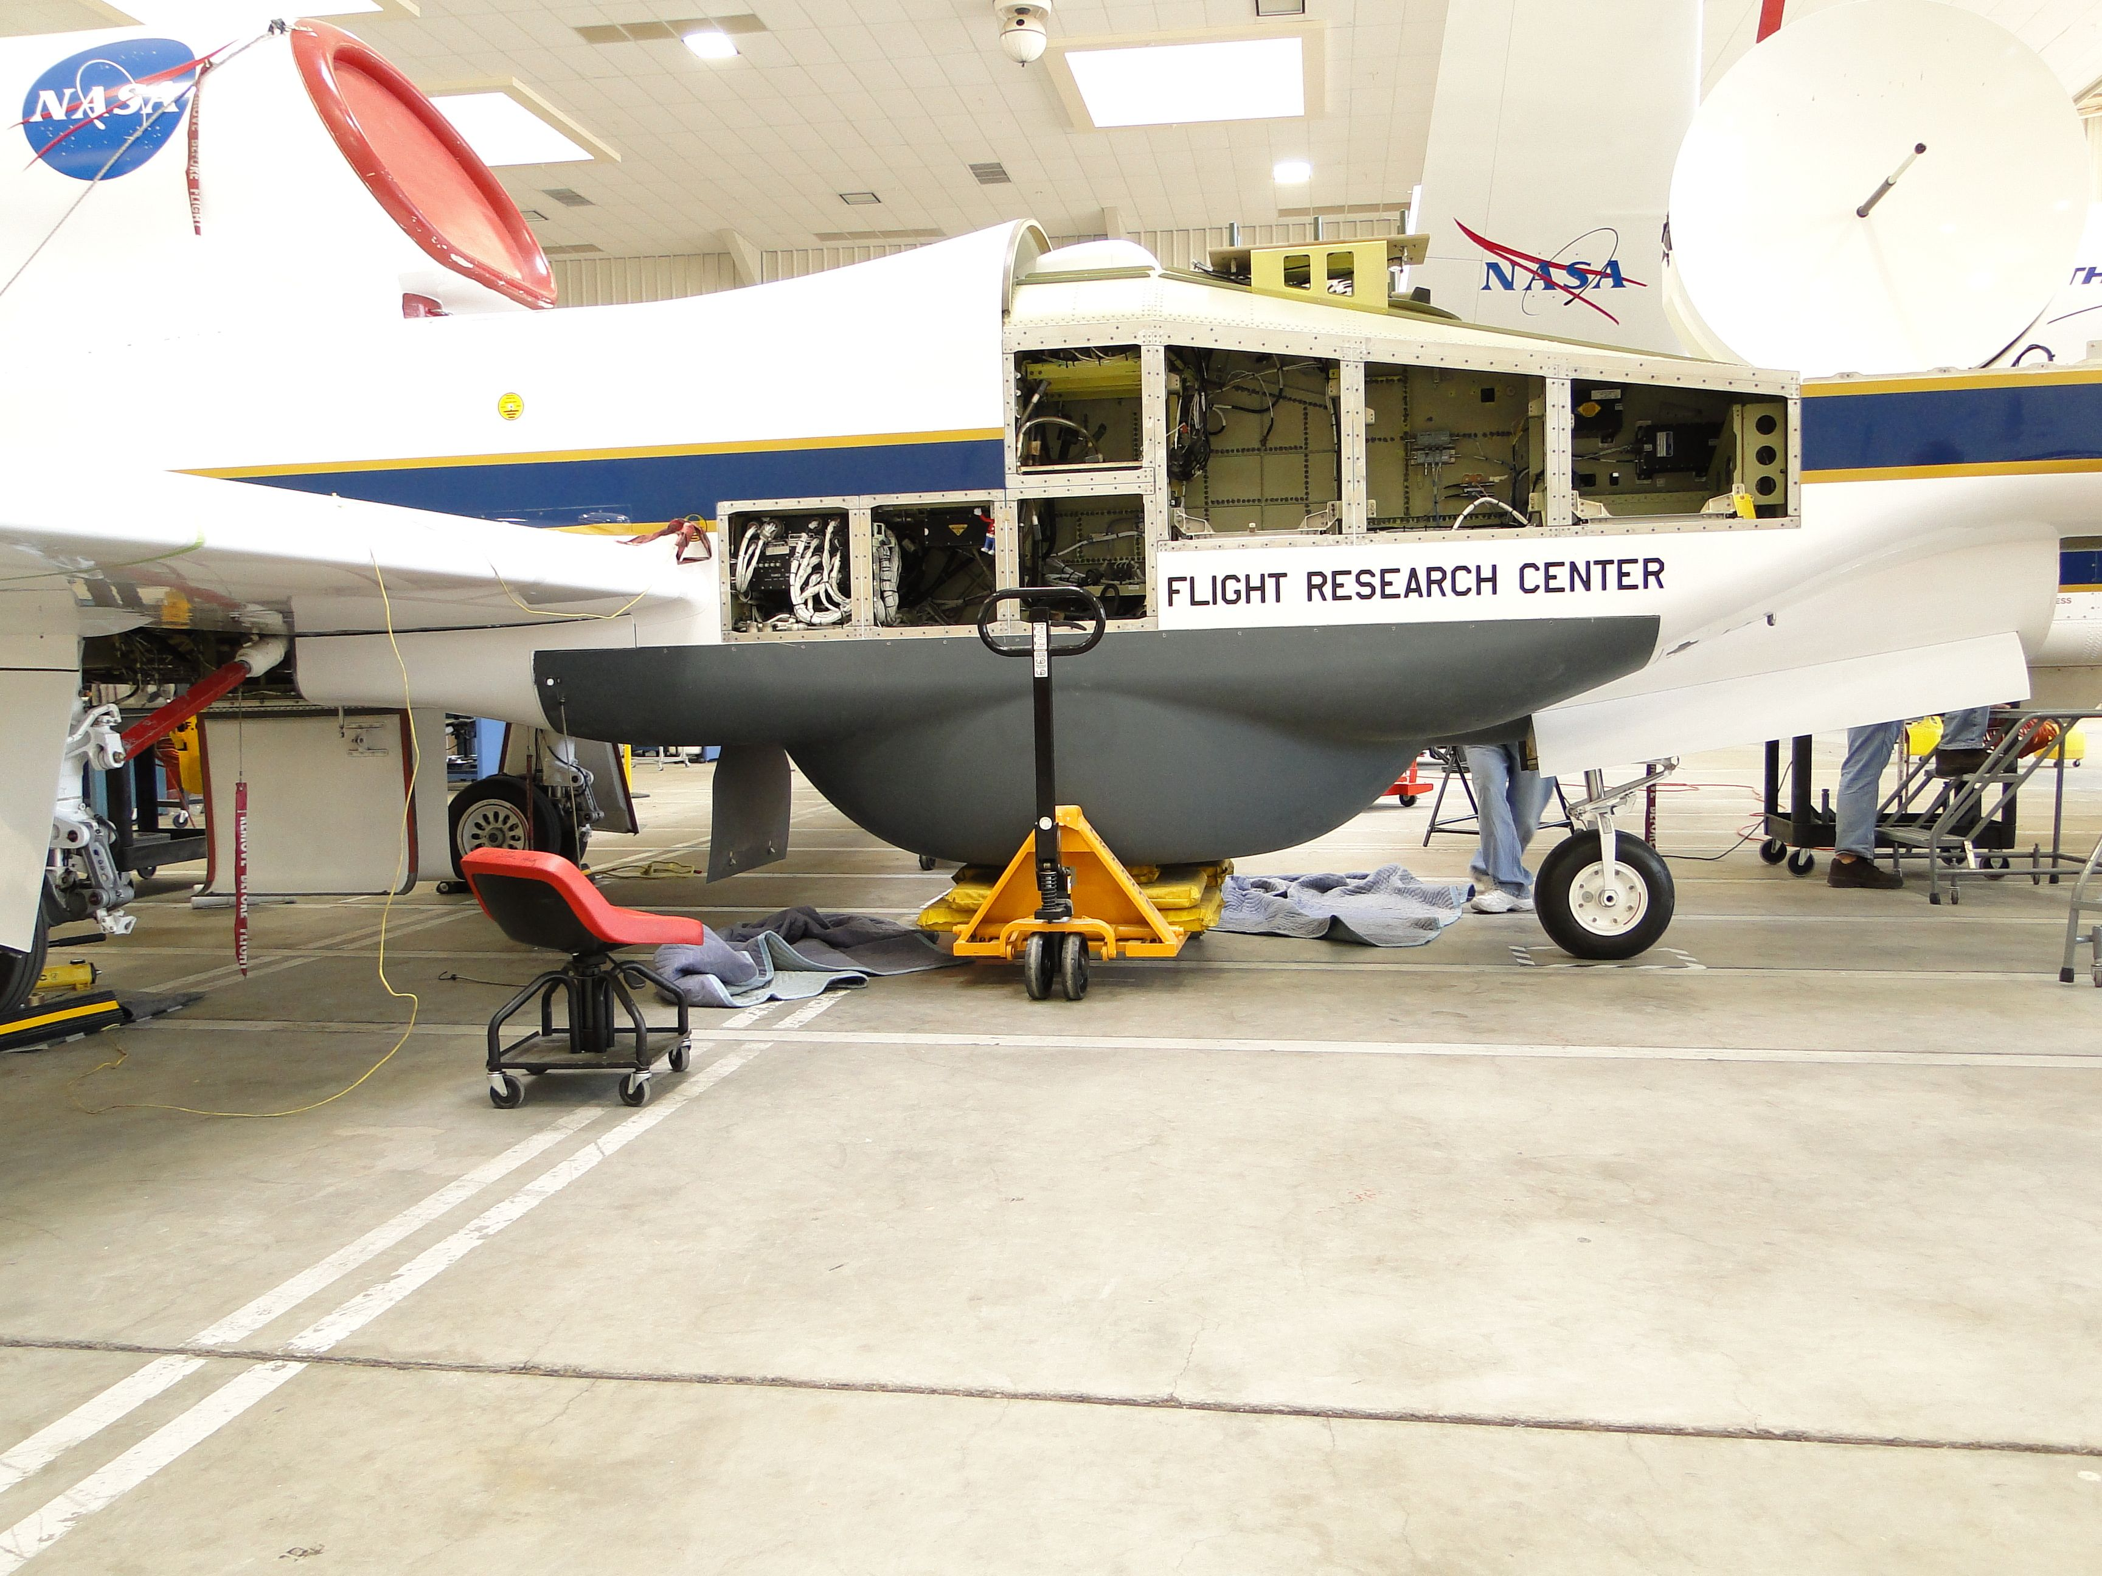

Slide 5
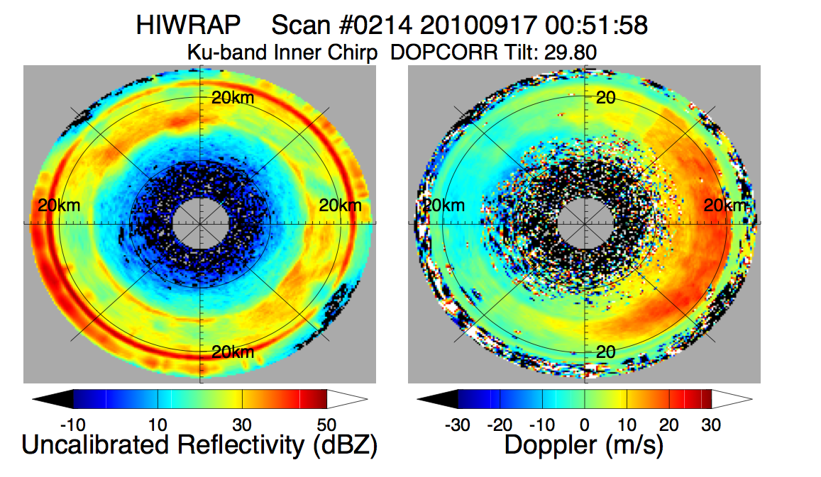
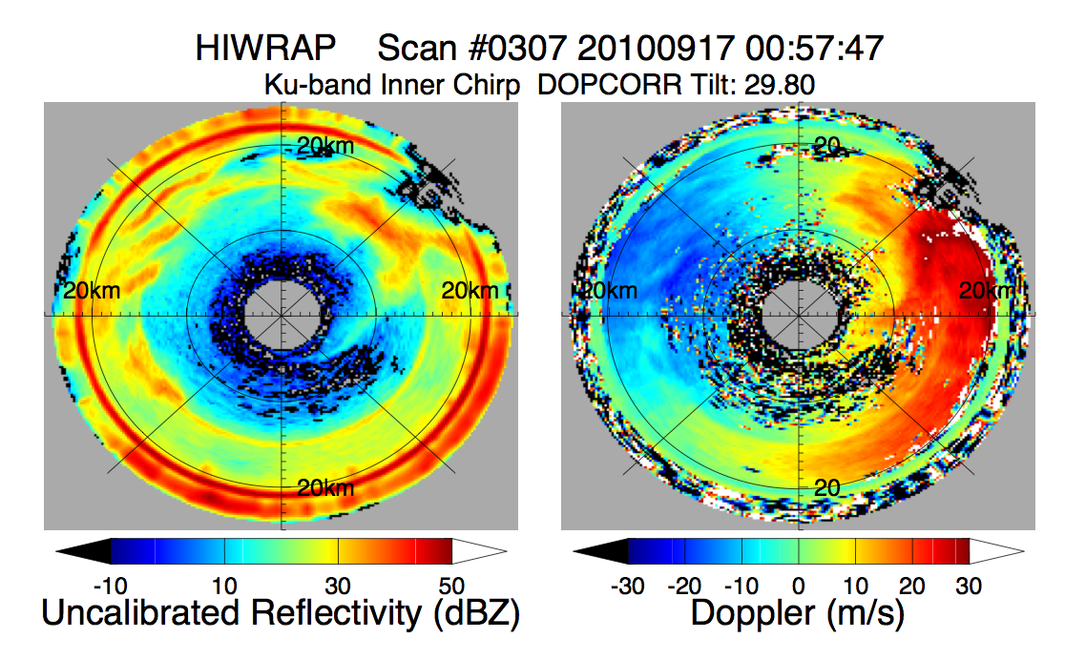
Polar Plot: 17 Sept 2010 Hurricane Karl
Reflectivity Doppler (air+fall speed)
HIWRAP: 20 crossings of Hurricane Karl on Sept. 17, 2010 during GRIP over 14 hours.
Doppler line of sight wind measurements are continually profiled during the conical scans.
Ku-band 30º H
Measurement Geometry
Ku-band 30º H

Slide 6
Wind Algorithms
High-data volumes currently collected and stored to disk on plane. Pulse-pair Doppler processing, unfolding, calibration, etc. performed on ground.
Atmospheric wind retrievals:
  Grid point analysis -> 3D volume under Global Hawk
    Guimond et al. Poster at meeting.
  VAD analysis -> 2D plane at nadir
    Tian et al.
  Good progress on wind algorithms and wind error analysis.
Ocean surface vector winds
  Still in early development
Data assimilation
  Sippel poster at meeting

Slide 7
Grid-point Analysis of Hurricane Karl (2010) Intensification During GRIP
~ 3 km height Ku-band Reflectivity (dBZ) & Wind Vectors
Grid-point analysis using inner (30 degree) beam.
Notes:
These are North to South GH overpasses of Hurricane Karl from HIWRAP. The passes span a total of ~ 12 hours with roughly 2 hrs between each N-S pass.
Actual delta T between each pass is: 2.25 h, 2.2 h, 2.5 h, 3 h, 1.67 h

Slide 8
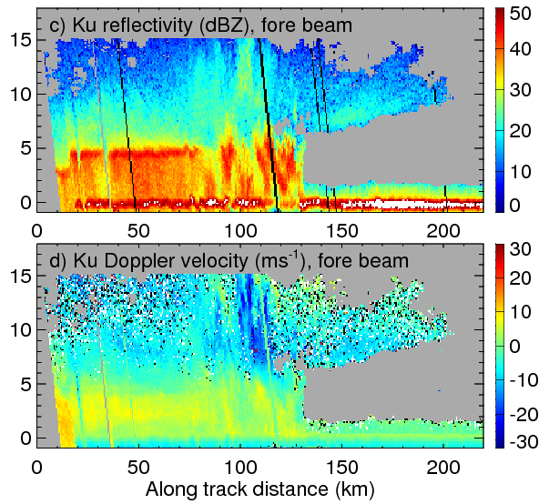
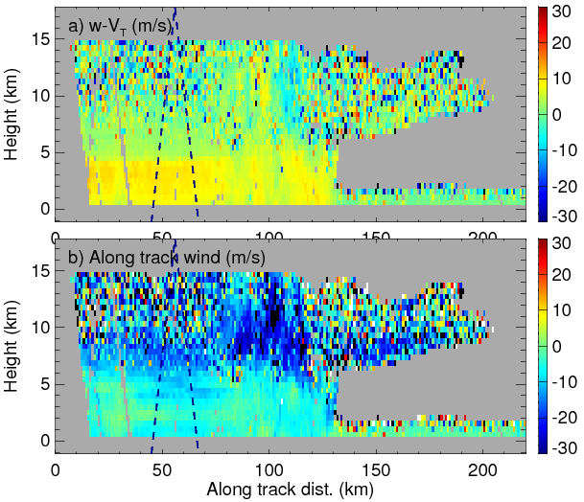
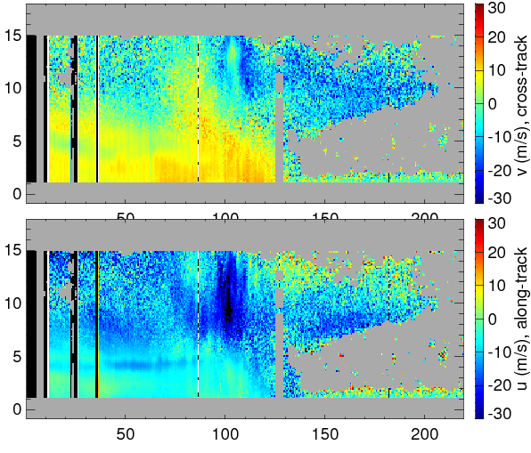
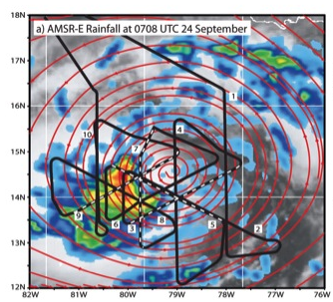
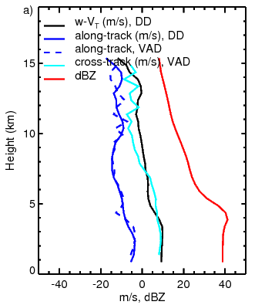
Nadir Wind retrieval for HIWRAP
Reflectivity (dBZ), Ku, inner, fore
Vertical particle velocity (m/s)
Cross-track wind, VAD, (m/s)
Doppler, Ku, inner, fore
Along-track wind, DD, (m/s)
Along-track wind, VAD, (m/s)
Along –track wind from dual-Doppler and VAD analyses agree in general;
Vertical wind from dual-Doppler analysis is used to compute the divergence assuming linear wind field in each VAD scan.

Slide 9
Hardware Upgrades for 2013
Upcoming improvements for 2013:
  New Ka-band transmitter for 12 dBZ sensitivity improvement
  New IF up/downconverters for better channel isolation
  Onboard Pulse Pair processing.
  Improved real-time data.

Slide 10
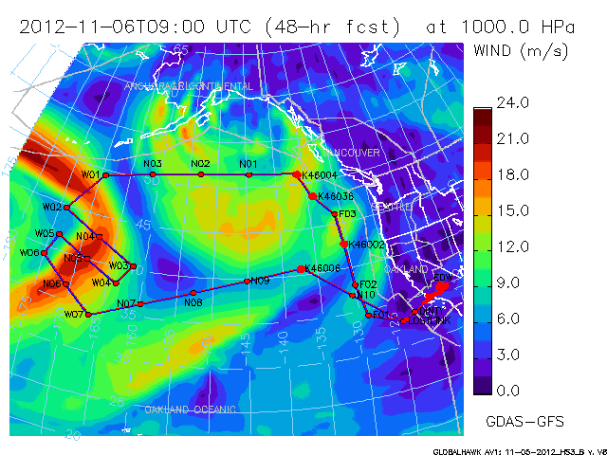
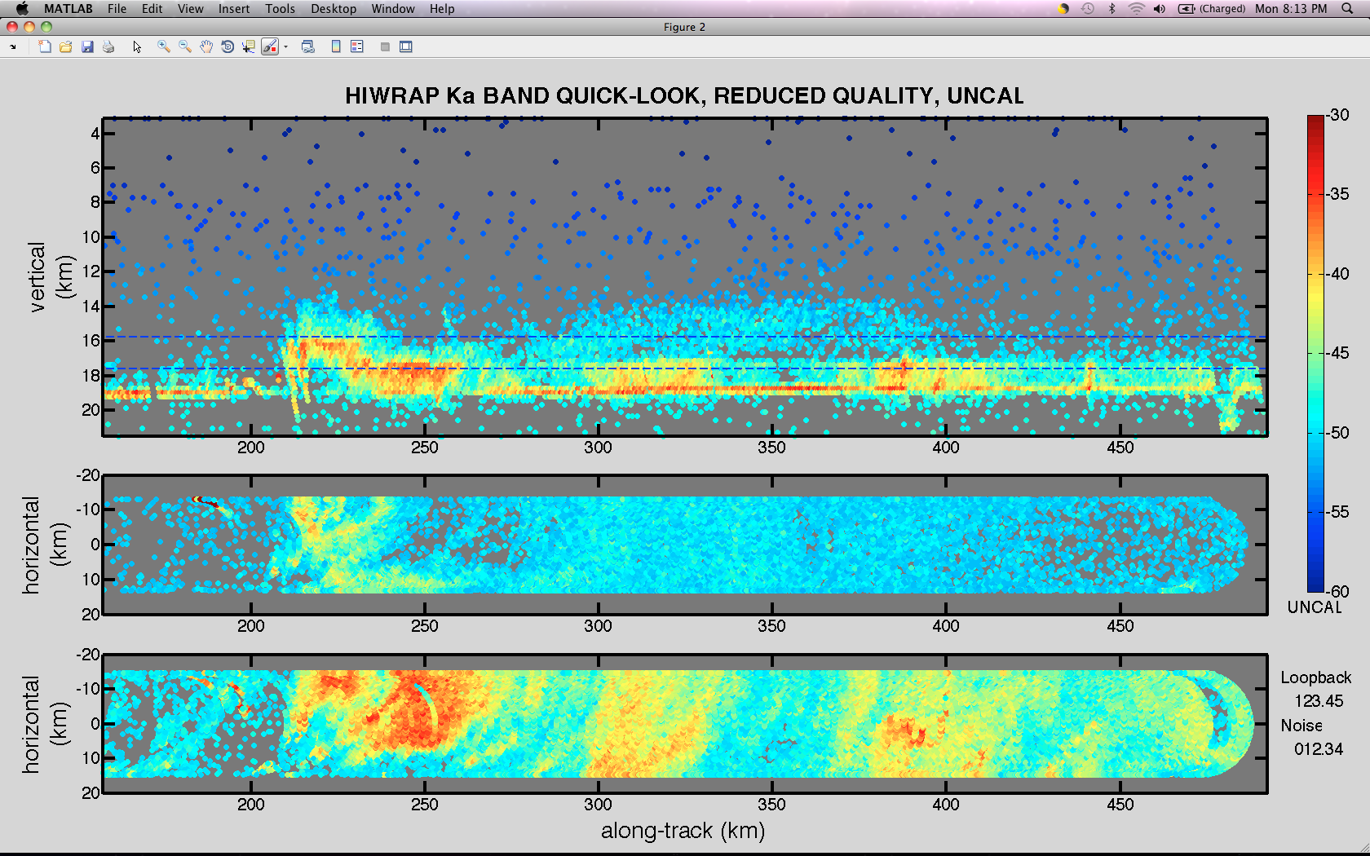
HS3 5-6 Nov 2012 Flight
Flight over the Pacific with emphasis on obtaining ocean surface winds.
Develop/evaluate ocean wind measurements.
HIWRAP obtained the first real-time data plots during AV-1 flights.
vert
4 km
<- First real-time data collected.
2 km

Slide 11
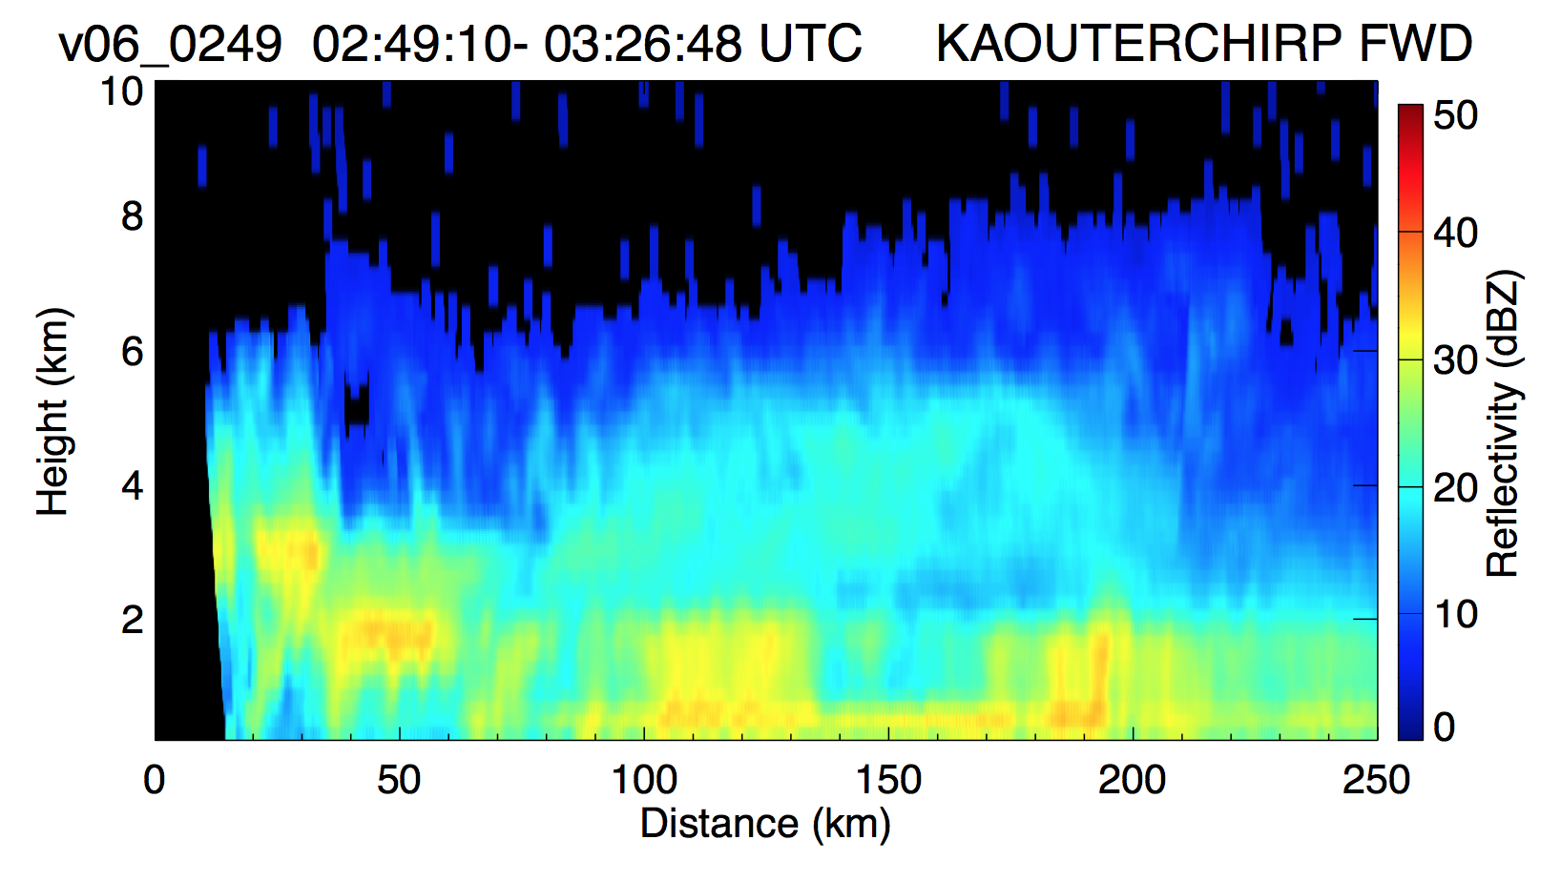
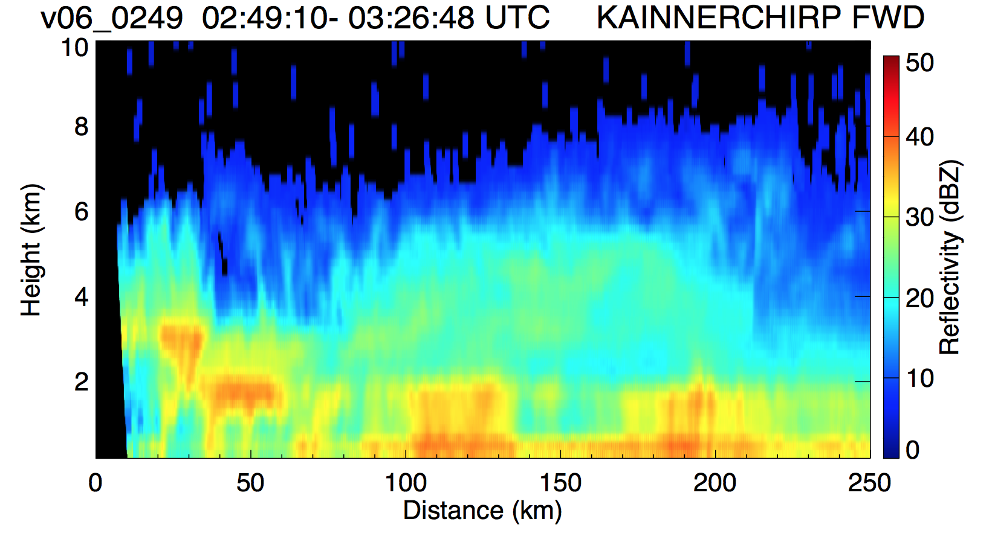
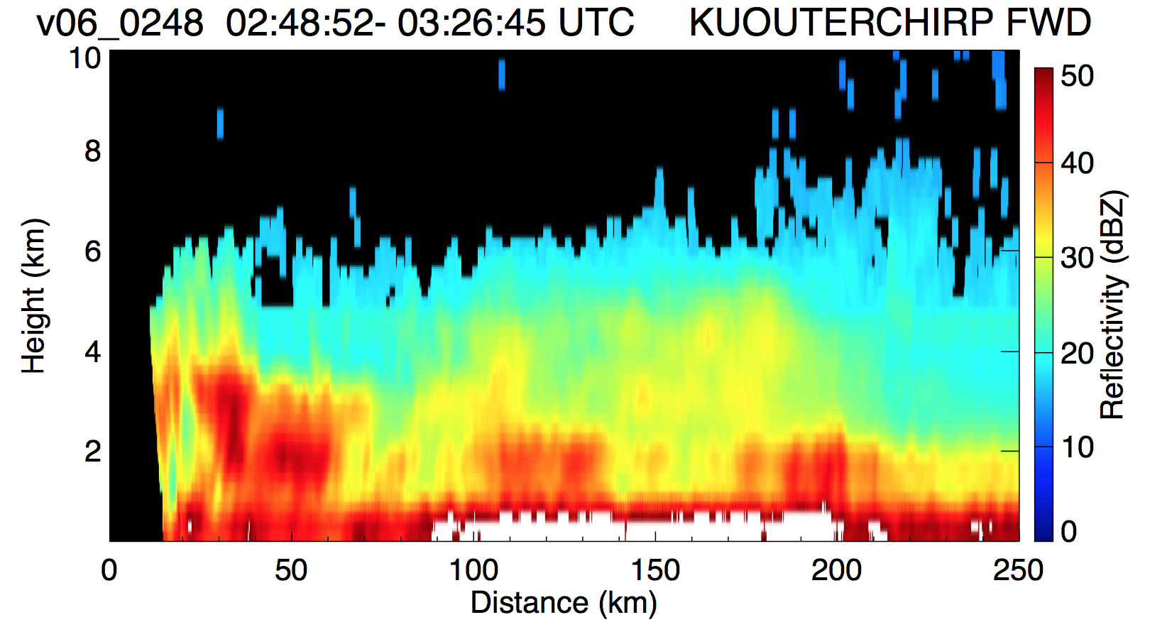
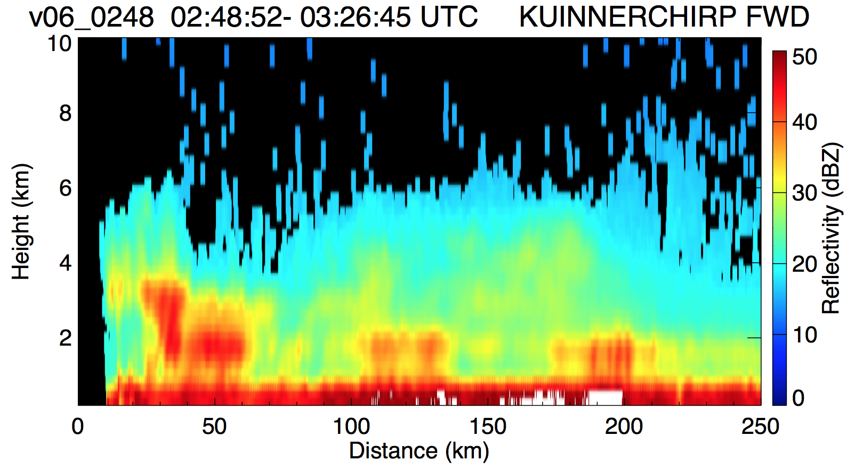
Reflectivity 5-6 Nov 2012
Frontal System off Oregon Coast
Outer, Inner Beam. Ku- and Ka-Band. Prelim. Calibration.
-> Ka higher sensitivity and resolution.

Slide 12
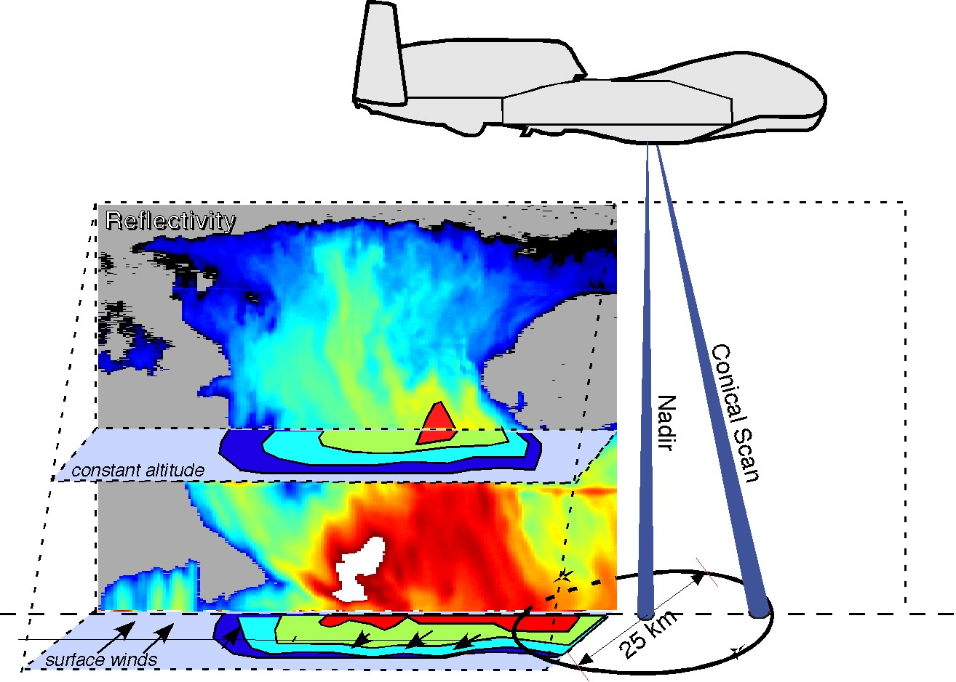
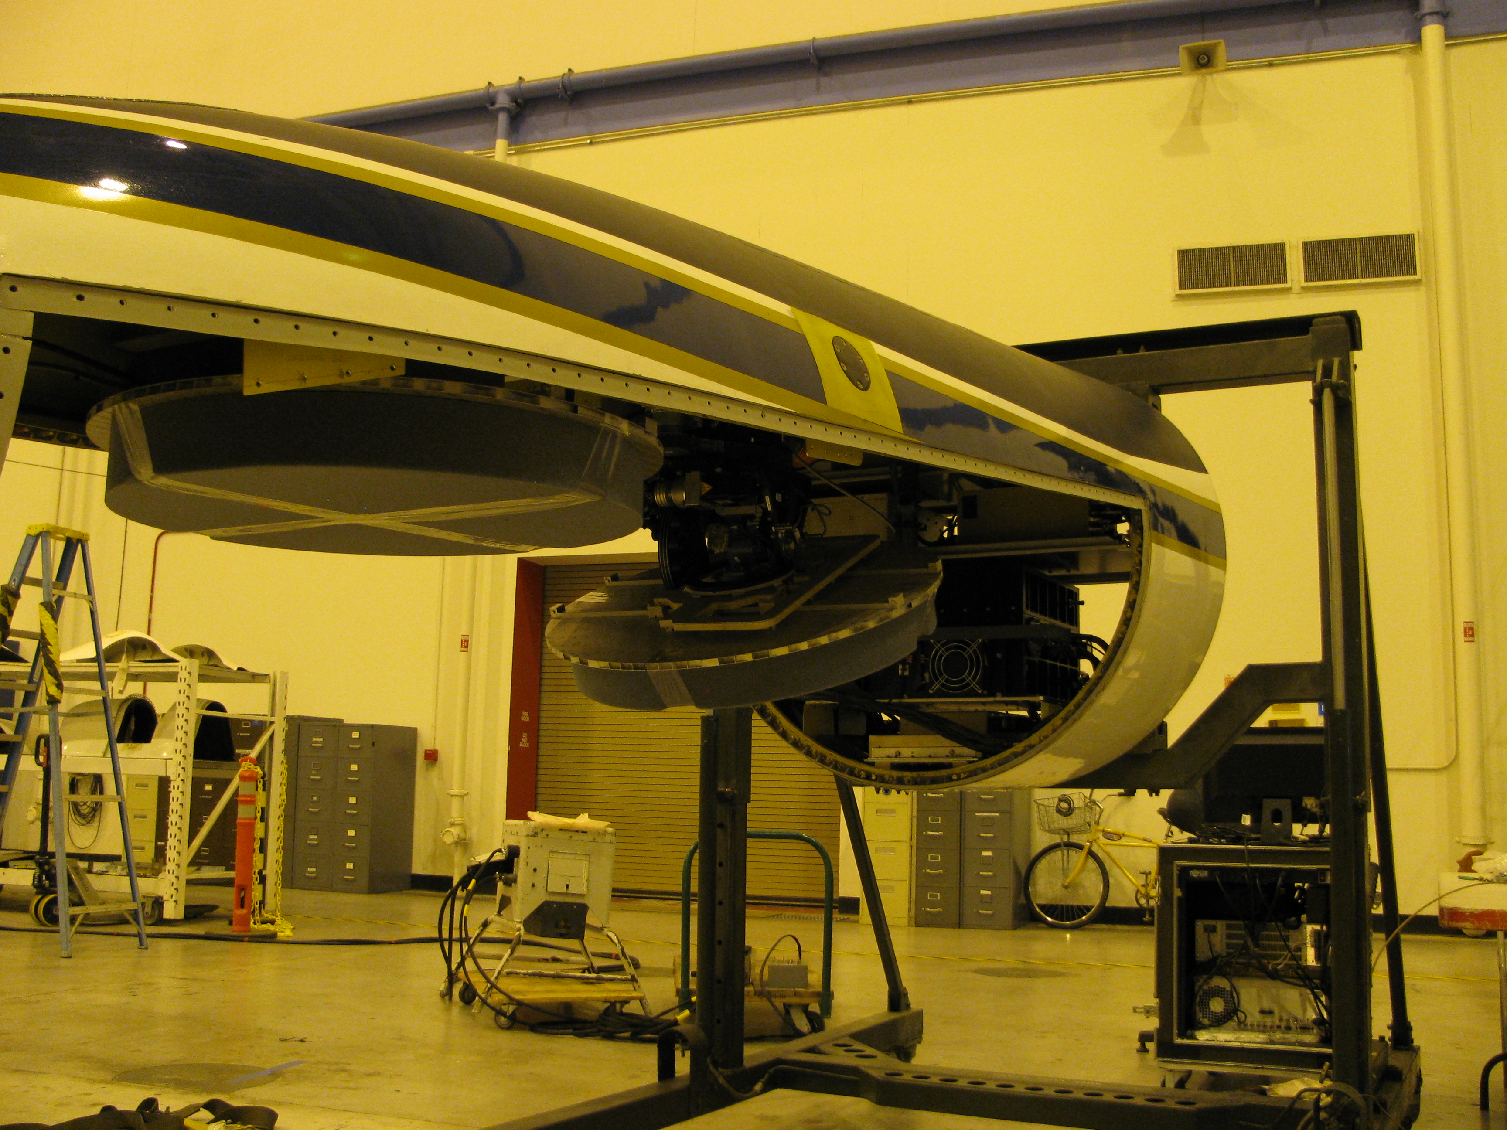
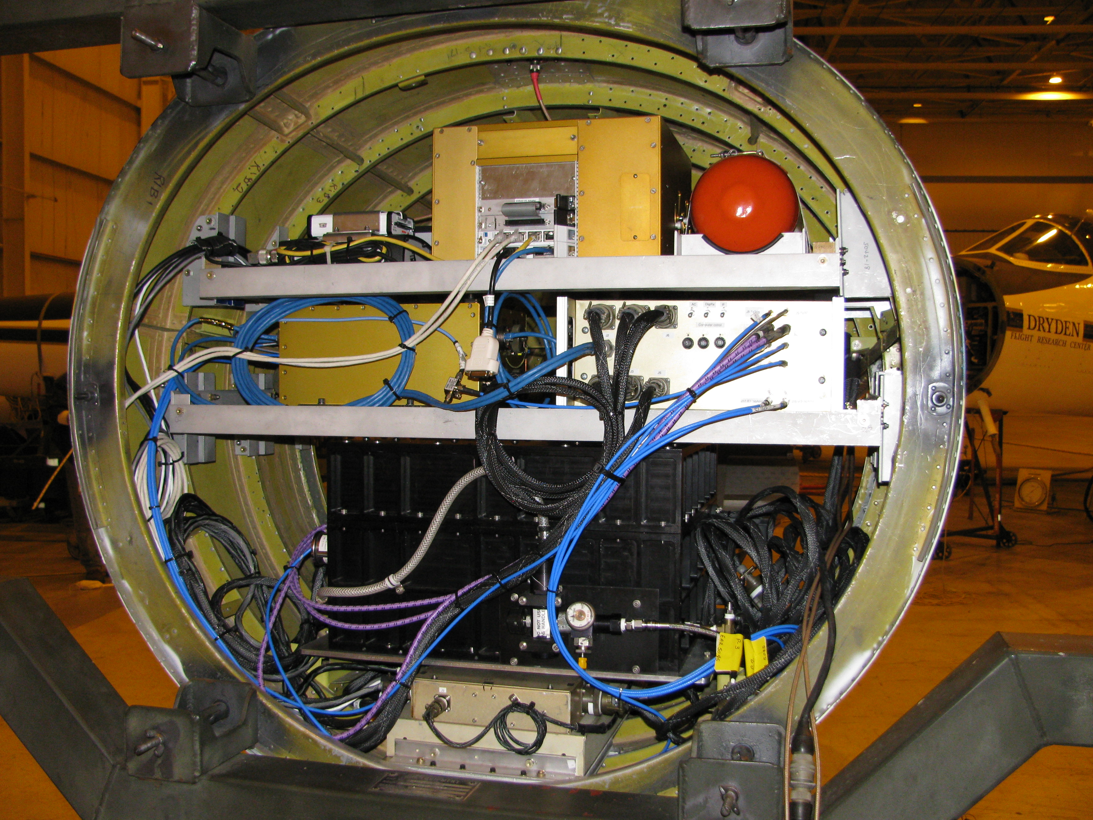
ER-2 X-band Radar (EXRAD)
Conventional high-power radar. Will also fly in Global Hawk.
Single frequency (9.6 GHz), Dual-beam.
  Fixed nadir pointing beam and a cross track/conical scanning beam
  Heritage: EDOP and CRS on ER-2
Conical scan like HIWRAP
First test flights Feb 2013 were successful.
EXRAD Measurement Concept
EXRAD Feb. 2013

Slide 13
Future
Real-time Data Possibilities – challenging but doable
  Expanded reflectivity plots
  Wind products (gridded, VAD, ..)
  Doppler data for assimilation
  Ocean surface wind vector
  Improved real-time data.

Slide 14
Questions?

