Slide 1
Computing Deep-Tropospheric Vertical Wind Shear Analyses for TC Applications: Does the Methodology Matter? Christopher Velden and John Sears Univ. Wisconsin - Cooperative Institute for Meteorological Satellite Studies (CIMSS) 67th IHC/Tropical Cyclone Research Forum March 5-7, 2013
1

Slide 2
Computing Deep-Tropospheric Vertical Wind Shear Analyses for TC Applications: Does the Methodology Matter?
Study Synopsis
Vertical Wind Shear (VWS) is well known as an important environmental influence on TC structure and intensity change. The traditional way to parameterize VWS in most research studies, and in operational forecast applications, is to use a simple vector difference of the 200 and 850hPa wind fields based on global model analyses. For example, this is how the operational SHIPS model employs VWS as a predictor of future TC intensity. However, is this the optimal approach to depict VWS?
In this study, we compare a different methodology to generate fields of VWS as produced by the University of Wisconsin-CIMSS. The CIMSS analyses use a 3-dimensional Recursive Filter objective analysis at high spatial resolution to put heavy weight on available high-density satellite-derived winds. Global model wind fields are only used as background analyses in satellite data-void regions. The resultant isobaric analyses are then used to create two layer-mean wind analyses; one upper-tropospheric (150-300hPa) and one lower-tropospheric (700-925hPa). These two layer-mean wind fields are then differenced to represent the VWS.
Our findings indicate the two VWS fields can diverge significantly in certain situations. This could impact the forecaster interpretation of the VWS significance as it impacts a TC, and also influence objective forecasts of intensity (i.e. SHIPS).
2

Slide 3
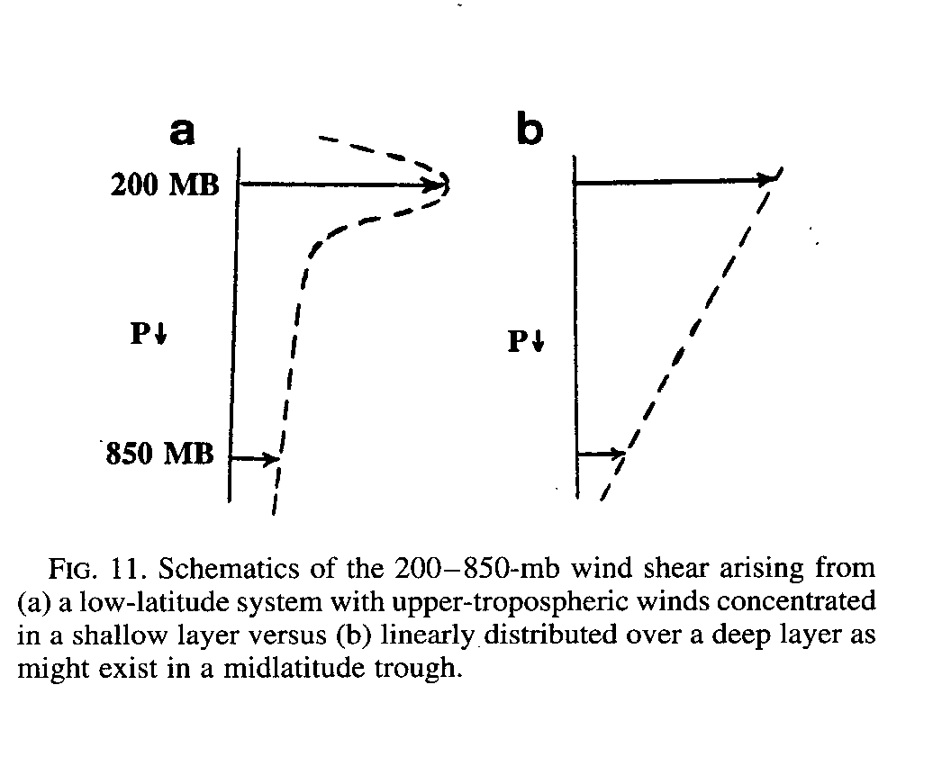
Computing Deep-Tropospheric Vertical Wind Shear Analyses for TC Applications: Does the Methodology Matter?
Elsberry, R. L., and R. A. Jeffries, 1996: Vertical Wind Shear Influences on Tropical Cyclone Formation and Intensification during TCM-92 and TCM-93. Mon. Wea. Rev., 124, 1374–1387.
3

Slide 4
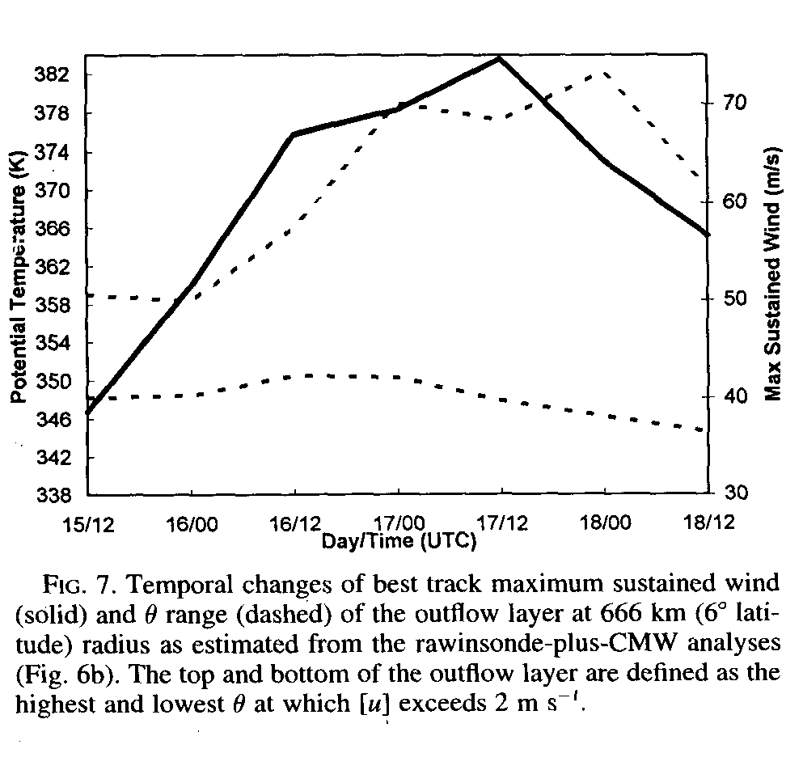
Computing Deep-Tropospheric Vertical Wind Shear Analyses for TC Applications: Does the Methodology Matter?
Typhoon Flo – analyzed from TCM-90 observations
“The effects of VWS in the ambient flow over the depth of the outflow layer must be considered, as this may control whether the low-Ө and high-Ө outflow from an intense storm are aligned in the vertical. Because outflow is associated with a negative PV anomaly, the superposition (or lack thereof) of these anomalies at different Ө levels may influence the strength of the induced upper-level circulation, its nonlinear evolution, and the ability of the storm to sustain mass outflow over its full Ө range for an extended period.”
Merrill, R., and C. Velden, 1996: A Three-Dimensional Analysis of the Outflow Layer of Supertyphoon Flo (1996). Mon Wea. Rev., 124, 47-63.
4

Slide 5
Computing Deep-Tropospheric Vertical Wind Shear Analyses for TC Applications: Does the Methodology Matter?
N=553
G-IV dropsonde wind profiles used to compare VWS magnitudes using
the CIMSS method and traditional 2-level (200-850hPa) method.
5

Slide 6
Computing Deep-Tropospheric Vertical Wind Shear Analyses for TC Applications: Does the Methodology Matter?
Dropsonde wind profiles representing the largest differences
between the two VWS approaches
6

Slide 7
Computing Deep-Tropospheric Vertical Wind Shear Analyses
for TC Applications: Does the Methodology Matter?
SHIPS VWS Calculation
Tropospheric Levels Used: 200hPa and 850hPa
Adjustment: Symmetric Vortex Removed at 850 and 200hPa Relative to GFS 850hPa Vortex Position
CIMSS VWS Calculation
Tropospheric Levels Used: 150-300hPa and 700-925hPa Layer-Means
Adjustment: Vortex Removed w/ Radius of 600km [Upper Layer] and 800km [Lower Layer]
Data: GFS Fields
Data: CIMSS Satellite Derived Winds Analyzed w/ GFS Background Fields
Final Value: Vector Diff. Analyzed at 600km Radial Average
Final Value: Vector Difference Analyzed at Storm Center
7

Slide 8
Computing Deep-Tropospheric Vertical Wind Shear Analyses for TC Applications: Does the Methodology Matter?
Comparison Results
Combinations
CIMSS Analyses w/ CIMSS VWS Calculation Method (CIMSS Approach)
CIMSS Analyses w/ SHIPS VWS Calculation Method
GFS Fields w/ CIMSS VWS Calculation Method
GFS Fields w/ SHIPS VWS Calculation Method (SHIPS Approach)
Experiment Combinations | Data VWS Source | Method | Benchmark VWS Values | Correlation | Bias [kts] | RMSE[kts]
1 & 4. | CIMSS | CIMSS | SHIPS | 0.74 | -5.3 | 8.9
2. | GFS | CIMSS | SHIPS | 0.78 | -3.1 | 6.5
3. | CIMSS | SHIPS | SHIPS | 0.86 | -0.1 | 4.3
2. | GFS | CIMSS | CIMSS | 0.87 | 2.1 | 5.7
3. | CIMSS | SHIPS | CIMSS | 0.84 | 5.2 | 7.7
N=824 Homogeneous Sample of Atlantic VWS Comparisons from 2008-2010
Takeaway Message: Changing the VWS calculation methodology leads to larger
differences than changing the wind analyses sources.
8

Slide 9
Computing Deep-Tropospheric Vertical Wind Shear Analyses for TC Applications: Does the Methodology Matter?
N=824 Homogeneous Sample of Atlantic VWS Comparisons from 2008-2010
9

Slide 10
Computing Deep-Tropospheric Vertical Wind Shear Analyses for TC
Applications: Does the Methodology Matter?
··· cimss_gfs - cimss_cimss ··· ships_gfs - ships_cimss
N=283 Homogeneous Sample of Atlantic VWS Comparisons from 2010
10

Slide 11
Computing Deep-Tropospheric Vertical Wind Shear Analyses for TC
Applications: Does the Methodology Matter?
Summary
The findings presented here illustrate how estimates of VWS can diverge significantly depending on initial wind analyses used, and especially the VWS calculation methodology.
The approach to calculate VWS employed by CIMSS in their tropical analyses uses layer-mean wind analyses rather than 2 discrete levels (200 and 850 hPa) as in the traditional approach.
The CIMSS method appears to better account for varying vertical wind profiles that may affect TCs in different ways, and correlates best with subsequent TC intensity change.
This could impact forecaster interpretation of the VWS significance in certain cases, and also influence objective method forecasts of intensity.
Thanks to Mark DeMaria for supplying the SHIPS code
CIMSS TC Analyses URL: tropic.ssec.wisc.edu
Contact: Chrisv@ssec.wisc.edu
11

