Slide 1


Further Development of a Statistical Ensemble for Tropical Cyclone Intensity Prediction
67th Interdepartmental Hurricane Conference – Tropical Cyclone Research Forum
03/06/2013 S6-07
Kate D. Musgrave¹
Mark DeMaria²
Brian D. McNoldy³
Yi Jin⁴
Michael Fiorino⁵
¹CIRA/Colorado State University, Fort Collins, CO
²NOAA/NESDIS/StAR, Fort Collins, CO
³University of Miami, Miami, FL
⁴Naval Research Laboratory, Monterey, CA
⁵NOAA/OAR/ESRL, Boulder, CO

Slide 2
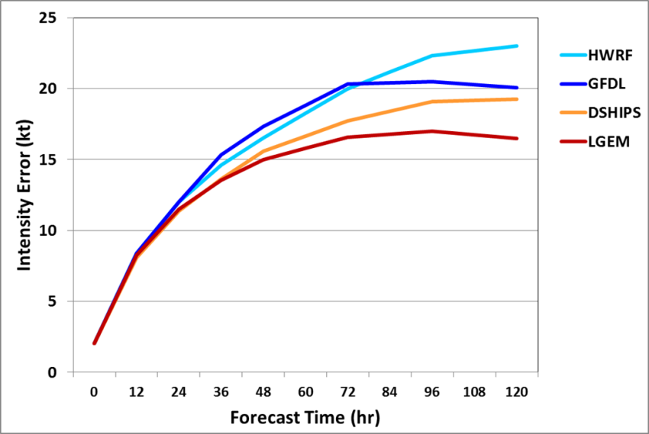
Motivation for Statistical Ensemble
The Logistic Growth Equation Model (LGEM) and the Statistical Hurricane Intensity Prediction Scheme (SHIPS) model are two statistical-dynamical intensity guidance models
SHIPS and LGEM are competitive with dynamical models
Both SHIPS and LGEM use model fields from the Global Forecast System (GFS) to determine the large-scale environment
Runs extremely fast (under 1 minute), using model fields from previous 6 hr run to produce ‘early’ guidance
Atlantic Operational Intensity
Model Errors 2007-2011
JTWC experience with a similar statistical model shows improvements with multiple inputs
We focus on using Decay-SHIPS (DSHP) and LGEM, initialized with model fields from GFS, the Hurricane Weather Research and Forecasting (HWRF) model, and the Geophysical Fluid Dynamics Laboratory (GFDL) model to create an ensemble

Slide 3
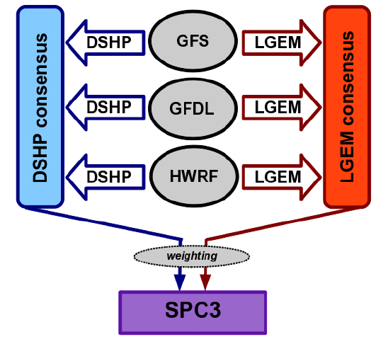
SPICE (Statistical Prediction of Intensity from a Consensus Ensemble)
SPICE forecasts TC intensity using a combination of parameters from:
  Current TC intensity and trend
  Current TC GOES IR
  TC track and large-scale environment from GFS, GFDL, and HWRF models
These parameters are used to run Decay-SHIPS and LGEM based off each dynamical model
The forecasts are combined into two unweighted consensus forecasts, one each for DSHIPS and LGEM
The two consensus are combined into the weighted SPC3 forecast
Model Configuration for Consensus

Slide 4
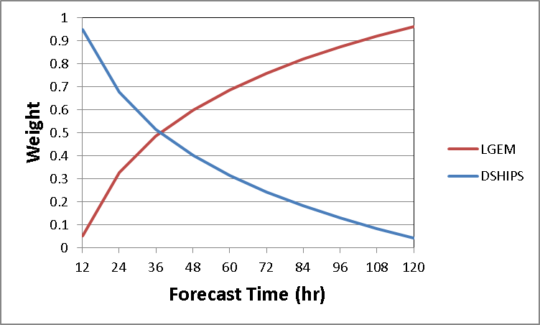
SPICE (Statistical Prediction of Intensity from a Consensus Ensemble)
Model Configuration for Consensus
DSHIPS and LGEM Weights for Consensus
Weights determined empirically from 2008-2010
Atlantic and East Pacific sample

Slide 5
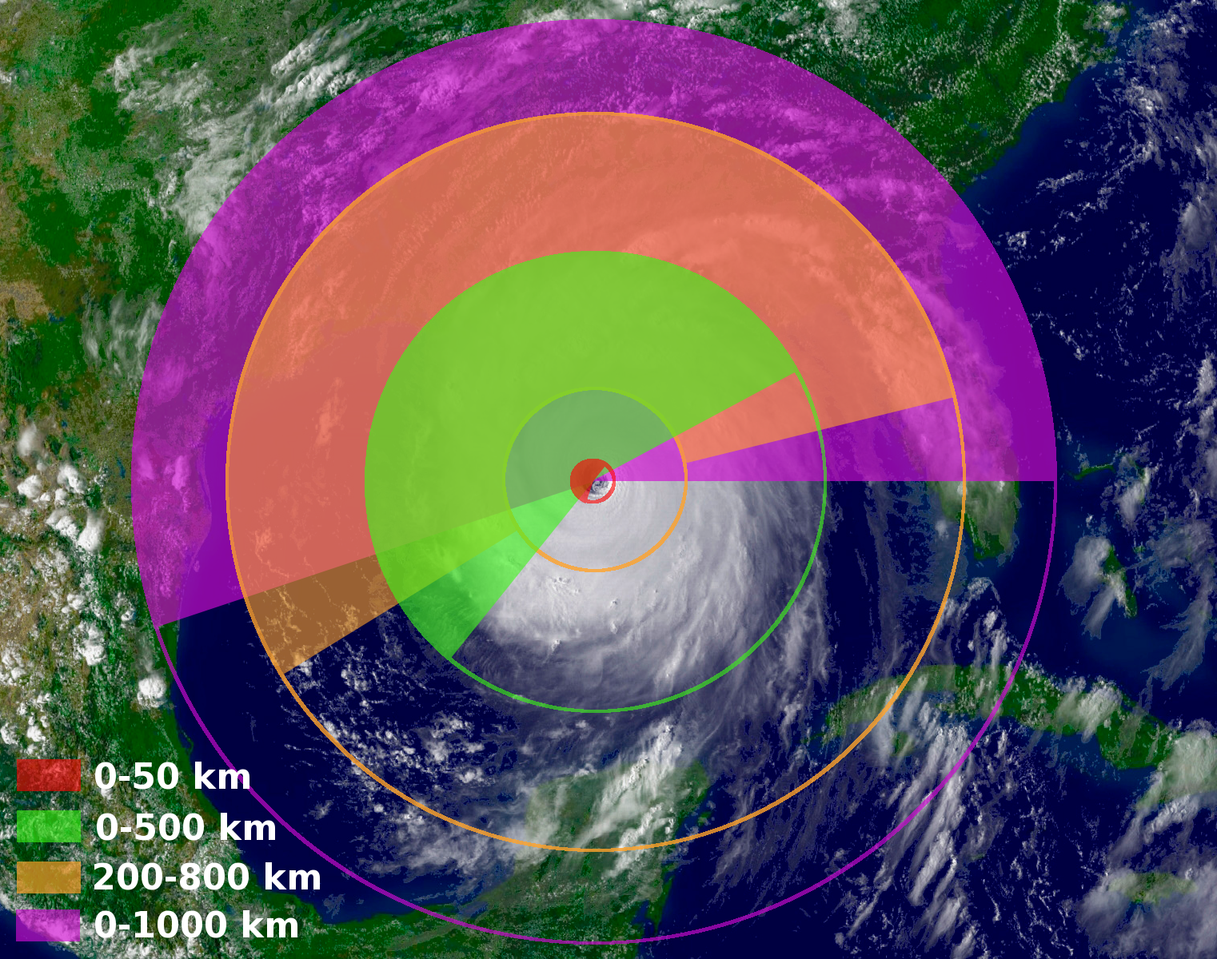
SPICE Input – Model Diagnostic Files
Simple ASCII file with SHIPS model predictors
Input required
  Model grib files
    u, v, T, RH, Z at mandatory levels 1000 to 100 hPa
    SST field if available
  Model storm track (A-deck format)
Output
  ~20 kbyte ASCII file per 126 hr forecast
Code available from CIRA
  Currently used by: EMC; GFDL; NRL; ESRL; NCAR; SUNY-Albany; Uwisc
Verification
  HWRF and GFDL diagnostic files (against GFS analysis)
Key parameters are calculated in prescribed areas...
This is already done with GFS output to create SHIPS “predictor” files available on NHC's FTP server
Sea surface temp (RSST)
850-200 mb shear (SHDC); 200 mb zonal wind (U20C)
200 mb temp (T200); 850-700 mb RH (RHLO)
700-500 mb RH (RHMD); 500-300 mb RH (RHHI)
200 mb divergence (D200); 850 mb vorticity (Z850)

Slide 6
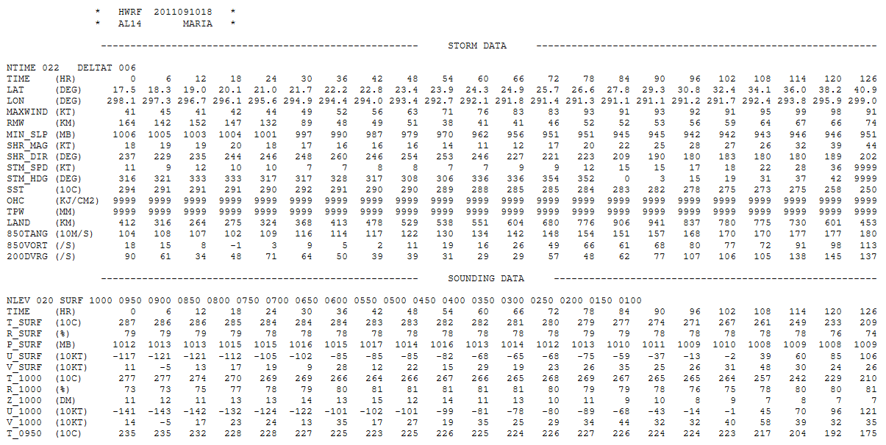
SPICE Input – Model Diagnostic Files
…
Diagnostic files available from http://www.hfip.org/products/

Slide 7
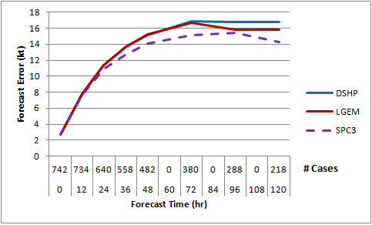
2009-2011 Atlantic Retrospective Runs for
HFIP Stream 1.5 Implementation

Slide 8
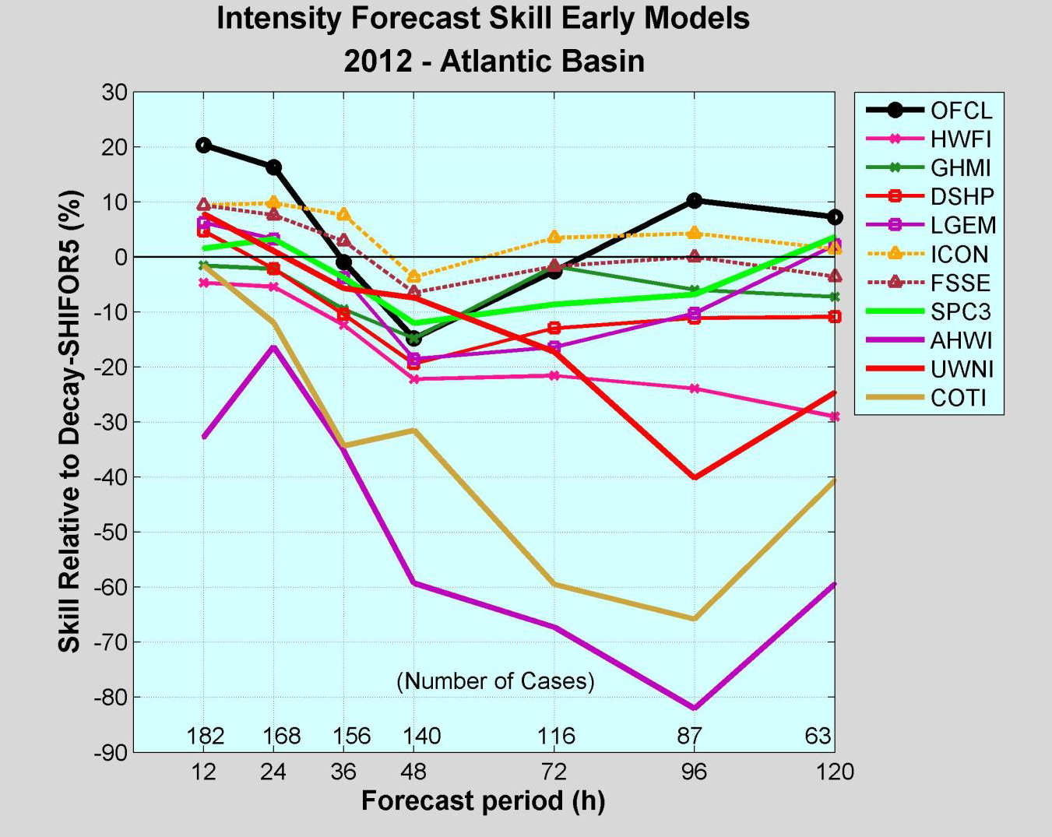
Results from 2012 Atlantic Season
SPICE
DSHP
LGEM
Figure courtesy of James Franklin

Slide 9
Results from 2012 Atlantic Season
SPICE
GFDL
HWRF
Figure courtesy of James Franklin

Slide 10
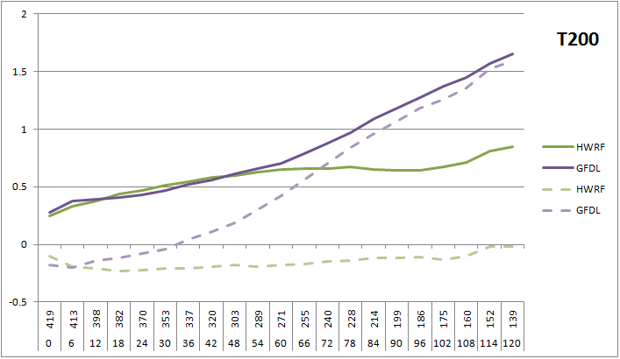
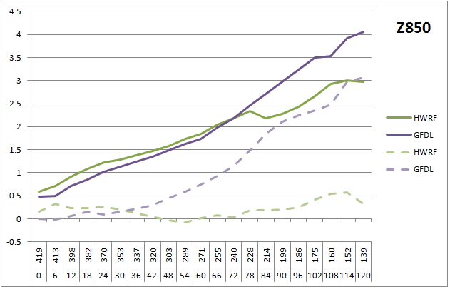
Results from 2012 Atlantic Season:
Model Diagnostic Files

Slide 11
Updates and Testing for 2013 Season
SPICE undergoing retrospective tests to run in HFIP Stream 1.5 for 2013 Season
  consensus handling of members that drop out before 120 hr
  assess weights assigned to SHIPS/LGEM
Two additional versions are undergoing testing:
  Regional ensemble: Combines additional regional models COAMPS-TC and AHW
  Global ensemble: Includes HFIP global model ensembles
HFIP retrospective testing is currently using operational parent model runs, retrospective parent model diagnostic files and tracks will be compared where available

Slide 12
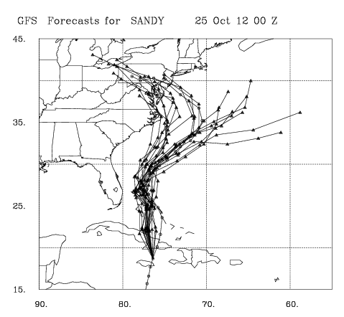
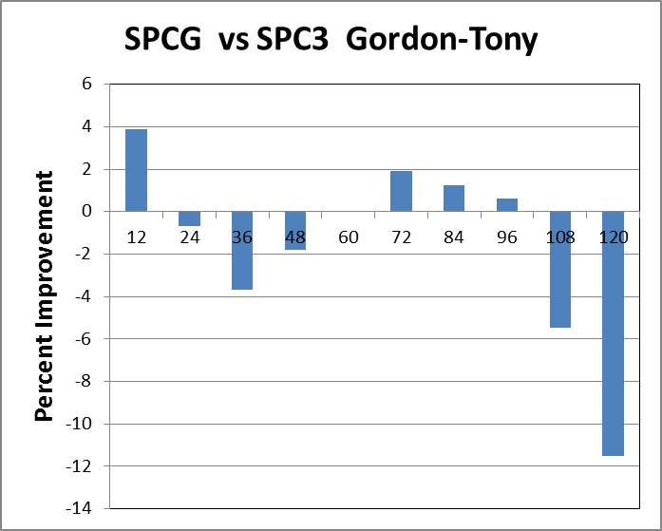
Global Ensemble Preliminary Results
Shown here using 20-member experimental GFS ensemble

Slide 13
Summary
SPICE model run for HFIP Stream 1.5
  For 2008-2010 Retrospective Runs, 2011 Demonstration, and 2009-2011 Retrospective Runs SPC3 showed skill improvements of up to 5-10% over SHIPS and LGEM
  2012 season showed mixed results, with SHIPS outperforming both LGEM and SPC3 at longer lead times
Outlier analysis may lead to SPICE improvements for 2013
  Testing changes in statistical models, consensus design
SPICE model should benefit from greater diversity of input models
  Regional and global ensembles currently undergoing testing
  Use model forecast intensity changes and diagnostic files to fit SHIPS coefficients for examination of model TC behavior in relation to environment

