Slide 1
Evaluation of the Ocean Response in HWRF: How Changes in the Atmosphere-Ocean Fluxes Affect Forecast Skill
Interdepartmental Hurricane Conference
March 6, 2012
Ligia Bernardet^{1*}, E. Uhlhorn², S. Bao^{1*} & J. Cione²
¹NOAA ESRL Global Systems Division, Boulder CO
²NOAA AOML Hurricane Research Division, Miami FL
*University of Colorado CIRES , Boulder CO
In collaboration with
R. Yablonsky and I. Ginis of University of Rhode Island
Vijay Tallapragada, NOAA Environmental Modeling Center

Slide 2
Ocean model in HWRF
Atmospheric Model: WRF
Allows greater accuracy in
SST field
Latent/sensible heat fluxes
Intensity
Can represent
Turbulent mixing (1D), upwelling and advection (3D)
Causes SST cooling as cold water below surface is transported up
Is crucial because SST can change rapidly under tropical cyclones
Radiative fluxes
Sensible, latent, momentum fluxes depend on
exchange coefficients
SST
air T,q, wind
Ocean Model: POM-TC

Slide 3
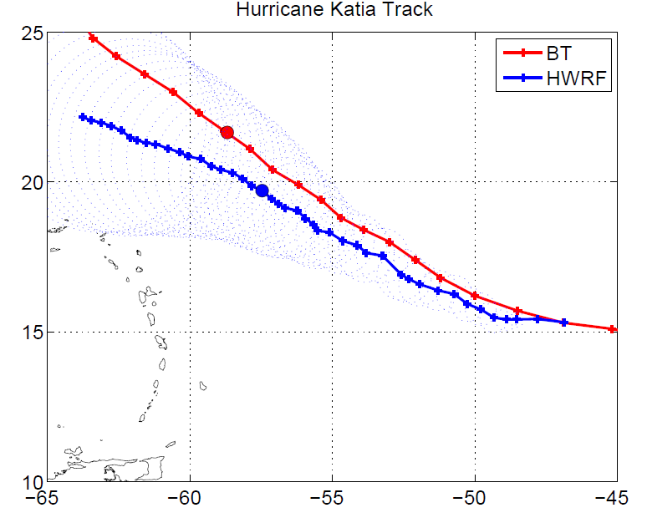
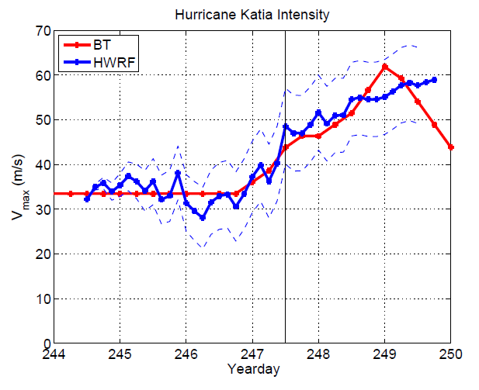
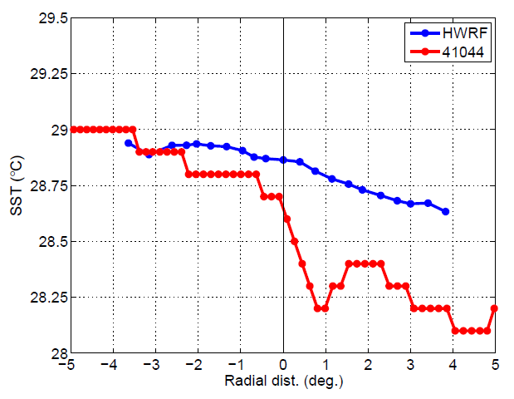
Background
Coupled HWRF tests (2007) indicated POM-TC over-cooling
To minimize over-cooling, HWRF fluxes to POM-TC were reduced by 25%
Yablonsky et al. (2010 IHC): confirmed POM-TC tended to over-cool in response to prescribed wind stress based on observed TC winds, when compared against buoy composites
Uhlhorn and Cione (2012): 2012 operational HWRF run retrospectively for 2011 storms under-cools relative to buoy composites
Example: Katia initialized 09/01/2011, 12 UTC
Buoy passage 9/4 12Z
Reasonable track forecast
Good intensity forecast
Poor ocean cooling forecast
Notes:
Cione et al. 2000 (TCBD) used in Yablonsky et al. (2010)
Uhlhorn and Cione, 2012. HFIP Regional Modeling Team Workshop
Yablonsky et al., 2010. IHC

Slide 4
HWRF Testing
Hypothesis (URI): flux reduction in HWRF not necessary (and should be eliminated as it is mostly non-physical)
Comprehensive test: 2012 HWRF with (HD12) and without (HDFL) flux reduction. Cases: entire 2012 season
Test supports HWRF operational implementation
Case study (Leslie 09/04 00 Z)
Comparison of forecast SST cooling against TCBD
Isolation of influence of flux reduction versus initial conditions
Note that HWRF is cycled, so IC for a given case are not identical between HDFL and HD12
Understanding of non-linear physical processes involved

Slide 5
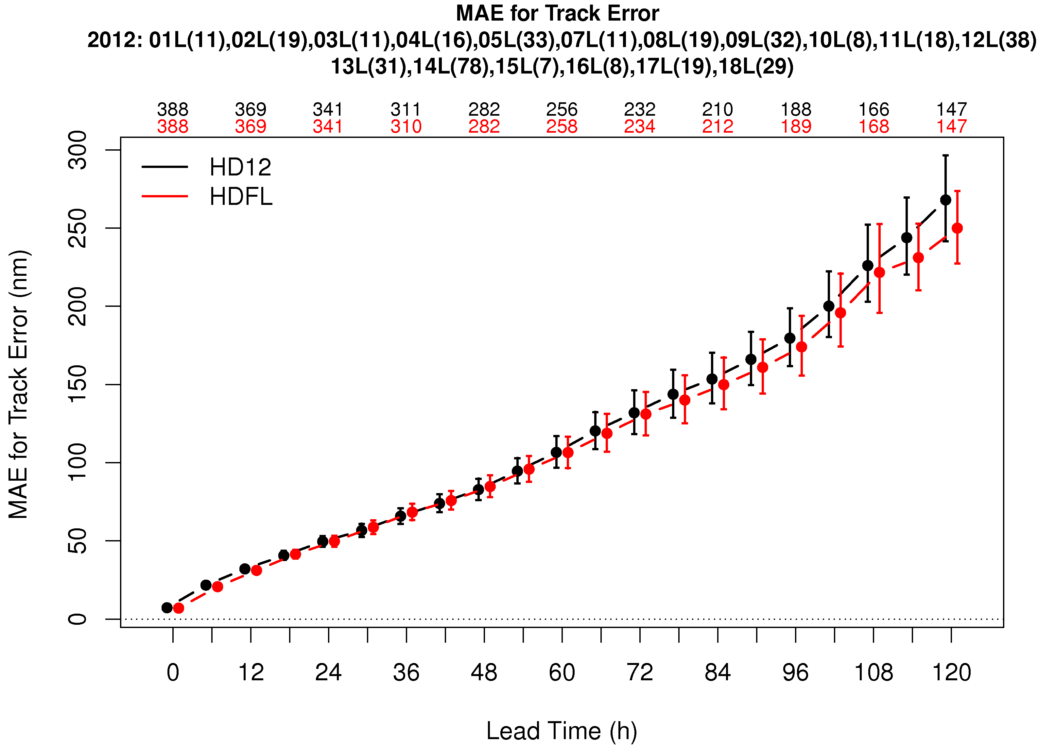
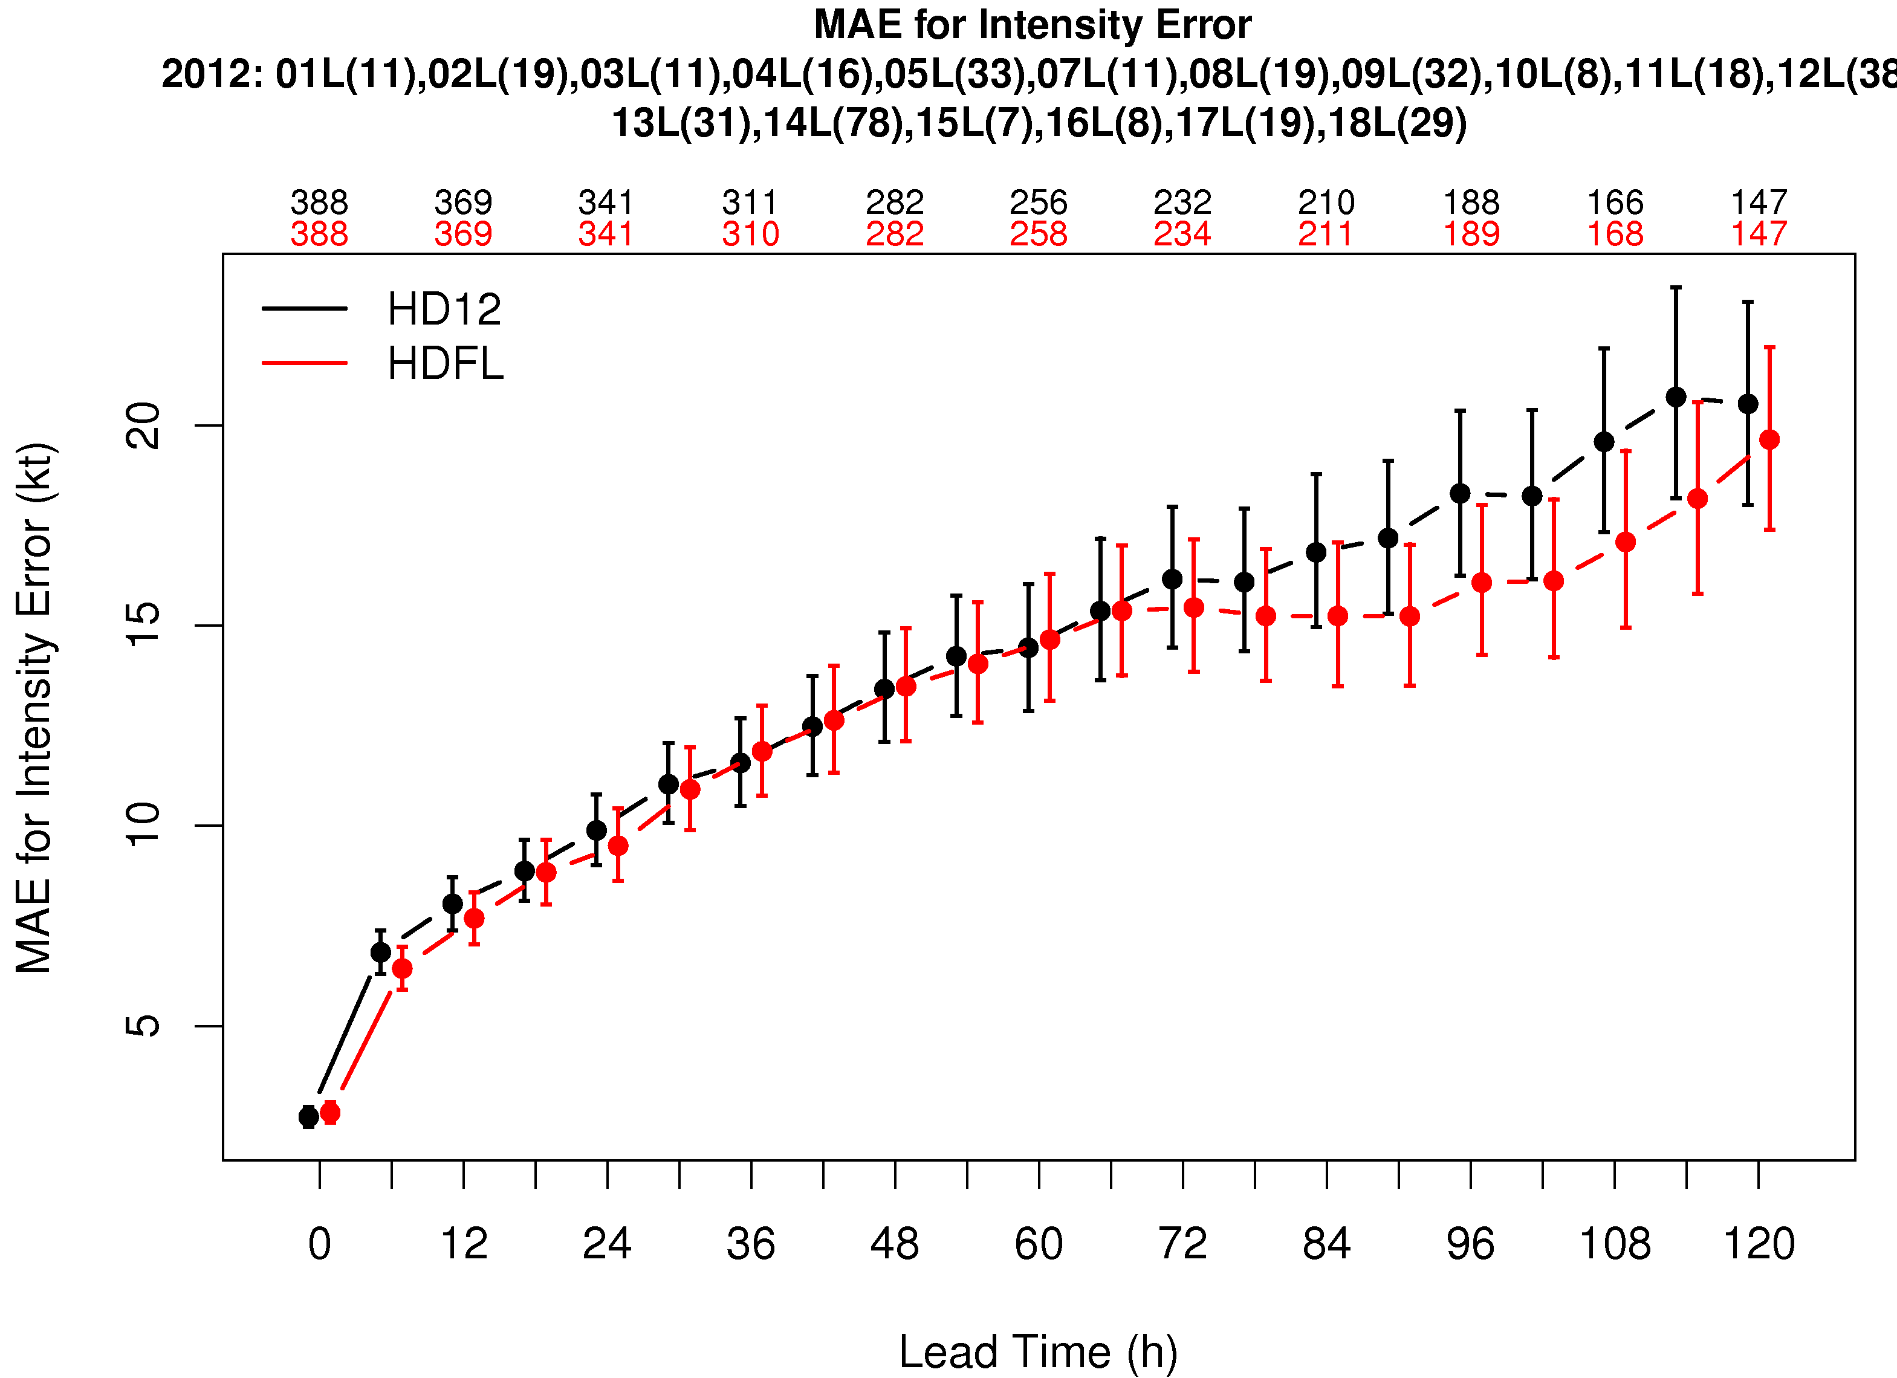
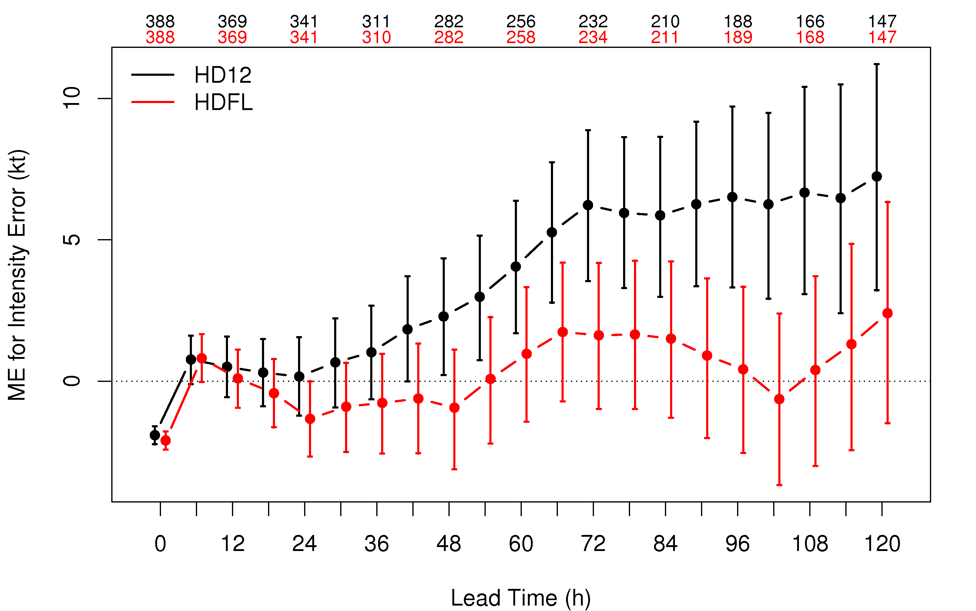
Atlantic track and intensity
Track ME: HD12 and HDFL very similar
Int MAE: HDFL SS better at 3 lead times
Int bias: HDFL lowers intensity and helps overintensification at long lead times
Hurricane Leslie (12L) is the storm with largest impact (large and slow)
Pacific impact is much smaller (POM-TC 1D)

Slide 6
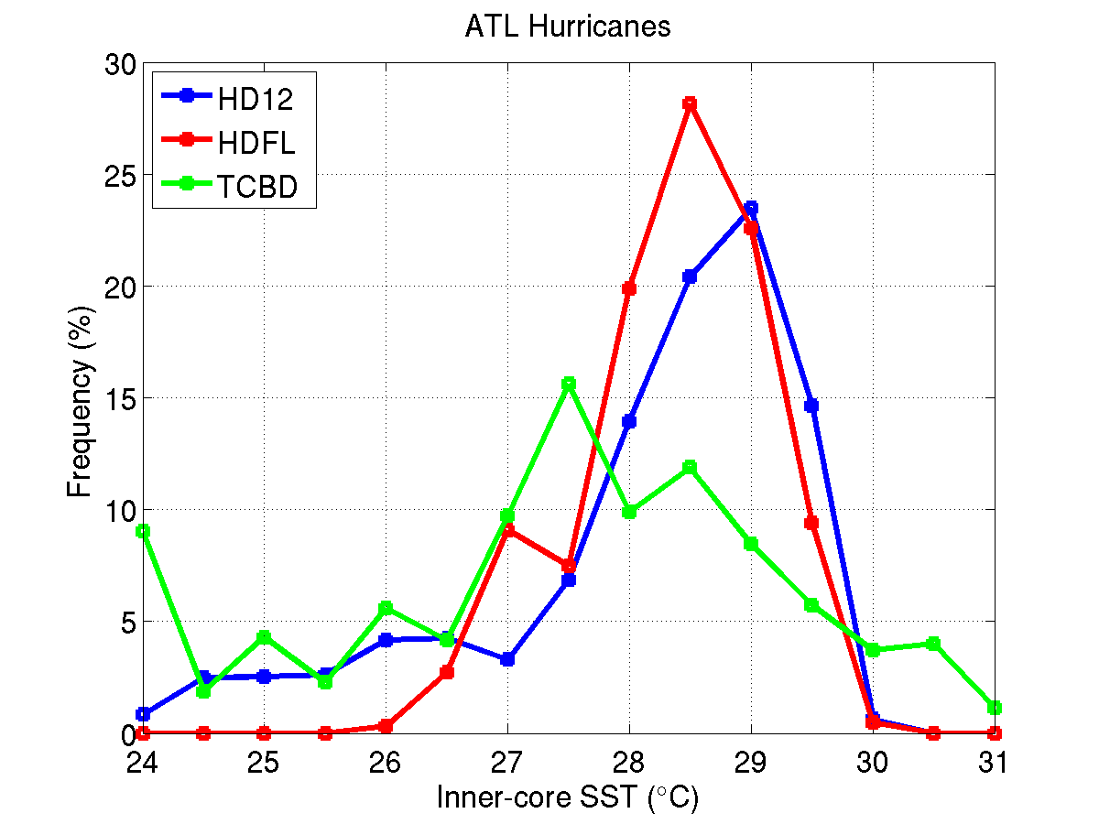
Simulated vs. TCBD Observations (AL)
Forecasts obtained from numerical model output fields at the same location as buoys
Hurricanes only
Forecasts are for for 2012 minus Sandy and Tony
Observations are TCBD composite 1975-2007
Inner-core 10-m winds
Distribution of Wind Speed
Storm Intensity
Inner-core SST
Inner core
Even though forecast 10-m winds are comparable with buoys, POM-TC SST is too warm
Notes:
Note1: HDFL has less Hurricanes than HD12.
Note 2: TCBD (green line) is for 1975-2007, while model is all 2012 AL season except for Sandy and Tony
Note 3: Only HU was sampled. If observed or forecast was TS, not included here.
Left plot: Storm maximum winds
Green line is NHC Best Track for 1975-2007
Blue and red are 2012 forecasts (using the GFDL Vortex Tracker).
Conclusion: Model has more cases with lower intensity and does not have high-intensity cases. This may be because 2012 was a weak season, and not due to model error.
Center plot: Inner core (<60 km radius).
Green line: buoy 10 m wind for cases in which an observed storm center was within 60 km of buoy.
Red and blue line: forecast 10m wind at buoy locations for cases in which a storm center was within 60 km of buoy
Conclusion: In inner core, model winds are higher than observed winds. See Leslie case study.
Right plot: inner core (<60 km radius)
Green line: buoy SST for cases in which an observed storm center was within 60 km of buoy.
Red and blue line: forecast SST at buoy locations for cases in which a storm center was within 60 km of buoy
Conclusion: Inner-core SSTs in HDFL runs are ~0.5 C cooler than HD12, but typically remain elevated (+1 C) well above expected values. From this figure, it is not possible to conclude if HWRF ocean is too warm after storm passes, or if it was too warm even before the storm.

Slide 7
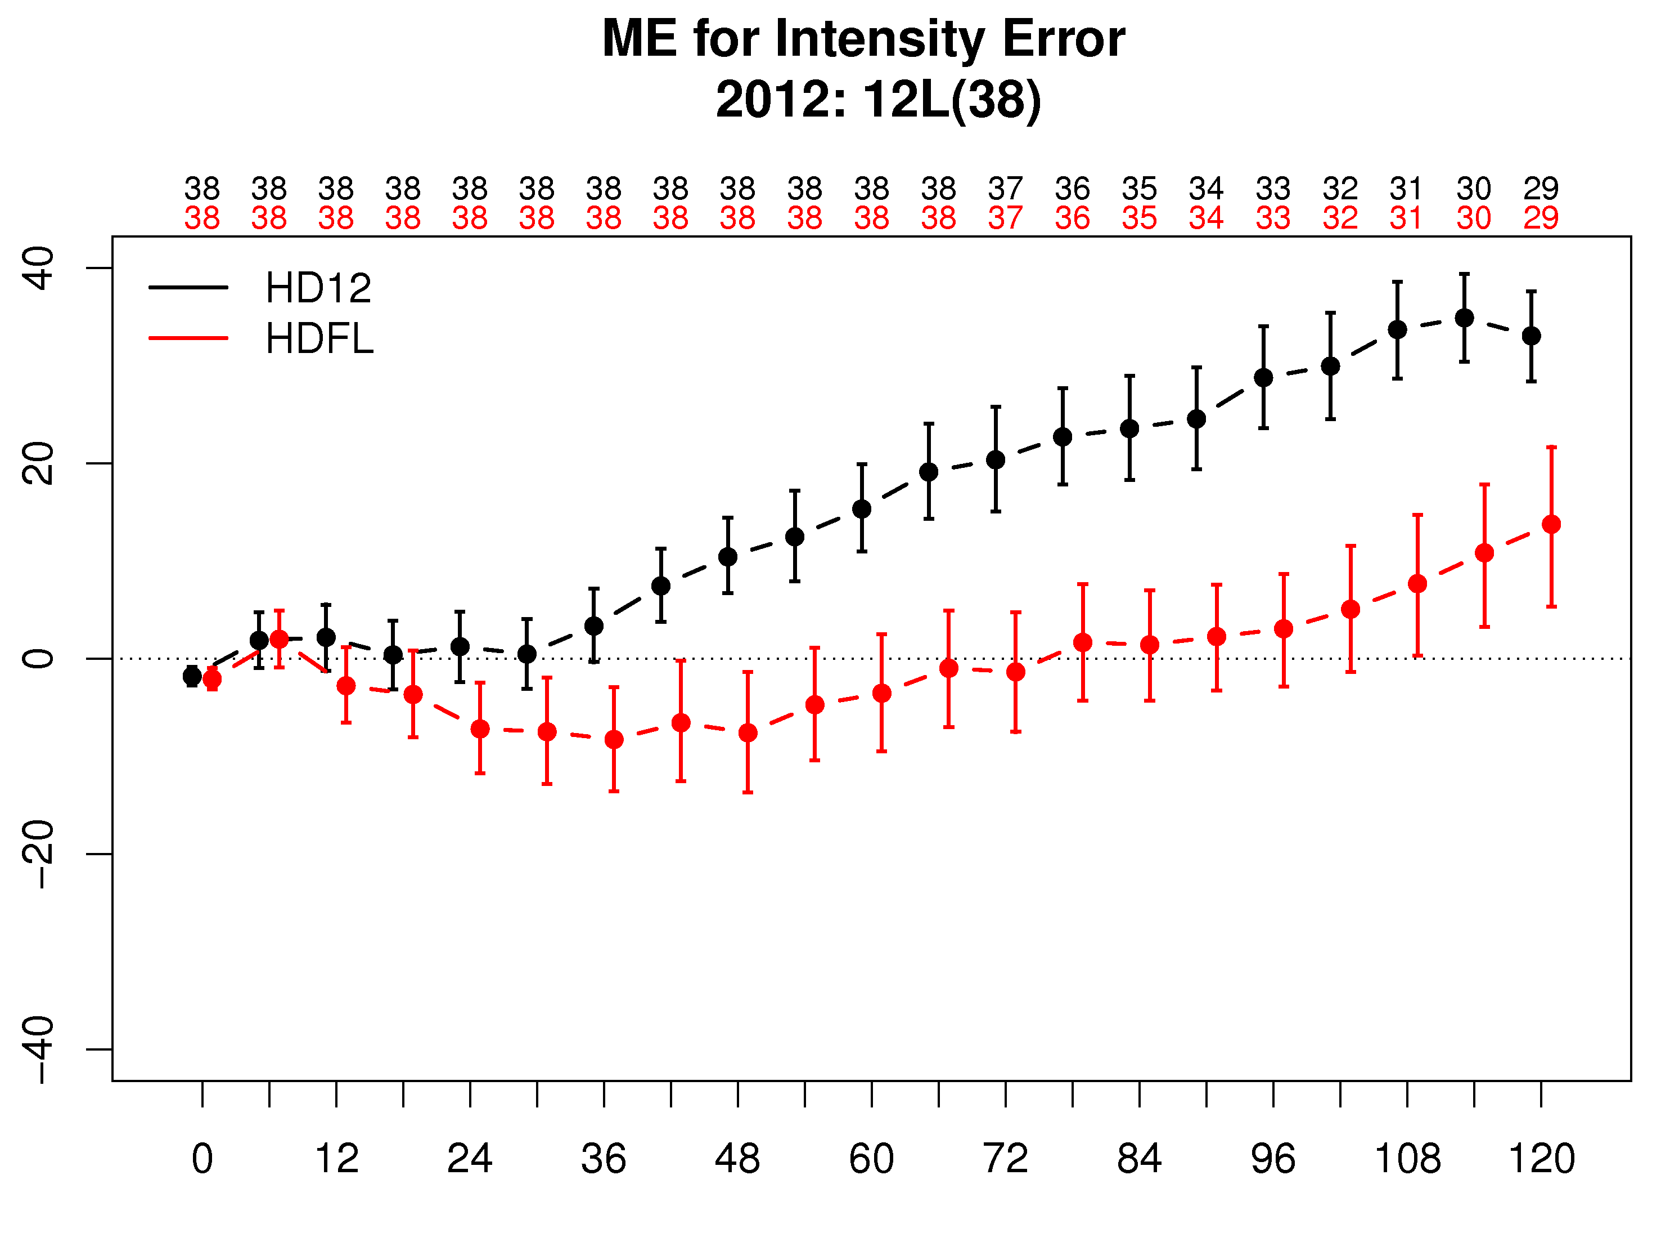
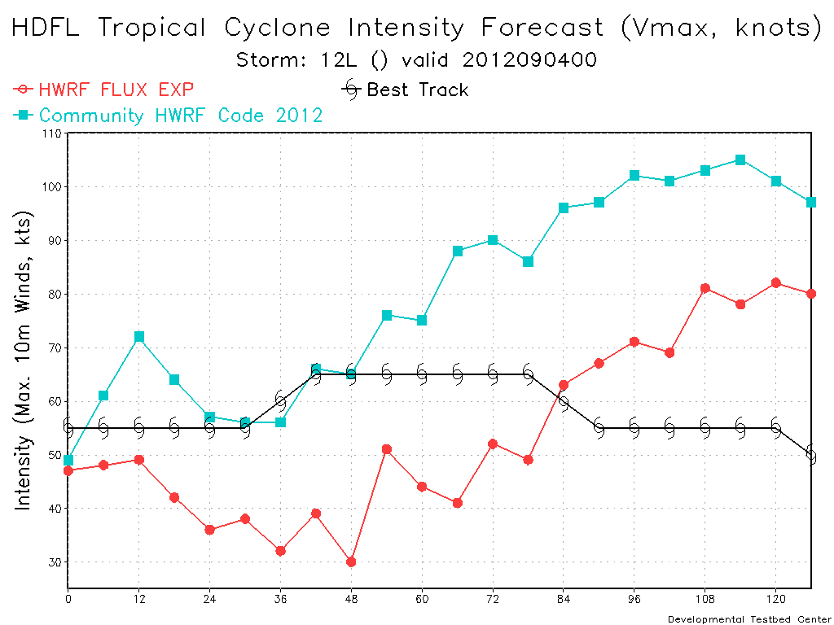
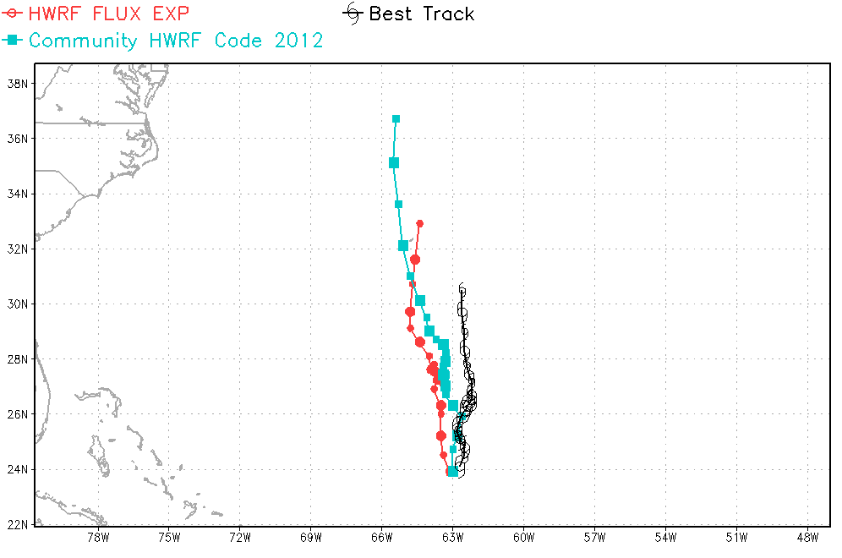
Largest impact: Hurricane Leslie
Case study 09/04 00 Z
HD12 and HDFL tracks are similar
HDFL reduces intensity (as expected)
Case study: 09/04 00 UTC HDFL has lower intensity

Slide 8
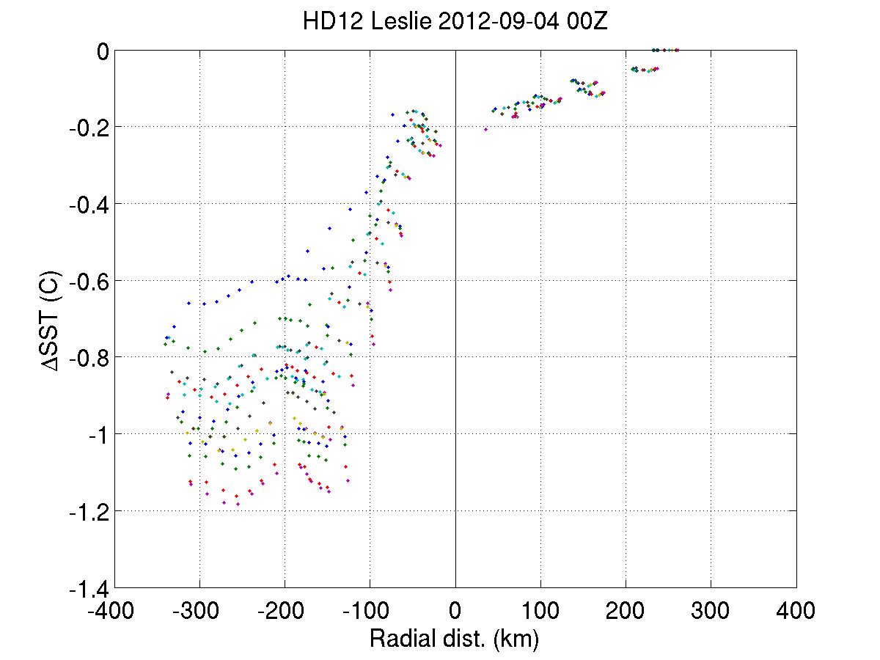
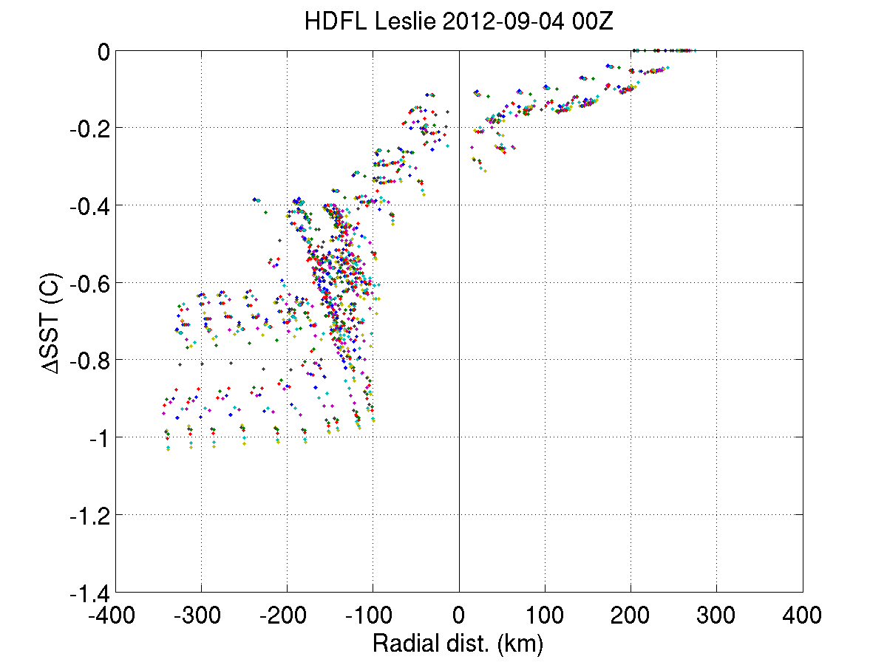
Leslie: case study 09/04 00Z
Forecast cooling in HDFL and HD12 is similar
Storm center approximately -0.2 C
Average observed cooling in TCBD is -1.0 C
If SST cooling is similar between HDFL and HD12, what explains difference in intensity?
Cione and Uhlhorn (2003)
Notes:
Top plots show Leslie along-track SST cooling. Note that center cooling is about -0.2 C while cooling goes down to -1 C 200 km behind storm.
Bottom plot is along-track SST cooling. Note that storm center is, on average, 1C cooler than pre-storm environment. So, in contrast with models -0.2 C.

Slide 9
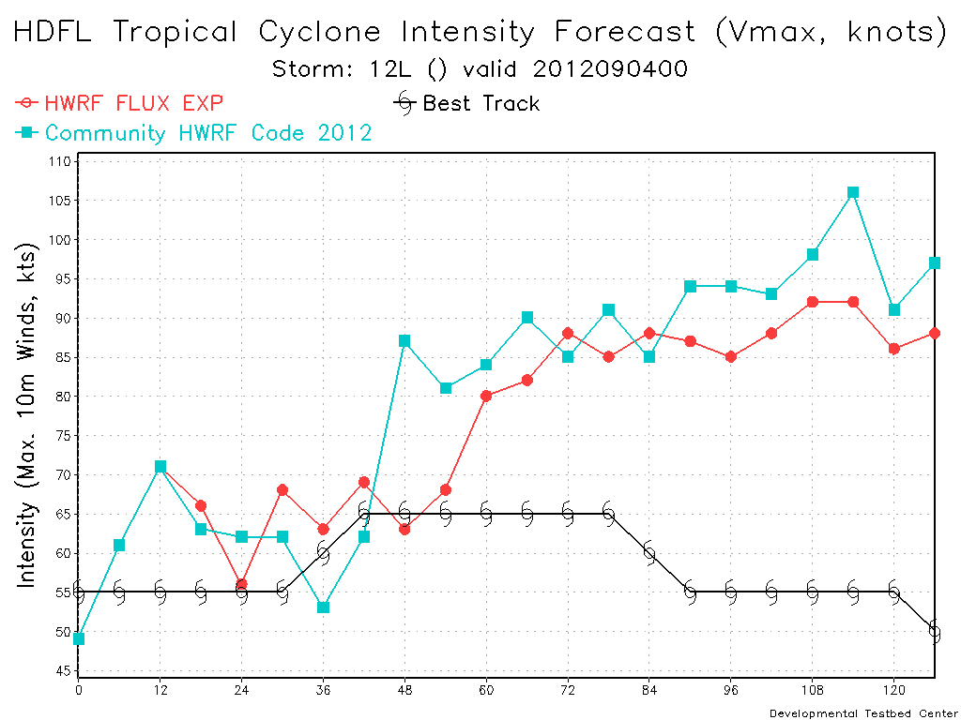
Leslie: rerun with same IC 09/04 00Z
Question: How much of the difference between HDFL and HD12 for a given case is due to fluxes change as opposed to sensitivity to IC?
Method: Ran with same IC
Answer: When same IC are used, differences between HD12 and HDFL are much smaller
Original run (cycled)
Rerun using same IC for control and flux experiment
Forecast differences are highly influenced by IC in addition to flux differences
In each run, different fluxes make a small difference, which gets compounded by cycling
Caution should be used when differences between a pair of runs are analyzed!!

Slide 10
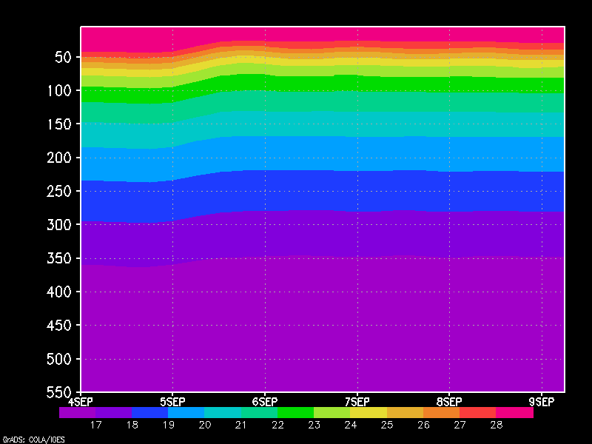
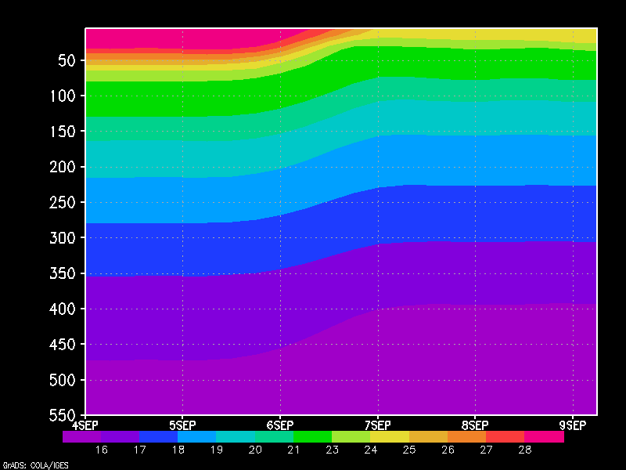
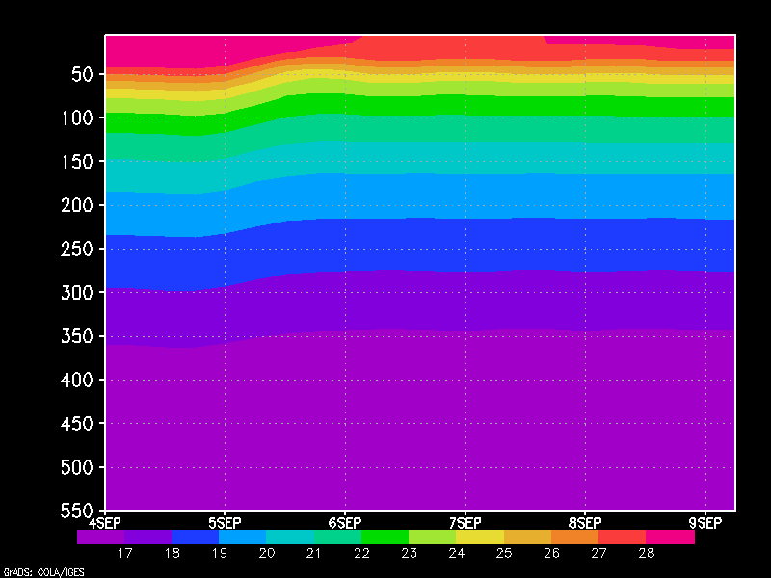
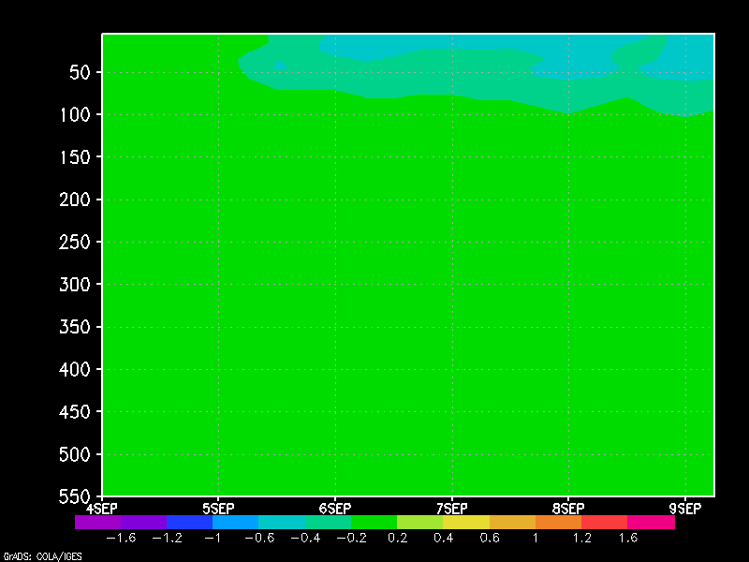
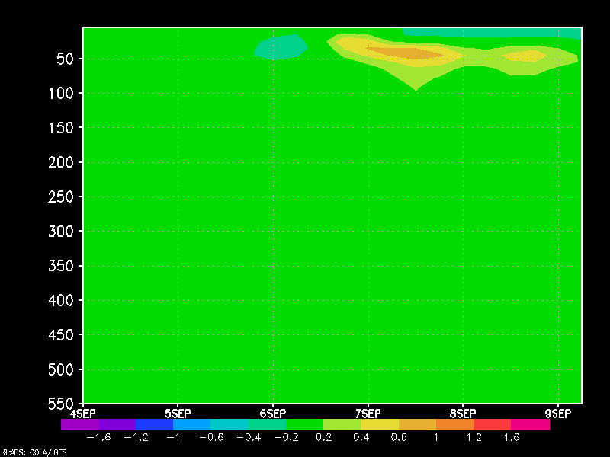
Nonlinearity in ocean response
Location X (24 h)
Location Y (48 h)
HD12
temp
Rerun using same IC for control and flux experiment
Depth 0 -500 m
HDFL
temp
More mixing
More SST cooling
Less intensity
Less mixing
Less SST cooling
More intensity
HDFL
-HD12
temp
HDFL cooler
HDFL warmer
0-120 h forecast

Slide 11
Conclusions and follow-up
Physically-based fluxes in 2012 HWRF improves AL intensity
2012 HWRF has 3-km grid spacing, revised PBL and C_{d}, C_{h}, therefore physical processes are better represented
This work demonstrated new collaborations and process
HRD conducted model evaluation
URI helped formulate hypothesis
DTC conducted extensive testing and case
HRD conducted additional verification and diagnostics studies
Change was proposed to and accepted by EMC
POM-TC in HWRF still not cooling enough
Proposals to HFIP from HRD, URI, DTC, EMC
Conduct field experiment to collect more observations for evaluation
Evaluate uncoupled POM-TC driven by observed winds

