Slide 1
Potential upgrades of PBL, convection and radiation physics of the 2013 operational HWRF model
Young C. Kwon, Vijay Tallapragada, Weiguo Wang, Qingfu Liu, Hualu Pan, Chanh Kieu(EMC/NCEP), Jun Zhang(HRD/AOML)

Slide 2
2013 HWRF pre-implementation test plan
 | Baseline (H130) | Physics upgrades |  |  |  | Combined (H213)
 |  | PBL(H131) | Meso-SAS (H132) | RRTMG (H133) | Ocean (H135) | Final configuration
Description | Revised init/GSI, New nest parent interpolations, Radiation bug fix, Revised nest movement, | Variable Ric | Meso SAS | Radiation | MPI-POM | Baseline+ physics
Person | Qingu, In-Hyuk Sam Trahan Mingjing, Young | Young/ Weiguo | Qingfu | Chanh | Biju Thomas (URI) | All
Cases | Whole 2011 and 2012 storms and some 2010 storms | Priority cases | Whole 2011 and 2012 storms and some 2010 storms | Priority cases | Whole 2011 and 2012 storms and some 2010 storms | Whole 2011 and 2012 storms and some 2010 storms

Slide 3
2013 HWRF baseline configuration (H130)
1. Vortex initialization
- Storm size correction – R34 and RMW
- Hurricane filter domain is revised (smaller than that of H212)
- Cold start use GFS vortex if a storm is weaker than 16m/s
2. Hybrid DA
- First guess is from GDAS 3, 6 and 9 hour forecast after vortex relocation
- Data assimilation on outer domain only followed by vortex initialization
- GSI hybrid analysis using global EnKF forecast ensemble
- 80 members of global ensemble members are given 75% weight to
background error covariance
- GSI hybrid analysis using global EnKF forecast ensemble

Slide 4
2013 HWRF baseline configuration (H130)
3. Infrastructure and bug fixes
- Change the preprocessors (prep_hybrid) for WP, resolution, vertical
interpolation
- Lager innermost domain with more frequent physics calling time step
- The vortex initialization codes are generalized for all basins (unibasin)
- POM: removal of flux truncation
- Upgrade SW corner computation
- Bug fix: GWD subgrid scale terrain, increase of ptsgm in WP, 10m wind
conversion(post)
- Update the nest-parent interpolation and nest motion algorithm
- MP physics feedback

Slide 5
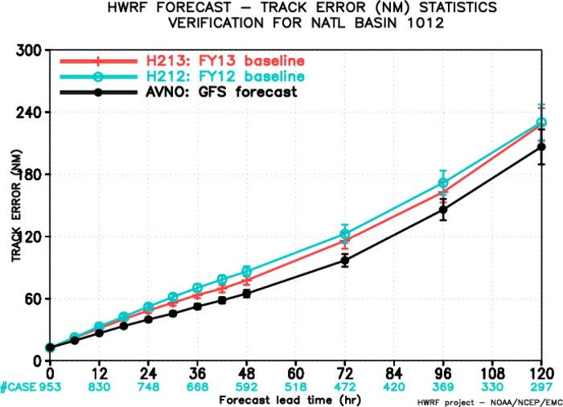
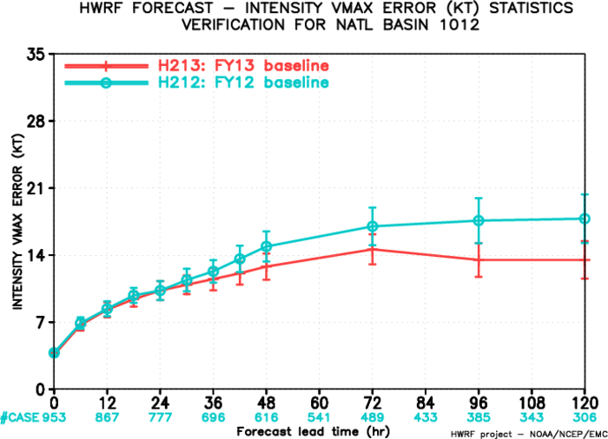
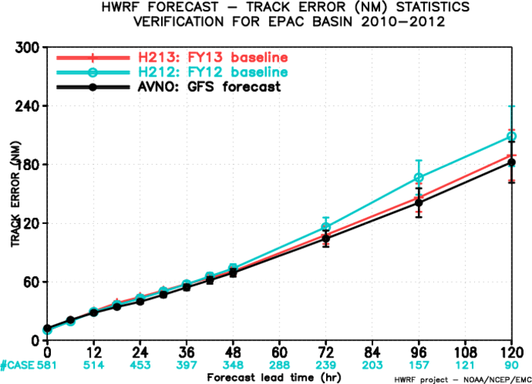
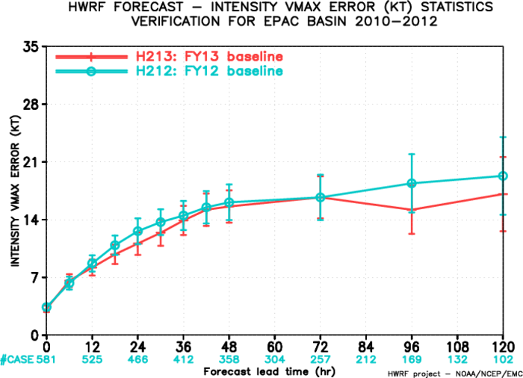
ATL track
ATL intensity
~8%
~25%
H212 (2012 HWRF)
H130 (2013 baseline)
EP track
EP intensity
~15%
~30%

Slide 6
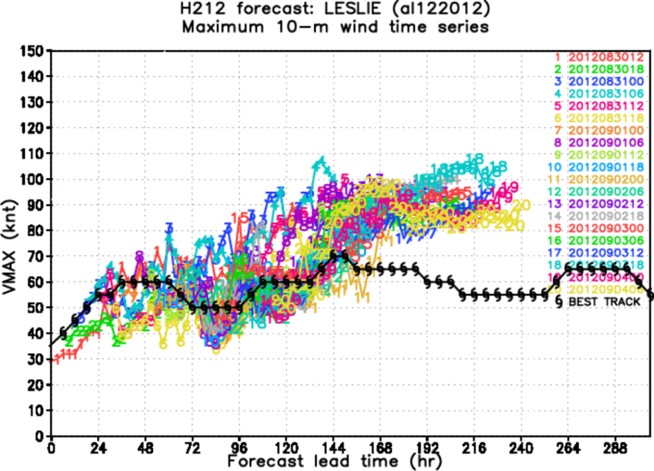
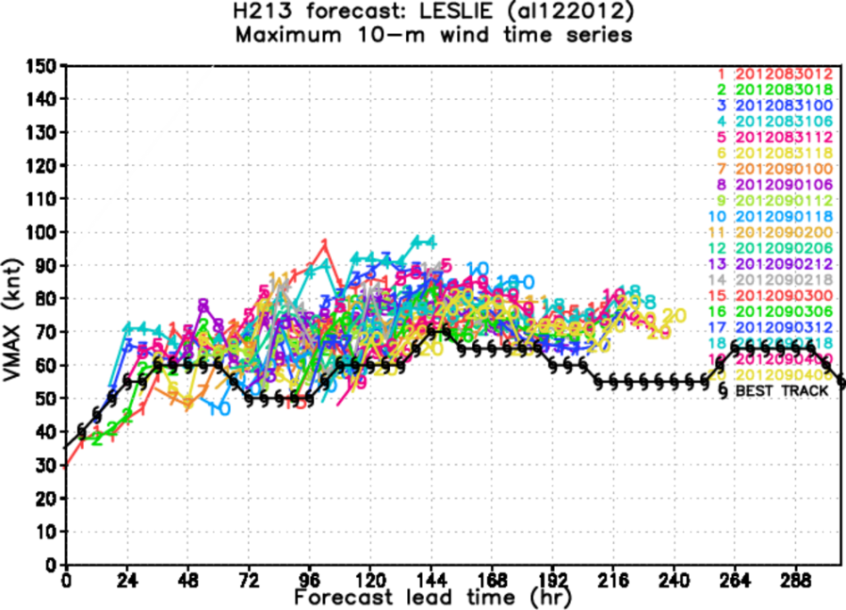
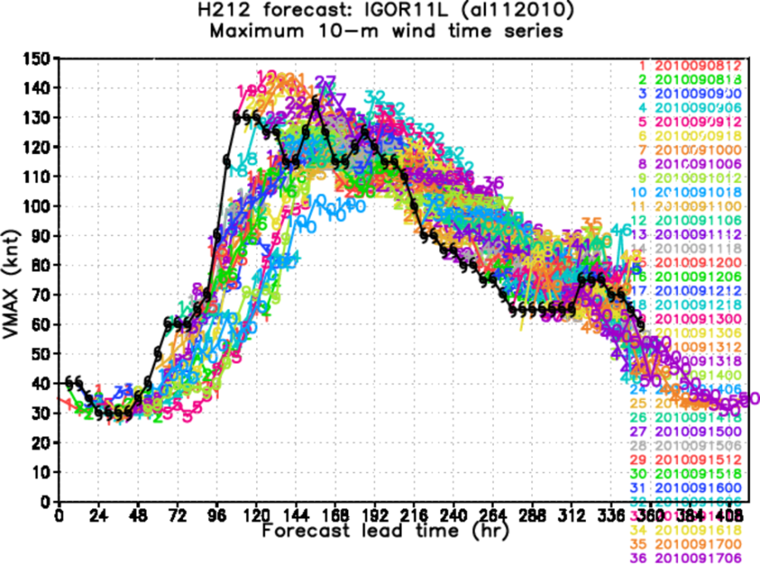
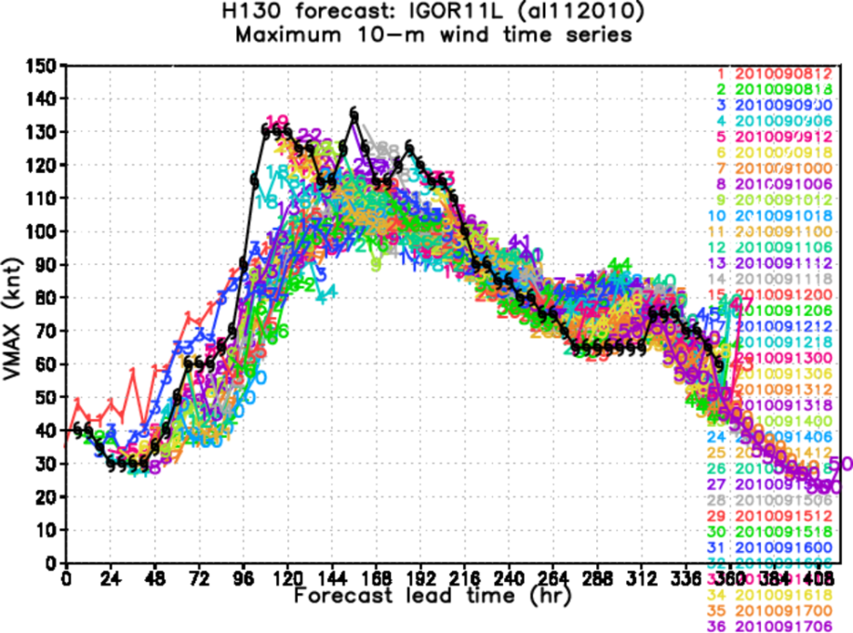
H212 H130
LESLIE
IGOR

Slide 7
MESO SAS convection scheme
fundamental assumption of SAS
The convective updraft area(Ac) is much smaller than grid box(Ae)
σ = Ac/Ae << 1.0 : updraft fraction
convective updraft area
When grid resolution becomes finer, the assumption will not be valid anymore (<~10km). The explicit MP scheme may also have a problem 10km or finer resolution to create moist adiabatic profile smoothly, which lead to grid-point storms.
Meso- SAS scheme is designed to resolve this issue of the original SAS scheme by removing the assumption of σ << 1.0 (Hualu Pan)

Slide 8
IMPORTANT:
We need one crucial closure assumption for the MESO SAS, which is the specification of the convective updraft fraction σ.
The current MESO SAS scheme determines σ based on the ratio of grid point vertical velocity and convective updraft vertical velocity as followed:
σ = 0.91 $\frac{\overline{W}}{Wc}$ + 0.09
($\overline{w}:grid vertical velocity, wc:convective vertical velocity)$
If $\overline{w}=wc$ , then σ=1 and convection is off.

Slide 9
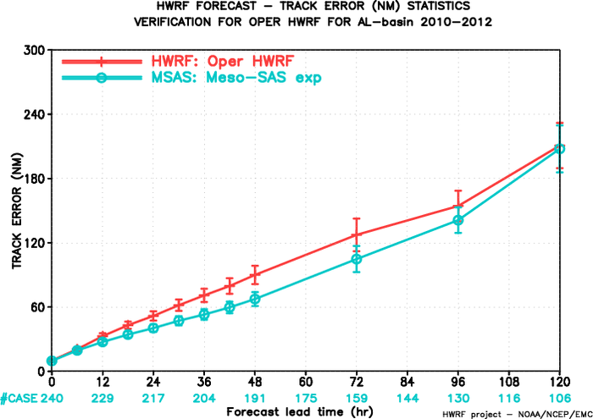
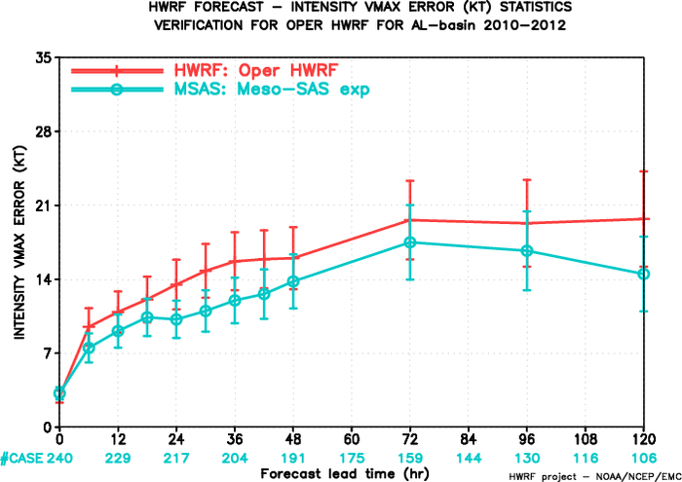
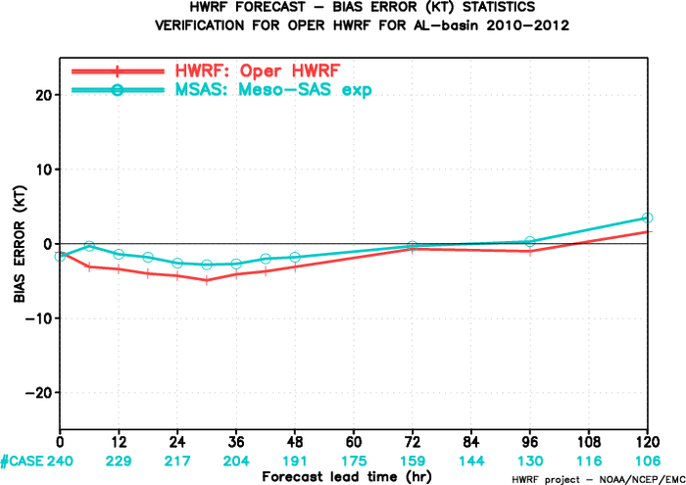
INTENSITY
TRACK
2012 operational HWRF
MESO SAS
BIAS
Preliminary results (with 2012 operational HWRF configuration:

Slide 10
Variable Critical Richardson number
(Vicker & Mahrt, 2003)
Motivation:
The GFS PBL scheme used in HWRF model has been known to produce too diffusive boundary layer in hurricane condition. Thanks to HRD’s effort to improve the hurricane PBL in HWRF model, the diffusivity and PBL height of HWRF model greatly improved based on composite dropsonde observations (e.g., Gopalakrishnan et al. 2013, JAS; Zhang et al. 2013, TCRR)
PBL$h=Ric \frac{θva |U\left(h\right)−U(0)|2}{g(θv\left(h\right)−θs)}$
$Km=α∗k u∗$ z (1 - z/h) ^{p}
However, outside of hurricanes, the GFS PBL behaves quite well and some underestimation of PBL height is reported (Jongil Han, personal communication). Therefore, it may worth trying to revise the current PBL scheme to work well in both inside and outside of hurricane area seamlessly.

Slide 11
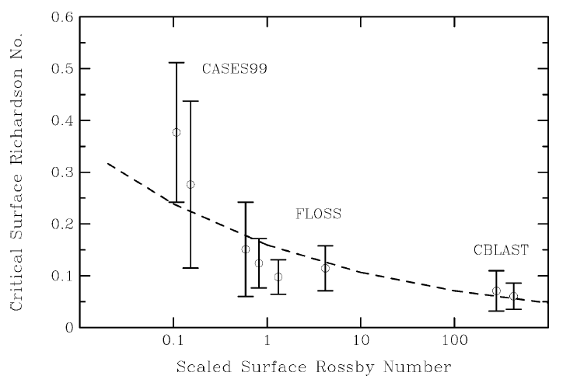
Critical Richardson number function of Ro (Vickers and Mahrt, 2003)
Vickers and Mahrt(2003)
Critical Richardson number is not a constant but varies with case by case.
R_{ic} = 0.16(10⁻⁷ $\frac{U10}{fZo}$)^{−0.18}
Hurricane cases
The magnitude of Ric modifies the depth of PBL and diffusivity, so the Ric varying with conditions would fit both hurricane condition and environments.

Slide 12
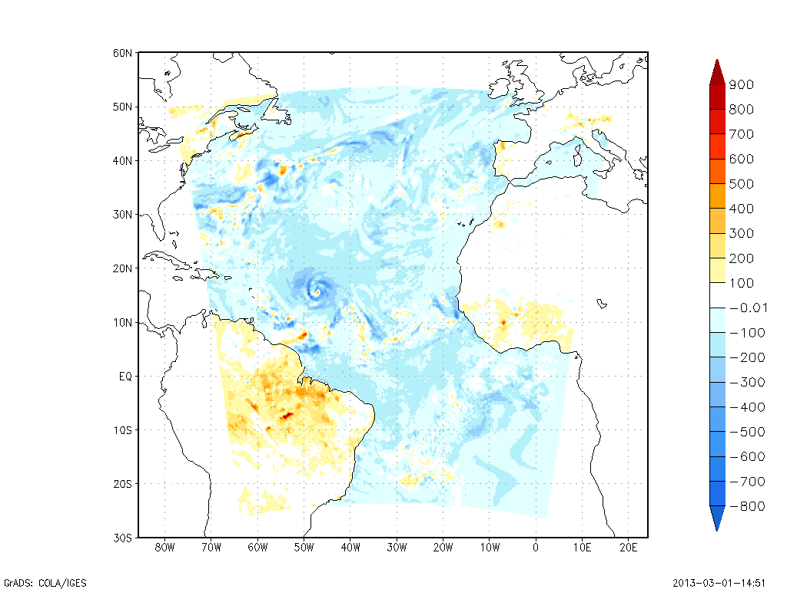
PBL height difference (new PBL scheme with var Ric – PBL scheme in 2012 HWRF with constant Ric=0.25)
Hurricane Katia (2011082906 +96hr)
PBL height over the ocean and hurricane area becomes shallower while that over land area becomes deeper
Both configurations have α set to 0.5

Slide 13
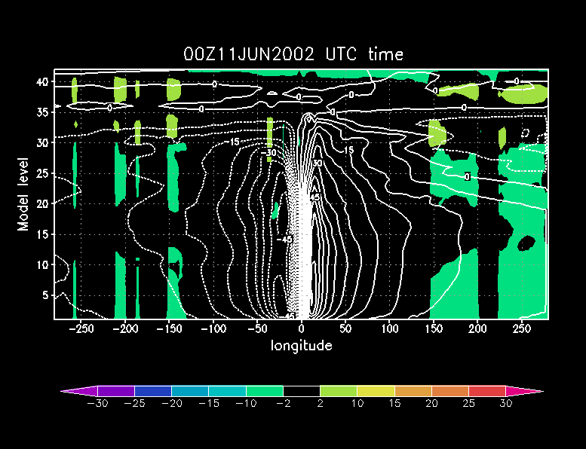
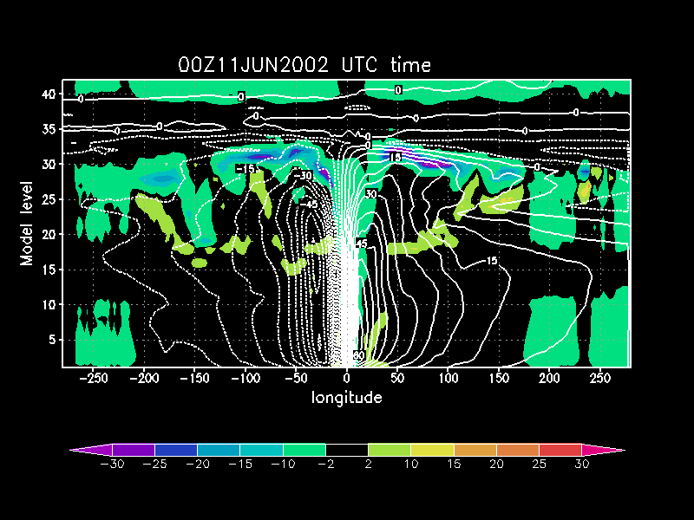
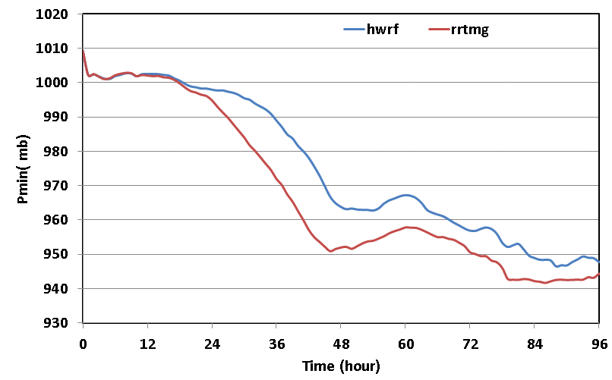
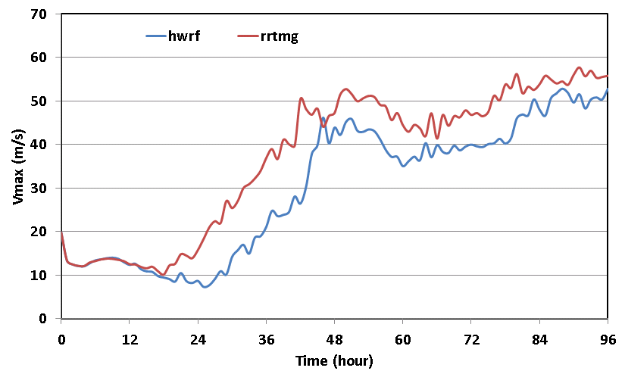
HWRF radiation package
RRTMG radiation package
HWRF
RRTMG

Slide 14
Summary
The performance of the 2013 HWRF baseline configuration improves track forecast skill by about 10-15% and intensity forecast skill by about 25-30% over 2012 operational HWRF for last three seasons (2010-2012).
The intensity improvements are seen in both strong and weak storms.
Convection, boundary layer and radiation schemes are identified as physics upgrade candidates for 2013 season. HWRF team tries to implement scientifically and observationally consistent schemes to the HWRF model.
The physics tests are in progress and the results will be available in the near future.

