Slide 1
Evaluation of Experimental Models for Tropical Cyclone Forecasting in Support of the NOAA Hurricane Forecast Improvement Project (HFIP)
Barbara G. Brown, Louisa Nance,
Paul A. Kucera, and Christopher L. Williams
Tropical Cyclone Modeling Team (TCMT)
Joint Numerical Testbed Program
NCAR, Boulder, CO
67th IHC/Tropical Cyclone Research Forum, 6 March 2013

Slide 2
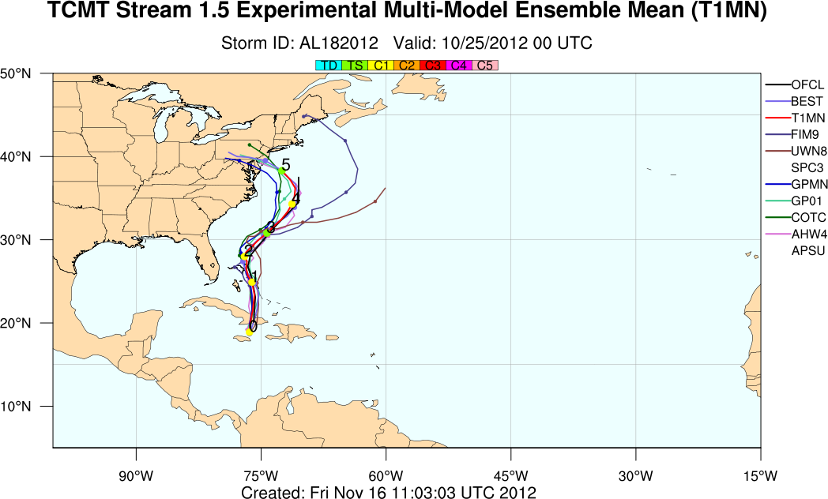
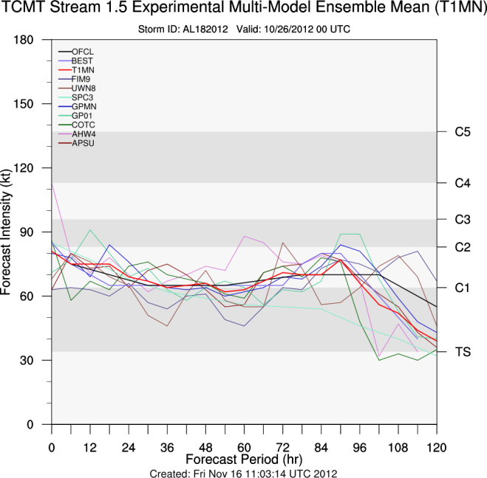
HFIP Retrospective and Demonstration Exercises
Retrospective evaluation goal: Select new Stream 1.5 models to demonstrate to NHC forecasters during the yearly HFIP demonstration project
Select models based on criteria established by NHC
Demonstration goal: Demonstrate and test capabilities of new modeling systems (Stream 1, 1.5, and 2) in real time
Model forecasts evaluated by TCMT in both the retrospective and demonstration projects

Slide 3
Methodology
Experimental Model
Operational Baseline
forecast
…….
forecast
forecast
…….
forecast
NHC Vx
…….
NHC Vx
NHC Vx
…….
NHC Vx
errors
…….
errors
errors
…….
errors
matching – homogeneous sample
Top flight models – ranking plots
Evaluation focused on early model guidance!
pairwise differences
error distribution properties
Graphics
SS tables
Notes:
Diagram depicts the methodology used for all verification studies.
Compute individual errors for both the experimental model and operational baselines
Match forecast errors to assure homogeneous sample
For one-to-one comparison, compute pairwise differences and determine SS based on properties of pairwise difference distribution – more powerful method then simply putting CIs on the error distributions.
Rank frequency plots for top-flight models

Slide 4
2012 Retrospective Exercise
Notes:
Start with a summary of the 2012 retrospective exercise

Slide 5
Stream 1.5 Retrospective Evaluation
Goals
Provide NHC with in-depth statistical evaluations of the candidate models/techniques directed at the criteria for Stream 1.5 selection
Explore new approaches that provide more insight into the performance of the Stream 1.5 candidates
Selection criteria
Track -
Explicit - 3-4% improvement over previous year’s top-flight models
Consensus – 3-4% improvement over conventional model consensus track error
Intensity –
improve upon existing guidance for TC intensity & RI
Notes:
Criteria to beat operational guidance by 3-4% stems from fact that operational models are also undergoing upgrades, so simply matching “old” operational guidance is not sufficient to merit including a model in stream 1.5

Slide 6
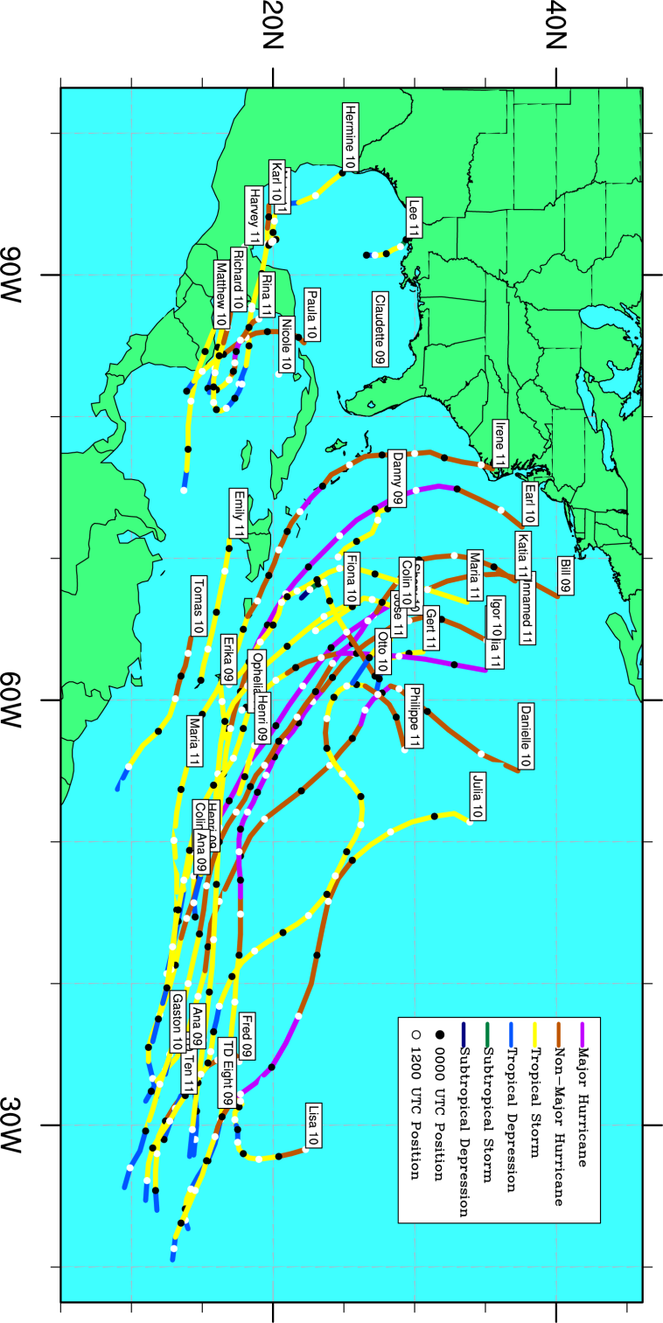
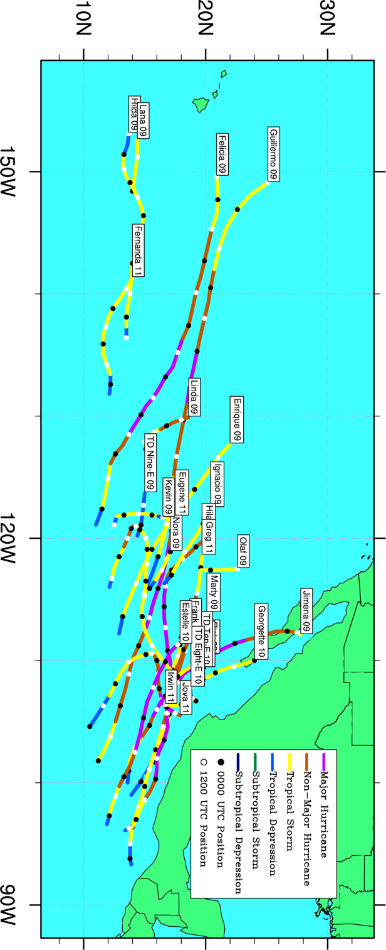
Atlantic Basin
2009: 8 storms
2010: 17 storms
2011: 15 storms
# of cases: 640
Eastern North Pacific Basin
2009: 13 storms
2010: 5 storms
2011: 6 storms
# of cases: 387

Slide 7
2012 Stream 1.5 Retrospective Participants
Organization | Model | Type | Basins | Config
MMM/SUNY-Albany | AHW | Regional-dynamic-deterministic | AL, EP | 1
UW – Madison | UW-NMS | Regional-dynamic-deterministic | AL | 1
NRL | COAMPS-TC | Regional-dynamic-deterministic | AL, EP | 1
PSU | ARW | Regional-dynamic-deterministic | AL | 2
GFDL | GFDL | Regional-dynamic-ensemble | AL, EP | 2
GSD | FIM | Global-dynamic-deterministic | AL, EP | 2
FSU | Correlation Based Consensus | Consensus (global/regional dynamic deterministic + statistical-dynamic) | AL | 1
CIRA | SPICE | Statistical-dynamic-consensus | AL, EP | 2
Notes:
4 regional deterministic models – PSU with and without radar, 1 regional ensemble – evaluated ensemble mean and unbogussed member, 1 global deterministic model and 2 types of consensus techniques – looked at both original SPICE and one based on regional dynamical models – all but SPICE considered late models that required conversion to early model prior to evaluation. Note that some groups only produced retro forecasts for Atlantic Basin, while others produced forecasts for both Atlantic and eastern Pacific

Slide 8
Comparisons and Evaluations
Performance relative to Baseline (top-flight) models
Track: ECMWF, GFS, GFDL
Intensity: DSHP, LGEM, GFDL
Contribution to Consensus
Track (variable)
Atlantic: ECMWF, GFS, UKMET, GFDL, HWRF, GFDL-Navy
East Pacific: ECMWF, GFS, UKMET, GFDL, HWRF, GFDL-Navy, NOGAPS
Intensity (fixed)
Decay SHIPS, LGEM, GFDL, HWRF

Slide 9
Sample retro results/displays
All reports and graphics are available at:
http://www.ral.ucar.edu/projects/hfip/h2012/verify/

Slide 10
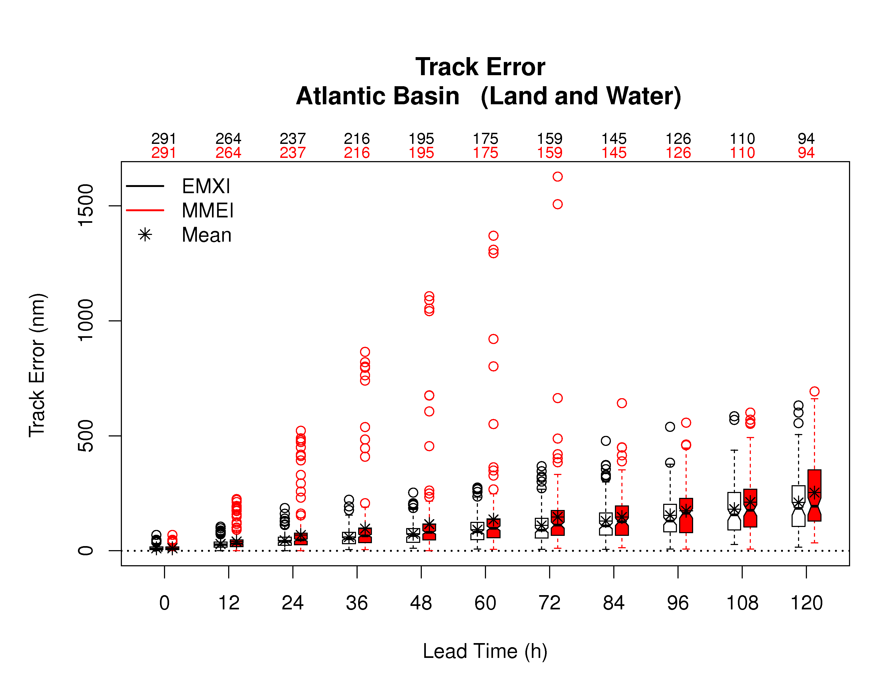
Error Distributions Box Plots
Notes:
Box plots of the error distributions were generated for each comparison – looked for noteworthy properties to call out in the reports, such as the large outliers shown in this example from the FSU Correlation Based Consensus

Slide 11
Statistical Significance – Pairwise Differences Summary Tables
Example COAMPS-TC
Practical Significance
 | Track | Intensity
SS differences | Δ < -20 | Δ < -2
 | -20 < Δ < -10 | -2 < Δ < -1
 | -10 < Δ< 0 | -1 < Δ< 0
 | 0 < Δ< 10 | 0 < Δ < 1
 | 10 < Δ< 20 | 1 < Δ < 2
 | Δ > 20 | Δ> 2
Not SS | Δ< 0 | Δ < 0
 | Δ> 0 | Δ> 0
mean error
difference
3.2
15%
0.992
% improve (+)
/degrade (-)
p-value
Forecast hour | 0 | 12 | 24 | 36 | 48 | 60 | 72 | 84 | 96 | 108 | 120
GHMI Track Land/Water | 0.0 0% - | -5.7 -17% 0.999 | -12.4 -22% 0.999 | -18.2 -23% 0.999 | -21.5 -22% 0.999 | -24.2 -20% 0.999 | -23.6 -16% 0.989 | -20.9 -12% 0.894 | -23.4 -11% 0.786 | -25.8 -10% 0.680 | -28.6 -10% 0.624
GHMI Intensity Land/Water | 0.0 0% - | -0.5 -6% 0.987 | 0.3 2% 0.546 | 0.8 5% 0.625 | 0.8 5% 0.576 | 1.6 9% 0.954 | 4.2 20% 0.999 | 5.1 24% 0.999 | 5.5 26% 0.999 | 4.8 23% 0.999 | 3.2 15% 0.992
Notes:
Tables for each pairwise comparison were compiled to provide a quick summary of the results – top line of each box contains the mean error difference, middle line is the % improvement or degradation and bottom line displays the p-value – shading is used to high light those lead times that meet the 95% confidence criteria used for this evaluation – used red to indicate times when stream 1.5 errors exceeded op baseline and green to indicate stream 1.5 errors less than op baseline – used different thresholds to high light the size of the error differences, where lighter shading denotes smaller differences and darker shading larger differences.

Slide 12
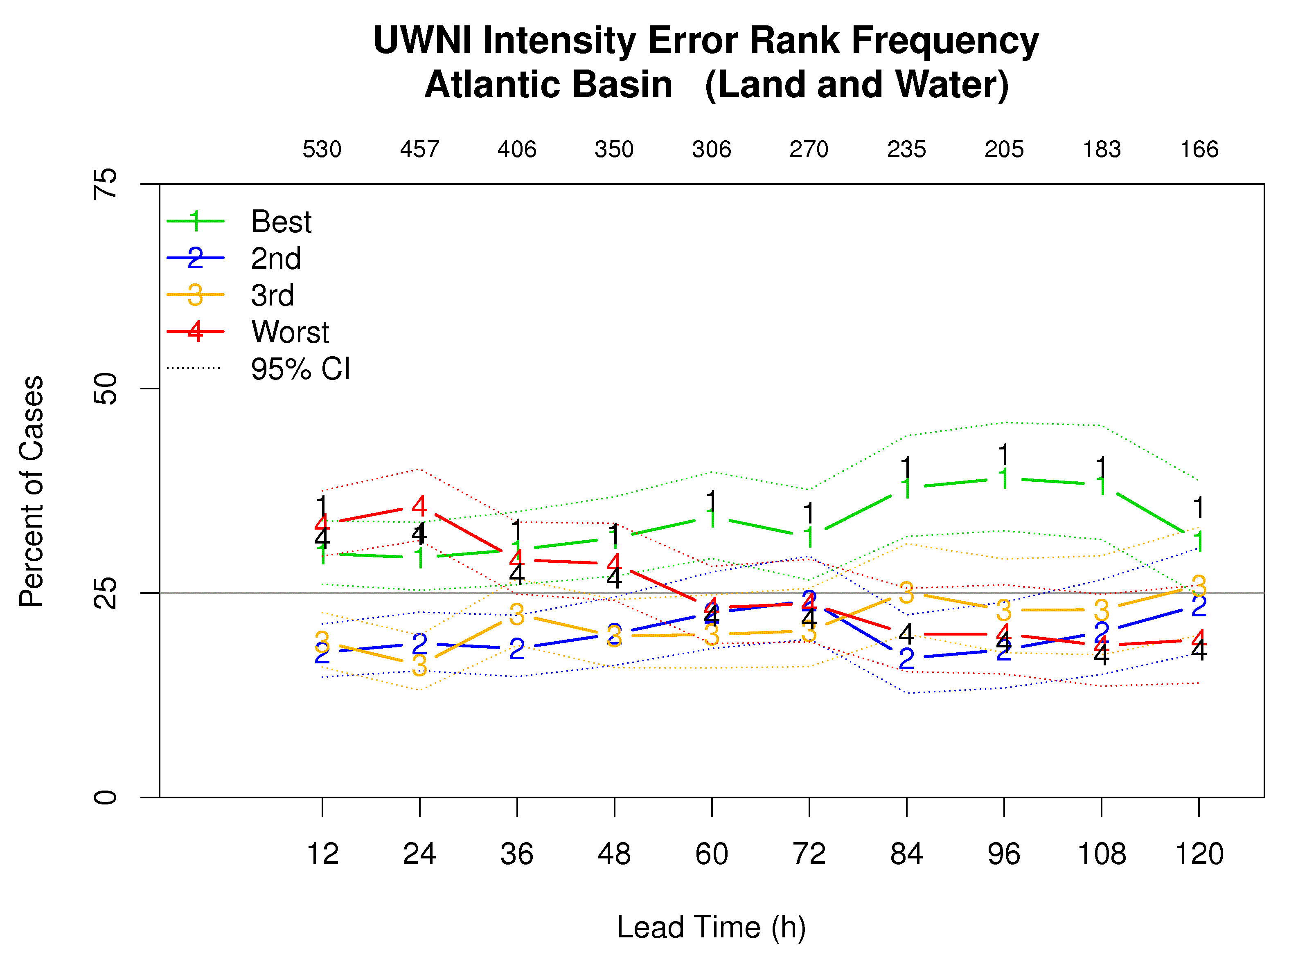
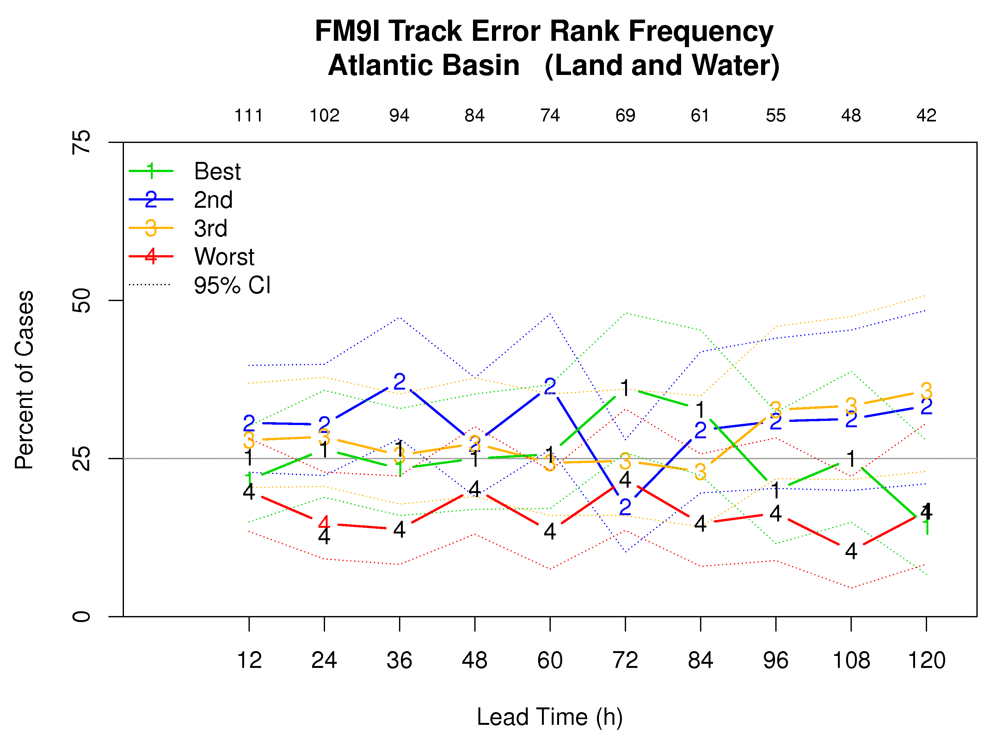
Comparison w/ Top-Flight Models Rank Frequency
U of Wisconsin:
1st or last for shorter lead times
More likely to rank 1st for longer lead time
FIM:
CIs for all ranks tend to overlap
Method sensitive to sample size
Notes:
This slide shows 2 examples of the new display we put together this year to address NHC’s request for a method looking at the stream 1.5 candidates performance wrt the top-flight models as a group to compliment the individual comparisons. This new approach allows display of all lead times in one graphic and by random assigning ranking ties, we were also able to put confidence intervals on these rank frequencies. The black numbers show the result if we had assigned ties such that stream 1.5 candidate was given the better rank.

Slide 13
NHC’s 2012 Stream 1.5 Decision
Organization | Model | Track | Track Consensus | Intensity | Intensity Consensus
MMM/SUNY-Albany | AHW |  | • |  | •
UW – Madison | UW-NMS |  |  |  | •
NRL | COAMPS-TC |  |  |  | •
PSU | ARW |  | • | • | •
GFDL | GFDL ensemble mean | • |  | •
 | No-bogus member | • |  | •
GSD | FIM |  | •
FSU | Correlation Based Consensus
CIRA | SPICE |  |  | •
Notes:
7 participants selected for 2011 Stream 1.5…how information was used by forecasters varied. Some of the guidance would be viewed explicitly while others only as part of a consensus.

Slide 14
2012 demo
All graphics are available at:
http://www.ral.ucar.edu/projects/hfip/d2012/verify/

Slide 15
2012 HFIP Demonstration
Evaluation of Stream 1, 1.5, and 2 models
Operational, Demonstration, and Research models
Focus here on selected Stream 1.5 model performance
Track: GFDL ensemble mean performance relative to baselines
Intensity: SPICE performance relative to baselines
Contribution of Str 1.5 models to consensus forecasts

Slide 16
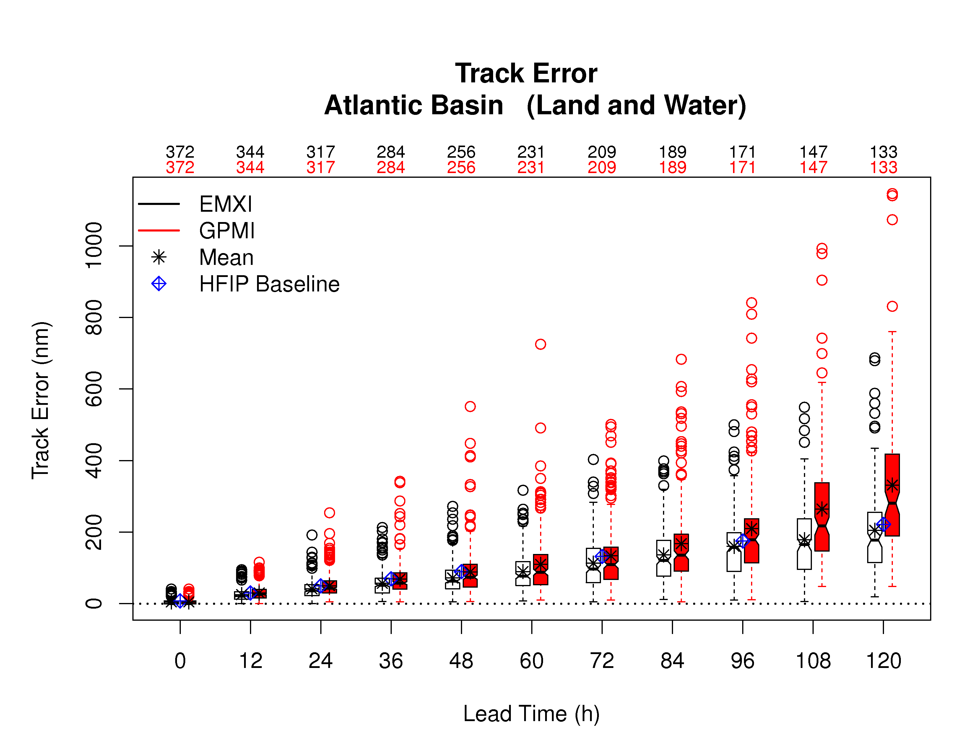
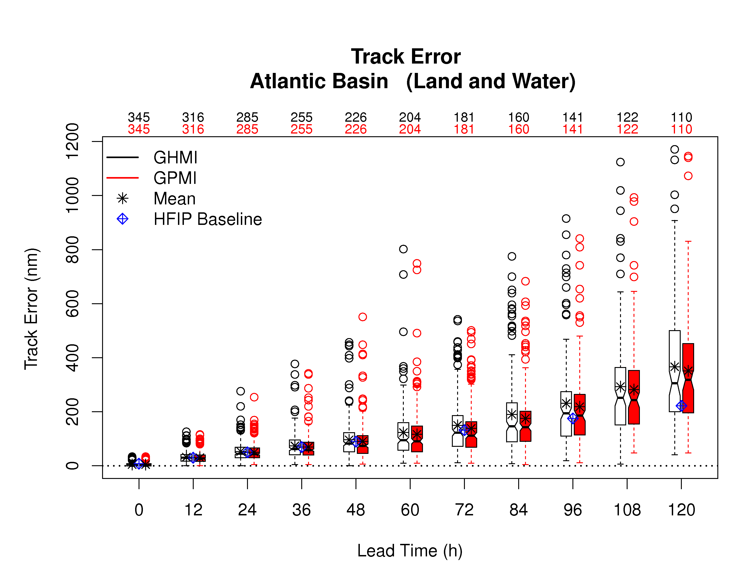
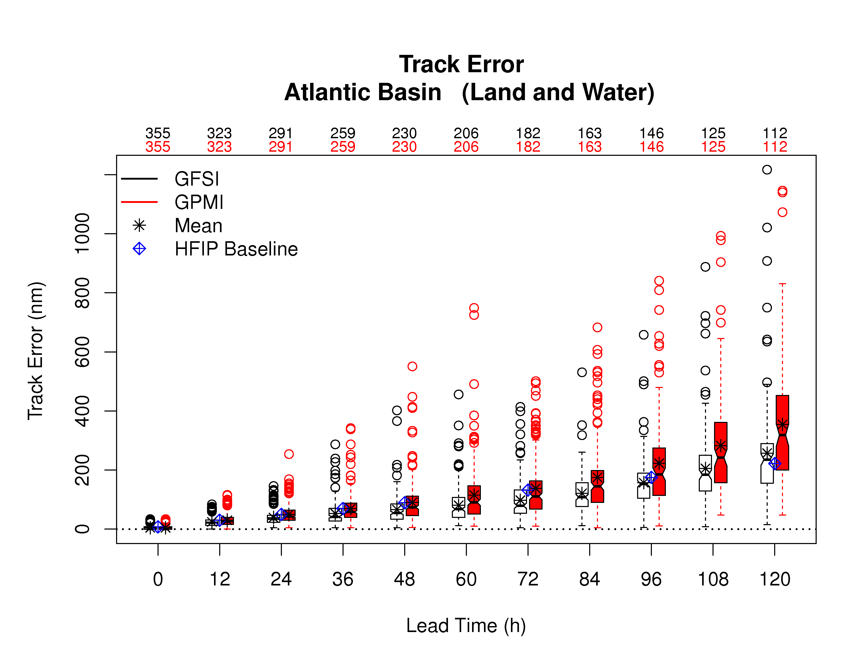
2012 Demo: GFDL Ensemble Mean Track errors vs. Baseline models
Red: GFDL Ensemble Mean Model errors
Baselines: ECMWF, GFDL (operational), GFS
ECMWF
GFDL
GFS
Notes:
Based on other supporting plots: SS differences for ECMWF and GFS baselines all favor operational baseline, whereas, SS differences for GFDL baseline all favor experimental GFDL ensemble mean. Tendency to rank 3rd appears to stem from ensemble mean beating deterministic GFDL guidance.

Slide 17
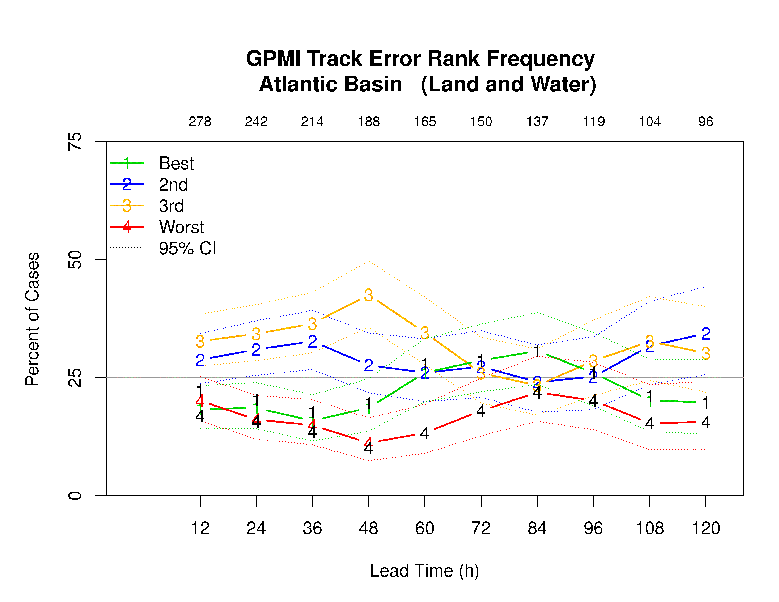
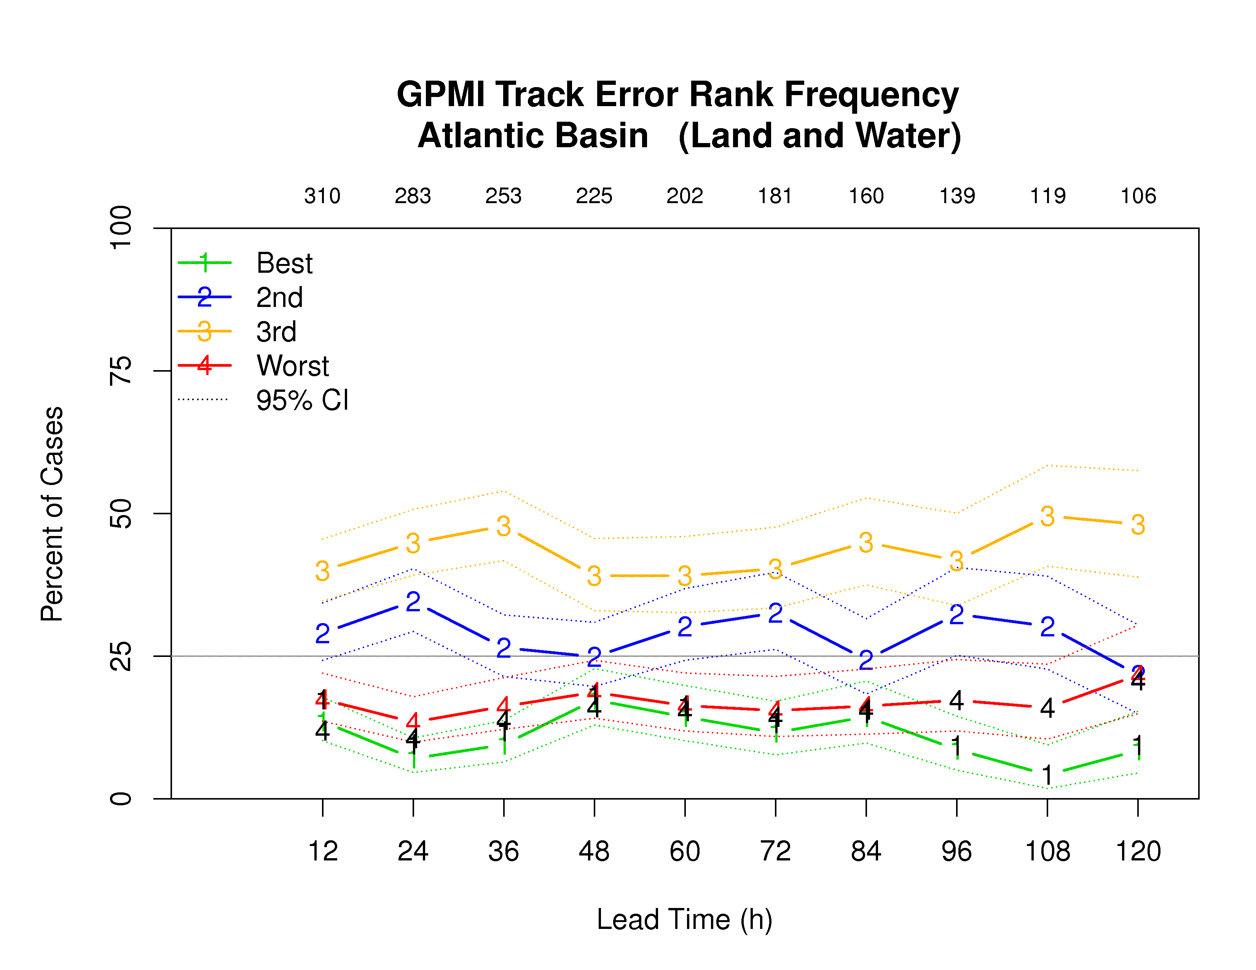
Comparison w/ Top-Flight Models Rank Frequency: GFDL Ensemble Mean
Retrospective (2009-2011)
Demo (2012)
Notes:
Tendency to rank 3rd appears to stem from ensemble mean beating deterministic GFDL guidance.

Slide 18
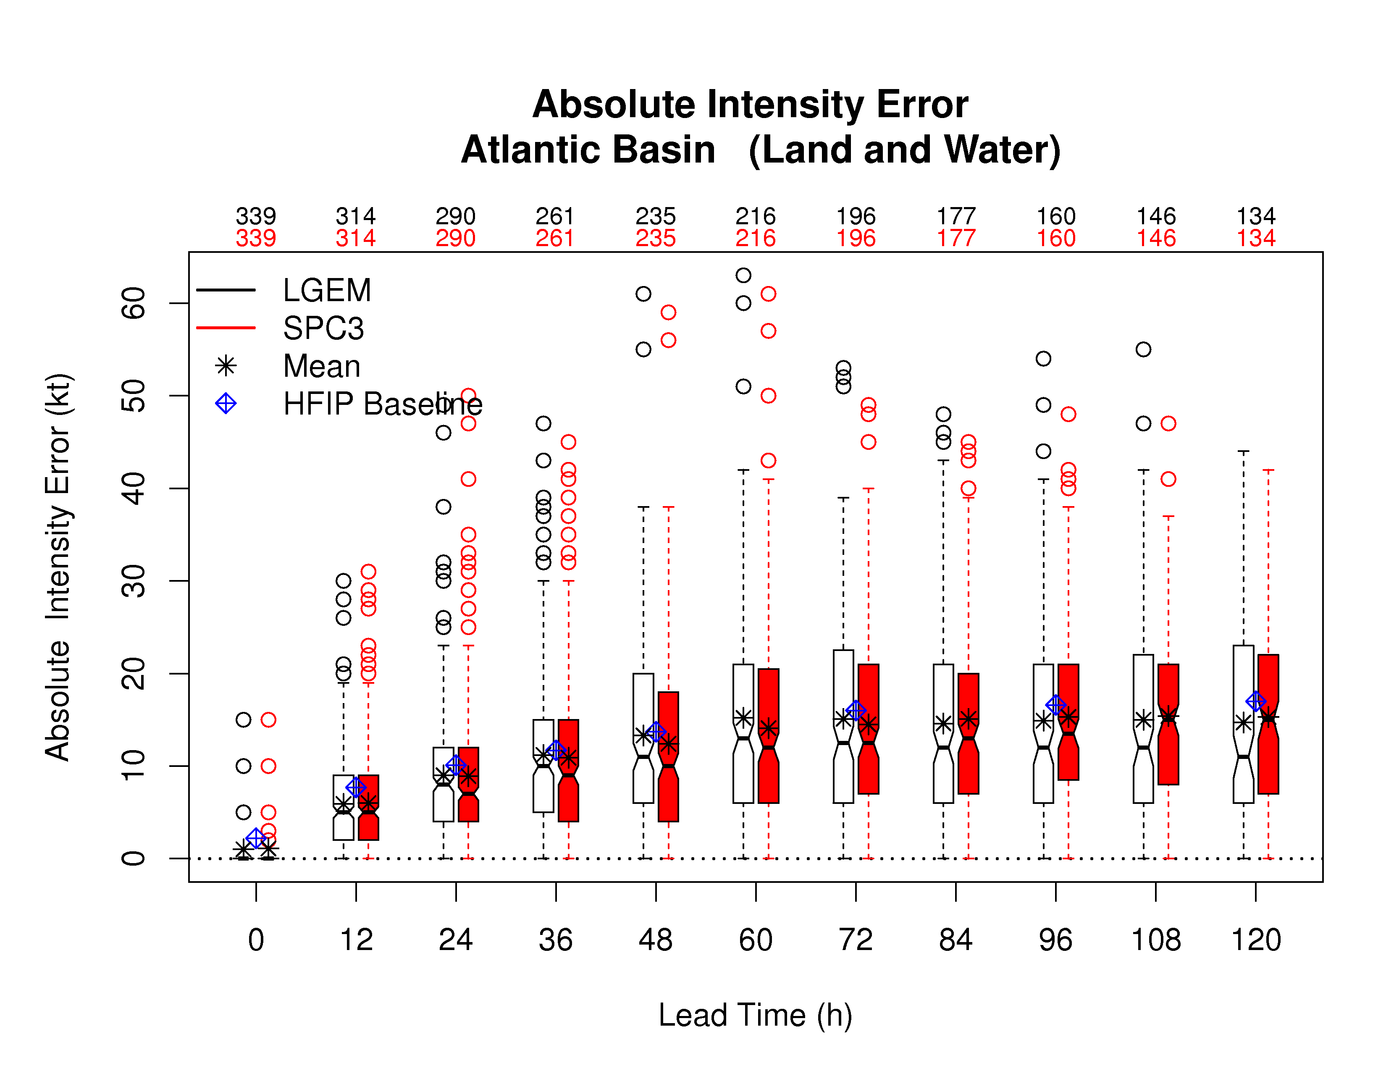
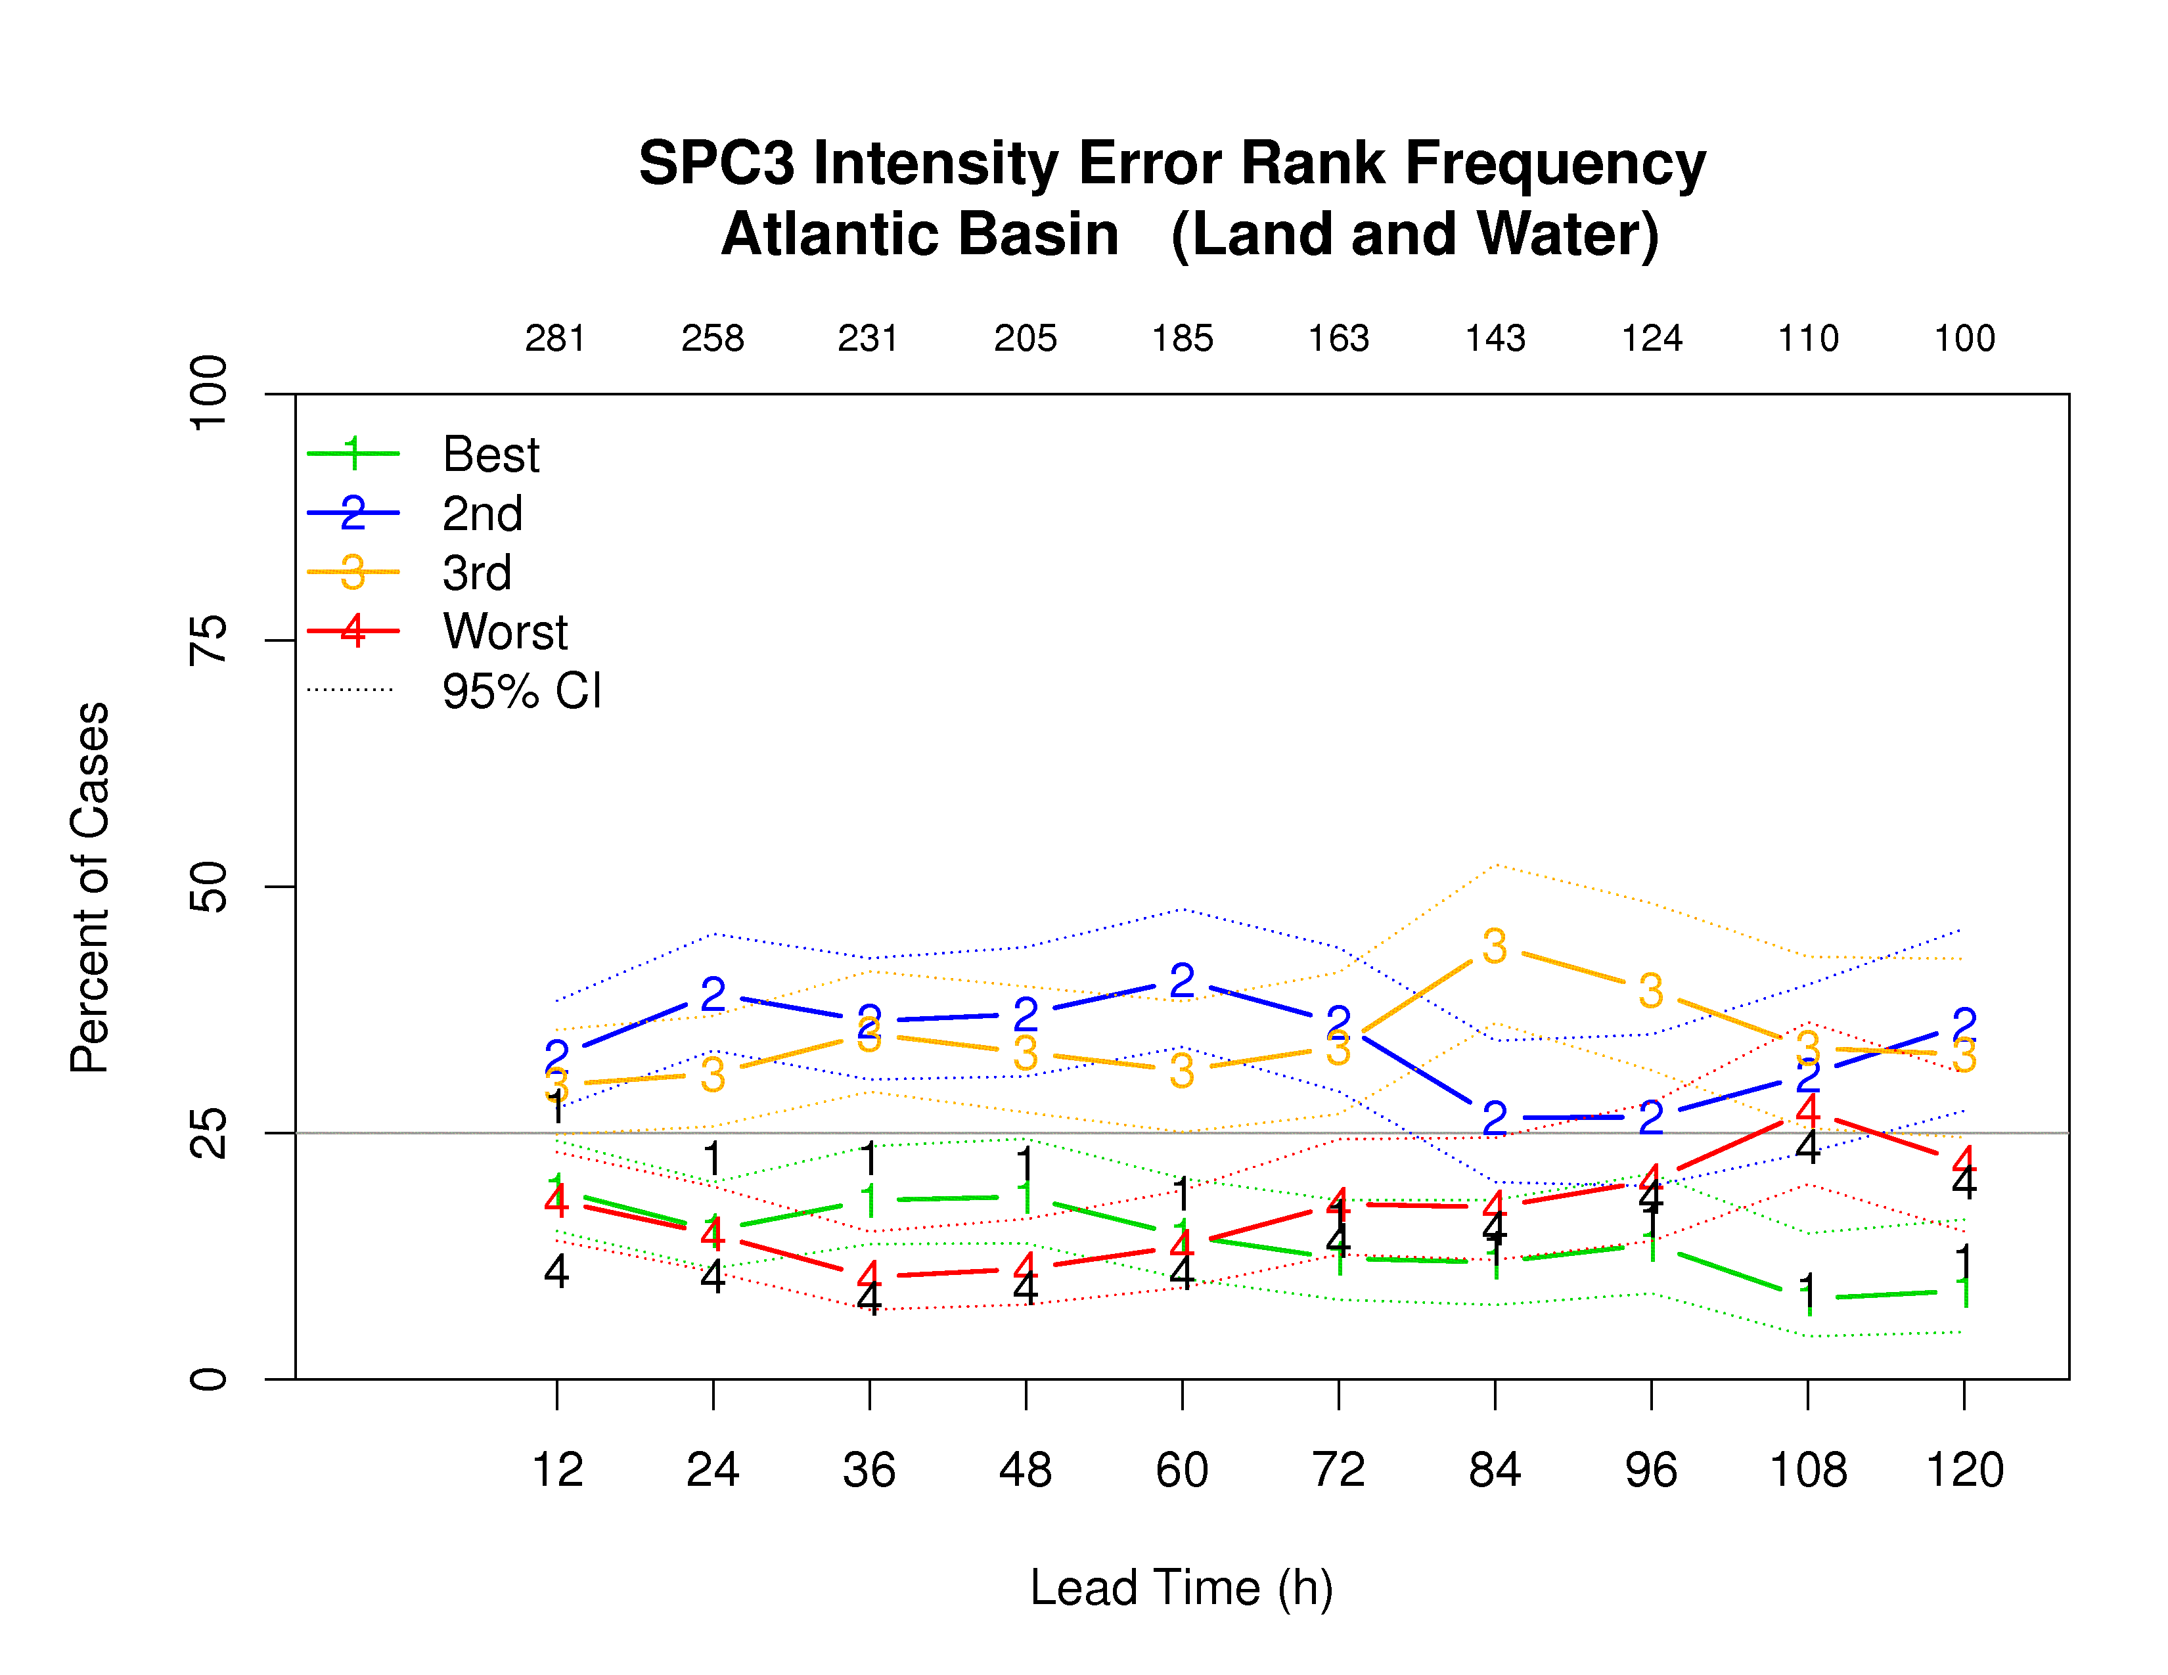
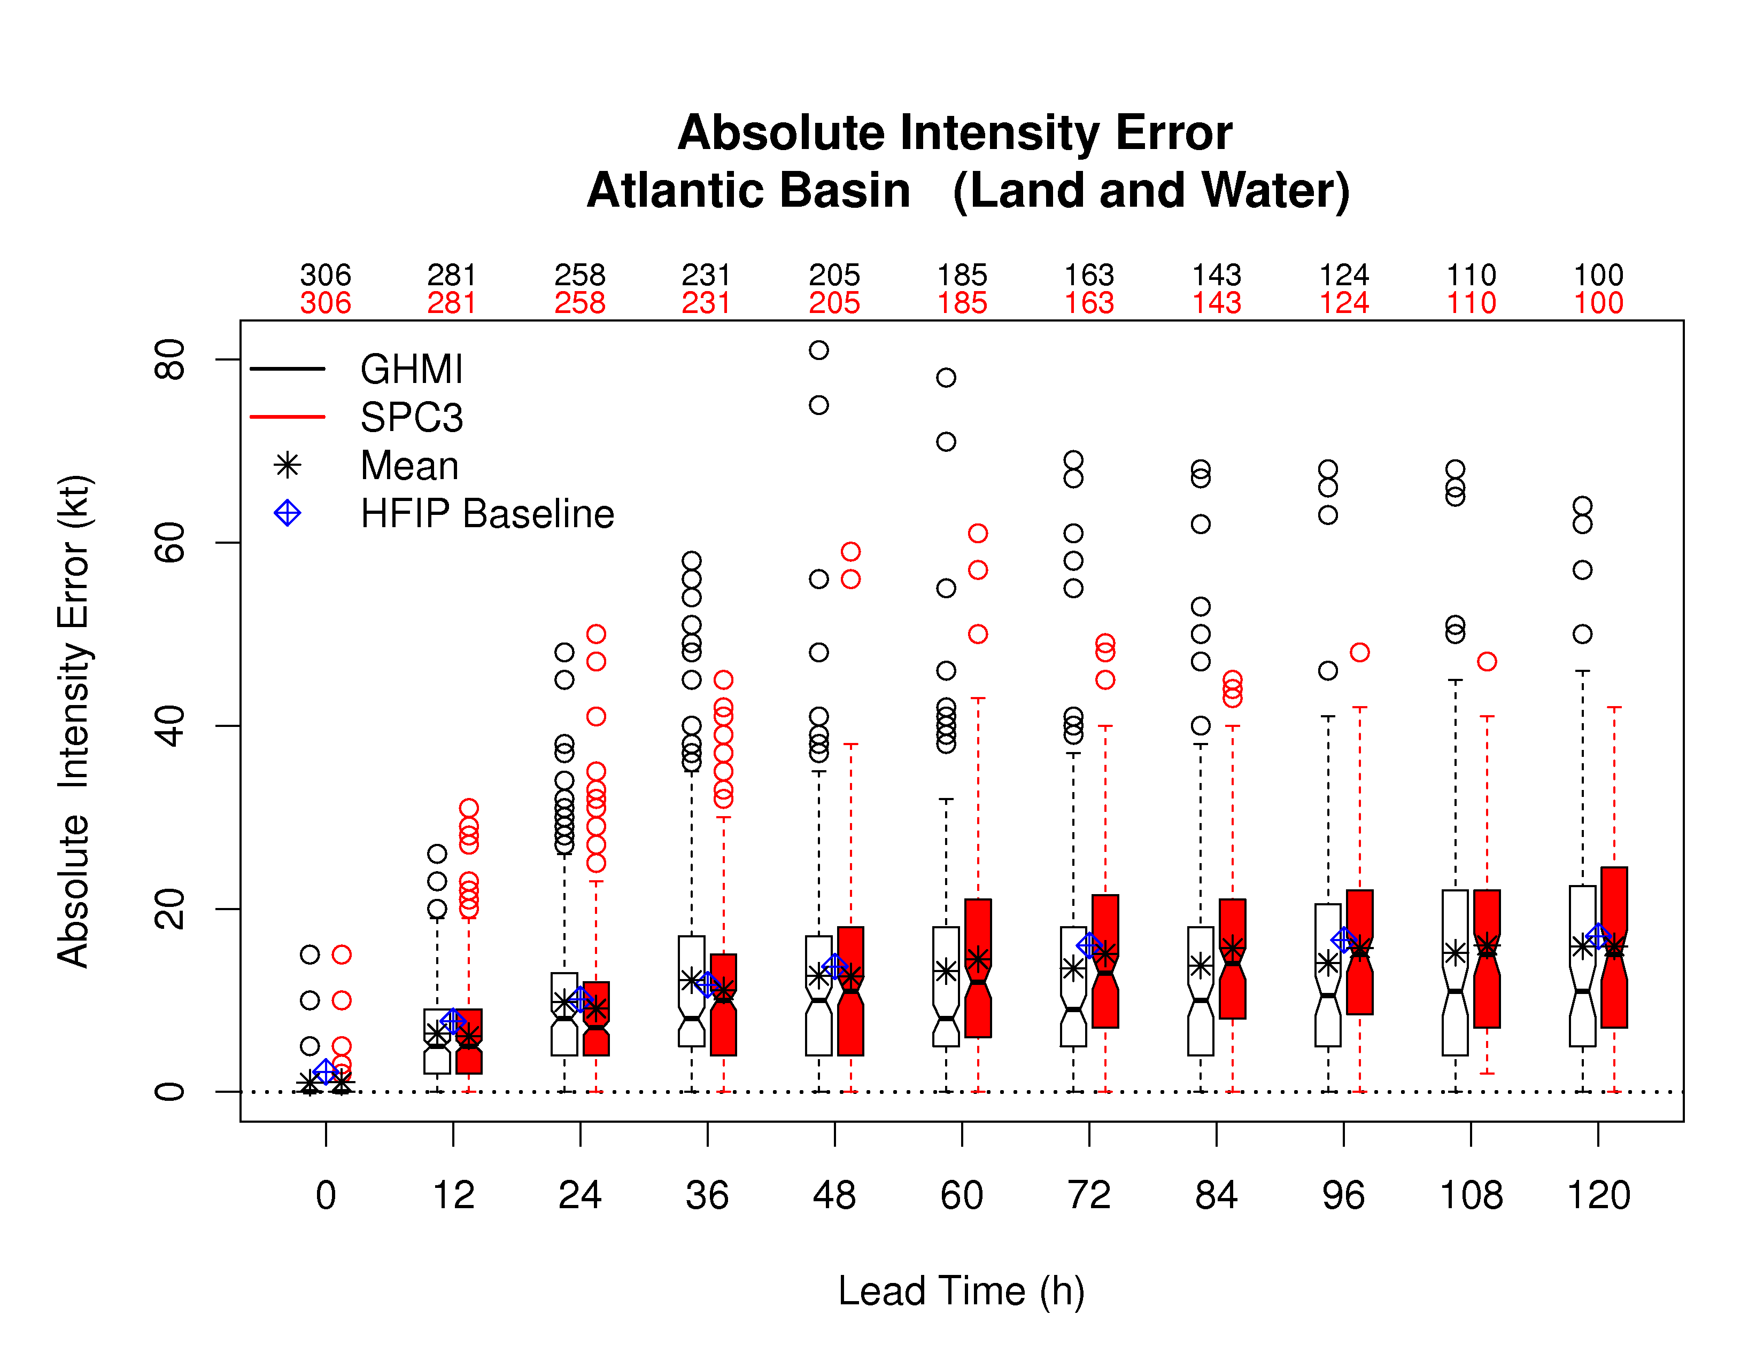
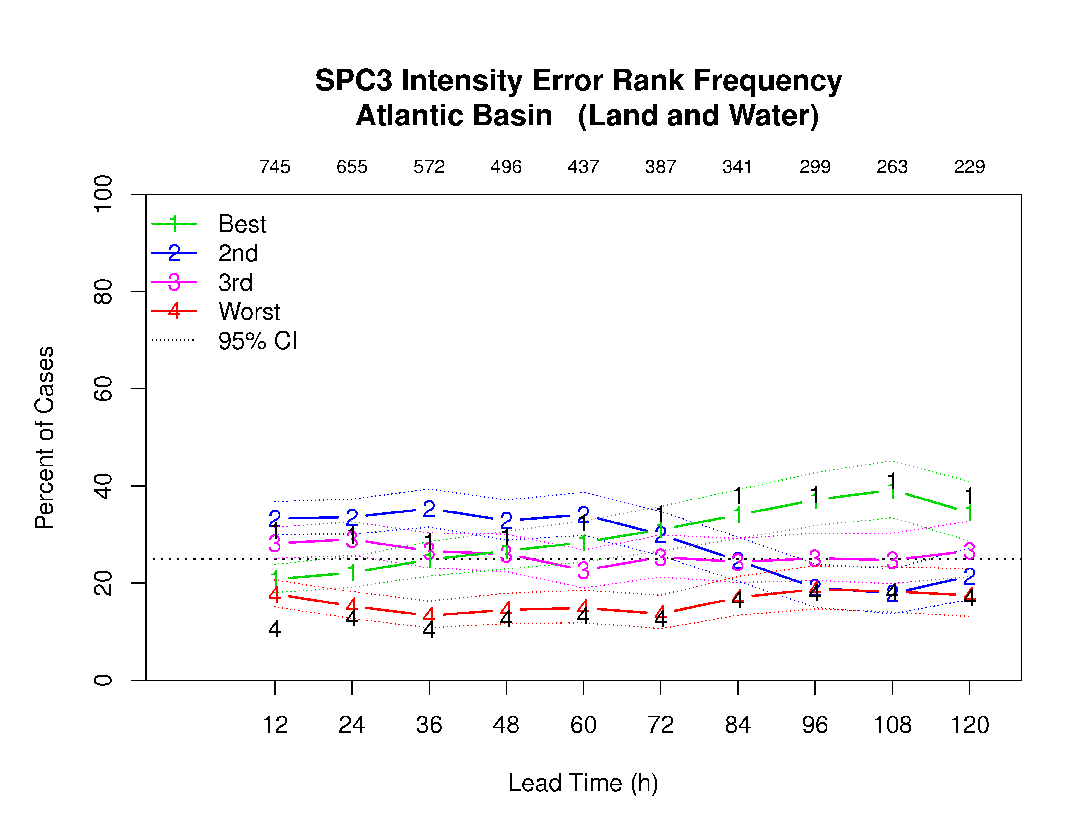
2012 Demo: SPICE (intensity)
Baseline Comparisons
Rank Frequency Comparisons
Demo
Retro

Slide 19
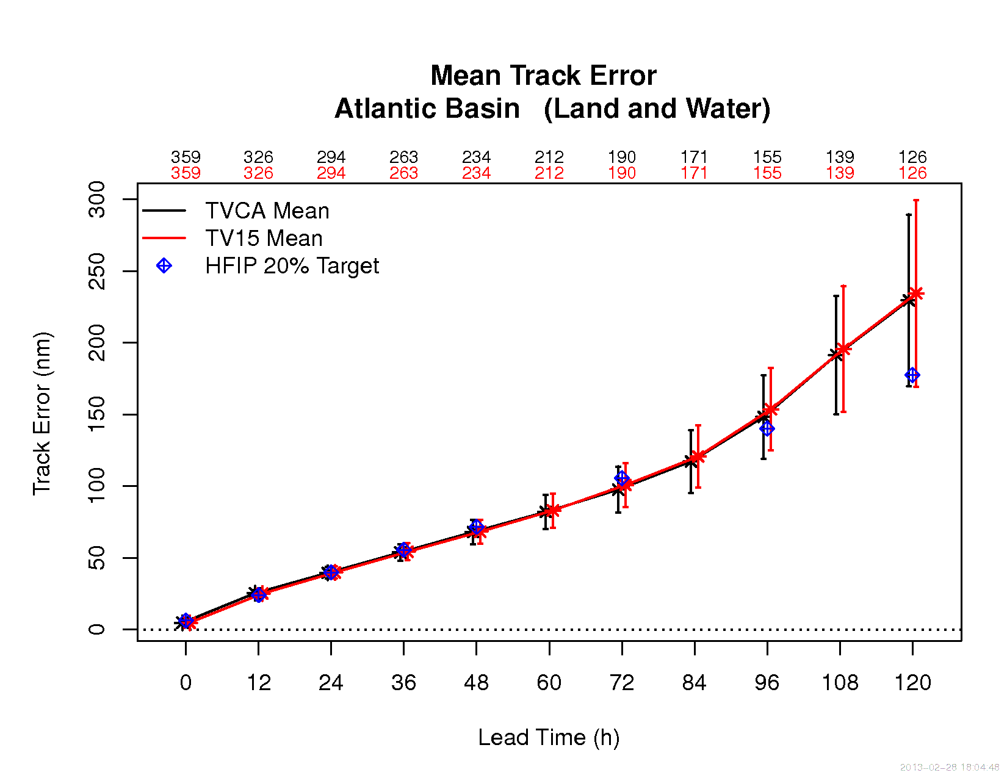
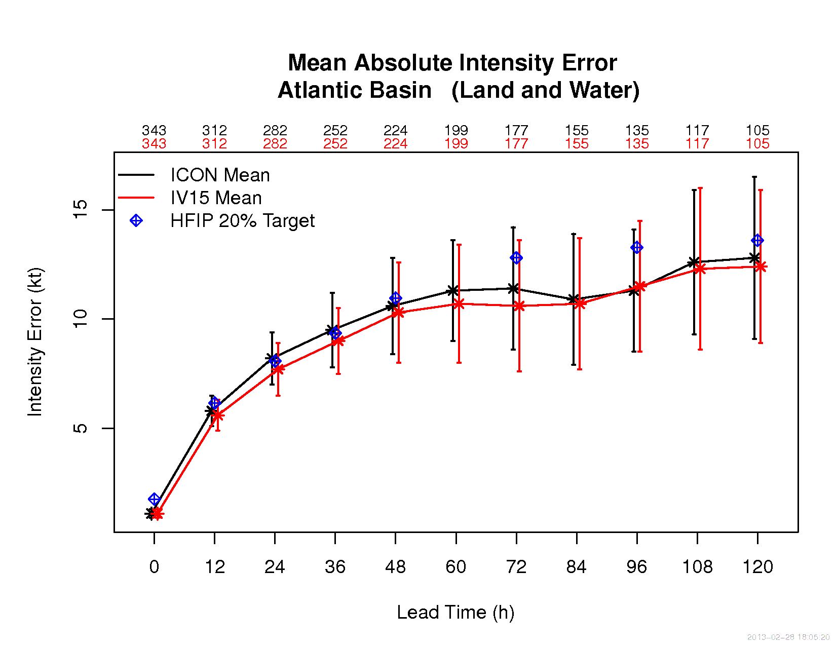
2012 Demo: Stream 1.5 Consensus
Stream 1.5 Consensus performed similarly to Operational Consensus, for both Track and Intensity
For Demo, confidence intervals tend to be large due to small sample sizes
Track
Intensity

Slide 20
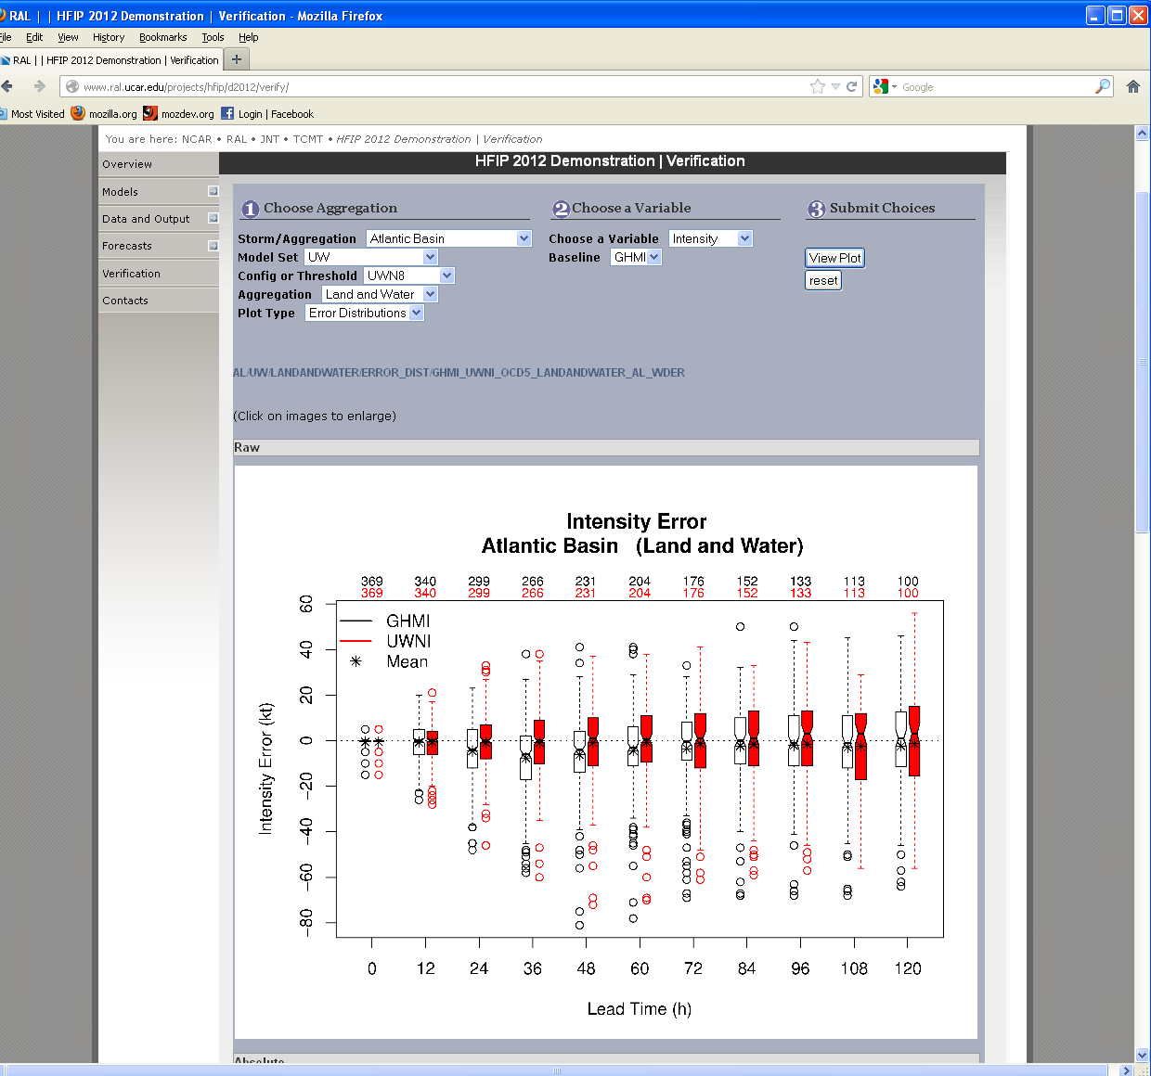
Online Access to HFIP Demonstration Evaluation Results
Evaluation graphics are available on the TCMT website:
http://www.ral.ucar.edu/projects/hfip/d2012/verify/
Wide variety of evaluation statistics are available:
Aggregated by basin or storm
Aggregated by land/water, or water only
Different plot types: error distributions, line plots, rank histogram, Demo vs. Retro
A variety of variables and baselines to evaluate
Notes:
This is example of error distributions for the UW model for the Atlantic Basin, land and water, for intensity errors compared to the GHMI Baseline

Slide 21
Thank You!

Slide 22
Baseline Comparisons
Operational Baselines | Stream 1.5 configuration
Top flight models: Track – ECMWF, GFS, GFDL Intensity – DSHP, LGEM, GFDL | Stream 1.5
Consensus: Track (variable) AL: ECMWF, GFS, UKMET, GFDL, HWRF, GFDL-Navy EP: ECMWF, GFS, UKMET, GFDL, HWRF, GFDL-Navy, NOGAPS Intensity (fixed) AL & EP: Decay SHIPS, LGEM, GFDL, HWRF | AHW, ARW, UM-NMS, COAMPS-TC, FIM: Consensus + Stream 1.5 GFDL, SPICE: Consensus w/ Stream 1.5 equivalent replacement FSU-CBC: Direct comparison
Notes:
One-to-one comparisons between stream 1.5 candidates and top-flight model plus a look at how the stream 1.5 model performed wrt the top-flight models as a group, impact of stream 1.5 candidates on consensus or direct comparison with consensus

