Slide 1
Further Advancements to the NCEP Operational HWRF Modeling System for 2013 and Beyond
Vijay Tallapragada & HWRF Team
Environmental Modeling Center,
NCEP/NOAA/NWS, NCWCP, College Park, MD 20740.
67th IHC/Tropical Cyclone Research Forum, March 6, 2013
Notes:
1
1

Slide 2
Outline
Review of HWRF performance for 2012 season
Priorities and planned upgrades for FY2013 implementation
Ongoing R&D activities and planned 2013 demo experiments
Future plans

Slide 3
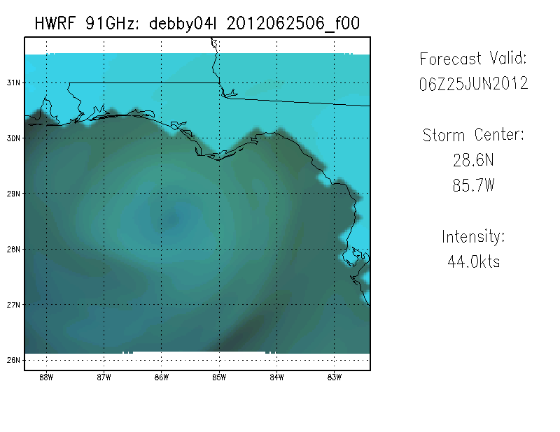
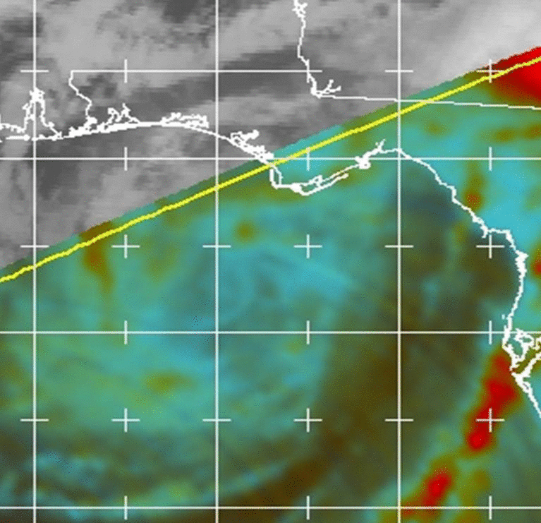
FY2012 High-Resolution Triple-Nested HWRF
Three telescopic domains: 27km: 75x75º; 9km ~11x10º 3km inner-most nest 6x5.5º
For the first time, a high-resolution hurricane model operating at cloud-permitting 3km resolution was implemented into NCEP operations, a result of multi-agency efforts supported by HFIP
Advanced high-resolution products from operations include synthetic satellite imagery, high-frequency track and intensity forecasts and additional large-scale and vortex scale diagnostics (http://www.emc.ncep.noaa.gov/gc_wmb/vxt/)
Synthetic Satellite Imagery (SSMI/S) from HWRF compared to observed ice scattering composite for TS Debby
Notes:
3

Slide 4
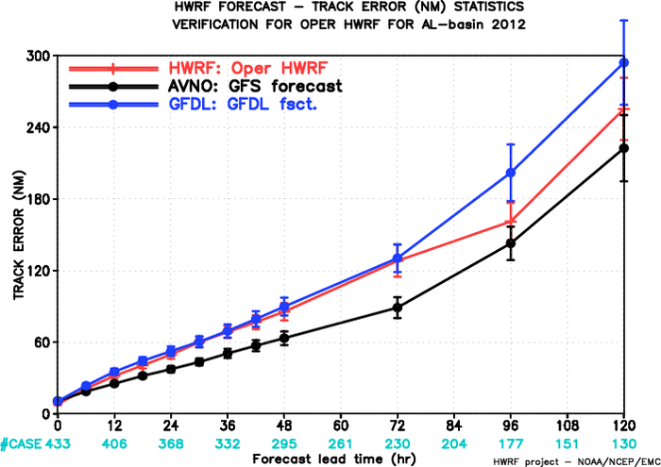
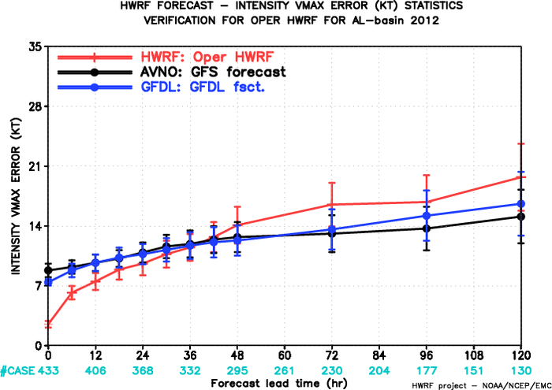
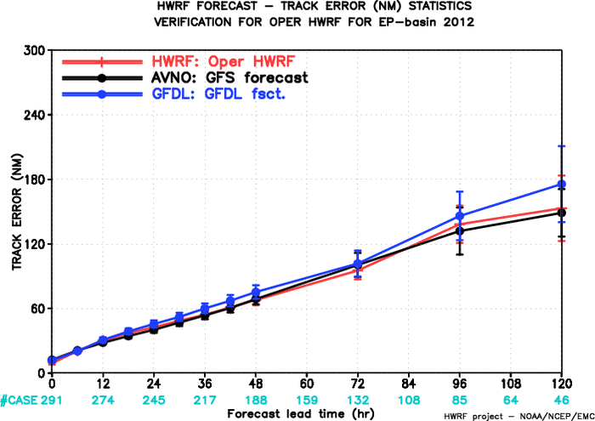
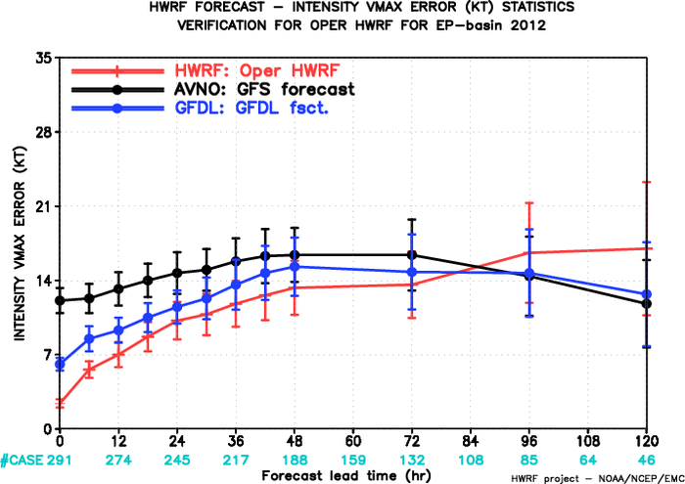
Verification of Operational HWRF for 2012 season
2011 HWRF 96hr FCST errors
2011 HWRF 96hr FCST errors
2012 HWRF 96hr FCST errors
2012 HWRF 96hr FCST errors
ATL-track
ATL-intensity
2011 HWRF 96hr FCST errors
2011 HWRF 96hr FCST errors
2012 HWRF 96hr FCST errors
2012 HWRF 96hr FCST errors
EP-track
EP-intensity

Slide 5
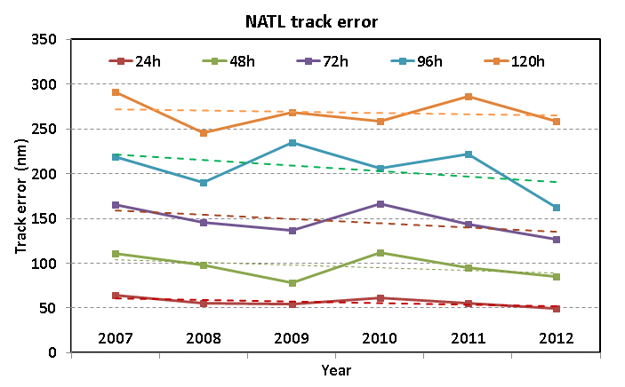
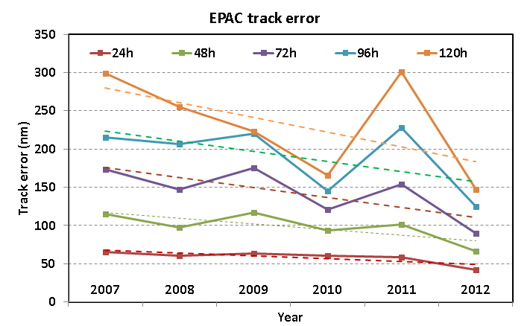
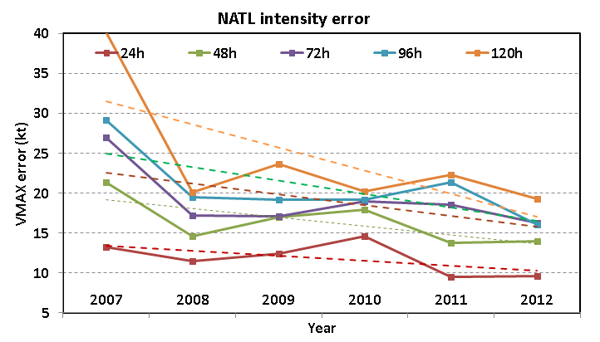
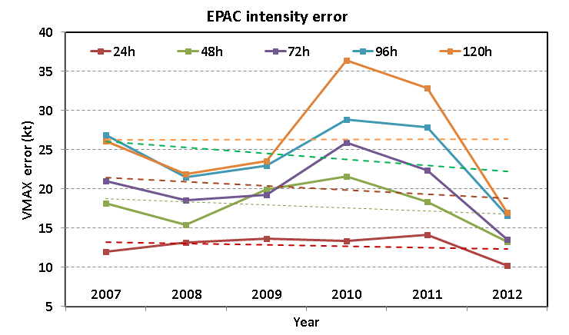
Operational HWRF Progress and Improvement w.r.t 2011 (FY2012 Operational Goals: 10% improvement in track and intensity at all times)
Lead time | 12 | 24 | 36 | 48 | 72 | 96 | 120
%improvement | 8 | 10 | 10 | 11 | 11 | 27 | 10
Lead time | 12 | 24 | 36 | 48 | 72 | 96 | 120
%improvement | 15 | 27 | 32 | 33 | 38 | 39 | 49
Lead time | 12 | 24 | 36 | 48 | 72 | 96 | 120
%improvement | 7 | -1 | -4 | 0 | 12 | 25 | 13
Lead time | 12 | 24 | 36 | 48 | 72 | 96 | 120
%improvement | 36 | 28 | 32 | 28 | 39 | 41 | 48

Slide 6
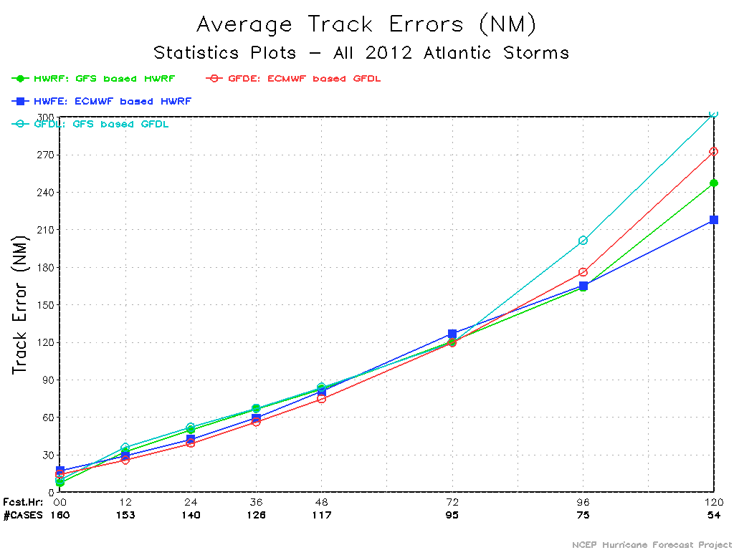
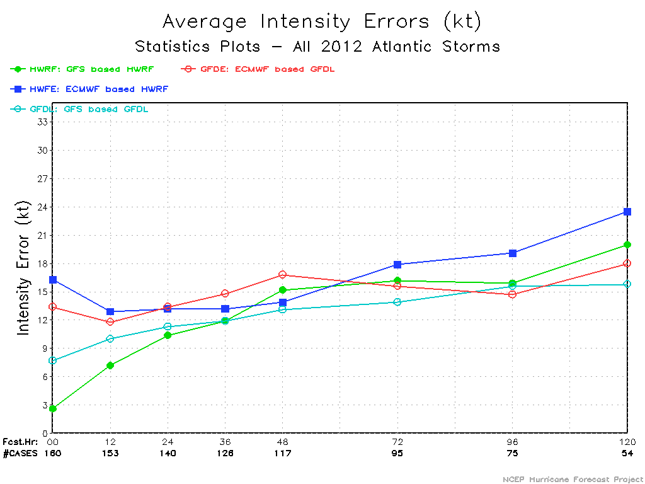
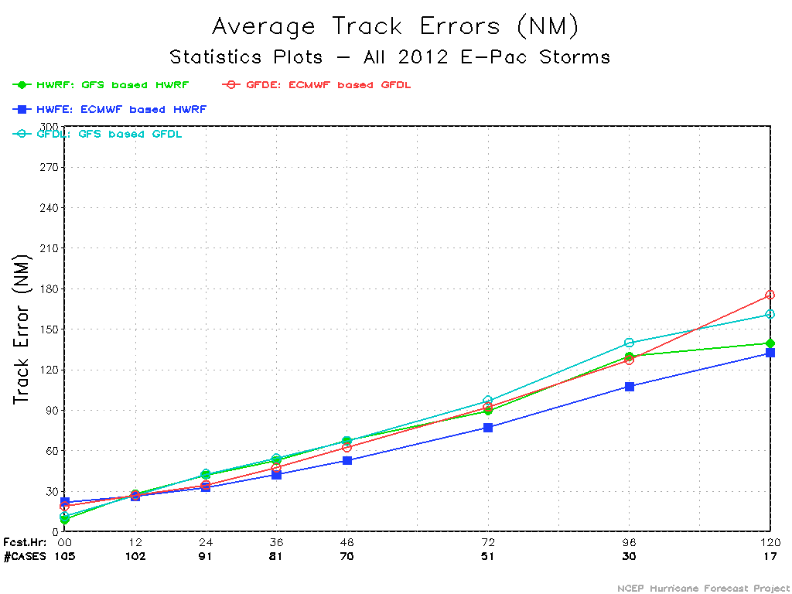
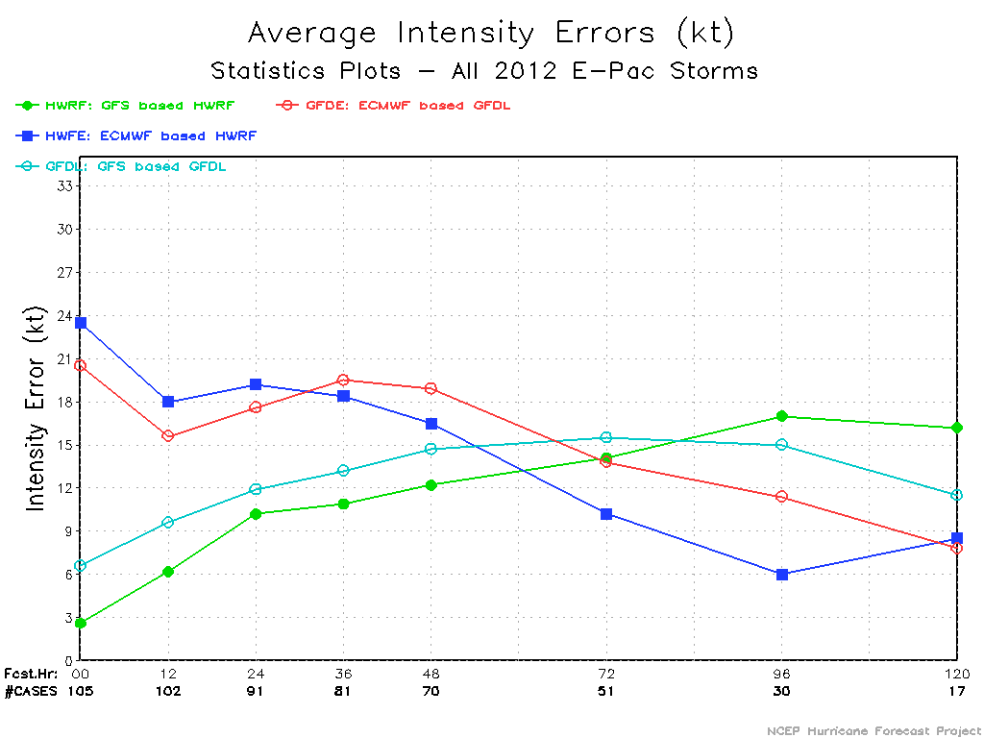
ATL-track
ATL-intensity
HWRF/GFDL driven by High-Res ECMWF
29%
17% 11%
12%
14%
11%
HWRF
HWFE
GFDL
GFDE
Special HFIP supported Real-Time Projects for 2012 Season: HWRF/GFDL driven by High-Res ECMWF Analysis/Forecasts
EP-track
EP-intensity
22% 14% 8% 6% 19%
21% 19% 22% 14% 17% 5%

Slide 7
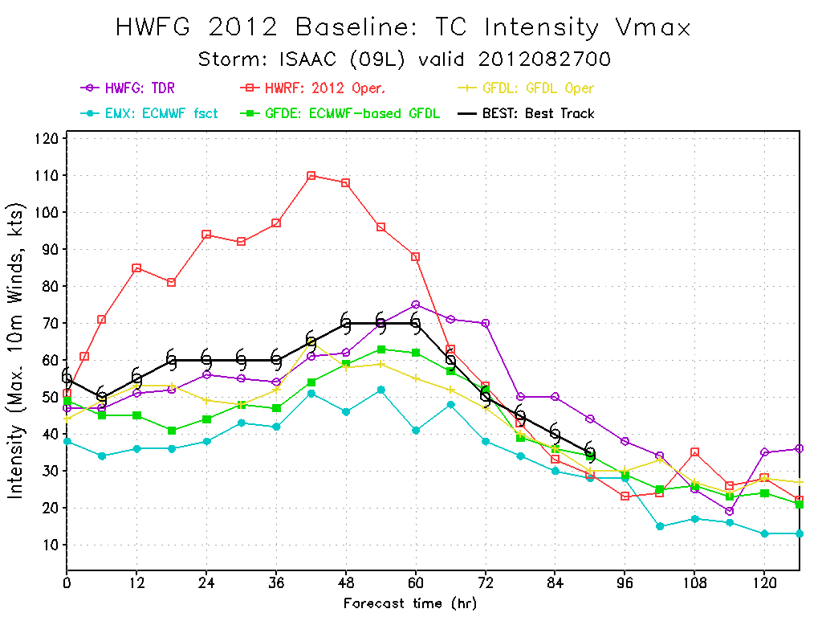
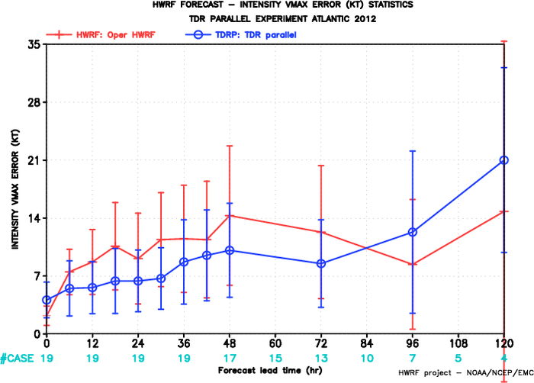
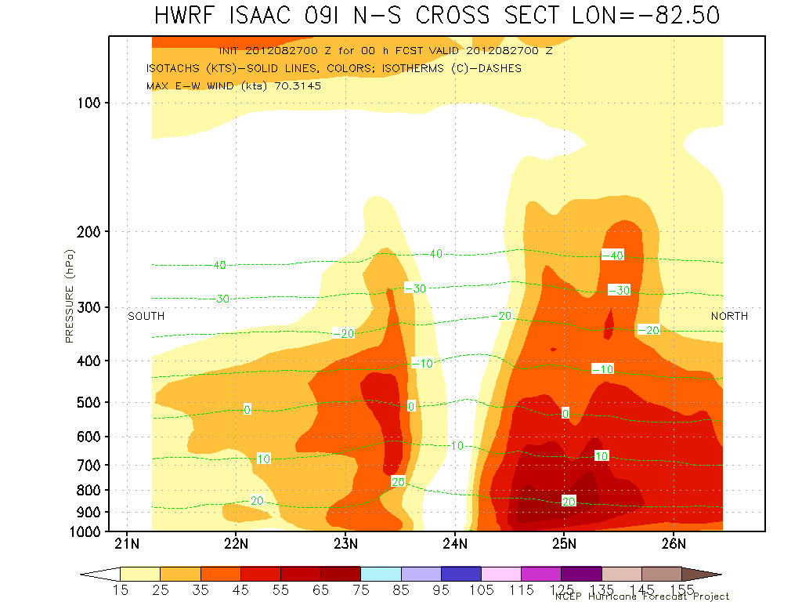
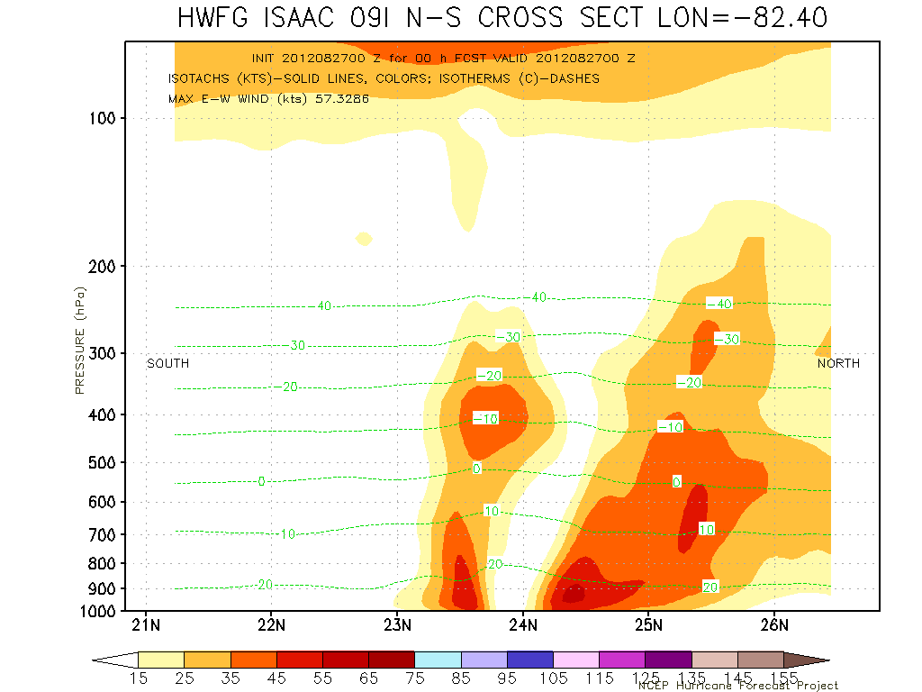
Special HFIP supported Real-Time Projects for 2012 Season:
Inner Core P3 TDR data assimilation
(includes one-way hybrid GSI for HWRF using GFS ensembles)
Intensity
OPER HWRF
HWRG TDR
Vertical Cross section at initial time
Accurate representation of vortex tilt

Slide 8
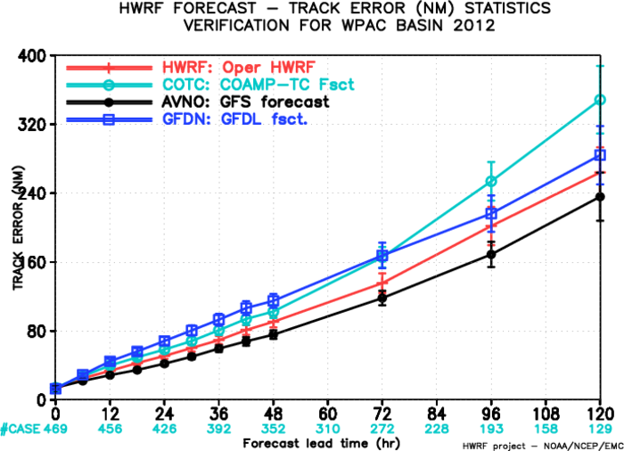
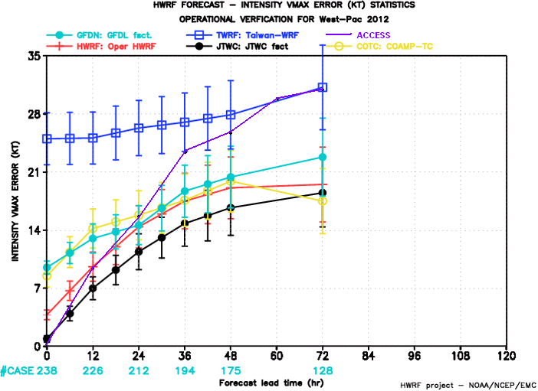
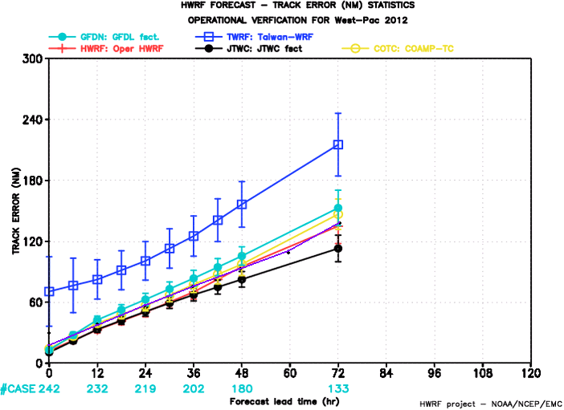
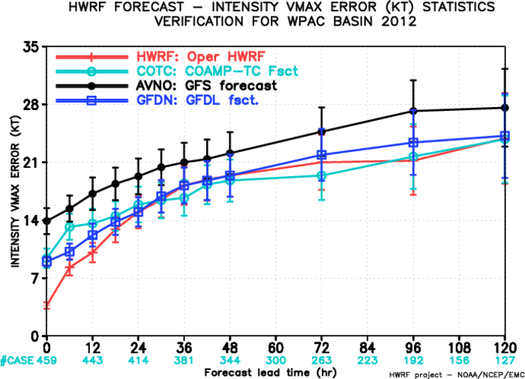
Special HFIP supported Real-Time Projects for 2012 Season
Operational HWRF for Western-Pacific Basin
For the first time, Real-Time forecast guidance from NCEP Operational HWRF (uncoupled) is made available for JTWC for all Western Pacific storms starting with Sanvu (03W) from May 21, 2012. 85% on-time delivery to JTWC using HFIP computing resources
All operational products, including synthetic satellite imagery, high-frequency track & intensity forecasts, and additional special graphics requested by JTWC are provided through HWRF website: http://www.emc.ncep.noaa.gov/HWRF/WestPacific/
HWRF track errors better than COAMPS-TC and GFDN
Track
TWRF
ACCESS-TC
TWRF
Track
HWRF
Intensity
HWRF
Intensity

Slide 9
Priorities for Operational HWRF for 2013 hurricane season
NHC’s Wish List for 2013:
Improved regional hurricane model guidance for intensity; request continued EMC participation and support of HFIP model development activities
Assimilation of inner-core aircraft data (Tail Doppler, flight-level, dropsonde winds) in the HWRF initialization
WCOSS Transition and Timelines
Pre-Implementation T&E
Operational Implementation Plans
HFIP supported real-time efforts
EMC HWRF Team will proceed with annual upgrade process and will work with NHC to make alternate arrangements FY2013 HWRF implementation and real-time product delivery (parallel feed from WCOSS with Jet as backup)
Developed a comprehensive pre-implementation T&E plan that includes extensive three-season testing
Create a new baseline that addresses known issues in FY12 implementation (see presentation from Sam Trahan)
Conduct scientific evaluation of physics upgrades (see presentation from Young Kwon)
Conduct Recon Data Impact experiments (FL, Dropsondes and TDR)
Extend the T&E for Western Pacific basin (including ocean coupling)
Deliver 20-member IC/Physics based HWRF ensemble forecasts to NHC through HFIP demo
Continue participating in several development activities and Stream 2.0 real-time demos

Slide 10
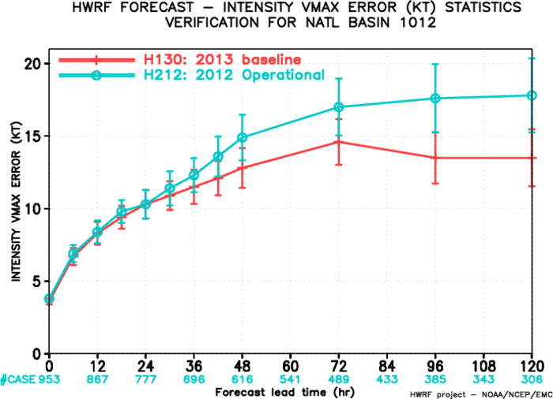
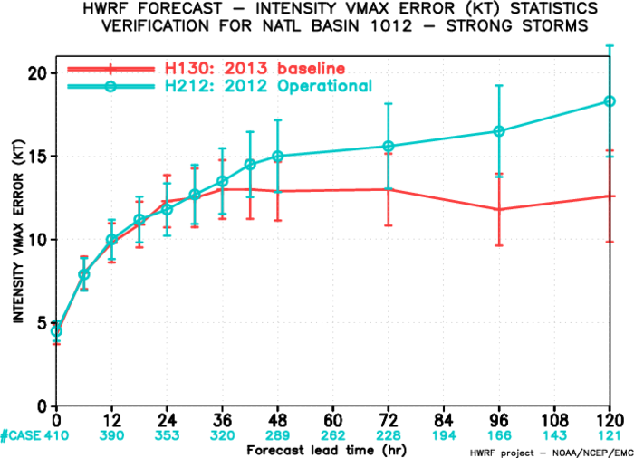
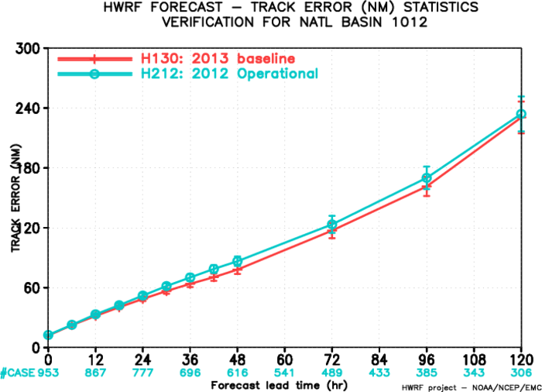
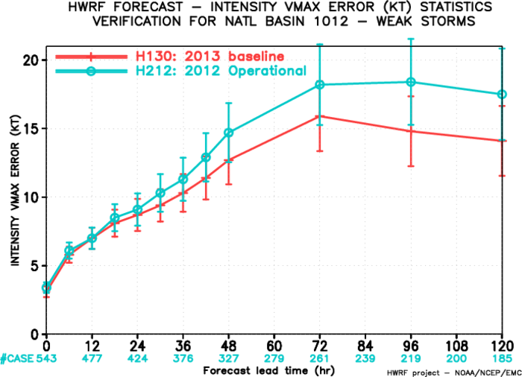
Progress towards 2013 HWRF implementation: Improved Intensity Forecasts
2010-2012 ATL
All storms
2010-2012 ATL
Strong storms (>50 kt)
1% 0% 7% 14% 14% 23% 24%
2% -4% 4% 14% 16% 28% 31%
Performance of the baseline configuration should be equal or better than the operational HWRF
Goal is to accomplish at least 20% improvement in intensity forecast skill from the combination of new baseline and physics upgrades
Track Forecasts
2010-2012 ATL Track Errors
2010-2012 ATL
Weak storms (<50 kt)
0% 4% 9% 14% 13% 20% 19%
5% 7% 9% 10% 5% 5% 1%

Slide 11
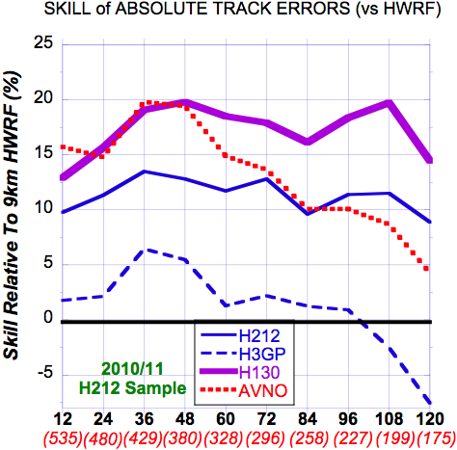
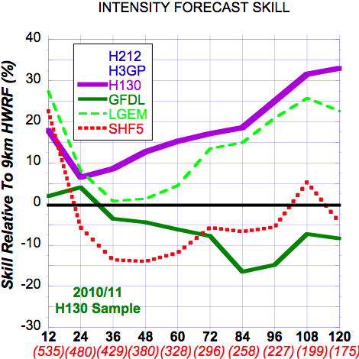
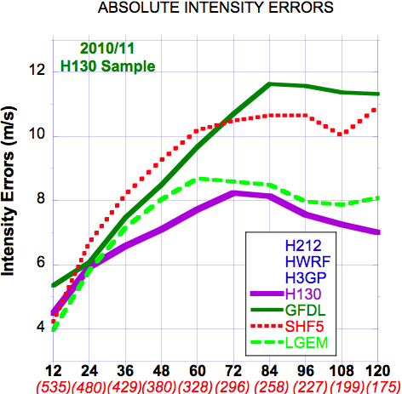
TRACK/Intensity Forecast Skill 2010-2011 Seasons Retrospective Runs H212/H3GP/H130 (27:9:3 km) relative to HWRF (27:9 km) All Cases
All Storms
H130: Best model of this sample
Past 24 hr. Skill vs. all of the models
shown here
H130: Improved over H212
& now better than AVN0 (GFS)
H130: Best model of this sample
Past 24 hr.
Courtesy: Stan Goldenberg, AOML/HRD
Notes:
Same rules as NHC verification -- tropical or subtropical --- at initial and verification
Wish I had looked at EPAC
Interpolation -- Early vs Late models -- Not just showing operational performance -- want to show model comparison and improvement

Slide 12
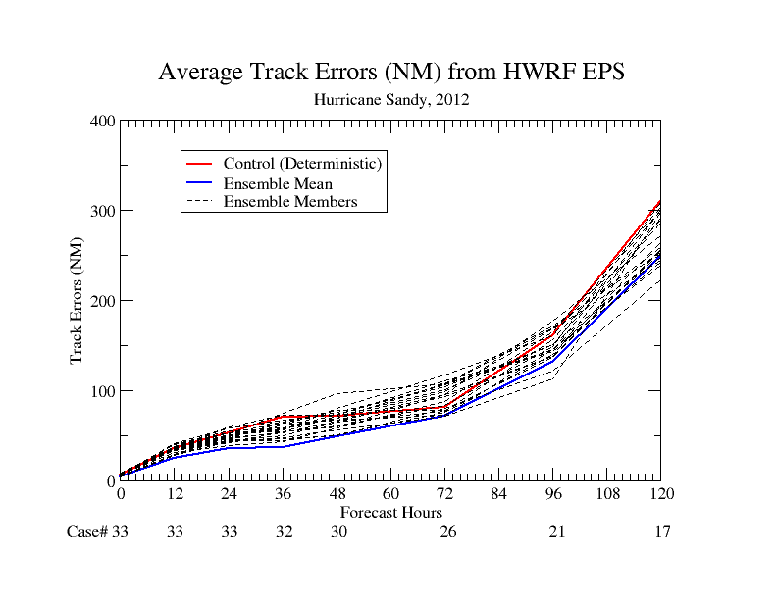
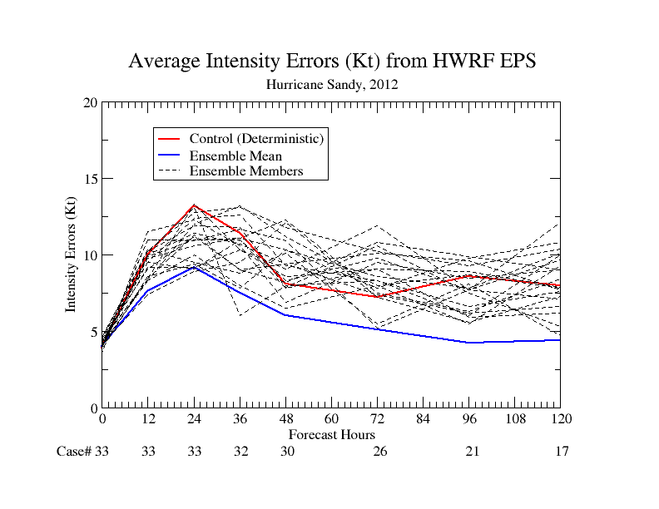
Real-time Experiments Planned for 2013 Season
20-member HWRF Ensembles based on IC perturbations and Stochastic Convective Trigger
Advanced Vortex Initialization and assimilation of inner-core data (satellite and recon)
HWRF-MPIPOM (including 3D ocean for Eastern Pacific) (collaboration with URI)
FY2013 HWRF for Western Pacific and Indian Ocean basins including ocean coupling (collaboration with JTWCI)
Basin-scale HWRF with regional hybrid-DA
Basin-Scale HWRF with multiple moveable domains (collaboration with HRD/AOML)
Continued evaluation of HWRF-HYCOM coupled system
Three-way coupled HWRF-POM/HYCOM-WWIII system (collaboration with URI/ESRL)

Slide 13
Advancing the HWRF System FY2013 & Beyond
 | 2013 | 2014* | 2015* | 2016* | 2017*
Resolution/ Infrastructure | New Nest-Parent Interpolations; expanded domain size & new nest movement algorithm | Increased vertical resolution with higher model top | community R2O efforts (HFIP), Multiple moving domains | Upgrades to infrastructure - NEMS/ESMF/NMM-B, Other oceanic basins, HWRF Ensembles, Global to local scale modeling for hurricanes
Physics | Meso-SAS, Modified PBL, Improved microphysics & Radiation | Microphysics, Radiation, Surface Physics, Coupling to Waves and Land Surface, Physics for high-resolution
DA/ Vortex Initialization | Modified vortex initialization and One-Way Hybrid with inner-core TDR and flight level DA | Inner core DA (TDR, satellite), cloudy radiance assimilation Two-Way regional Hybrid DA HWRF Ensembles |  | Hybrid-EnKF DA, advanced vortex relocation procedure, improved GSI/Hybrid techniques, DA for moving nests
Ocean | 3-D ocean for Eastern Pacific & removal of flux truncation | Improved ocean data assimilation, physics and resolution, unified coupled system for ATL & EPAC
 | HWRF-HYCOM for all oceanic basins (driven by Global RTOFS)
Waves | Atmosphere-Ocean-Wave Coupling |  | Multi-grid surf zone physics, effects of sea spray
Diagnostics and Product Development | HWRF Ensemble based products, Coupling to Hydrological/ Surge/ Inundation models, advanced model diagnostics based on observations, improved product development
.
2013 upgrades
Planned/ongoing developments
*Resource permitting

Slide 14
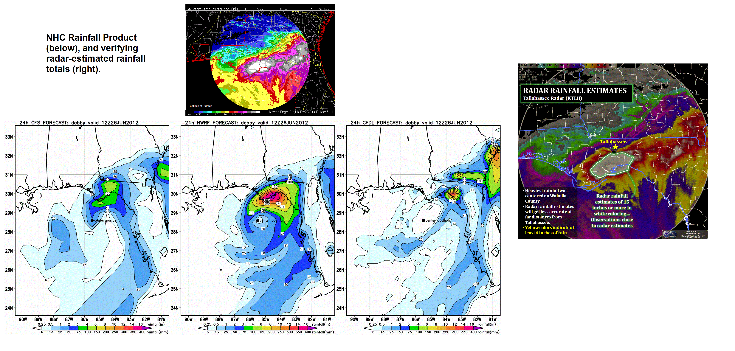
Thanks for your attention
HWRF Real-time and pre-implementation T&E
http://www.emc.ncep.noaa.gov/gc_wmb/vxt
Questions?
Acknowledgements:
HWRF team at EMC, EMC and HFIP Management
Collaborations with NHC, DTC, HRD/AOML, PSD/ESRL, GFDL, URI, UMD, FSU, CIRA and HFIP partners
Notes:
14

