Slide 1
Eyewall Replacement Cycles: Forecasting Onset and Associated Intensity and Structure Changes
A Joint Hurricane Testbed Project
James Kossin^{1,2}, William Lewis², Matthew Sitkowski², and Christopher Rozoff²
¹NOAA’s National Climatic Data Center, Asheville, North Carolina, USA
²NOAA Cooperative Institute for Meteorological Satellite Studies, Madison, Wisconsin, USA
Acknowledgements: This NOAA Joint Hurricane Testbed project was funded by the US Weather Research Program in NOAA/OAR's Office of Weather and Air Quality, and by NOAA’s National Climatic Data Center.
RAMMB/CIRA team
NHC personnel
67th Interdepartmental Hurricane Conference
College Park, MD
5-7 March 2013

Slide 2
JHT project goals:
Transition a new model to operations that provides probabilistic forecasts of eyewall replacement cycle (ERC) events in hurricanes.
Utilize low-level aircraft reconnaissance data to expand the general climatology of intensity and structure changes associated with ERCs.
Use the new climatology to construct new operational tools that can provide some objective guidance for forecasting intensity and wind structure changes associated with ERCs.
Continue model development toward increasing skill.

Slide 3
Models: probability of ERC onset
3 statistical/empirical models have been developed and tested:
1. Bayesian probability
2. Bayesian probability with optimized feature selection
3. Logistic regression
The models provide probability of the onset of an ERC within lead-time periods: 0−12h, 12−24h, 24−36h, 36−48h.
All models execute within SHIPS using environmental and satellite-based features as input.

Slide 4
Operational Model Verification 2008-2012 (Brier Skill Scores)
Year | N (TS) | N (HUR) | N (ERC) | 00-12 hr | 12-24 hr | 24-36 hr | 36-48 hr
2012 | 19 | 10 | 1 | +57 +54 +54 +56 | +58 +53 +51 +54 | +58 +54 +42 +52 | +57 +54 +35 +49
2011 | 18 | 6 | 5 | +21 +22 +10 +20 | +18 +16 +11 +17 | +14 +13 +6 +14 | +19 +16 +11 +18
2010 | 19 | 11 | 9 | +27 +41 +25 +38 | +23 +20 +25 +28 | +11 +17 +15 +20 | +10 +17 +8 +17
2009 | 9 | 3 | 3 | −6 −6 +11 +7 | −2 −8 +6 +3 | −1 −6 +28 +17 | +5 +6 +36 +27
2008 | 16 | 8 | 4 | +14 +11 +2 +10 | +12 +4 −7 +4 | −5 −7 +0 +0 | +2 −6 −4 +0
2008-2012 | 81 | 38 | 22 | +20 +26 +22 +27 | +17 +16 +18 +21 | +9 +13 +15 +17 | +11 +15 +12 +17
Bayesian Optimized Bayesian Logistic Regression Ensemble

Slide 5
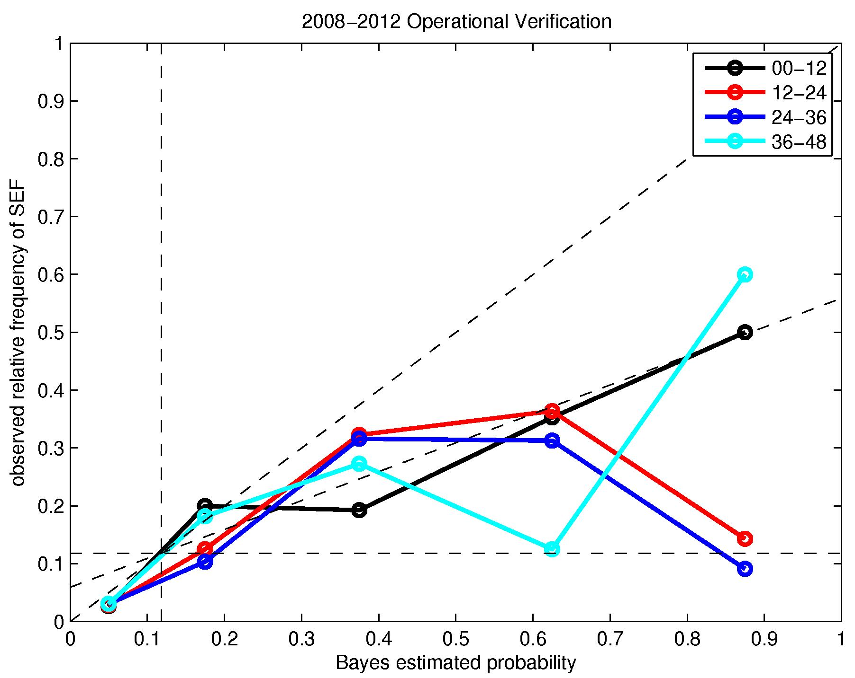
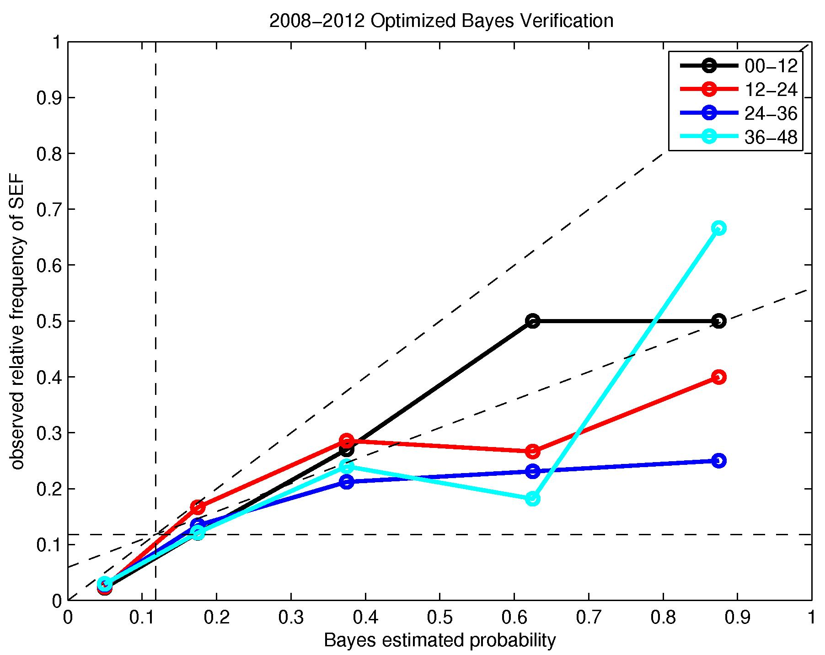
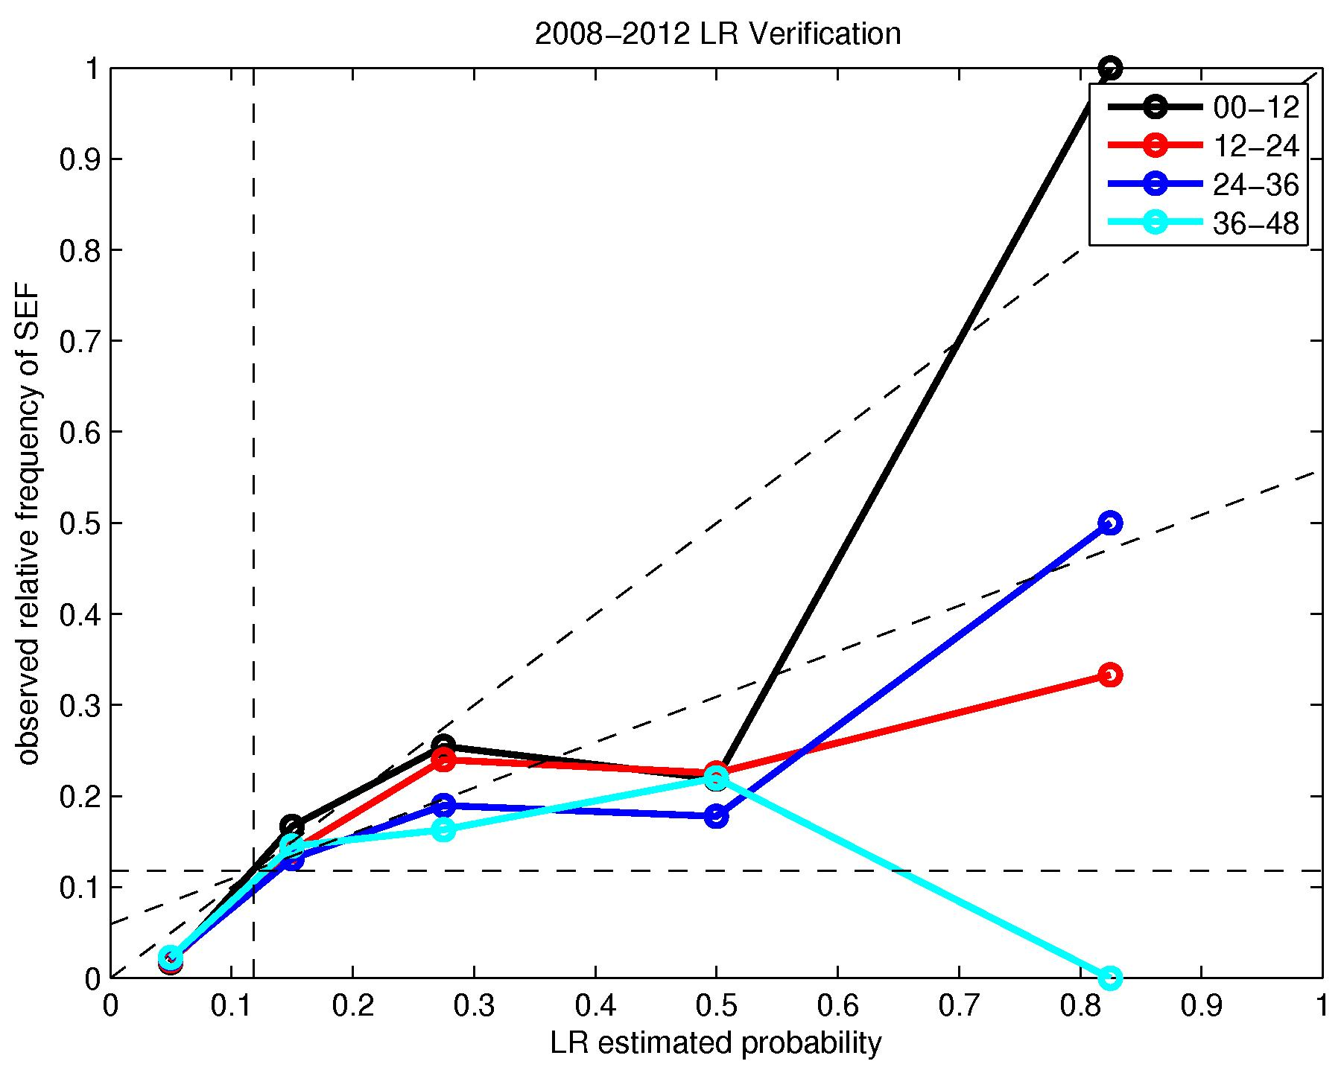
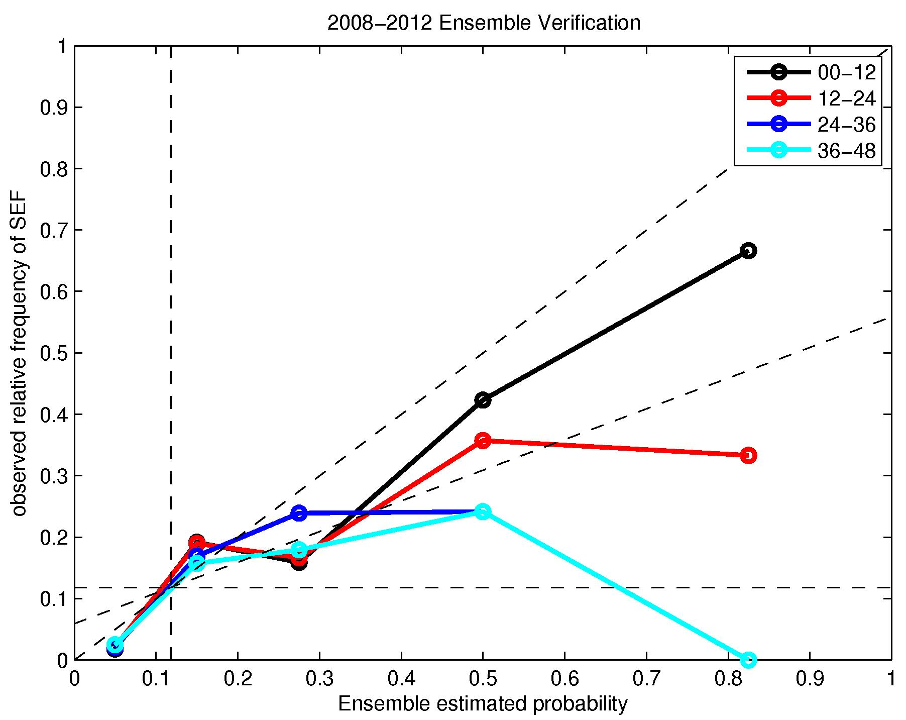
Operational model verification 2008-2012 (attributes diagrams)
Bayesian
Optimized Bayesian
Logistic Regression
Ensemble

Slide 6
An ERC is forecast to begin or there is evidence that one is starting...
What are the forecast questions?
How much does the usual intensity guidance need to be tweaked?
How much will the current intensification rate change?
How much weakening, if any, will occur? Over what period of time?
When will re-intensification begin? At what new rate?
Subjective expectation during ERC:
Intensification rate decreases or weakening occurs
re-intensification
Wind field expansion
}
transient effect
~permanent effect

Slide 7
The Three Phases of an Eyewall Replacement Cycle
expected intensity evolution (provided by traditional guidance)
coherent secondary wind maxima start to appear in flight-level data
intensity
required intensity forecast adjustment
I
II
III
well-defined secondary convective rings start to appear in microwave imagery
time

Slide 8
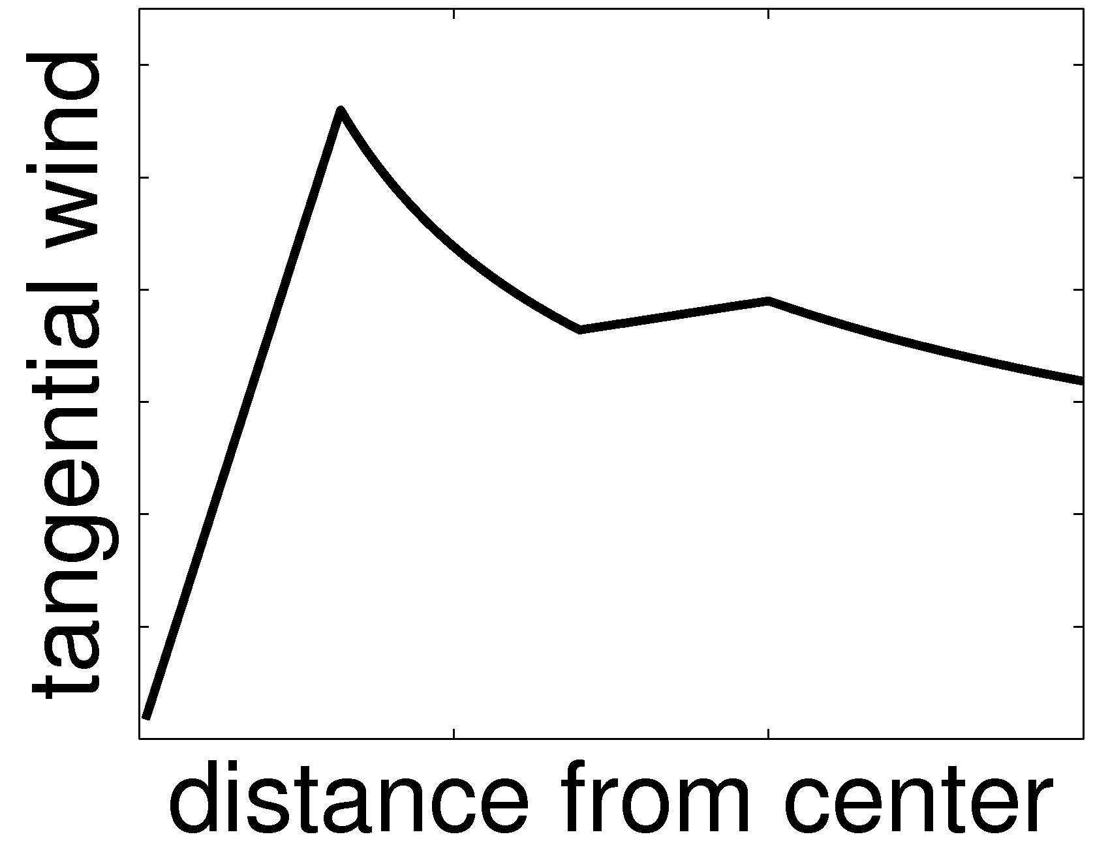
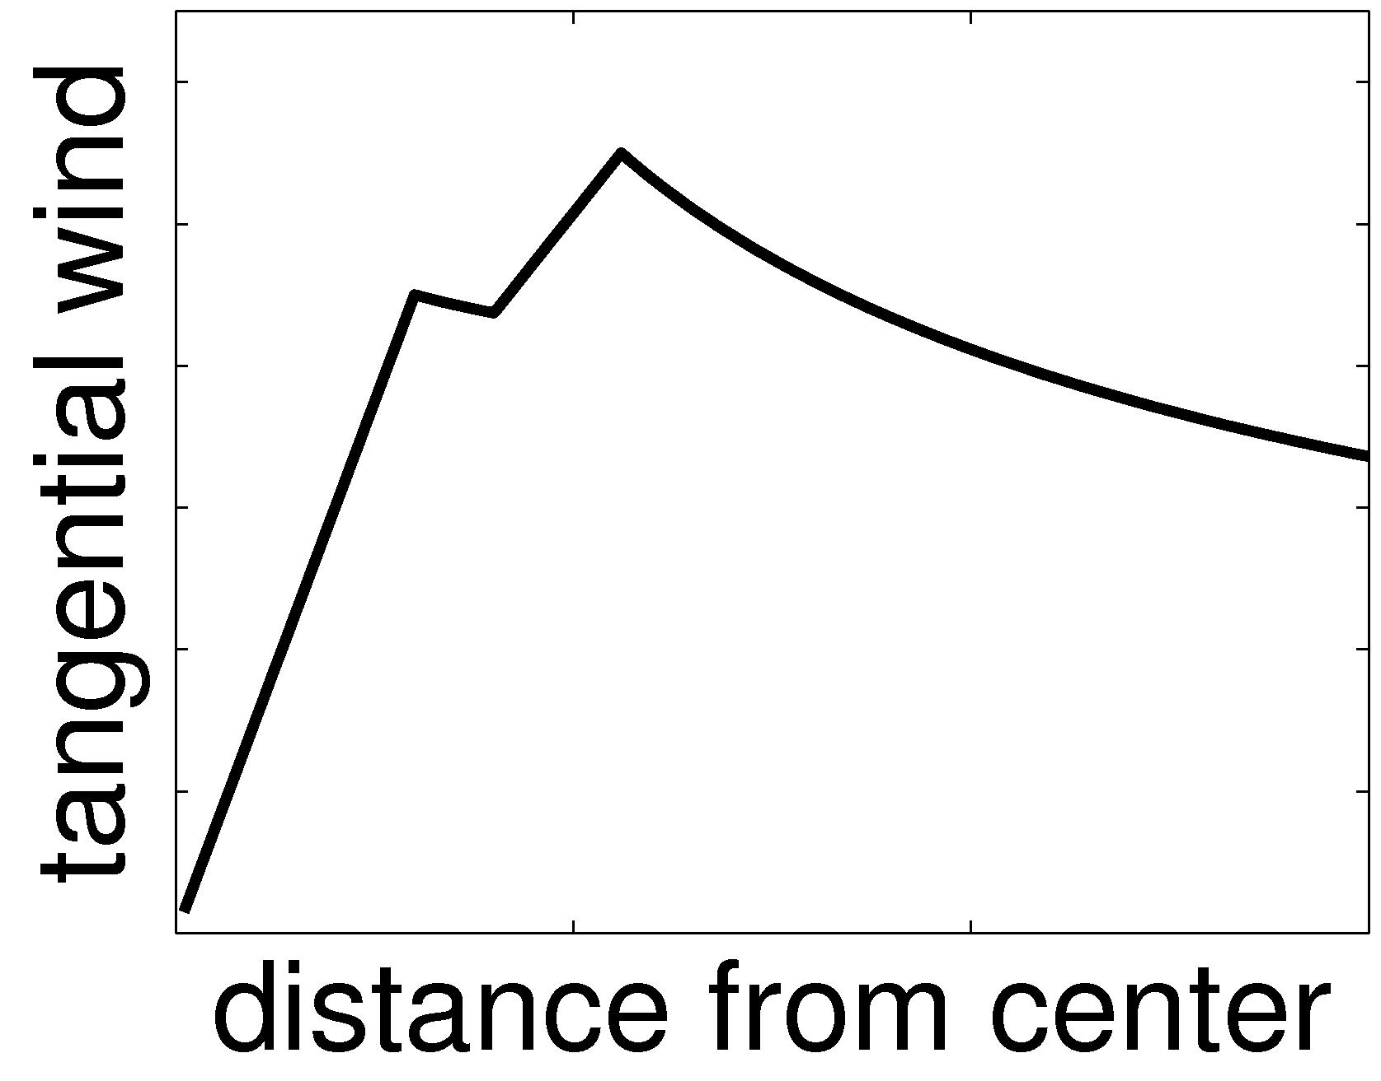
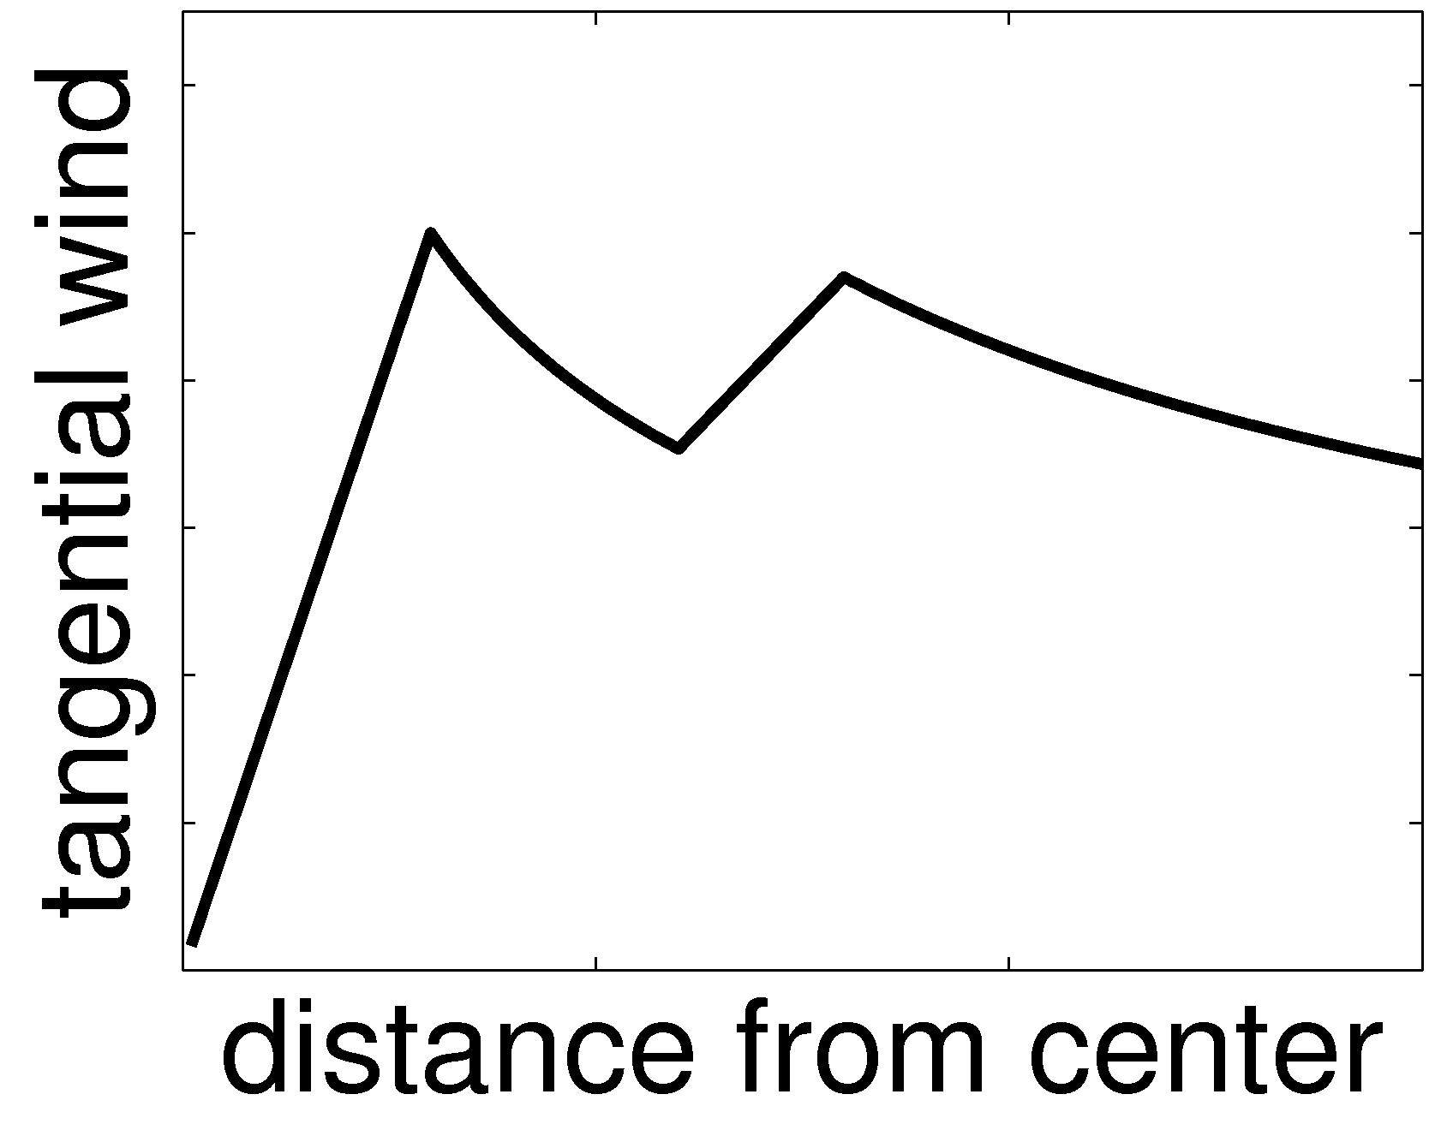
The Three Phases of an Eyewall Replacement Cycle
mean RMW = 50 km
mean RMW = 28 km
I
intensity
III
II
time

Slide 9
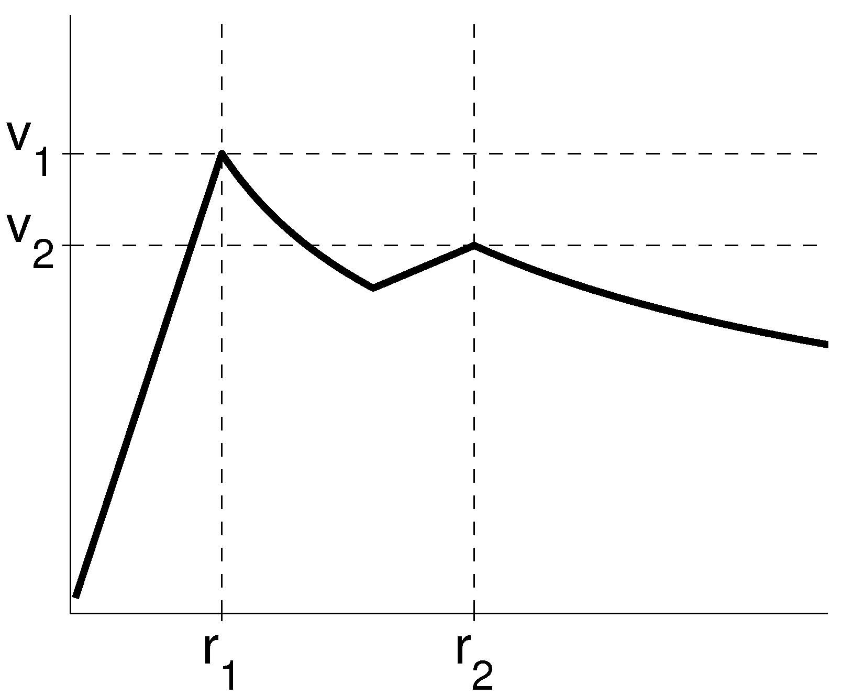
Climatology of intensity and structure changes
(based on limited events that were well-observed throughout the process)

Slide 10
Can we use this climatology and the SHIPS
features (F) to create useful predictive models?
Phase II ΔV : mean = –20 kt, STDev = 18 kt
ΔV = f (F) R² = 68%, RMSE = 3.6 kt
Phase II ΔT : mean = –17 hr, STDev = 9 hr
ΔT = f (F) R² = 49%, RMSE = 6.2 hr
Phase III ΔV / ΔT : mean = +0.8 kt hr ^{–1}, STDev = 2.3 kt hr ^{–1}
ΔV / ΔT = f (F) R² = 47%, RMSE = 1.3 kt hr ^{–1}
Total expansion of RMW : mean = 22 km, STDev = 13 km
ΔRMW = f (F) R² = 51%, RMSE = 9.9 km

Slide 11
Summary
The P(ERC)-model has performed skillfully in the NHC operational environment for the past 3 seasons (2010, 2011, 2012). Overall operational skill for the extended period 2008-2012 is also good and has been consistent and stable. Improvements to the original P(ERC)-model and use of a simple ensemble have improved the skill further.
The climatology of flight-level intensity and wind structure changes associated with ERCs has been used to construct new intensity forecasting tools. The utility of these tools and whether they should be transitioned into the NHC operational test-bed needs to be discussed further with NHC personnel.

