Slide 1
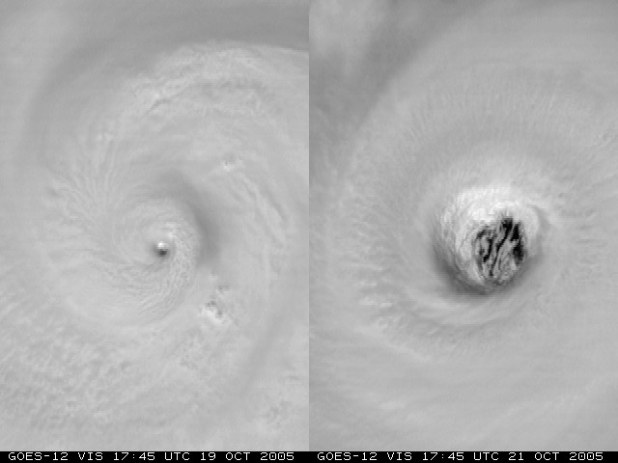
Improvements in Statistical Tropical Cyclone Forecast Models: A Year 2 Joint Hurricane Testbed Project Update
Mark DeMaria¹, Andrea Schumacher²,
John A. Knaff¹ and Renate Brummer²
¹NOAA/NESDIS, Fort Collins, CO
²CIRA, Colorado State University, Fort Collins, CO
NHC POCs: Lixion Avila, Robbie Berg, Chris Landsea
Interdepartmental Hurricane Conference
March 2013

Slide 2
Outline
Project Tasks
Extended range baseline models for track and intensity
Update of SHIPS/LGEM databases using new NCEP Climate Re-analysis
Extending LGEM to 7 days
SHIPS/LGEM specific for the Gulf of Mexico
Progress so far
Plans for 2013 season

Slide 3
1. New Baseline Forecast Models
CLIPER and SHIFOR used as baseline for measuring track and intensity forecast skill
Errors provide estimate of forecast difficulty
Input to linear regression equations
t = 0 h max wind, lat, lon, motion vector
t =-12h max wind, lat, lon, motion vector
Julian Day
Output
5-day forecast of lat, lon, max wind
Decay-SHIFOR modifies intensity over land using CLIPER track and climatological decay rate

Slide 4
Trajectory Approach for Baseline Models (T-CLIPER)
dx/dt = u dy/dt = v (1)
Estimate u,v from climatological motion vector fields
Modify u,v at early times using t=0 motion vector
Integrate (1) to desired time
Similar approach for intensity using LGEM prediction equation with climatological input and T-CLIPER track
Can be run to any forecast time until storm leaves model domain

Slide 5
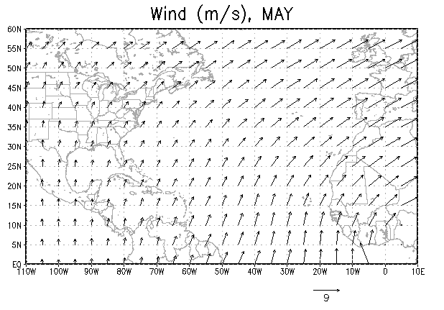
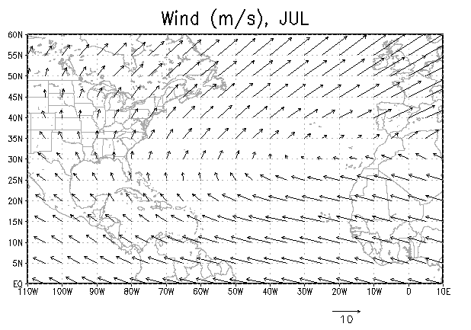
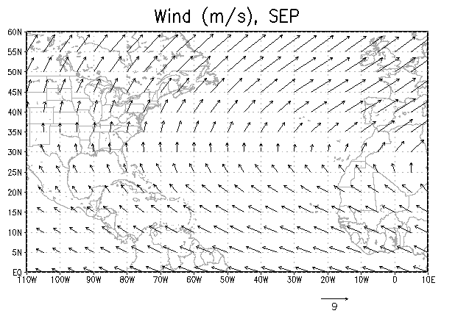
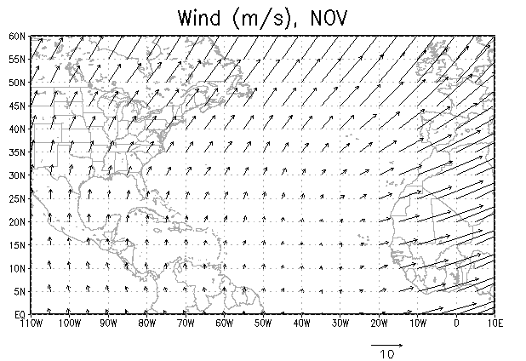
Mean Storm Motion Fields from 1982-2011 Sample

Slide 6
T-CLIPER Tests
Run in real time for most of 2012 season
Re-runs for 2003-2011 using CARQ input
Evaluation questions
How do average errors compare with OCD5 to 5 days?
Are annual average T-CLIPER errors correlated with NHC OFCL forecast errors?
What is the error behavior beyond 5 days?

Slide 7
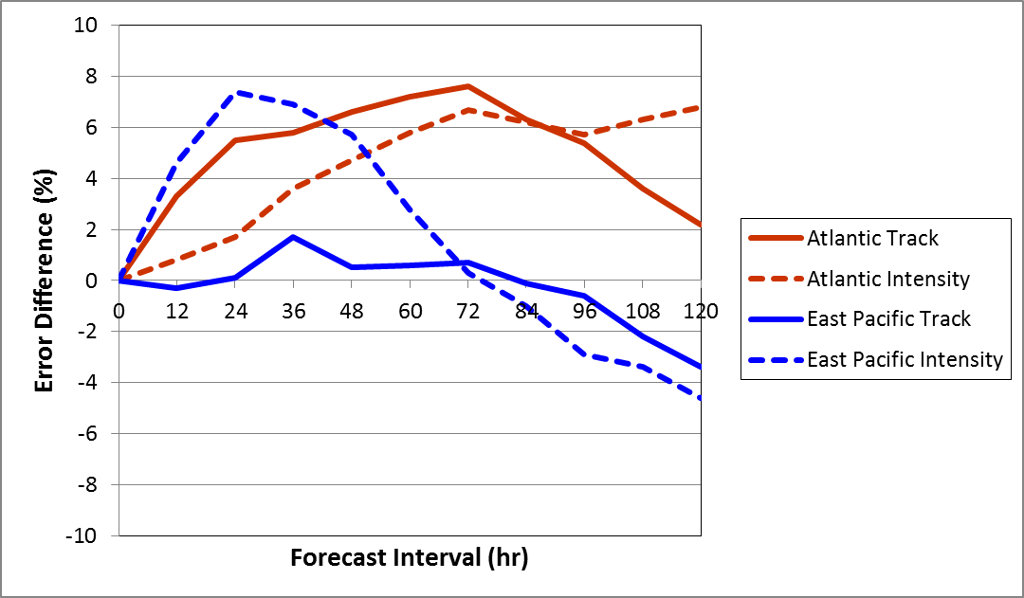
Comparison of T-CLIPER and OCD5 10-year Average Errors

Slide 8
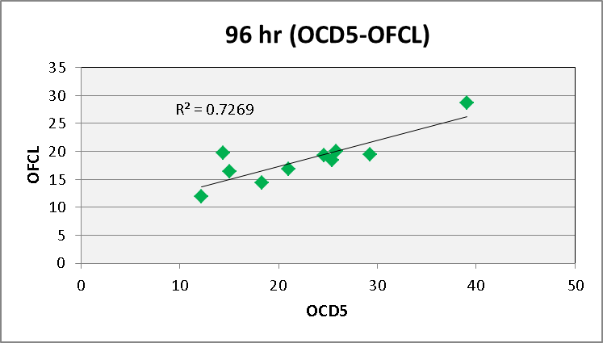
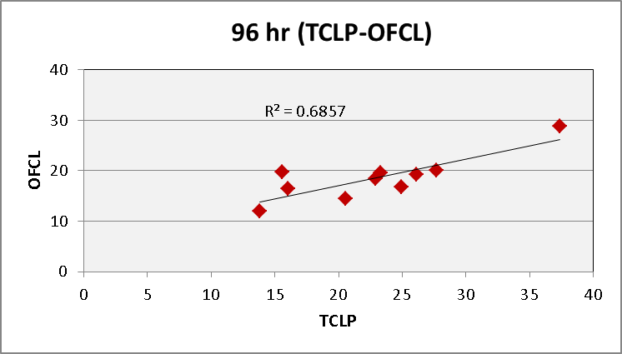
Correlation of Annual OCD5 and T-CLIPER Errors with OFCL
Correlate OCD5 and OFCL annual errors for 10 year sample
Repeat for T-CLIPER and OFCL
Plot r² versus forecast interval
Plot r² as negative if r is negative

Slide 9
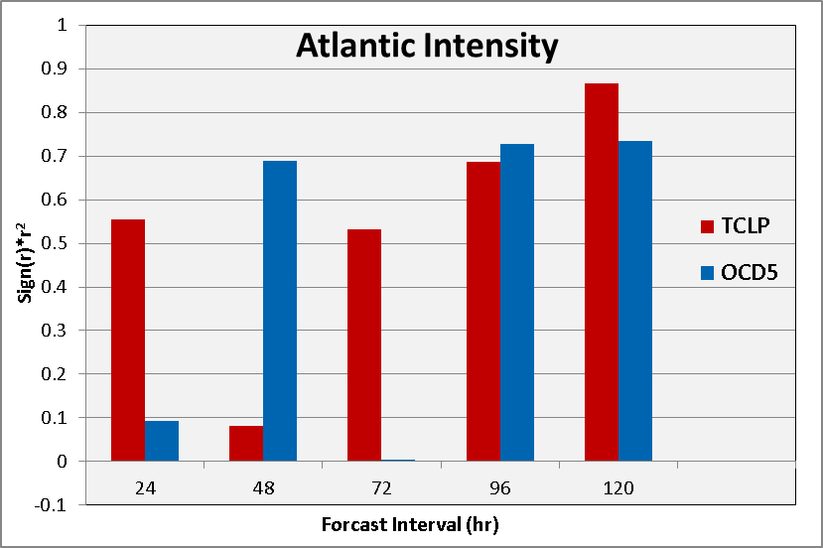
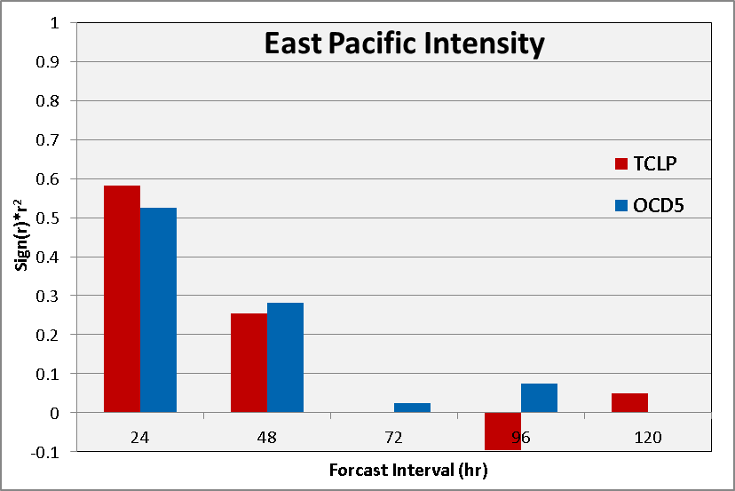
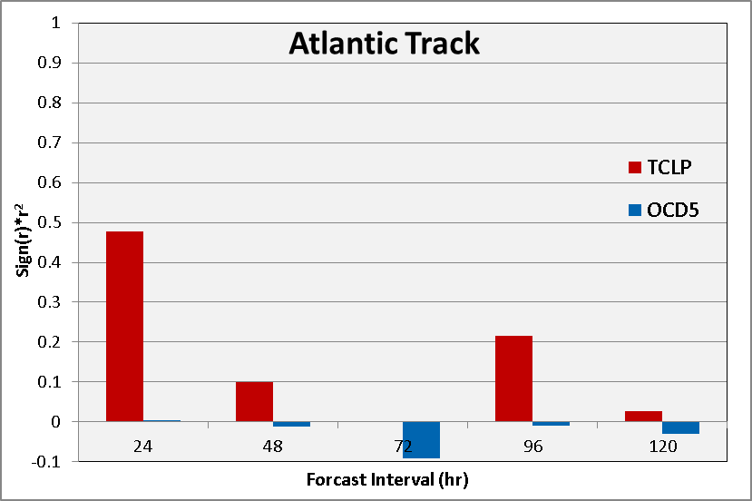
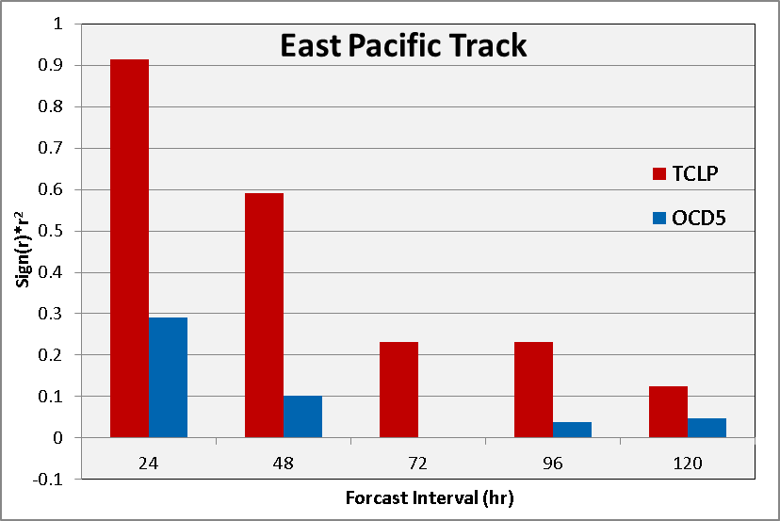
Variance of OFCL Errors Explained by OCD5 and T-CLIPER

Slide 10
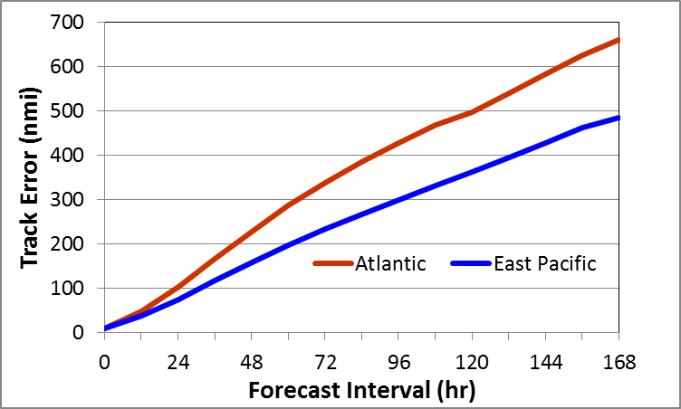
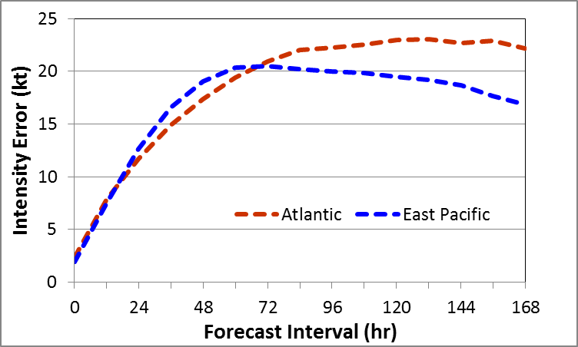
10-Year Average T-CLIPER Errors
Track Intensity

Slide 11
2. New Climate Reanalysis Fields
New NCEP CFSR reanalysis fields obtained for 1979-2009
0.5º lat/lon grib files
Current SHIPS database
1982-1999 Old NCEP reanalysis (2.5º)
2000-2011 Operational GFS analyses (2º)
Inconsistency of RH and GFS vortex parameters
Old reanalysis not used in RII
Incomplete operational analyses used for 1989-1999
2000-2009 – New, Old reanalysis and Operational analyses all available

Slide 12
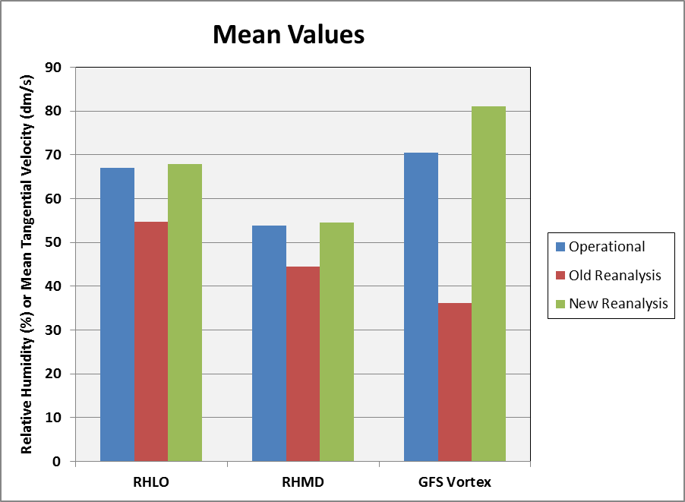
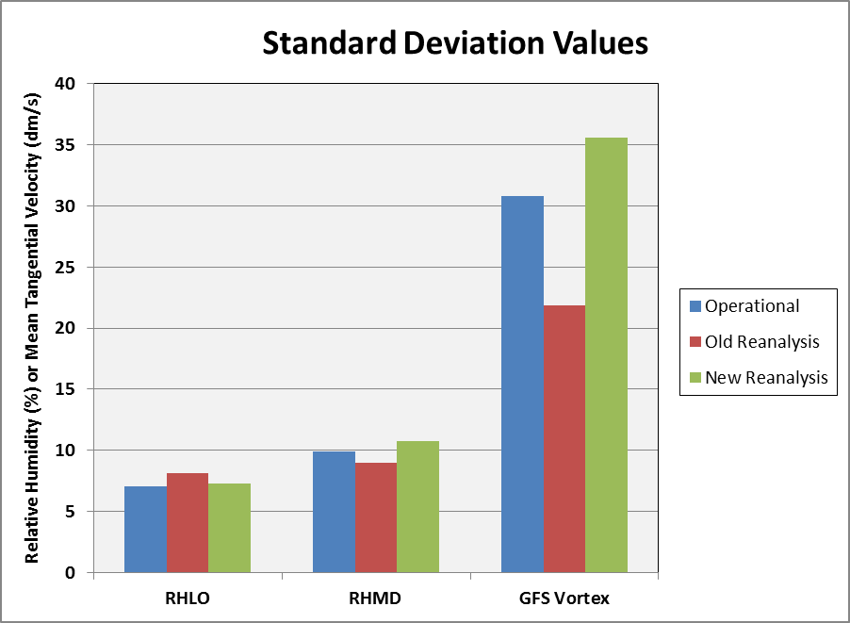
Comparison of SHIPS Predictors for Different Analyses (2000-2009 Atlantic Sample)
RHLO = 850-700 hPa RH r=200 to 800 km
RHMD = 700-500 hPa RH r=200 to 800 km
GFS Vortex = 850 hPa tangential wind, r= 0 to 600 km

Slide 13
New SHIPS Database
1979-2009: New NCEP reanalysis (1º)
2010-2012: Operational GFS analysis (1º)
2013 SHIPS, LGEM and RII will all use the same database

Slide 14
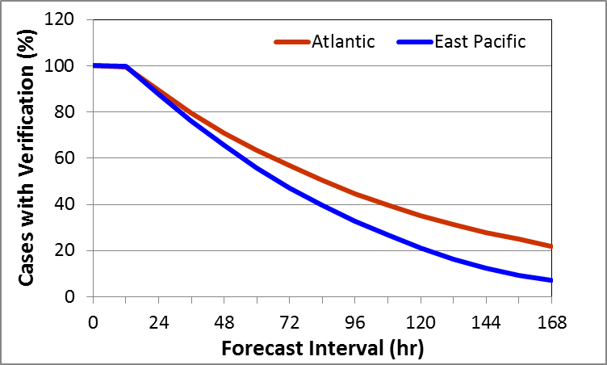
3. Seven-Day LGEM
Small sample size beyond 5 days makes fitting difficult
Use new formulation of LGEM that fits entire forecast at once
2003-2012 Sample

Slide 15
Comparison of Fitting Methods
LGEM Equation: dV/dt = κV – β(V/V_{mpi})^{n}V
β, n, V_{mpi} known or specified, need to find κ
Old fitting method
Solve for κ: κ = (1/V)dV/dt + β(V/V_{mpi})^{n}V
Calculate κ from best track
Fit best track κ to predictors using least squares at each forecast period (6, 12 …, 168 h)
New fitting method
Define “cost” function E = ½ ∫(V_{fcst}-V_{obs})dt
Find single set of κ coefficients to minimize E
Requires adjoint of LGEM equation for fitting

Slide 16
Features of 7-Day LGEM
Adjoint minimization instead of least squares fit to κ
Need to reduce predictor set for efficiency
Replace simple empirical MPI function with theoretical Bister and Emanuel (2003) formula
Can incorporate SST cooling and entrainment in MPI formula
Include persistence and GOES data through modification of κ at early times
Similar to T-CLIPER approach

Slide 17
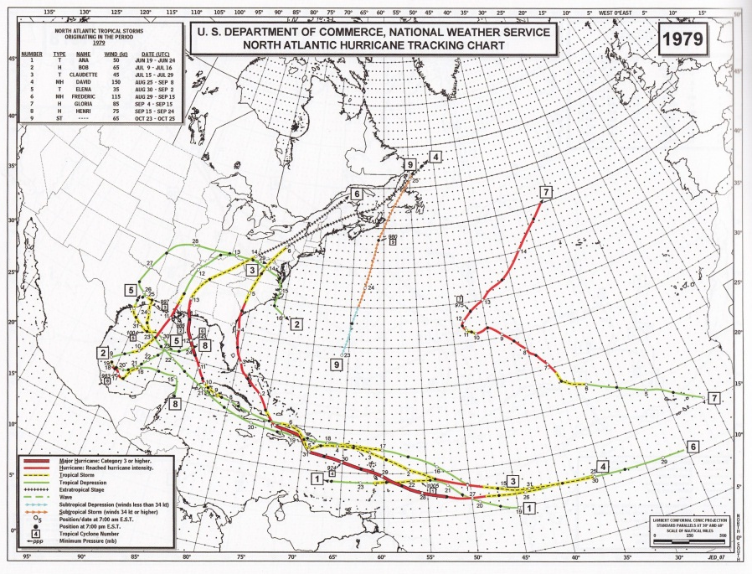
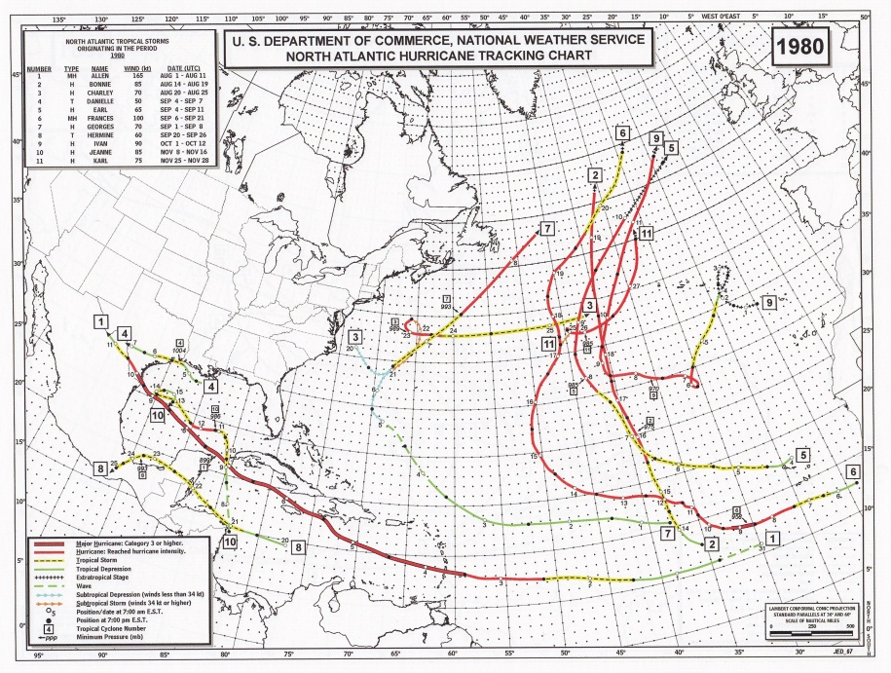
4. Gulf of Mexico LGEM
Rappaport et al. (2010) showed Gulf storms have consistent behavior
Gulf-specific SHIPS/LGEM may improve skill
Gulf sample size very small, especially beyond 72 h
Use same formulation as 7-Day LGEM
Add new Gulf cases from 1979-1980

Slide 18
Plans for 2013 Hurricane Season
Run standard 5-day SHIPS/LGEM
Run parallel 7-day LGEM with new formulation
Includes Gulf-specific version
Pre-season tests
Run on HFIP stream 1.5 retrospective cases
2010-2012 sample
Only 2012 to 7 days since NHC track needed
Run for 2008-2009 cases with recon

Slide 19
Summary
T-CLIPER provides new extended range forecast baseline
Errors within +8% to -5% of OCD5 to 5 days
Predicts OFCL intensity error similar to OCD5
Predicts OFCL track errors better than OCD5
New NCEP reanalysis provides more consistent and higher resolution developmental sample
7-day and Gulf-specific LGEM to be run in parallel in 2013 season
SHIPS/LGEM/RII being developed for W. Pacific, Indian Ocean and S. Hemisphere
Acknowledgement: This NOAA Joint Hurricane Testbed project was funded by the US Weather Research Program in NOAA/OAR's Office of Weather and Air Quality

