Slide 1
Improvements to the SHIPS Rapid Intensification Index: A Year-2 JHT Project Update
J. Kaplan (NOAA/HRD), C.M. Rozoff (UWisc-CIMSS),
C.R. Sampson (NRL-MRY), J.P. Kossin (NOAA/NCDC),
C.S Velden (UWisc-CIMSS), M. DeMaria (NOAA/NESDIS)
Computer programming support: P. Leighton (HRD)
NHC JHT points of contact: C. Landsea, E. Blake, S. Stewart
This NOAA JHT project is being funded by the USWRP in NOAA/OAR’s Office of Weather and Air Quality, with elements of the research funded by the GOES-R Risk Reduction Program

Slide 2
Background and Motivation
Predicting episodes of tropical cyclone (TC) rapid intensification (RI) remains one of NHC’s top forecast priorities.
To aid in the forecasting of RI, a statistically-based rapid intensification index (RII) that uses large-scale predictors from the SHIPS model has been developed and is currently used operationally by the NHC (Kaplan and DeMaria 2003, Kaplan et al. 2010, Kaplan et al. 2011) .
Current JHT Project Goals
Although the current operational RII is generally skillful, its skill is still rather limited (particularly in the Atlantic basin). Thus, our current project seeks to improve the forecasting utility of the operational RII by performing the following tasks:
Develop new versions of RII for forecast lead-times out to 48-h using multi-model ensemble-based approach
Incorporate new multi-lead time ensemble-based probabilistic RII in recently developed deterministic rapid intensity guidance model
Derive new microwave-based version of RII

Slide 3
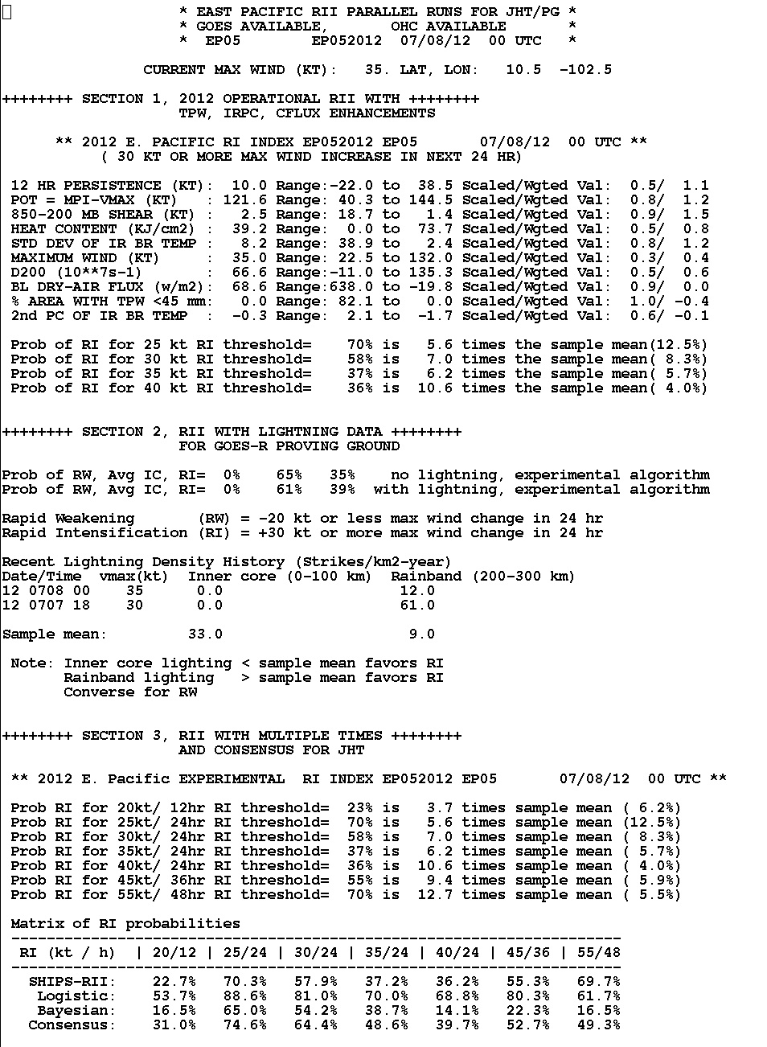
Multi lead-time ensemble-based RII
New multi-lead time ensemble based versions of RII were developed for 12-h, 24-h, 36-h and 48-h lead times for both the Atlantic and E. Pacific basins.
The ensemble-based RII is the average (consensus) of the SHIPS, Bayesian, and Logistic versions ( Rozoff and Kossin 2011).
Multi-lead time ensemble-based RII was first run in real-time starting ~Aug 1, 2012 at CIRA in Colorado with forecasts made available to forecasters via a website.
Forecasts for cases prior to Aug 1 were also obtained using real-time data at the time that the new version was first run at CIRA.
Emilia (2012)
New multi-lead time ensemble-based RII

Slide 4
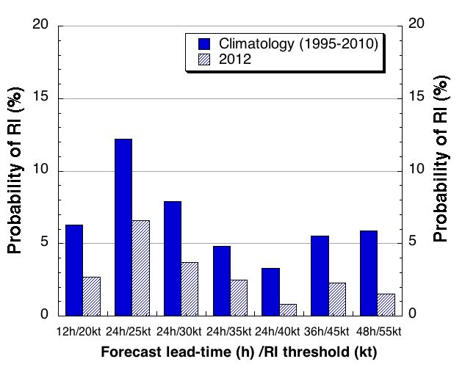
Brier Score (BS) of the 2012 Atlantic RII “Real-time” and 1995-2010
cross-validated RI forecasts as well as those of climatology (top panel).
The probability of RI for each of these time periods is also shown (bottom panel).
where y_{k} is the forecasted probability of RI from the RII and
o_{k}= 0 if no RI occurs and
o_{k}= 1 if RI does occur
0<BS<1
(where 0 denotes perfect skill)

Slide 5
Skill of the 2012 Atlantic multi-lead time
“Real–time RII forecasts
Verification rules: All 24-h over-water RII forecasts for tropical and subtropical systems (including unnamed depressions) were verified using most recent NHC best track data.
Results are shown for the SHIPS (Kaplan et al. 2011) , Bayesian, Logistic, and ensemble based versions of the RII (Rozoff and Kossin 2011).
Skill = (1. – BSM/BSREF)*100
where BSM=Brier score of the RII forecasts and BSREF is the Brier score of the climatological forecasts.
-∞<Skill<100
(so perfect skill is 100%)

Slide 6
Temporal variability in skill of the cross-validated Atlantic basin multi-lead time ensemble-based RII. The 2012 real-time skill of the ensemble-based RII is also provided.

Slide 7
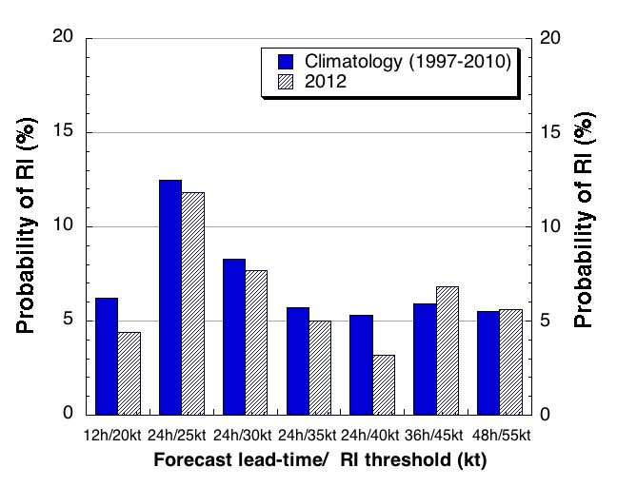
Brier Score (BS) of the 2012 E. Pacific RII “Real-time” and 1997-2010
cross-validated RI forecasts as well as those of climatology (top panel).
The probability of RI for each of these time periods is also shown (bottom panel).

Slide 8
Skill of the 2012 E. Pacific multi-lead time
“Real–time RII forecasts

Slide 9
Temporal variability in skill of the cross-validated E. Pacific basin multi-lead time ensemble-based RII. The 2012 real-time skill of the ensemble-based
RII is also provided.

Slide 10
Deterministic RI Aid
Uses probabilistic RII forecast probabilities
Assigns intensification rate when RII forecasted probability > 40%
Can be displayed directly on ATCF
Reduces bias and mean error if included in IVCN
Reference
Sampson, C. R., J. Kaplan, J. A. Knaff, M. DeMaria, C. A. Sisko, 2011:
A deterministic rapid intensification aid, Wea. Forecasting, 26, 579-585.

Slide 11
Deterministic RI and modified consensus verification for the combined independent 2011 and 2012 Atlantic and E. Pacific samples
(132) (121) (116)
IVCN is the operational NHC intensity consensus, RI25 is a deterministic RI aid derived from RI probabilities, and IVRI is a consensus that includes the IVCN members and operational deterministic RI aids (RI25, RI30, RI35, RI40). IVRI shows significantly improved skill and bias over IVCN in this independent sample.

Slide 12
Deterministic RII forecast verification of the ensemble-based RII forecasts for the dependent 2008-2010 Atlantic and E. Pacific samples
(58) (56) (54) (17) (7)
RX25 is a deterministic RI aid derived from then ensemble RI probabilities, and IVRI is a consensus that includes IVCN members and deterministic RI aids from the ensemble. IVRI shows improved skill and bias over IVCN, and RX25 outperforms both in this dependent sample.

Slide 13
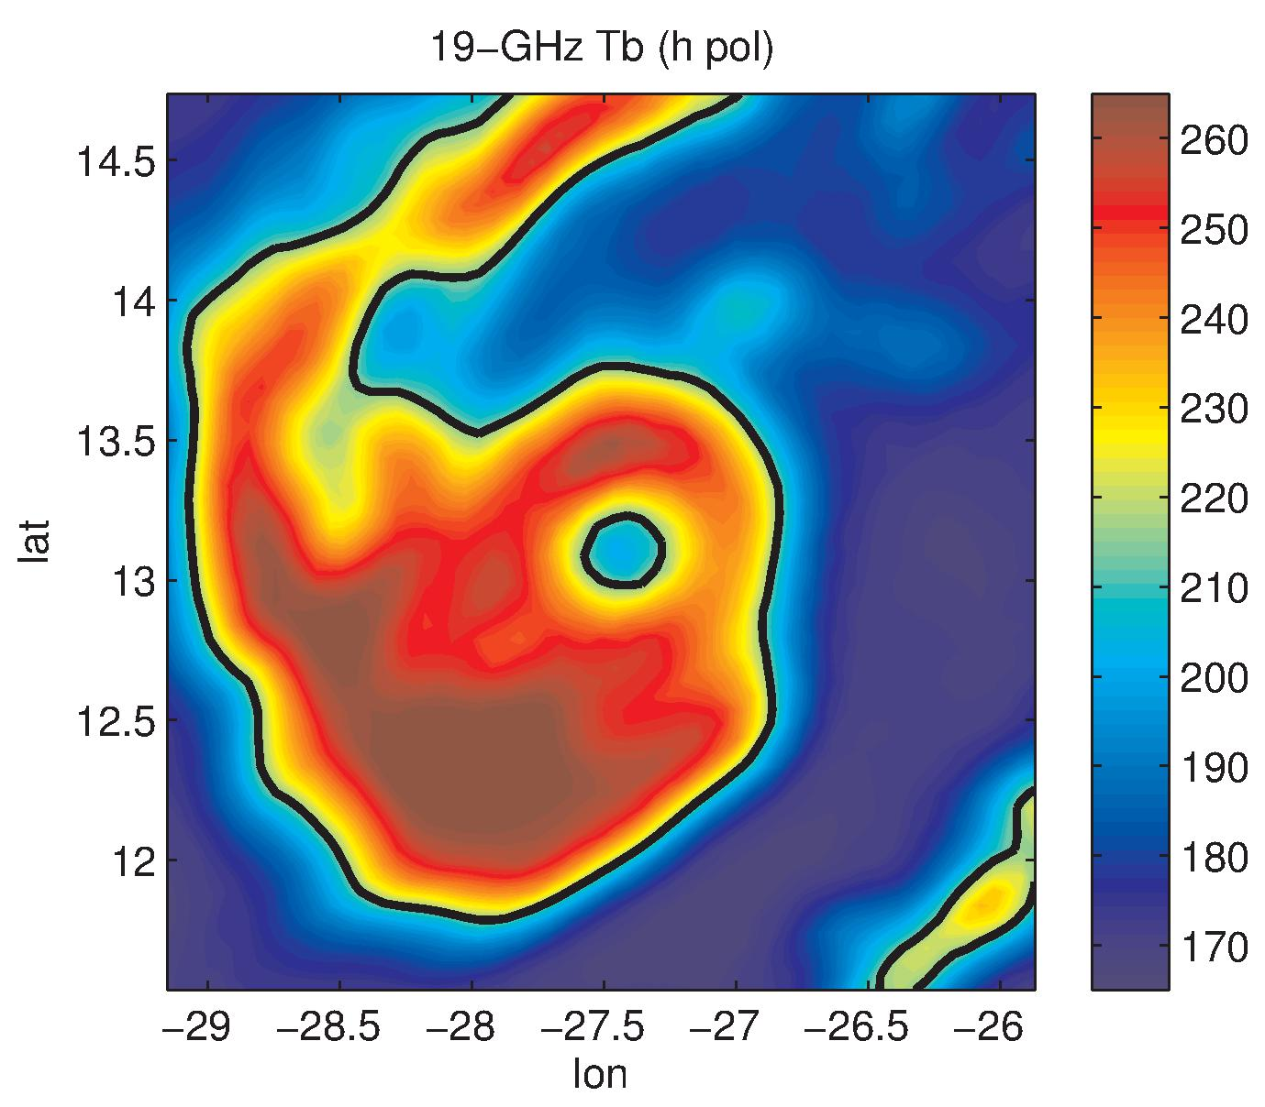
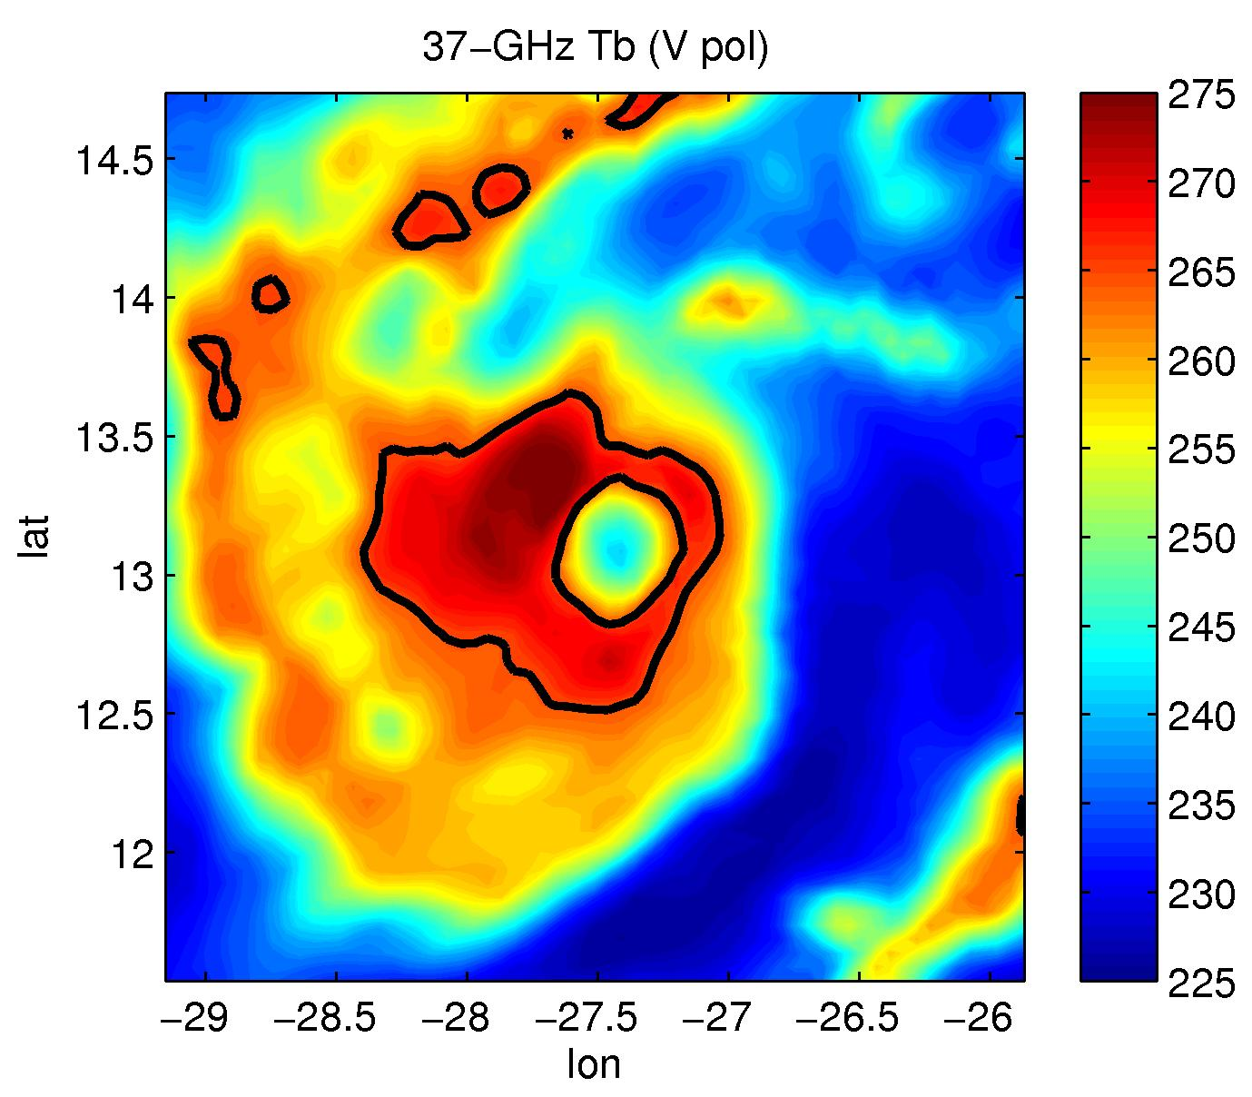
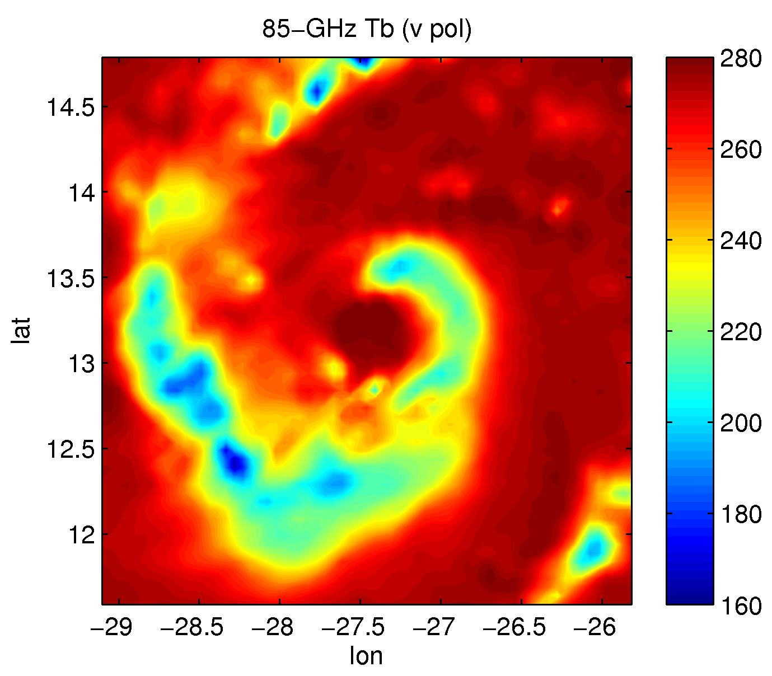
Microwave Imagery-enhanced models
Developmental data:
SHIPS developmental dataset (DeMaria et al. 2005)
SSM/I, WindSat, TMI, and AMSR-E from 1998 – 2008. Frequencies used: 19, 37, and 85-GHz
Example from TMI/Danielle (2004) – each channel provides different information.
19 (H) GHz
Mostly warm rain
Lowest resolution
37 (V) GHz
Some warm rain + ice
Intermediate resolution
85 (V) GHz
Ice scattering
Highest resolution

Slide 14
Microwave Imagery-enhanced models
Baseline model:
logistic regression model from Rozoff and Kossin (2011)
Enhanced model:
Baseline model + additional MI-based predictors.
These predictors describe aspects of the precipitation structure such as eye and eyewall brightness temperatures, the degree of structural symmetry and the radial extent of precipitation.
MI-based Predictors for RI (35 kt/24 h) | RI ave
19.4-GHz average T_{b,v} (r = 100 – 300 km) | higher
19.4-GHz minimum eye T_{b,v} | higher
19.4-GHz average ring T_{b,h} | higher
37.0-GHz radius of maximum T_{b,h} | lower
37.0-GHz average T_{b,v} (r = 0 – 100 km) | higher

Slide 15
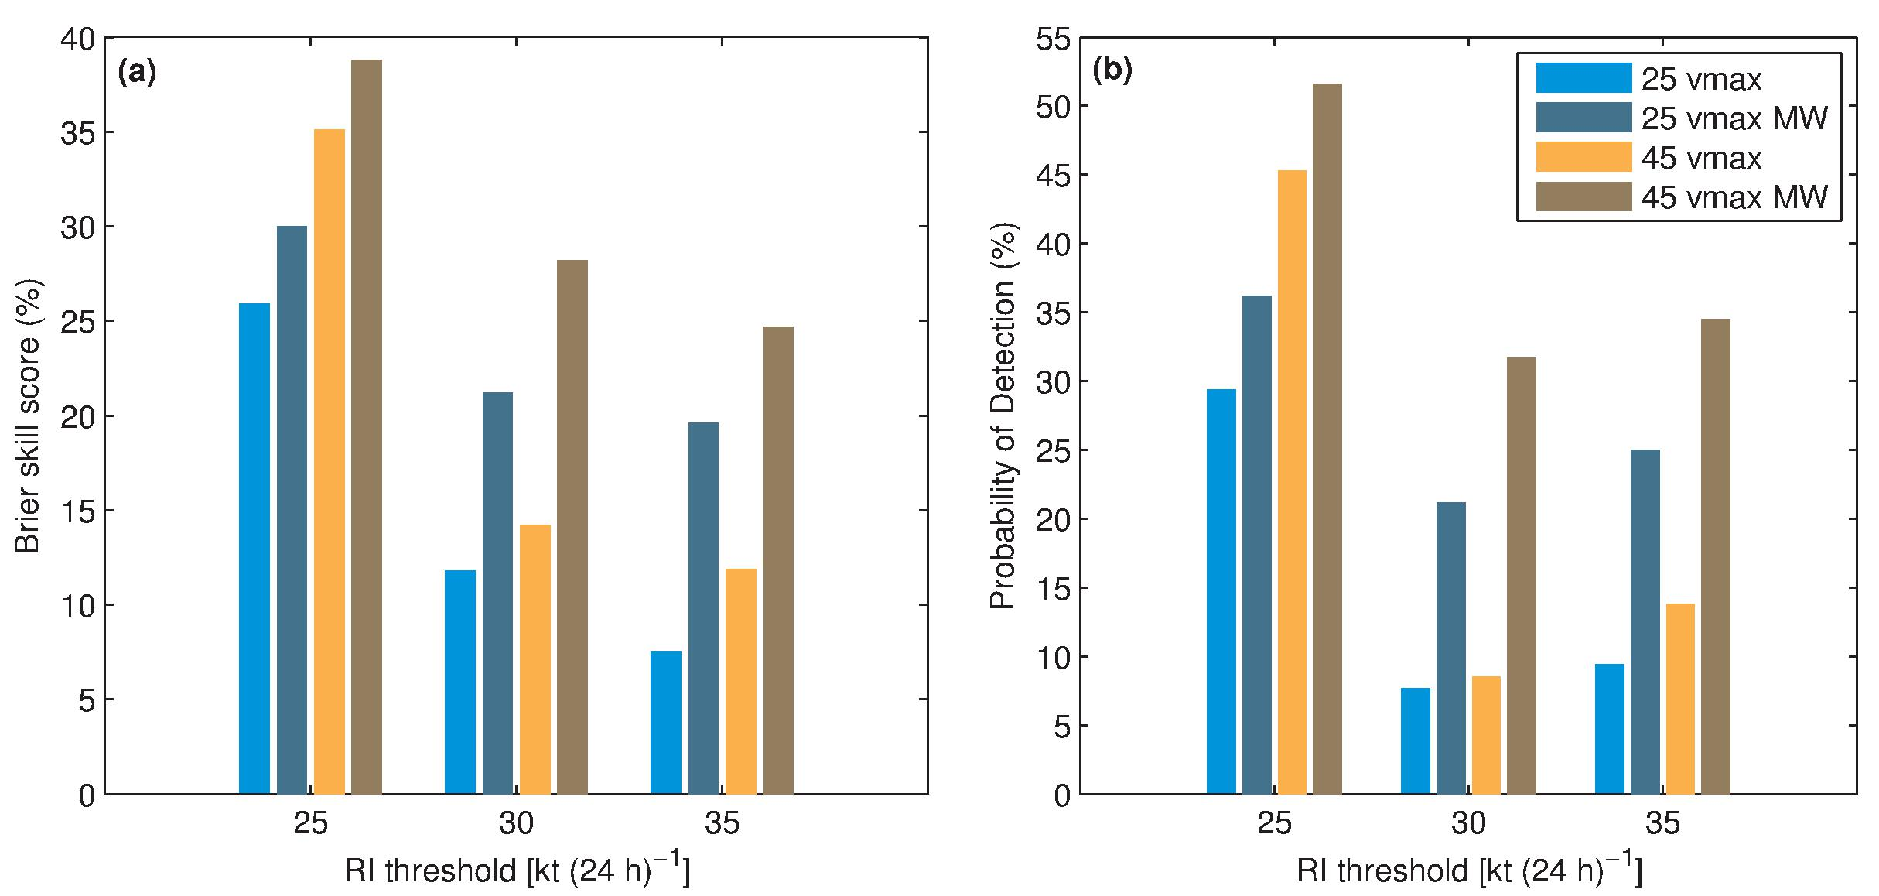
Contributions of Microwave Imagery to the Logistic Regression Model
The skill impact of adding MI-based predictors to the logistic regression model (results
shown for versions of the model without MI (light blue, orange) and with MI
(dark blue, brown). (a) Brier skill score (with respect to climatology) and (b)
probability of detection (based on a 50%-decision rule). Results are shown for storms
having at least 25 kt and 45-kt current intensity. (Results for the Atlantic, 1998-2008.)
* Results here use TRMM-TMI, AMSR-E, SSM/I, and WindSat. SSMI/S has recently been added (Feb. 2013).

Slide 16
Summary
A new multi-lead time ensemble-based RII was developed and tested in the Atlantic and E. Pacific basins in real-time during the 2012 season.
Verification of the 2012 RII forecasts showed that the multi-lead time ensemble-based Atlantic forecasts were not skillful at any lead-time relative to climatology while the E. Pacific forecasts were skillful at all lead times.
The lack of skill of the 2012 Atlantic RII forecasts was likely due in part to both the anomalously low rate of RI events in that basin in 2012, as the 2012 forecast errors were less than those of the long-term cross-validated sample mean, as well as the expected year to year variability in skill of RI forecasts.
An evaluation of the independent deterministic intensity forecasts for the combined 2011-2012 Atlantic and E. Pacific basin sample showed that these forecast exhibited significant skill relative to IVCN in terms of error and bias. Skill was also found relative to IVCN when the multi-lead time ensemble-based RII was employed to make intensity forecasts for the 2008-2010 dependent sample.
The microwave-based RII model is currently being re-derived with updated datasets, including data from 2009-2011 and now all SSMI/S data. Results, including testing of the 2012 season, should also be available within the next few months.

Slide 17
Future Work
Continue to perform real-times tests of the new ensemble-based multi-lead time RII during the upcoming 2013 Atlantic and E. Pacific Hurricane seasons.
Also, test recently developed ensemble-based version of the RII aid in the Atlantic and E. Pacific basins during the upcoming 2013 Hurricane season.
Finally, complete re-derivation of microwave-based RII and perform real-time testing during the upcoming 2013 Hurricane Season in both the Atlantic and Eastern Pacific basins

