Slide 1




Development of a Probabilistic Tropical Cyclone Genesis Prediction Scheme
Jason Dunion¹, John Kaplan², Andrea Schumacher³, Joshua Cossuth⁴, & Mark DeMaria⁵
1 University of Miami/CIMAS – NOAA/AOML/HRD – SUNY/Albany
2 NOAA/AOML/Hurricane Research Division
3 Colorado State University/CIRA
4 Florida State University
5 NOAA/NESDIS/STAR
Acknowledgements
Funding: This NOAA Joint Hurricane Testbed project was funded by the US Weather Research Program in NOAA/OAR's Office of Weather and Air Quality
NHC Points of Contact: Robbie Berg, Dan Brown, John Cangialosi, & Chris Landsea

Slide 2
Discussion Outline
Motivation
Explore utility of an objective, disturbance-centric scheme for identifying the probability of TC genesis for the NATL;
Credit NHC’s visiting scientist program & a quiet night in the tropical NATL
NHC’s Tropical Weather Outlook (TWO)
Tropical Cyclone Genesis Index (TCGI*)
Year-1 efforts (completed)
Year-2 efforts (ongoing and upcoming)
Preliminary Results
Conclusions & Future Work
* 1st Runner-up: Genesis of Nascent Forming Storms and Hurricanes (GoNFSHn)

Slide 3
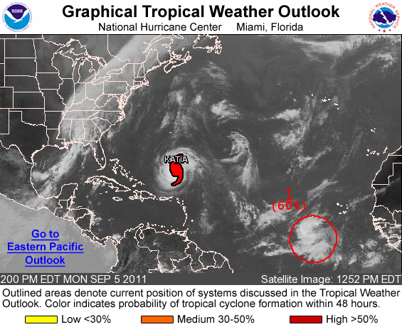
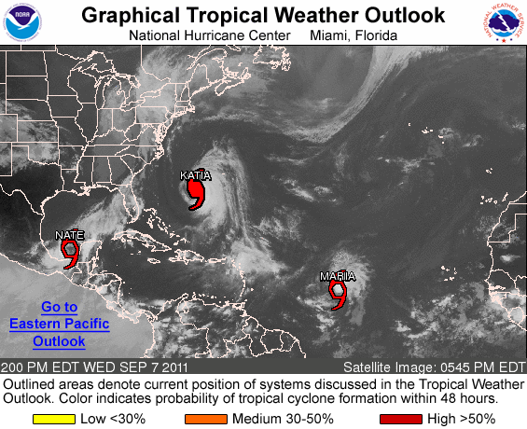
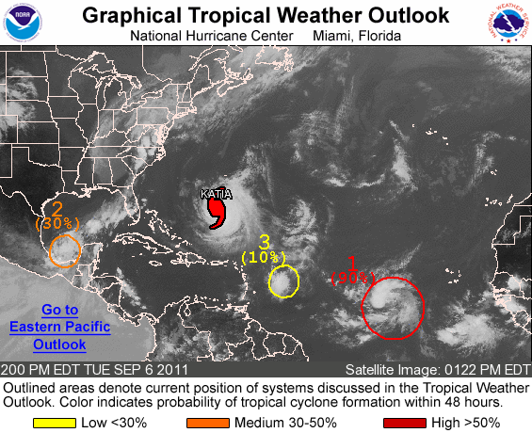
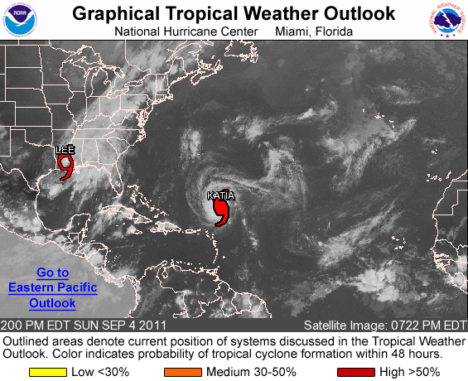
NHC’s Tropical Weather Outlook
Highlight areas of disturbed weather & the potential for TC genesis (0-48 hr);
0-120 hr currently produced “in house” (“public”: summer 2013);
”Middle ground” probabilities (~40-70%): most challenging;
Semi-subjective process: limited objective tools for providing guidance;
Notes:
TCGI strategy: complete the TWO efforts going on at NHC

Slide 4
Timeline: Year-1
(Completed Tasks)
Feb 2012:
Complete identification/development of genesis predictors into the TCGI database (CIRA TCFP/SHIPS/Rapid Intensity Index);
60 potential predictors for testing (0-48 hr and 0-120 hr);
Feb 2012:
Begin to develop/incorporate the TPW predictor into the TCGI database;
March 2012:
Present year-1 results at IHC
June 2012:
Complete identification/development of TPW & Dvorak T-number/CI value TCGI predictors;
Develop a complete, continuous “Invest Best track” from a 10-yr Dvorak dataset: TAFB Dvorak fixes/Interpolation/Special BAMM);

Slide 5
Timeline: Year-2
June-Nov 2012 (nearing completion):
Begin sensitivity testing for optimal combination of TCGI predictors (0-48h & 0-120h);
Utilize RI Index methodologies (Kaplan et al.)
Dec 2012 (ongoing):
Develop code for running TCGI in real-time (0-48 h and 0-120 h);
Jun-Aug 2013 (upcoming):
TCGI real-time tests (0-48 and 0-120 h);
Utilize NESDIS computers at CIRA (output via ftp site) or JHT computers;
Aug 2013 (upcoming):
Final TCGI code will be made available;
Possible installation on the IBM >> operational SHIPS/LGEM guidance suite (if project is accepted);

Slide 6
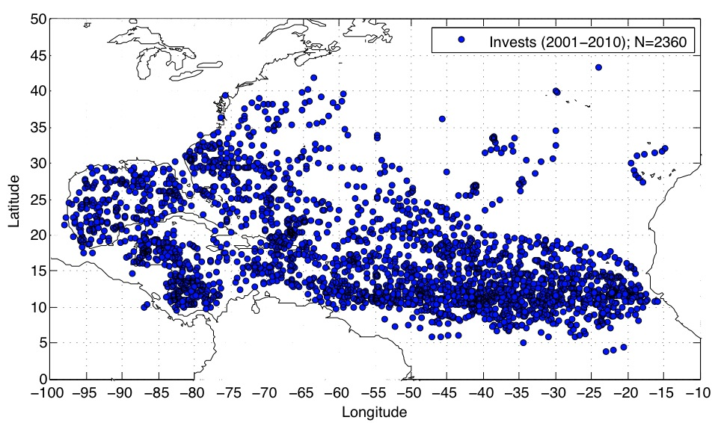
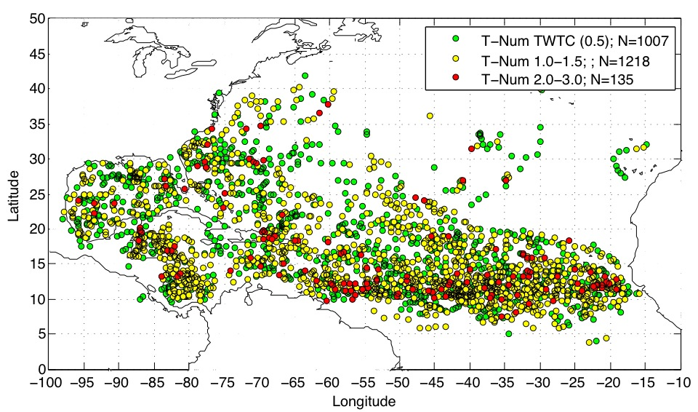
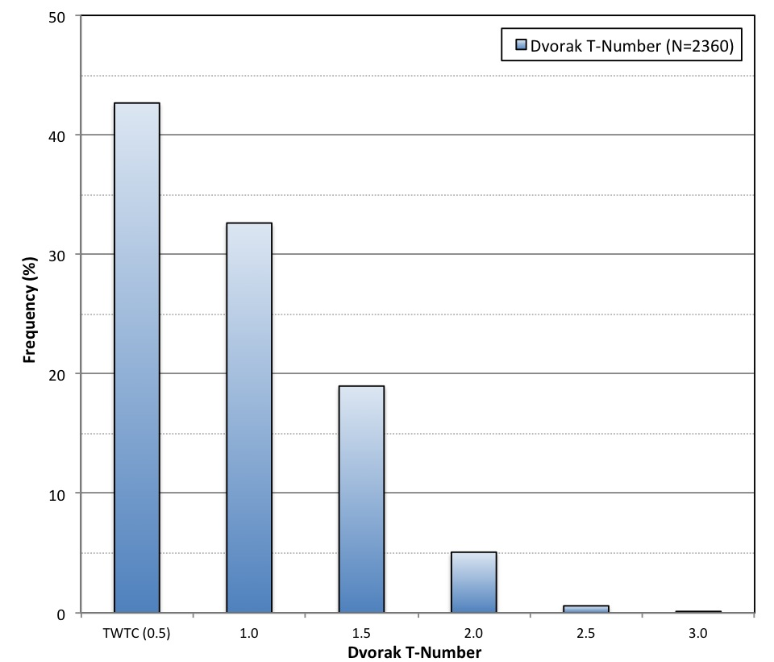
TC Genesis Index (TCGI)
TAFB Dvorak Fixes: Pre-Genesis Locations

Slide 7
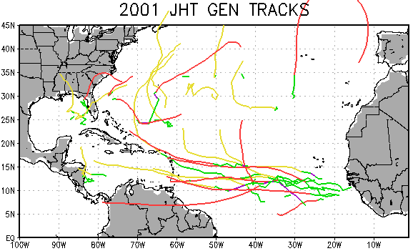
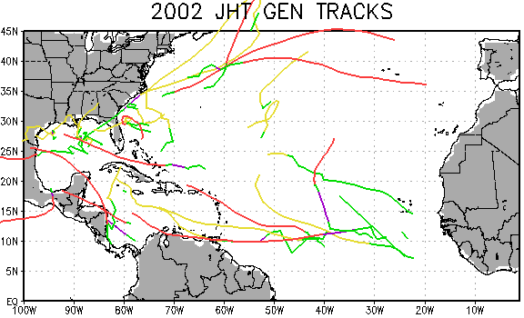
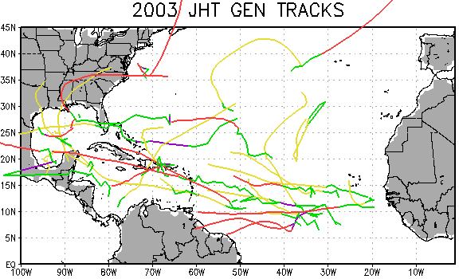
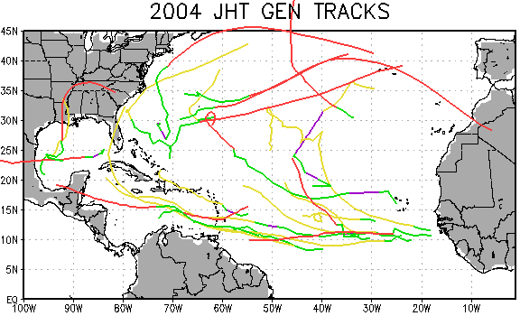
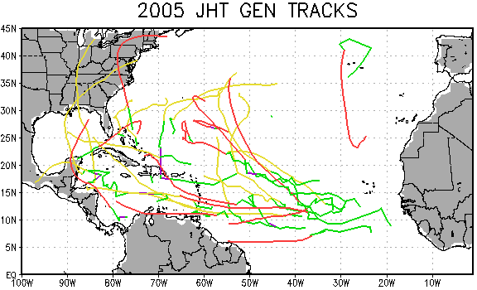
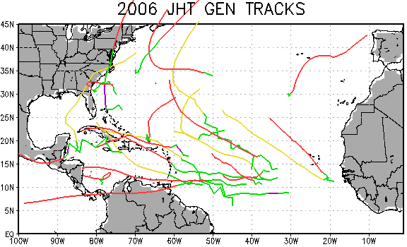
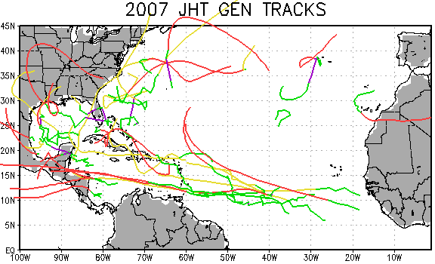
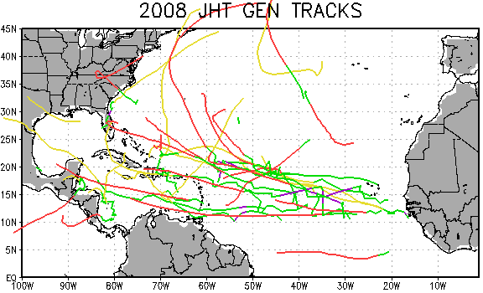
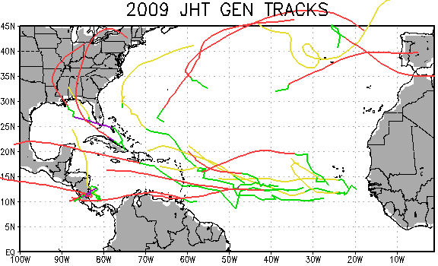
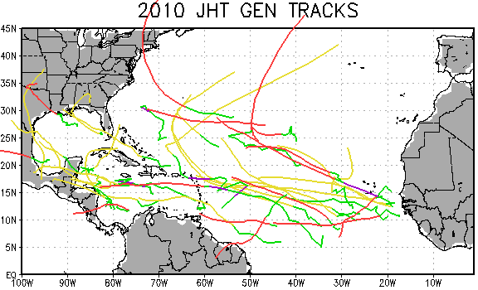
TC Genesis Index
Invest Tracks (2001-2010)
Dvorak Fixes
Interpolation
Best track (post-gen)
Special BAMM
Notes:
2001-2010 invest Dvorak positions, interpolations, and Special BAMM positions (out to 120 hr)

Slide 8
TC Genesis Index (TCGI)
Predictor Development
Methodology (Kaplan et al. 2010, RI Index)
Examine potential TCGI predictors (60 total);
Predictor Selection: significant at the 99.9% level;
Magnitude of each predictor >> evaluated for (0-48h & 0-120h) for all 2001-2010 cases;
Sensitivity tests >> determine which combination of predictors yields the most skillful genesis forecasts
0-48 h and 0-120 h;
linear discriminant analysis;
Notes:
Nix #4 and clean up

Slide 9
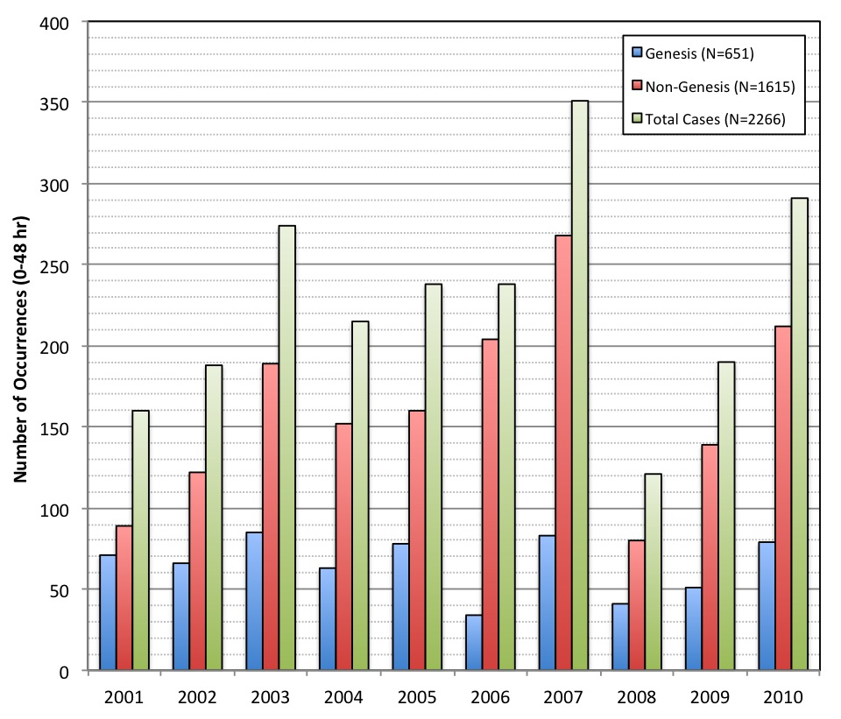
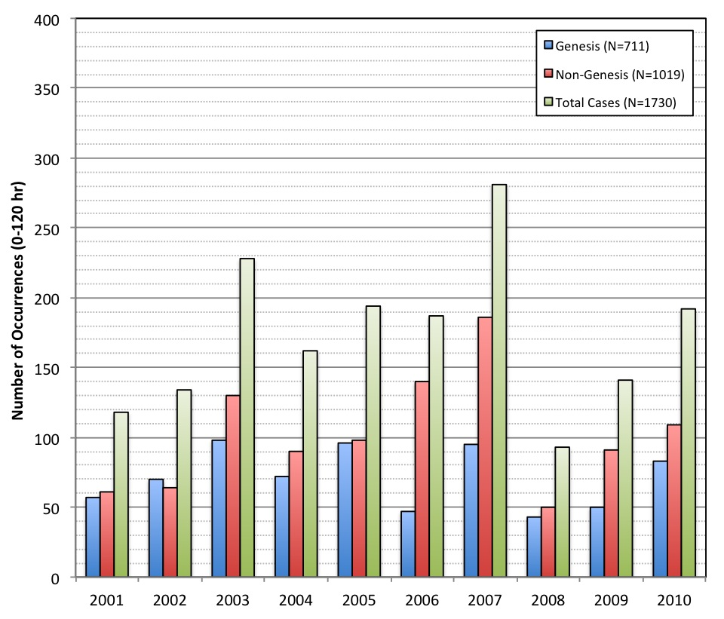
TC Genesis Index (TCGI)
2001-2010 Genesis vs Non-Genesis
TCGI (0-48 hr)
TCGI (0-120 hr)
Notes:
if a case didn’t have all predictors at all 6-hr time periods in the TCGI forecast, it was thrown out
Stdev of NG for a given year ~3x that of G

Slide 10
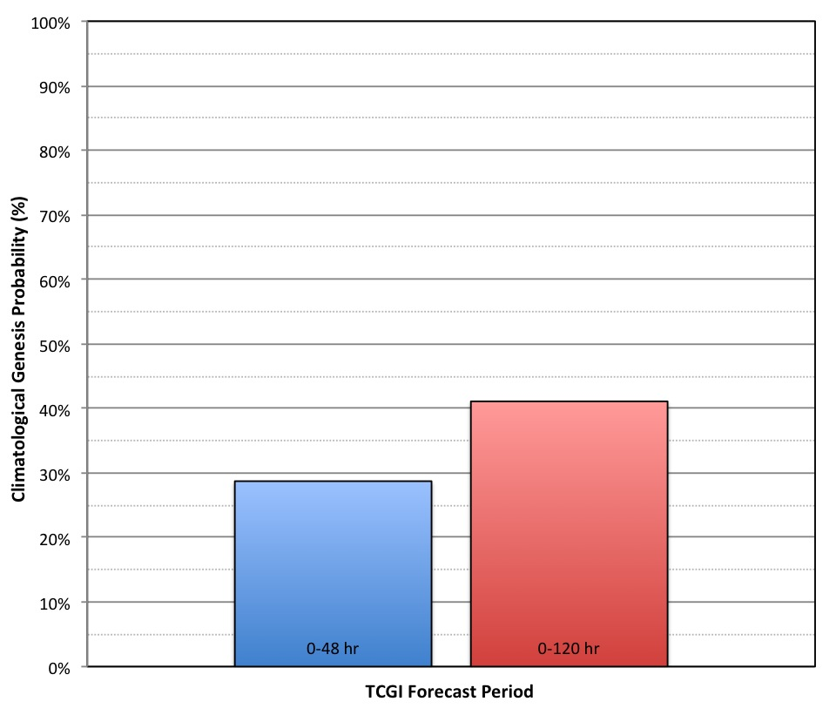
TC Genesis Index (TCGI)
2001-2010 Invest Genesis Probabilities

Slide 11
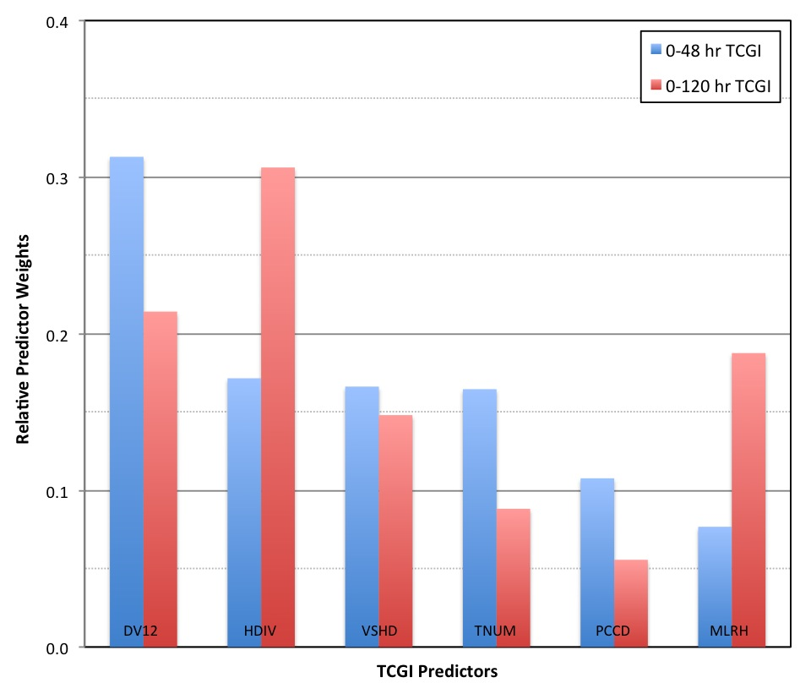
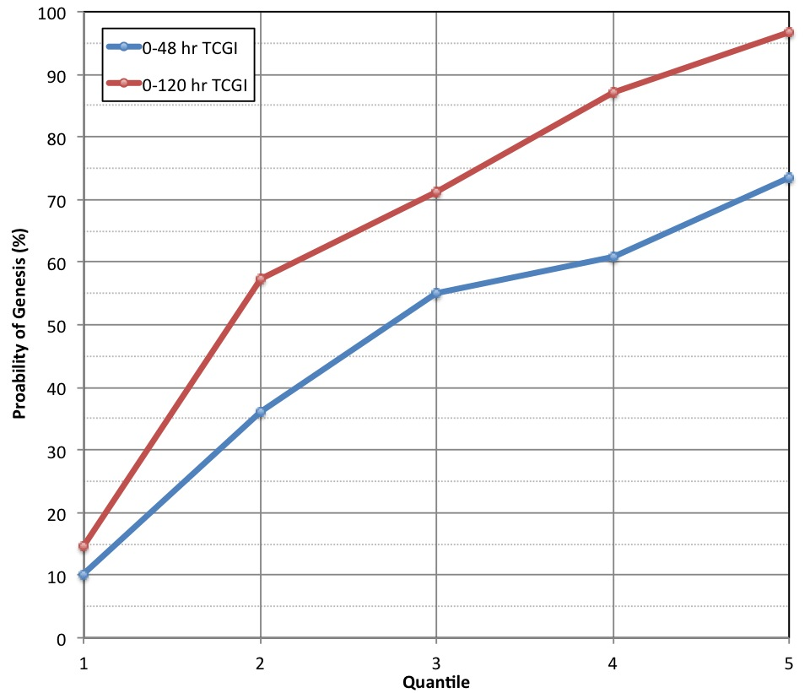
TC Genesis Index (TCGI)
Predictors/Probabilities/FAR
DV12: GFS 12-hr Vortex Tendency (t=+12hr – t=0hr; 0-500 km)
HDIV: 850 hPa Divergence (0-500 km)
VSHD: 200-850 hPa Vertical Wind Shear (0-500 km; Vortex Removed)
TNUM: Dvorak T-Number (t=0hr)
PCCD: GOES Cold Cloud (<-40 C) Pixel Coverage (R=0-500 km)
MLRH: 600-mb RH (R=0-500 km)
Notes:
Andrea- deep shear” was there vortex to remove?
John
Predictors: Relative weights only, right? Is 0-120 hr HDIV more than 2x important compared to VSHD?...or does it not work like that?
Predictors: From your RII work, are these weights impressive or is it really comparing apples to oranges?
Quantiles: each bin has ~same # of gen cases: what do scalebgn, scalend, and scaleavg average mean descriptively? Are they some total of the different predictors (be they pos or neg)?
So can TCGI not predict ~>75% chance at 0-48 and ~>97% at 120? >> no we did have 100% occurrence and we extrapolate to 100% using bins 4&5 and to 0 using bins 1&2

Slide 12
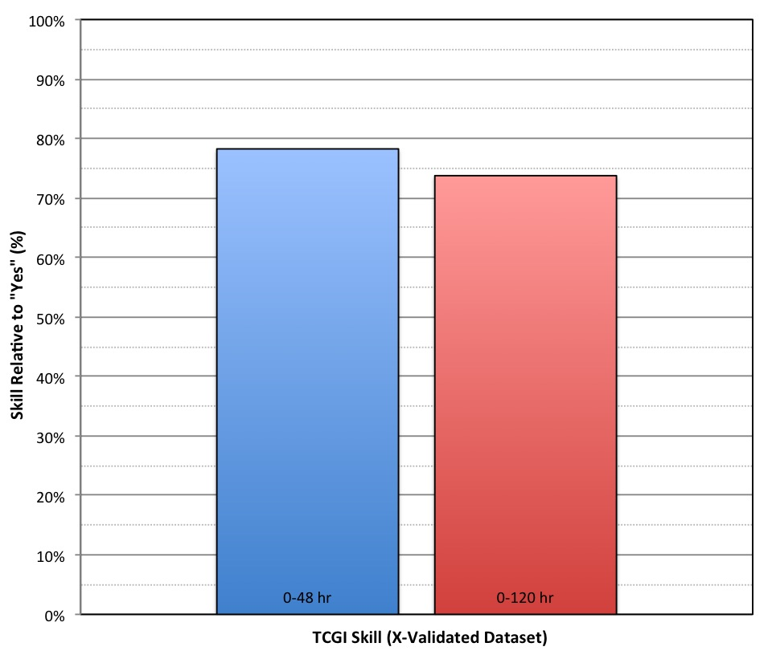
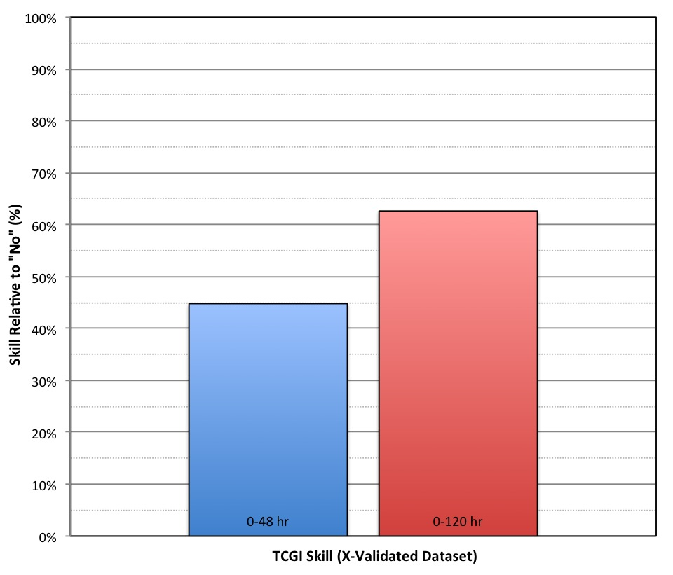
TC Genesis Index (TCGI)
Skill Relative to “Yes” and “No”
Notes:
Nix dependent?
Note: if all tropical cloud clusters were used instead of invests: skill wrt “yes” goes up…skill wrt to “no” drops

Slide 13

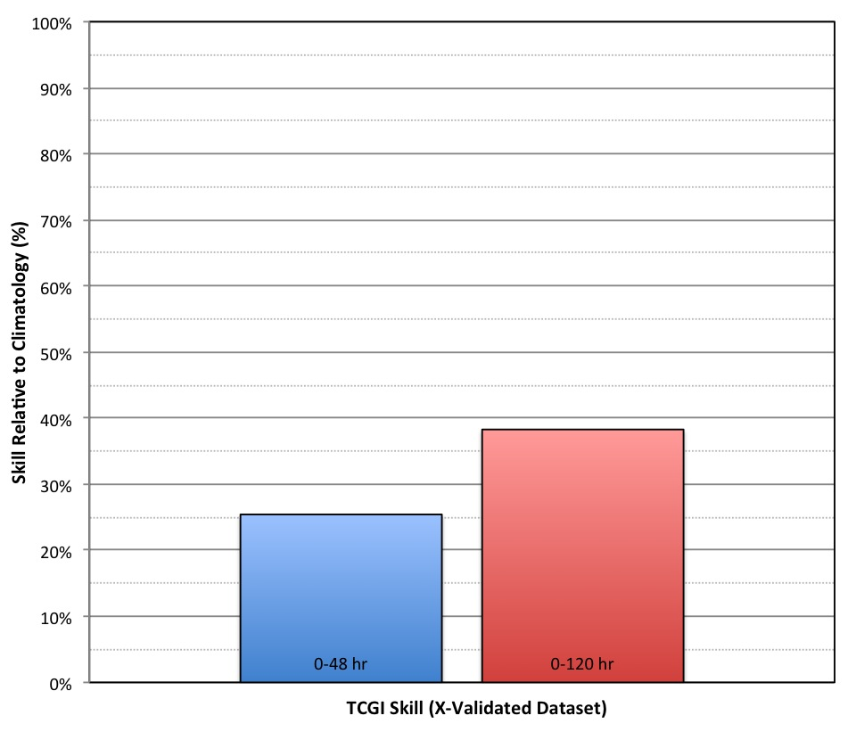
TC Genesis Index (TCGI)
Skill Relative to Climatology

Slide 14
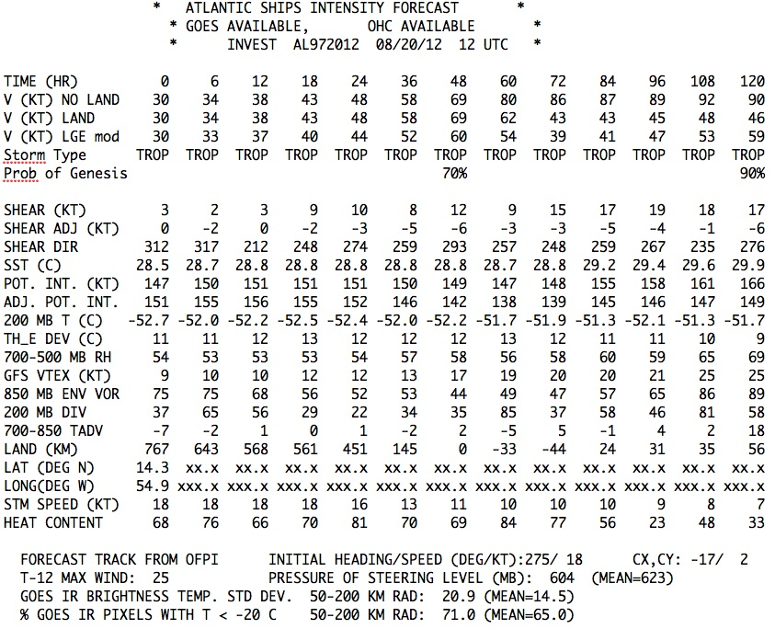
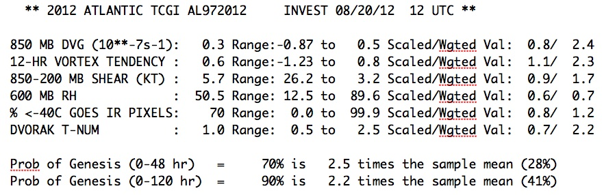
TC Genesis Index (TCGI)
Possible Output Format

Slide 15
Conclusions & Future Work
TC Genesis Index (TCGI)
Disturbance-centric/objective/probabilistic
0-48 hr and 0-120 hr forecasts
60 predictors were evaluated
6-predictor prototype scheme has been developed
Skill (relative to climatology): ~25% (0-48 hr); ~42% (0-120 hr)
Year-1 Efforts: completed
Development of Dvorak “Invest Best track” & TCGI predictors
Year-2 Efforts: on-going
Testing optimal combination of TCGI predictors: nearing completion
Real-time code development: beginning
TCGI real-time tests (0-48 and 0-120 h): June-Aug 2013
Future Direction
Microwave imagery (e.g. 37 & 85 GHz)
Ensemble model information
Automated scheme for identifying Invests
Expand TCGI to other basins

