Slide 1
Development of a Real-Time Automated Tropical Cyclone Surface Wind Analysis: A Year 2 Joint Hurricane Testbed Project Update
Presented by
John A. Knaff
NOAA NESDIS, Fort Collins, CO
Renate Brummer, Mark DeMaria, Chris Landsea, Michael Brennan, Robbie Berg and Jessica Schauer

Slide 2
Purpose
This project seeks to create a real-time and fully automated surface wind analysis system at the National Hurricane Center (NHC) by combining the existing satellite-based six-hourly multi-platform tropical cyclone surface wind analysis (MTCSWA) and aircraft reconnaissance data.
Attempt to mimic how Hurricane Specialists would analyses observations using NHC’s proceedures
Notes:
Right shows thinned flight-level winds over surface wind speeds estimated from the analysis. This image morphs to AMSU rain rate estimates valid at almost exactly the same time. Shows where the heaviest rain is occuring in relationship to the maximum winds. The image was created originally for the NOPP proposal.

Slide 3
In Year 1
What input data?
Reconnaissance
Flight-level winds
SFMR wind speeds
Multi-platform tropical cyclone wind analyses
Satellite winds at 700 hPa
Analysis Issues?
Determination of sufficient data
For the polar variational analysis
Data weighting
Filter coefficients
Automated Quality control/RMW determination
Determination of wind radii
Data Issues?
How to handle data at multiple levels
Reduce analysis to a 10-m estimated wind
When to run the analysis?
Before (T-0:30)
Early (T)
After (T +1:30)
How to distribute results?
ATCF fix
N-AWIPS grids

Slide 4
Flight-level to Surface Reduction
Assumptions
Reduction Factors
Two regions
Eyewall [r ≤ min(2 * rmw, 20 n.mi)]
Outer vortex (r ≥ 4 * rmw)
4 % azimuthal variation of reduction factors
4 (17) % azimuthal asymmetry with maximum-left and minimum-right in the eyewall (outer vortex)
Six-hour storm direction is used for the asymmetry
20 degree inflow angle
Over land, additional 20 degree inflow and 20% reduction
Level (hPa) | Eyewall | Outer Vortex
600-800 | 0.88 | 0.83
800-900 | 0.78 | 0.78
900-990 | 0.73 | 0.73
990-Sfc | 0.77 | 0.77

Slide 5
When/How to Run
(BEFORE) Just before the synoptic time (T) for assistance with the TC vitals (Bogus)
(EARLY) Just after T for assistance with generating the TC vitals prior to requesting model guidance be run.
(LATE) After the TC vitals has been prepared and after the model guidance has been submitted.
T-0:30
BEFORE
For TC vitals
T+0:10 – T+0:30 ?
EARLY
For TC vitals
T+1:30
LATE
For refinement

Slide 6
Process Run at CIRA in 2012
Active storms?
Gather track information
Flight-level-to-surface reduction
Diagnostics
Fix generation
Gridding and display
Gather HDOBS
Gather MTCSWA
Motion relative framework
Sufficient Data?
Analyze
Find observed rmw
Re-correct data to common level (700 hPa)
Final analysis
Outputs provided on the RAMMB ftp server.
Correct data to common level (using rmw=50km)
Analyze
QC (50%)
Repeat 2&3 (40%)
Notes:
I will spend a bit of time on the circled items.

Slide 7
Summary of the Real-Time Testing
Before synoptic time there is often not enough data to create an analysis (Could the aircraft be tasked earlier?)
There were some “odd” analyses resulting from:
Coding error resulting in negative data weights to the MTCSWA inputs.
Quality control too stringent for weak systems
Azimuthal filter weights were to small in some cases.
Wind radii estimates in Sandy… logical error.
Solutions:
Fix the coding error that caused negative data weights
Reduce initial quality control constraint
Make Azimuthal filter weights larger and sometimes dynamic
Fix the logical error in the wind radii estimates.
2010-2012 Analyses are viewable at
http://rammb.cira.colostate.edu/research/tropical_cyclones/tc_surface_wind_analyses/

Slide 8
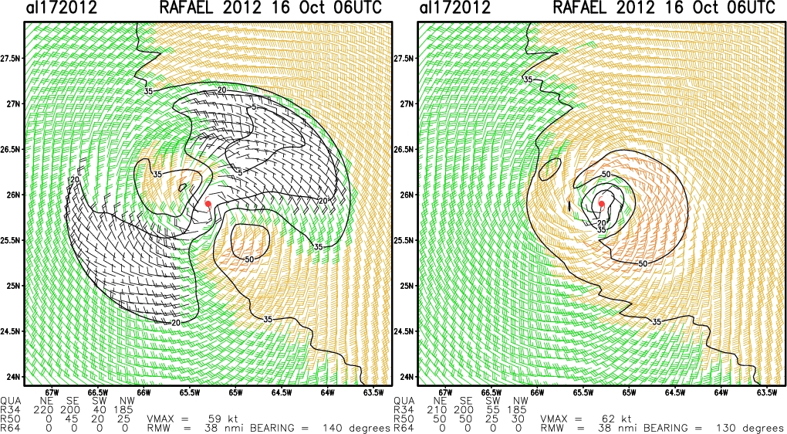
REAL-TIME
RE-RUN

Slide 9
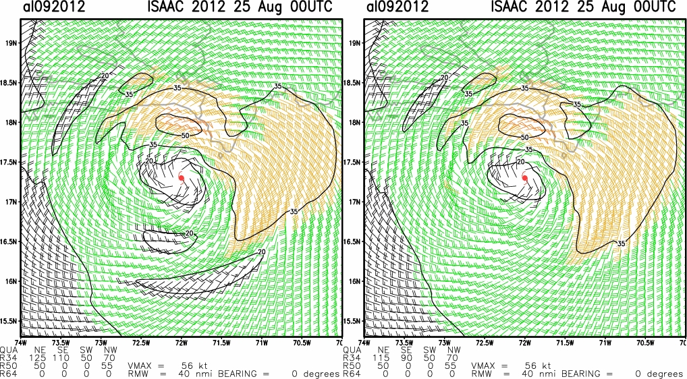
REAL-TIME
RE-RUN

Slide 10
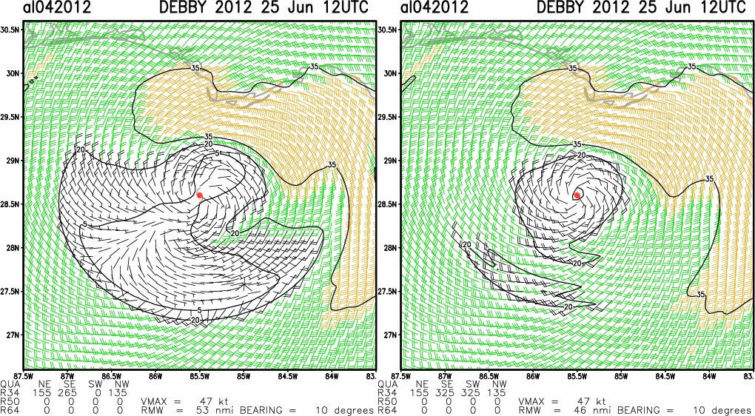
REAL-TIME
RE-RUN

Slide 11
Unique Issues with Sandy
Winds beyond 200 km radius rely on MTCSWA and reduction to surface
Should reduction factors be larger beyond some radius?
Should we truncate the analysis domain?
Wind radii beyond the analysis domain
Do we try to separate storm from its environment?

Slide 12
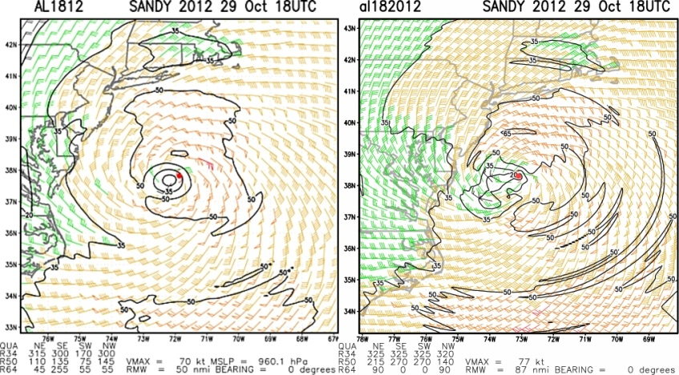
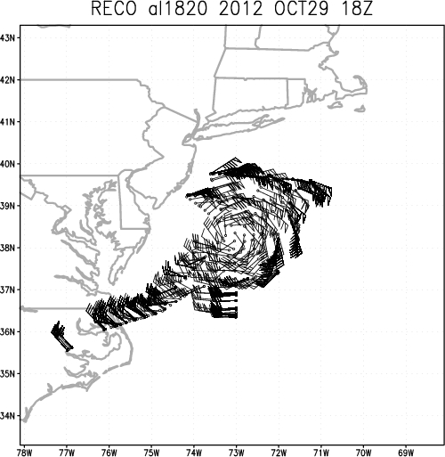
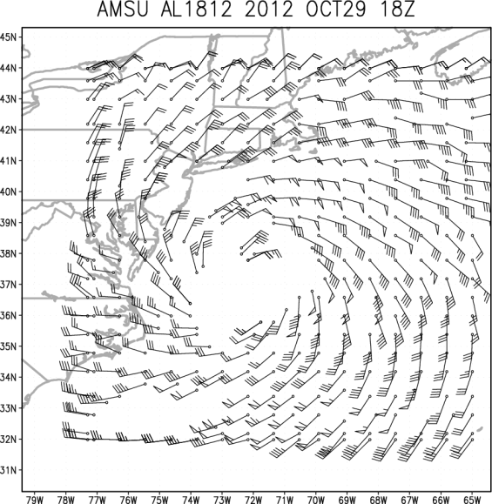
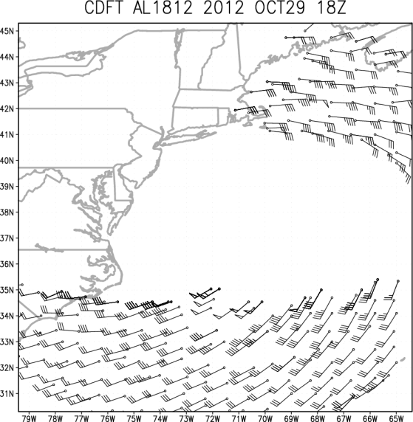
MTCSWA JHT-TCWA
No surface observations in this area
It is doubtful the wind speeds are as large as indicated in the analysis

Slide 13
Remaining Milestones
May 2013 – Prepare the analysis for a full season of real time testing
Jun 2013 – Gather feedback and make appropriate changes to the analysis system
Jun 2013 – Transition the analysis to NHC control, if approved for implementation
Jun 2013 – Project ends

Slide 14
Next Steps
Setting things up
Concerns
Housekeeping
Clean up FORTRAN Code
Clean up scripts add python control scripts
Work with NHC on display
Fixes or data to ATCF
Run in real-time for 2013
Port Code to NHC
Ingest MTCSWA
Ingest HDOBS
HDOBS decoders
FORTRAN
Questions
Flight-level to surface reduction beyond 200km
Data availability
Is there enough data to provide EARLY/BEFORE analyses
NAWIPS and ATCF
Pick-up and regular display
ATCF Fixes
NAWIPS grids
AWIPS-II?

Slide 15
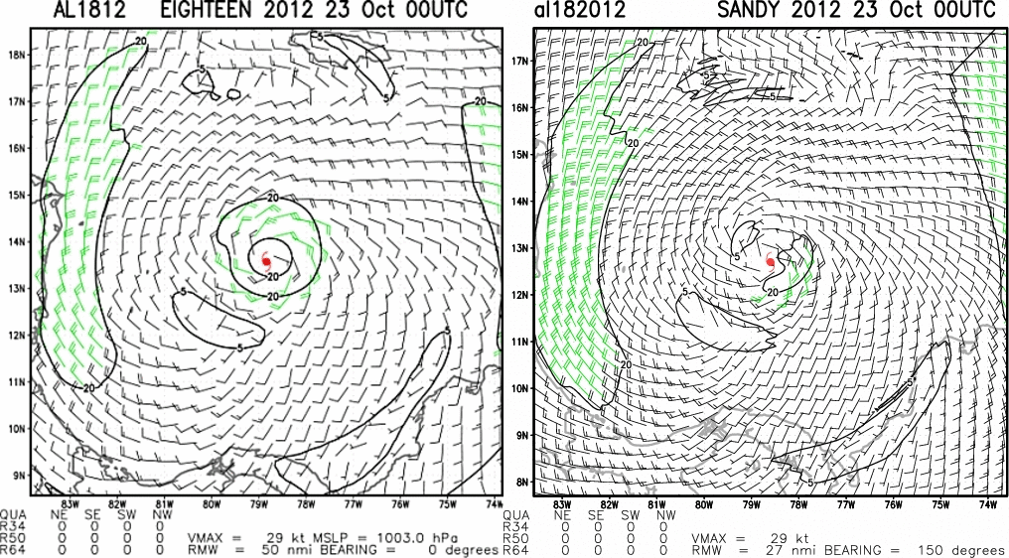
Questions?
MTCSWA JHT-TCWA
Acknowledgements: This NOAA Joint Hurricane Testbed project was funded by the US Weather Research Program in NOAA/OAR's Office of Weather and Air Quality.

