Slide 1
An Overview of Joint Typhoon Warning Center Tropical Cyclone Forecast Improvement Focus
Captain Ashley Evans, Commanding Officer
Mr. Bob Falvey, Director
67th INTERDEPARTMENTAL HURRICANE CONFERENCE
5-7 MAR 2013
COLLEGE PARK, MD
Brian Strahl, Presenter

Slide 2
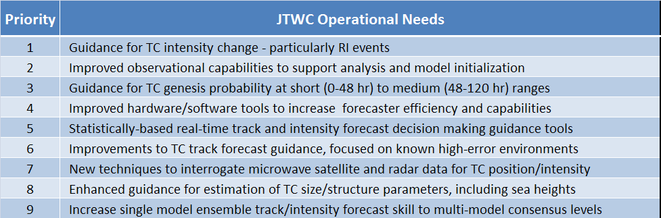
JTWC-Prioritized R&D Requirements Tied to Operational Needs
Top 9 JTWC operational needs (summarized) from the 2013 Joint Hurricane Testbed Announcement of Federal Funding Opportunity (AFFO).
Notes:
Starting out by showing the top 9 (out of 17) JTWC operational needs from the 2013 JHT AFFO are shown. There is a shared list of priorities and verbiage that the centers review to rank our priorities. The top two priorities from all centers (JTWC,NHC, CPHC) are #1 –TC intensity change guidance and #2 – improved observations. The remainder of the list varies somewhat from NHC/CPHC and varies slightly from year to year.
Although there are numerous operational needs presented, they can be grouped into 4 broad categories, which together affect how we go about reaching the three primary mission goals…

Slide 3
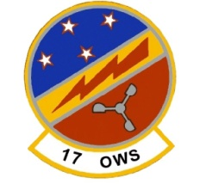
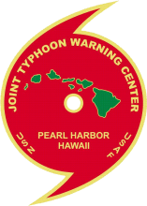
JTWC Tropical Cyclone
Strategic Goals
Tropical Cyclone Forecasting
Tropical Cyclone Reconnaissance
Improve TC Intensity / RI Forecasts
Improve TC Genesis Forecasts
Improve TC Track Forecasts
RESEARCH-TO-OPS
MODELS
DATA / ANALYSIS
OPERATIONS
UNCLASSIFIED
Joint Typhoon Warning Center
Forward, Ready, Responsive Decision Superiority
Notes:
Transitioning from the previous slide, the four broad areas are at the bottom of the pyramid (Reasearch-to-OPS, Models, Data/Analysis, and Operations (tools, Enterprise)
Can briefly mention how JTWC strategic goals feed off its PACOM-directed mission of TC forecast/warning services and TC recon, and how these two areas compliment each other. Can note the fact that our SATOPS is collocated with Typhoon Duty Officers
Then from those come the strategic goals of 1) Improving TC Intensity Forecasting, particularly for RI events – recent statistics I compiled shows that over the past year, on average, 44% of WPAC TC’s had at least one occurrence of RI. Intensity forecast skill has remained almost completely flat for 20+ years.
2) Improving TC track forecasting. While significant improvements in track forecast skill have been realized over the past 20+ years, there remains significant outliers, associated with environments known to have high uncertainty or variability (e.g., accelerating re-curvers/systems becoming ET, stalled/Q-S systems, and loops – as well as the interaction of TCs and upper-level troughs, which are more prevalent in WPAC than any other basin.
3) Improving the forecast (and analysis) of TC genesis, which relies heavily on satellite TC recon capabilities, particularly in JTWC AOR where areal recon is not available.

Slide 4
JTWC Strategic Goals vs.
Focus Areas*
*Top 3 Strategic Goals for Tropical Cyclone Mission
Create Meso-Scale Model Consensus for Intensity
Tropical Cyclone Forecasting
Tropical Cyclone Reconnaissance
Grow Statistical-Dynamical Intensity Forecast Techniques For All Basins
Affect Model Improvements (Resolution, DA, Physics, etc)
Sustain Microwave Satellite Reconnaissance Capabilities
Improve TC Intensity / RI Forecasts
Sustain Ocean Surface Vector Wind Estimation Capabilities
Improve TC Track Forecasts
Improve TC Genesis Forecasts
Enhance/Develop in-situ Observation Capabilities (Global Hawk, Radar)
Enhance Current JTWC consensus/Expand Ensemble Track Capabilities
Improve Analysis of Storm Size and Structure – Model Inputs
RESEARCH-TO-OPS
MODELS
DATA / ANALYSIS
OPERATIONS
Acquire New and/or Improved Analysis & Display Tools/Software/Hardware
UNCLASSIFIED
Joint Typhoon Warning Center
Forward, Ready, Responsive Decision Superiority
Notes:
In order to reach the strategic goals, there are a number of focus areas(?) that are essential to making the improvements noted (list is not all-encompassing), either drawn directly from the Operational needs list or a re-statement of those needs.
Need a super-ensemble (multi-model+single model) of TC models (COTC, HWRF, GFDN, ?) and statistical evaluation tools to determine most likely forecast intensity and assess the spread of the uncertainty
Continue STIPS/SHIPS/SHIPS-RI/LGEM, etc improvements/refinements across all basins
Be a driver of requirements for model improvements
Sustain remote sensing capabilities essential to TC recon, and storm analysis
Investigate alternate observing platforms, continually investigate new sources of data and ways to access
Continually evaluate JT consensus performance and consider new models for addition. Closely follow research in ensemble analysis and grow in-house capabilities for data mining of ensemble output
Continually improve analytical products and the forecaster’s understanding and use of these products – the forecast begins with an analysis – poor analysis will negatively feedback throughout the forecast process.
Similarly, acquire new + improved Analysis & display tools to allow for more & better capabilities to view, overlay and enhance multiple data types easily and quickly. Push for AWIPS-II or similar

Slide 5
Questions?

Slide 6
JTWC WATCH TIMELINE
JTWC Watch Timeline
Average Annual TC Activity By Basin
The JTWC AOR encompasses over 110 million sq. miles and nearly 89% of global TC activity. Process efficiency must be a critical performance parameter consideration for R&D transition.
T-00:30-T+00:20 Satellite Image Processing
METWATCH/ ADVISORIES/ ALERTS
T00:20-00:40
Dvorak Analysis,
METWATCH/ ADVISORIES/ ALERTS
T00:40-01:00
Best-track analysis,
Input Bogus
METWATCH/ ADVISORIES/ ALERTS
T01:00-02:00
Model analysis, Consensus Assessment, Forecast
METWATCH/ ADVISORIES/ ALERTS
T02:00-03:00 Generation and issue of all forecast graphics & text products
METWATCH/ ADVISORIES/ ALERTS
T03:00-06:00
METWATCH
Data Analysis
Conference Calls
Sig. Trop Wx Advisories
METCON
TC Formation -
Alerts
Processes must fit within the operational battle rhythm
Notes:
The 12-hour watch begins at 03 and 15Z (5am/pm), with two warning cycles (NH). The warning cycle begins at synoptic time and takes 3 hours from start to finish. Time management is crucial during this period: TDO’s must fuse a lot of analyses into a one coherent forecast philosophy, with very little time to spend on any given product.

Slide 7
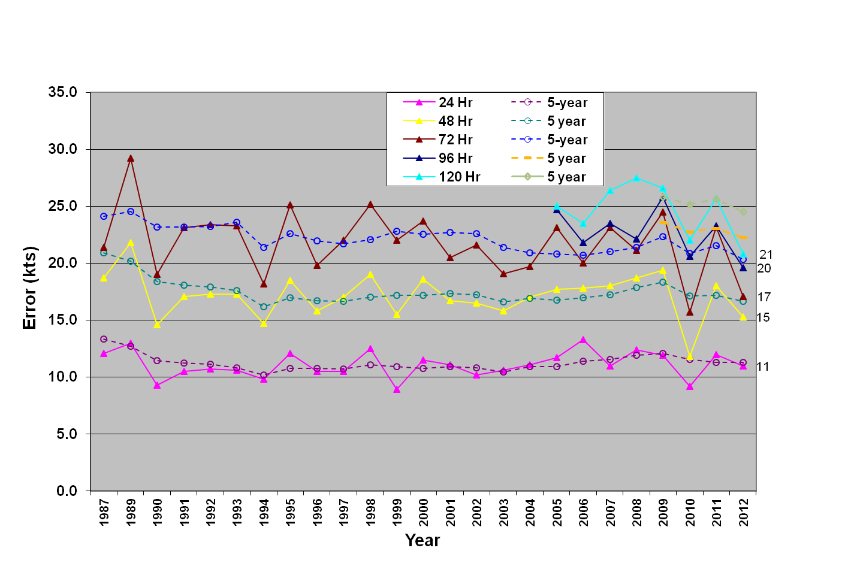
TC Intensity Forecasting
JTWC INTENSITY ERRORS
(Western North Pacific 24-120 Hours)
Intensity forecast improvement top priority for all U.S. TC forecast agencies
Little significant change of intensity forecast skill in past 20 years
High uncertainty due to TC-synoptic scale interaction
Rapid Intensification/Dissipation (RI/D) a major challenge without aerial recon, RI occurs in ~40% of WPAC TCs
Way Ahead
JTWC Action
Improvements in meso-scale model resolution, physics, data assimilation
Development of meso-scale ensembles
Remote sensing D&A investment
Increased understanding, use, and analysis of microwave data
Improve statistical-dynamical models
Improve understanding & diagnosis of TC – synoptic interactions (e.g. TC-TUTT)
COTC IOC implementation , added HWRF through HFIP partnership
Continued use of GFDN in consensus and resourcing for development
IOC WPAC LGEM/SHIPS-RI capability
Improving TC-TUTT interaction understanding - UH Ph.D student intern
Upgraded hardware/software to facilitate intensity fcst improvements

Slide 8
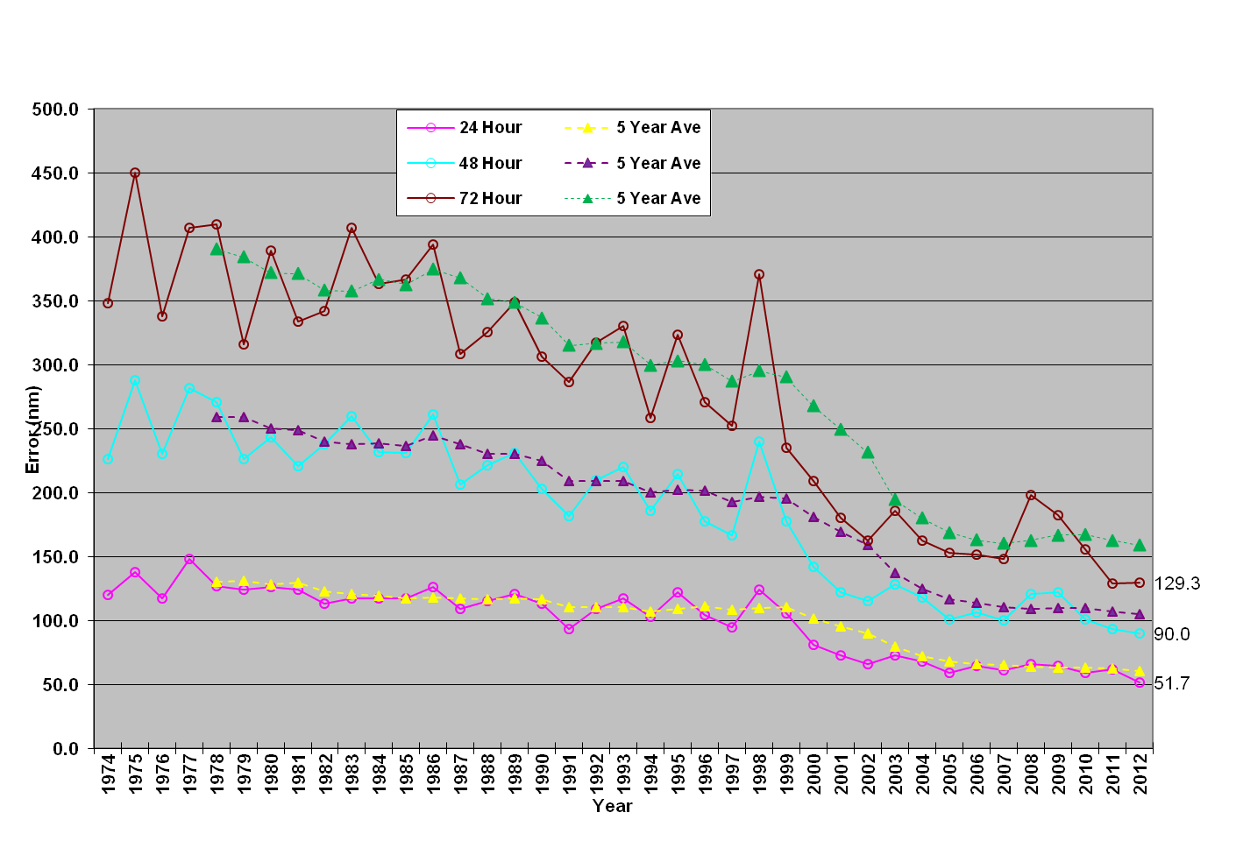
TC Track Forecasting
JTWC TRACK ERRORS
(Western North Pacific 24-72 Hours)
Downward trend of forecast track errors leveling off
Significant model improvements, particularly ECMWF and GFS
Area for most improvement: Mid-latitude interaction, curve/re-curve bifurcation, and Q-S systems
Multi-model consensus top aid -single-model ensemble consensus lags
Way Ahead
JTWC Action
Improvements in model resolution, physics, and data assimilation
Expanded use of ensembles, advanced statistical analysis of results
Quantification of forecast uncertainty via ensemble analysis
Improved analysis of synoptic environment (tools and methods)
Continued use of model consensus
Expanded usage of ensembles (single and multi-model); hardware/software upgrades to facilitate further efforts
Evaluating additional models (COTC, HWRF, TWRF, ARPEGE, ACES, UM)
Tools and training to improve forecaster recognition of meso and synoptic scale patterns

Slide 9
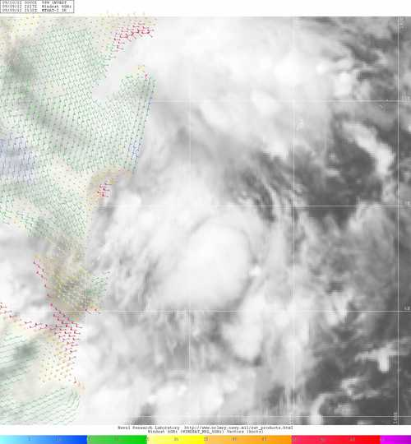
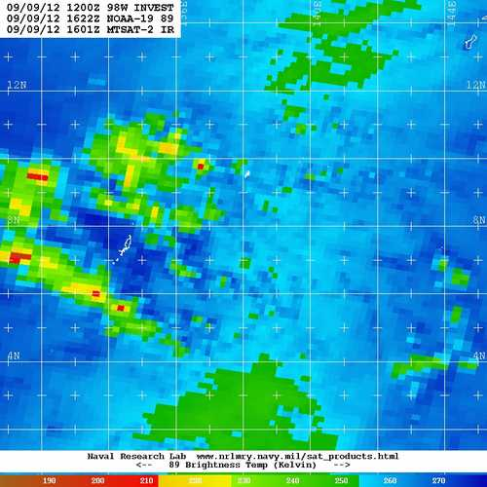
TC Genesis Forecasting
Lack of aerial recon in JTWC AOR adds to TC genesis forecast challenge
JTWC warning criteria for WPAC: 25 kts
Loss or degradation of remote observing will compound the problem
New techniques have shown promise for predicting TC genesis, even in the 15-30 day range
Way Ahead
JTWC Action
Interagency collaboration to sustain national remote sensing capability (microwave & OSVW), increase understanding and usage
Investigate alternate platforms (e.g., Global Hawk)
Collaborate with researchers to refine genesis forecast tools, transition to OPS
Acquire improved analysis tools
In-house Genesis Potential checklist
Maintaining db of develop/non-develop systems & genesis parameters
Evaluating & providing feedback on genesis research projects
Collaborating with NOAA et al. on Global Tropical Hazards Outlook
Scatterometry training from NESDIS
Notes:
Add citation in notes for genesis research

