Slide 1
Review of the 2012
Central Pacific Tropical Cyclone Season
and Verification
National Weather Service
Central Pacific Hurricane Center
Honolulu, Hawaii
Tom Evans
Deputy Director, CPHC
Interdepartmental Hurricane Conference
March 2013

Slide 2
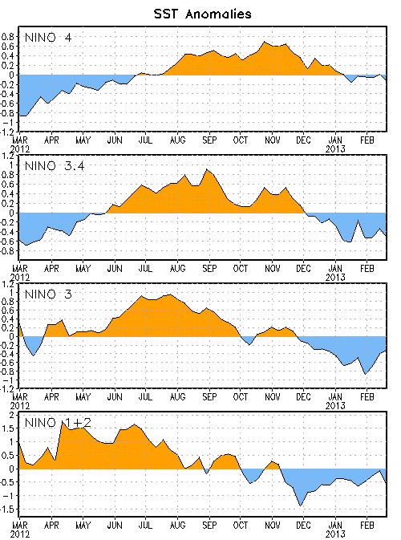
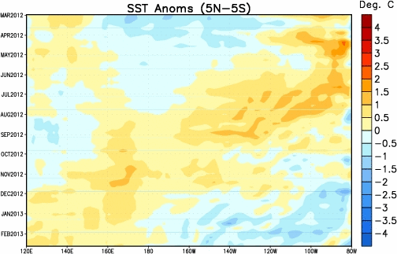
Neutral ENSO Conditions Kept Equatorial Pacific Slightly Warmer for the 2012 Tropical Cyclone Season

Slide 3
Colder than normal Temperatures Around the Islands

Slide 4
Hurricane Daniel July 4-12
Formed in Eastern Pacific on July 4
Crossed into Central Pacific on July 11
Max intensity 100 knots on July 8
Max intensity in Central Pacific 30 knots on July 11
Three tropical cyclone forecast packages issued by CPHC.

Slide 6
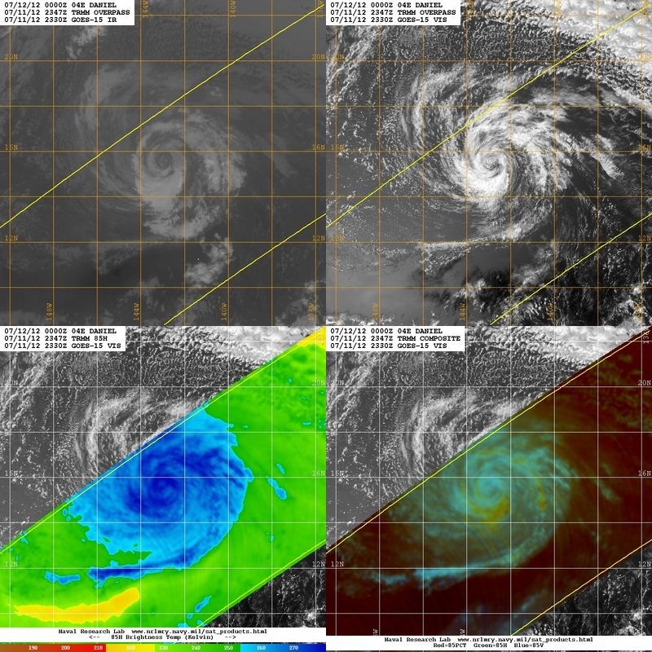
TC Daniel
July 11, 2012
2330Z/2347Z
GOES-15 &
TRMM
Notes:
DANIEL CONTINUES MOVING WESTWARD AT ABOUT 13 KT AND THIS GENERAL MOTION IS EXPECTED TO CONTINUE FOR THE NEXT COUPLE OF DAYS. THE SYSTEM REMAINS ALONG THE SOUTHERN PERIPHERY OF A HIGH PRESSURE SYSTEM SITUATED TO ITS NORTH. THE OFFICIAL FORECAST TRACK IS JUST AN UPDATE OF THE PREVIOUS ADVISORY TRACK AND LIES NEAR THE MIDDLE OF THE GUIDANCE ENVELOPE. DANIEL HAS BEEN VOID OF DEEP CONVECTION FOR SEVERAL HOURS...THUS IT HAS BEEN DOWNGRADED TO A TROPICAL DEPRESSION. THE INITIAL INTENSITY IS SET AT 30 KT AND THESE WINDS ARE LIKELY CONFINED TO A SMALL AREA IN THE NORTH SEMICIRCLE. ALTHOUGH SLIGHTLY WARMER WATERS LIE ALONG THE FORECAST TRACK...INCREASING VERTICAL WIND SHEAR IS EXPECTED TO COUNTERACT ANY POTENTIAL FOR INTENSIFICATION. DANIEL IS EXPECTED TO CONTINUE WEAKENING INTO A POST-TROPICAL/REMNANT LOW WITHIN THE NEXT 12 TO 24 HOURS. THE INTENSITY FORECAST CLOSELY FOLLOWS MOST INTENSITY GUIDANCE WITH SLOW DISSIPATION OVER THE NEXT FEW DAYS.

Slide 7
Central Pacific Tropical Cyclone Season
1970 to 2012: 177 Tropical Cyclones
37% Hurricanes
30% Tropical Storms
33% Tropical Depressions
Central Pacific Average per Year
4-5 Tropical Cyclones
Third Consecutive Season with Only One Tropical Cyclone

Slide 9
Central Pacific Tropical Cyclones 1970-2012

Slide 11
Aloha !

