Slide 1


Slide 2


Slide 3
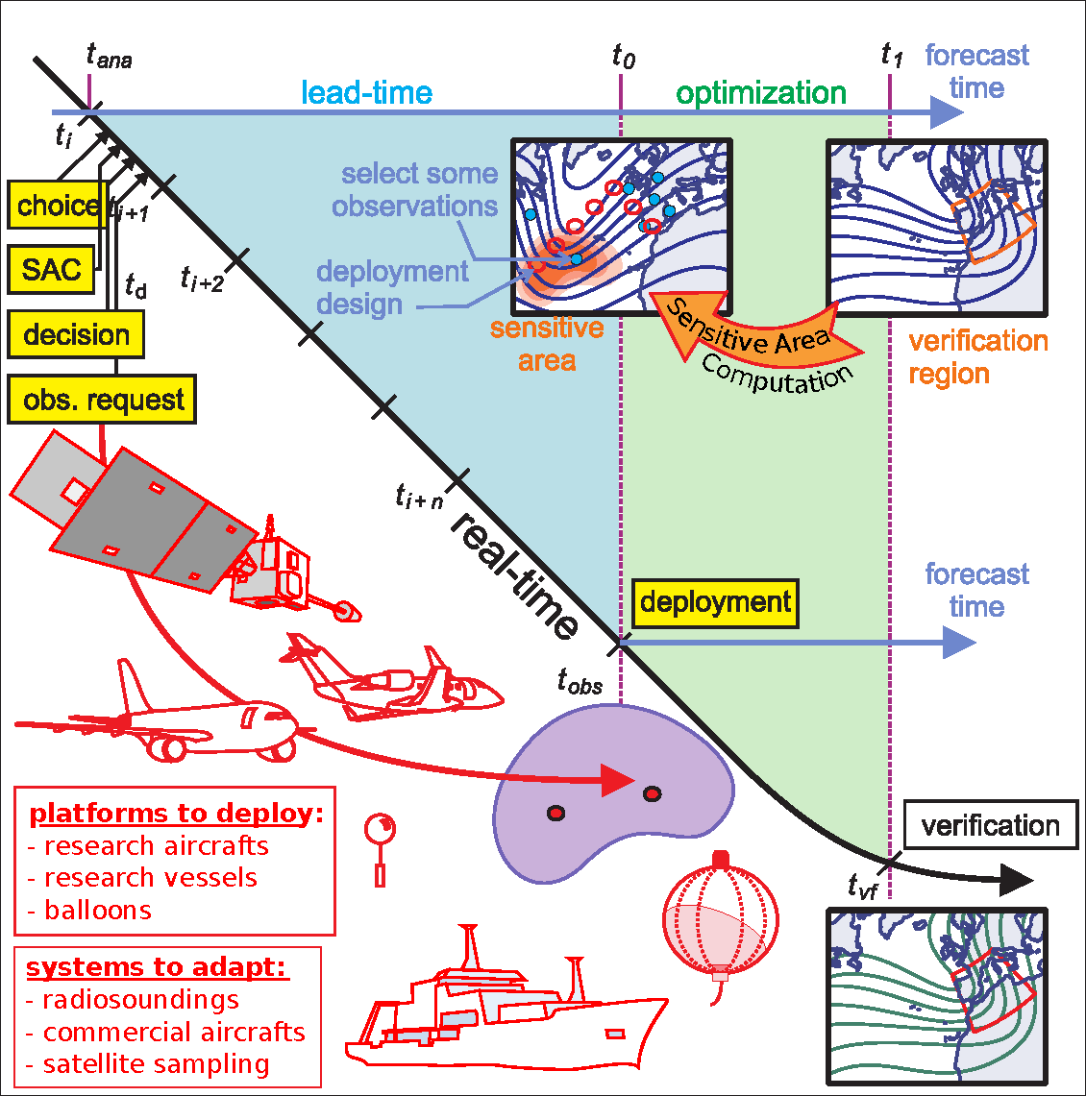
A. Doerenbecher
Notes:
FIGURE 1. Illustration of the typical procedure for the deployment of targeted observations.

Slide 4
Evaluations
TC Track: TCS-08/T-PARC 2008
  Dropwindsondes
  Satellite Atmospheric Motion Vectors (AMVs)
TC Track: NOAA Synoptic Surveillance
  Overview
  Hurricane Irene (2011) incl raobs
  Hurricane Sandy (2012) incl raobs
Winter Storm Reconnaissance
  2011 ECMWF data denial

Slide 5
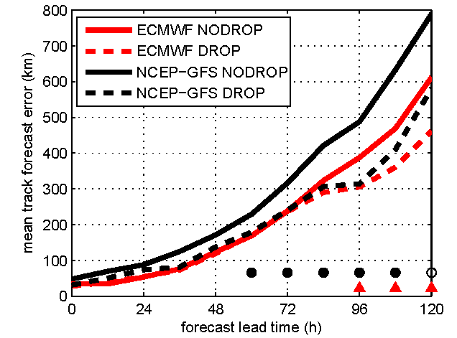
T-PARC Summer Phase (2008):
Overall impact of dropwindsondes on TC track
Weissmann et al. (2011)
Notes:
FIGURE 7. Tropical cyclone track forecast errors during the Summer T-PARC period for four assimilation-forecast systems. The solid (dashed) lines represent parallel analysis-forecast cycles excluding (including) T-PARC dropwindsonde data. Empty (filled) markers indicate times where the mean differences are significant at a 90% (95%) confidence level using a Student’s t-test.. Note that the sample size is different for the panels. (Adapted from Figs. 5 and 6 in Weissmann et al. 2011)

Slide 6
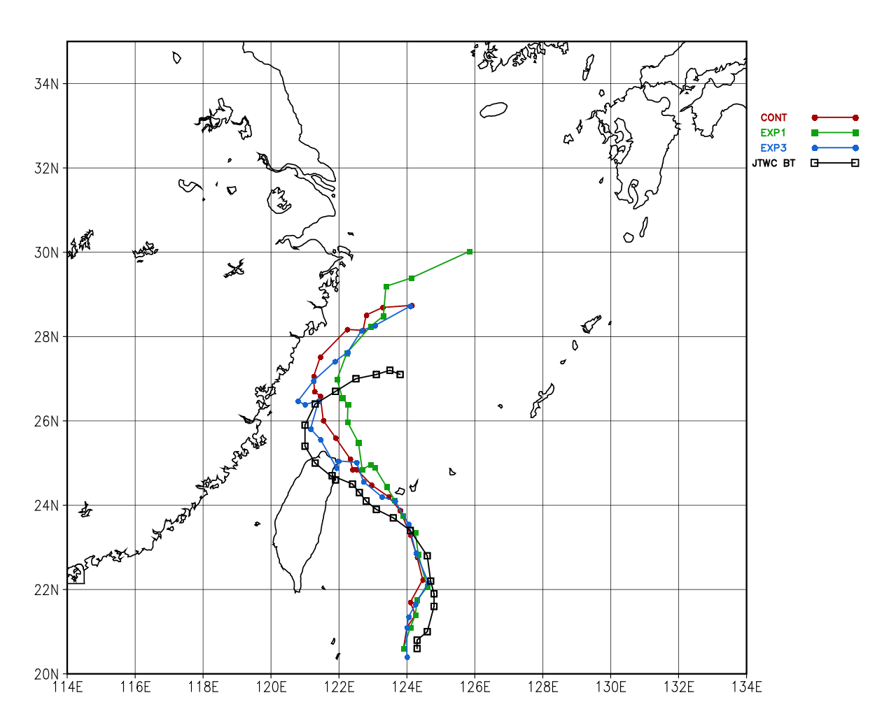

Typhoon Sinlaku (2008): Satellite AMVs
HOURLY AMVS INCLUDED
ALL AMVS REMOVED
RAPID-SCAN ADDED
Adapted by Rolf Langland from Berger et al. (2011)
Notes:
(c) (Adapted from Berger et al. 2011): Composite track forecasts of Typhoon Sinlaku for 3 NOGAPS experiments: CONT: All operational observations including hourly AMVs. EXP1: Same as CONT but excludes all AMVs processed by CIMSS. EXP3: Same as CONT but with rapid-scan winds added between 1200 UTC 10 September 2008 and 0600 UTC 13 September 2008. For each numerical experiment, an average position of all forecasts initialized at 12-hourly intervals beginning 1200 UTC 10 September 2008 is plotted. Each solid circle or square corresponds to the average of all analyses and forecasts from the particular experiment, valid at a particular time. Note that these points vary in the number of forecasts and the forecast lengths that are provided in the composite; the points early in Sinlaku’s life cycle only include short-range forecasts, whereas the points late in Sinlaku’s life cycle represent a composite of 0-5 day forecasts. (from Rolf Langland)

Slide 7
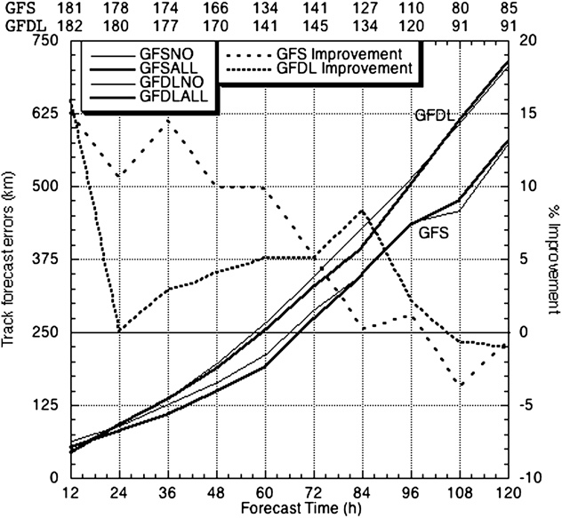
NOAA Synoptic Surveillance
10-15% improvement in 12-60 h NCEP GFS track forecasts between 1997-2006.
But, this is an old result!
Aberson (2010)

Slide 8
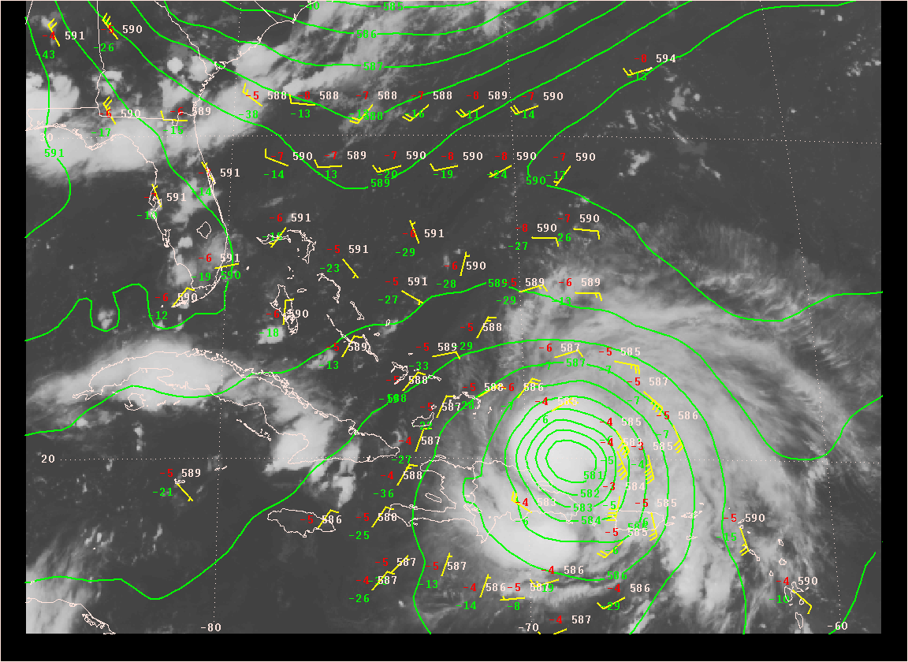
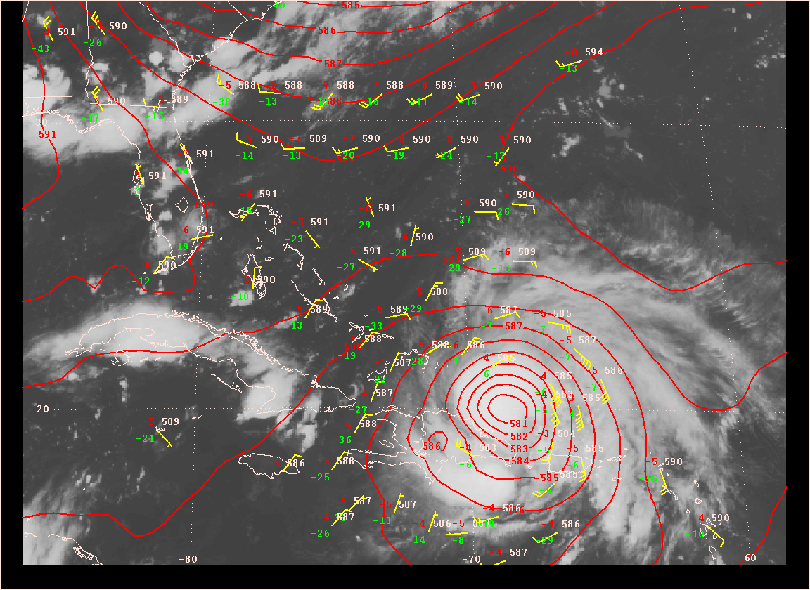
Hurricane Irene: 00Z 23 August 2011
First dropwindsonde missions centered around this time
500-mb height analysis
GFS Control
GFS No Drop
Mike Brennan, NHC

Slide 9
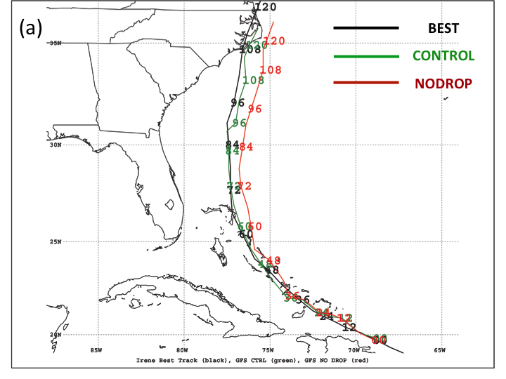
Statistically significant improvement from dropwindsonde and supplemental rawinsonde data for 42-60 h forecasts initialized at 0600 and 1800 UTC.
Magnitude of impact was small for Irene.
Majumdar et al. (2013)

Slide 10
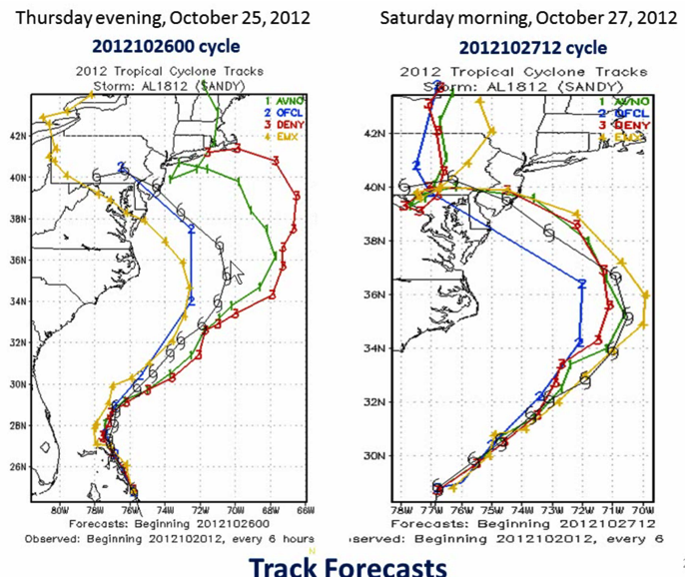
L. Uccellini, AMS Town Hall, 2013

Slide 11
2011 Winter Storm Reconnaissance: ECMWF data denial
22 high, 62 medium, 14 low-priority cases, and 776 dropwindsondes deployed.
Target verification times from +12 to +120 h.
Overall conclusion: No significant positive forecast impact from assimilation of 2011 WSR data in ECMWF system.
Hamill et al. (MWR 2013)

Slide 12
Satellite data usage at ECMWF: past, present and near future
Millions of observations assimilated per 24h period

Slide 13
Conclusions
Observations primarily targeted to attempt to improve short-range (1-3 day) forecasts.
  Tropical cyclones: track forecasts mostly beneficial statistically, recent systematic evaluations lacking.
  Extratropics: value of targeted data small but positive on average, needs further evaluation.
Recognize that forecast skill is improving due to improved resolution, observations, DA, physics. Hence, the average marginal impact of an individual observing system is decreasing.
Open question: what is the overall cost-effectiveness of targeted observations?

Slide 14
Recommendations
Explore utility for targeting existing observations (e.g. selected satellite data)
Improve understanding and quantification of the socio-economic value of observations.
More emphasis on science of targeting.
Explore for longer range forecasts (3-5 days).
Keep evaluating operational field programs in multiple NWP systems.

Slide 15
Targeting on the mesoscale?
Forecasts of TC structure, intensity etc
  Potential with rapidly adaptable observational resources, quick response time necessary.
  Need rapidly updated models and ensembles, more continuous, serial targeting than has been done on synoptic scales?
  Can models retain memory of the observations?

Slide 16
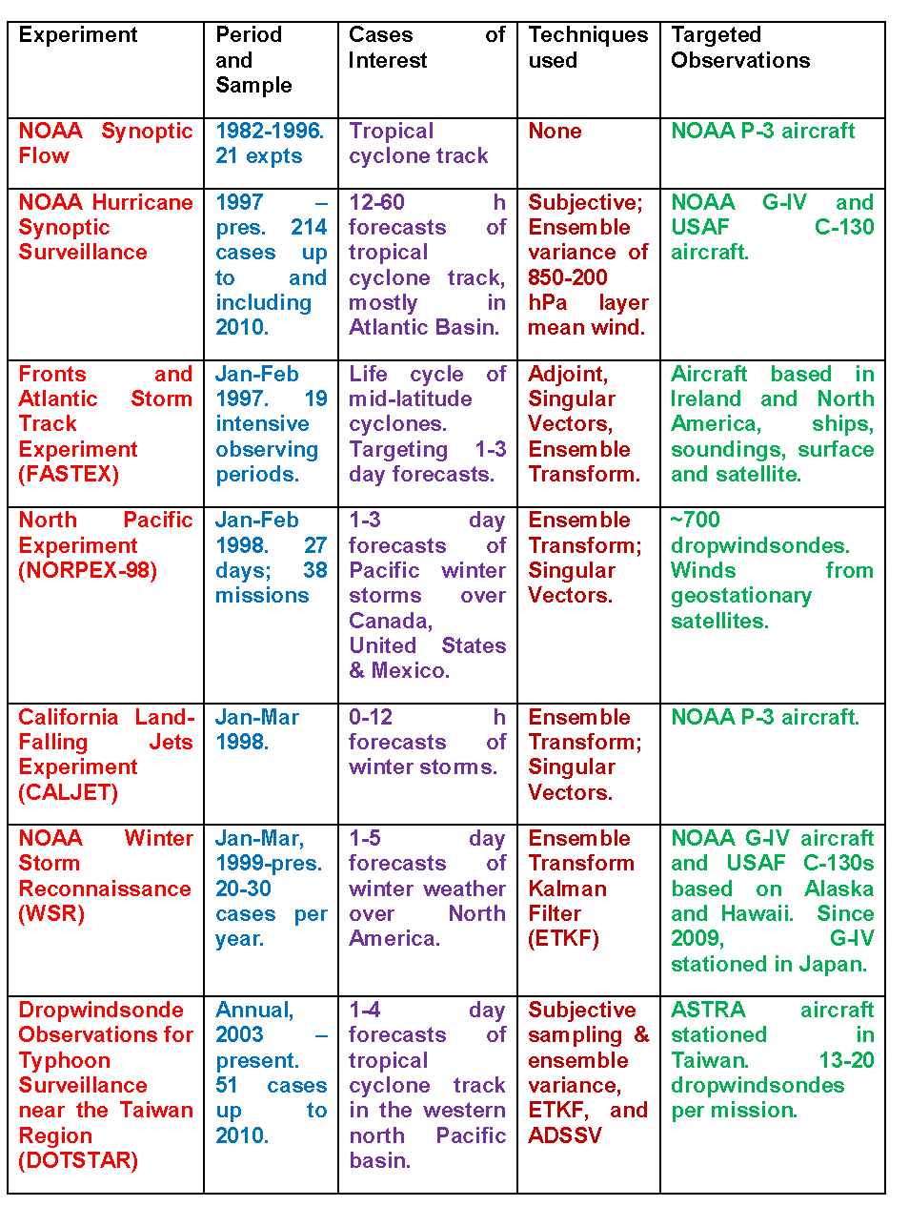
Pre-THORPEX and Independent Field Campaigns
Winter storms and tropical cyclones

Slide 17
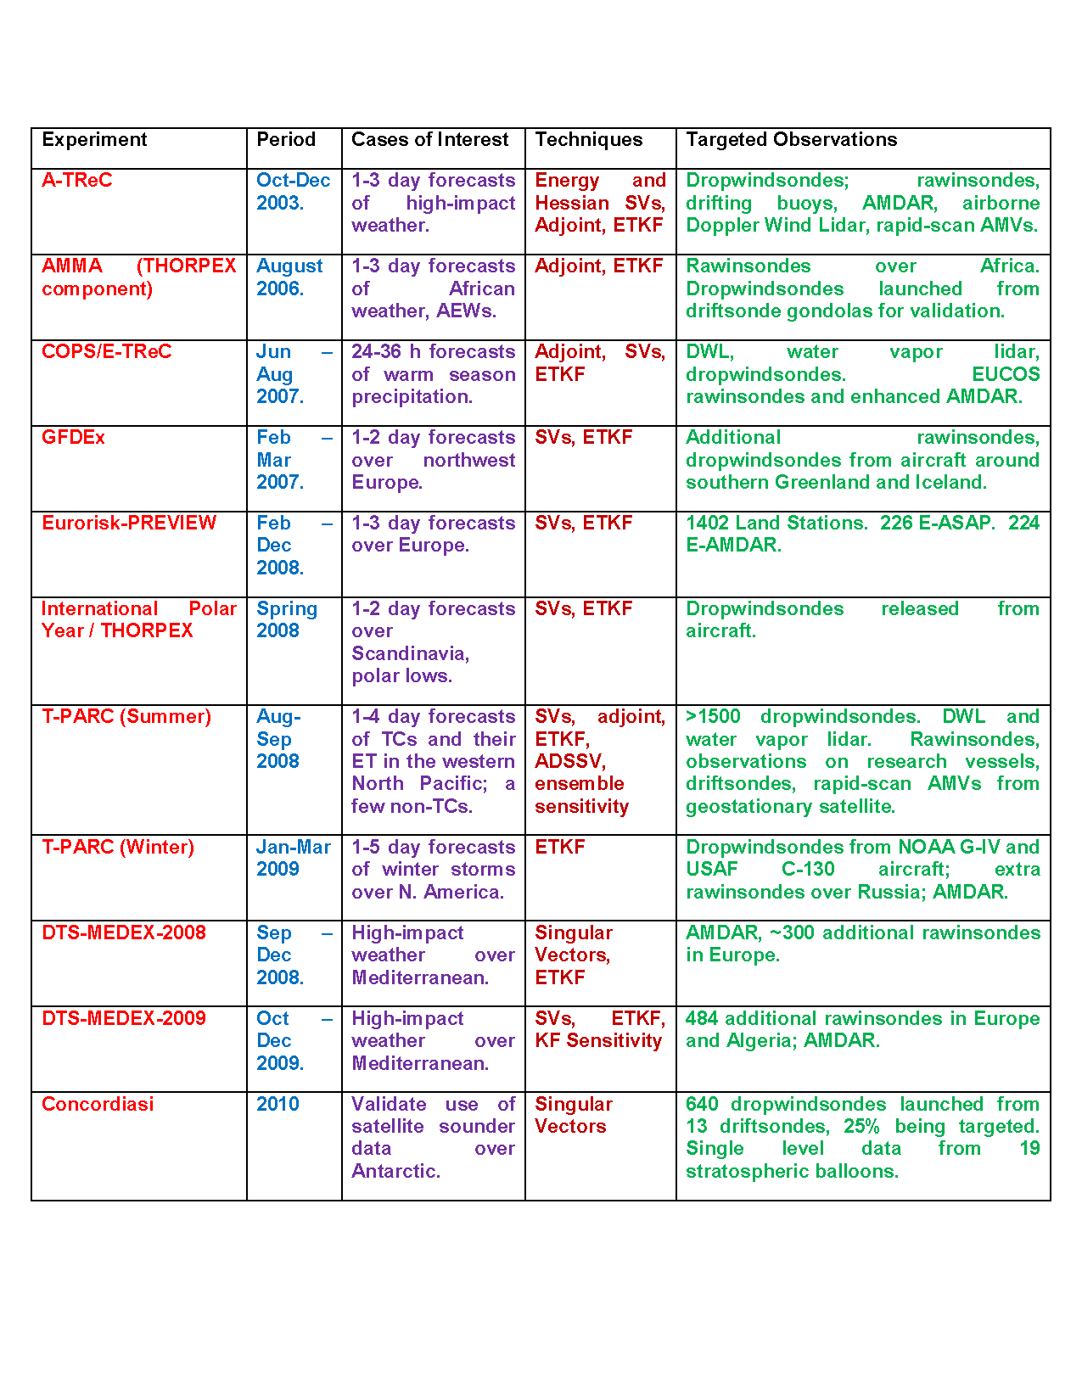
Field campaigns related to THORPEX (2003-)
Polar, mesoscale, rainfall, tropical weather …

Slide 18
Field campaigns related to THORPEX (2003-)
Polar, mesoscale, rainfall, tropical weather …

Slide 19
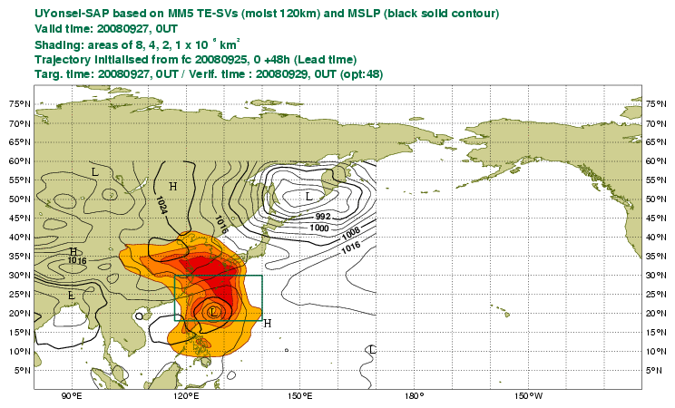
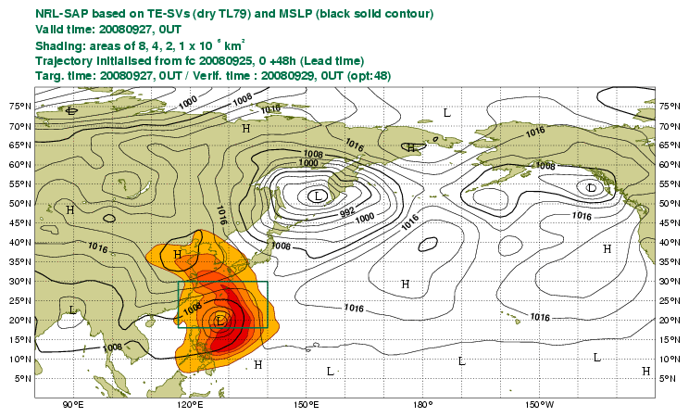
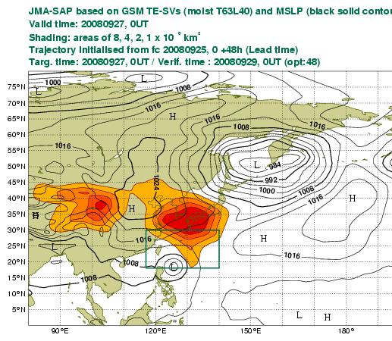
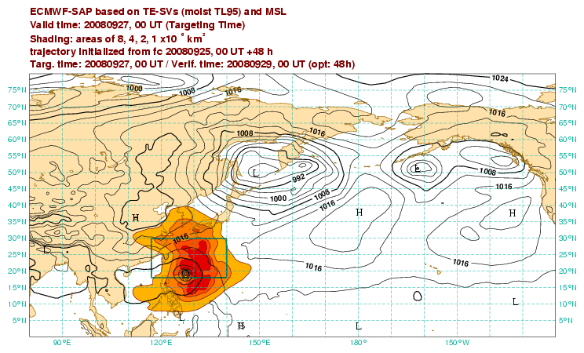
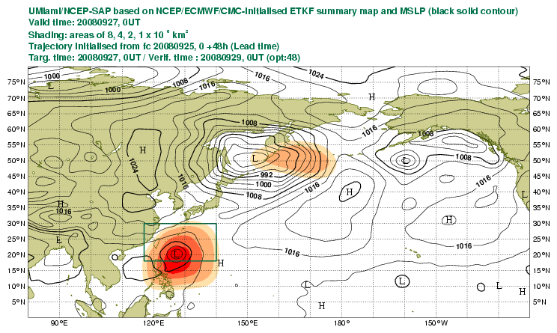
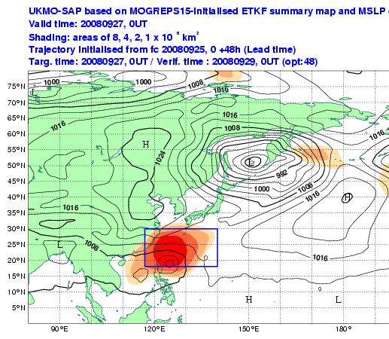
Targeted observing guidance
UYonsei MM5SV
NRL SV
JMA SV
ECMWF SV
UMiami-NCEP ETKF
UKMO ETKF
Notes:
FIGURE 2. Intercomparison of sensitivity guidance for a 2-day forecast of Typhoon Sinlaku during the summer phase of T-PARC, for a targeted analysis time of 0000 UTC 10 September 2008. Shading: maxima of guidance values. Contours: mean sea level pressure from the respective deterministic model. The rectangular box is the forecast verification region. All guidance was plotted on the PREVIEW Data Targeting System.

Slide 20
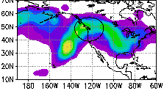
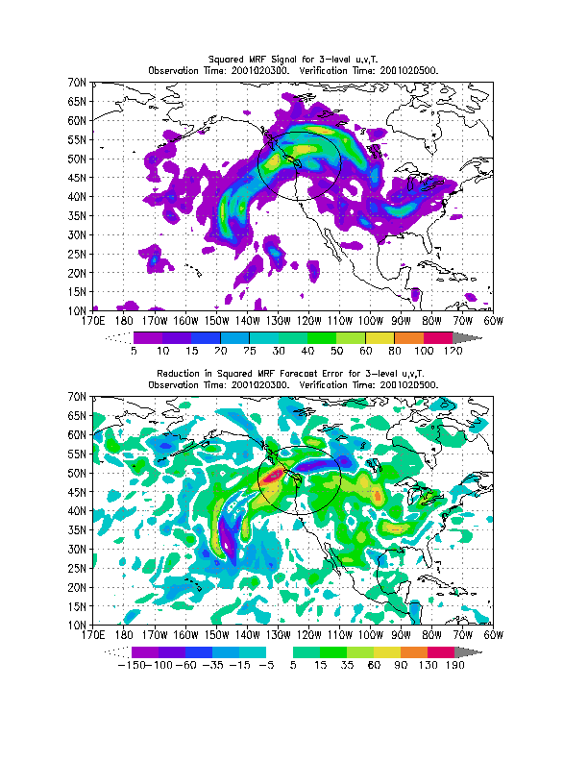
ETKF predicted signal variance
NCEP signal from targeted dropwindsondes
Forecast improvement
Majumdar et al. (2001)
Notes:
FIGURE 5. (a) ETKF prediction of 48-h forecast signal variance, assuming a WSR mission from Hawaii. A total energy norm comprising tropospheric horizontal winds and temperature (units m²/s²) is used, based on perturbations from a 50-member ECMWF ensemble initialized 36 h prior to the targeted observing time. The black circle in each panel indicates the verification regions of radius 1000 km. (b) Corresponding 48-h forecast ‘difference total energy’ signal in the NCEP GFS system, due to targeted dropwindsondes launched from the same flight. The signal is computed as the mean square difference between two NCEP GFS cycles, which respectively include and exclude the dropwindsonde data. (c) The reduction in error of the 48-h NCEP GFS forecast due to the assimilation of the dropwindsonde data. Errors are computed with respect to the verifying NCEP GFS analysis. Warm colors represent an improvement to the forecast; cold colors represent degradation. (From Sharanya Majumdar)

Slide 21
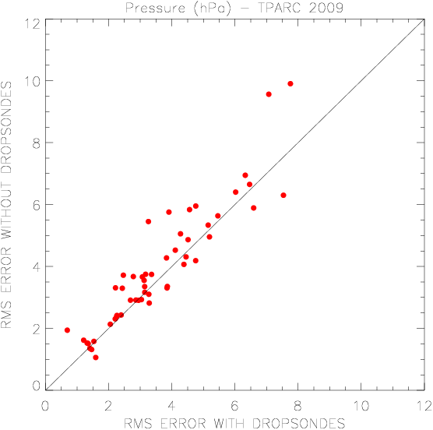
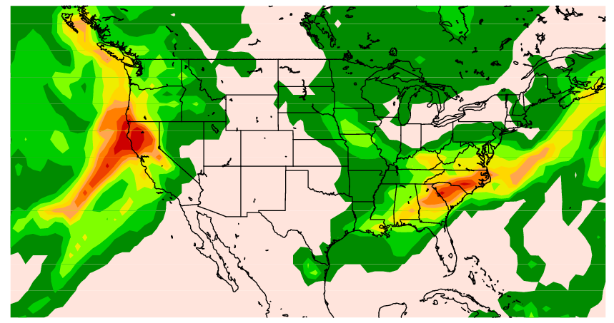
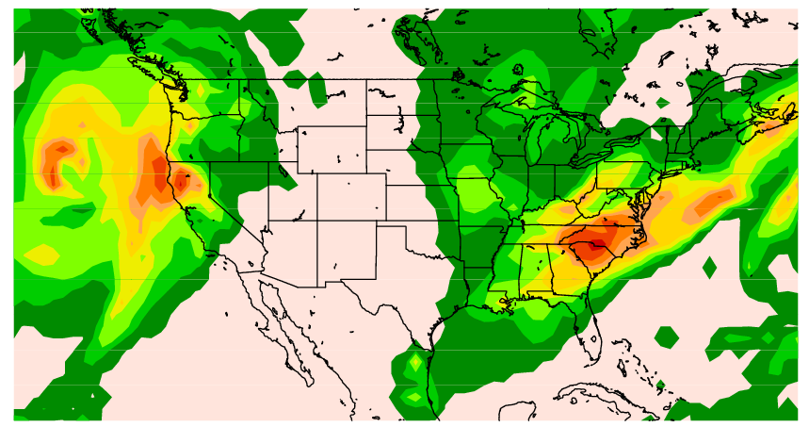
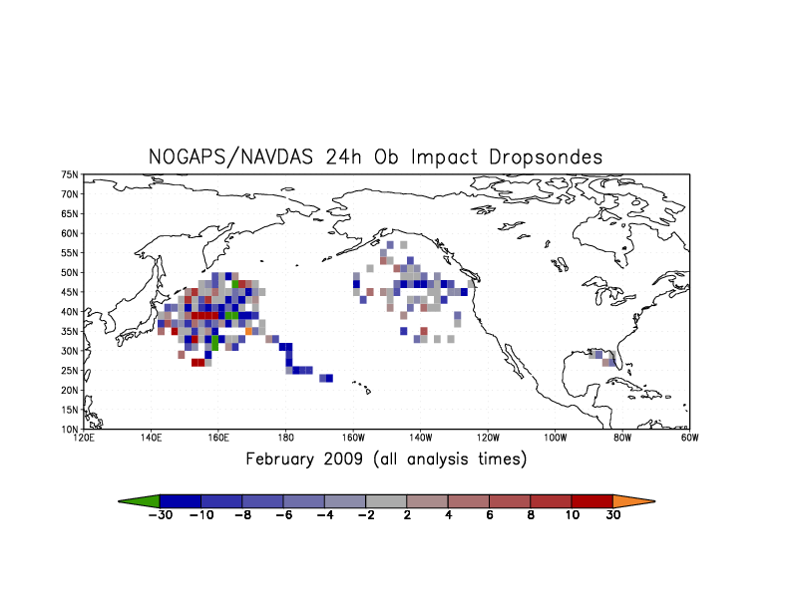
T-PARC Winter Phase (2009)
Surface Pressure
12
i. Observing Systems Experiments (OSEs)
RMS Error Without Dropwindsondes
0
12
RMS Error With Dropwindsondes
ii. Adjoint-based impact of dropwind-sondes
i. Yucheng Song;
ii. Rolf Langland
Error Reduction Error Increase
Notes:
FIGURE 4. (a) Composite of adjoint sensitivity of 24-h NOGAPS forecast error to initial conditions, between 1-28 February 2009. (b) Targeted dropwindsonde impact on 24-h forecast error in NOGAPS/NAVDAS for the same period. A norm of moist total energy error in the global domain is used, with units of 1x10⁻³ J kg⁻¹. A total of 355 dropwindsonde profiles were used. (From Rolf Langland)

Slide 22
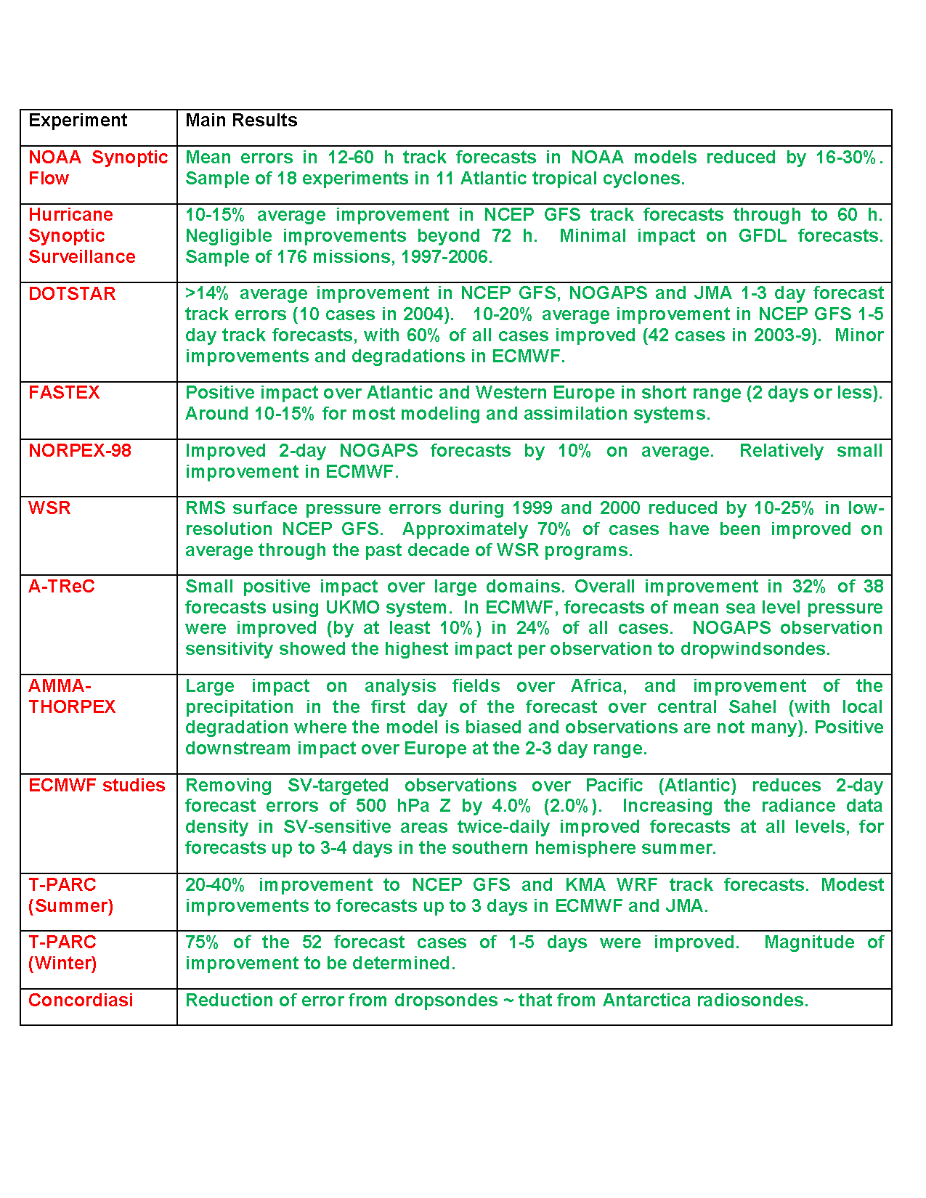
Main results: Pre-THORPEX / Independent campaigns

Slide 23
Main results: THORPEX studies and campaigns

Slide 24
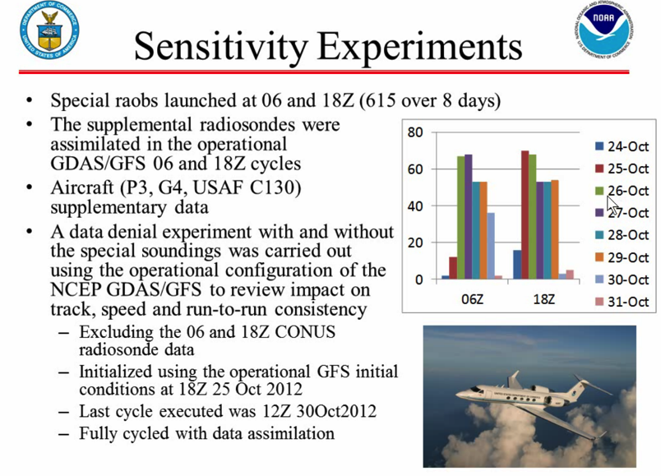
L. Uccellini, AMS Town Hall, 2013

Slide 25
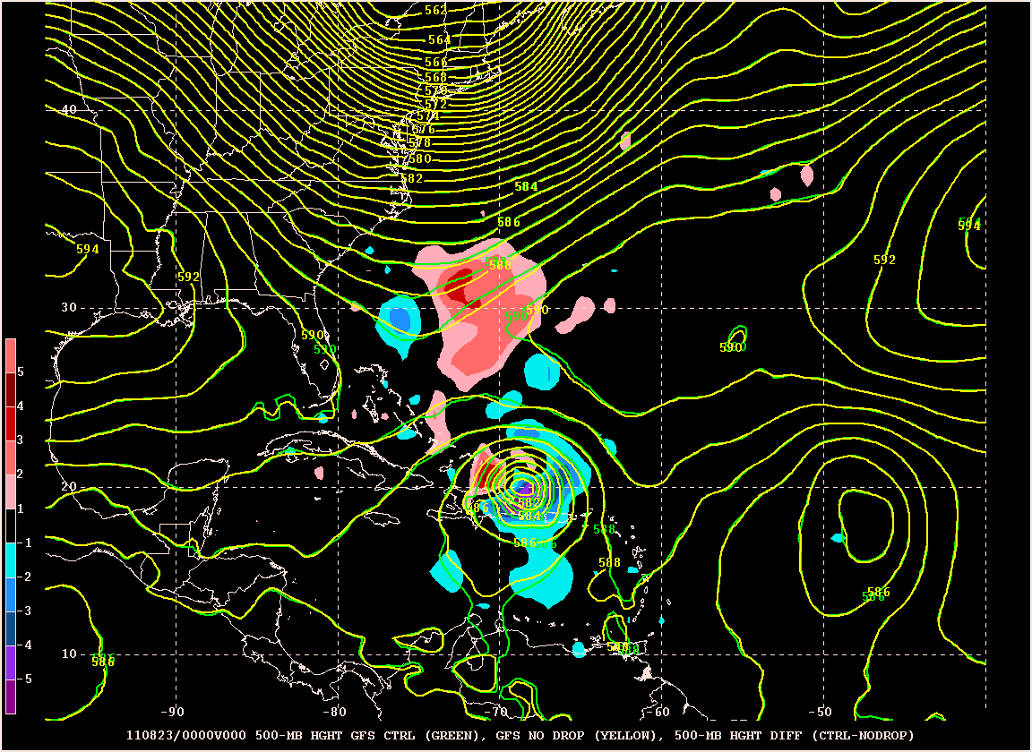
00Z 23 August – Analysis
500-hPa geopotential height and difference field (CTRL-NODROP)
Control No Drop

Slide 26
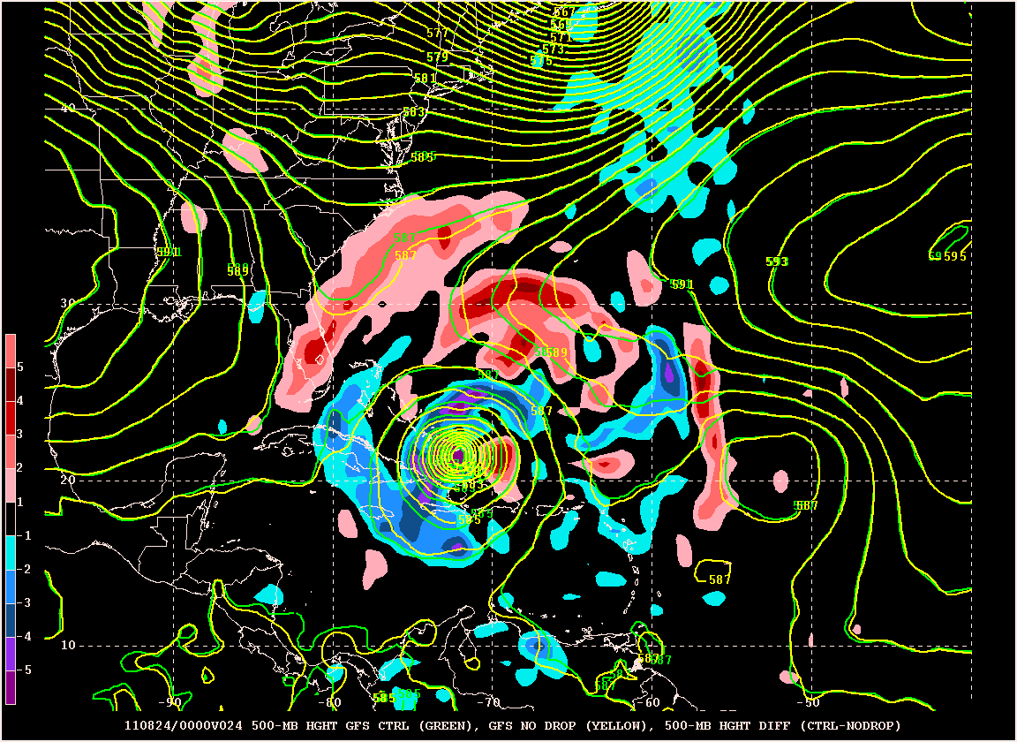
00Z 23 August – 24-h Forecast
500-hPa geopotential height and difference field (CTRL-NODROP)
Control No Drop
Trend toward higher heights north and northwest of Irene becomes more pronounced

Slide 27
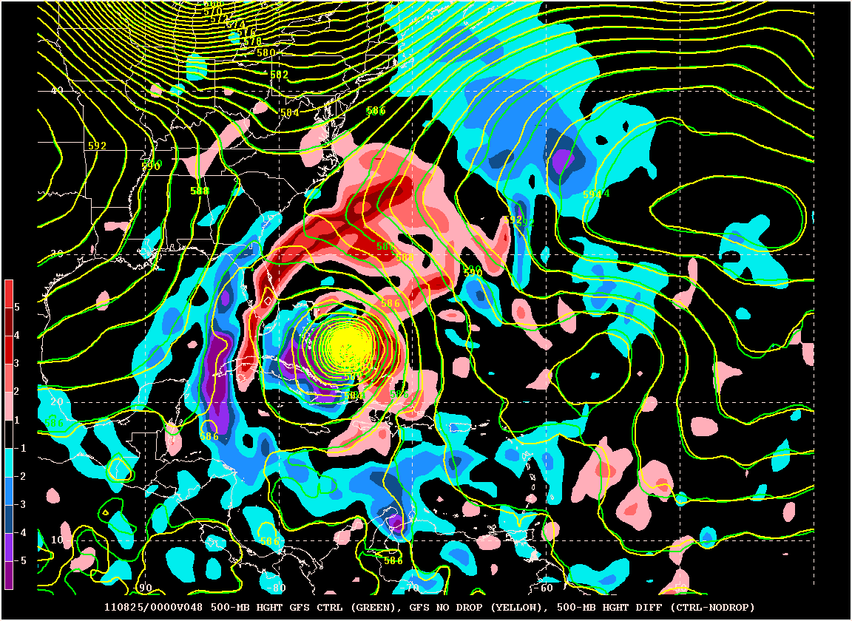
00Z 23 August – 48-h Forecast
500-hPa geopotential height and difference field (CTRL-NODROP)
Control No Drop

Slide 28
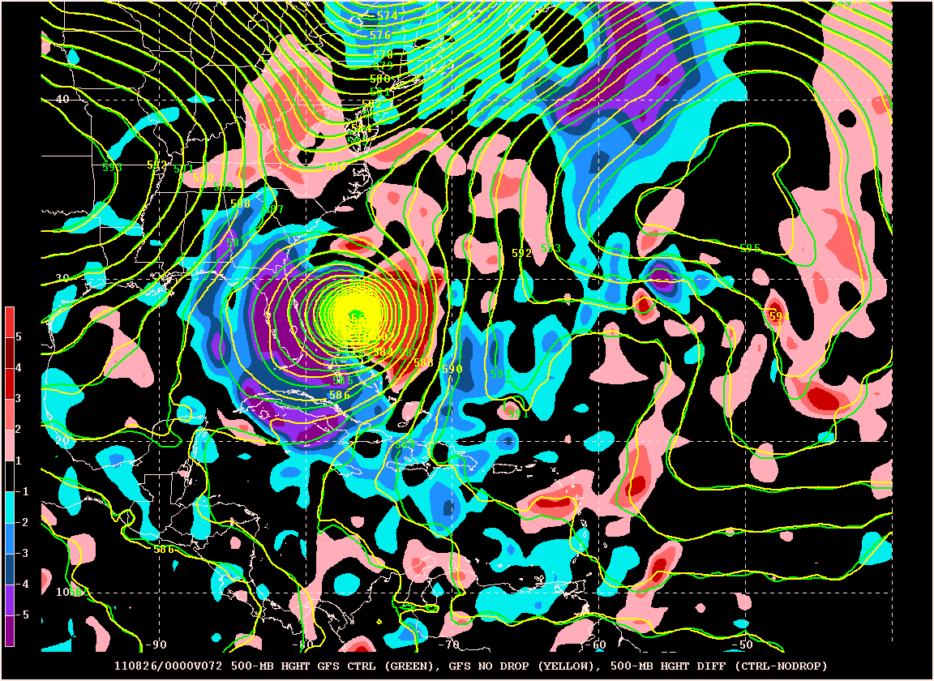
00Z 23 August – 72-h Forecast
500-hPa geopotential height and difference field (CTRL-NODROP)
Control No Drop
Differences begin to decrease

Slide 29
Improvement
*
For 00Z and 12Z cycles, small positive impact of drops early in the forecast cycle remains, but larger degradations are seen at later times
Not much impact from raobs
Improvement due to drops at 48 h statistically significant at the 95% level
Degradations not statistically significant
Degradation

Slide 30
Improvement
*
*
*
*
*
*
*
*
*
*
For 06Z and 18Z cycles, impact of all data consistently positive at all lead times
* → statistically significant at the 95% level
Degradation

