Slide 1

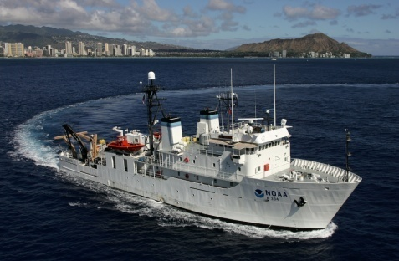
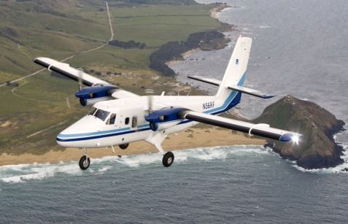
Town Hall
67th INTERAGENCY HURRICANE COFERENCE
6 MARCH 2013
Jim McFadden, Jack Parrish, Ian Sears and CDR Devin Brakob
NOAA Aircraft Operations Center
Paul Chang and Zorana Jelenak
NOAA /NESDSI

Slide 2
Agenda
2012 Season Hurricane Summary – by the numbers.
What did we accomplish during the 2012 season?
Key Instrumentation Plans for 2013 and beyond.
P-3 Service Life Extension Program and Schedule

Slide 3
2012 Hurricane Summary
P-3 181.7 hours 28 flights
G-IV 90.3 hours 12 flights
Total 282.0 hrs. 40 flights
3
Notes:
3

Slide 4
2011 Hurricane Summary
P-3 198.3 hours 31 flights
G-IV 144.2 hours 18 flights
Total 342.5 hrs. 49 flights
4
Notes:
4

Slide 5
Hurricane Hours Flown
FY 2008-2012

Slide 6
2012 Hurricane Summary
What did we do in 2012?
G-IV TDR accepted by NOAA
13 Missions (6 G-IV; 7 P-3) flown for TS/Hurricane Isaac
10 Missions (3 G-IV; 7 P-3) flown for Hurricane Sandy
All back-to-back missions for Isaac and Sandy completed with one P-3.
G-IV TDR test flights completed into Hurricanes Leslie and Sandy
RVP-8 portion of P-3 radar upgrade completed on N42RF
Gulf OHC Survey Missions -1st real-time data xmission to NCO.
Ocean Winds Satellite Cal/Val in Hurricanes Leslie and Sandy
6
Notes:
6

Slide 7
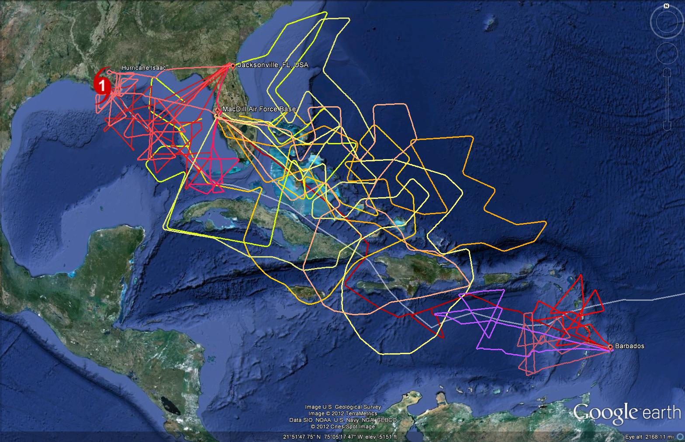
TS/Hurricane Isaac P3 and G-IV coverage (Aug. 22-27, 2012)
49RF G-IV
Seven TDR flights with one break
~12 hr sampling cycle
Operated out of Barbados, MacDill AFB and Jacksonville, FL
2nd crew ComAir to Barbados and POV to Jacksonville
Six G-IV missions.
42RF P-3
42RF P-3

Slide 8
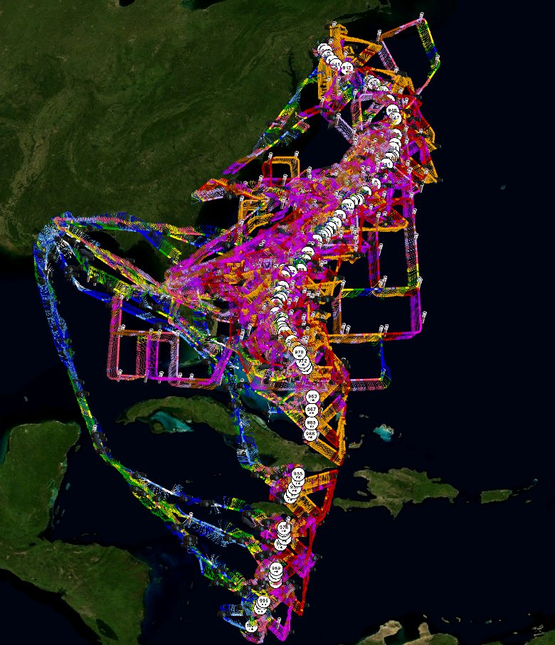
Hurr. SandyP-3, G-IV and AF C-130 coverage
Seven P-3 TDR flights with one aircraft, two crews and no breaks
Three G-IV missions.
~12 hr sampling cycle
All P-3 and G-IV flights from KMCF
Courtesy Tropical Atlantic website
(tropicalatlantic.com)

Slide 9
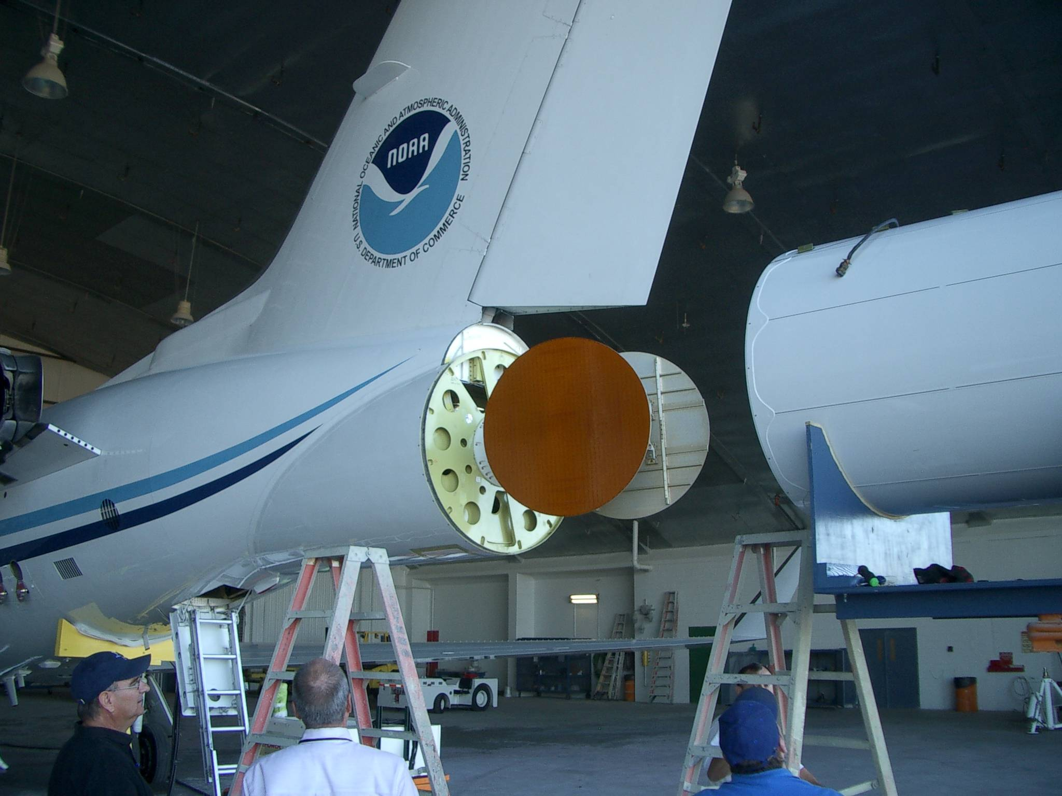

Slide 10
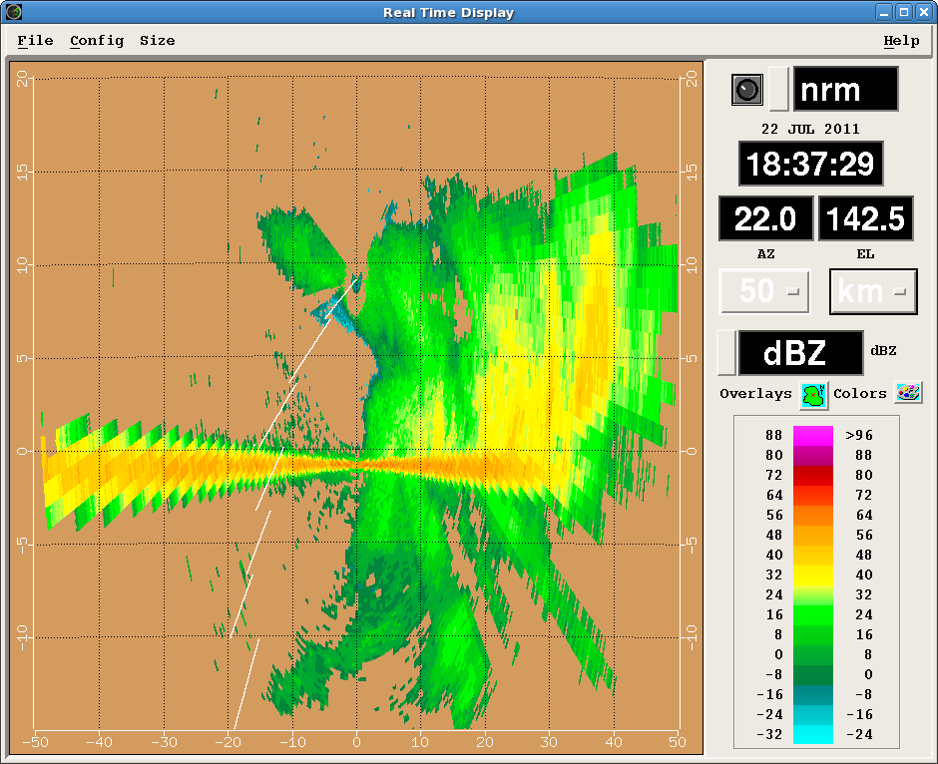
Notes:
Least costly option.
High risk for missing hurricane season tasking..
2015 and 2019 season not covered.
42 chosen based on SLAP findings, costs, and schedule.
Assumes 300 hours per year on active aircraft.

Slide 11
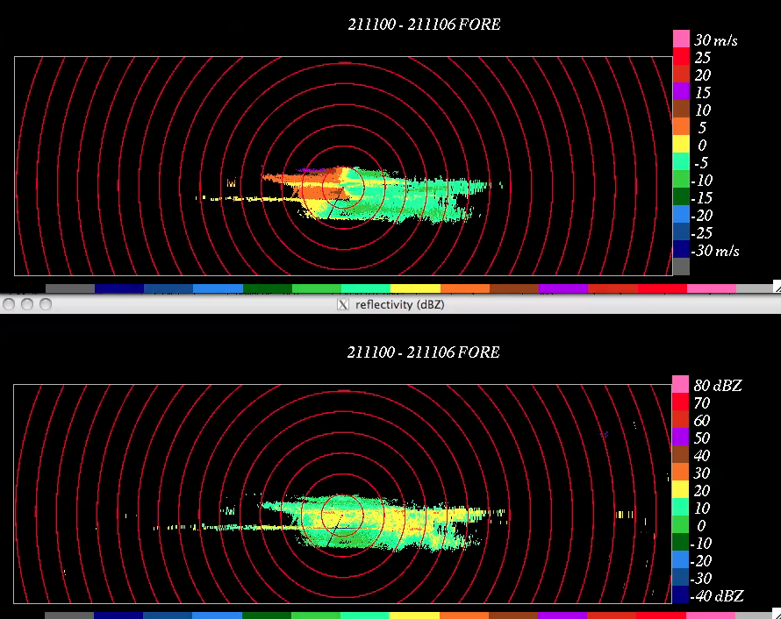

Slide 12
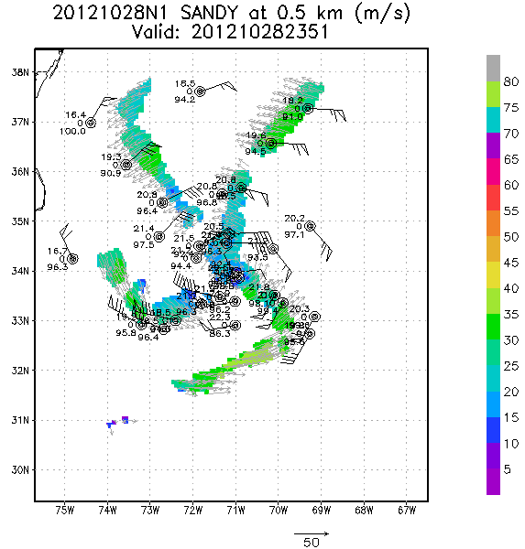
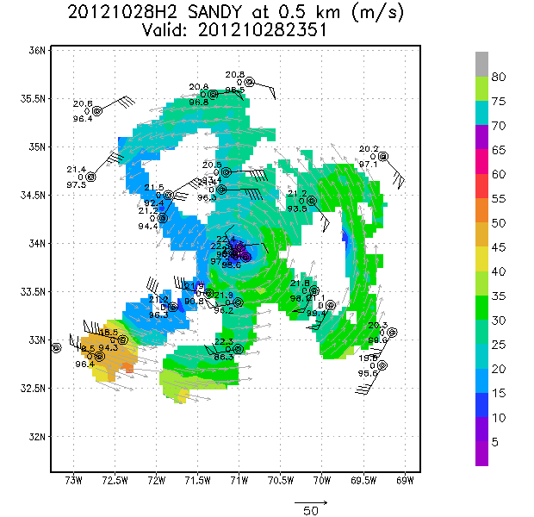
HURRICANE SANDY
G-IV AND P-3 TDR DERIVED WIND FIELD (from HRD)
G-IV
P-3
Notes:
Least costly option.
High risk for missing hurricane season tasking..
2015 and 2019 season not covered.
42 chosen based on SLAP findings, costs, and schedule.
Assumes 300 hours per year on active aircraft.

Slide 13
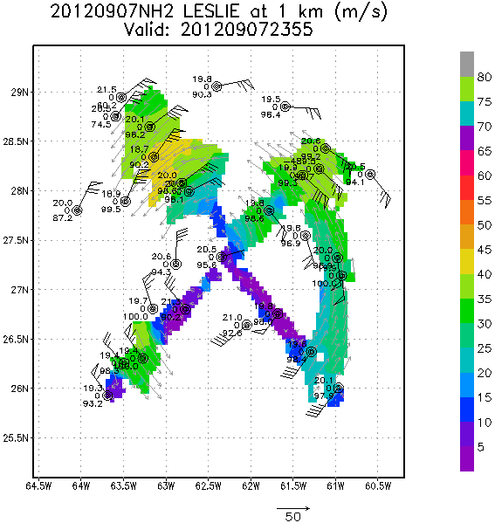
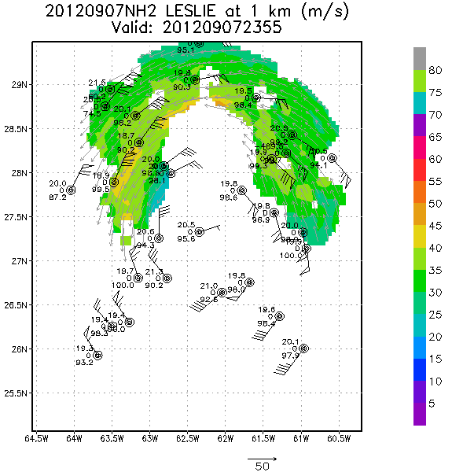
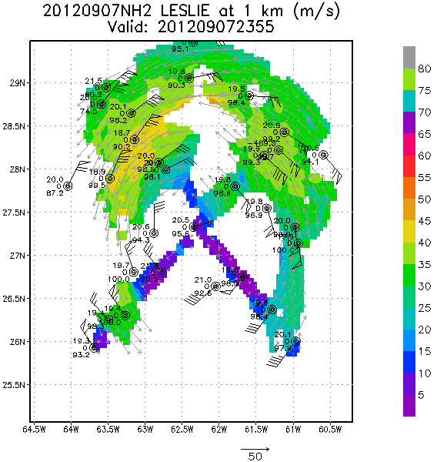
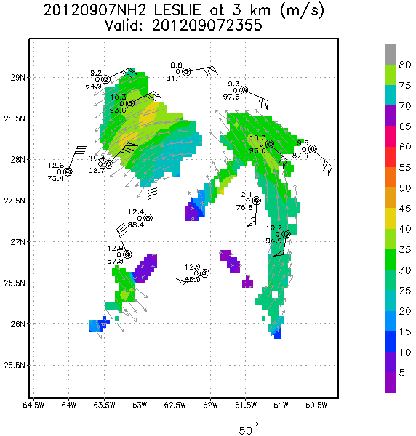
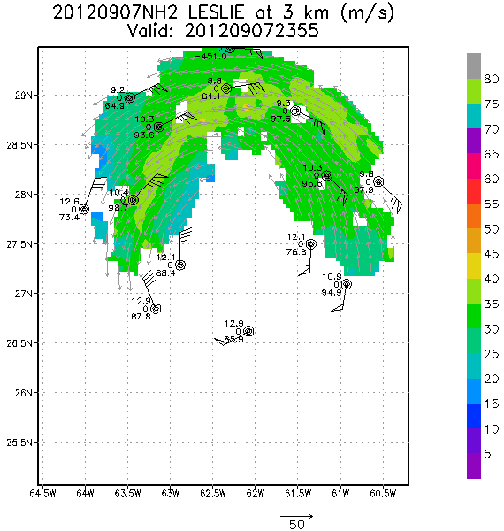
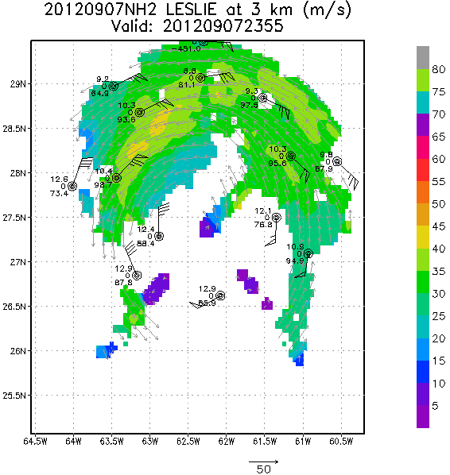
HURRICANE LESLIE
G-IV AND P-3 TDR DERIVED WIND FIELD (from HRD)
P-3
G-IV
G-IV and P-3
1-km
3-km
Notes:
Least costly option.
High risk for missing hurricane season tasking..
2015 and 2019 season not covered.
42 chosen based on SLAP findings, costs, and schedule.
Assumes 300 hours per year on active aircraft.

Slide 14
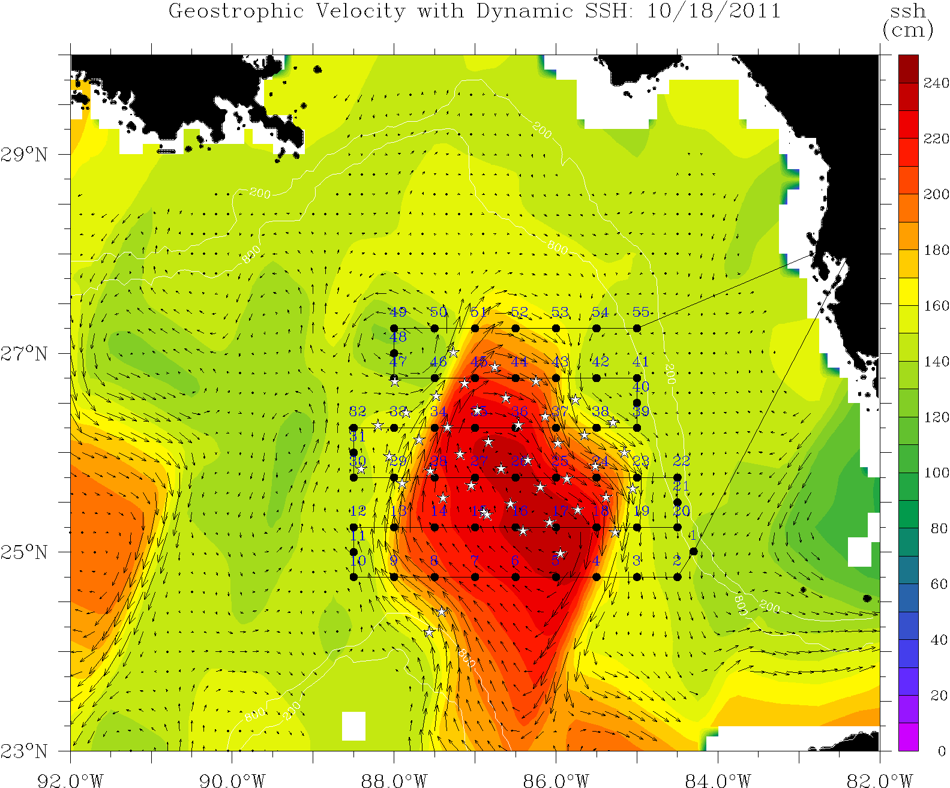
Notes:
Least costly option.
High risk for missing hurricane season tasking..
2015 and 2019 season not covered.
42 chosen based on SLAP findings, costs, and schedule.
Assumes 300 hours per year on active aircraft.

Slide 15
HURRICANE ISAAC 2012
Post-storm Ocean Heat Content Mission – AXBT, AXCP and AXCTD
Notes:
Least costly option.
High risk for missing hurricane season tasking..
2015 and 2019 season not covered.
42 chosen based on SLAP findings, costs, and schedule.
Assumes 300 hours per year on active aircraft.

Slide 16
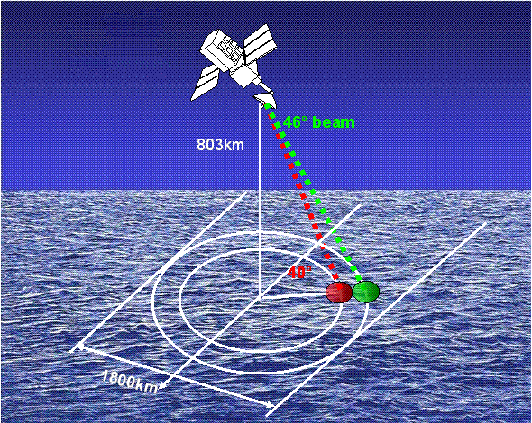
Scanning Scatterometer Measurement Geometry
16
Notes:
16
The conical scanner onboard the QuikSCAT satellite provides a distinctive alternate method (compared to either the ERS or the NSCAT scatterometer) to receiving a multi-view observation of the backscattered microwave energy. In addition, the SeaWinds instrument takes advantage of the slightly different incident (look) angles (46 and 52 deg for the h- and v- pol emitters, respectively) and emittance properties of the two polarizations in order to obtain two distinct measurements for most azimuthal position. (Note: only one solution exists along the swath edge where the h- cone does not see out as far as the v-cone.) The required differences in viewing angle in order to solve the wind retrieval solution is then obtained by catching the same footprint on the ocean surface while in front of the satellite, then again, while behind the satellite. The best geometries are when the same area is caught at 90 deg differences (off to the side of the subtrack) while the worse geometry occurs along the subtrack because 0 deg (in front) and 180 deg (in back) differences do not provide a unique difference in viewing angle. As previously discussed, since the microwave emission off the ocean varies with the orientation of the Bragg waves , a series of possible speed/wave angle solutions are possible for each geometry.

Slide 17
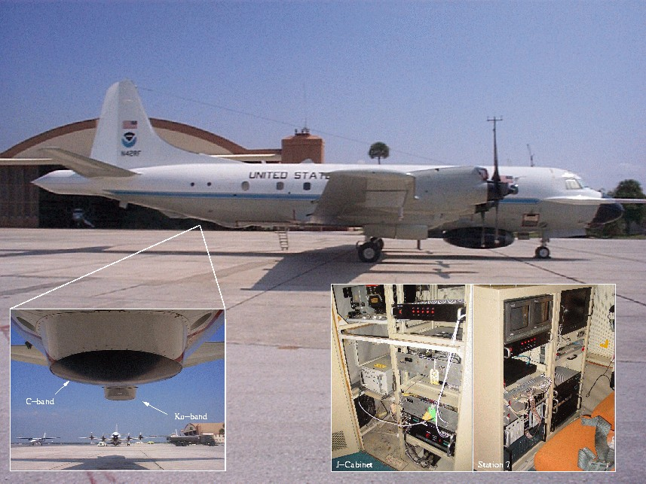
Imaging Wind and Rain Airborne Profiler – IWRAP
(designed and operated by University of Massachusetts)
Reflectivity and Doppler profiles – four beams, two frequencies (C and Ku), two polarizations (H and V) – simultaneously.
High-resolution surface and volume backscatter.
High resolution ocean surface vector winds (OSVW)

Slide 18
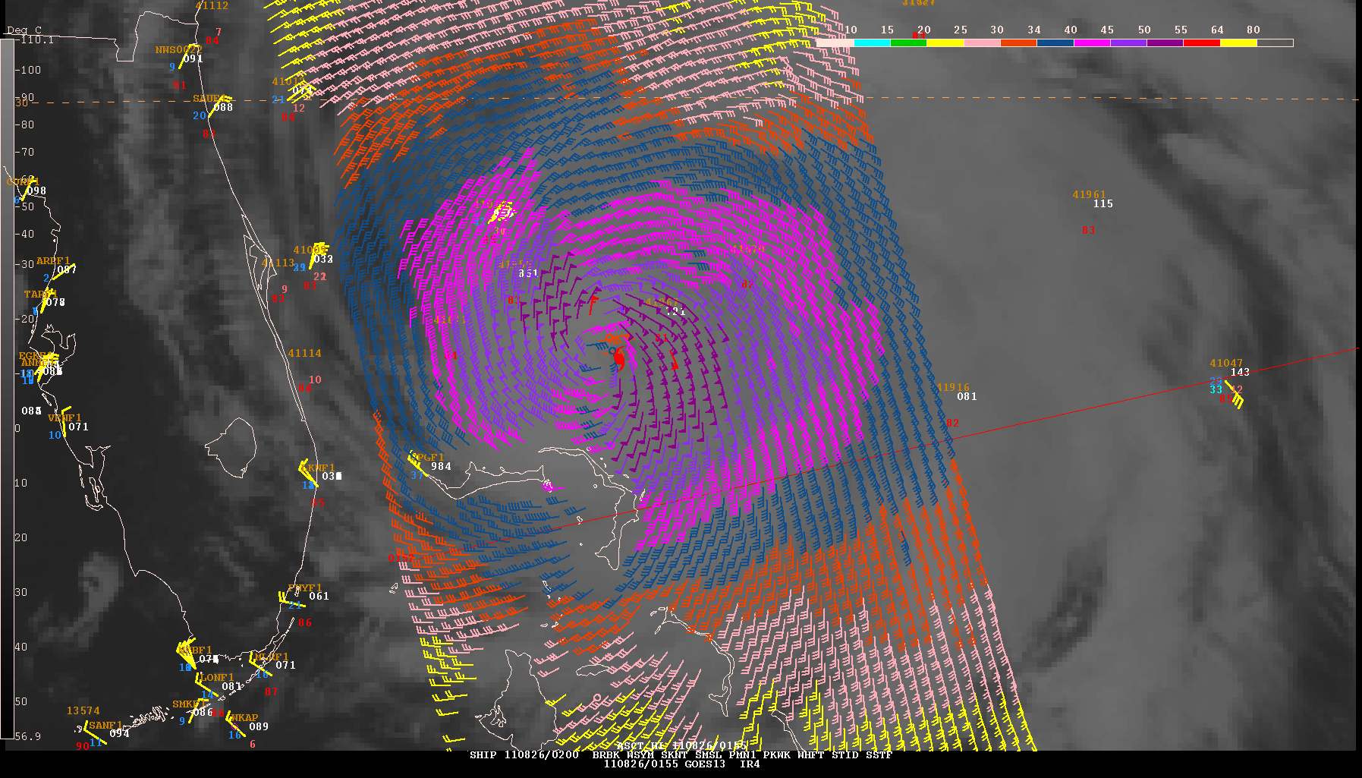
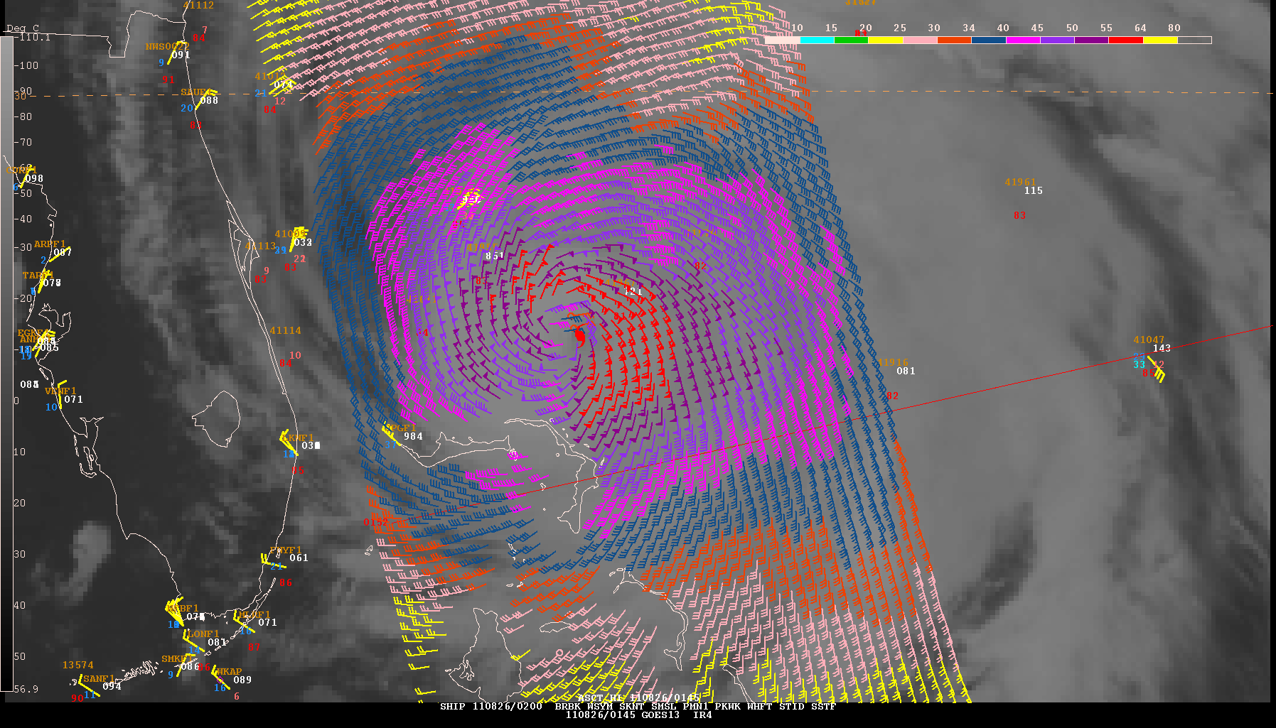
New ASCAT GMF Impact in TC Wind Field Analysis
Hurricane Irene
0152 UTC 26 August 2011
Analyzed wind radii from all sources
(including aircraft)
50 KT.......110NE 100SE 50SW 75NW.
34 KT.......250NE 200SE 125SW 160NW
ASCAT wind radii (new GMF)
50 KT.......90NE 105SE 60SW 70NW.
34 KT.......170NE 205SE 135SW 175NW.
New GMF
Old GMF
New ASCAT GMF has compared favorably to 34 and 50 kt wind radii estimates from aircraft data in some cases

Slide 19
FY13 and Beyond Priorities and Plans
1. G-IV Tail Doppler Radar – observational
strategies
Notes:
19

Slide 20
FY13 and Beyond Priorities and Plans
1. G-IV Tail Doppler Radar – observational
strategies
2. P-3 Radar Upgrade – new antenna/waveguide
Notes:
20

Slide 21
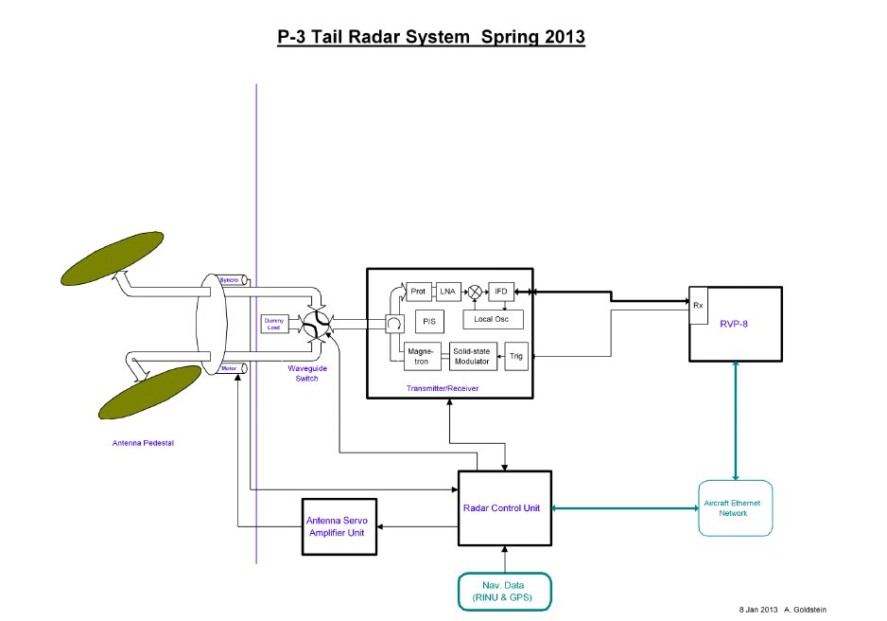

Slide 22
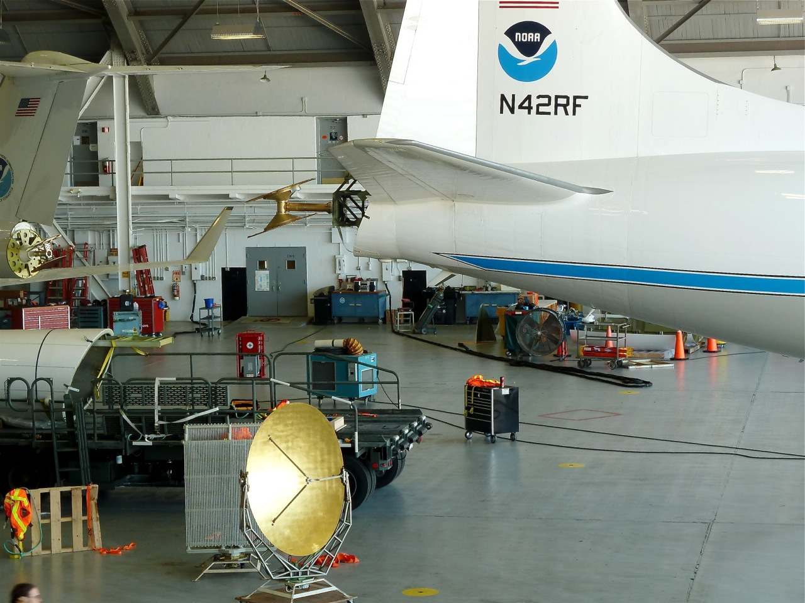
Notes:
Least costly option.
High risk for missing hurricane season tasking..
2015 and 2019 season not covered.
42 chosen based on SLAP findings, costs, and schedule.
Assumes 300 hours per year on active aircraft.

Slide 23
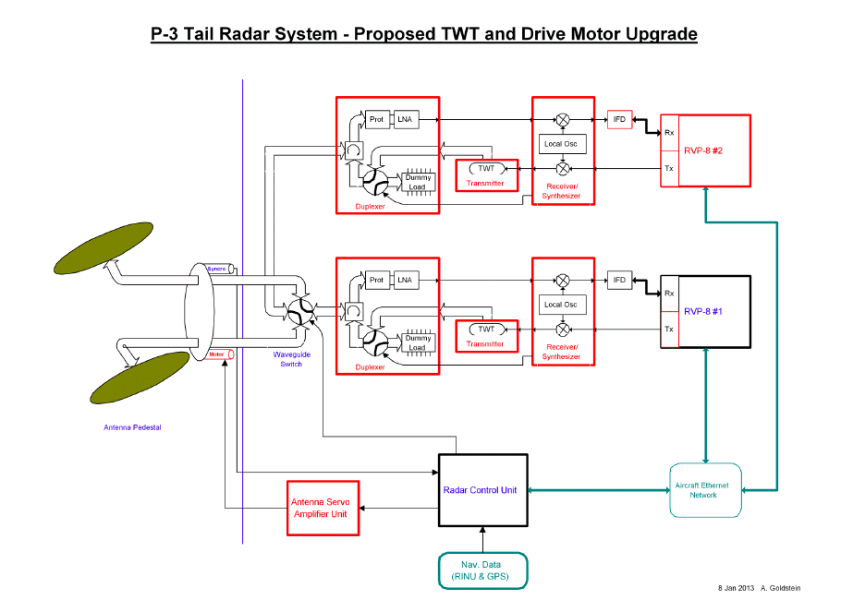
Notes:
Least costly option.
High risk for missing hurricane season tasking..
2015 and 2019 season not covered.
42 chosen based on SLAP findings, costs, and schedule.
Assumes 300 hours per year on active aircraft.

Slide 24
FY13 and Beyond Priorities and Plans
1. G-IV Tail Doppler Radar – observational
strategies
2. P-3 Radar Upgrade – new antenna/waveguide
Upgrade of ICS System
Installation of Digital HF Radio
Notes:
24

Slide 25
FY13 and Beyond Priorities and Plans
1. G-IV Tail Doppler Radar – observational
strategies
2. P-3 Radar Upgrade – new antenna/waveguide
Upgrade of ICS System
Installation of Digital HF Radio
P-3 Service Life Extension
Notes:
25

Slide 26
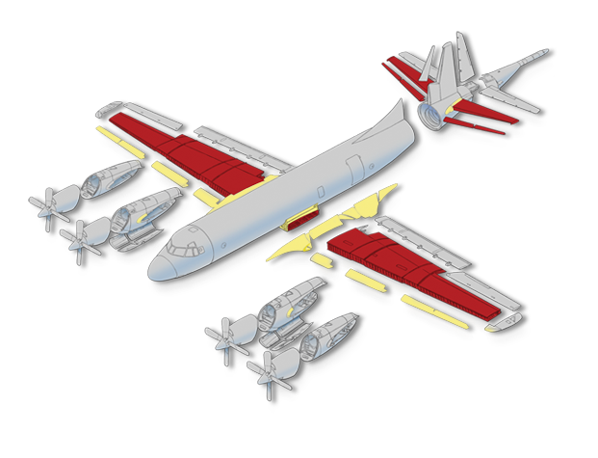
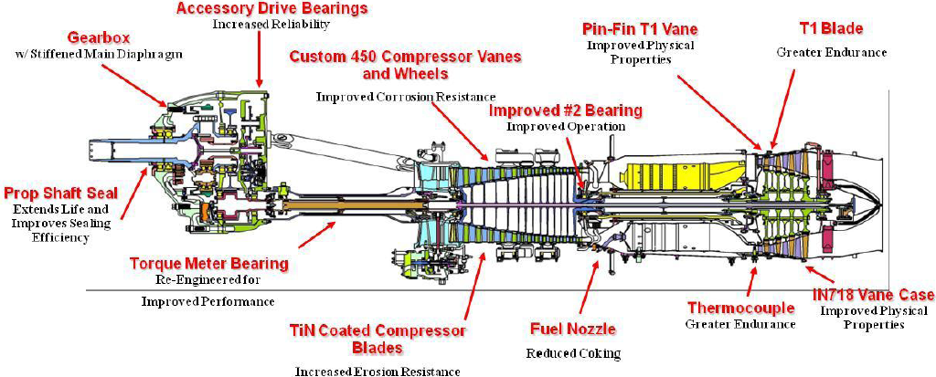
Project: WP-3D Service Life Extension - Scope
Wing-sets (Two)
  New Outer wing assemblies
  New Ctr. Wing front and rear beam and upper surface
  New Horizontal Stabilizer
  Installation
Rolls Royce T-56-14 Engines (Ten)
Overhaul and refurbish (Zero-time) all engines
Possible upgrade to Series 3.5
Avionics (TBD)
  Tail Doppler Radar (TDR) Upgrades
  Lower Fuselage Radar (LF) Upgrades
  Digital HF for N43RF
  Digital Autopilot
  Moving Map Display
  Automatic Dependent Surveillance Broadcast (ADSB) traffic control system

Slide 27
P-3 SLE SCHEDULE
N42RF inducted into FRCSE (Navy JAX)
January 2015. Completion date January 2016.
Return to service February 2016
N43RF inducted into FRCSE for re-winging
August 2016, Return to service late August 2017.
Some avionics upgrades concurrent with
re-wining.
Notes:
27

Slide 28
67th IHC
QUESTIONS?
28

