Slide 1
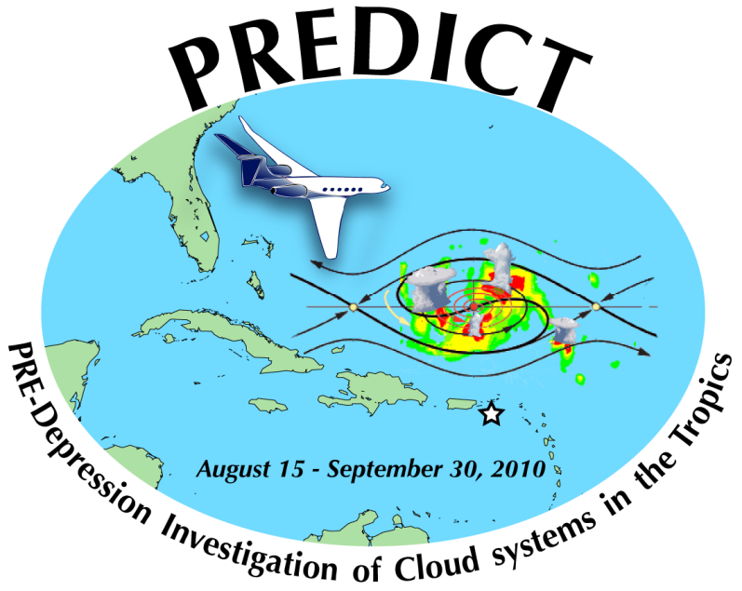
Probabilistic Verification of Ensemble Forecasts of Tropical Cyclogenesis
Sharanya J. Majumdar
RSMAS / University of Miami
Ryan D. Torn
SUNY at Albany
IHC / Tropical Cyclone Research Forum, 3/6/13

Slide 2
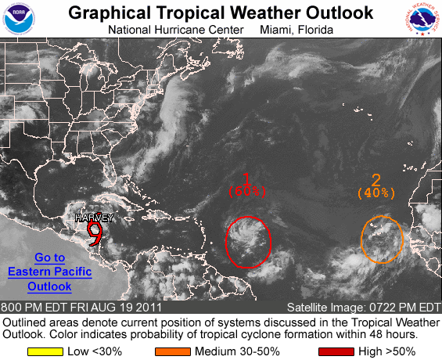

Slide 3
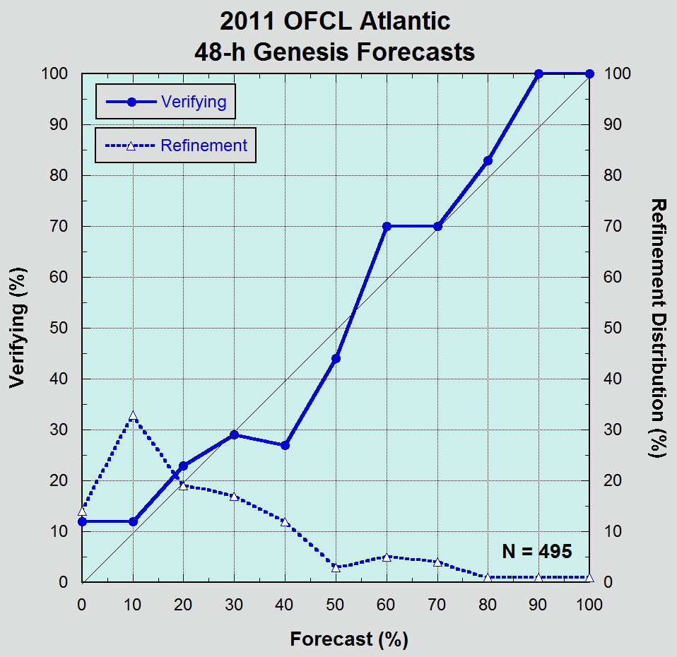

Slide 4
How to define a TC in a model?
LOW-LEVEL CYCLONIC CIRCULATION. 700-850 hPa layer mean relative vorticity, averaged within a disk of radius 200 km, exceeding 8 x 10⁻⁵ s⁻¹.
WARM CORE. Local 200-850 hPa geopotential thickness (averaged within a disk of r=100 km) exceeding environmental thickness (averaged within a disk of r=1000 km) by 45 m.
CLOSED SURFACE LOW. Closed surface low with minimum sea level pressure < 1012 hPa.
CALIBRATE values in analysis using NHC best track.

Slide 5
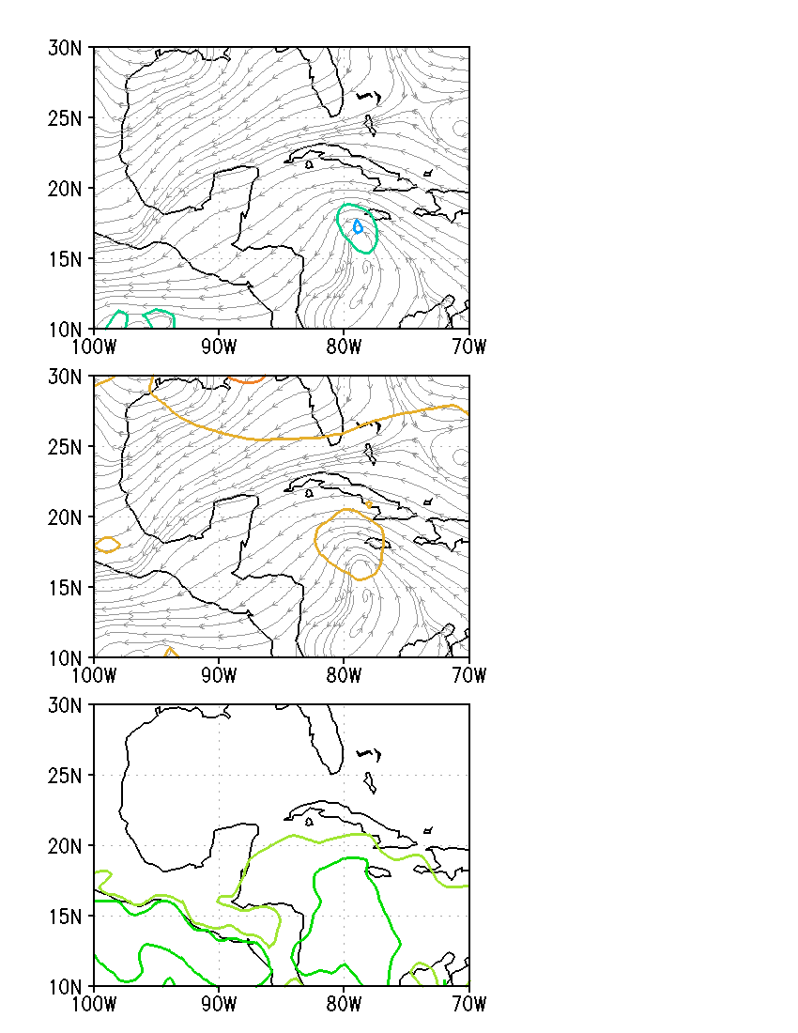
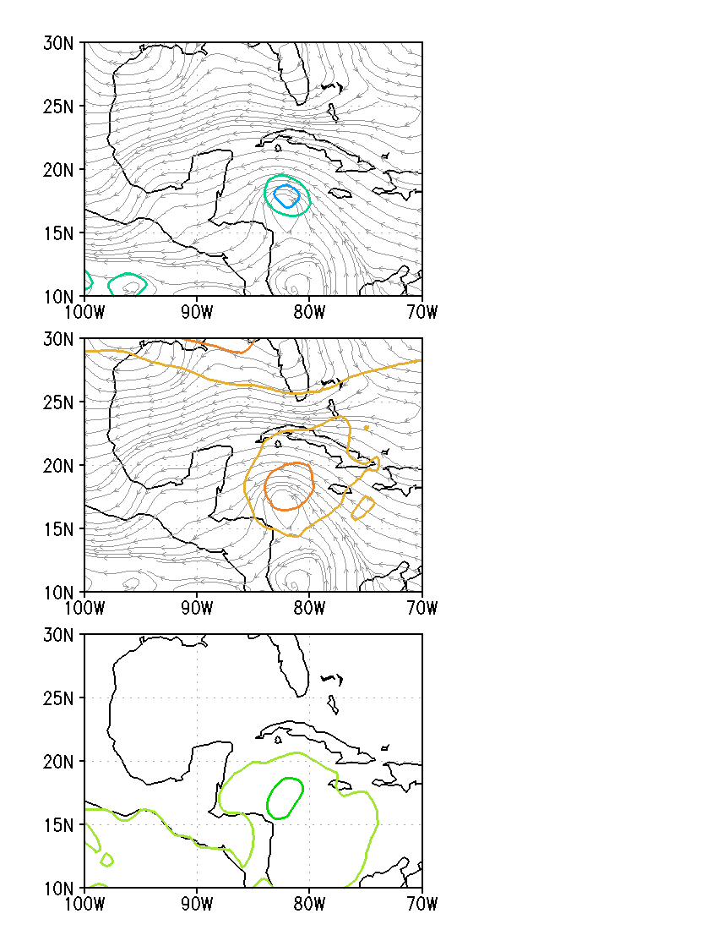
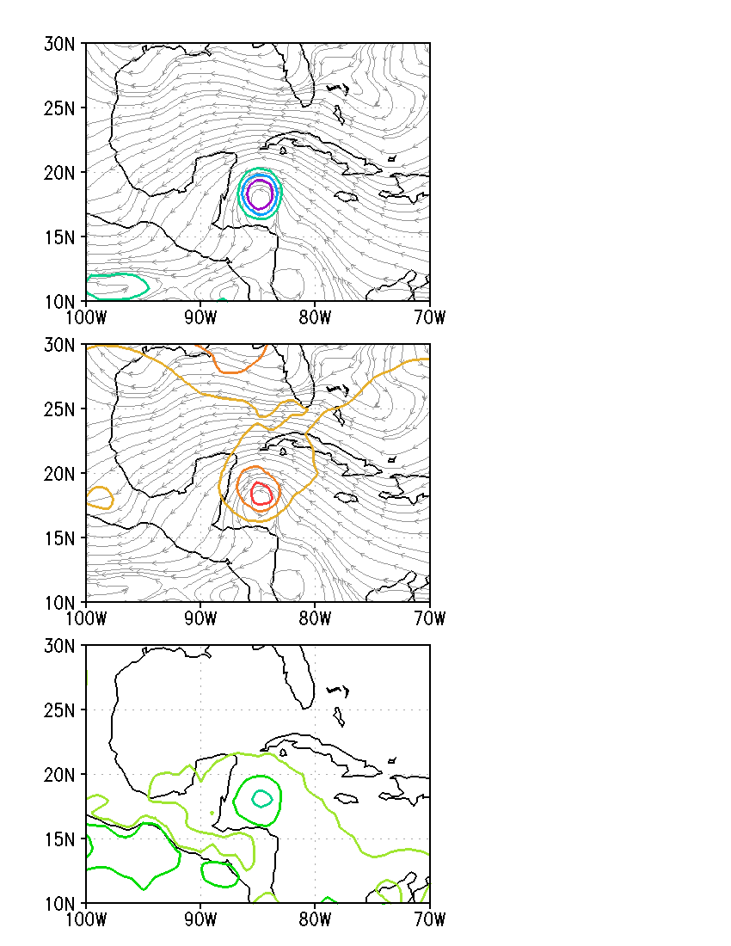
0000 UTC 14th
1200 UTC 14th
0000 UTC 15th
CIRC
THICK
MSLP

Slide 6
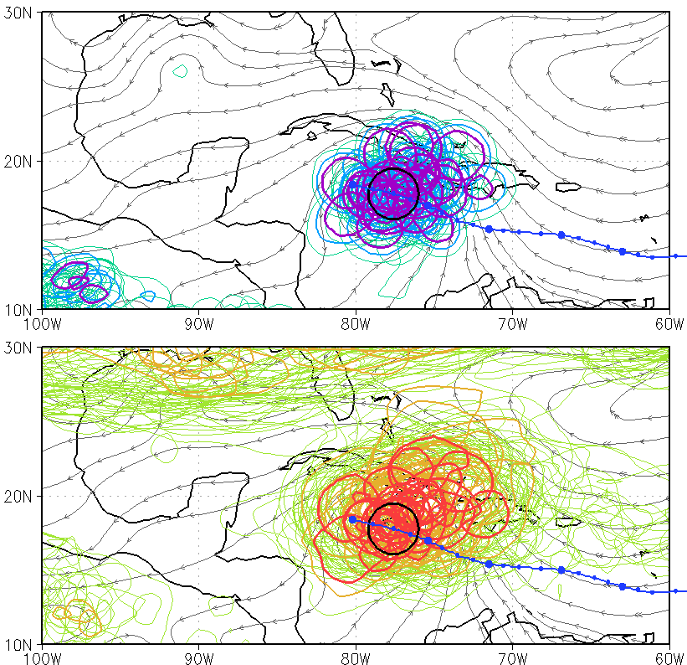
108 h ECMWF Ensemble Forecast of pre-Karl, init. 0000 UTC 10 Sept 2010
CIRC
THICK
Probability (TC at 108 h) = 68%
MSLP

Slide 7
Verification
Homogeneous Comparison: Aug 15 – Sep 30 2010
3-day ECMWF ensemble forecasts, 00 and 12 UTC
3-day WRF/EnKF ensemble forecasts, 00 and 12 UTC
ECMWF ensemble forecasts, Jun 1 – Nov 30, 2010-2012
7-day forecasts, 00 UTC only
All forecasts up to and including genesis.
Verification: NHC best track. TC or not TC.
Our question: what is the probability that a TC exists at XX h? (with time tolerance of 1 day). Focus on timing.
Slightly different from NHC question: what is the probability that a TC forms within the next XX h?

Slide 8
Homogeneous Comparison ECMWF versus WRF/EnKF

Slide 9
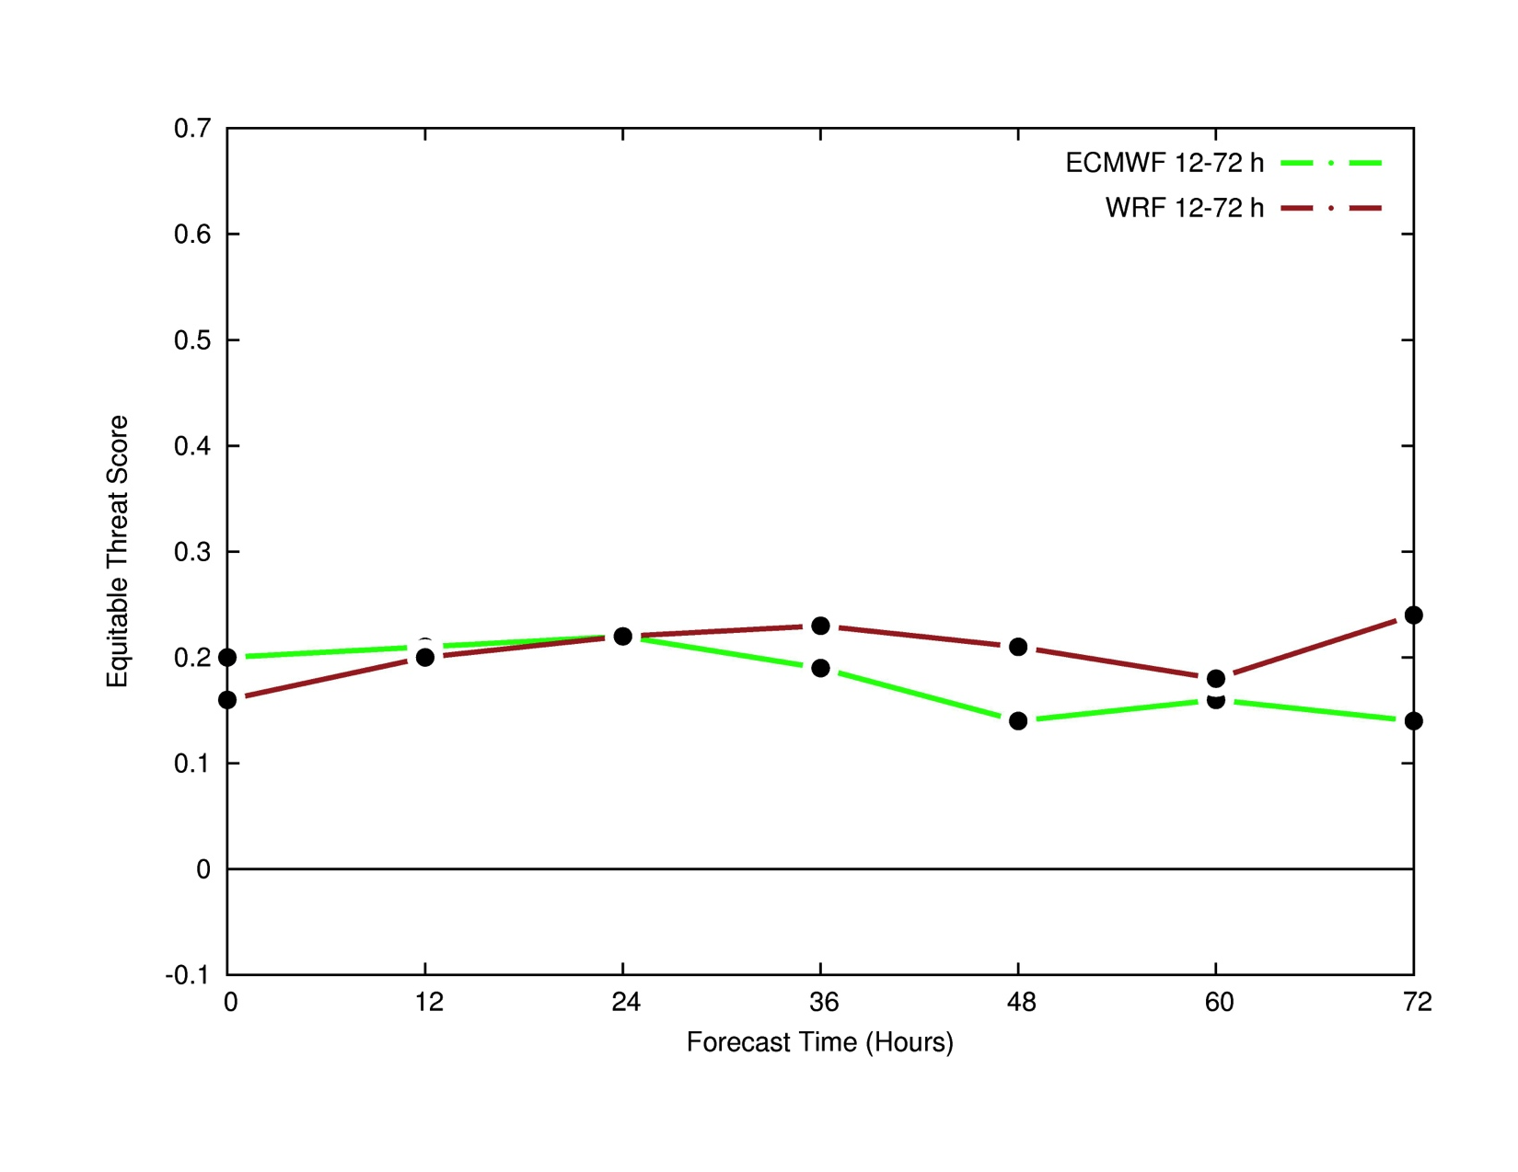
ETS = (H – Hr) / (H + M + FA – Hr)

Slide 10
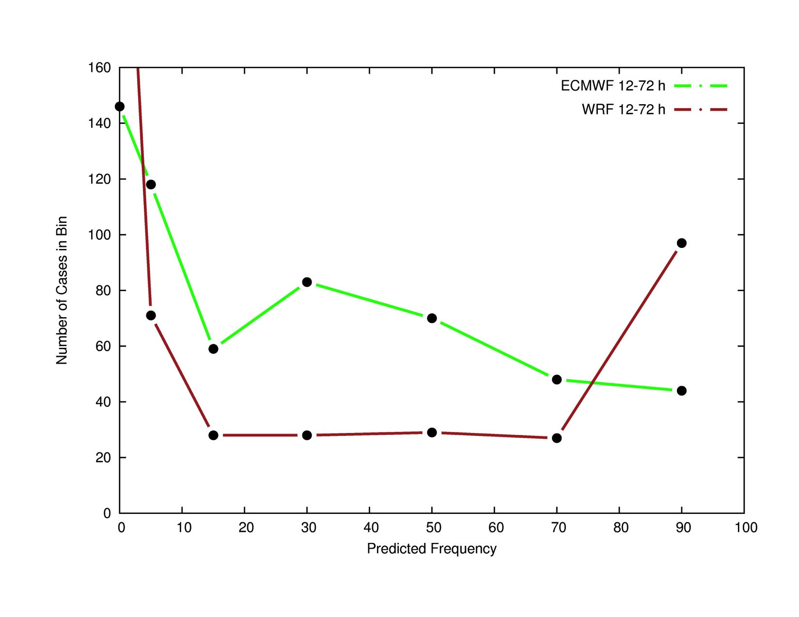
Number of cases in each probability bin

Slide 11
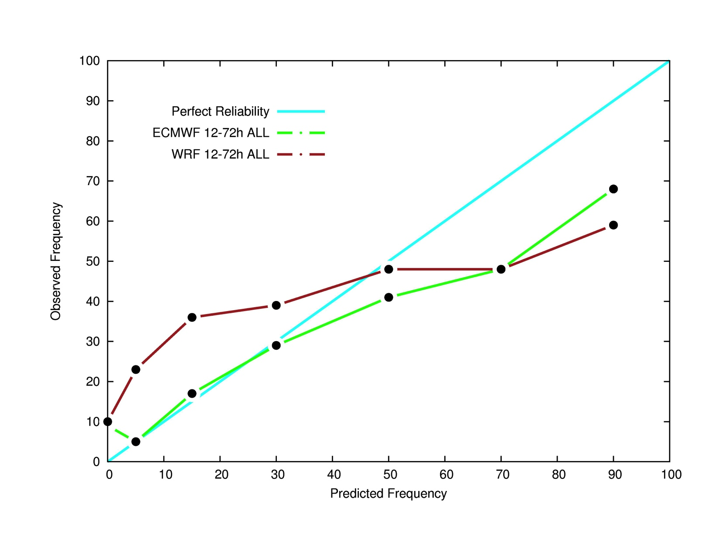
Reliability Diagram

Slide 12
ECMWF 2010, 2011, 2012 Hurricane Seasons

Slide 13
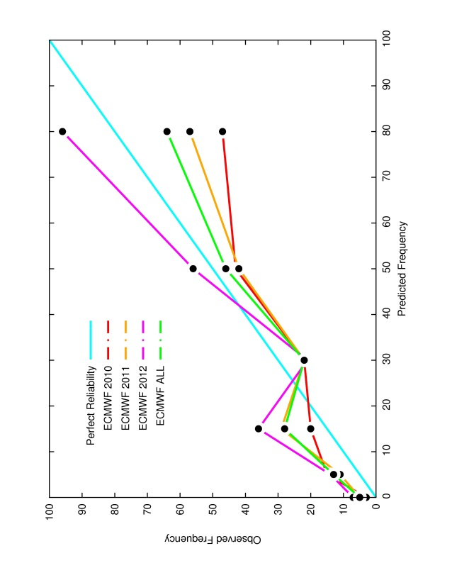
Reliability Diagram: 12-48 h

Slide 14
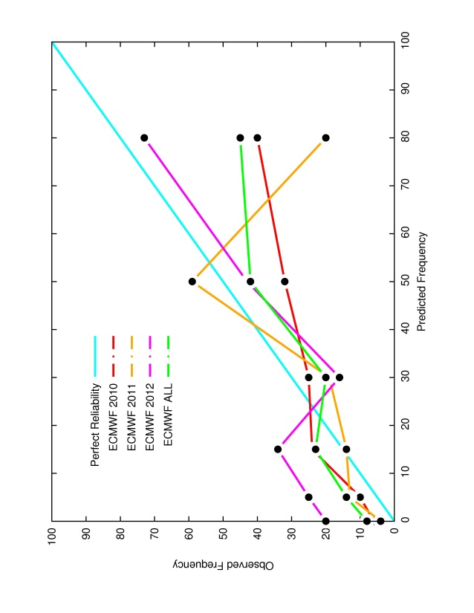
Reliability Diagram: 60-96 h

Slide 15
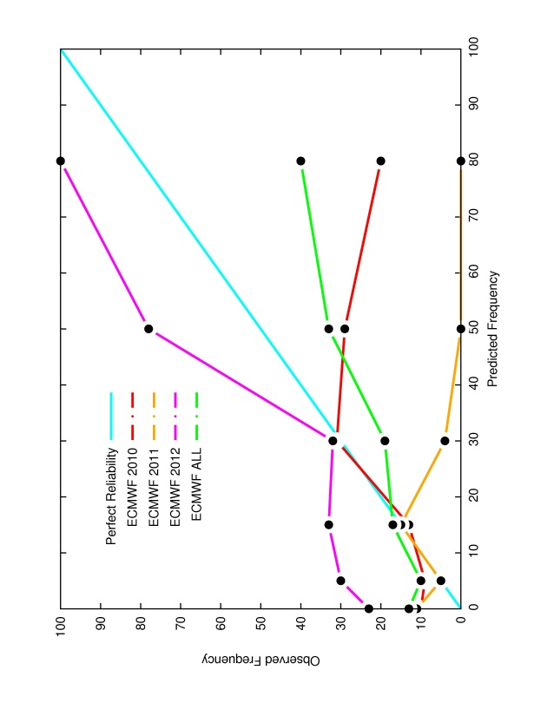
Reliability Diagram: 108-144 h

Slide 16
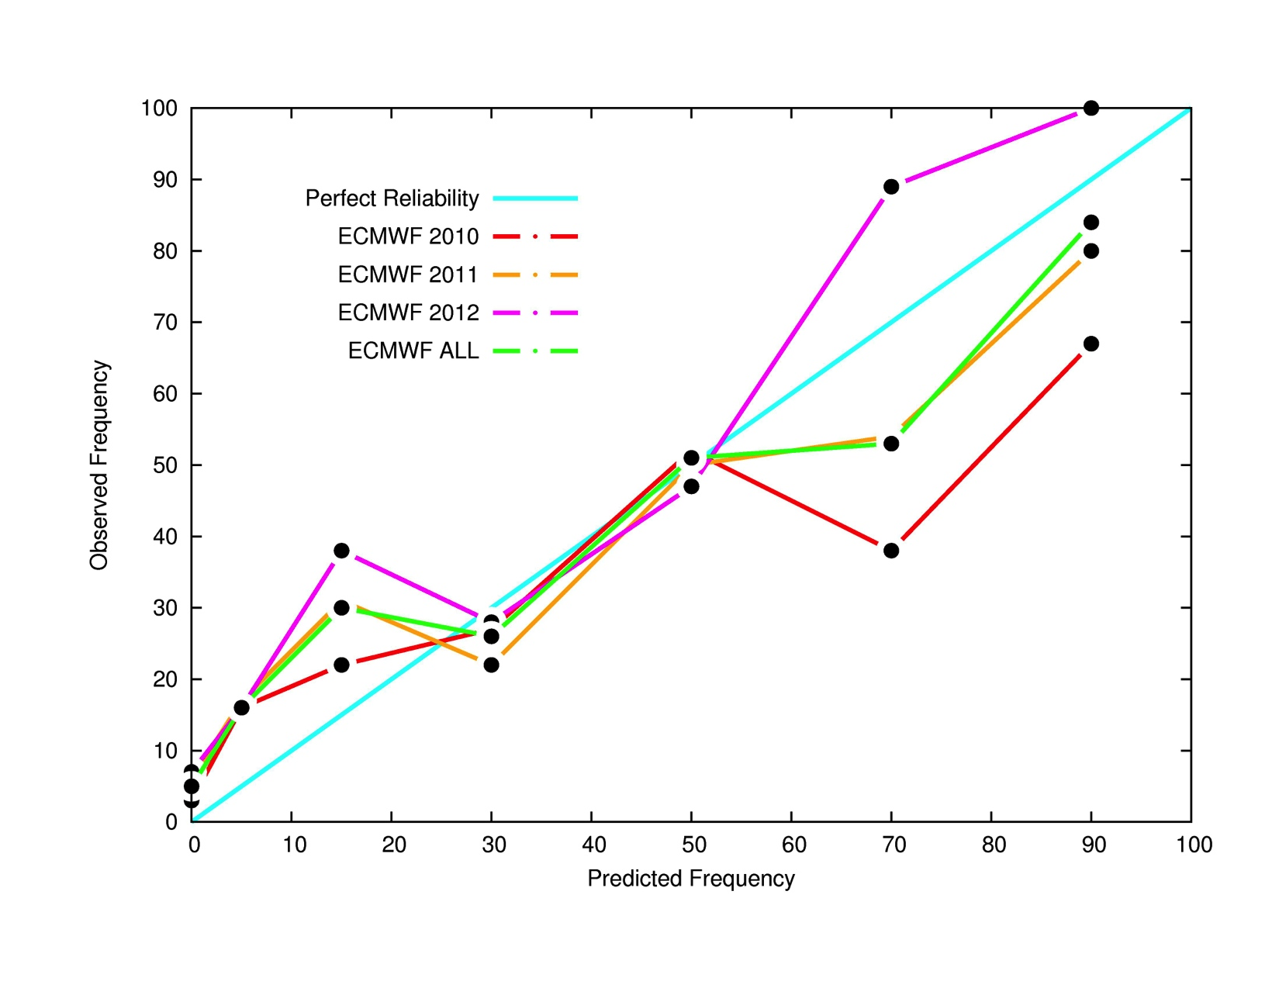
Reliability Diagram: Probability of genesis within 48 h

Slide 17
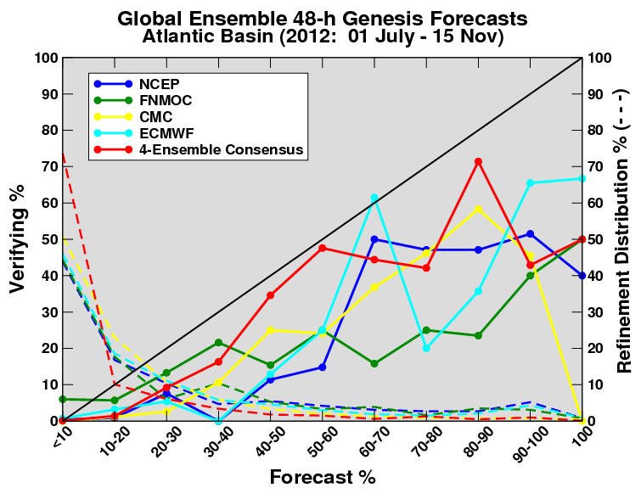
FROM HFIP

Slide 18
Conclusions
WRF/EnKF and ECMWF are comparable for 1-3 day forecasts (Aug – Sep 2010)
Reliability diagrams out to at least 96 h generally slope upwards, average gradient less than 1.
Dependence on definition of TC?
Stratify statistics based on genesis mechanisms.

Slide 19
Extra Slides

Slide 20
NHC

Slide 21
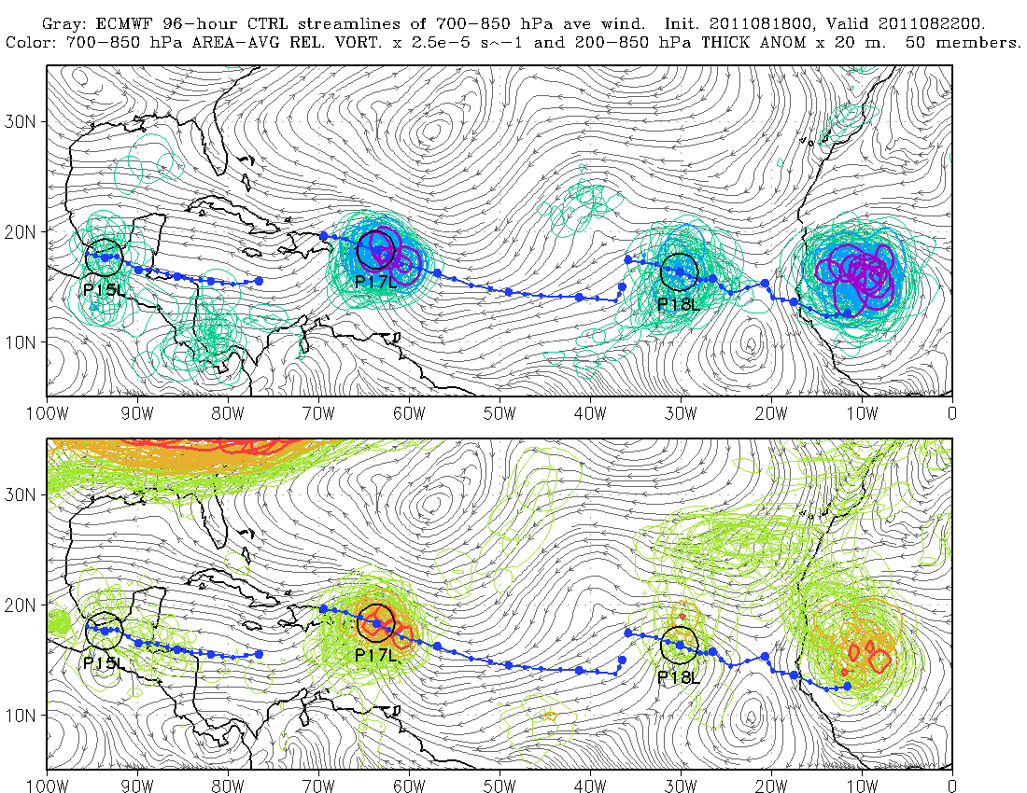
Real-time ensemble products, 2010-11
http://www.rsmas.miami.edu/personal/smajumdar/predict/

Slide 22
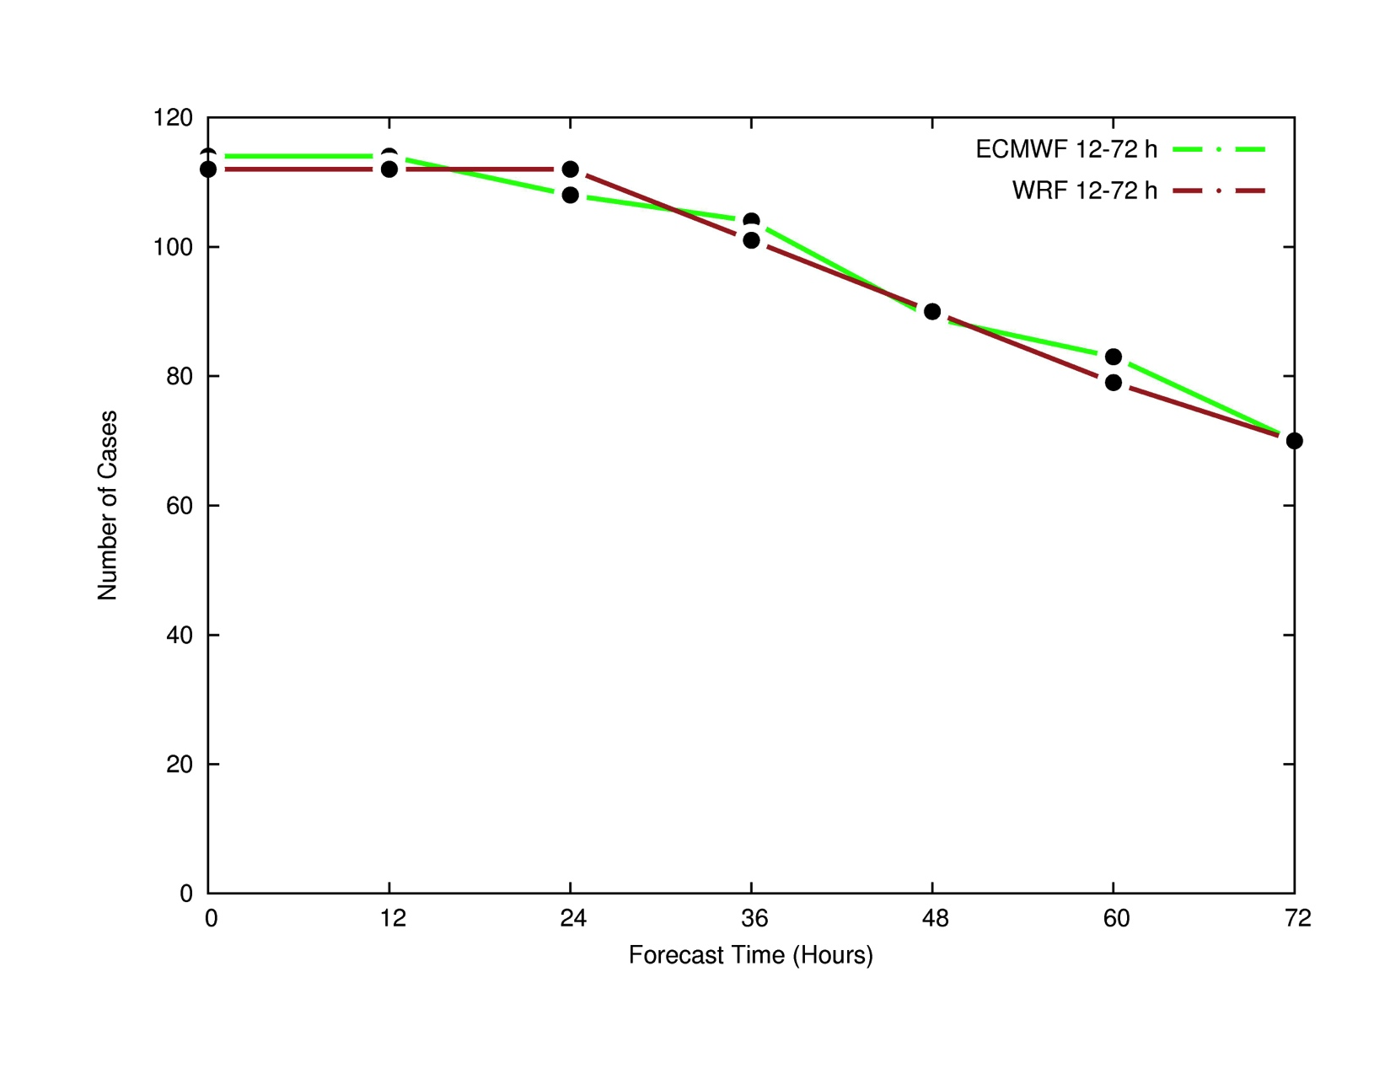
Number of cases

Slide 23
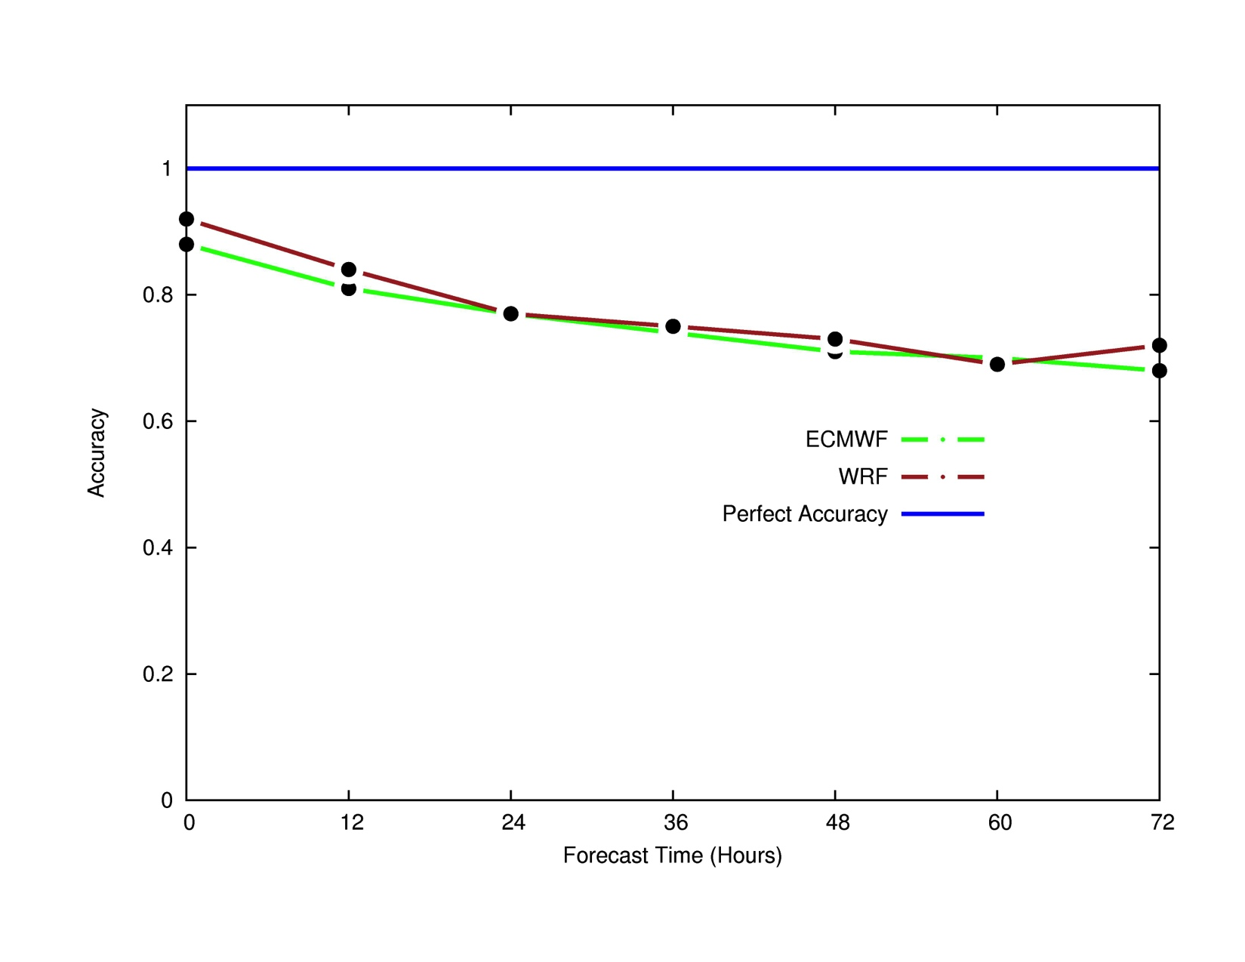
Accuracy = (H + CN) / Total

Slide 24
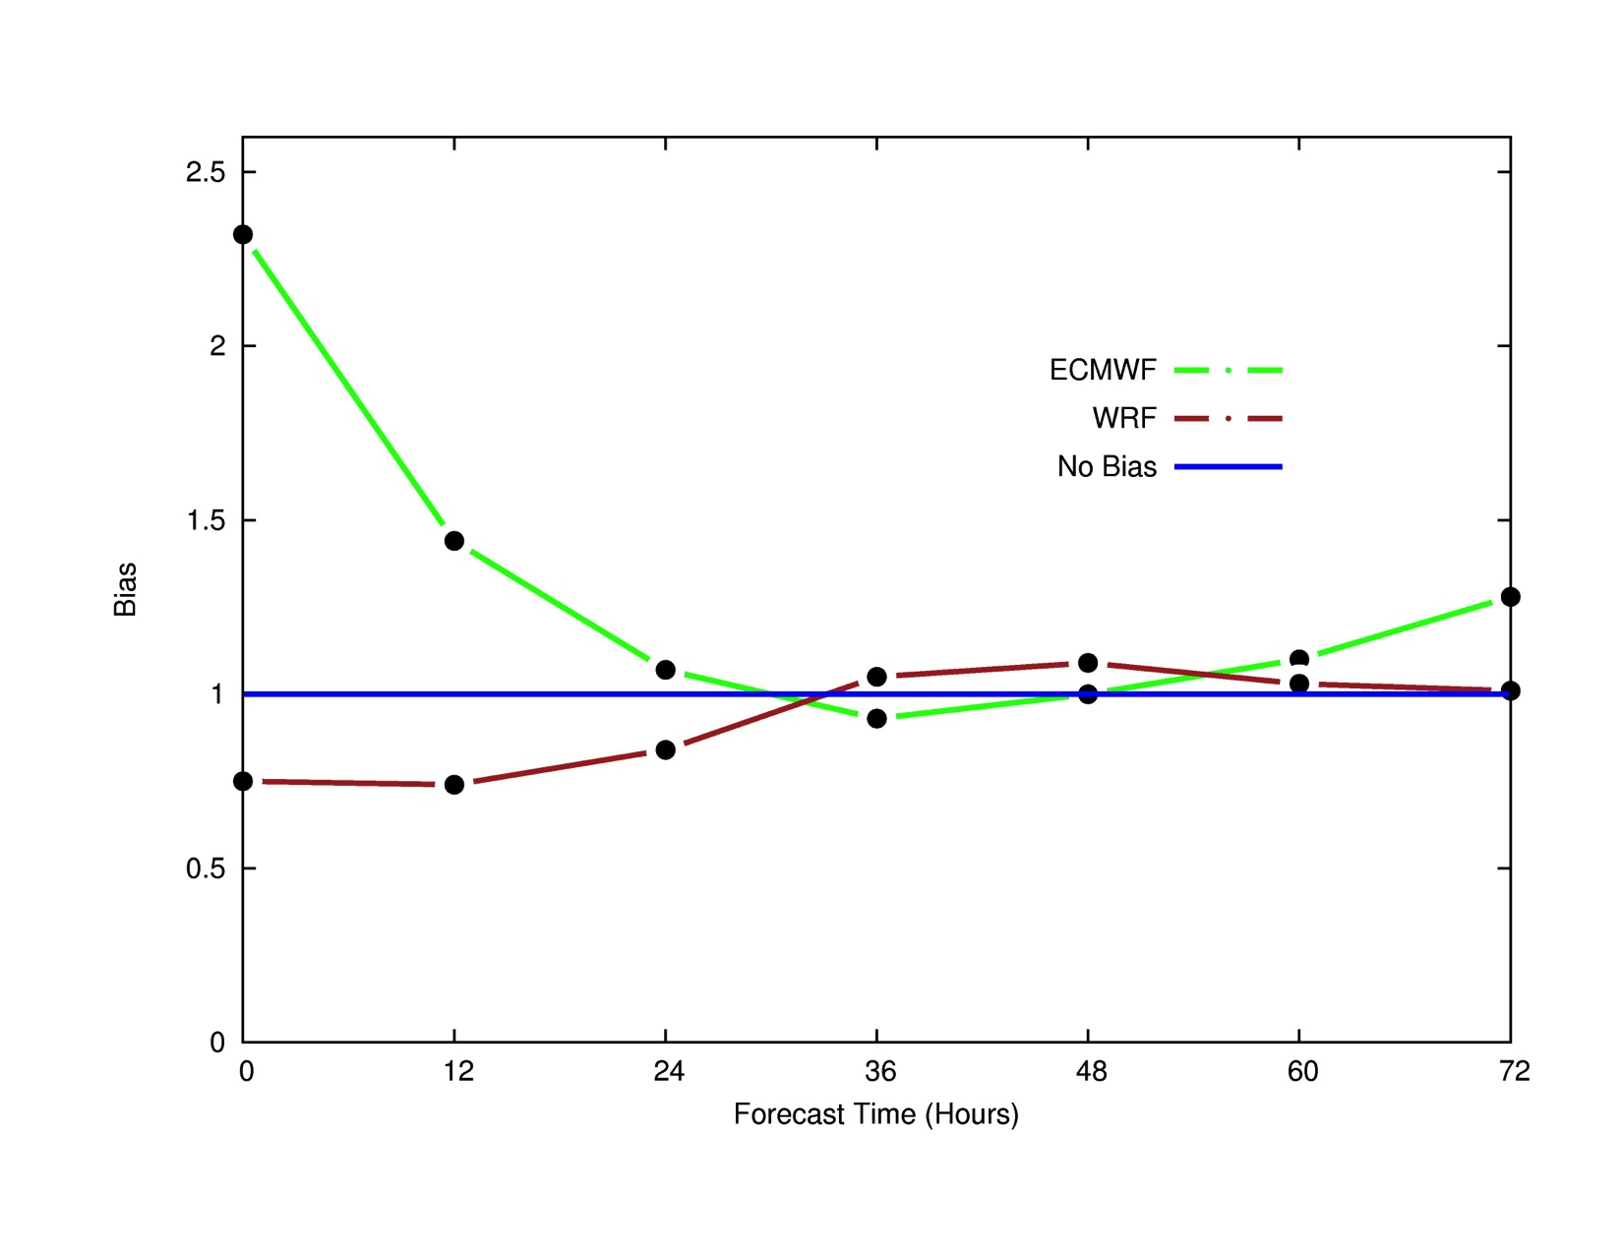
Bias = (H + FA) / (H + M)

Slide 25
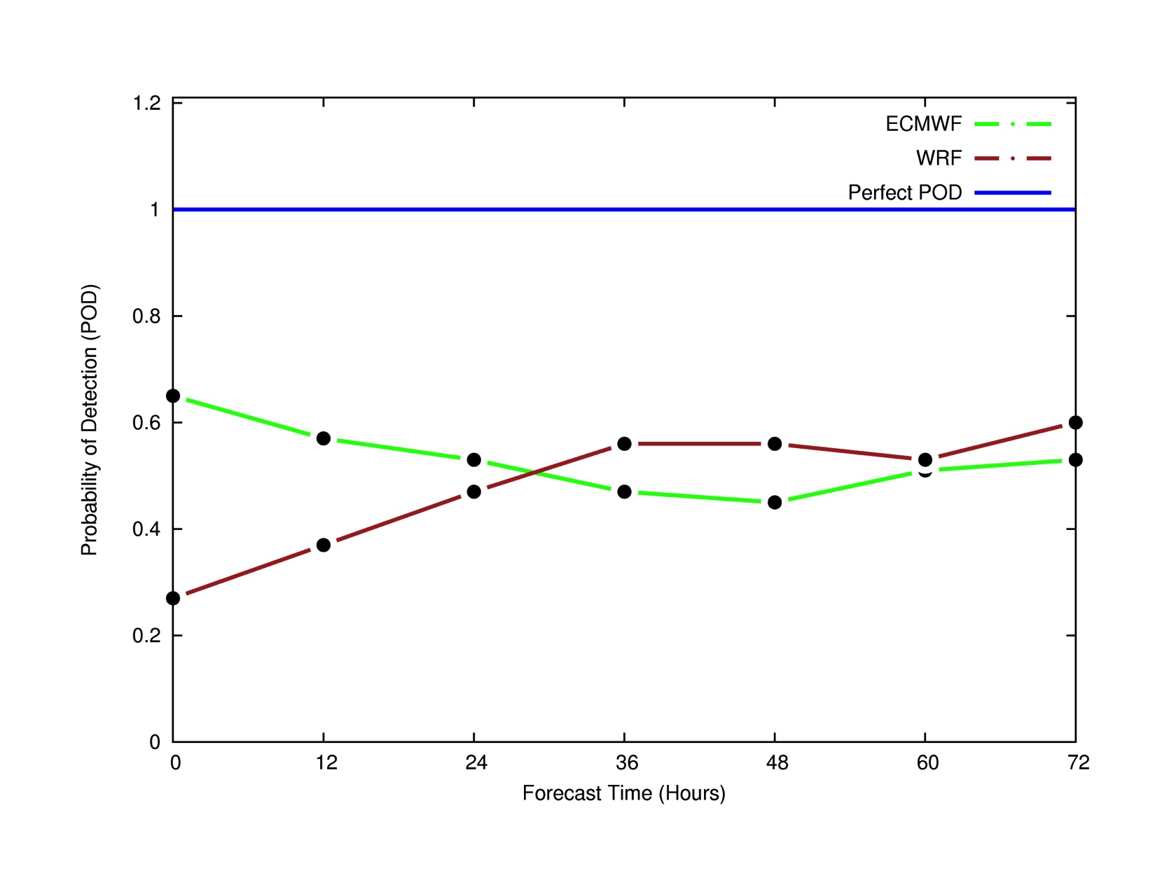
POD = H / (H + M)

Slide 26
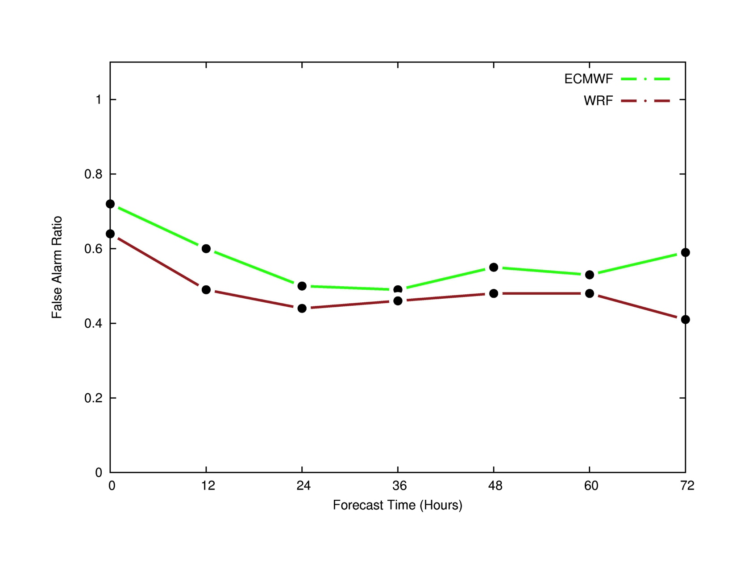
FAR = FA / (H + FA)

Slide 27
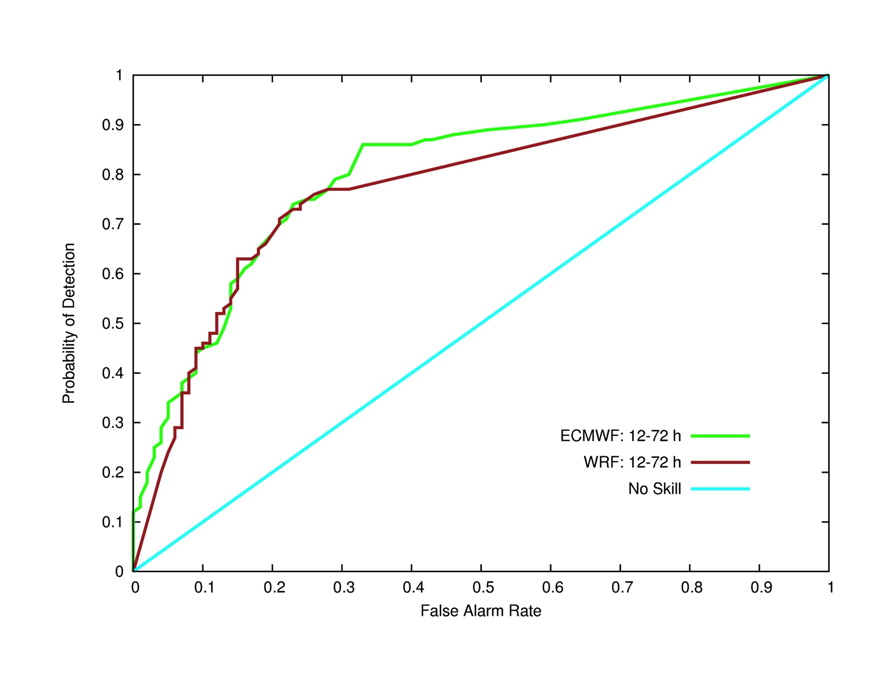
Relative Operating Characteristic

Slide 28
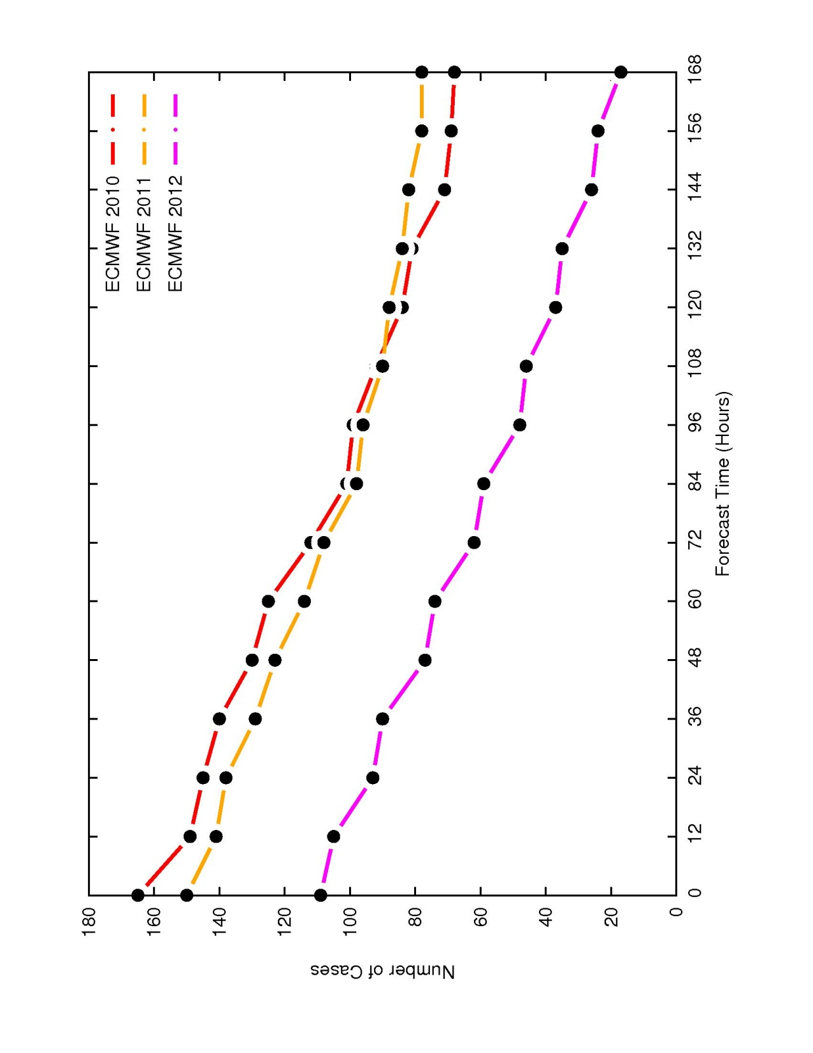
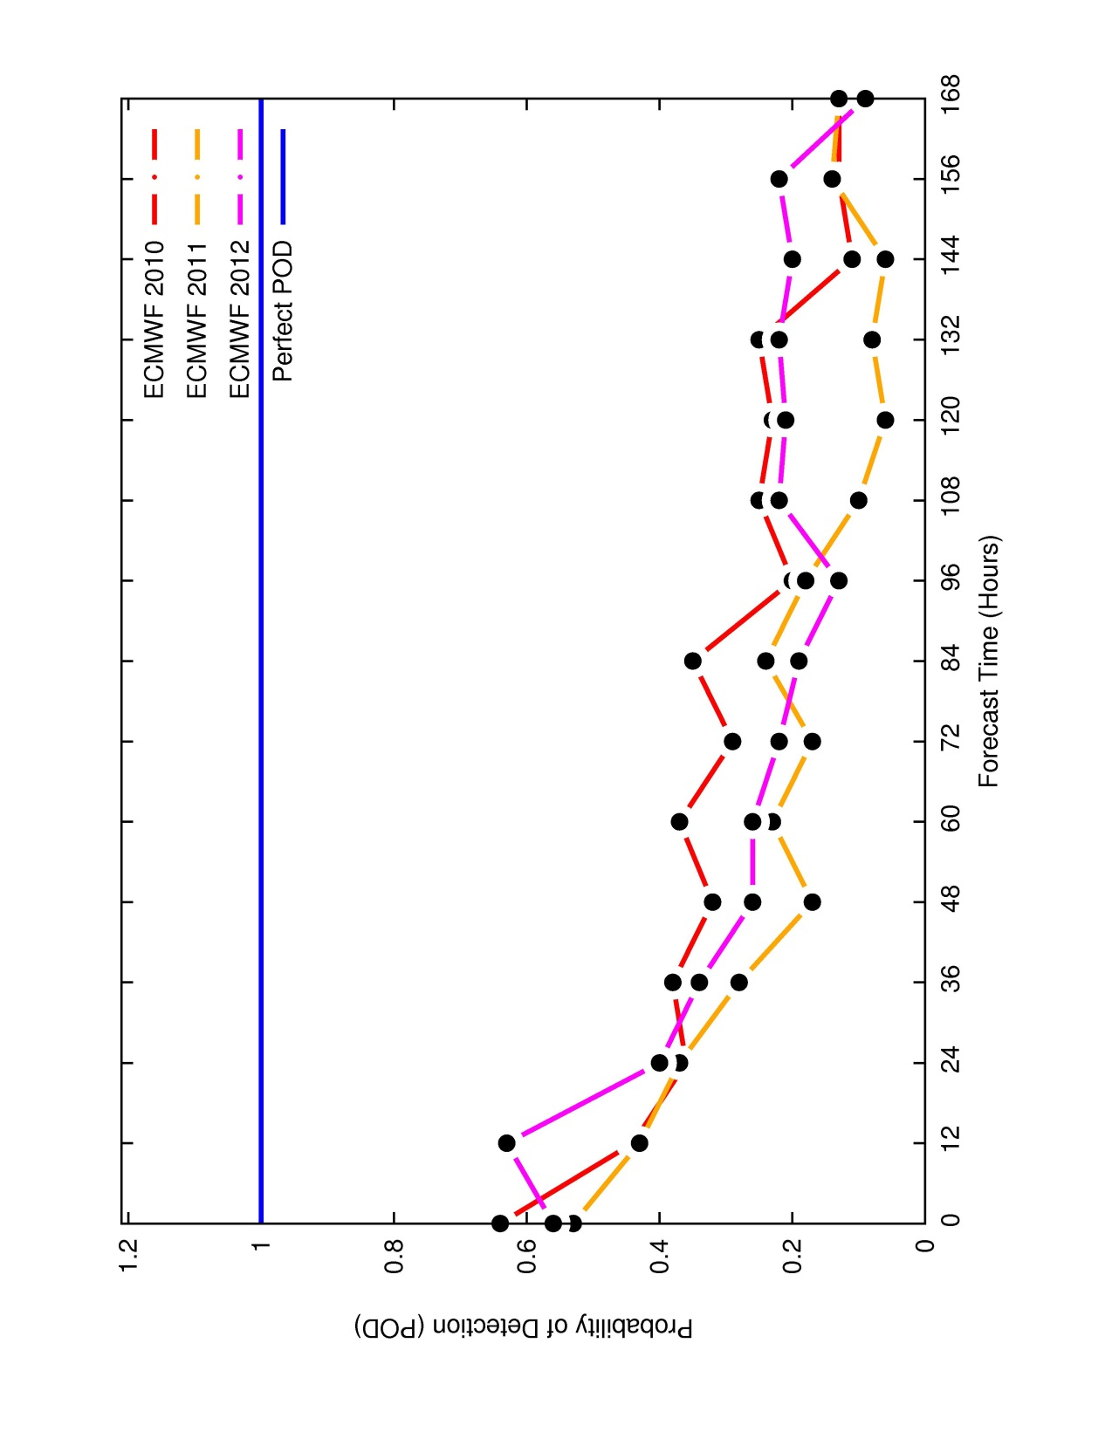
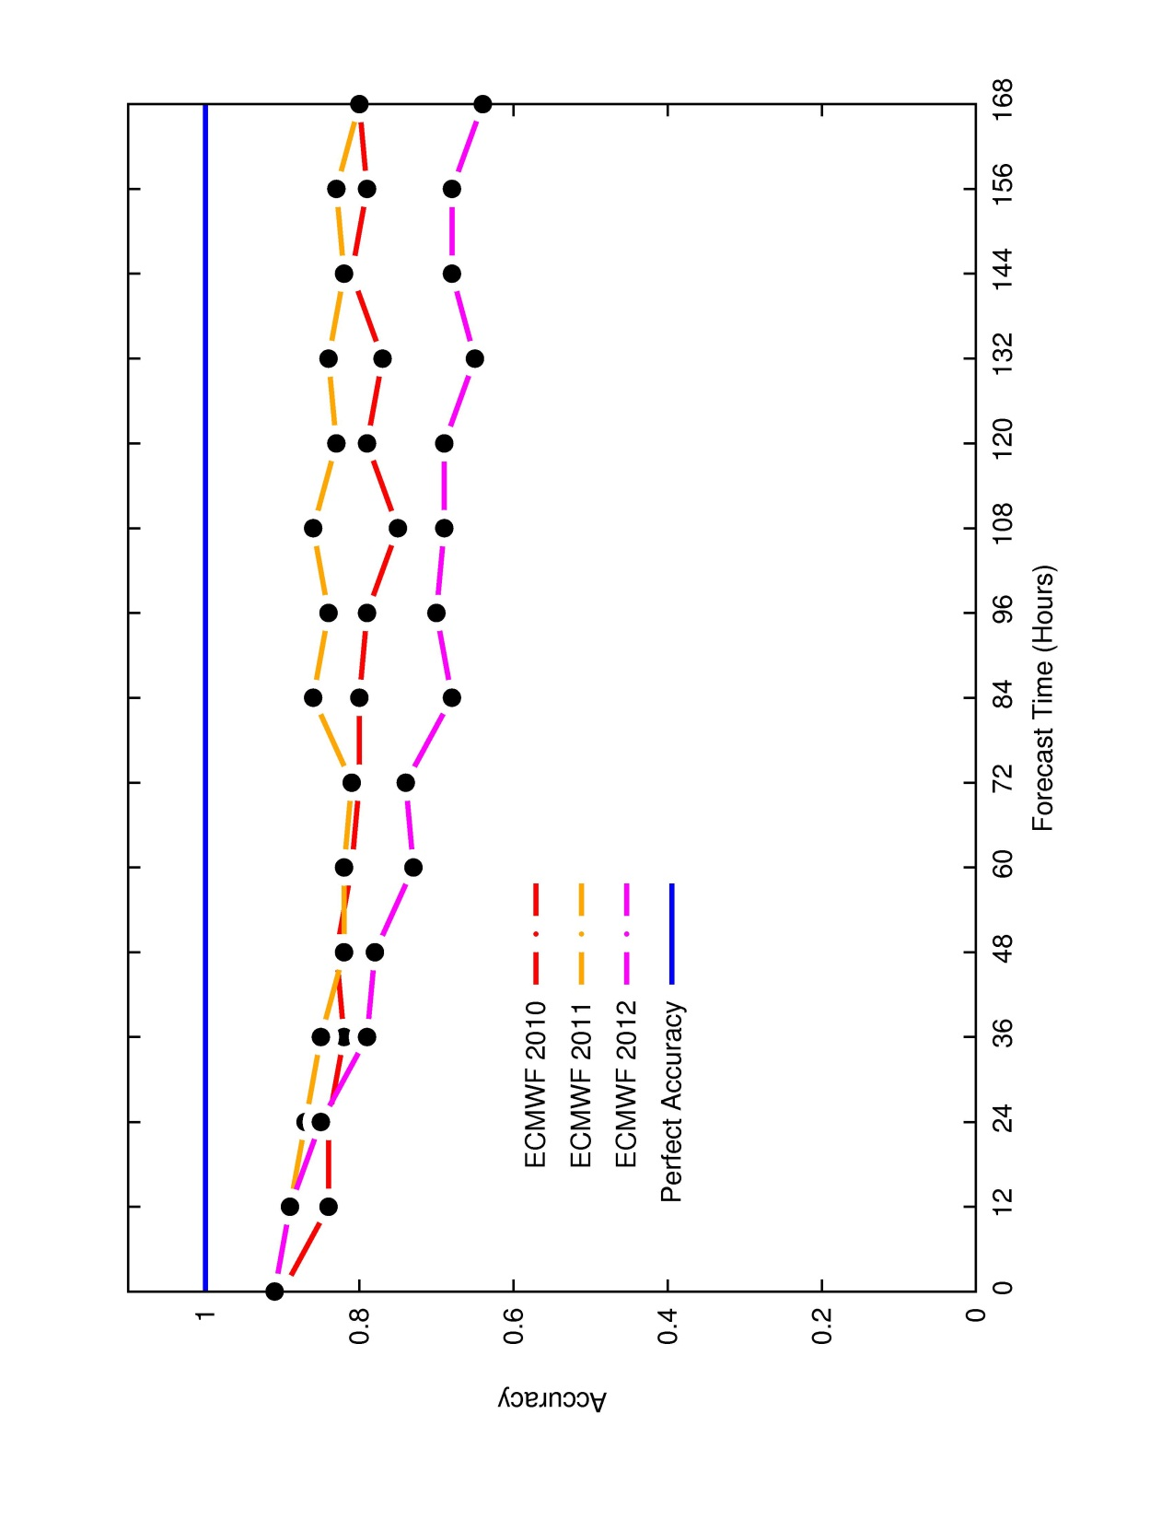
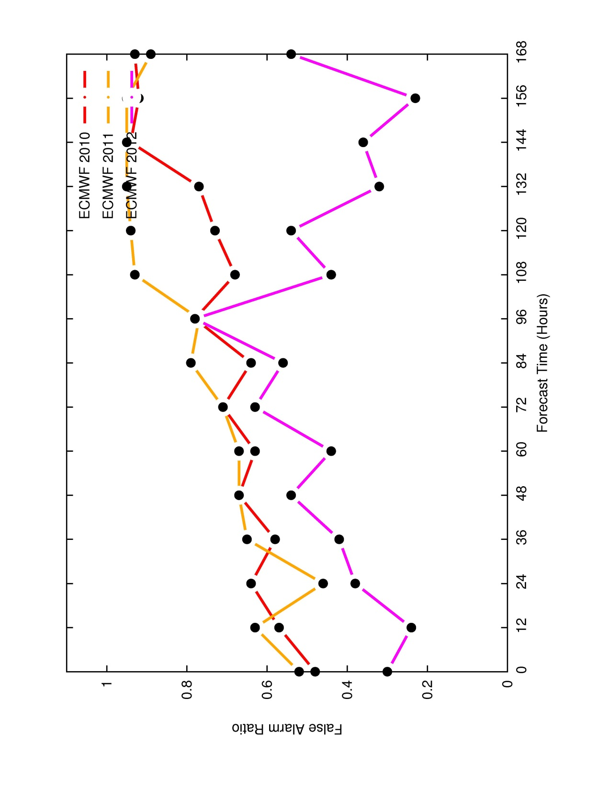
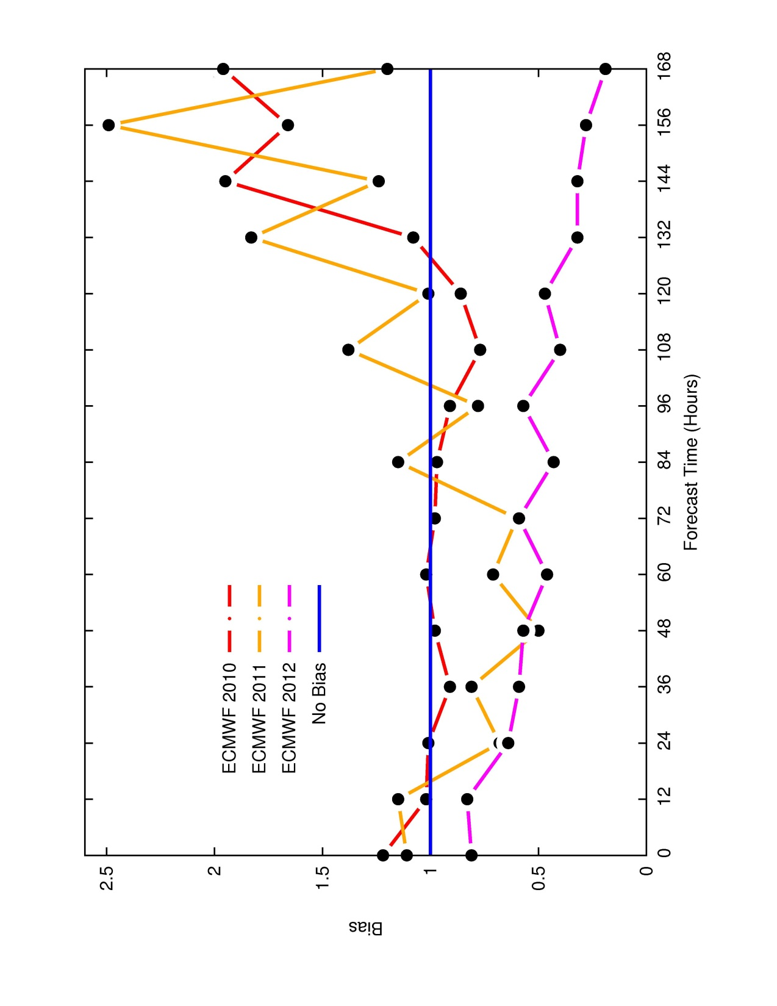
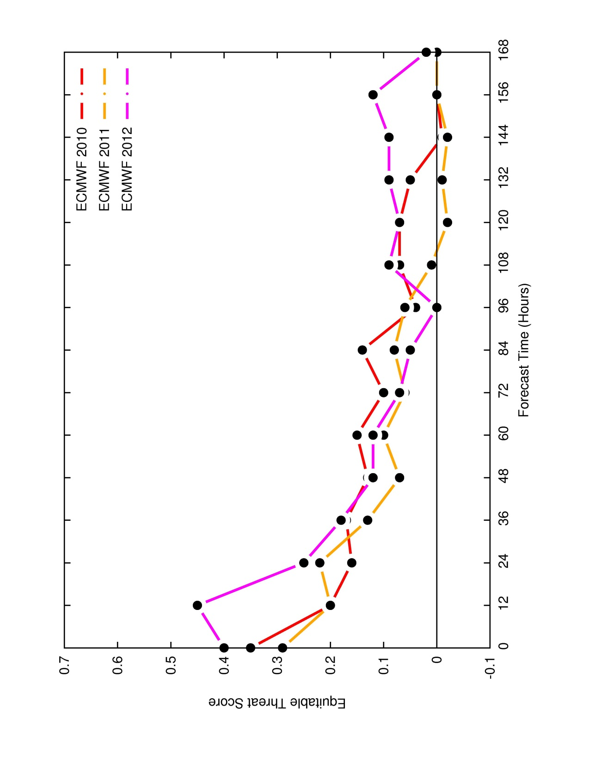
Number of Cases
Probability of Detection
POD = H / (H + M)
Accuracy = (H + CN) / Total
False Alarm Ratio
FAR = FA / (H + FA)
Equitable Threat Score
ETS = (H – Hr) / (H + M + FA - Hr)
where Hr = (H + M)(H + FA) / Total
Bias = (H + FA) / (H + M)

Slide 29
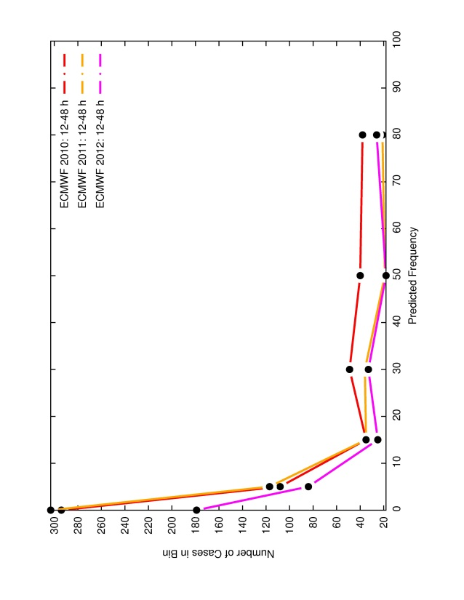
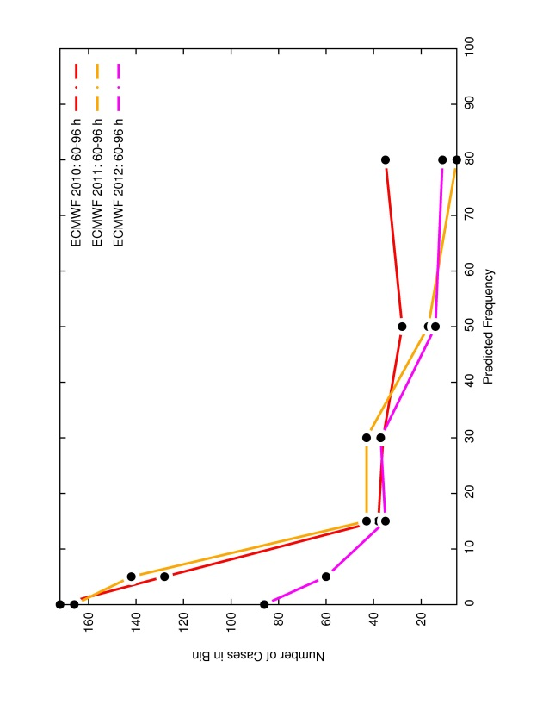
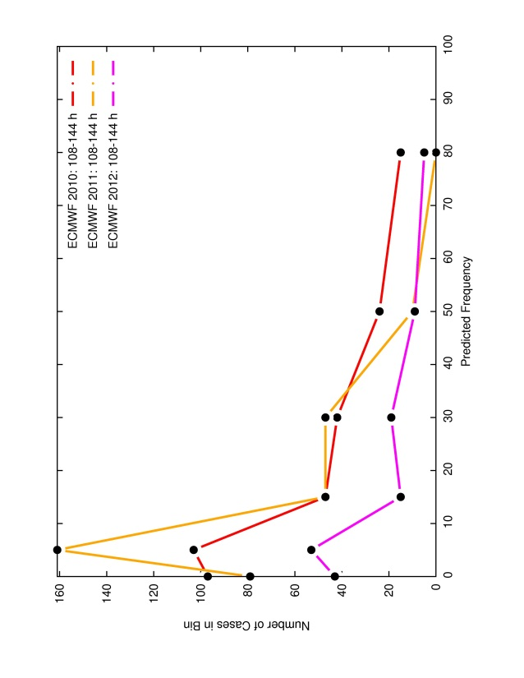
Reliability Diagrams
Number of Cases
12-48 h
Number of Cases
60-96 h
Number of Cases
108-144 h

Slide 30
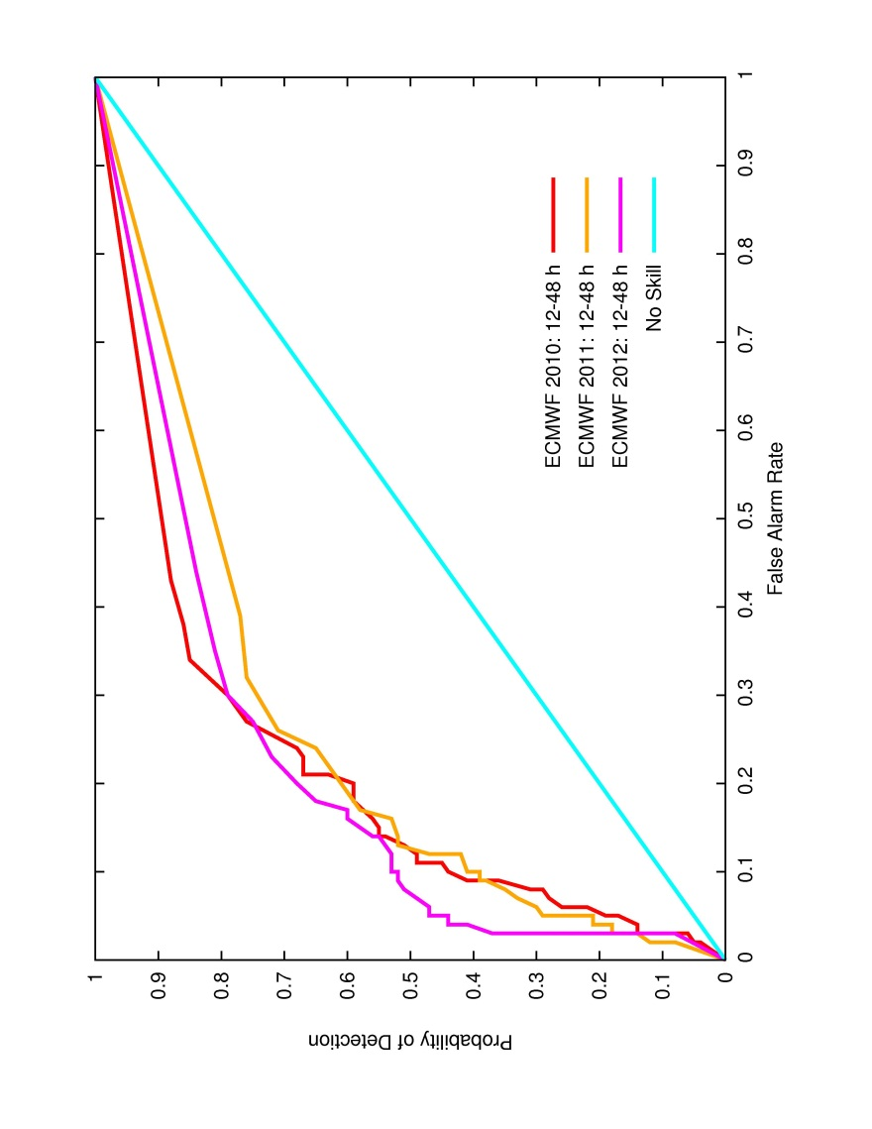
ROC: 12-48 h

Slide 31
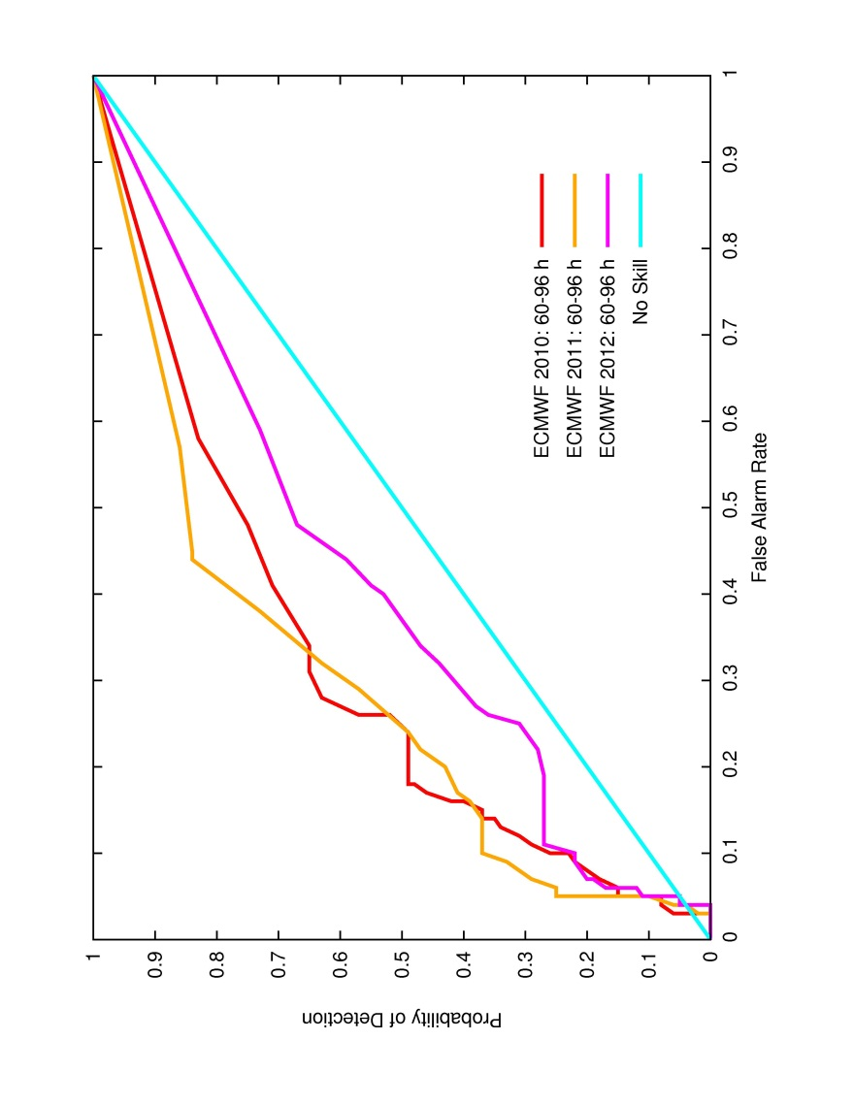
ROC: 60-96 h

Slide 32
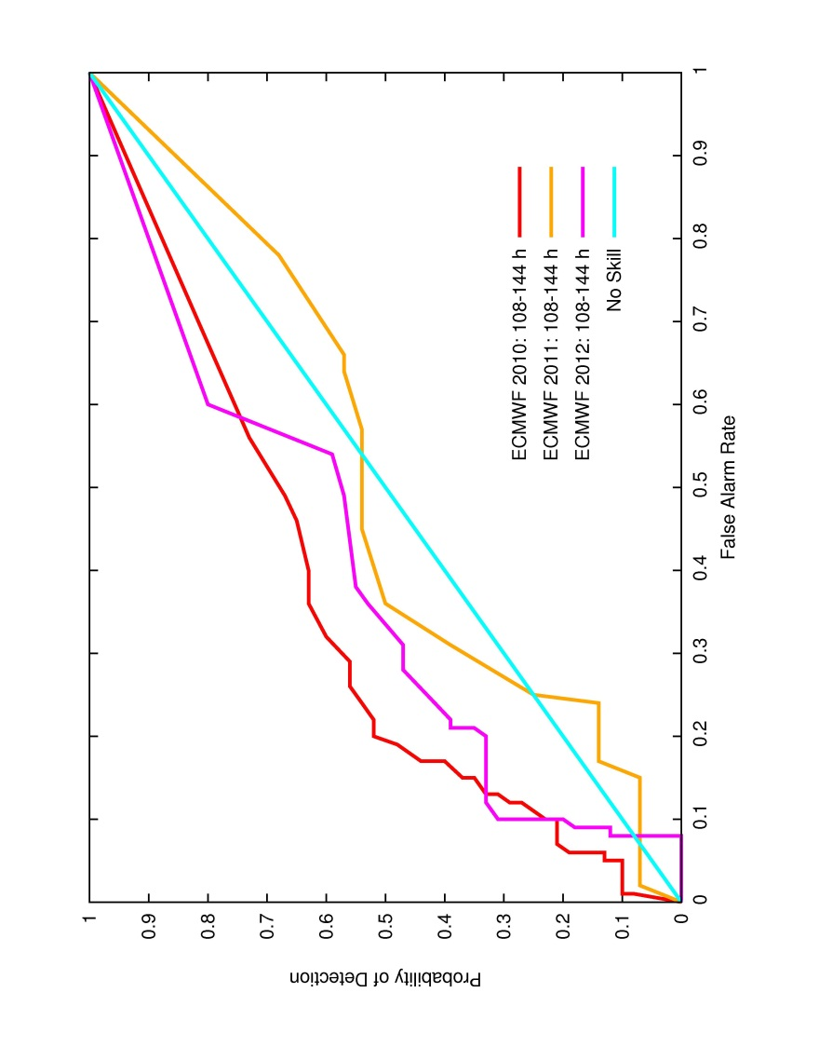
ROC: 108-144 h

