Slide 1
From Large-Eddy-Simulation to climate modeling:
GFDL's unified global-regional non-hydrostatic modeling framework
S. J. Lin

Slide 2
GFDL’s unified regional-global weather and climate modeling system is designed for all temporal-spatial scales
Examples:
Regional cloud-resolving Radiative-Convective Equilibrium (0.5 km)
Global cloud-system resolving experiments (3.5 km)
High-resolution present-day climate simulations (12.5 km)
5-10 day hurricane predictions (25 km)
Intra-seasonal TC predictions (25 km)
TC seasonal predictions (25km)
Simulations of TC climatology and response to warming scenarios (50km)
IPCC AR5 high-res time-slice experiments (25 & 50 km)
IPCC AR5 coupled chemistry-aerosol-climate system (200 km)
Grid size

Slide 3
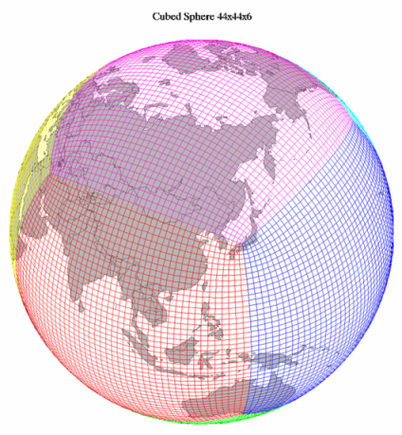
The GFDL FV3: Finite-Volume Dynamical Core on the Cubed-Sphere
4th order Finite-Volume algorithms with a true Lagrangian vertical coordinate (Lin 2004)
Designed for fine-grained parallelism (MPI, openMP, and GPU); scalable to ~million cores (IBM BG) at cloud-resolving resolution
Hydrostatic or non-hydrostatic, regional or global (run time options)
Applicable to arbitrary non-orthogonal coordinate on a sphere (filled with quadrilateral cells) or limited area. Current global grid choice: Cubed-Sphere with two variable-resolution options (stretched and 2-way regional-global nesting)

Slide 4
Two non-hydrostatic solvers
Semi Implicit Method (SIM)
4th order finite-volume discretization
Stable for arbitrary time step size
Best for mid-high to low resolution (1 km to 100 km)
“Lagrangian“ Riemann Invariant Method (RIM)
Based on conservation of Riemann invariants with open (for sound waves) top boundary condition
Fully explicit; conditionally stable (up to CFL ~ 100 in the PBL)
Best for LES and cloud-resolving simulations ( < 1 km)

Slide 5
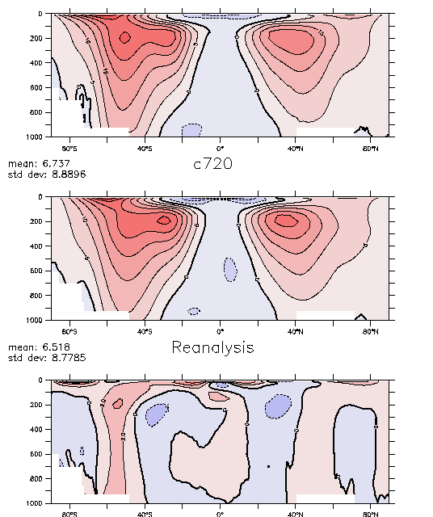
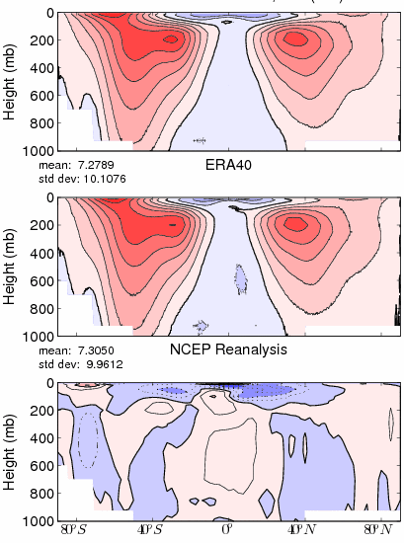
Quality of present-day climate simulation: annual mean zonal wind
C720
(12.5-km)
ECMWF analysis
NCEP
analysis
NCEP
analysis
RMSE=1.27 (m/s)
RMSE=1.09

Slide 6
Seasonal hurricane predictions with GFDL’s 25-km global model
Observed tracks
GFDL seasonal prediction

Slide 7
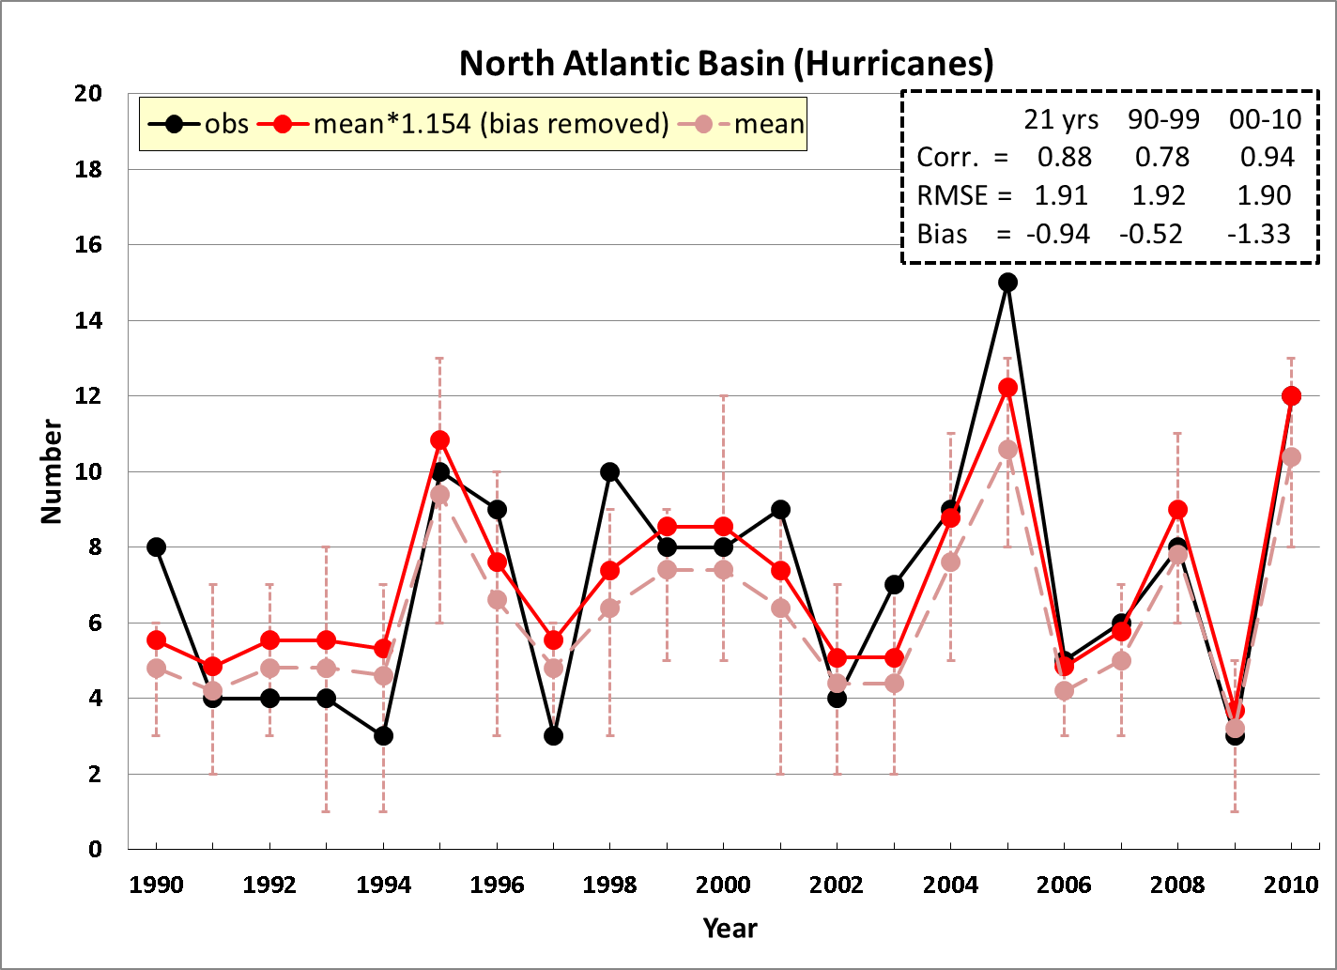
Retrospective Seasonal hurricane predictions
1990-2010 (J-A-S-O-N)
(Chen and Lin 2012)
0.78
0.94
0.88
Notes:
6

Slide 8
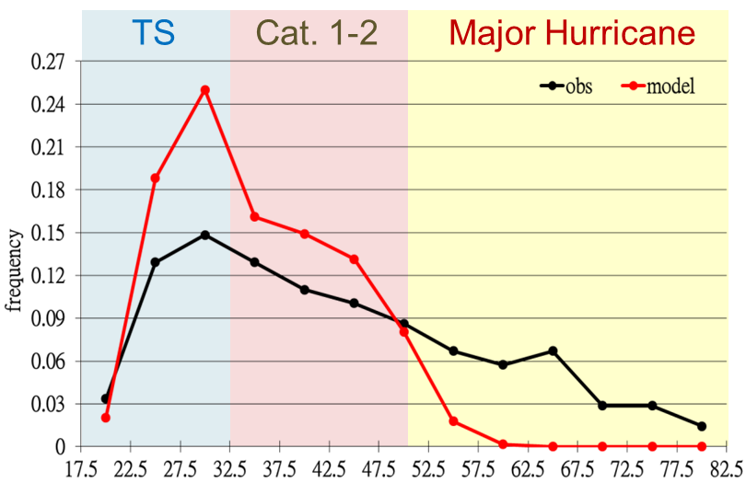
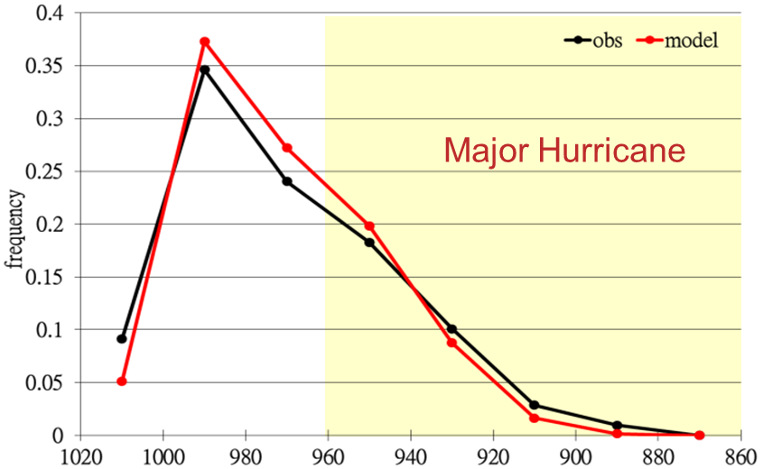
Predicted PDF of the Tropical Cyclones intensity (all basins 1990-2010) with the 25-km GFDL model
10-m wind
Central pressure
(Chen & Lin 2012)

Slide 9
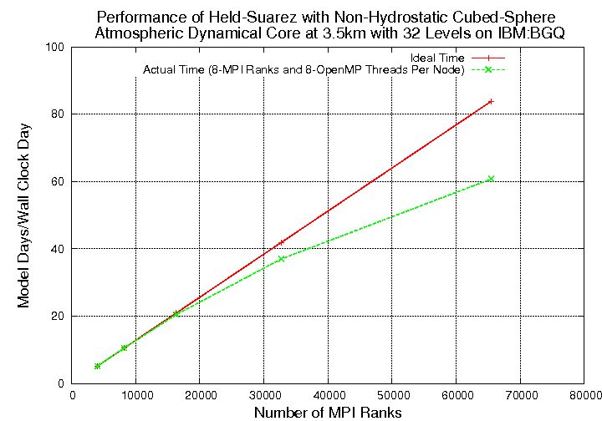
Is it computationally feasible to perform seasonal prediction using global 3.5 km resolution model?
Hybrid MPI/openMP with ~0.5 million threads

Slide 10
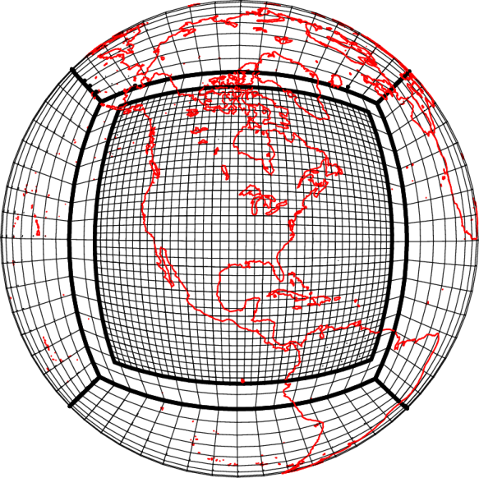
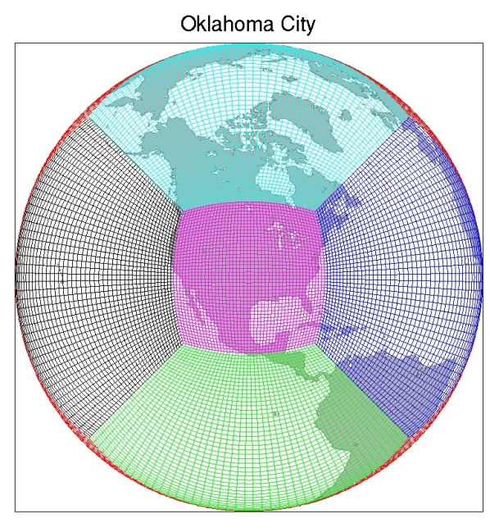
GFDL ‘s affordable ultra-high resolution regional-global model
I. Nested regional-global model
Regional model can be run independently or two-way nested with the global model
Suitable for weather & climate
II. Variable resolution global model
Single model framework with smooth transition in resolution (e.g., 3.5 km over CONUS stretched to 28 km over Indian ocean)
Suitable for weather & climate

Slide 11
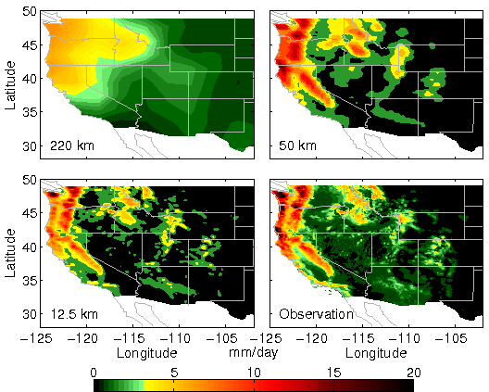
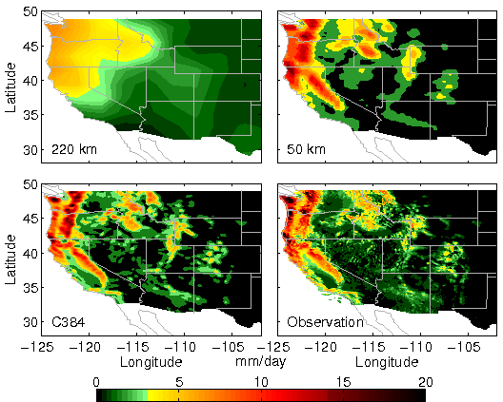
DJF precipitation: GFDL HiRAM vs. Observation
Need hi-res to provide regional details. But global uniform resolution is still too expensive
→
Make hi-res affordable with variable-res approach
C384 stretched
(~10 km over CONUS)

Slide 12
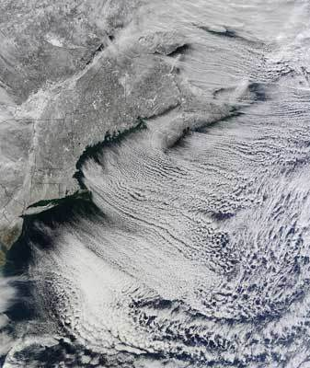
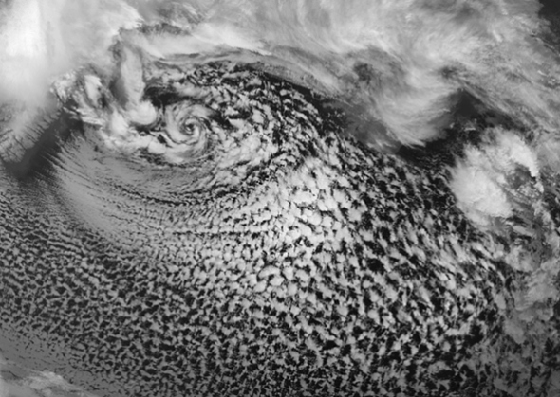
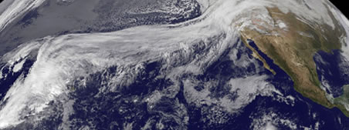
Some fine-scale wintertime phenomena that used to be impossible to simulate in a global model:
Cloud streets off US east coast
Polar low near Iceland
Pineapple express

Slide 13
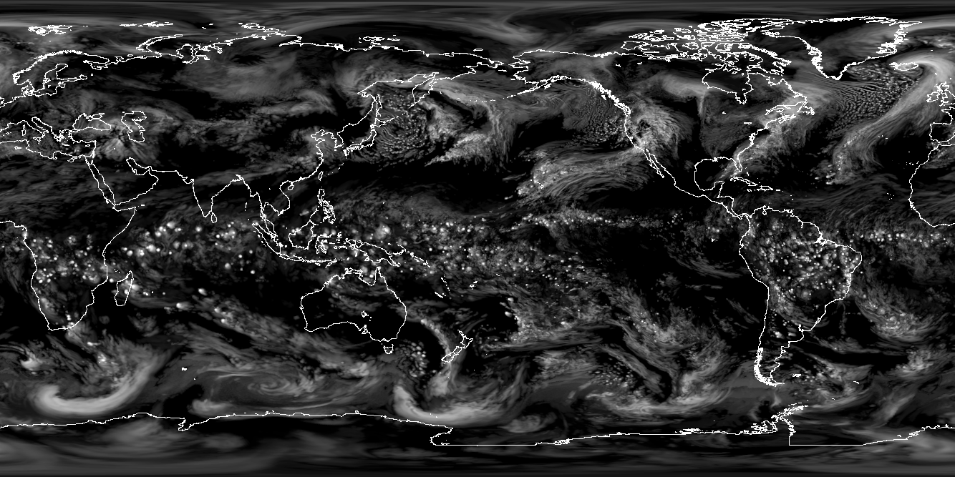
Seeing the world through cloud-ice
via GFDL’s variable-resolution
Weather-Climate model (3.5 km to 28
Ice Water Path: 24 Jan – 03 Feb

Slide 14
Final notes
The GFDL FV3 is a non-hydrostatic regional-global modeling framework with no spatial or temporal scale restriction.
GFDL’s high resolution climate model (essentially the same model used for IPCC AR5 assessments) has been demonstrated to possess remarkably high skill for seasonal hurricane predictions
GFDL is exploring the next frontier of global modeling with non-hydrostatic cloud-system resolving capability:
To provide ultra-high resolution details for regional stakeholders
To resolve, not just hurricanes (easy), but also tornado-producing thunderstorms (difficult for climate models)
Seasonal “tornado outbreak risk” prediction? Can we say something about climate change and the timing/frequency of tornado outbreaks in the US?

Slide 15
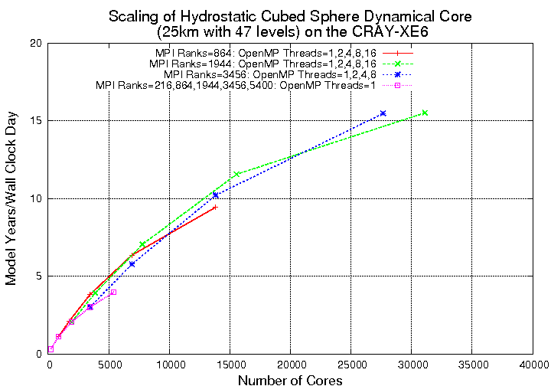
C360 (~ 25 km) L47; Held-Suarez with 4 tracers
on CRAY XE6
Hybrid MPI-OpenMP
(GPU-openACC version under construction)

