Slide 1
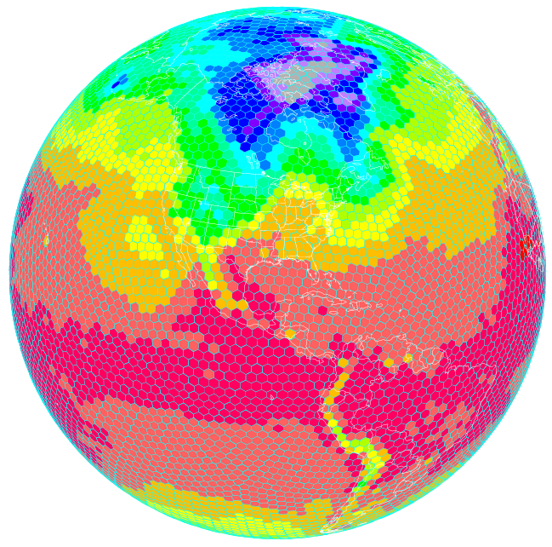
Next-generation Global Model Development at NOAA/ESRL
FIM
Flow-following
finite volume
Icosahedral
Model (FIM)
/Nonhydrostatic Icos Model
(NIM)
atmosphere
ocean
Stan Benjamin, Jin Lee
NOAA Earth System Research Lab
IHC67 - Tues 5 March 2013
iHYCOM

Slide 2


FIM Model Development – testing – http://fim.noaa.gov
FIM – Flow-following finite volume Icosahedral Model
“soccer-ball” grid design for uniform grid spacing
Isentropic/sigma hybrid vertical coordinate
New 7-14-day forecast twice daily
  10km, 15km, 30km, 60km
  Grids to NCEP for evaluation
Real-time experimental at ESRL
FIM
atmosphere
ocean
iHYCOM – Icosahedral Hybrid Coordinate Ocean Model
Matched grid design to FIM for coupled ocean- atmosphere prediction system
Experimental testing at ESRL, Navy development
Testing of coupled FIM/iHYCOM – toward experimental NMME contribution
iHYCOM

Slide 3
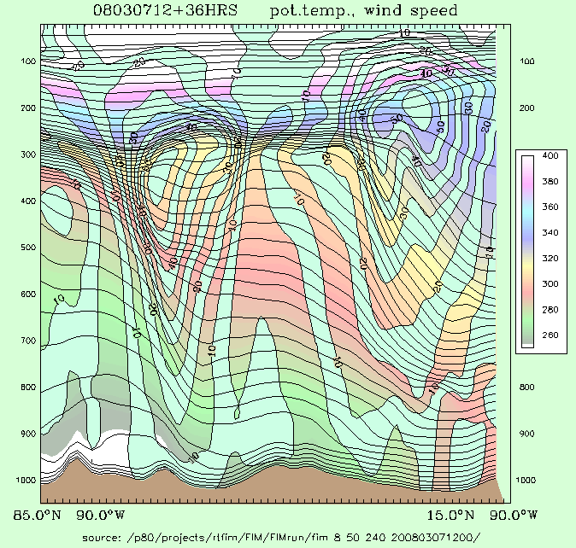
FIM global model development at NOAA/ESRL and NCEP
Horizontal grid – icosahedral (largely hexagons)
Vertical grid – hybrid isentropic-sigma
Resolution
Real-time testing at 60km, 30km, 15km, 10km resolution - icosahedral horizontal grid
64 vertical levels – hybrid θ-σ
Ptop = 0.5 hPa, θ-top = 2200K
Physics
Currently GFS physics suite (2011 version)
Testing with WRF (Grell cumulus, PBL)
Initial conditions
GFS/GSI spectral data to FIM icos hybrid θ-σ vertical coordinate
Ensemble Kalman data assimilation in development using FIM model (using NOAA GSI-ensemble code)

Slide 4
FIM global model
Horizontal grid
  Icosahedral, Arakawa A grid – testing 60km/30km/15km
Vertical grid
  Staggered Lorenz grid, ptop = 0.5 hPa, θtop ~2200K
  Generalized vertical coordinate
    Hybrid θ-σ option (64L)
    GFS σ-p option (64 levels)
Numerics
  Adams-Bashforth 3rd order time differencing
  Flux-corrected transport, finite-volume
Physics
  GFS physics suite, WRF-Grell cumulus
Coupled model extensions
  Chem – WRF-chem/GOCART
  Ocean – icosahedral HYCOM
GPU/MIC capability – dynamics complete, physics within 6 mos

Slide 5
FIM NIM global model – non-hydrostatic incl <5km
Horizontal grid
  Icosahedral, Arakawa A grid – testing 60km/30km/15km
Vertical grid
  Staggered Lorenz grid
  Vertical coordinate
    Sigma-z option (64L)
Numerics
  Adams-Bashforth 3rd order time differencing
  Flux-corrected transport, finite volume
Physics
  GFS physics suite, GRIMS (Korea mesoscale) suite
Coupled model extensions
  Chem – WRF-chem/GOCART - future
  Ocean – icosahedral HYCOM - future
GPU/MIC capability – dynamics complete, physics within 6 mos

Slide 6
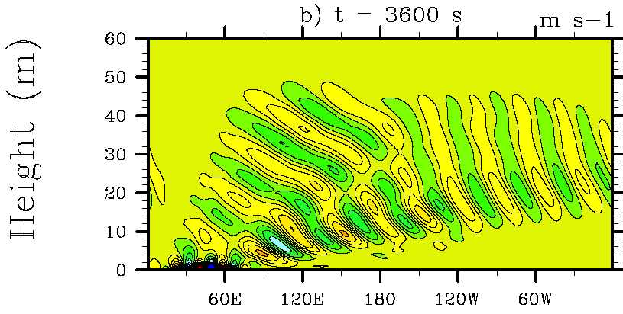
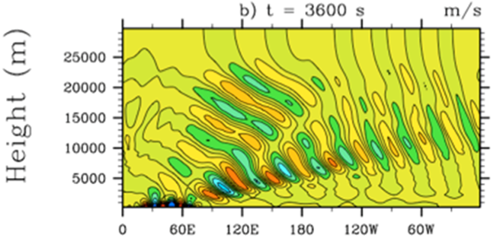


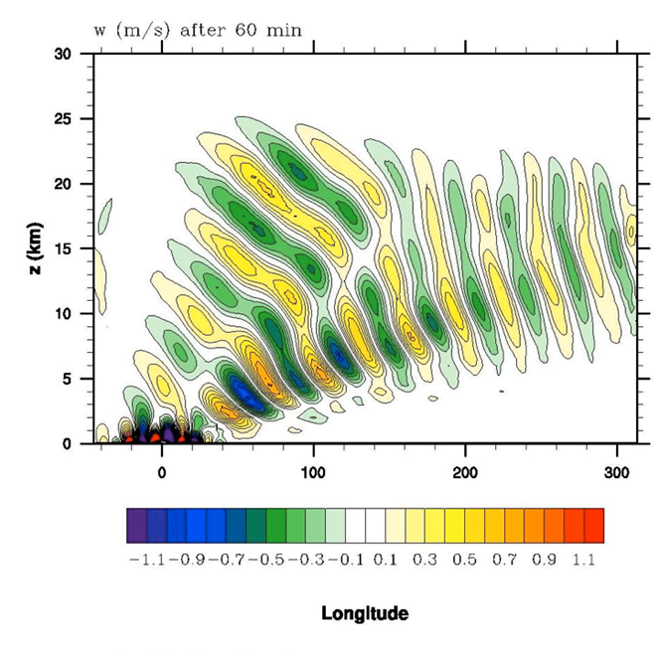
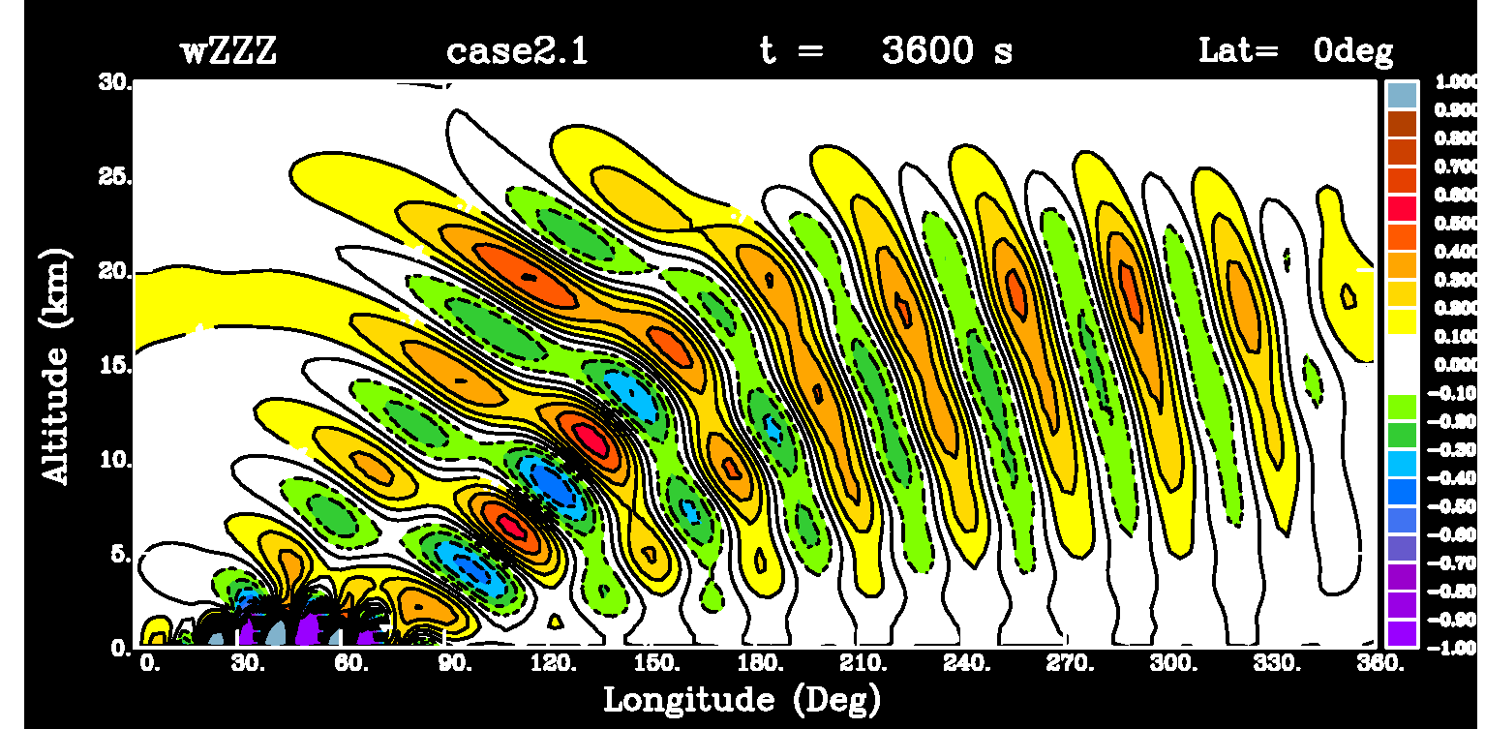
DCMIP – Dynamic Core Model Intercomparison Project:
Experiment 2.1 (non-hydrostatic mountain wave - small earth)
ENDgame - UKMO
ICON-IAP – Germany - DWD
MPAS/G5 - NCAR
NIM/G5 - ESRL

Slide 7
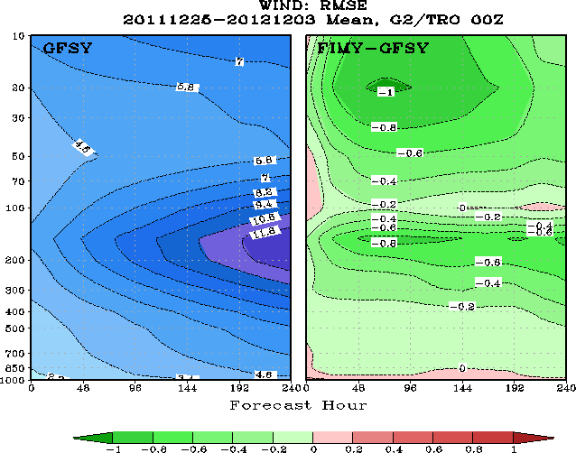
FIM vs. GFS using ECMWF as verification
- Tropical winds
http://www.emc.ncep.noaa.gov/gmb/wx24fy/fimy/
Green ➔ FIM more accurate than GFS

Slide 8
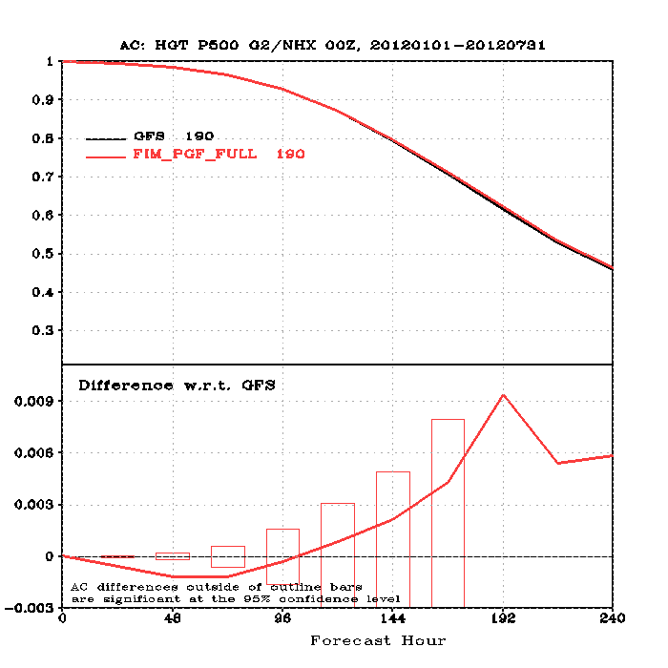
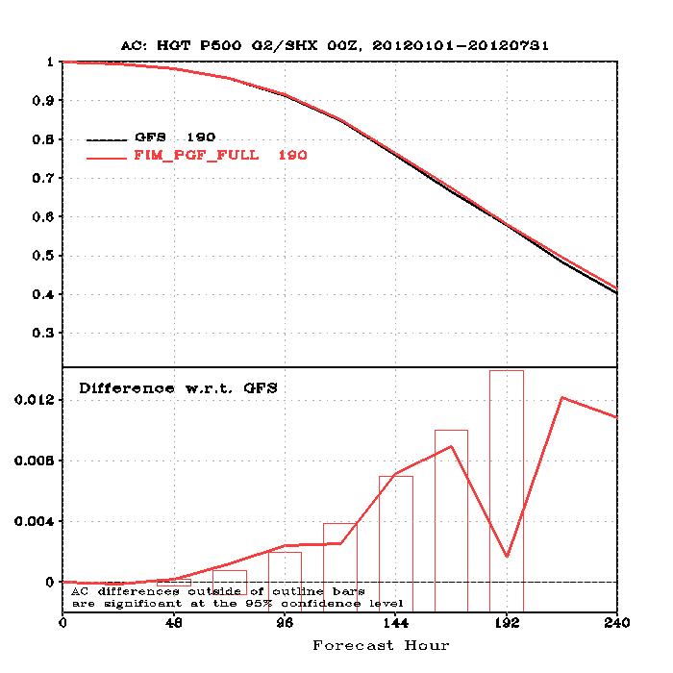
FIM vs. GFS – 500 hPa AC - Jan-July 2012
N. Hemisphere
S. Hemisphere

Slide 9
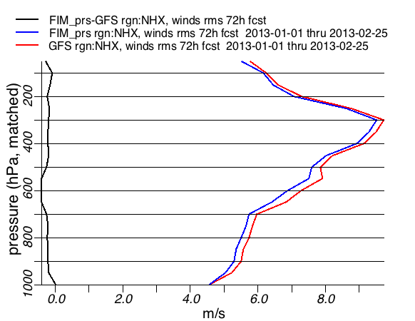
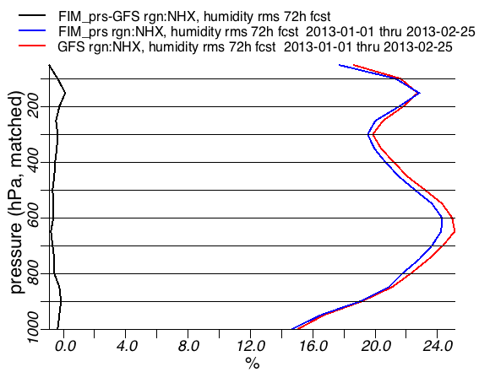
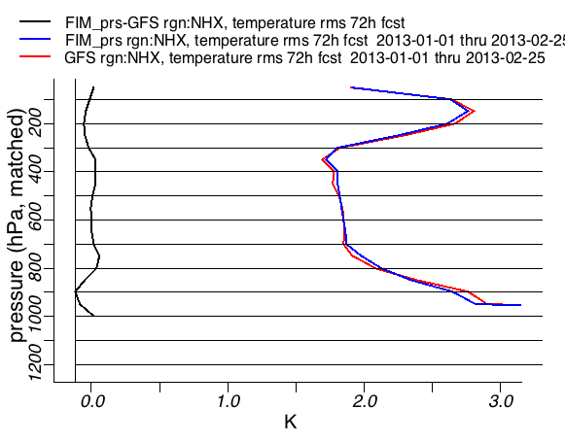
FIM better
GFS better
FIM better
GFS better
72h forecasts vs. raobs
N. Hemisphere 20-80N
FIM vs. GFS - 2013
(FIM lower rms errors for V, T, RH at all levels, similar results at 24h,48h)
FIM better
GFS better

Slide 10
Versions of FIM in real-time runs – Fall 2012 – current
 | Resolution | Init conds | Physics | Diffusion
FIM | 30km | GFS oper | GFS (May 2011,not May 2012) | 2nd-order
FIM9 | 15km | GFS oper | GFS | 2nd-order
FIM9 - zeus | 15km | GFS oper | GFS | 4th-order
FIM95 (Jan13) | 10km | GFS-ESRL | GFS | 2nd-order
FIMX | 30km | GFS oper | GFS + WRF-chem, testing of Grell cu | 2nd-order
FIM7 | 60km | GFS oper | GFS | 2nd-order

Slide 11
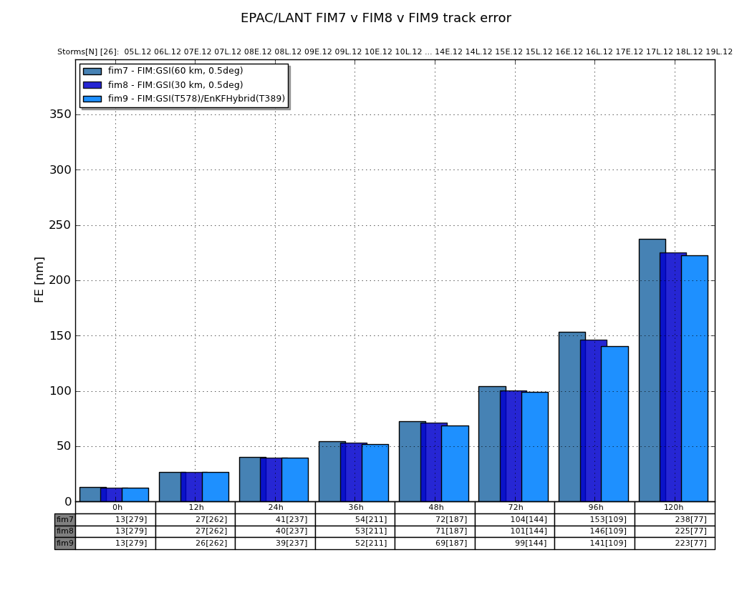
FIM track forecast skill for 60km, 30km, 15km versions - 2012
- no other differences
Improved track skill with higher resolution for LANT and EPAC domains

Slide 12
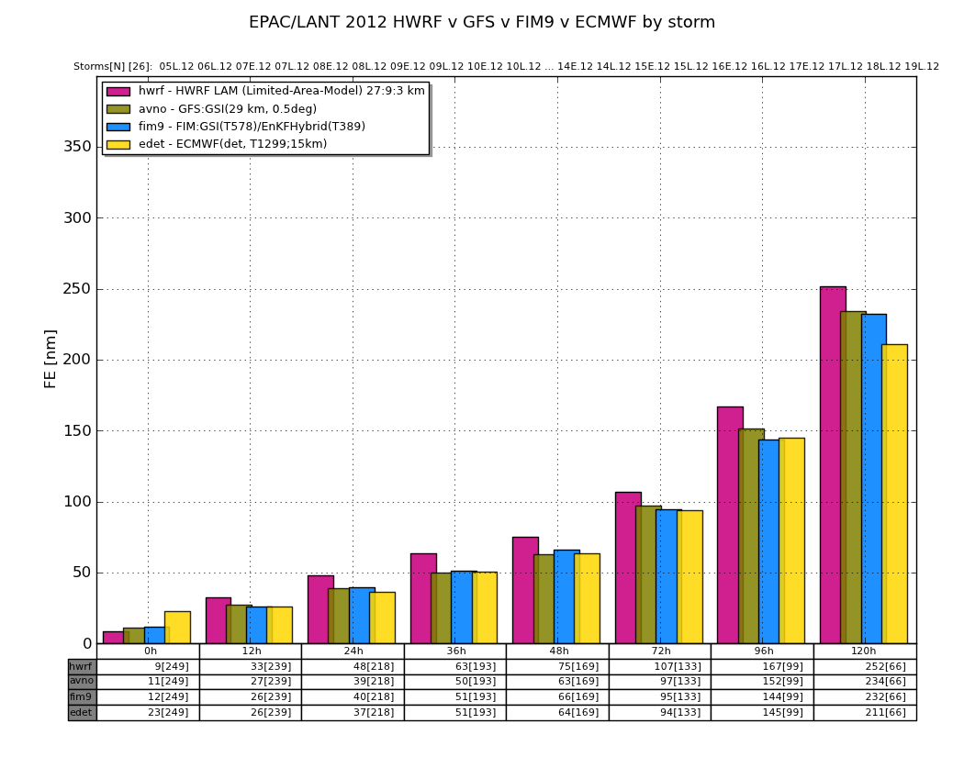
Full 2012 track errors – Atlantic + E.Pacific basins

Slide 13
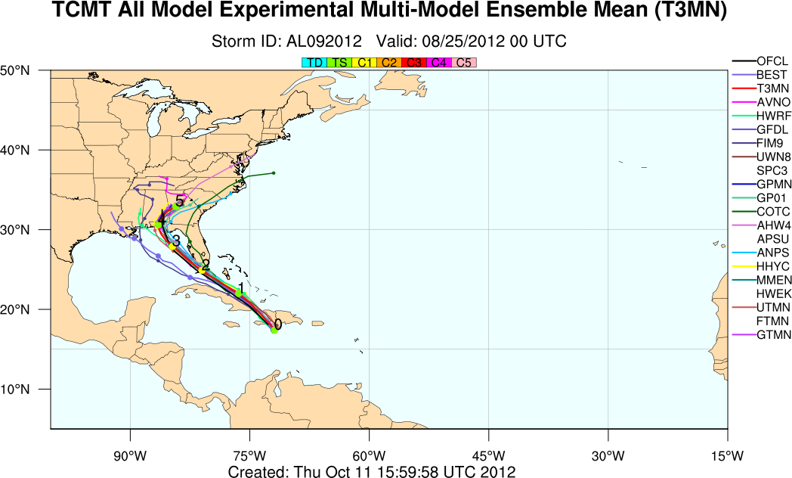
Isaac forecasts from HFIP
FIM9

Slide 14
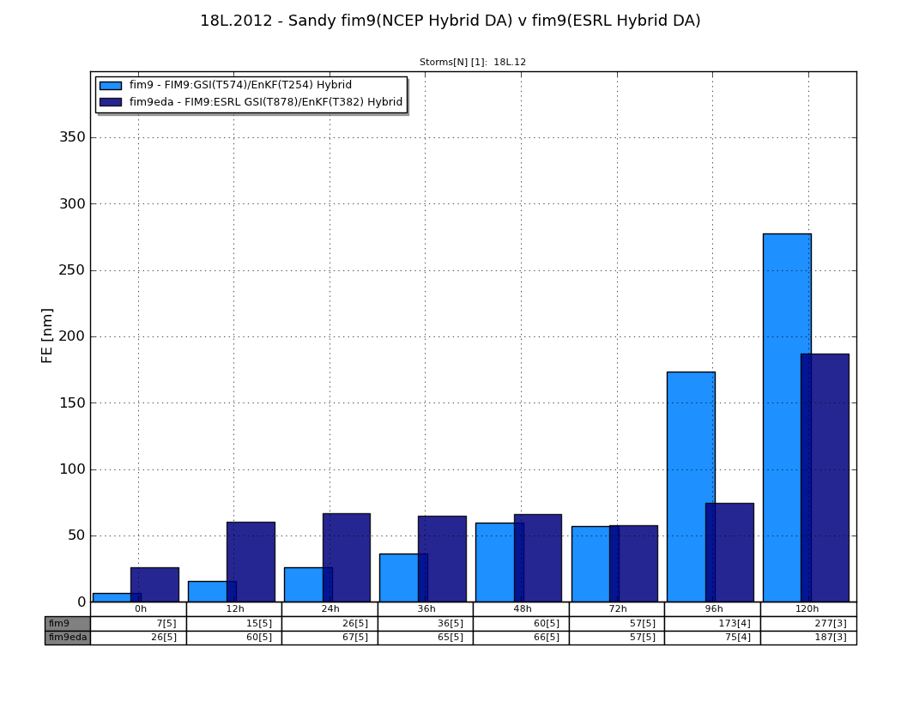
Hurricane Sandy forecasts – FIM9 (15km) runs - comparisons with 2 sets of initial conditions
1) GFS-operational T574 hybrid DA
(used in FIM9 real-time runs for HFIP)
2) ESRL T878 GFS-EnKF/hybrid DA
FIM9 – HFIP – Stream 1.5
FIM9 – ESRL DA
Sandy track forecasts

Slide 15
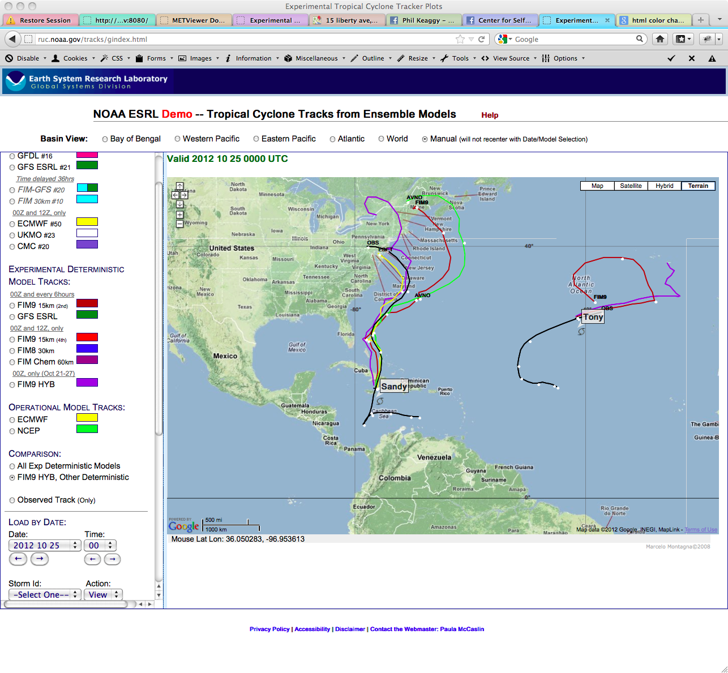
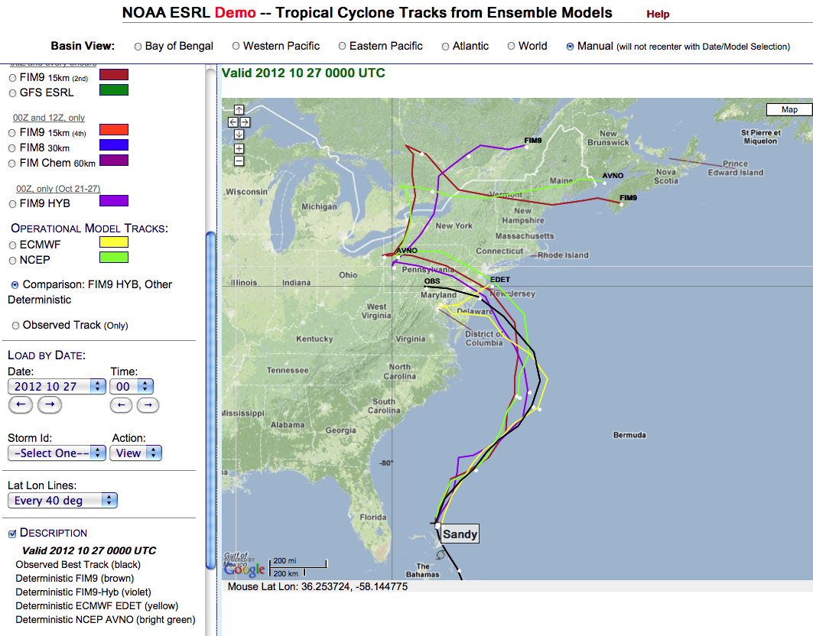
Sandy – initial time 25 Oct 00z
HFIP
ESRL-DA

Slide 16
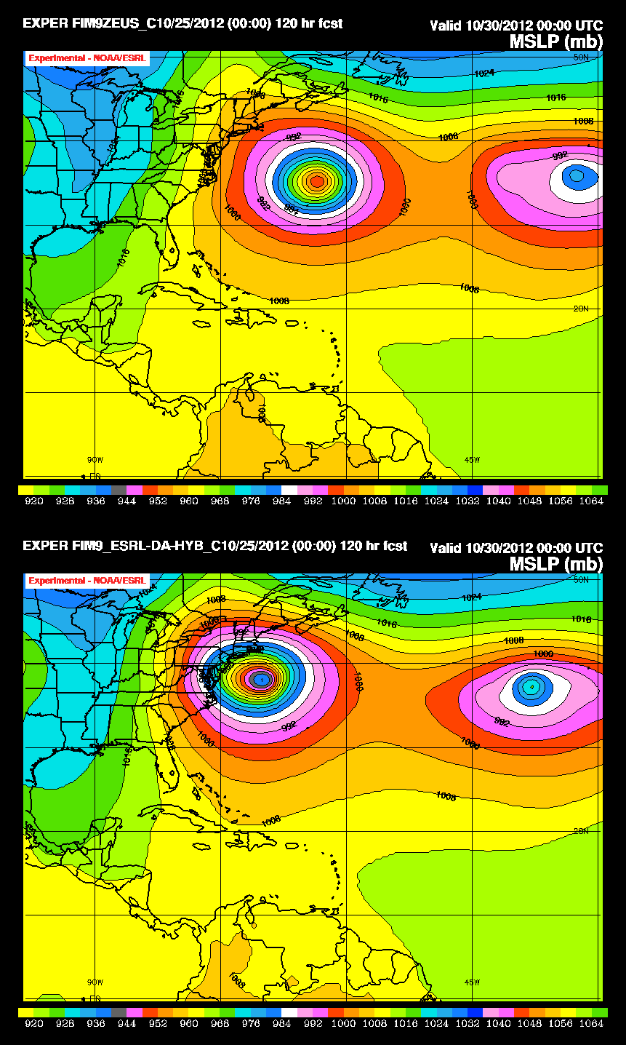
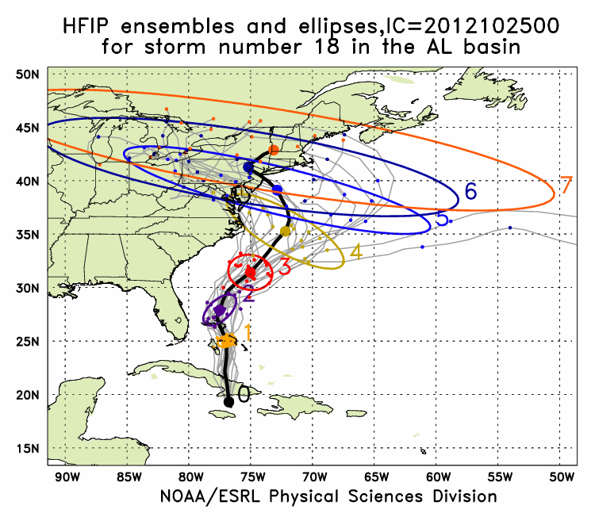
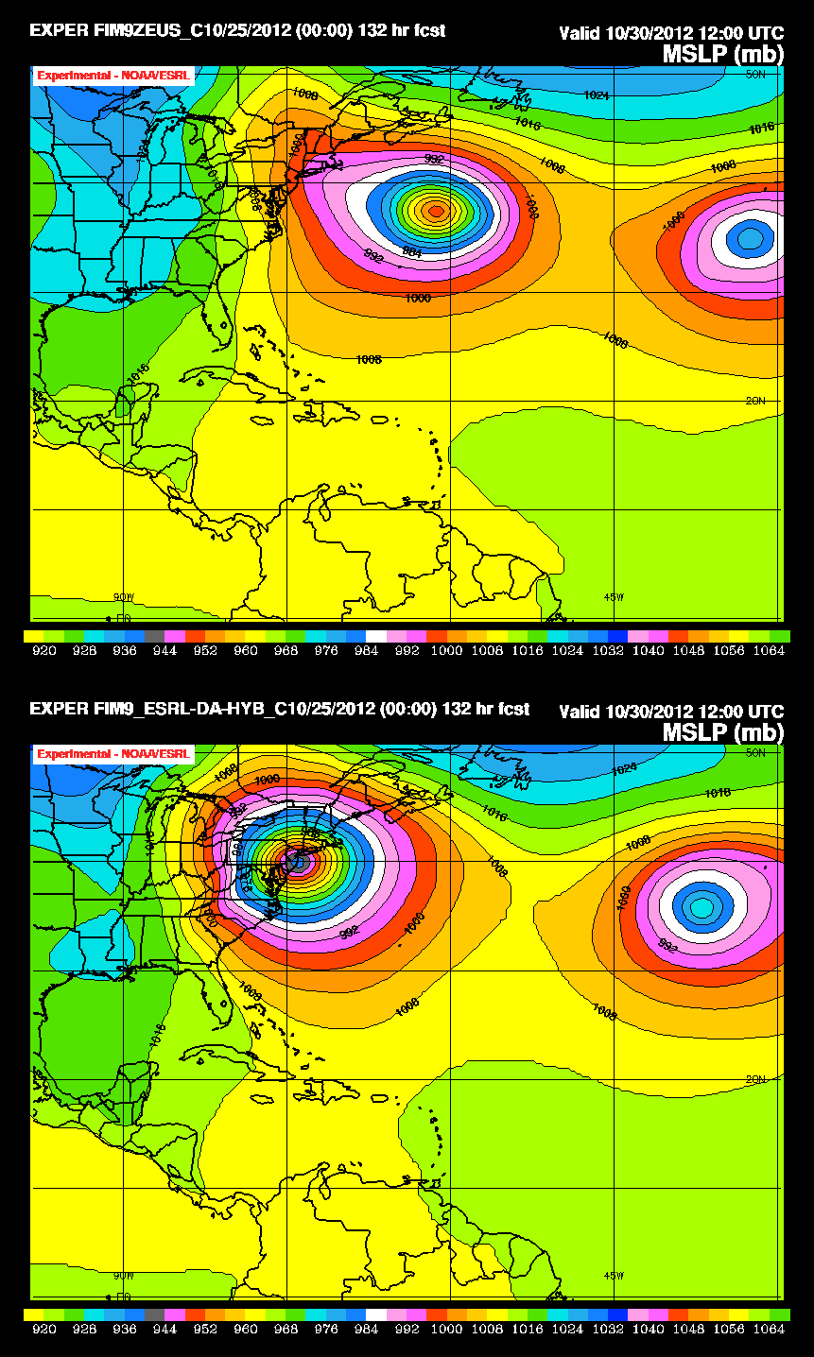
120h
00z 25 October
Init time runs
132h
FIM9-DA-HYB
Used ESRL experimental higher-resolution GFS hybrid/EnKF data assimilation for IC

Slide 17
120h
00z 25 October
Init time runs
132h
FIM9-DA-HYB
Used ESRL experimental higher-resolution GFS hybrid/EnKF data assimilation for IC

Slide 18
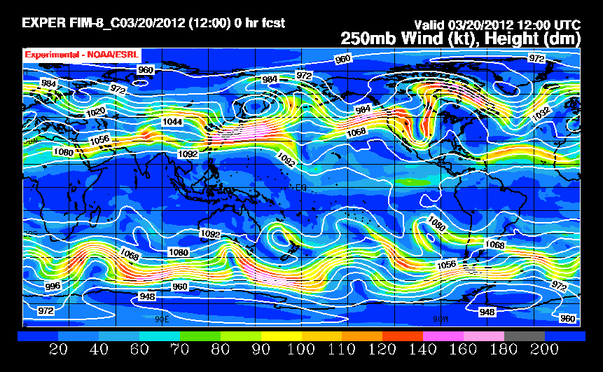
Episodic Weather Extremes from Blocking
Longer-term weather anomalies from atmospheric blocking -Defined here as either ridge or trough quasi-stationary events with duration of at least 4 days to 2+ months
ESPC demo #1 Target: improved 1-6 month forecasts of blocking and related weather extremes
Lead - Stan Benjamin
NOAA Earth System
Research Laboratory
Boulder, CO
Other ESPC Demo #1 team members
Wayne Higgins Randy Dole Shan Sun Melinda Peng
Arun Kumar Judith Perlwitz Rainer Bleck
Mingyue Chen Marty Hoerling John Brown
Kathy Pegion Mike Fiorino

Slide 19
Outcomes from prolonged blocking events or persistent anomalies
Flooding
Droughts, excessive fires
Heat wave or cold wave
Excessive or season-long absent snow cover
Excessive ice cover or absence of normal ice cover (example: Great Lakes – 2011-12 winter)
Human and economic impact increases exponentially with duration of blocking event

Slide 20
Processes related to blocking for onset, maintenance, cessation
NWP components needed
Initial value – data assim | High-res Δx | Coupled ocean | Stochastic physics | PV cons. Numerics | Chem/aerosol | Soil/snow LSM accuracy
✓ | ✓ |  | ✓ | ✓
✓ | ✓ | ✓ | ✓ | ✓ | ✓
✓ | ✓ | ✓ | ✓ |  | ✓
✓ | ✓ | ✓ | ✓ | ✓ | ✓ | ✓
✓ |  |  |  | ✓ | ✓
✓ |  |  |  |  | ✓ | ✓
✓ |  | ✓ |  |  | ✓ | ✓
Extratropical wave interaction
MJO life cycle
Other tropical processes/ENSO
Trop storms, extratrop transitions
Sudden strato warming events
Snow/ice cover anomalies
Soil moisture anomalies

Slide 21
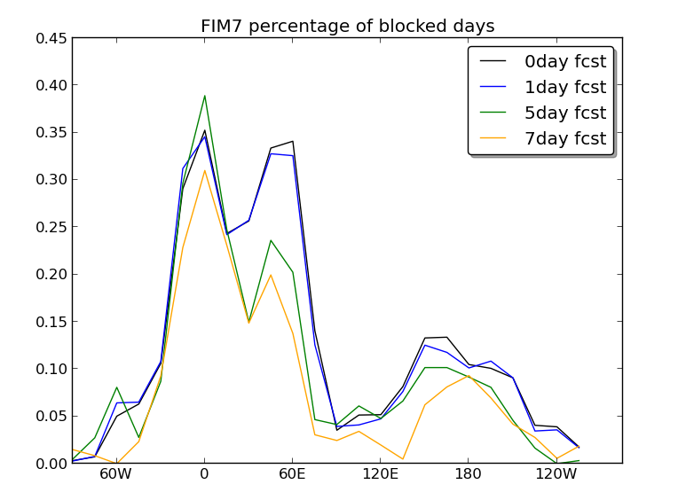
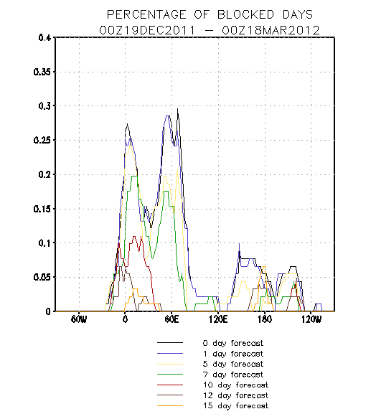
Percentage of blocked days
NCEP GFS – 1-15 day fcsts
Dec 2011 – March 2012
7-day GFS forecast blocking frequency is about 50% of observed
7-day FIM 60km forecast blocking frequency is about 80% of observed

Slide 22
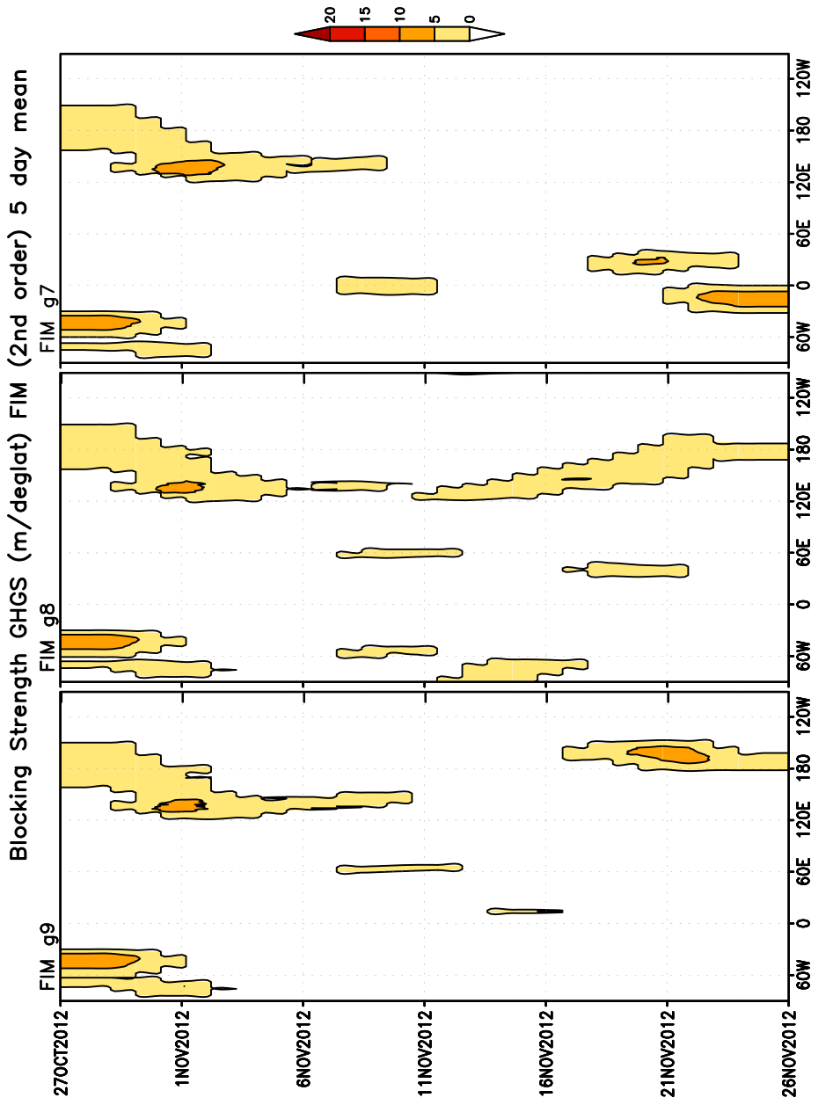
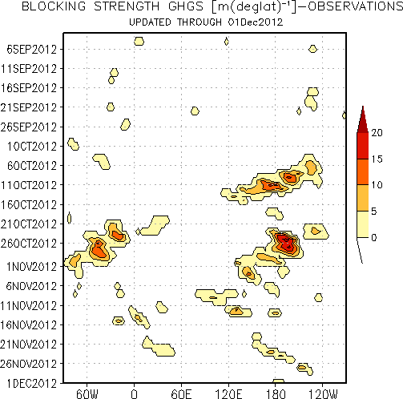
Blocking Strength (m/deg lat) – FIM 30-day forecasts
15km
30km
60km
Observed
Observed

Slide 23
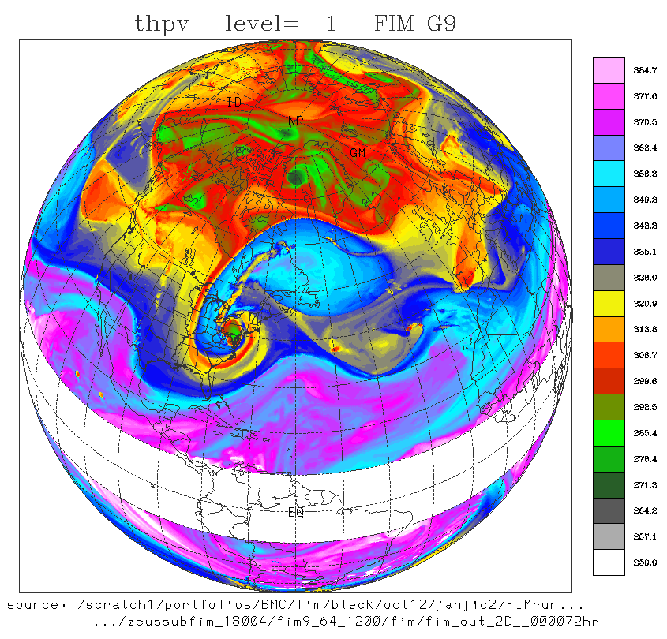

72h forecast
Valid 12z 30 Oct
Potential temp on PV =2 surface
15km FIM model

Slide 24
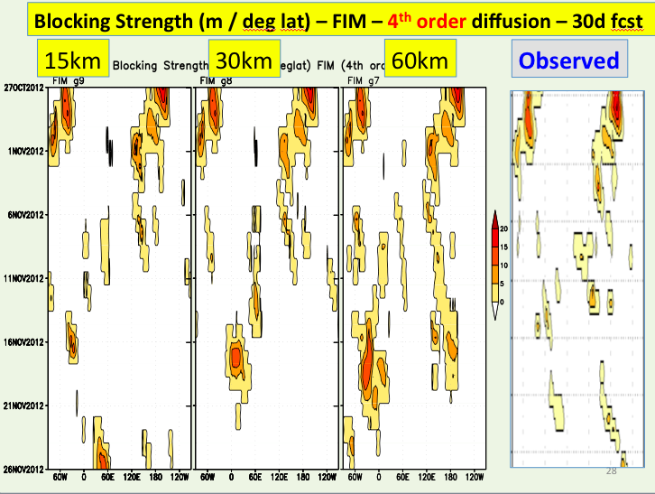
ESPC Blocking Demo #1 initial findings
Lower blocking frequency in weather and climate models compared to observed
  Known problem, worthy of ESPC Demo #1 effort, critical for improved subseasonal-seasonal forecasts
Initial 30-day blocking tests with FIM
  Much higher blocking frequency than GFS
    Hypothesis: due to numerical differences
  Independent of resolution
  (15km, 30km, 60km)
  Block duration sensitive to
  model diffusion and res for FIM
Efforts have just barely started

Slide 25
ESPC Demo #1 directions (2013-18)
Hypothesis: Blocking deficiencies may be addressable through improved coupled models (numerics, resolution, physics)
What’s new: next-generation global AMIP/CMIP models (higher resolution, modified numerics, readying for GPU/MIC computational era)
Expand laboratory links for planned collaboration for blocking research topics for prediction over 1-26 week duration
Build on NMME community operational ties, also labs with WWRP/ WCRP/THORPEX
research “Subseasonal to Seasonal
Prediction Research Implementation Plan

Slide 26
ESRL/NOAA plans on global modeling
Complete FIM-EnKF-GSI data assimilation, 4densvar
Improved numerics/physics (PBL, ocean)
GEFS experimental FIM testing (plan with NCEP)
NMME experimental testing – coupled FIM
  - FIM/iHYCOM coupled model (more at GODAE mtg)
HFIP (tropical cyclone) real-time forecasts – 15km, 25km ensemble
FIM-chem/CO2/volcanic ash earth system apps
NIM real-data tests
Application of FIM/GFS/advanced data assimilation but also NIM and MPAS in NOAA Research-Regular Pilot Test (also toward HFIP, ESPC goals)

