Slide 1
Earth System Prediction Capability (ESPC)
Daniel P. Eleuterio, Ph.D.
Jessie C. Carman, Ph.D.

Slide 2
ESPC Overview
Introduction
ESPC is an interagency collaboration (DoD, NOAA, DoE, NASA, NSF) to coordinate R2O for an extended range earth system analysis and prediction capability at the weather to climate interface.
Common prediction requirements and forecast model standards enable agencies to improve leverage and collaboration.
Cooperative five-year demonstration projects inform S&T and R&D efforts.
Integrate of atmosphere-ocean-land-ice and space predictions into a fully coupled global prediction capability.
Sources of Predictability:
Improve Model Physics through:
Coupled global modeling
Improved resolution & parameterization
Improve Initial Value Problem through
Joint observational retrievals
New hybrid DA approaches
Increase Forecast Information through
Stochastic prediction and post-model processing
National Multi-model ensembles
Seamless prediction
Increase System Resolution affordably through
Efficient Computational Architectures
Efficient Numerics/Discretization
Notes:
We held a town hall here last year to discuss an opportunity to form a new interagency collaboration for earth system modeling. Since then we have held two science workshops and presented ideas to an executive steering committee of agency leaders. We’re here to bring you up to date on our program and ask for comments and participation.

Slide 3
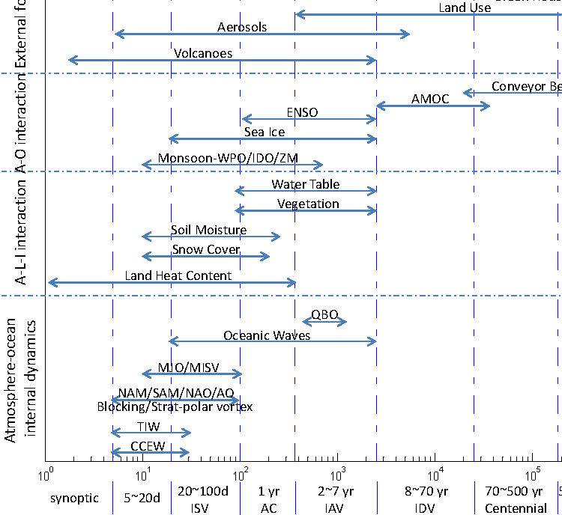
Sources of Extended Range Predictability: Subseasonal, Intraseasonal and Interannual (ISI) Timescales
ESPC Focus
Assessment of Intraseasonal to Interannual Climate Prediction and Predictability, 2010, THE NATIONAL ACADEMIES PRESS • 500 Fifth Street, N.W. • Washington, DC 20001

Slide 4
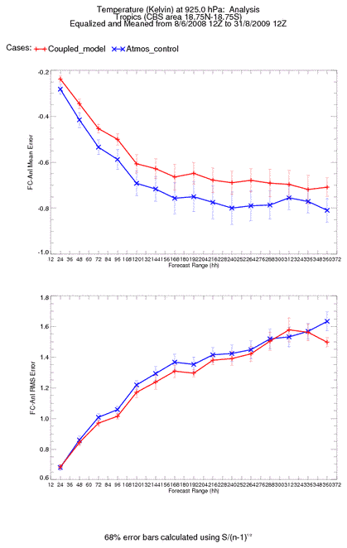
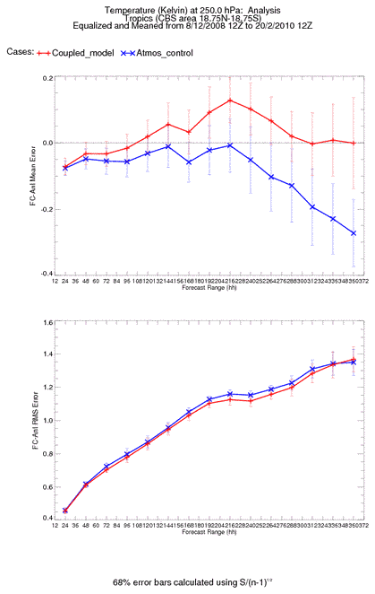
Global Coupled Models
Global air-sea coupled models were first implemented for climate applications but are increasingly being used at subseasonal to ISI timescales.
Benefit is seen especially in the tropics in both atmospheric and oceanic verification with largely comparable skill in extra-tropics and some benefit still seen at higher latitudes from coupling in the Southern Hemisphere.
At week two and beyond, coupling produces skill improvements comparable to doubling resolution in some research cases.
Crown copyright Met Office

Slide 5
Recent ESPC Activity
Demonstrations Workshop 13-15 Nov 2012
Attended by Demo team leads, working group participants, Agency/lab representatives (for coordination)
Organized around Demo groups: Preliminary talks, breakouts for working group discussions, reconvened/summarized
Drafted implementation plans that are in refinement now for a July 2013 start
0-100 day Pilot Project included in ESPC Project Office focus Jan 2013
NOAA/ESRL initiative to improve R2O transitions
Overlaps ESPC time scale
Benefits from greater interagency inclusiveness
Demo Projects provide focused improvements to extended-range capability, but do not, themselves, provide a forecast capability
NOAA OAR working on infrastructure shortfalls, working cross-agency on science funding shortfalls

Slide 6
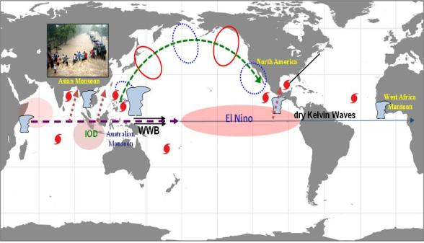
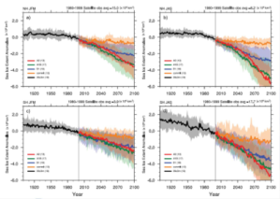
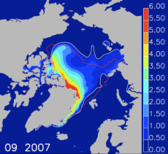
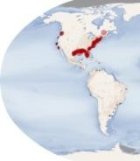
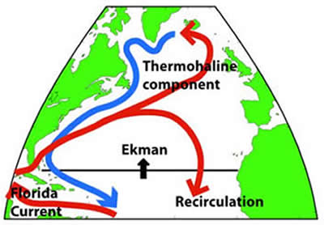
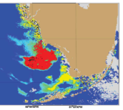
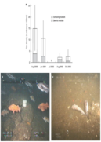
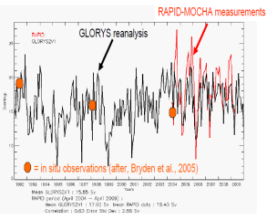
ESPC Demonstrations
(10 days to 1-2 years)
Extreme Weather Events: Predictability of Blocking Events and Related High Impact Weather at Leads of 1-6 Weeks (Stan Benjamin, ESRL)
Seasonal Tropical Cyclone Threat: Predictability of Tropical Cyclone Likelihood, Mean Track, and Intensity from Weekly to Seasonal Timescales (Melinda Peng, NRL MRY)
Arctic Sea Ice Extent and Seasonal Ice Free Dates: Predictability from Weekly to Seasonal Timescales (Phil Jones, LANL)
Coastal Seas: Predictability of Circulation, Hypoxia,
and Harmful Algal Blooms at Lead Times of 1-6 Weeks (Gregg Jacobs, NRL SSC)
Open Ocean: Predictability of the Atlantic Meridional Overturning Circulation (AMOC) from Monthly to Decadal Timescales for Improved Weather and Climate Forecasts (Jim Richman, NRL SSC)

Slide 7
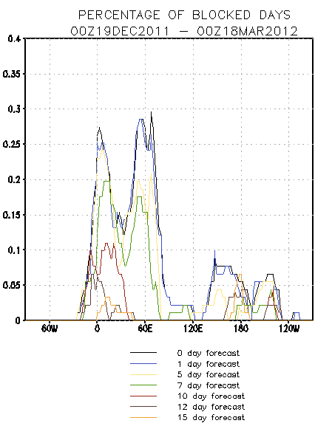
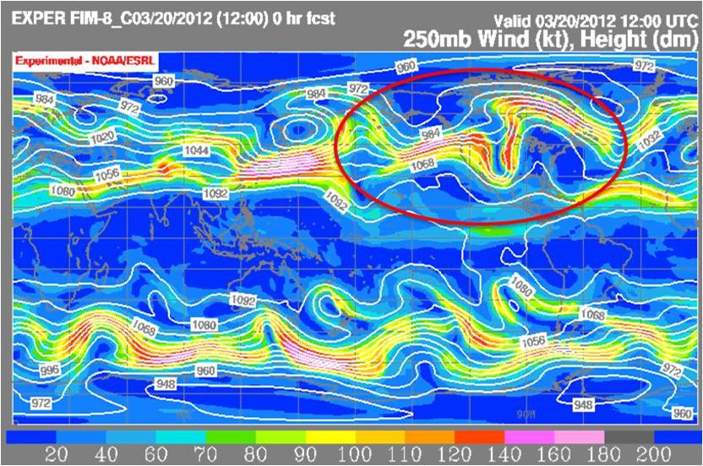
Extreme Weather Events: Predictability of Blocking
Events and Related High Impact Weather
at Lead Times of 1-6 Weeks
ESPC Demonstration #1 – Improved guidance for extreme weather events related to atmospheric blocking flow (flooding, drought, persistent anomalously cold/warm conditions).
Objective:
Apply current understanding of the blocking process to develop,
assess utility of model diagnostics to current state and forecast.
Thrusts:
Diagnose longer-term weather anomalies from atmospheric blocking
(quasi-stationary events with duration of at least 4 days to 2+ months)
Predict seasonal statistics (below/normal/above average
conditions) at various lead times up to six months.
Predict individual events (onset/persistence/cessation)
Predict outcomes (floods, droughts, fires, extreme temps, snow).
Challenges:
Several possible causes are postulated each with unique sources
of predictability and technical approach. These include MJO
interaction, TCs/extratropical transition, SSW events, and early season snow cover or melting.

Slide 8
Processes related to blocking: onset, maintenance, cessation
Components needed
Initial value – data assim | High-res Δx | Coupled ocean | Stochastic physics | PV cons. Numerics | Chem/aerosol | Soil/snow LSM accuracy
✓ | ✓ |  | ✓ | ✓
✓ | ✓ | ✓ | ✓ | ✓ | ✓
✓ | ✓ | ✓ | ✓ |  | ✓
✓ | ✓ | ✓ | ✓ | ✓ | ✓ | ✓
✓ |  |  |  | ✓ | ✓
✓ |  |  |  |  | ✓ | ✓
✓ |  | ✓ |  |  | ✓ | ✓
Extratropical wave interaction
MJO life cycle
Other tropical processes/ENSO
Trop storms, extratrop transitions
Sudden stratospheric warming events
Snow/ice cover anomalies
Soil moisture anomalies

Slide 9
Impact of Divergent Outflow Pattern on Downstream Flow
Circular outflow pattern
Linear outflow pattern
Cyclonic wave breaking
Blocking onset
Ridge amplification
Rossby wave dispersion
L
Jet elongation
L
9
9
9
9
Harr and Archambault (2013).
Divergent wind
Upper-level PV contour
Precipitation/diabatic heating
Wind speed max
Trough axis
9
Recurving tropical cyclone
Ridge axis
9
Downstream cyclone
L

Slide 10
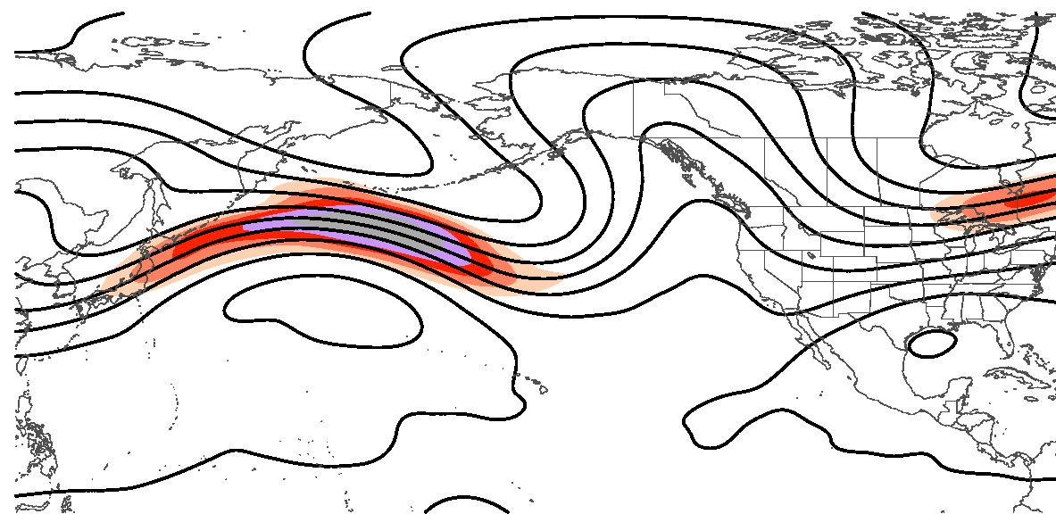
Physical Mechanisms that Link Recurving Tropical Cyclones to Blocking
4) High-latitude ridge amplifies
3) Cyclones form in exit region of intensified jet
BLOCK
2) Tropical cyclone outflow intensifies jet
L
COLD
L
9
9
1) Tropical cyclone recurves
Tropical cyclone outflow characteristics impact the type of midlatitude response:
Circular outflow pattern and ridge amplification
Linear outflow pattern and jet elongation
The midlatitude response impacts the potential for blocking, the longitude of blocking, and the intensity of the block
Harr and Archambault (2013).

Slide 11
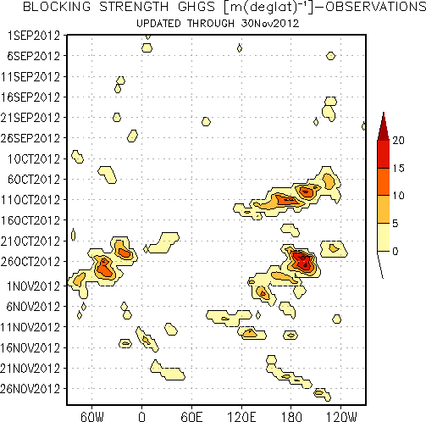
Extreme Weather Events: Blocking
Key Research Questions:
What is predictability at 1-6 wks of duration of blocking and stationary waves from existing global models?
What is the minimum horizontal and vertical resolution needed for global models to capture blocking events?
For predicting onset/cessation of stationary wave events, to what extent is it necessary to accurately predict
MJO, stratospheric warming events?
Subtropical jets (existence, persistence)?
Planetary wave breaking (with anticyclonic jets)?
To what extent are deficiencies in prediction of blocking dependent on model physics suite (deep convection, radiation)?
Time
Sandy landfall
ATL longitude

Slide 12
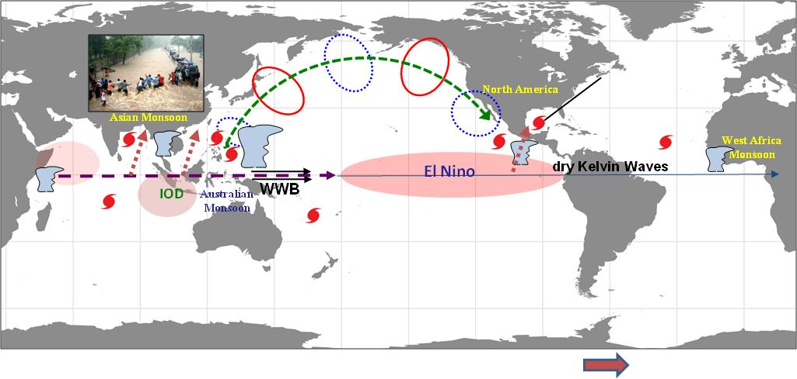
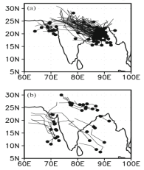
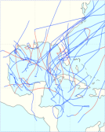
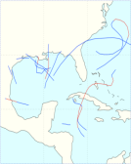
Seasonal Tropical Cyclone Threat: Predictability of Tropical Cyclone Likelihood, Mean Track, and Intensity from Weekly to Seasonal Timescales
ESPC Demonstration #2 – Improved pre-season guidance of tropical cyclone seasonal track
and frequency statistics as well as sub-seasonal outlooks for civil and military planning.
Objectives:
Prediction of seasonal basin scale tropical cyclone
genesis and track distributions and potential intensity.
Thrusts:
Initial value, short range prediction improvements for
track and structure.
Boundary value, longer range probabilistic forecasts of
maximum likelihood genesis, track, intensity.
Landfall probability with the accompanying potential
intensity and precipitation to support resource
management, evacuation plans, ship routing, etc.
Challenges:
Multi-scale convective processes and interaction between tropical cyclone and the large scale environment, and our understanding and ability to predict them vary widely from basin to basin.
Goswami et al. (2003)
Maloney and Hartmann (2000)

Slide 13
Seasonal Tropical Cyclone Threat: Predictability of Tropical Cyclone Likelihood, Mean Track, and Intensity from Weekly to Seasonal Timescales
Key Research Questions:
Madden Julian Oscillation (MJO) is the most prominent signal of the intra-seasonal oscillations
TC genesis is correlated with the positive (convective) phase of MJO
Phase of MJO influences the intensity of TCs
El Nino and Southern Oscillation (ENSO) is the most prominent signal of interannual variability
SST variations
ENSO impacts TC activities
What is the predictability of these phenomena?
Tropical cyclone activities are closely linked to seasonal, intraseasonal oscillations, and ENSO

Slide 14
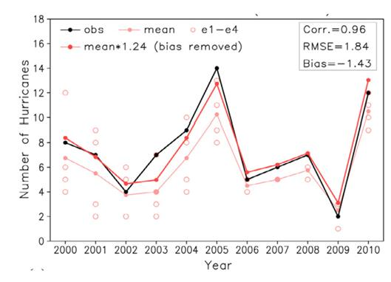
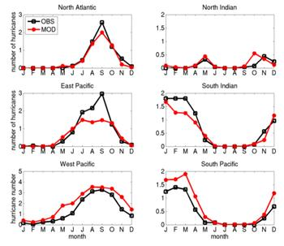
Tropical Cyclone Demonstration Phase I
Seasonal Tropical Cyclone Approach
Leverage advanced model predictions on seasonal to inter-annual timescales for improved seasonal tropical cyclone predictions
Interannual variability (El Nino and La Nina) affects TC activity, formation locations, track type, and intensity in all basins, but especially in the Atlantic
Dynamical seasonal TC forecasts have been shown to be as skillful as statistical techniques (Camargo et al. 2007)
Tropical cyclone activity and maximum intensity distribution have been used as metrics demonstrating viability of advanced climate models such as GFDL High-resolution Atmospheric Model (HIRAM)

Slide 15
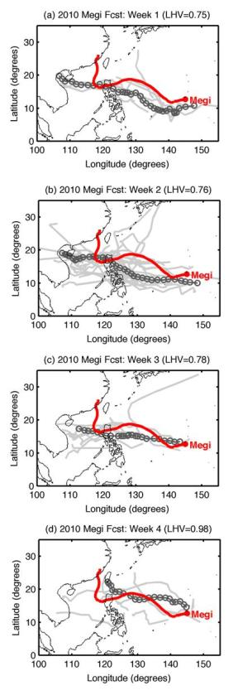
Tropical Cyclone Demonstration Phase I
Extended-range (5-30 day) approach
Recent research has advanced understanding, predictive capability of intraseasonal variability (e.g. MJO), and modulation of intraseasonally-varying large-scale circulation on tropical cyclone formation, tracks
Active phase of MJO is favorable for TC formation in conjunction with monsoon circulation (e.g., western North Pacific)
TC motion is primarily determined by large-scale steering flow; intensification to typhoon intensity requires favorable environmental conditions over a large area, so TC tracks TCs are also modulated on intraseasonal timescales
ECMWF 32-day ensemble has been demonstrated to predict MJO variability on 20 day timescales

Slide 16
Tropical Cyclone Phase II Predictive Capability (2018-2025)
Seamless Tropical Cyclone Prediction
(1 day to seasonal)
Focus in Phase II: fill the subseasonal gap between the extended-range (5-30 day) and seasonal time scales
Utilize advanced seasonal tropical cyclone prediction models in the subseasonal time range
Extend the integrations of multiple skillful extended-range models into subseasonal time range
ECMWF is already considering a 45-day ensemble

Slide 17
High Impact Weather 0-100 Day Pilot Project (HIWPP)
Vision
Improve prediction of high-impact weather events in the 0 to 100 day range: extreme events
Produce regular research-reliable runs from multi-agency models
Unify physics, scale-aware parameterizations, statistical and other post-processing
Implement common modeling standards across local enabling technologies (ESMF, NUOPC Interoperability Layer, nesting, unstructured grids; dynamical core, other numerics)
Use common skill metrics, diagnostics and prognostics
A response to:
Perceived recent increase in frequency/character of extreme weather
Increased national assets/infrastructure at risk
Hurricane Sandy supplemental funds available to develop some of these capabilities

Slide 18
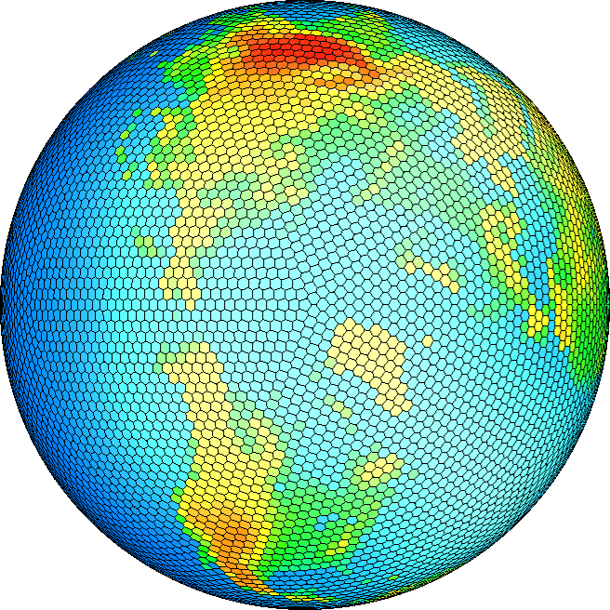
High Impact Weather 0-100 Day Pilot Project: Improved Computational Efficiency
Incorporate next-generation Global Atmospheric Cloud Resolving Models (GCRM) – and Air-Wave-Ocean Coupled Models across scales.
GFS/CFSv2, NMMB, FIM/iHYCOM, FMS/MOM, HiRAM, MPAS, NUMA, NAVGEM/HYCOM, MPAS, CESM etc.
High resolution for regional high impact and extreme events
Adaptive/unstructured mesh is less dispersive and allows for better scaling/computational efficiency
Potentially improved prediction at weather to short term seasonal climate variability scales (5-100 days)

Slide 19
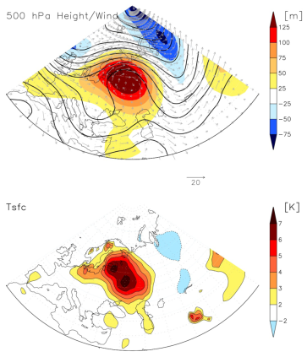
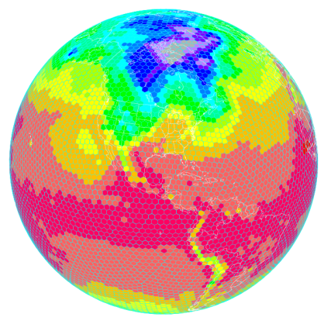
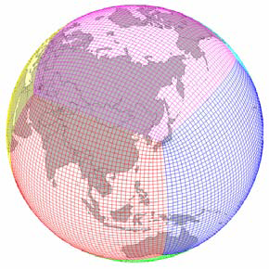
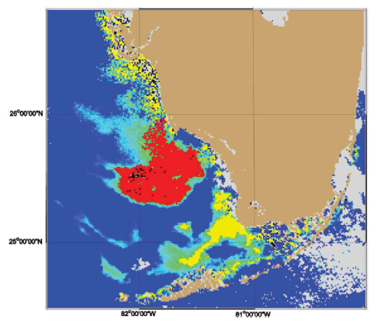
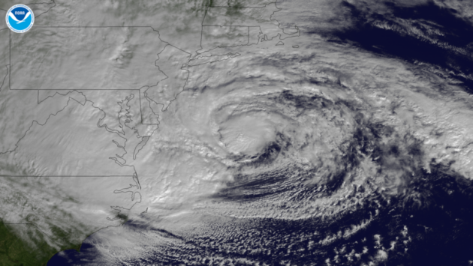
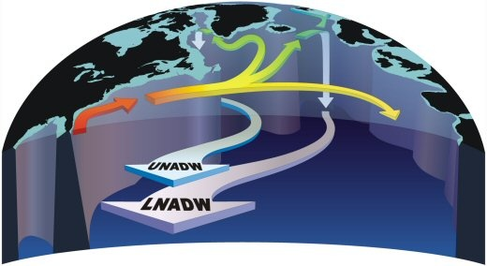
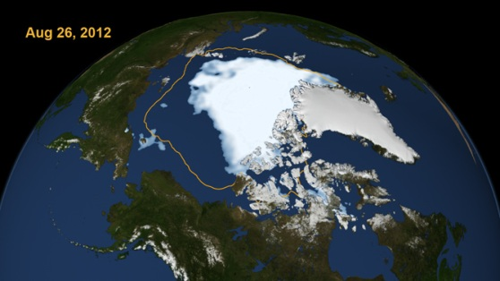
High Impact Weather 0-100 Day Pilot Project (HIWPP)
HABs/Hypoxia
Blocking
0-100 Day Pilot Project
Arctic
Tropical Cyclones
AMOC

Slide 20
Summary
There is an increasing effort to partner on environmental prediction within the Federal agencies as represented by NUOPC and ESPC
ESPC will provide the next generation of operational environmental prediction service to the Nation in order to meet increasing needs for guidance beyond ten days to decades
Through recent workshops, ESPC has been better defined and has proposed five thrusts at ISI timescales in addition to exploring the feasibility of operational decadal prediction
Some ESPC efforts directly support improved TC forecasting at sub-seasonal to seasonal time scales
The ESPC demonstrations are open to wide participation
Notes:
20

Slide 21
Discussion

Slide 22
Use of Dynamical Approaches to Seasonal Prediction is Increasing
 | North Atlantic | Eastern North Pacific | Central North Pacific | Western North Pacific | Australia | North Indian Ocean | South Indian Ocean | South Pacific
City Univ. Hong Kong (China) |  |  |  | X Statistical
Colorado State Univ. (USA) | X Statistical
Cuban Meterological Institute (Cuba) | X Statistical
ECMWF (EU) | X Dynamical | X Dynamical |  | X Dynamical | X Dynamical | X Dynamical | X Dynamical | X Dynamical
International Research Institute for Climate and Society (IRI) (USA) | X Dynamical | X Dynamical |  | X Dynamical | X Dynamical |  |  | X Dynamical
Macquarie Univ. (AUS) |  |  |  |  | X Statistical |  |  | X Statistical
National Meteorological Institute (MEX) |  | X Statistical
National Climate Centre (China) |  |  |  | X Statistical
NOAA CPC (USA) | X Statistical | X Statistical | X Statistical
Tropical Storm Risk (UK) | X Statistical |  |  | X Statistical | X Statistical
Adapted from Camargo et al. (2007).
Notes:
Contains some guesses

Slide 23
Strategy
Synergy among academia, laboratories, and operation centers
Team members are experts on TCs, intraseasonal to interannual variabilities, and model developers
Team members
Models
Basic Research
NOAA Weather and Climate Forecast System (GFS/CFS)
GFDL High-resolution Atmospheric Model (HiRAM)
Navy Global Environment Model (NAVGEM)
Flow-following finite-volume Icosahedral Model (FIM)
Non-hydrostatic Unified Model for Atmosphere (NUMA)
Model for Prediction Across Scales (MPAS)
Community Earth System Model (CESM)
Melinda Peng (NRL)
Suzana Camargo (U C)
Mark DeMaria (NESDIS)
Russ Elsberry (NPS)
Tim Li (U H)
Eric Maloney (CSU)
Shian Jiann Lin (GFDL)
Duane Waliser (JPL)
Stan Benjamin (ESRL)
Bill Skamarock (NCAR)
Jim Dudhia (NCAR)
Rich Neale (NCAR)
Wayne Higgins (CPC)
Jae Schemm (CPC)
Carolyn Reynolds (NRL)
Tim Whitcomb (NRL)
Model Development
Operational Implementation

Slide 24
ESPC Roadmap
2010-2011
Planning, First ESPC scientific workshop (Boulder, CO Sep 2010)
2012-2013
Interim Scientific Steering Committee formed, ISSC workshop (Silver Spring, MD, Mar 2012)
Proposed demonstration systems for IOC at 2018, Demo workshop (Nov 2012)
2013-2017
Construct implementation plan for each demonstration project
Develop a better understanding of the bounds on prediction skill at various time and space scales in the current “skill nadir”
Implement systematic improvements in Research towards Operations
Conduct verification and validation with common metrics
2018
Initial Operational Capability (IOC) towards a FOC by 2025

