Slide 1

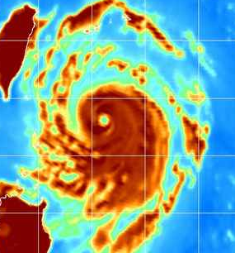


Improving the Assimilation of Multiple and Integrated High-Resolution Satellite Datasets in Mesoscale Models of Tropical Cyclones
PIs: Christopher Velden (CIMSS/U. Wisconsin)
Sharan Majumdar (RSMAS/U. Miami)
Co-PIs: Jim Doyle and Jeff Hawkins (NRL-Monterey)
Jeff Anderson and Hui Liu (NCAR), Jun Li (CIMSS/U. Wisconsin)
Collaborators: Bob Atlas (NOAA/AOML), John Knaff (NOAA/NESDIS), William Lewis (CIMSS / U. Wisconsin), Alex Reinecke, Song Yang, Hao Jin (NRL)
Ph.D. Student: Ting-Chi Wu (RSMAS/U. Miami)
IHC / Tropical Cyclone Research Forum 3/5/13

Slide 2
Overarching Goals
Supplement contemporary atmospheric observation capabilities with optimal data assimilation (DA) configurations and methodologies that exploit enhanced full-resolution satellite-derived observations in order to improve mesoscale ensemble analyses and forecasts of tropical cyclones (TCs).
From lessons learned through demonstrations and case study experiments, provide a pathway towards advanced satellite DA in operational TC forecast models.

Slide 3
Approach
Prepare and utilize full-resolution satellite datasets with the processing strategies designed for mesoscale analyses.
Employ Ensemble Kalman Filter DA
  WRF-ARW and COAMPS-TC in NCAR’s DART framework
  Ported onto NOAA HFIP Jet computer
  Investigate ensemble size, inflation, localization, observation error
  Examine integrated, multiple dataset assimilation
  Explore ensemble-based bogus vortex configurations

Slide 4
Assimilation Experiments
84 ensemble members.
9km moving nest with feedback to 27km grid when TC is present.
Case | Non-Satellite | Satellite Dataset(s) | Cycling Interval
CTL | Radiosondes, aircraft data, surface obs, JTWC TC advisory data | Atmospheric Motion Vectors (AMVs) from NCEP analysis file (source: JMA) | 6 hours
CIMSS(h) |  | Hourly AMVs produced by CIMSS | 3 hours
CIMSS(h+RS) |  | Hourly AMVs and Rapid-Scan AMVs (CIMSS) | 3 hours
AIRS T and Q |  | Single Field of View (15 km resolution) soundings derived by CIMSS | 6 hours
TPW |  | AMSR-E TPW retrievals derived by CIMSS | 6 hours
ALL |  | AMVs(h+RS) + AIRS T and Q + TPW | 3 hours
Notes:
Assimilation is done on 27km, integrate the model forward by 9km

Slide 5
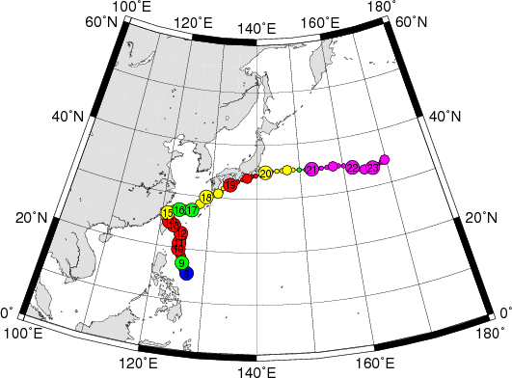
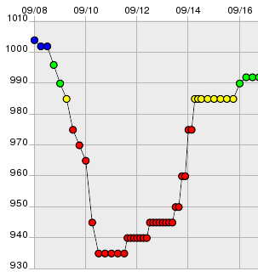
Case Study: Typhoon Sinlaku (2008)
Rapid-Scan mode activated

Slide 6
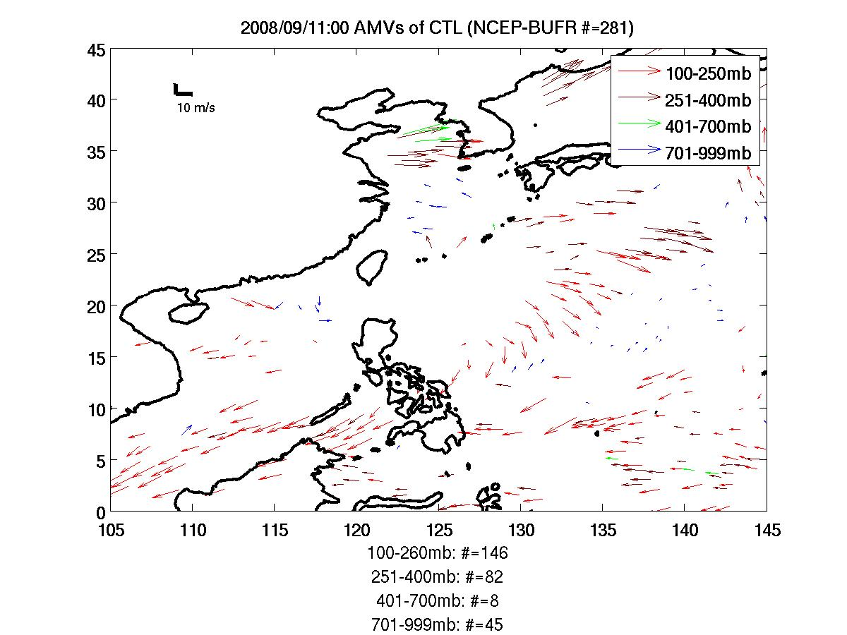
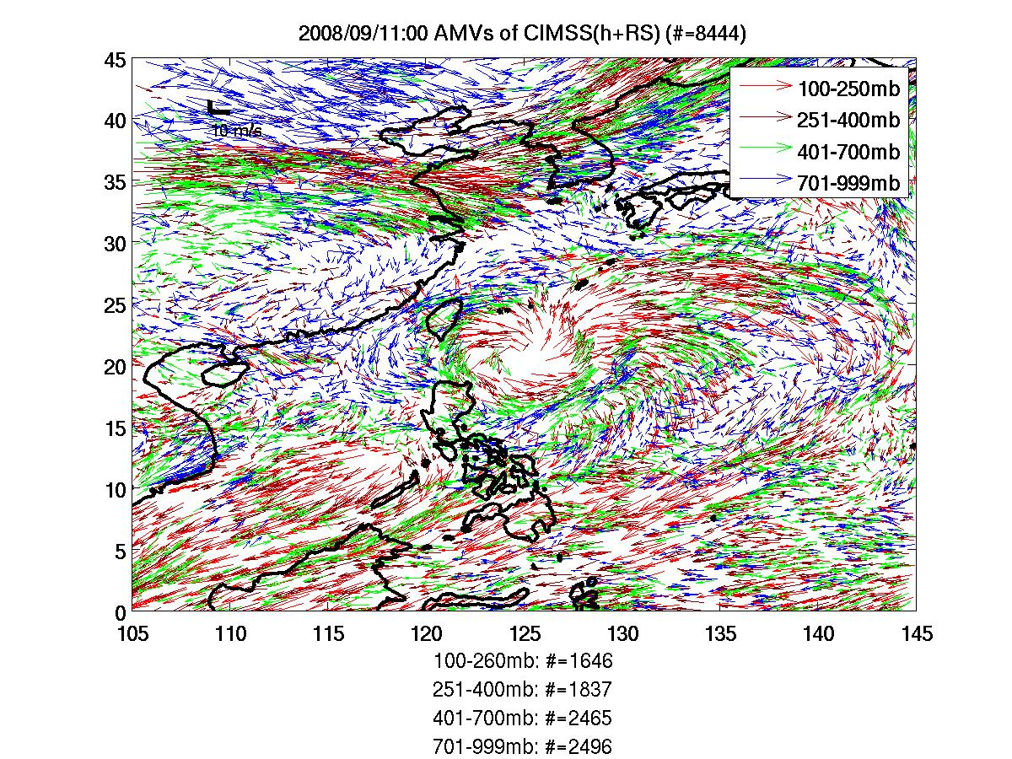
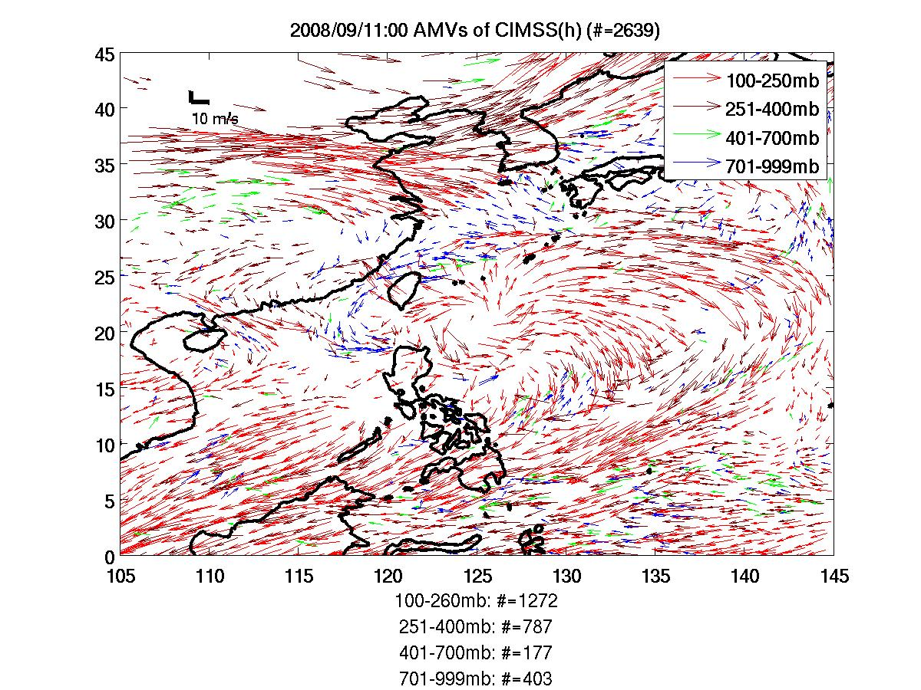
Enhanced AMVs in the EnKF Cycles
701-999mb
401-700mb
251-400mb
100-251mb
Notes:
CIMSS(h) has almost 10 times more of AMVs than CTL, and most of it is from upper layer (400mb ).
CIMSS(h+RS) not only has an increased overall volume of AMVs, but also more AMVs at lower levels (400mb and below).

Slide 7
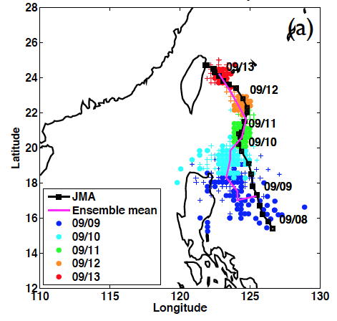
Ensemble analyses (TC position): CTL
Notes:
The upper 3 panels are analyses track and spread against JMA best track in solid black line.
Colored dots are TC locations as a function of time from magenta to red.
A general narrower spread can be observed along the analysis time.
In the early state, CTL had an erroneously straight westward motion while CIMSS(h)

Slide 8
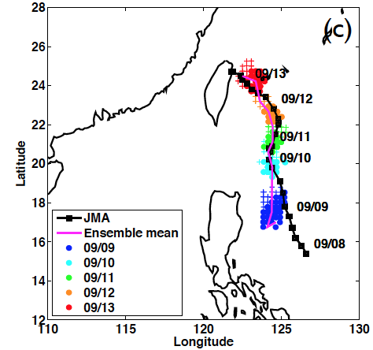
Ensemble analyses (TC position): CIMSS(h)
Notes:
The upper 3 panels are analyses track and spread against JMA best track in solid black line.
Colored dots are TC locations as a function of time from magenta to red.
A general narrower spread can be observed along the analysis time.
In the early state, CTL had an erroneously straight westward motion while CIMSS(h)

Slide 9
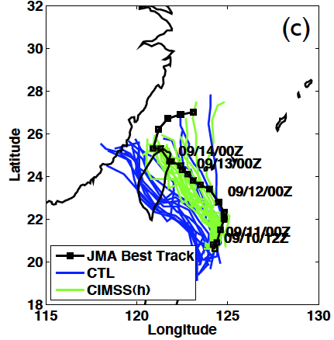
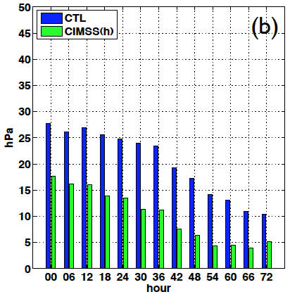
72-h WRF/EnKF Ensemble Forecasts
Sinlaku Track Forecasts
Sinlaku Intensity (MSLP) Forecast Errors

Slide 10
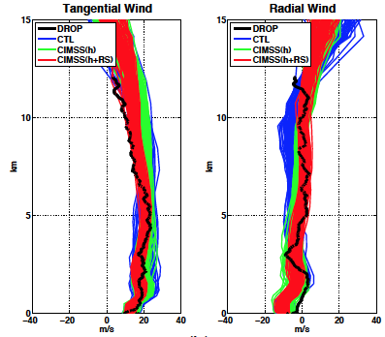
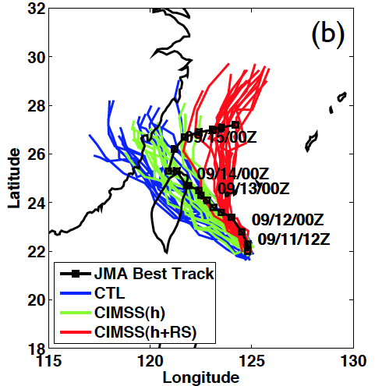
Influence of Rapid-Scan AMVs
WRF track forecasts with rapid-scan AMVs capture recurvature, although prematurely.
Rapid-Scan AMVs provide better ensemble analysis agreement with dropsonde data.

Slide 11
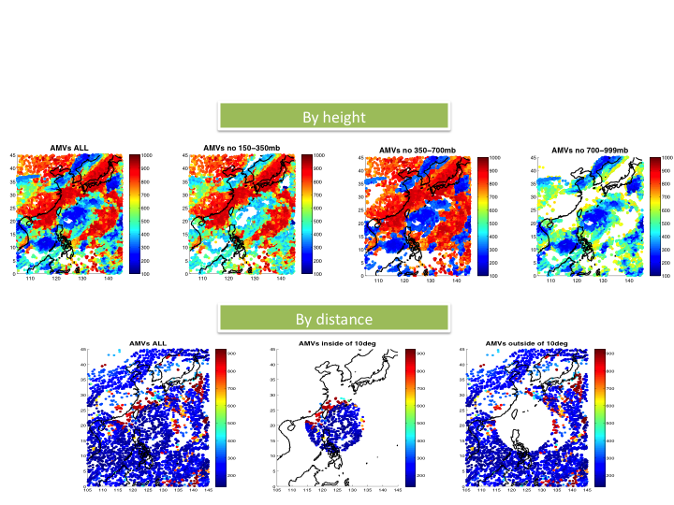
Impact of AMVs on TC Sinlaku Forecasts: Stratified by Near/Far Environment, and Tropospheric Layers

Slide 12
AMV Assimilation Study: Sinlaku
Hourly AMVs improve track and intensity analyses and forecasts.
Rapid-Scan AMVs improve the TC vertical structure and modify near-environment flow → earlier recurvature.
Need to exploit higher space/time AMVs with more frequent (hourly) assimilation, and at higher resolution (at least 9 km).
AMVs in vortex region/near-environment and lower-layer AMVs are essential for improving structure analyses and short-range intensity forecasts.
Upper-layer and far environment AMVs lead to greatest reduction in track forecast error.
Issues: ensemble spread too small; initial model imbalance and model error (biases) can be tough to overcome.

Slide 13
Assimilation Experiments with AIRS T and Q; AMSR-E TPW
Single Field of View (SFOV) retrievals (clear sky)
TPW retrievals
AIRS and AMSR-E SFOV retrievals all post-processed at CIMSS
and provided for the lifetime of TC Sinlaku for assimilation into DART.

Slide 14
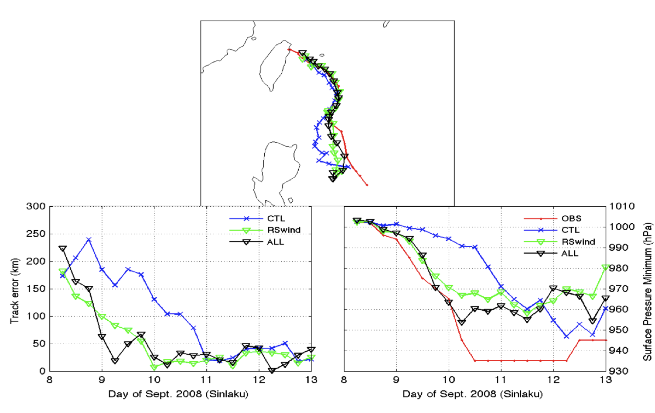
Combined Impact of AIRS T and Q, AMSR-E TPW, and AMVs on Sinlaku Analyses
AIRS T analysis position estimates superior to CTL.
Little change to intensity analyses using AIRS T and Q.
AMSR-E TPW coverage superior to MODIS TPW.
AMSR-E TPW improves analysis position and intensity.
AIRS T + Q and TPW moderately improves upon AMV track analyses.
Intensity analyses improved further through combining all data.
JMA BEST
CTL
ALL AMV
ALL
MSLP

Slide 15
Primary Accomplishments
Successfully tested an end-to-end system in research mode on a case study of Typhoon Sinlaku:
Enhanced satellite-based observations >
Advanced mesoscale DA >
Ensemble-based forecasts >
Verification of forecast improvement >
Diagnostics and lessons learned
Demonstrated potential for operational considerations, although a real-time trial on at least a full season of storms is still warranted.

Slide 16
Current and Future Work
Cloudy radiances being tested. Challenges with bias.
Optimize the integration of the satellite data.
Better understanding of the relative impact of winds, temperature and moisture input on TC forecasts.
Include satellite ocean surface winds: scatterometers
Possibly examine other satellite datasets:
  Surface wind analyses from NESDIS/CIRA
  AMSU-based products
  Microwave radiances (sounder and imager)
  Hyperspectral IR radiances

Slide 17
Potential Transitions
Follow-on studies will need to:
  Demonstrate the capability to assimilate the special satellite datasets in (near) real-time to simulate an operational-like environment.
  Prove the positive results stand up over a long period of testing (significant sample of TCs).
  Compare results from research system versus operational system (analyses and forecasts).
  Upon success of the above, transition to operations.
Our NOPP study funding ends in 2013. To accomplish the above, a proposal has been submitted to the JCSDA by CIMSS to integrate and test the AMV findings into HWRF. In addition, we plan to propose to HFIP and work with the satellite data assimilation Tiger Team to address other elements of the above transition list.

Slide 18
Synergies with Other Projects
ONR TCS-08 Initiative
  Enhanced AMVs in Navy models (PI Velden)
  TC sensitivity and initialization (PI Majumdar)
Advanced IR soundings (PI Li)
NRL COAMPS-TC DA efforts (PI Doyle)
Related NCAR DA projects
Leveraging components of NOAA HFIP
  Satellite DA Tiger Team

Slide 19
Extra Slides

Slide 20
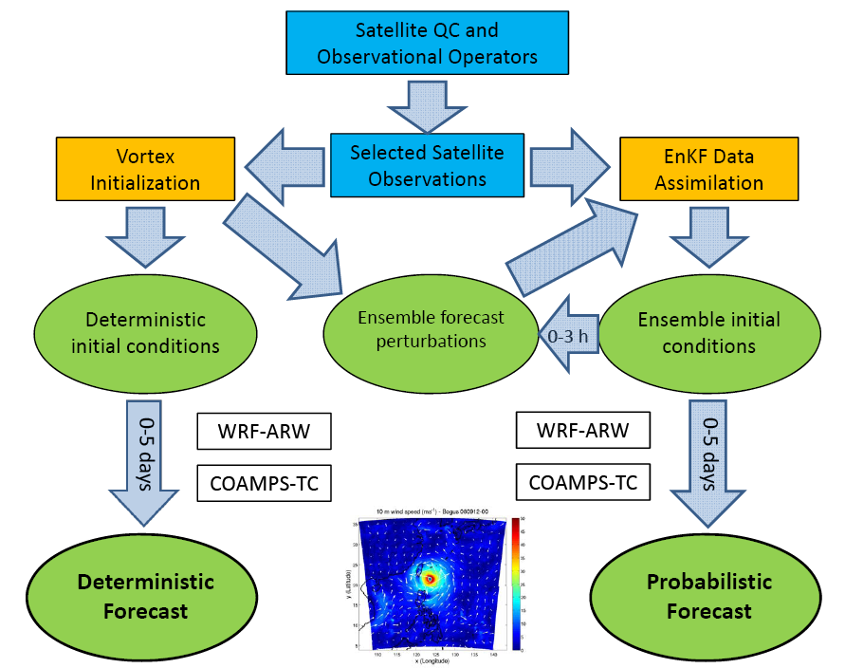
WRF-ARW
COAMPS-TC
HWRF
WRF-ARW
COAMPS-TC
HWRF

Slide 21
Datasets prepared at NRL Monterey
Data Name | Variables | Resolution | Coverage | Source
ASCAT Wind | Lat, lon, time, wind speed and direction, ECMWF wind speed & direction, wind flag | 25 km | Orbit | EUMETSAT
BYU QuickSCAT Wind | Lat, lon, time, wind speed & direction, surface type | 2.5 km, 25 km | 20x20 deg box following TC | BYU
UCF QuickSCAT Wind | Lat, lon, time, wind speed & direction, RR_flag, TB | 1/8 degree grid | 10 lat x 20 lon box following TC | UCF
NOAA Windsat EDR | Lat, lon, time, wind speed & direction, SST, TPW, CLW, RR, surface type | Pixel | Orbit | NOAA
NRL Windsat EDR | Lat, lon, time, SST, TPW, CW, RR, WSP_err, TPW_err, CLW_err | 25X35 km 35x53 km 50x71 km | Orbit | NRL
SSM/I EDR | Lat, lon, time, TPW, CLW, wind speed, RR, Wind_flag, surface type | Pixel and 1/3 degree grid | Orbit | NOAA/NESDIS
SSMIS EDR | Lat, lon, time, TPW, CLW, wind speed, RR, wind_flag, surface type | 1/3 degree grid | Orbit | NOAA
RSS EDR (AMSR-E) | Lat, lon, time, SST, Wind speed, TPW, CLW | 0.25 deg grid | Daily ascending & descending | RSS
RSS EDR (MWSST) | Lat, lon, SST | 0.25 deg grid | Daily | RSS
RSS EDR (QuikSCAT) | Lat, lon, time, wind speed & direction, RR, flag | 0.25 deg grid | Daily | RSS
RSS EDR (SSMI-F13) | Lat, lon, time, wind speed, TPW, CLW, RR | 0.25 deg grid | Daily | RSS
RSS EDR (TMI) | Lat, lon, time, SST, wind 11GHz, wind37GHz, TPW< CLW, RR | 0.25 deg grid | Daily | RSS

Slide 22
Datasets prepared: CIMSS/UWisc.
Enhanced fields of AMVs
- from MTSAT during West Pacific Typhoon Sinlaku (TCS-08 field program)
- from GOES for Atlantic Hurricane Ike (2008)
Hourly datasets
Use of rapid scans when available
Tailored processing and new quality indicators
  Observation confidence estimates; forward operator error estimates for DA

Slide 23
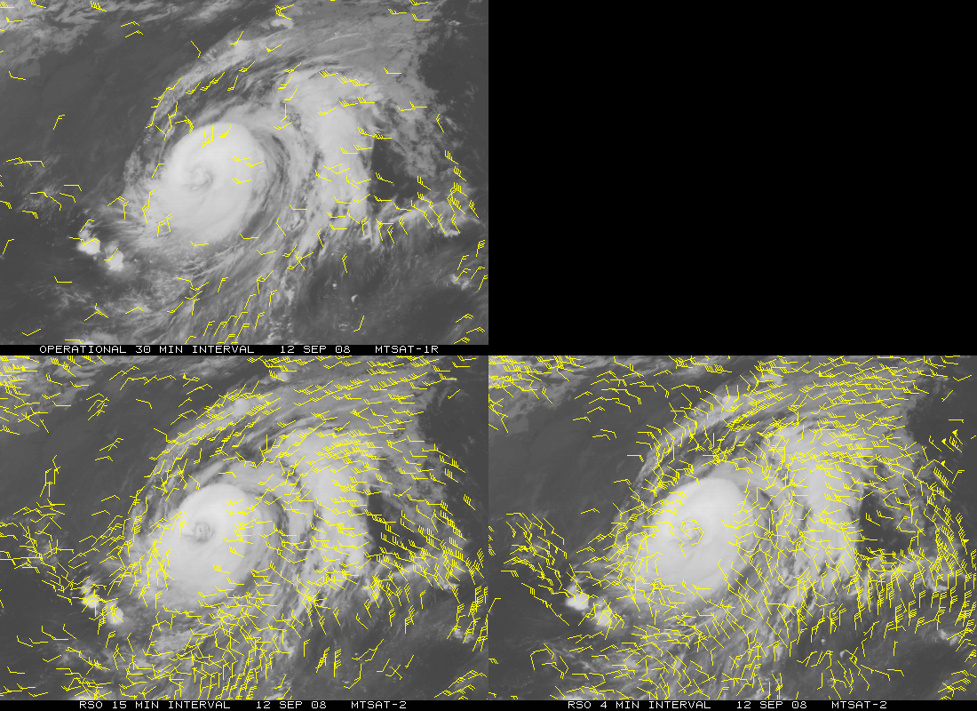
MTSAT AMV Example
Left: AMV (IR-only) field produced from routinely available hourly sequence of MTSAT-1 images during Typhoon Sinlaku
Bottom Left: Same as above, but using a 15-min rapid scan sequence from MTSAT-2
(better AMV coverage and coherence)
Bottom Right: Same as above, but using a 4-min rapid scan sequence (improved coverage/detail of typhoon flow fields)

Slide 24
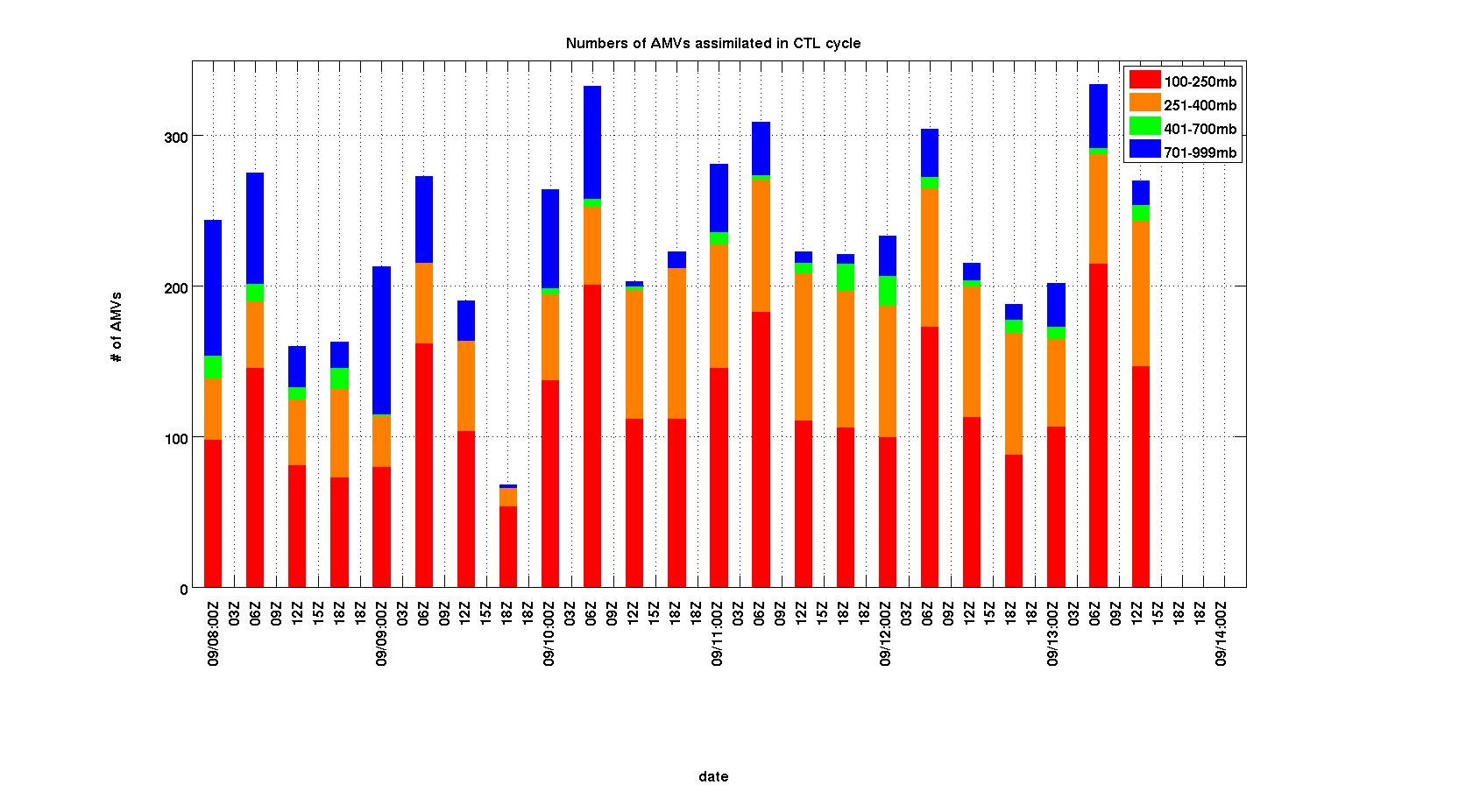
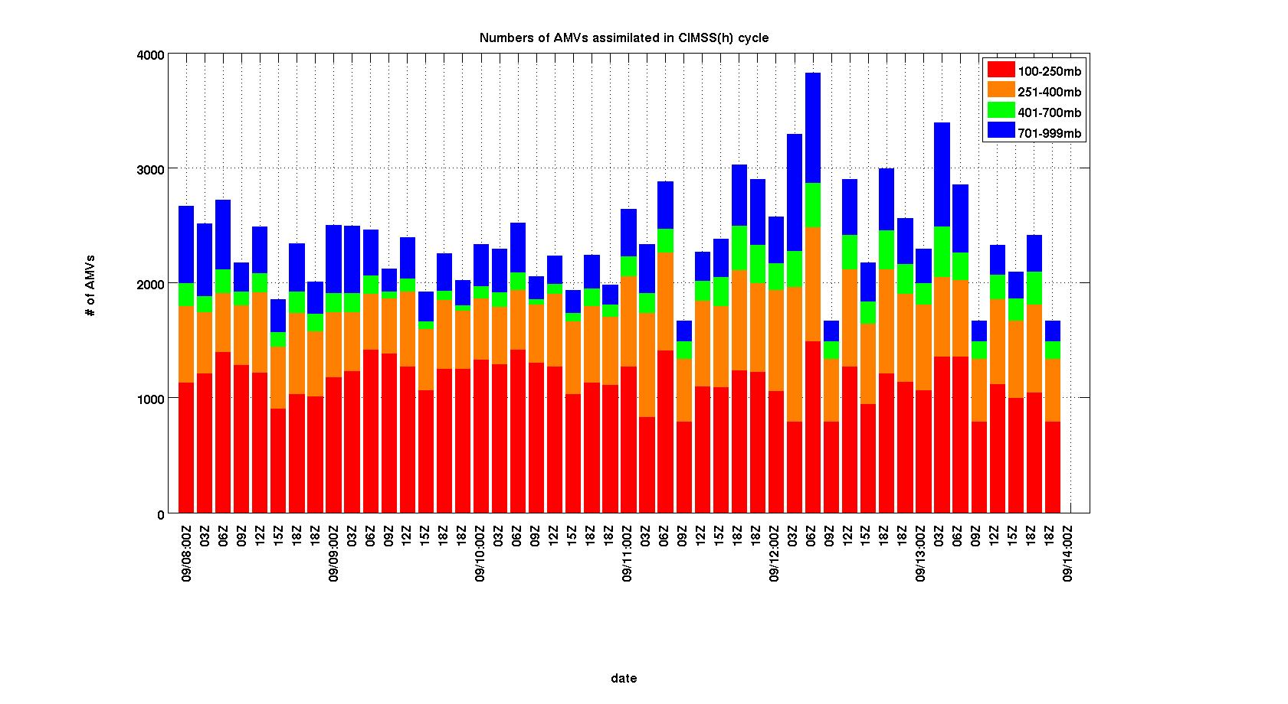
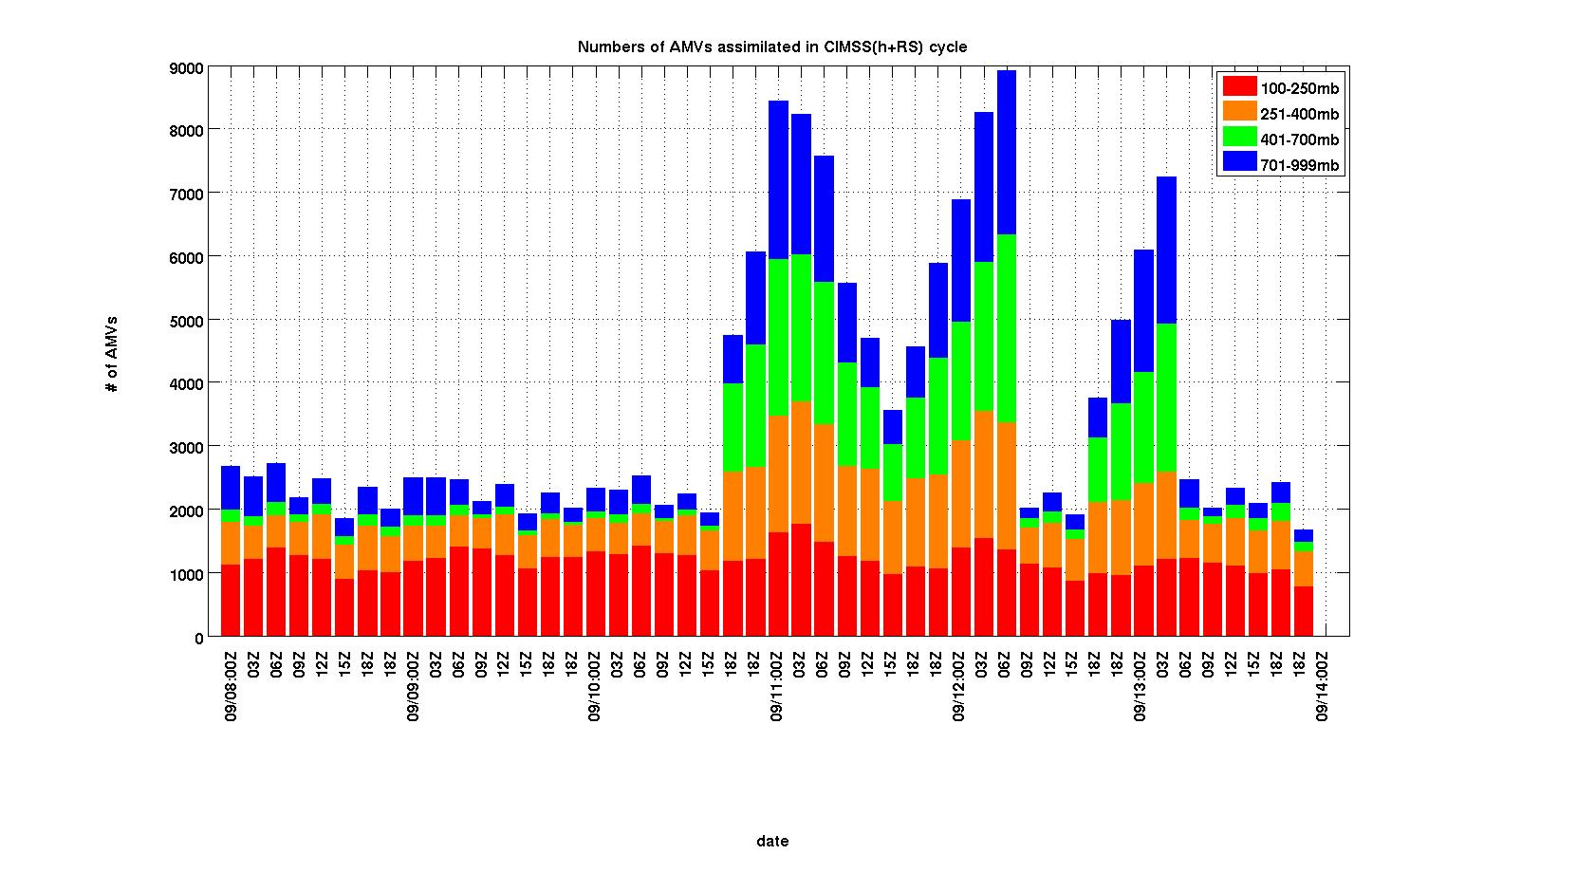

Slide 25
Other Satellite Datasets
NESDIS-RAMMB
  6-hourly, multi-platform TC surface wind analyses
  AMSU-based TC data and products

Slide 26
Upgraded data assimilation at NCAR
Revised WRF/DART system:
  Ensemble size is increased from 32 to 84
  Microphysics: WSM 5 classes is updated to WSM 6 classes
32 versus 84 members
  Analyses using CIMSS AMVs and routine observations are similar
  However, for AIRS-Q and TPW data, the differences are large
Sampling error correction showed little impact on the analyses.
Current localization cutoff distance was found to be the most effective (half-width cutoff = 650km).

Slide 27
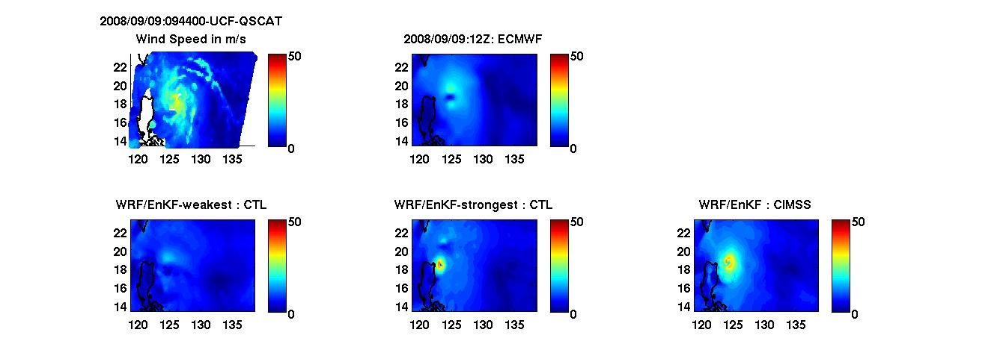
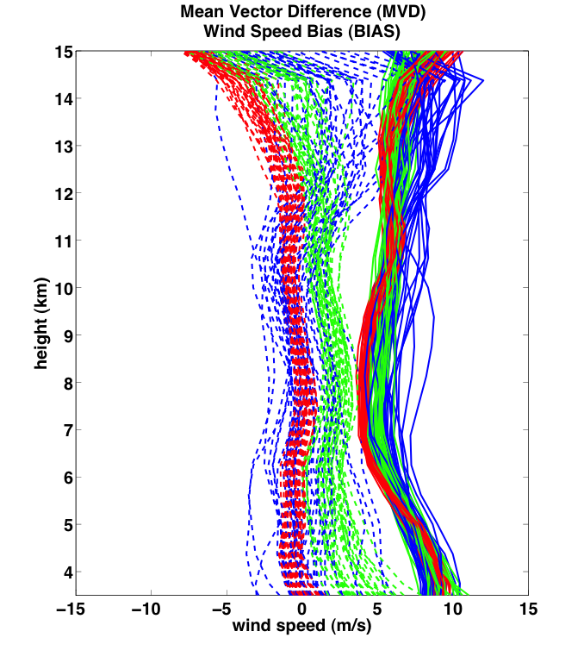
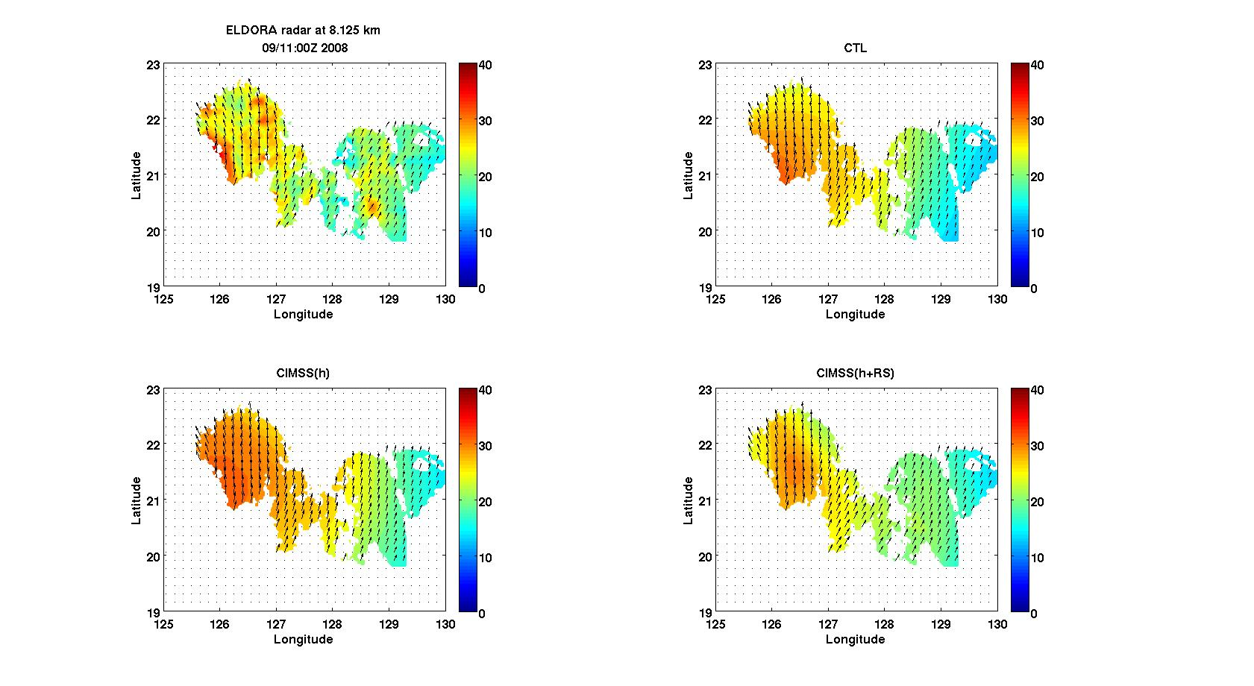
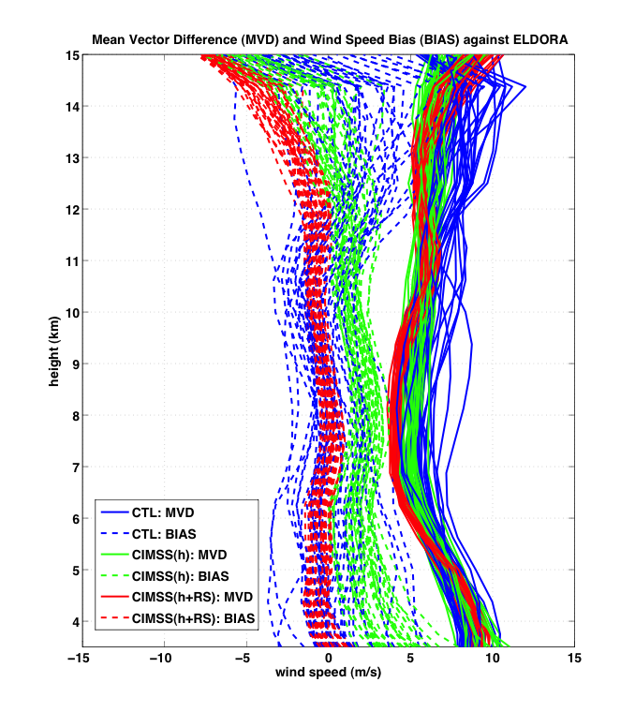
Analyses vs Independent Observations
QuikSCAT-UCF WD: 12 UTC 9 Sep
(h)
NRL P3 Eldora Radar WD: 00 UTC 11 Sep
ELDORA
CTL
CIMSS(h)
CIMSS(h+RS)
Notes:
25 km in QuikSCAT
3 km in Eldora Radar

Slide 28
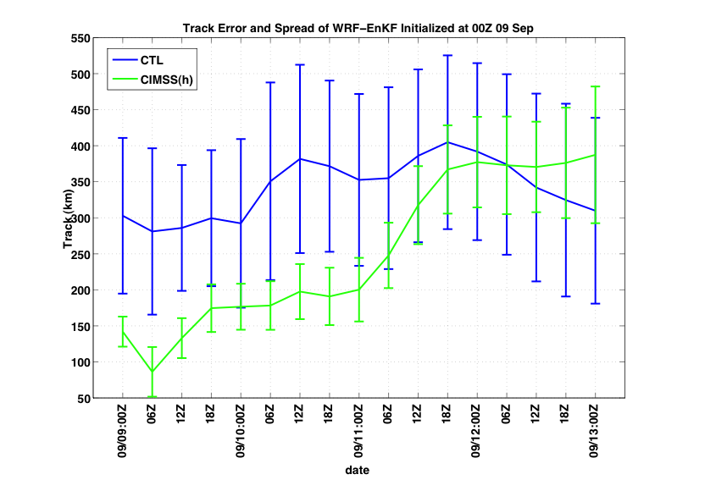
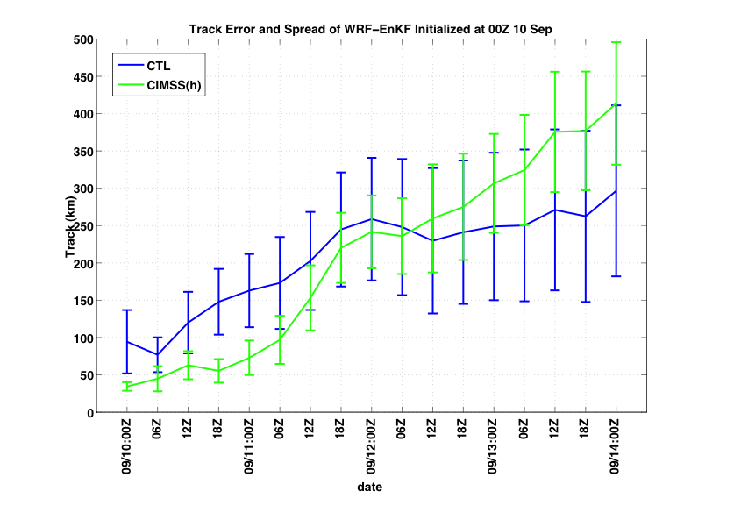
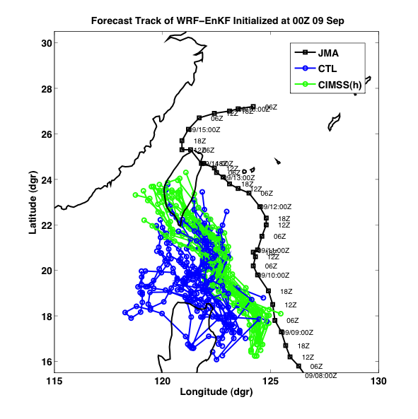
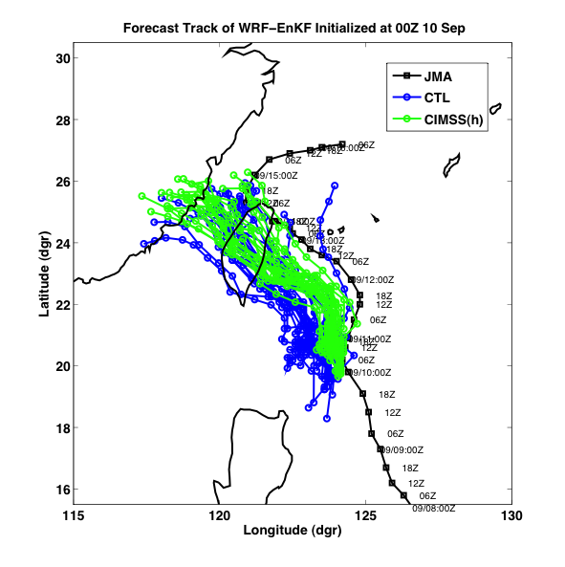
Forecast track error, spread and track
FC09
FC10
00 24 48 72 96
00 24 48 72 96

Slide 29
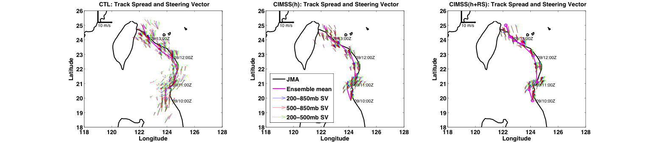
Deep-layer steering flow is the best estimate of the motion vector, especially in the CIMSS(h+RS).

Slide 30
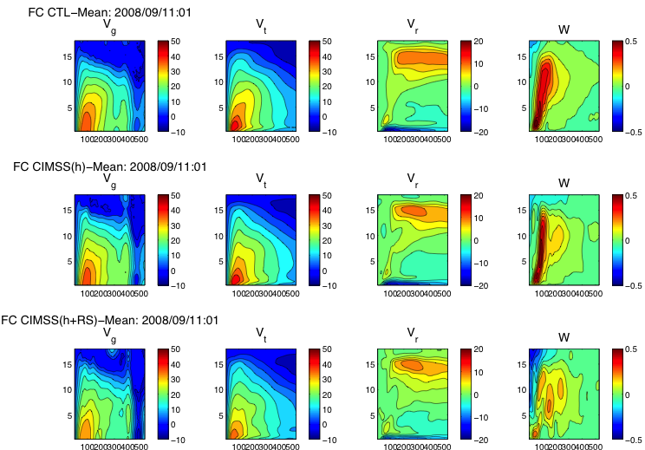
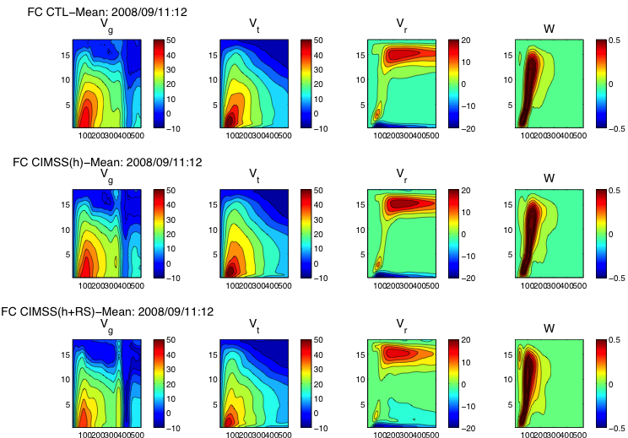
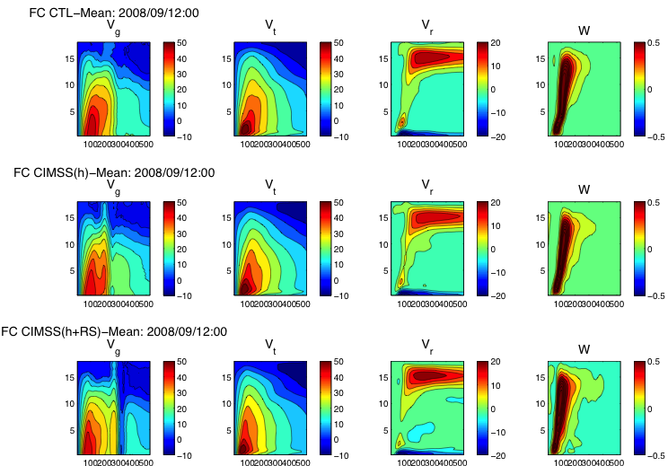
FC11
01H
12H
24H
CTL
CTL
CTL
CIMSS(h)
CIMSS(h)
CIMSS(h)
CIMSS(h+RS)
CIMSS(h+RS)
CIMSS(h+RS)
Notes:
Height-radius plots of azimuthal-mean tangential wind, radial wind and vertical wind

Slide 31
96-h WRF/EnKF Forecasts
27 km domain with 9 km nested domain using 20 members.
Same BC, physics and dynamics.
WRF-EnKF parallel forecasts | Initial time | Initial conditions
FC09 | 00 UTC 09 Sep, 2008 | CTL and CIMSS(h)
FC10 | 00 UTC 10 Sep, 2008 | CTL and CIMSS(h)
FC11 | 00 UTC 11 Sep, 2008 | CTL, CIMSS(h) and CIMSS(h+RS)

Slide 32
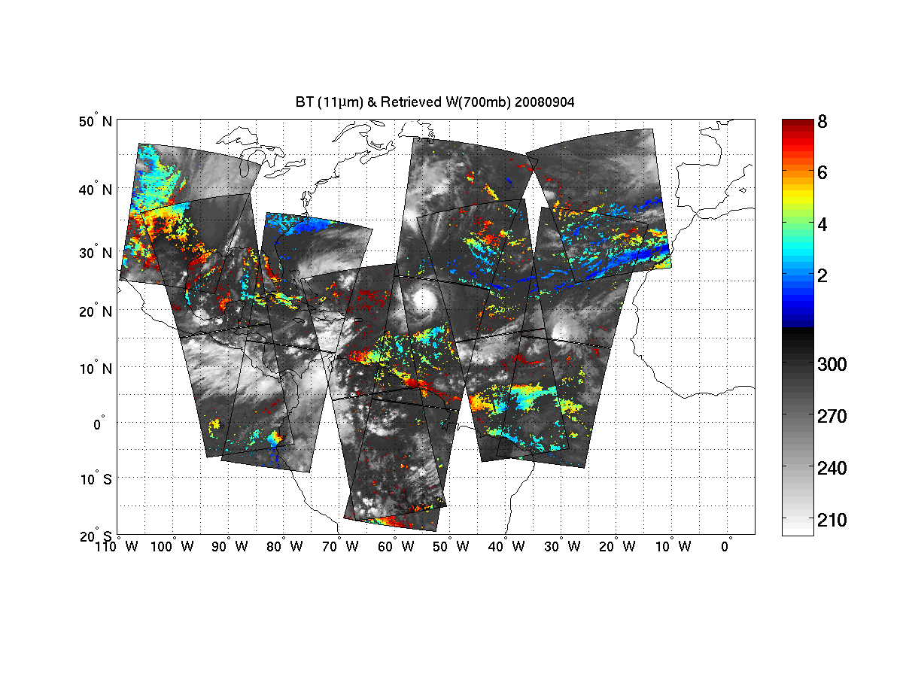
Datasets prepared: CIMSS/UWisc.
Single field of view AIRS temperature/moisture profiles
Recently adapted for IASI clear sky soundings
Under development: algorithms for cloudy sky soundings

Slide 33
Assimilation of AIRS T/Q Soundings (from CIMSS) and TPW
Control (CTL): Radiosondes, cloud winds (AMVs from JMA) extracted from NCEP/GFS dataset, aircraft data, station and ship surface pressure data, JTWC advisory TC positions, 6-hourly analysis cycle.
AIRS T: Add only CIMSS single view (15km) T profiles.
AIRS Q: Add only CIMSS single view (15km) Q profiles.
AIRS T/Q: Add both CIMSS T and Q profiles.
TPW: Add only CIMSS processed AMSR-E microwave TPW data.
AIRS T data reduces the initial track error.
Assimilation of TPW greatly improve the intensity and track analyses.

Slide 34
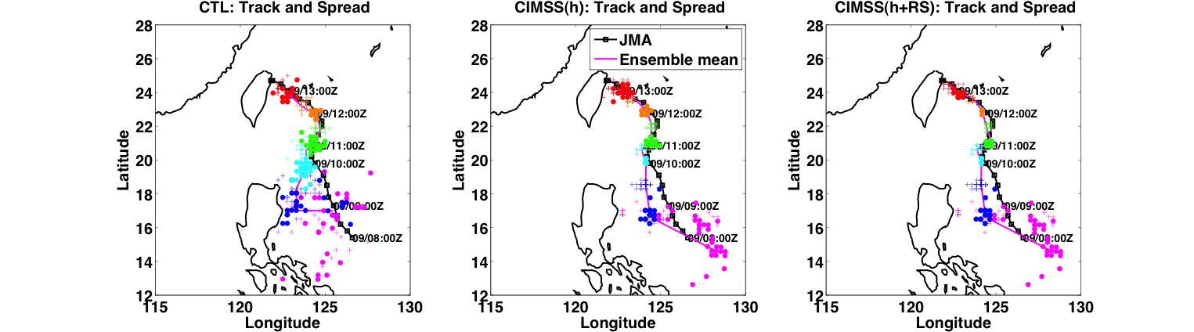
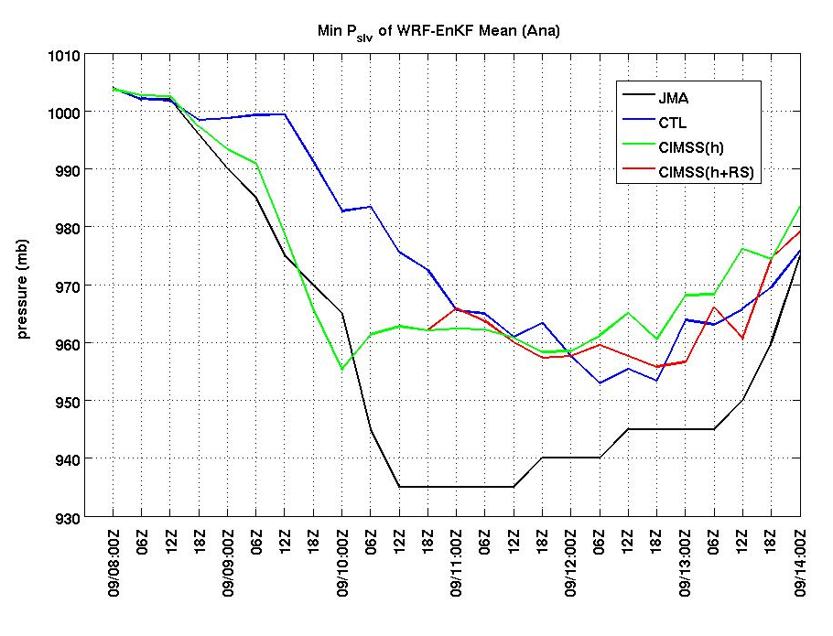
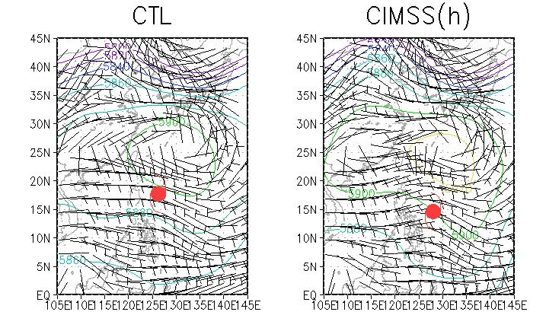
Analysis track and intensity
Minimum Sea-level Pressure
500mb Geopotential Height / wind
Notes:
The upper 3 panels are analyses track and spread against JMA best track in solid black line.
Colored dots are TC locations as a function of time from magenta to red.
A general narrower spread can be observed along the analysis time.
In the early state, CTL had an erroneously straight westward motion while CIMSS(h)

Slide 35
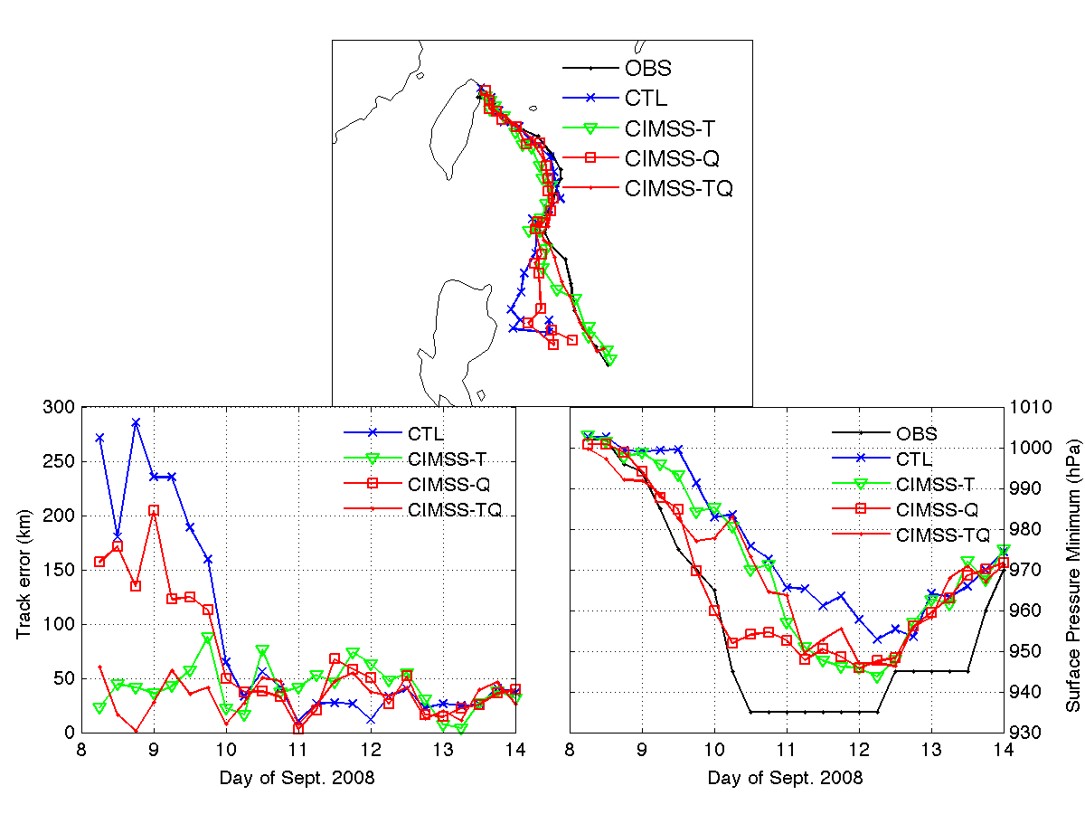
Sinlaku track/intensity analysis: AIRS soundings (WRF/DART)
CTL run: assimilate radiosonde, satellite cloud winds, QuikSCAT winds, aircraft data, COSMIC GPS refractivity, ship, and land surface data.
OBS
CTL
AIRS-T
AIRS-Q
AIRS-TQ
Rapid intensification from 9 to 10 September 2008 captured with water vapor soundings assimilated
CTL
AIRS-T
AIRS-Q
AIRS-TQ
OBS
CTL
AIRS-T
AIRS-Q
AIRS-TQ
Temperatures reduce track errors during rapid intensification

Slide 36
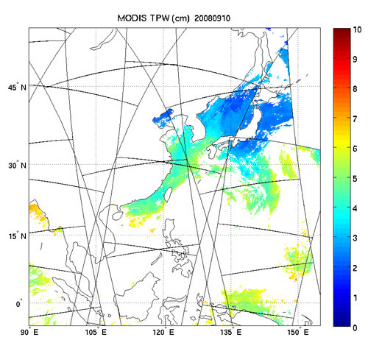
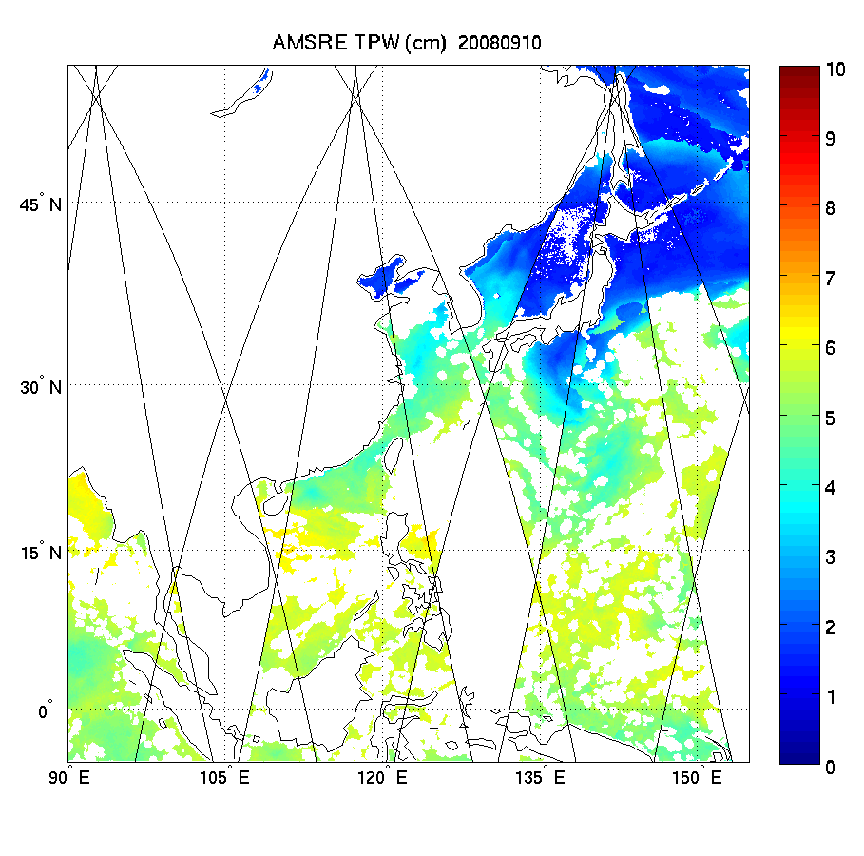
MODIS TPW (left) & AMSR-E TPW (right)
5 km res
17 km res

Slide 37
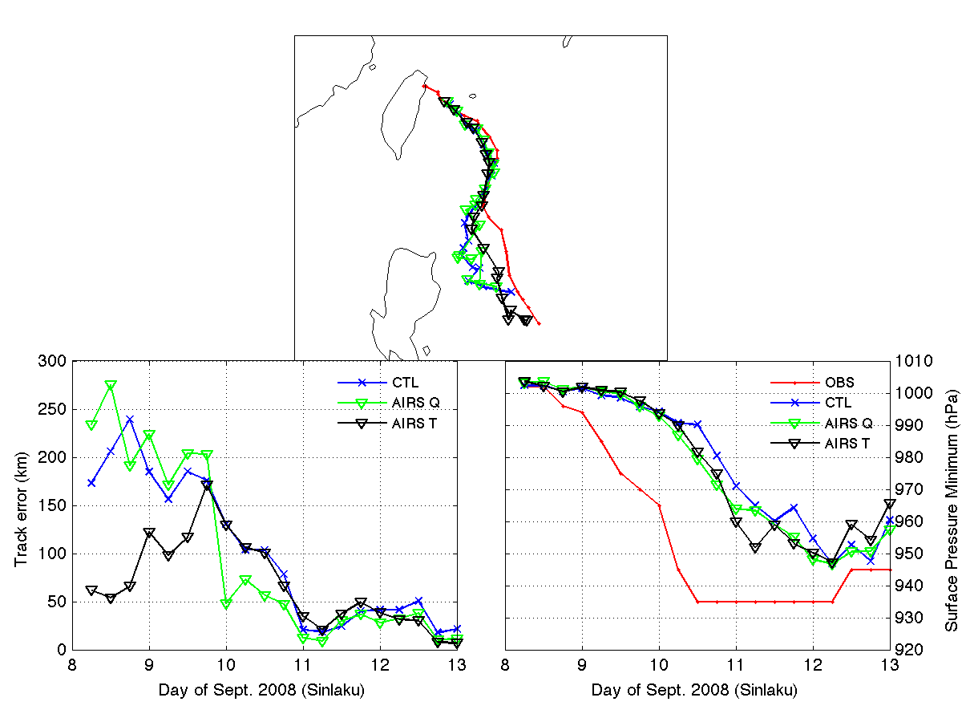
Impact of AIRS T and Q Data on Sinlaku Analyses
Analysis Position Error
Analysis Intensity Error

Slide 38
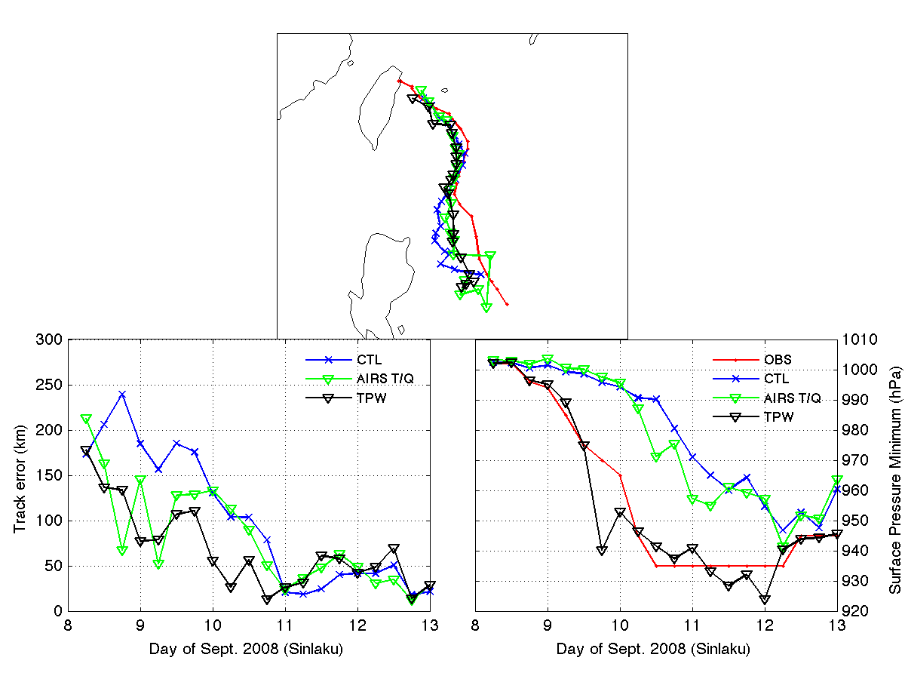
AIRS T and Q and AMSR-E TPW (84)
AIRS T&Q has positive impact on TRACK analysis
AMSR-E TPW has dramatic positive impact on INTENSITY analysis

Slide 39
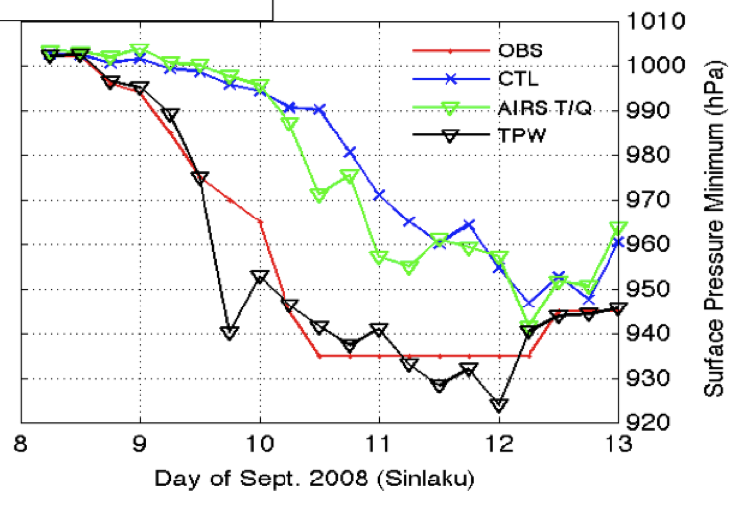
Combined Impact of AIRS T and Q, AMSR-E TPW, and AMVs on Sinlaku Analyses
JMA BEST
CTL
AIRS T+Q
AMSR TPW
JMA BEST
CTL
ALL AMV
ALL
MSLP
MSLP
JMA BEST
CTL
ALL AMV
ALL
CTL
ALL AMV
ALL
POSITION ERROR
ANALYSIS TRACK

Slide 40
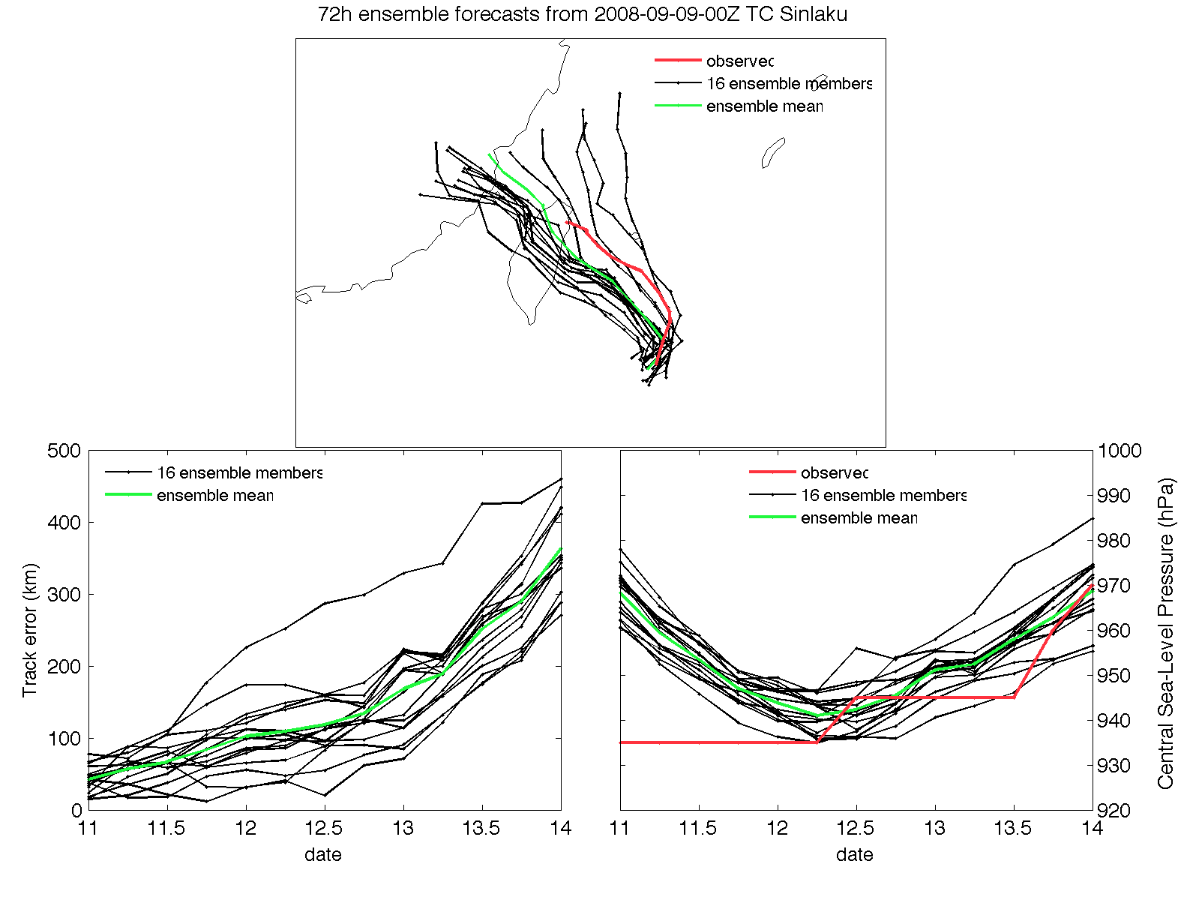
3-day Ensemble Forecast: CTL

Slide 41
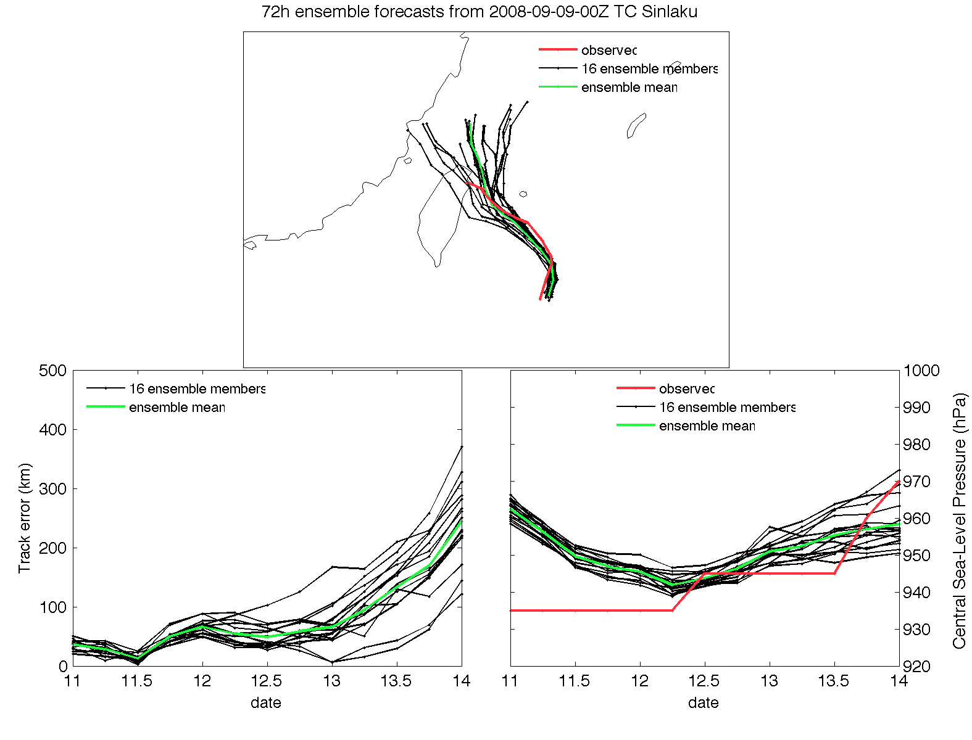
3-day Ensemble Forecast: ALL

Slide 42
Conclusions from Satellite Multi-Variable Product Assimilation Studies
For assimilation of TPW and AIRS-Q, the larger ensemble size improves the analyses of TC Sinlaku.
Assimilation of water vapor observations requires a much larger ensemble size than 32?
For AMVs, the larger ensemble size has little impact on the analyses.
AMVs and TPW data have a particularly strong impact on the initial analyses of Sinlaku

Slide 43
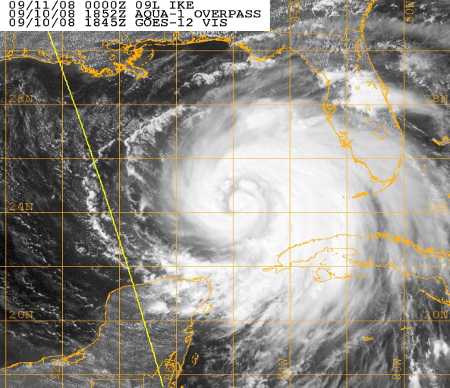
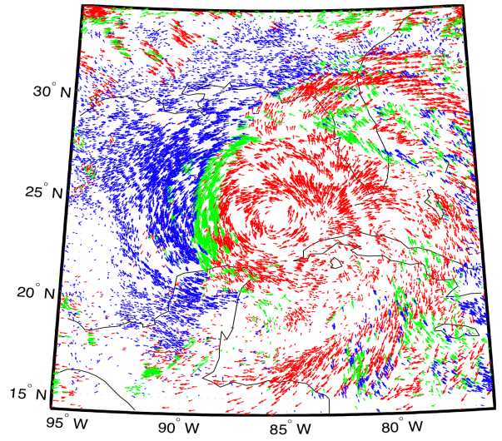
Hurricane Ike 10 Sep 18 UTC
TC intensity, size and asymmetry are all important. Enhanced AMVs depict banding features as well as extent and magnitude of flow at low, middle and upper levels.
P ≤ 350 hPa 350 < P ≤ 800 hPa P > 800 hPa
An ensemble of bogus vortices is used to initialize GSI-Hybrid / WRF DA, thereby representing background uncertainty with respect to intensity and size.
Background:
LAT, LON, MIN SLP, VMAX, RMW from TCVITALS
Ensemble:
LAT, LON, MIN SLP, VMAX, RMW perturbed about TCVITALS values.
O-F MAE and Bias (mean over all DA windows)
34-kt radii (nm) | CTL | EXP3HR
NE Quadrant | 34.6 (+31.9) | 19.1 (+9.0)
SE Quadrant | 33.2 (+23.1) | 27.3 (+1.5)
SW Quadrant | 24.0 (+19.8) | 14.7 (+2.8)
NW Quadrant | 23.9 (-10.9) | 28.0 (-17.8)
AMV assimilation using a
3-hrly cycle produces significantly better fit to Best Track wind radii relative to Control (GDAS PREPBUFR obs only).

Slide 44

COAMPS-TC Ensemble System
80-member ensemble for Data Assimilation
GFS-EnKF lateral boundary conditions.
Serial EnKF for data assimilation (DART)
Two-way interactive DA – highest resolution nest defines the innovation
Control Observations: Surface/ship stations, cloud-track winds, aircraft data, dropsondes, radiosondes, synthetic tropical cyclone observations, storm position.
6-hr update cycle
Distance based localization, multiplicative based adaptive inflation.
GFS-EnKF fields interpolated to COAMPS grid for the initial ensemble
DA and forecast for Atlantic, EastPac, and WestPac basins
Fixed 45-km mesh for each basin
Imbedded 15- and 5-km moving nests
10-20 members for forecast ensemble

Slide 45
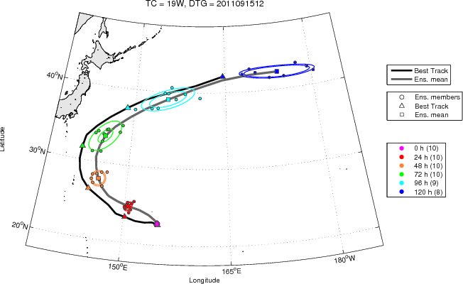
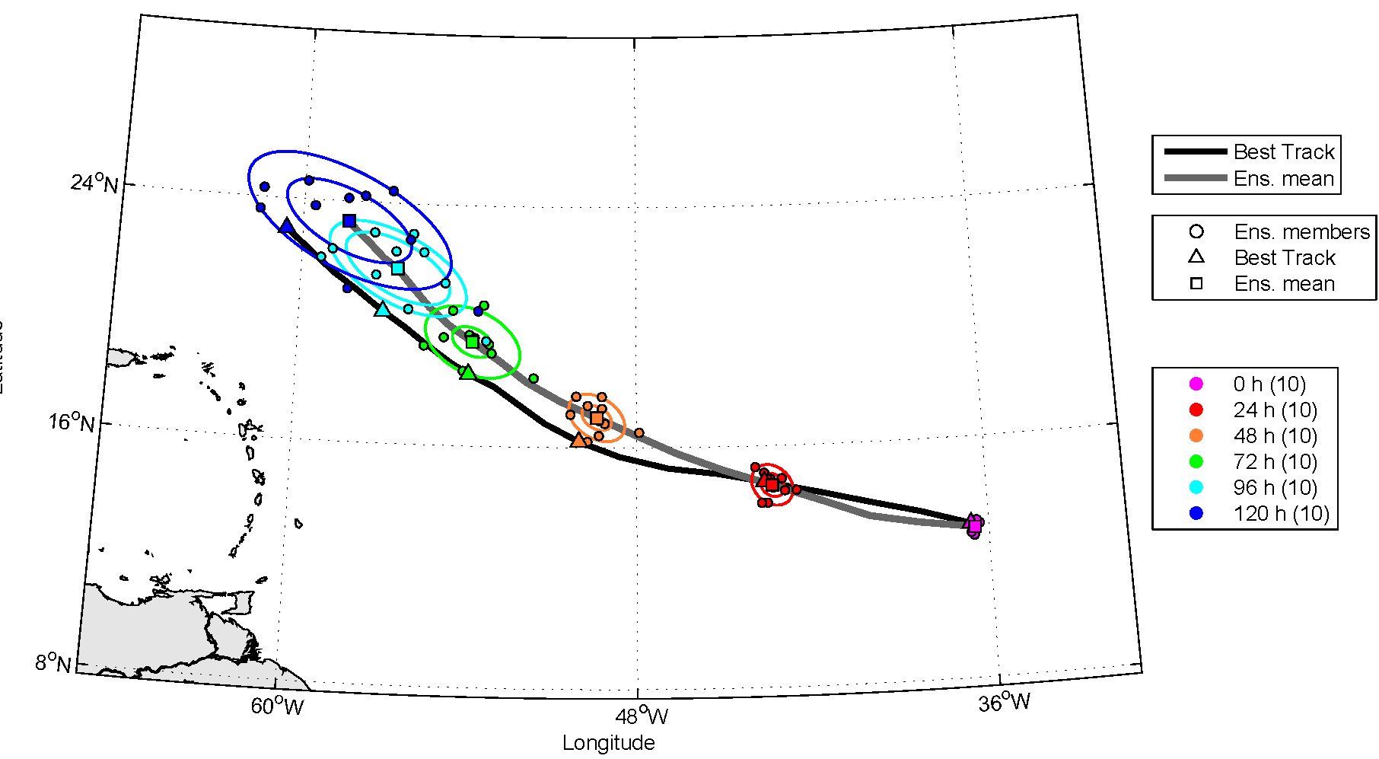
Real Time Evaluation
Sonca 2011 (WestPac)
12 UTC 15 September
Katia 2011 (Atlantic)
00 UTC 31 August
Over 250 real-time analyses and forecast made between August and September for the Atlantic and Pacific basins.
Track forecasts real-time probabilistic guidance for forecasters
Data set provides a control for data inclusion/denial experiments.

Slide 46
COAMPS-TC FY12 Experiments
For a subset of the 2011 real-time data set, perform a series of experiments with various observation sets added to the analysis.
Relatively large data set will allow for statistical significance testing.
Experiments to be performed:
  Assimilation of AMSU-A radiance observations from METOP and NOAA-15, 16 & 18 using global-model bias coefficients.
  Same AMSU-A experiment except using bias coefficients spun up with COAMPS-TC.
  Denial of AMV’s.
  Assimilation of TPW observations.
  Testing with a 3-hr update cycle (currently 6-hr is used).

Slide 47
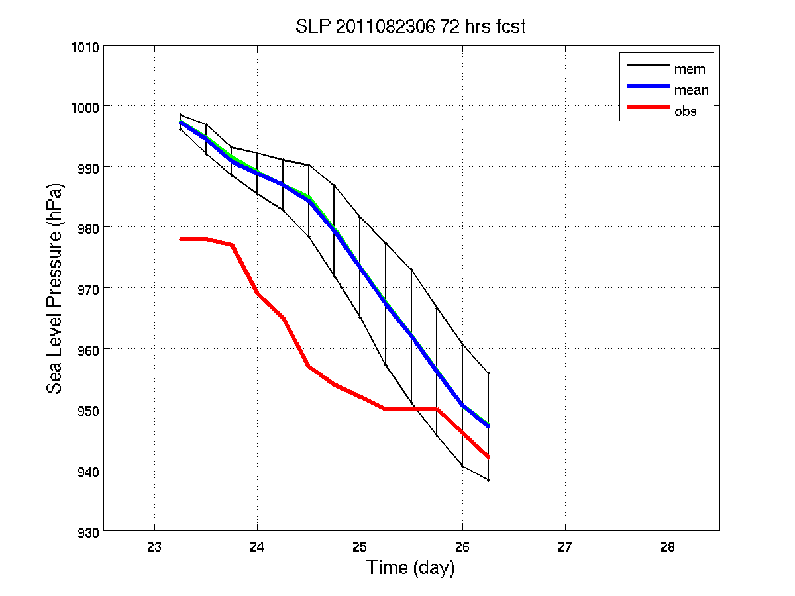
Other DA experiments
Hurricane Ike (2008)
  WRF/3d-Var 12 km: AIRS T and Q
  Improvement of track and MSLP forecasts
Hurricane Irene (2011)
  WRF/DART 36 km …
CTL
AIRS
Best

Slide 48
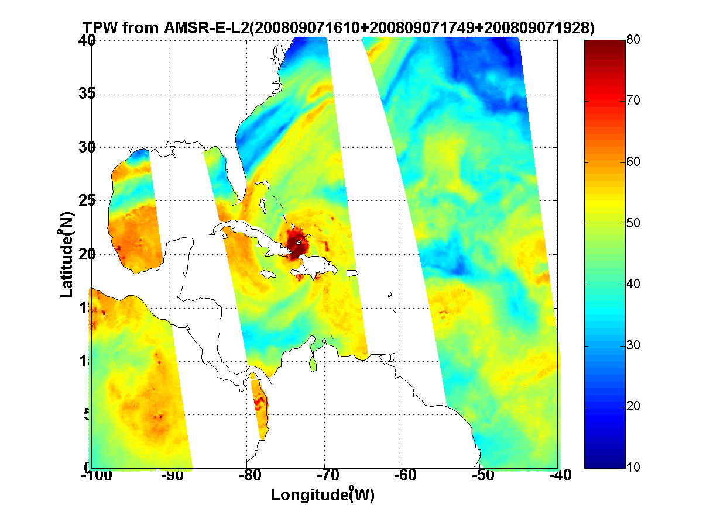
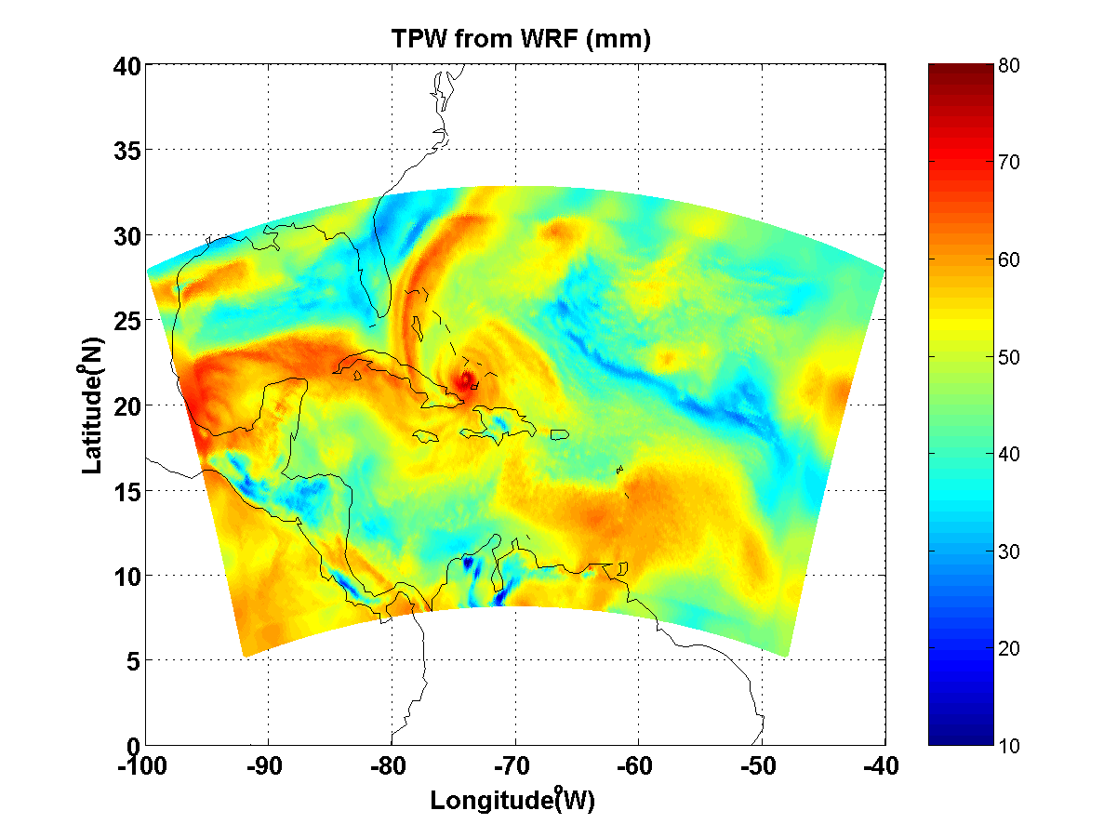

How to verify impact on forecast?
Traditional track / MSLP metrics
TC size (using CIMSS analyses)
Comparisons vs independent observations
Can use GOES images, AMSU, MIMIC …
e.g. TPW as a qualitative (and quantitative) metric

Slide 49
Relevant Publications
Doyle, J.D., C.A. Reynolds, and C. Amerault, 2011: Diagnosing tropical cyclone sensitivity. Computing in Science and Engineering, 13, 31-39.
Hendricks, E.A., J.R. Moskaitis, Y. Jin, R.M. Hodur, J.D. Doyle, and M.S. Peng, 2011: Prediction and Diagnosis of Typhoon Morakot (2009) Using the Naval Research Laboratory’s Mesoscale Tropical Cyclone Model. Terr. Atmos. Ocean. Sci., 22, (In Press).
Kwon, E.-H., J. Li, Jinlong Li, B. J. Sohn, and E. Weisz, 2011: Use of total precipitable water classification of a priori error and quality control in atmospheric temperature and water vapor sounding retrieval, Advances Atmos. Sci. (accepted).
Wu, T.-C., H. Liu, S. Majumdar, C. Velden and J. Anderson, 2012: Influence of assimilating satellite-derived atmospheric motion vector observations on analyses and forecasts of tropical cyclone track and structure. Mon. Wea. Rev. (in preparation)
Zheng, J., J. Li, T. Schmit and Jinlong Li, 2011: Assimilation of AIRS soundings for improving hurricane forecasts with WRF/3DVAR, J. Geophys. Res. (submitted).
Zheng, J., J. Li, T. J. Schmit, J. Li, and Z. Liu, 2012: Variational assimilation of AIRS temperature and moisture profiles for improving hurricane forecasts. J. App. Met. Clim. (in preparation)

