Slide 1
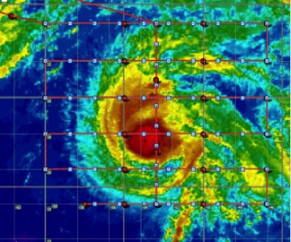
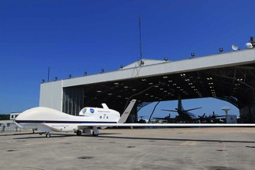
NASA’s Hurricane and Severe Storm Sentinel (HS3): Results from the 2012 Deployment and Plans for 2013
Scott Braun
Paul Newman
(NASA/GSFC)

Slide 2
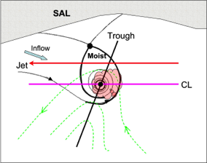
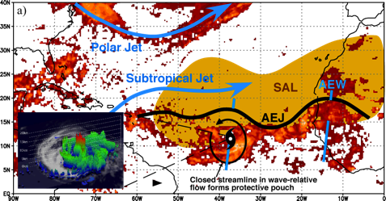
HS3 Science Questions
What is the role of the Saharan Air Layer?
What is the role of upper-level wind patterns?
Contribution to vertical wind shear
Interaction with storm outflow
What is the role of the “pouch” in protecting storms from dry air?
Are intense hot towers (convective bursts) fundamental building blocks for storm formation and intensification?

Slide 3
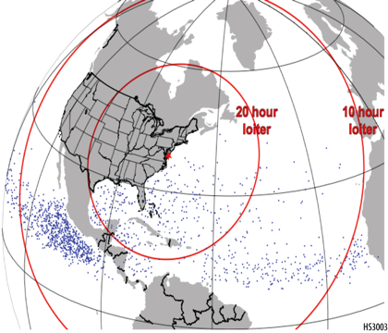
HS3 Mission Overview
• Two Global Hawks, one equipped for the storm environment, one for over-storm flights
• Deployments of GHs from the East Coast— Wallops Flight Facility in VA
• 4-5 week deployments in 2012, 2013, and 2014
• 275 flight hours per deployment (10-11 flights)
16 h
loiter
6 h
loiter
Dots indicate genesis locations. Range rings assume 26-h flights.

Slide 4
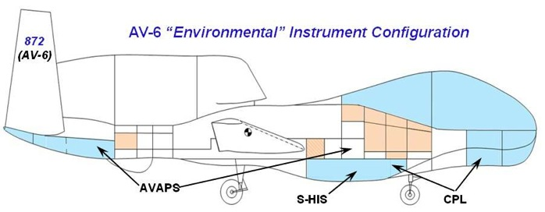
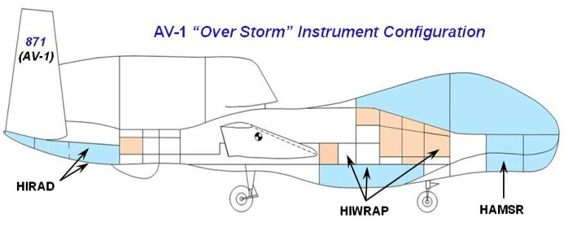
2012 Payloads
NOAA/NCAR Dropsonde
NASA/GSFC
Cloud Physics
Lidar
U. Wisc. Interferometer sounder
NASA/MSFC SFMR-type scanning
radiomter
JPL microwave
sounder
NASA/GSFC Doppler radar

Slide 5
Global Hawk Presents Challenges for Hurricane Science/Operations
Chase aircraft required for takeoffs/landings
Only in daylight hours
Significant cloud cover can cancel flights
Flight plans submitted to FAA 2 business days in advance
Because of dropsondes, limited flexibility to modify flight plan during flight
While it can fly for 26 hours, there can be large gaps between flights

Slide 6
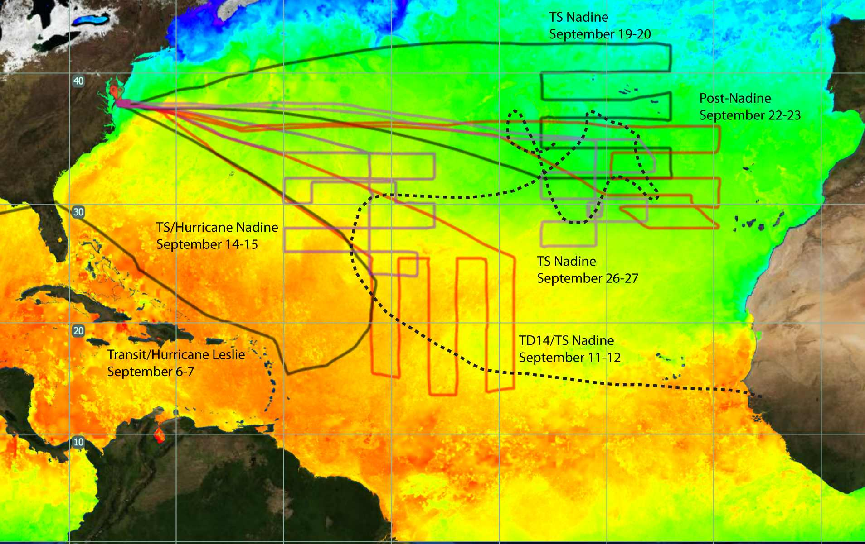
Hurricane and Severe Storm Sentinel (HS3)
2012
Nadine’s track
21
26
28
30
32

Slide 7
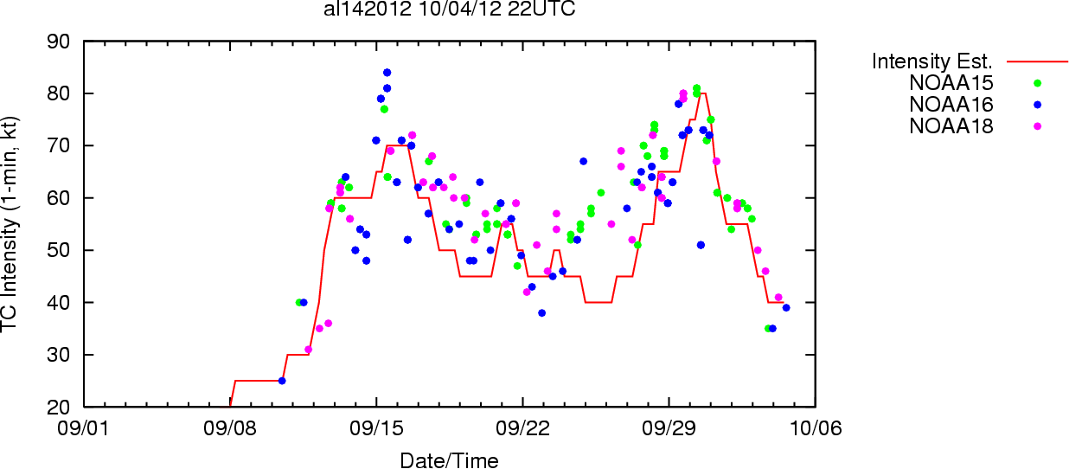
Flight Times As a Function of Storm Life Cycle
Post-tropical low
Hurricane
HS3 Flights
Tropical Storm

Slide 8
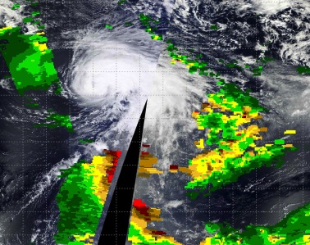
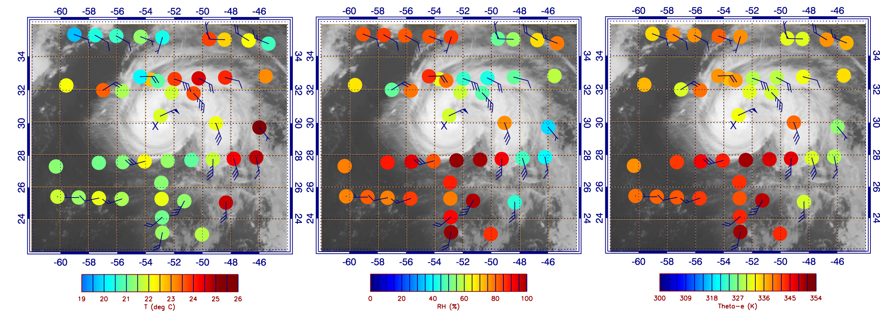
Was SAL Air Getting Into Nadine on Sept 14-15?
925 hPa Temperature
925 hPa RH
925 hPa θe
Notes:
Summary of the second Nadine flight on Sept. 14-15 when Nadine intensified slightly from a strong tropical storm to a weak hurricane. The storm was experiencing strong vertical wind shear, with dry air apparently getting into the circulation. There was a large convective burst that was likely induced by the shear, but that enabled the storm to attain hurricane status. The four dropsonde profiles are taken along the points shown in the satellite image. Going from west to east (from 1 to 4), we saw moist low-to-mid level conditions transition to a distinct SAL air mass. This pattern is consistent with a S-HIS cross section of relative humidity that showed low-level moist conditions and upper level dry conditions to the west of Nadine transitioning to low-level dry/mid-level moist conditions associated with the SAL. These results suggest that the SAL was still isolated to the eastern and perhaps northern far sections of the storm and that any dry air getting into the storm was probably related to non-SAL mid-level dry air.

Slide 9
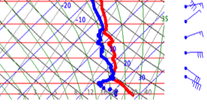
925 hPa Temperature
925 hPa RH
925 hPa θe
Notes:
Summary of the second Nadine flight on Sept. 14-15 when Nadine intensified slightly from a strong tropical storm to a weak hurricane. The storm was experiencing strong vertical wind shear, with dry air apparently getting into the circulation. There was a large convective burst that was likely induced by the shear, but that enabled the storm to attain hurricane status. The four dropsonde profiles are taken along the points shown in the satellite image. Going from west to east (from 1 to 4), we saw moist low-to-mid level conditions transition to a distinct SAL air mass. This pattern is consistent with a S-HIS cross section of relative humidity that showed low-level moist conditions and upper level dry conditions to the west of Nadine transitioning to low-level dry/mid-level moist conditions associated with the SAL. These results suggest that the SAL was still isolated to the eastern and perhaps northern far sections of the storm and that any dry air getting into the storm was probably related to non-SAL mid-level dry air.

Slide 10
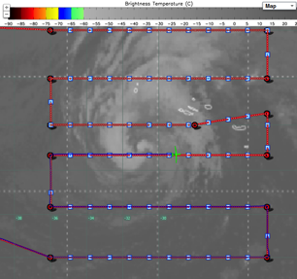
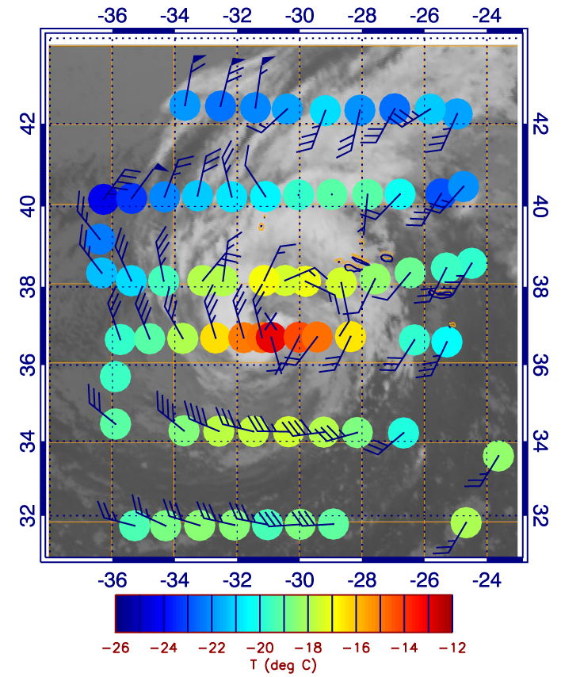
Nadine Survives Despite Adverse Conditions (Sept 19-20)
• Despite strong vertical shear, dry air and low SSTs (~22°C), Nadine survives
• Dropsondes reveal warm core structure near center through most of the troposphere
•NHC uses HS3 observations, among others, to maintain Nadine as a tropical storm
400 hPa Temperature
Notes:
Summary of the third Nadine flight on Sept. 19-20. At this point, Nadine had moved over colder waters and was still experiencing strong vertical shear. The NHC was close to considering Nadine either a sub-tropical storm or post-tropical storm. Observations from the GH showed strong winds of ~50 knots near the surface on the western side of the storm and revealed that a warm core was still present at most levels in the troposphere. As a result, the NHC mentioned HS3 data in their discussion and kept the storm as a tropical storm.

Slide 11
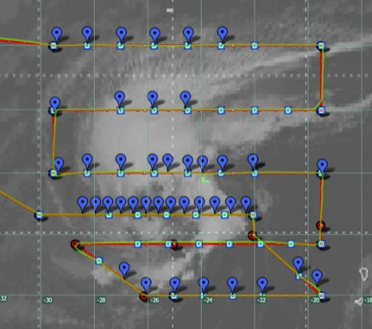
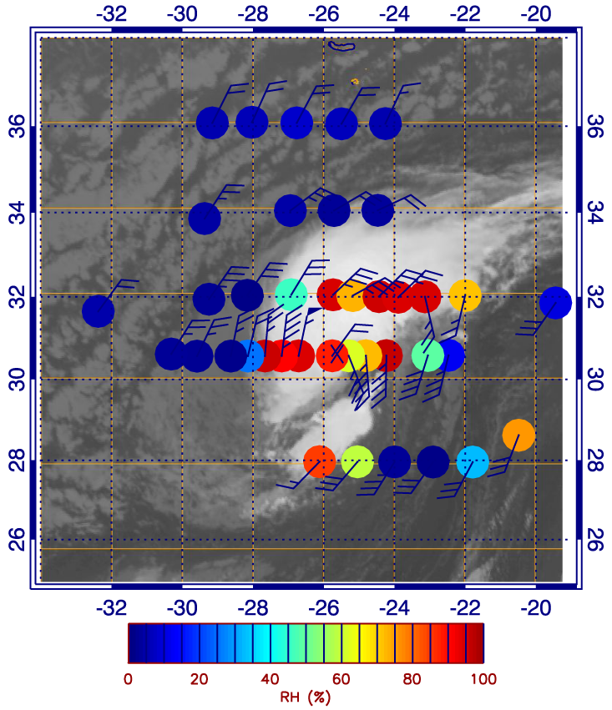
HS3 Shows That Nadine Is A Tropical Storm Again! (Sept 22-23)
• Despite moderate but increasing shear, low SSTs (~24°C), Nadine redevelops
• 70 knot wind at 900 hPa
• Extremely dry air in nearby environment
600 hPa RH
WEST
EAST
15
SAL Dust
10
Height (km)
5
0
Notes:
Summary of the fourth Nadine flight on Sept. 22-23. Nadine was no longer being tracked by the NHC, although they were identifying it as a region of possible redevelopment. Nadine was still over marginal temperature waters with moderate vertical wind shear. During the flight, convection had resumed, with some lightning observed. Dropsondes observed winds up to 70 knots at 925 hPa (lower left), so the NHC declared Nadine to be a tropical storm again. This flight was highlighted by the availability, for the first time, of real-time skew-T plots of temperature and dewpoint temperature from S-HIS (lower right).

Slide 12
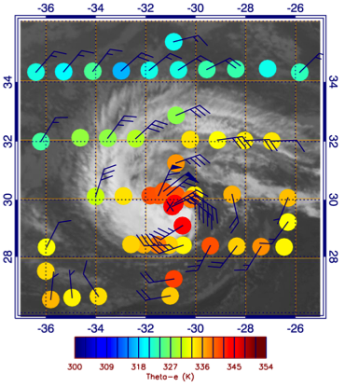
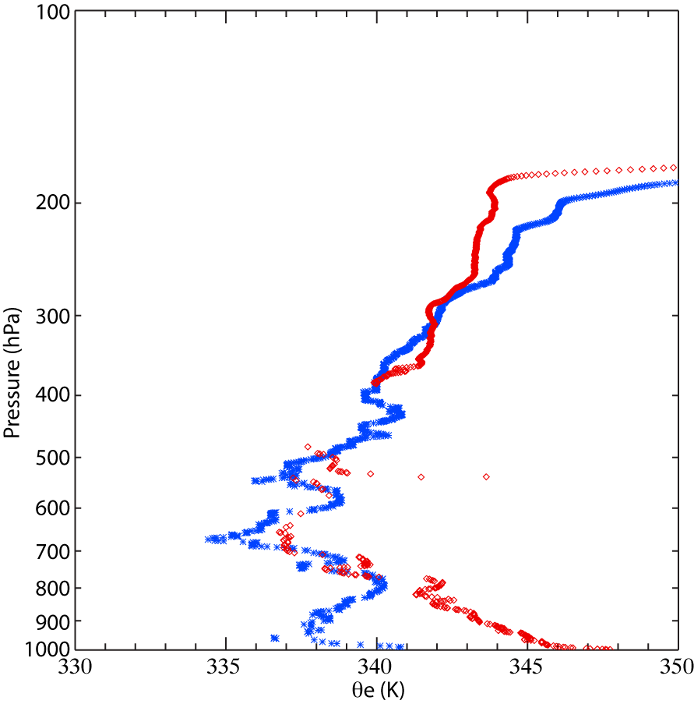
Precursor Conditions for Nadine’s Re-intensification to Hurricane (Sept 26-27)
• Conditions improve: Weak but increasing shear, more moist mid levels, and movement over warmer SSTs (~24-26°C)
• Jump in θe values from previous flight in the core as convection increases
925 hPa θe
Distinct change in θe profiles
23 Sept
27 Sept
Notes:
Summary of the fifth Nadine flight on Sept. 26-27. Nadine was a tropical storm during the flight and was drifting southward toward somewhat warmer waters. There was a lot of dry air around the storm (top right), but significant bursts of convection were taking place during the flight. By the next day (lower right), the convection had expanded, the storm had strengthened, and a new eye had formed. The low light camera captured the cloud tops within Nadine under the full moon.

Slide 13
AV-1 Prep for 2013-2014
• AV-1 did not make the 2012 deployment due to aircraft issues
• Test flight in Pacific on Nov. 5-6
• In addition to HAMSR and HIWRAP, flying HIRAD for the first time
Overflights of
buoys
OSCAT image from 00 UTC 6 November

Slide 14
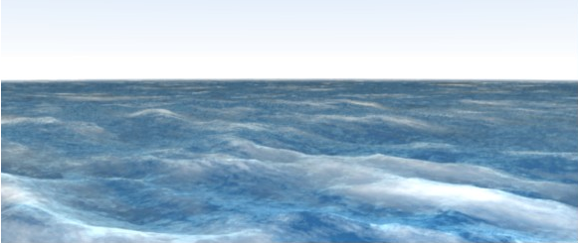
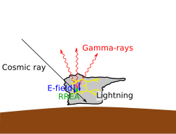
Plans for 2013
GPS
z
h
Piggybacks
GPS surface wind sensors
Gamma ray detector
Deployment dates
Aug 20-Sept 24
S
Reflection Area
x
γ
y
P

Slide 15
HS3 Data
Research products will be made available to any user after QC/processing
CPL data available since Nov. 2012
S-HIS data became available Feb. 2013
Dropsonde data likely available March 2013
For complete information on HS3 and links to data, go to
http://espo.nasa.gov/missions/hs3/

Slide 16
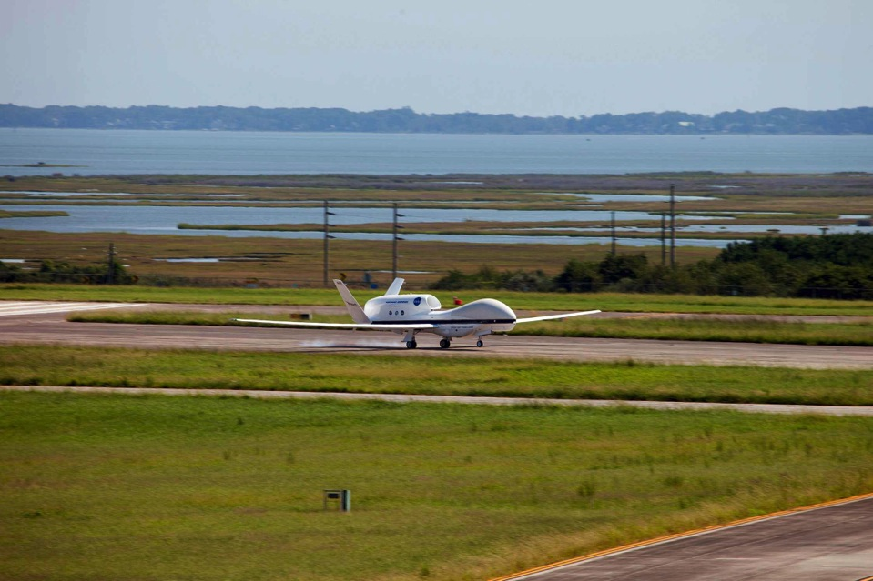
Questions?
http://espo.nasa.gov/missions/hs3/
First Global Hawk landing at Wallops Flight Facility, Sept. 7, 2012.

