Slide 1
NSF SUPPORT OF TROPICAL CYCLONE RESEARCH
Michael C. Morgan
Atmospheric and Geospace Sciences Division, NSF
Presentation at IHC 5 March 2013

Slide 2
Outline
AGS support for TC research
Ongoing and future opportunities
NSF’s Hazards SEES
EarthCube
NSF-NOAA Visiting Scientist Program
National Ensemble Project

Slide 3
NSF’s investments in building capacity
Support for students, post-docs, and faculty through unsolicited and solicited proposals, and NCAR
Support for undergraduates (REUs)
Support for gradate students (GRFs)
Support for post-doctoral researchers (PRFs)
Support for early career faculty (CAREER)

Slide 4
. . . and a responsiveness to national priorities
AGS supports research activities that are consistent with or linked to well-vetted, community-informed, national strategic science priorities.

Slide 5
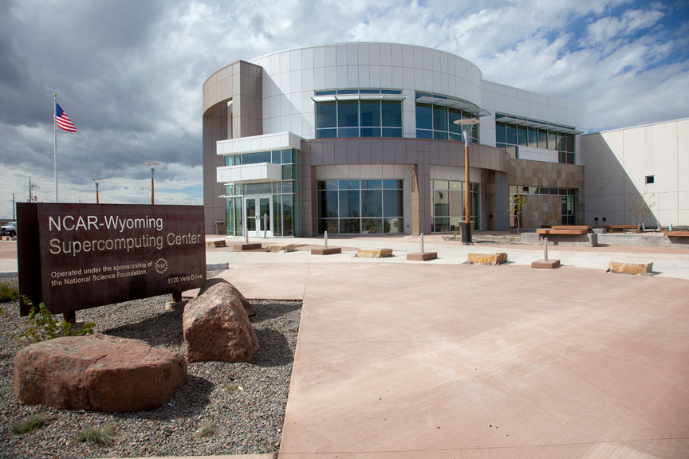
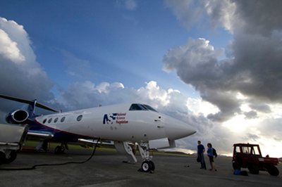
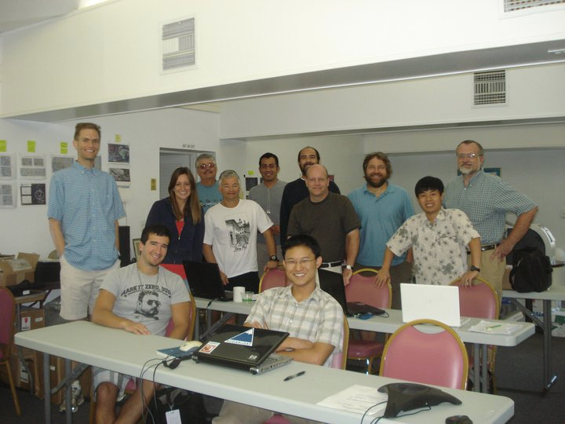
AGS Investments
Notes:
The Yellowstone system will be a 1.6-petaflops IBM iDataPlex cluster with 74,592 Intel Sandy Bridge EP cores, 149.2 TB of memory, and 11 PB of parallel disk storage. Yellowstone is expected to deliver nearly 30 times the capacity of NCAR's current Bluefire. This integrated computing resource is what makes this system exceptional for geoscience research - the linking of a very large centralized file and data storage system to a high-performance computational cluster and visualization resource. WRF model has over 18,000 users world-wide, with nearly 6000 within the US. Support for PI’s and their students, GRF, AGS-PRFs, post-docs, CAREER funding. COSMIC sponsored by NSF, UCAR, NASA, USAF, ONR, Taiwan Nat’l Space Organization, NOAA; GV maximum range 6500 nm, cruise altitude: 51,000 ft (15.5 km) instruments include microwave temperature profiler, differential GPS, small ice detector, tunable diode laser hygrometer.

Slide 6
Physical and Dynamic Meteorology (PDM) and Climate and Large-scale Dynamics (CLD) Programs
PDM and CLD have supported a spectrum of basic research related to TCs:
Aerosols, nucleation & cloud physics (laboratory + field)
Boundary layer, land-surface/air-sea exchange measurements & their parameterization
Storm kinematics/dynamics & precipitation processes at scales from individual to “large mesoscale” (e.g., TCs)
Data assimilation studies
Atmos. modeling/predictability studies for all the above
Development of select new observing techniques and proof-of-concept studies for new, innovative climate observations
Processes that govern mean climate, climate variability, and climate change

Slide 7
Hazards SEES
The overarching goal of NSF’s Hazards SEES program is to catalyze well-integrated interdisciplinary research efforts in hazards-related science and engineering … to improve the understanding of natural hazards […], mitigate their effects, and to better prepare for, respond to, and recover from disasters = preventing hazards from becoming disasters.
Hazards SEES aims to make investments in strongly interdisciplinary research that will reduce the impact of such hazards, enhance the safety of society, and contribute to sustainability.

Slide 8
Hazards SEES seeks to:
advance understanding of the fundamental processes associated with specific natural hazards and technological hazards linked to natural phenomena, and their interactions;
better understand the causes, interdependences, impacts and cumulative effects of these hazards on individuals, the natural and built environment, and society as a whole; and
improve capabilities for forecasting or predicting hazards, mitigating their effects, and enhancing the capacity to respond to and recover from resultant disasters.

Slide 9
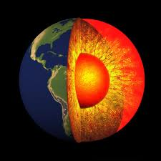
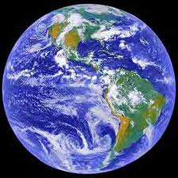
EarthCube
Goal: to transform the conduct of research in geosciences by supporting community-based cyberinfrastructure to integrate data and information for knowledge management across the Geosciences.
AGS response: EarthCube workshop in December 2012 supported by GEO focused on ensemble prediction and data assimilation
GEO-OCI Partnership
Notes:
NSF seeks transformative concepts and approaches to create integrated data management infrastructures across the Geosciences. The Geosciences Directorate (GEO) and the Office of Cyberinfrastructure (OCI) recognize the multifaceted challenges of modern, data-intensive science and education and envision an environment where low adoption thresholds and new capabilities act together to greatly increase the productivity and capability of researchers and educators working at the frontiers of Earth system science.

Slide 10
Possible future opportunities
NSF-NCEP sponsored Visitor Program
University-based Nat’l Ensemble Program

Slide 11
NSF-NCEP sponsored Visitor Program
Goal: To provide the AGS PI community and their research groups access to NCEP models, data, and talents while concomitantly fostering the transfer of basic research to operations
Mechanism: Dear Colleague Letter to PI community this spring highlighting this opportunity to announce possibility of supplements to existing NSF awards.

Slide 12
GOAL: A university-based national ensemble
To advance the national ensemble prediction capability by:
providing the tools necessary to accelerate research: a large, real-time ensemble database, tools to verify and interrogate ensemble output;
increasing accessibility and participation of the university community to this enterprise;
providing the non-atmospheric science community a sense of how uncertainties in prediction might be tapped for economic and societal benefit

Slide 13
CONCEPT: A university-based national ensemble
Ensemble would be created using the computing resources resident on desktops in university labs across the country (world?)
Initial conditions could be transferred to each computing system and model output (a single forecast) transferred to a central, cloud accessible, repository.
Each forecast challenged with an analysis of record
Analyses and output available to public/private sector for research (and perhaps operational) uses.

Slide 14
WRF-ARW possible ‘physics’ configurations
14 - microphysics 3 - zero moisture options 2 - hail 2 - ice 2 - latent heating 7 - lw 7 - sw 8 - sfclay 5 - surface physics 5 - urban physics 12 - boundary layer 10 - cumulus 3 - shallow cumulus 2 - subsidence spread 2,2,2 - heat, snow, ice fluxes from surface

Slide 15
WRF-ARW possible ‘physics’ configurations
14 - microphysics 3 - zero moisture options 2 - hail 2 - ice 2 - latent heating 7 - lw 7 - sw 8 - sfclay 5 - surface physics 5 - urban physics 12 - boundary layer 10 - cumulus 3 - shallow cumulus 2 - subsidence spread 2,2,2 - heat, snow, ice fluxes from surface
Just considering the microphysics, BL schemes and CP’s, you could conceivably get an ensemble of 1680 members (or so)
Clearly could create a large-member, multi-member physics-based ensemble using a single dynamical core and various parameterization packages for the unresolved physics

Slide 16
Potential opportunities for advancing
Science
Improvement in the tools used to do science
What ensemble size for error statistics to converge?
Operations
New uncertainty products?
Development of forecast scenarios
Education
Allows participants to understand, NWP, assimilation, uncertainty evolution and communication
There are potential links to this activity that could link it to EarthCube (“big data”) and
Hazards SEES (“improve capabilities for forecasting or predicting hazards”)

Slide 17
Issues/Challenges/Questions
What sort of ensemble (IC, MP, MM)?
What domain? Limited-area or global: dictates length of integration – trade-offs (grid-spacing, size of community participation, “research-worthiness”)
Who decides all of the above?
Volume and quality of data?
What tools are necessary to interrogate this massive data set?
Would such a data set be of use to the research and operational communities?

Slide 18
Possible implementation path
Organizing workshop, volunteers identified, common interests identified
Pilot examples . . .
N. American domain for winter/spring and tropical domain for summer and fall?
Summer/Fall pilot informed by HFIP experience?
Post-pilot
Regional virtual field campaigns triggered by actual field campaigns or events of special interest (e.g., “high-impact” events)
Full-scale spin-up with a larger community

Slide 19
What’s necessary to begin?
Community interest with a compelling science case. What science could be accomplished with this data set? How might HFIP benefit or support such an effort?
Community organization and coordination
Community plan for work- and data-flows
Community plan for education and training

