Slide 1
NOAA’s Hurricane Forecast Improvement Project (HFIP)
Frank Marks NOAA/AOML Hurricane Research Division
5 March 2013
Notes:
Hurricane Earl 2 September 2010

Slide 2
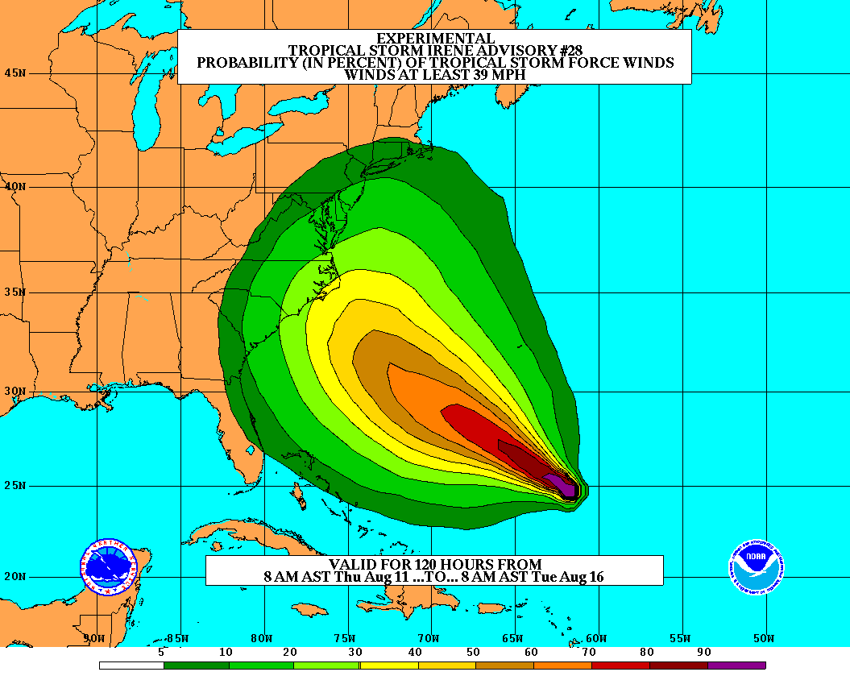
Goals
Improve Forecast Accuracy
Hurricane impact areas (track) – 50% in 10 years
Severity (intensity) – 50% in 10 years
Rapid intensity change detection
Extend forecast reliability out to 7 days
Quantify, bound and reduce forecast uncertainty to enable risk management decisions
http://www.hfip.org/
Notes:
http://www.nrc.noaa.gov/HFIPDraftPlan.html
HFIP Team
Frank Marks, research lead
Ed Rappaport, operations lead
Fred Toepfer, project manager
Robert Gall, development manager
Mark DeMaria
Chris Fairall
Jim McFadden
Daniel Melendez
HFIP executieve oversight board:
OAR AA/Robert Detrick, co-chair
NWS AA (acting)/Laura Furgione, co-chair
NCEP/Louis Uccellini,
NHC/Rick Knabb,
NESDIS/Mark DeMaria,
NOS/Jesse Feyen,
AOML/Bob Atlas
PPI/Paul Doremus
NMFS/Bonnie Ponwith,
NOS/Liz Scheffler,
NMAO-PM Aircraft/Mike Devany
OFCM/Sam Williamson
Executive Secretariat: OAR/Brian Orndorff and NWS/Nasheema Lett
http://www.hfip.org/

Slide 3
HFIP Technical Scope: What NOAA HFIP Funds
Builds and tests the technology necessary to transition hurricane research to NWS operations:
Advance hurricane forecast system/global forecast system to reduce error in intensity and track guidance
Make better use of existing observing systems; define requirements for future systems to enhance research and operational capabilities
Expand and improve forecaster tools and applications to add value to model guidance
Does not include the acquisition or operation of “operational” observing systems
HFIP bridges Research and Operations
Notes:
Much of the improvement in tropical cyclone forecasting is attributed to advances in regional and global NWP modeling systems. These advances are mainly the result of: improvements in observations; data assimilation techniques; improved model physics in global forecast systems and high resolution regional models; the development of ensemble-based model guidance; and significant investments in supercomputing at operational NWP centers.
The HFIP Portfolio has 3 major components that describe WHAT needs to be done to achieve our goals.
Model improvements
Focuses on the strategies to optimize new and existing observing system and platforms for BOTH modeling and direct use by the forecasters
More tools and applications beyond traditional models and direct obs into the forecasters suite of tools

Slide 4
HFIP Charter signed August 1, 2007
Hurricane Executive Oversight Board (HEOB)
Jointly chaired by AA for National Weather Services and AA for Oceanic and Atmospheric Research
Cross-NOAA Membership
HFIP Management
Project Manager: Fred Toepfer, NWS/OST
Development Manager: Robert Gall, UCAR
Research Lead: Frank Marks, OAR/AOML/HRD
Operations Lead: Ed Rappaport, NWS/NHC

Slide 5
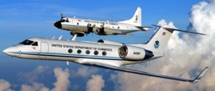
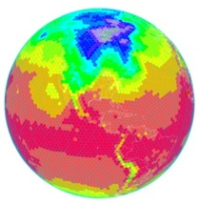
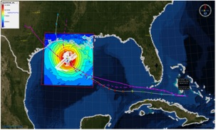
HFIP Activities
Traditional Hurricane Research Activities:
Observations, analysis, database, & instrument R&D (IFEX)
Statistical-dynamical model development
Advances in operational models (Stream 1)
New HFIP Research Thrusts:
Experimental global and regional hurricane model development (Stream 2)
Data assimilation techniques and observing system strategy analysis development (Stream 1 & 2)
Model evaluation tool development (Stream 1.5)
Application and tool development for forecasters
D1
D2
Partnership: NCEP, AOC, AOML, ESRL, GFDL, DTC, USWRP, NESDIS/STAR
http://www.hfip.org/documents/
Notes:
http://www.hfip.org/documents/
Two Stream Approach to HFIP developments:
Stream 1– Operational Transition and Implementation
Stream 2 – Advanced Technology Demonstration
Unconstrained by near-term availability of operational computing
Uses both NOAA’s and computing resources from major supercomputing centers for testing and evaluation.
Emphasis is on high resolution global and regional models run as ensembles
Real-time or near real time runs during hurricane season
Stream 1.5 (JHT-like)
NHC Forecaster Defined.
Subset of Stream 2 that forecasters see as particularly promising or provides demonstrated capability
Will be configured to run in real-time and products made available to NHC.

Slide 6
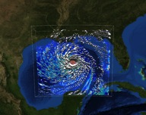
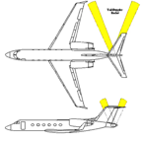
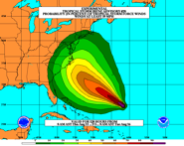
How to get there?
Research &Development (9 Teams)
Improved understanding from combination of observations & models
Higher resolution coupled models – critical to storm evolution forecasts – especially intensity changes
Forecast techniques to understand, reduce &communicate uncertainty
Information Technology
Increased computing power - run advanced hurricane/global models and reduce uncertainty
IT infrastructure for inter-agency data exchange
Observing Strategy
Improved use of existing and planned systems
Improved Products for Forecasters
Notes:
HFIP 2008-2009 activities
HRH Workshop:
http://www.dtcenter.org/plots/hrh_test/workshop2009/presentations/1_Gall_HRH%20HFIP%20presentation.pdf
http://www.dtcenter.org/plots/hrh_test/index.php
HFIP-TACC Real-time test
ftp://ftp.aoml.noaa.gov/pub/hrd/marks/HFIP-TACC_Summary.pdf
Diagnostics Team Workshop:
http://rammb.cira.colostate.edu/research/tropical_cyclones/hfip/workshop_2009/

Slide 7
Changing HFIP Team Structure
Emphasis on achieving 10-year goals in next 5 years (STRATEGIC TEAM).
Program must be more focused on developing systems that can be implemented within 1-2 year (TIGER TEAM)
Reorganized 9 teams into:
6 Strategic Teams – Longer term strategy for model and system improvements
6 Tiger Teams – to implement new technology within next year
Tiger Teams have limited life and serve to address Strategic Team needs

Slide 8
2013 Team Structure
FY 2013 Strategic Planning Teams | FY 2013 Team Leads
1. HFIP Model Strategy | Vijay Tallapragada, Stan Benjamin
2. Model Physics | Brad Ferrier, Jian-Wen Bao
3. Data Assimilation/Initialization | John Derber, Xuguang.Wang
4. Ensemble Development | Jeff Whitaker, Jiayi Peng
5. Post Processing and Verification Development Team | Mark DeMaria, David Zelinski, Tim Marchok
6. Societal Impacts | Jennifer Sprague, Rick Knabb
FY 2013 Tiger Teams | Strategic Team | FY2013 Team Leads
1. Web Page Design | 5 | Paula McCaslin, Thiago Quirino
2. 3-km Physics Package | 2 | Joe Cione, Chan Kieu
3. Regional Hybrid DA System | 3 | John Derber, Jeff Whitaker
4 Use of Satellite Data in Hurricane Initialization | 3 | Tomi Vukicevic, John Knaff, Emily Liu
5. Stream 1.5 & Demo System Implementation | 1 | James Franklin, Barb Brown
6. Recon Data Impact Tiger Team | 1 | James Franklin, Vijay Tallapragada
Notes:
Highlighted in Yellow are tiger teams from last year.

Slide 9
HFIP Science Review Committee
Purpose: evaluate scientific soundness and technical feasibility of proposed activities to further HFIP’s goals
Specific tasks undertaken by SRC include:
Review and suggest possible changes to annual plan
Review proceeding year accomplishments
Review model system development and observing strategy plans
Review objectives and makeup of demonstration system
Report annually to address these aspects of the program
Name Organization Area of Expertise Term of Service
Mike Montgomery NPS TC dynamics 3 year
Dave Nolan Miami TC regional models 3 years
Gary Barnes UH/Manoa TC structure 3 years
Jim Price Woods Hole Coupled models 2 years
Bob Hart FSU TC environment interaction 2 years
Jim Goerss NRL Monterey Global models/ensembles 2 years

Slide 10
HFIP Success to Date
HFIP focused research efforts within NOAA & interagency partners
HFIP defined solution to transition research into operations with Stream 1.5 products available to NHC forecasters in real-time
Transitioned global hybrid DA system and 3-km HWRF into operations last season
HFIP making significant progress – 5-year goals within reach
See Bob Gall’s presentation in the next session for details
http://www.hfip.org/documents/reports2.php
Notes:
http://www.hfip.org/documents/reports2.php

Slide 11
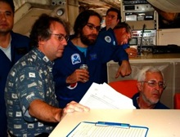
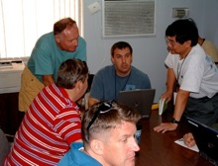
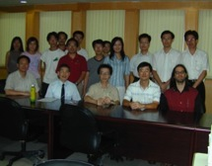
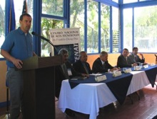
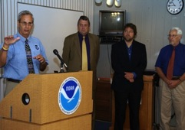
Keys to Success
Partnership: NOAA Research working closely with NOAA Operations, and Federal & Academic Partners (NASA, NSF, ONR, NRL, NCAR)
More integrated use & support of Testbeds (JHT, DTC, JCSDA)
Blend traditional hurricane and HFIP research activities
Manpower (diversity) to evaluate model performance with hurricane data sets is a critical need
CBLAST
IFEX/RAINEX
DOTSTAR
IFEX/TCSP
IFEX/PREDICT/GRIP

Slide 12
Questions?

