Slide 1
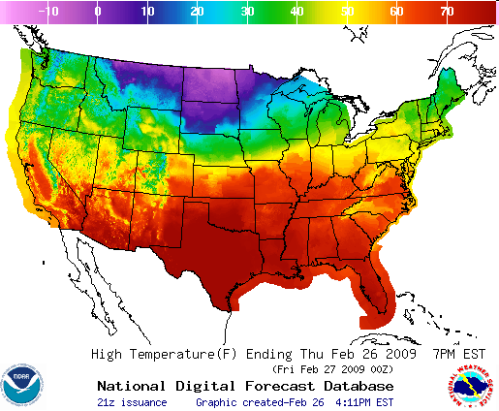
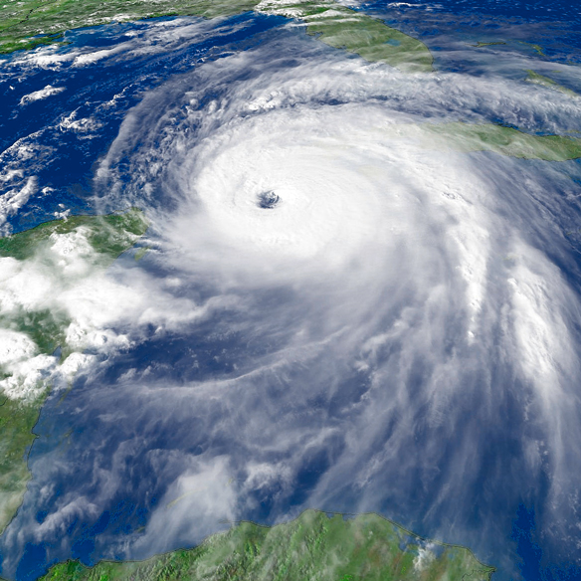
National Oceanic and Atmospheric Administration Building a Weather-Ready Nation
Welcome to the 67th IHC Tropical Cyclone Research Forum
Dr. Louis Uccellini
NOAA Associate Administrator for Weather Services and
Director, National Weather Service
College Park, MD
March 5, 2013

Slide 2
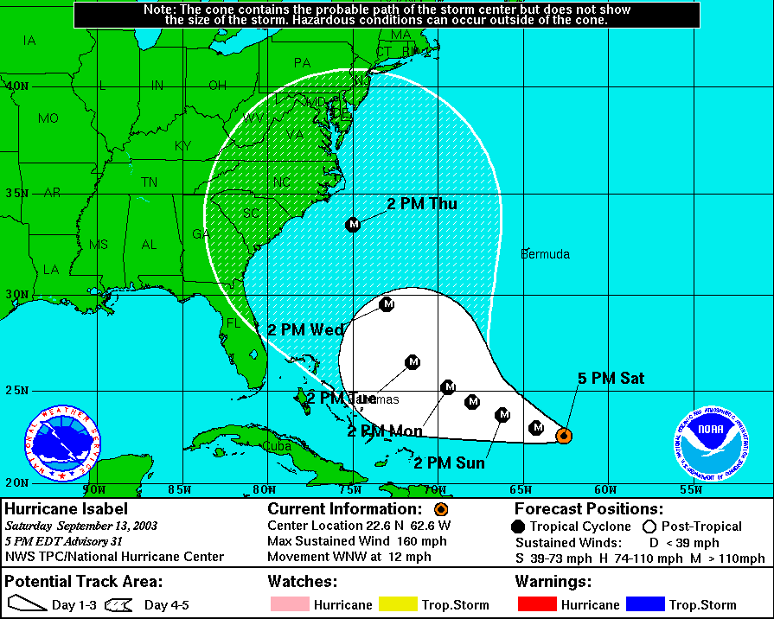
White cone – 2003
Blue cone - 2010
4:34 PM
Notes:
2

Slide 3
Jet Stream 10/30/12 12Z (Blue) Uncertainty in Sandy’s track
Jet Stream forms a pattern like a Greek Ω (Omega)
Jet Stream
H
L
Jet Stream
L
Sandy
10/30/12 12Z
Jet Stream
Possible tracks as Sandy interacted with developing Omega Block

Slide 4
Hurricane Sandy
October 21, 2012 0345Z through October 31, 2012 1315Z
National Hurricane Center's 5 day forecast track issued at 11 a.m. EDT on Thursday, October 25

Slide 5
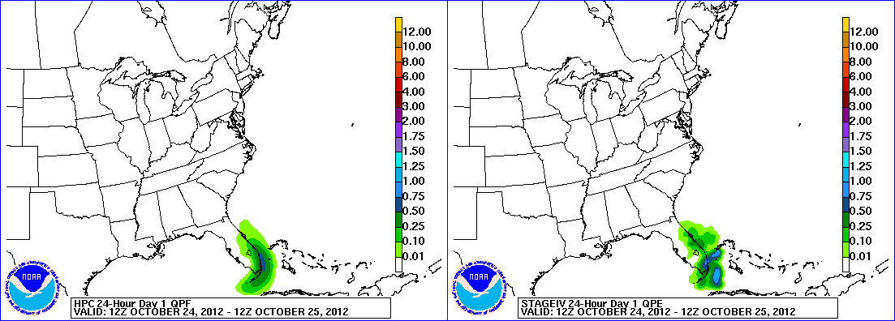
Hurricane Sandy Precipitation
HPC Forecast
Verification
October 24 – November 1, 2012

Slide 6
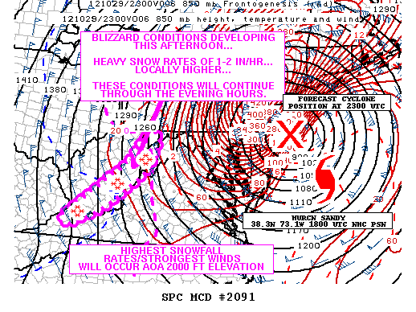
3 day Snow Total: valid Oct 28-Oct 30
SPC – Mesoscale Discussion highlighting blizzard conditions in the Appalachians
Snow Totals (Inches)
...WEST VIRGINIA...
CLAYTON 2 NNW 33.0
QUINWOOD 29.0
DAVIS 28.0
FLAT TOP 28.0
HUTTONSVILLE 5 WSW 28.0
CRAIGSVILLE 26.0
ALEXANDER 24.0
ALPINE LAKE 24.0
NETTIE 24.0
TERRA ALTA 24.0

Slide 7
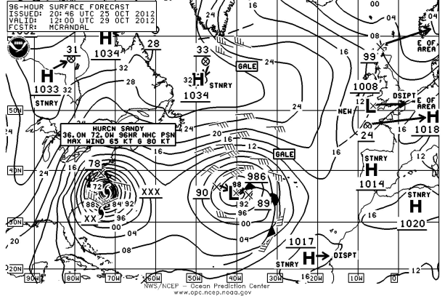
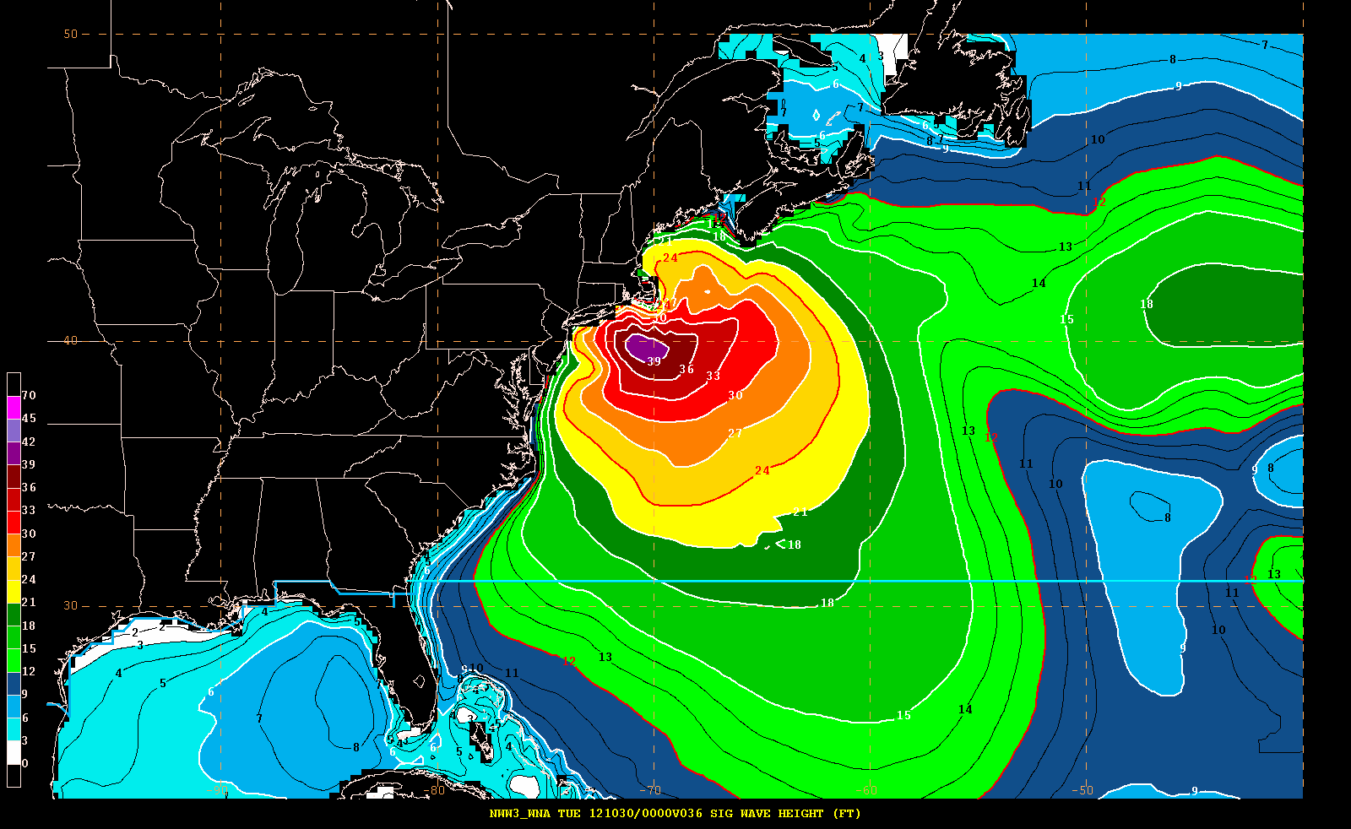
Hurricane Sandy: Collaborative Forecast Process
OPC – 96 hour surface chart
EMC – Wave Model forecasts
36 hour wave height forecast (ft)
7

Slide 8
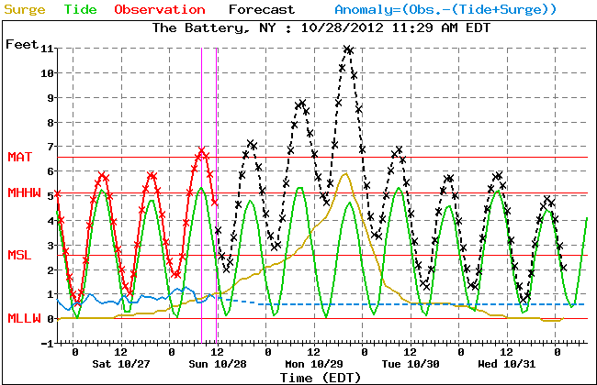
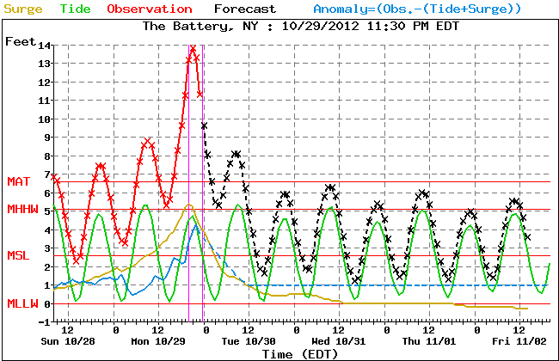
Hurricane Sandy: Collaborative Forecast Process
MDL NWS Surge Forecast:
Forecasts were coordinated among OPC, NHC, local WFOs
8

Slide 9
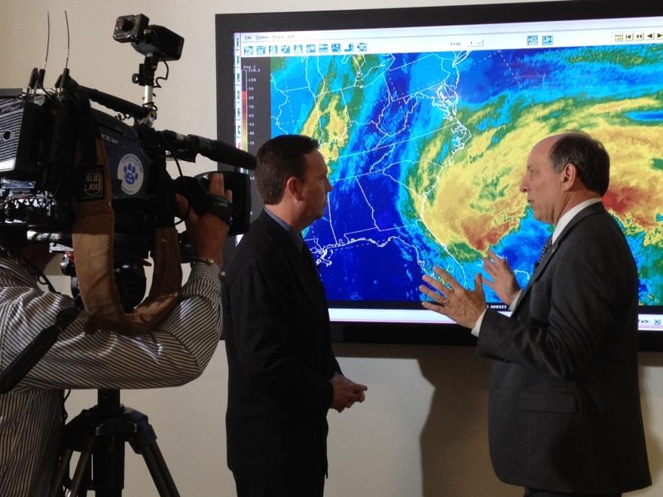
Hurricane Sandy: Communication Strategy
Messaging Focused on Impact-Based Decision Support Services
Unique nature of storm (tropical to extratropical transition)
Large area affected by strong winds
East to west track toward NJ
Record surge/inundation in NJ→ NYC→ SE New England
Threats emphasized particularly dangerous storm – “worst case scenario” compared to the Perfect Storm
Record blizzard in Appalachian Mountains & WV
9
9
Notes:
9

Slide 10
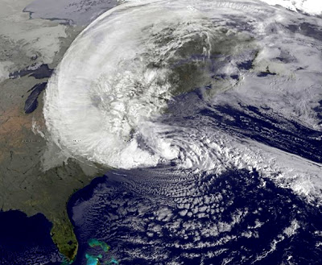
Summary
Forecasts were generally based on ensemble model approach (from U.S., Europe and Canada).
ECMWF higher resolution deterministic and ensemble models provided consistent alert (7+ days in advance) with remarkable accuracy, yet did over-forecast the storm intensity
Be careful with overgeneralizations, GFS had best track forecasts for 2012 season
Beginning Thursday – Friday: NOAA/NWS communicated/coordinated all forecasts with FEMA/emergency management community; NHC provided briefings to the White House
Media coordination started on Thursday and continued through the event
Conveyed consistent forecast message to EMs/media/public on the historic nature, unique characteristics and destructive potential for this storm
Primary model issue for this case: ongoing HFIP research points to enhanced resolution to improve deterministic and ensemble systems

