Slide 1
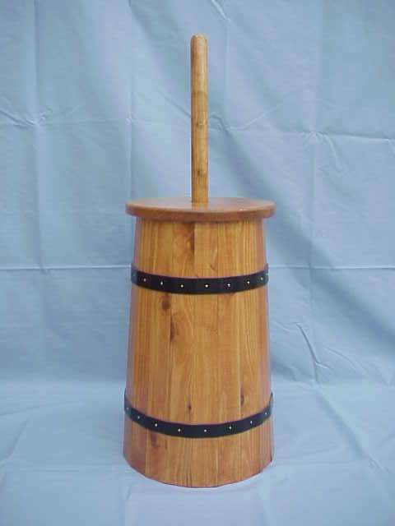
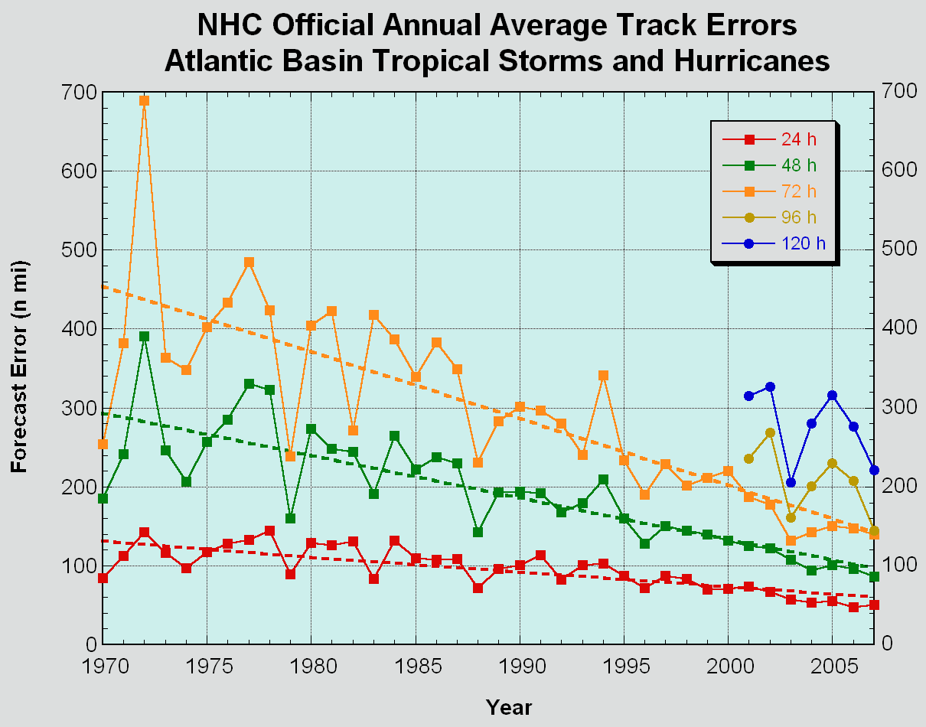
Interdepartmental Hurricane Conference
March 2, 2011
Scott Gudes
Vice President, Legislative Affairs
Space Systems & Operations
W A S H I N G T O N O P E R A T I O N S

Slide 2
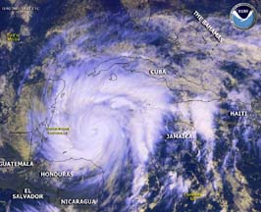
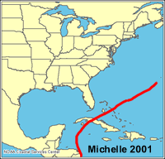
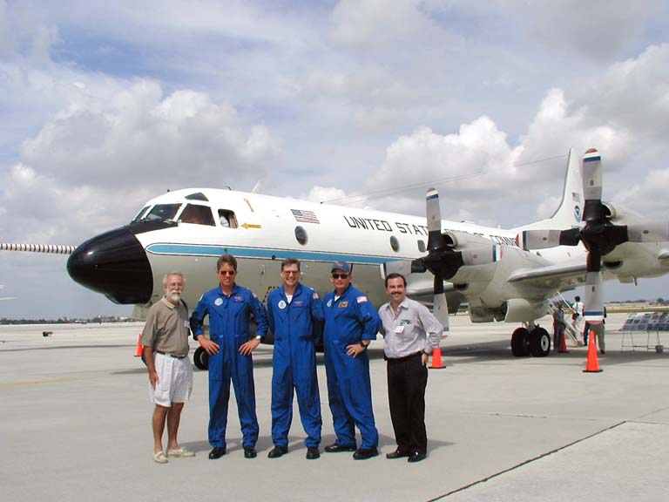
Hurricane Michelle Nov. 2001

Slide 3
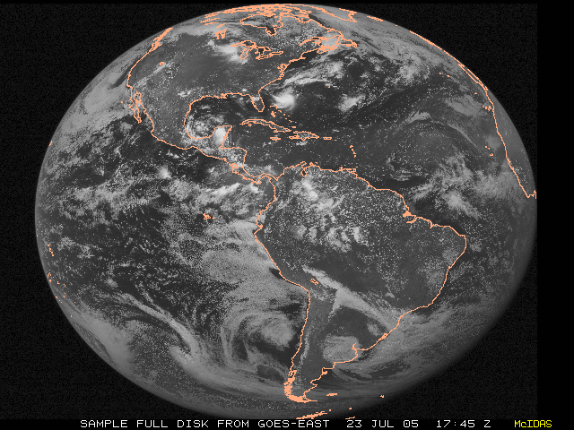
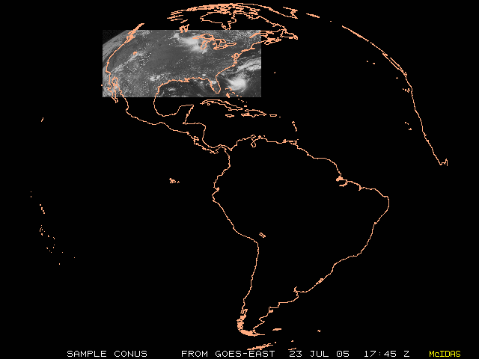
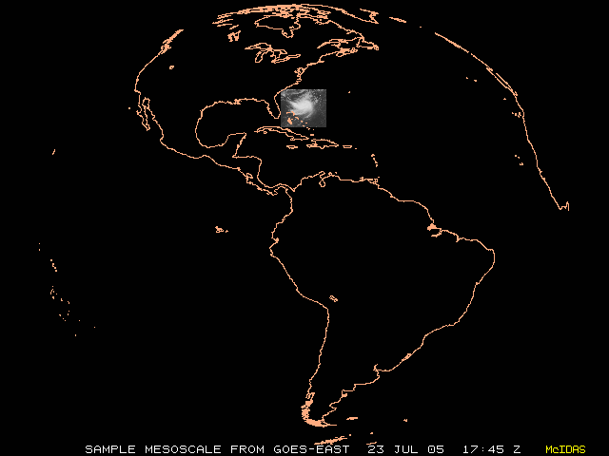
GOES R…4th Gen. Hurricane & Severe Weather Satellite
G
Hemisphere
CONUS
Mesoscale

Slide 4
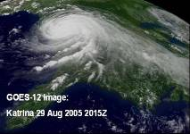
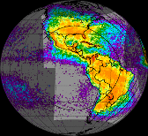
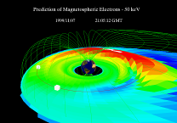
GOES-R Mission Overview
Since 1975, NOAA has operated a system of Geostationary Operational Environmental Satellites (GOES) to provide continuous weather imagery and monitoring of meteorological and space environment data to protect life and property across the United States and the Western Hemisphere.
GOES-R is the next generation of GOES satellites that will provide a major improvement in quality, quantity and timeliness of data collected.
The GOES-R constellation consists of two operational satellites in geostationary orbit at 75°W and 135°W, plus a spare at 105°W.
GOES West
135° West
GOES East
75° West
Spare
Visual & IR Imagery
Lighting Mapping
Space Weather Monitoring
Solar Imaging
Advanced Baseline Imager (ABI)
Geo Lightning Mapper (GLM)
Space Environment in-Situ Sensor Suite (SEISS)
Magnetometer
Solar Ultra-Violet Imager (SUVI)
Extreme UV/X-Ray Irradiance Sensors (EXIS)
Notes:
GOES program consists of multiple generations, or series, of satellites
GOES satellites are geosynchronous and provide a staring capability covering the western hemisphere
Our operational constellation includes two operational satellites; one over the east coast and one over the west coast
In order to maintain continuous coverage, we nominally have two operational and an on-orbit spare at all times. The two operational satellites provide the coverage, with the on-orbit spare available in case there is an unanticipated failure. It is also less expensive and safer to store a GOES satellite on-orbit than on the ground. We consider these factors, plus the expected life of on-orbit satellites, when planning for when we buy and launch the GOES satellites.
We have augmented our constellation with GOES-10, which is presently parked at 60 degrees in support of South America
When a satellite is launched it is checked out to ensure it works properly and then it becomes the spare satellite
When an operational satellite fails, spare takes its place
Operations concept requires that a replacement spare be launched, checked out, and ready to assume role as spare NLT the time at which existing on-orbit spare will be required as replacement for the planned end-of-life of an operational satellite
For unplanned failure of an operational satellite, a replacement spare satellite is launched as soon as possible

Slide 5
GOES Comparisons
 | GOES I-P | GOES-R
Full Disk Image | 30 minutes | 5 minutes
Imager bands | 5 | 16
Visible | 1 kilometer | 0.5 kilometer
Near Infrared | N/A | 1 kilometer
Infrared | 4 kilometer | 2 kilometer
Bit Depth | 10 bits | 12 bits – Visible, 14 bits Infrared
Raw Instrument Data | 2.62 Mbps | ~ 100 Mbps (ABI: ~60Mbps)
Space Weather | ~100 kbps | 3.5 - 4Mbps
Geostationary Lightning Mapper | N/A | 7.5 Mbps
Telemetry | 4 kbps | 1, 4 & 32 kbps
Planned Data Outage | >300 hrs/yr | <2 hrs/year
GRB/GVAR | 2 Mbps | 31 Mbps
HRIT/EMWIN | LRIT: 128 kbps EMWIN: 19.2 kbps | 400 kbps
DCS | 233 simultaneous downlinks | 466 simultaneous downlinks
SARSAT | 36 dBm uplink power | 32 dBm uplink power (will be able to detect emergency beacons with weaker signals)

Slide 6
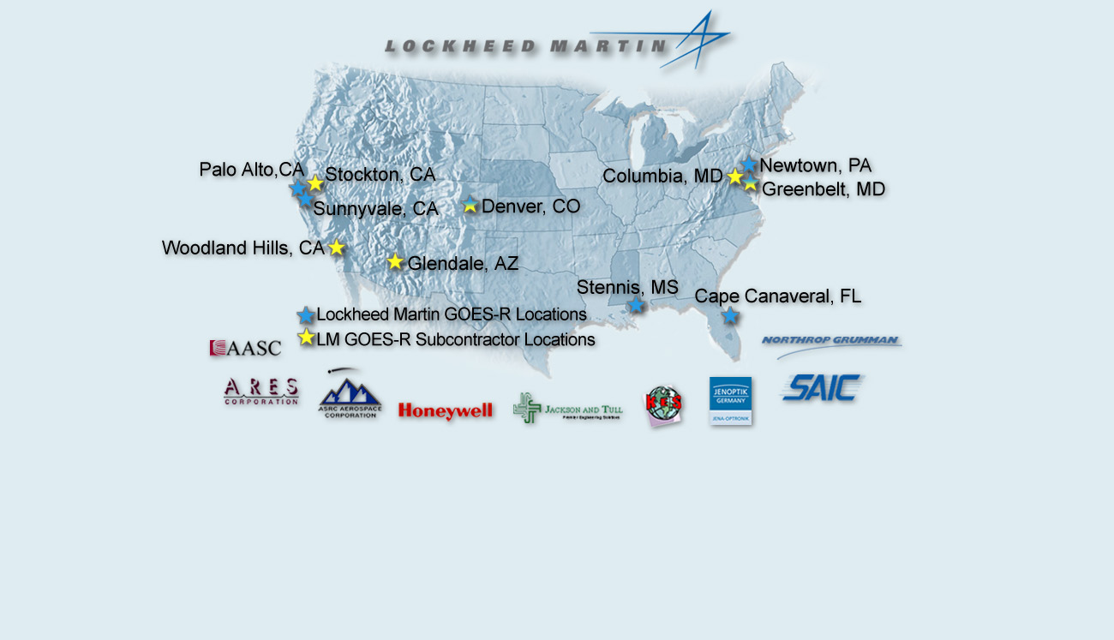
Nationwide Contractor Team Effort
ITT Ft. Wayne
Harris Corp. Melbourne

Slide 9
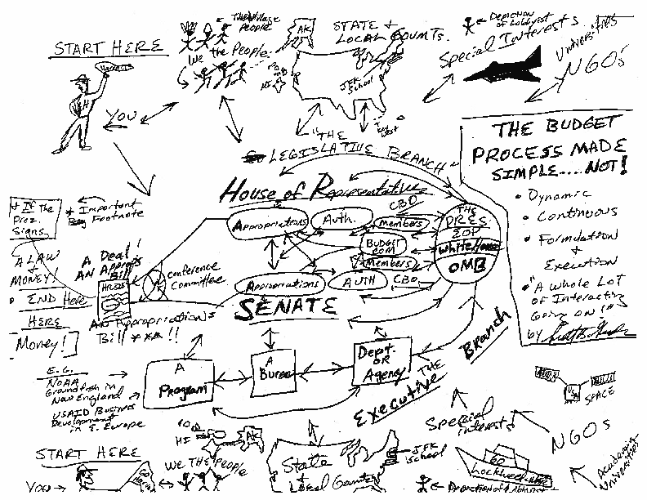

Slide 10
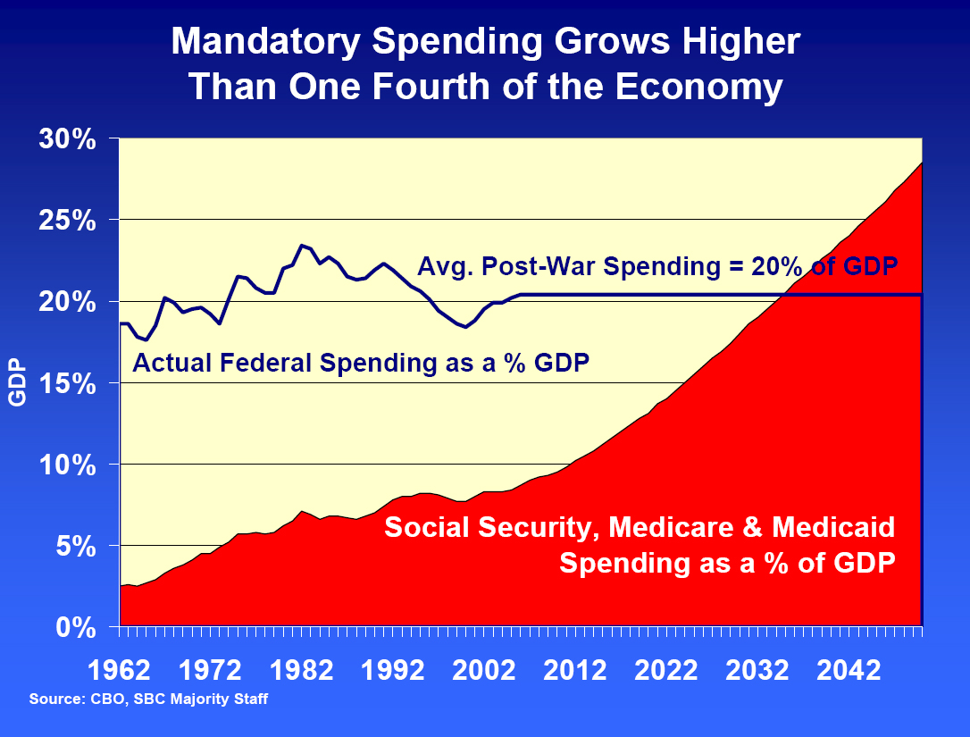

Slide 11
Entitlement Spending Grows Appropriations Frozen FY 2012 PRESBUD ($,Outlays in Billions)
FY 2012 FY 2020
Discretionary*
Security 884 23.7% 897 16.5%
Non Security 456 12.2% 449 8.3%
Total 1,340 35.9% 1,346 24.8%
Mandatory/
Entitlements 2,140 57.4% 3,273 60.4%
Net Interest 242 6.5% 793 14.6%
Disaster Plug 6 10
US Budget 3,729 5,422
* Discretionary = Appropriations
Trillions?

Slide 12
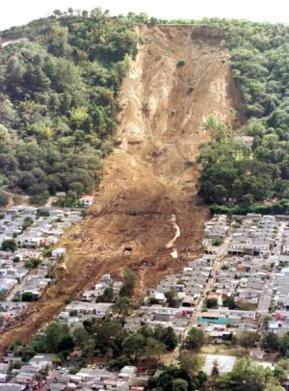
Nov. Election--Tectonic Shift By the Numbers:
111th Congress (2009/2010)
House: 256 Dems, 179 Repubs, 2 vacancies
Senate: 59 Dems, 41 Repubs
112th Congress (2011/2012)
House: 193 Dems, 242 Repubs 63 R pickups
Senate: 53 Dems, 47 Repubs ** 6 R pickups
** Allocates Sen. Lieberman and Sen. Sanders with Dems and Sen. Murkowski with Repubs.

