Slide 1
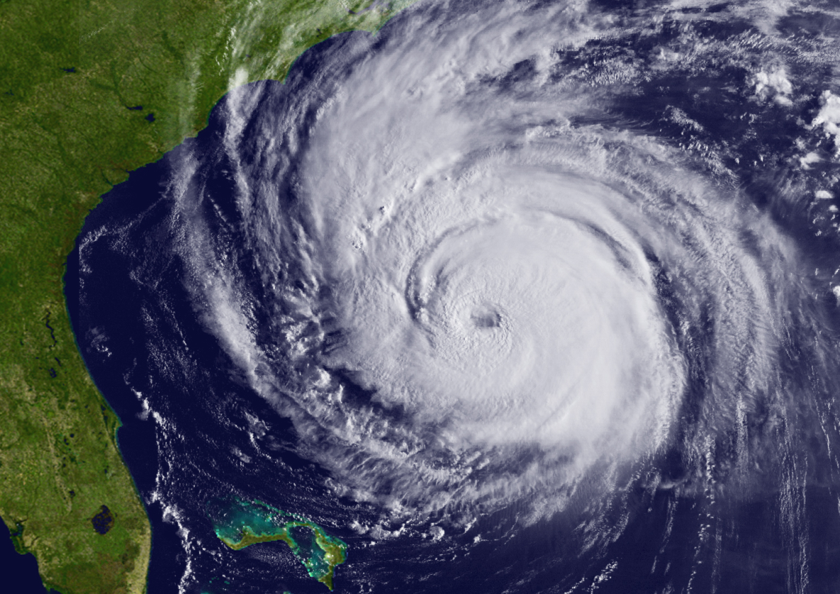
65th Interdepartmental
Hurricane Conference
“Ocean and Atmospheric Influences on Tropical Cyclone Predictions: Challenges and Recent Progress”
February 28 – March 3, 2011
Notes:
This slide is on the screen as the FC walks to podium

Slide 2
Closing Remarks
Mr. Samuel P. Williamson
Federal Coordinator for Meteorology
65th Interdepartmental Hurricane Conference
“Ocean and Atmospheric Influences on Tropical Cyclone Predictions: Challenges and Recent Progress”
Sponsored and hosted by:
The Office of the Federal Coordinator for Meteorological Services
and Supporting Research

Slide 3
Overview
Motivation and Objectives
Conference Highlights
Next Steps
Conference Materials
Special Recognition
Location of the Next IHC

Slide 4
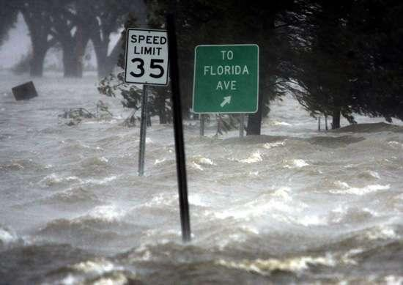
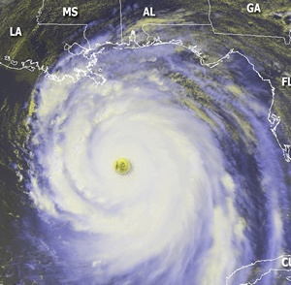
Why Are We Here?
Continue to exchange information to ultimately aid in improved services to help prevent loss of life and injuries
Minimize the nation’s vulnerability to natures most destructive forces
Enable a strong homeland defense through a safe overseas presence
Build upon synergies / collaboration in the tropical cyclone community
Notes:
4

Slide 5
Conference Objectives
Review the Nation’s tropical cyclone forecasting and warning program
Address actions from previous IHCs
Update the National Hurricane Operations Plan for 2011
Review comparison of 2008 and 2010 snapshots of tropical cyclone R&D activities, including their contributions toward forecasting and warning centers’ operational priorities
Review Joint Hurricane Testbed (JHT) projects and recognize candidates that may be successfully transitioned into operations
Build upon tropical cyclone partnerships, leveraging agency capabilities to meet the operational needs of the tropical cyclone forecasting and warning centers

Slide 6
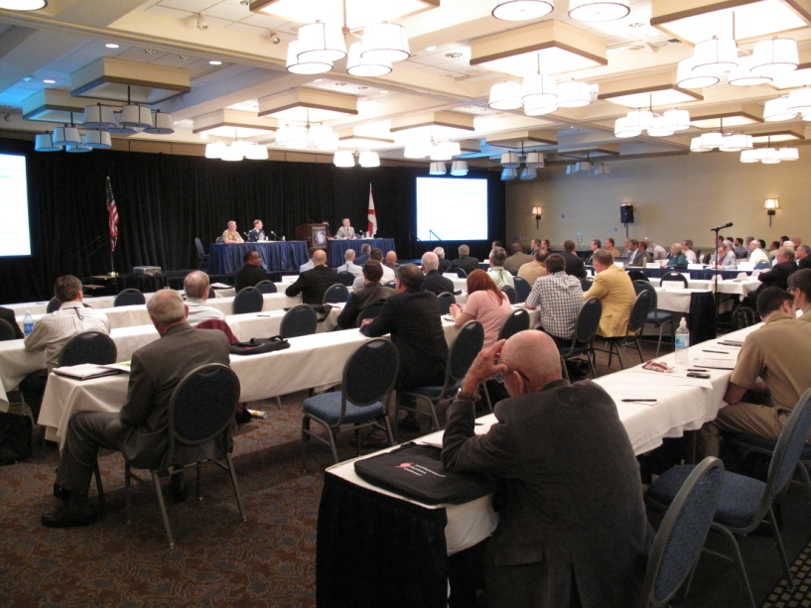
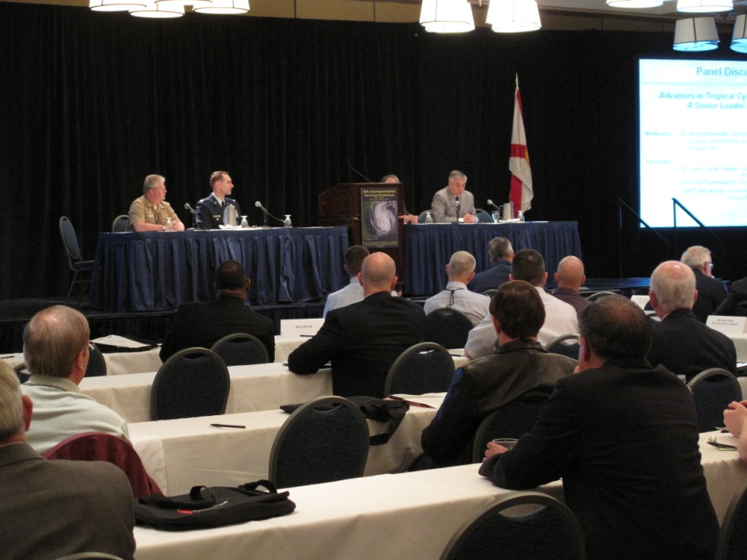
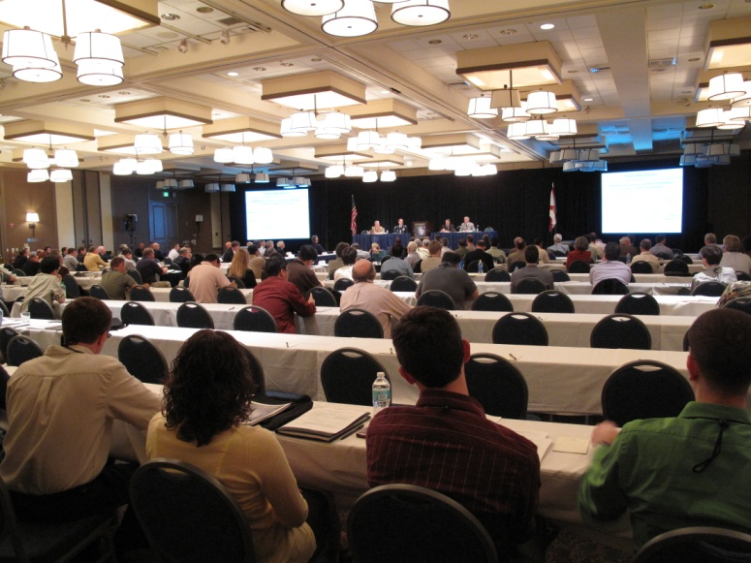
Conference Highlights
Number of attendees: 226
Walk-ins: 15

Slide 7
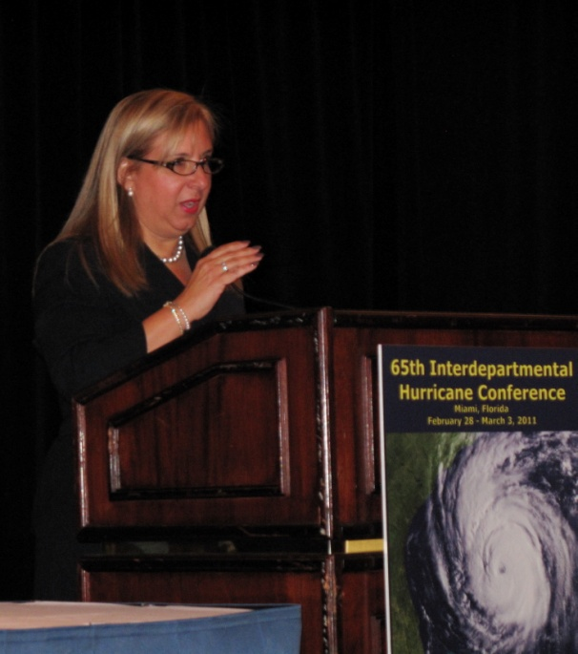
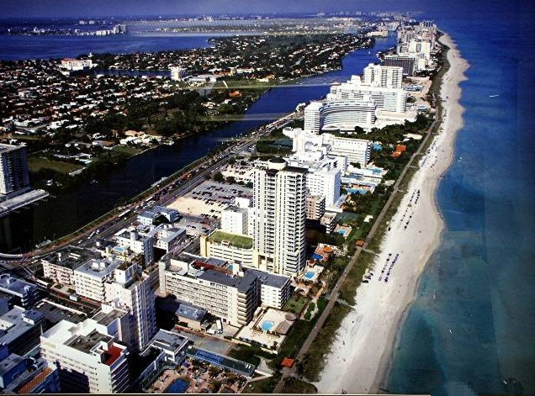
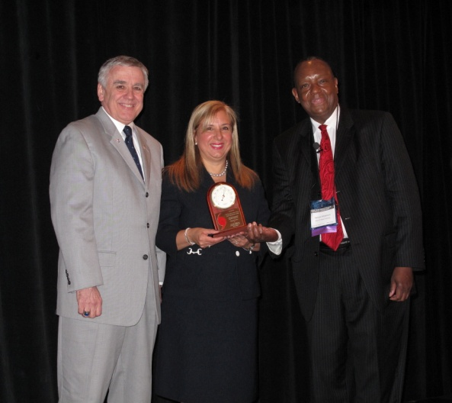
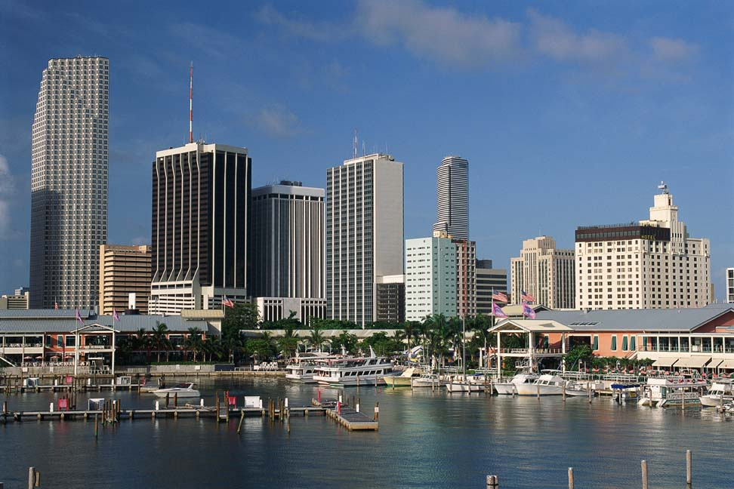
Conference Highlights
Representing the Honorable Carlos Alvarez
Mayor, Miami-Dade County
Alina Hudak
Assistant County Manager

Slide 8
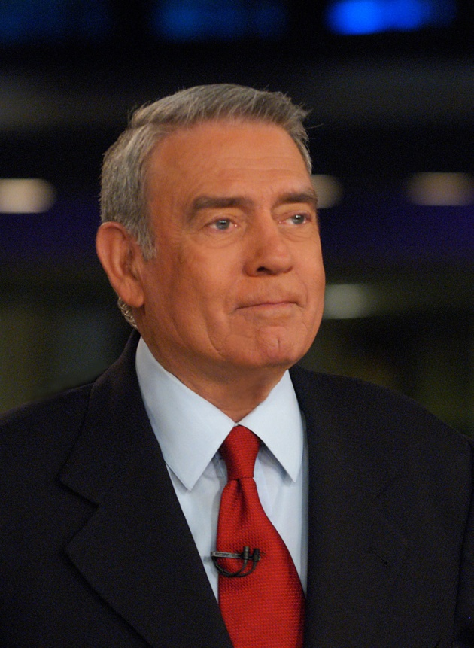
Conference Highlights
Mr. Dan Rather
Anchor and Managing Editor of HDNet’s Dan Rather Reports
Special Opening Session Welcome
Notes:
8

Slide 9
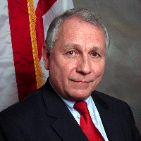
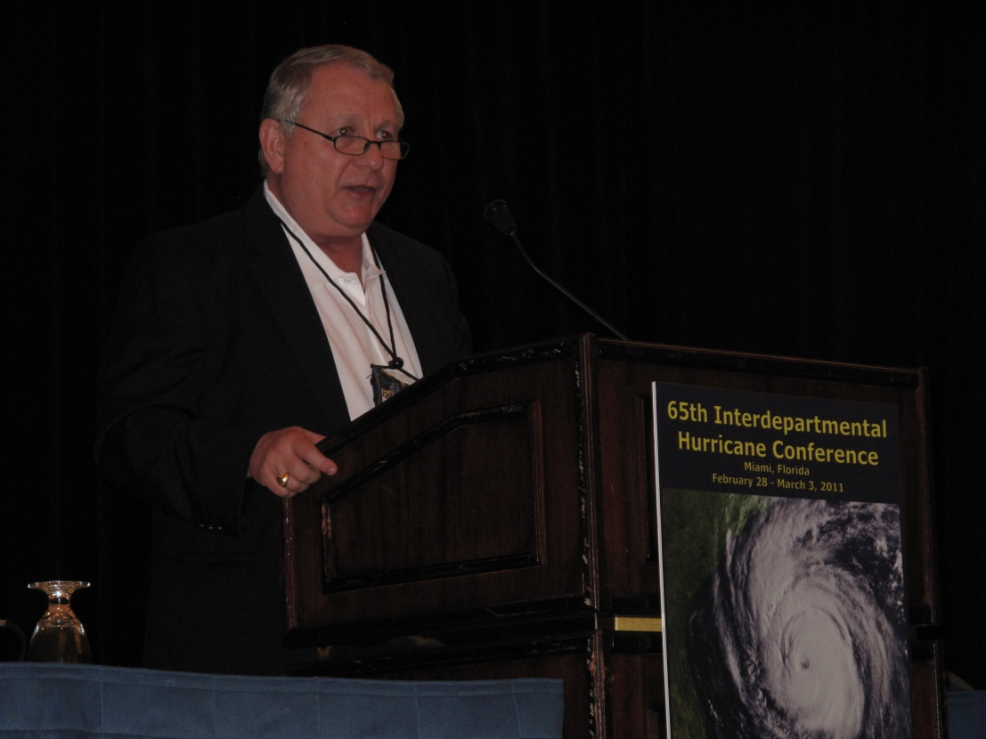
Conference Highlights
Major Phillip May
Region IV Administrator
Notes:
9

Slide 10
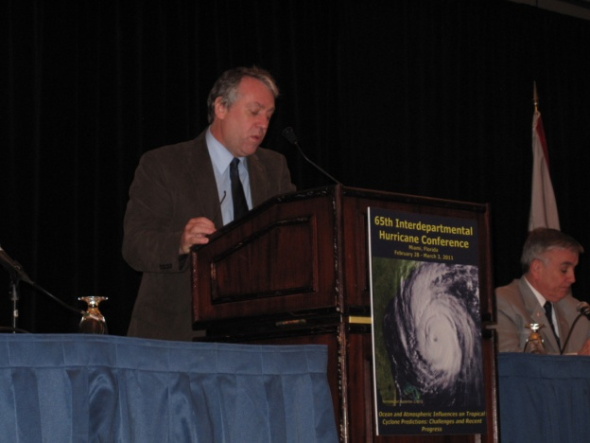
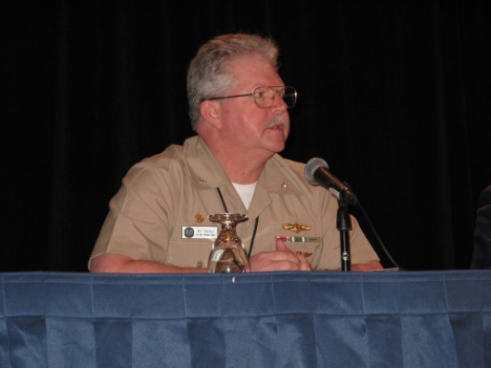
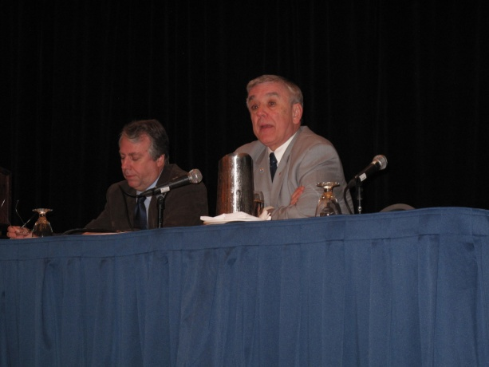
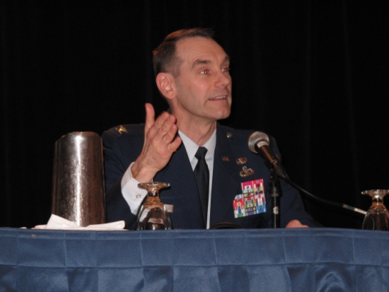
Conference Highlights
Advances in Tropical Cyclone Predictions: A Senior Leader Perspective
Moderator: Dr. Kerry Emanuel, Director, Program in Atmospheres, Oceans, and Climate, and Professor of Atmospheric Science, MIT
Panelists:
Dr. John “Jack” Hayes, Assistant Administrator for Weather Services, NOAA
Col John Egentowich, Air Force Deputy Director of Weather
CAPT William Nisley, C.O., Fleet Weather Center, Norfolk

Slide 11
Conference Highlights
Session 1: Comparisons of the 2008 and 2010 Snapshots of Tropical Cyclone R&D
Session Leader: Dr. Haiyan Jiang, Department of Earth & Environment, Florida International University
Dr. Frank Marks, Co-Chair, Working Group for Tropical Cyclone Research and Director, Hurricane Research Division
Dr. Ronald Ferek, Co-Chair, Working Group for Tropical Cyclone Research and Program Officer, Marine Meteorology Program

Slide 12
Conference Highlights
Sessions 8 and 9 on last year’s major field experiments
2010 Joint Hurricane Field Experiments: PREDICT, GRIP, and IFEX (PGI)
ITOP/TCS-10: Coupled Air-Sea Observations and TC Predictions
Thank you to the sponsoring agencies and everyone involved in these major projects!

Slide 13
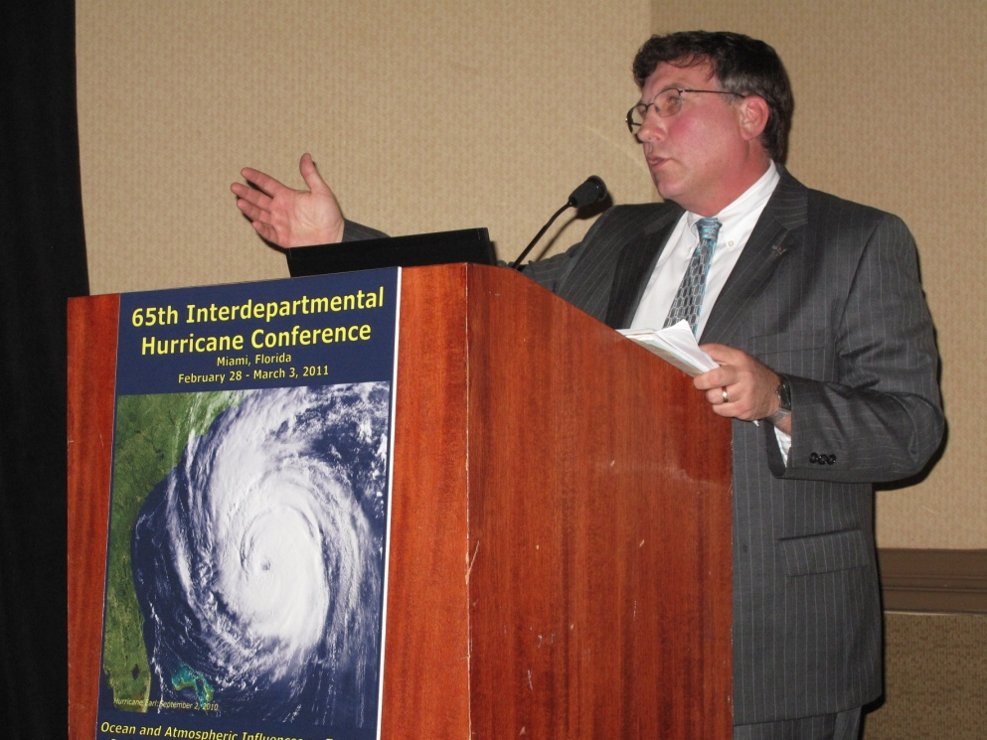
Conference Highlights
Banquet Speaker
Mr. Scott B. Gudes
Vice President, Legislative Affairs
Space Systems and Operations
Lockheed Martin Corporation

Slide 14
Conference Highlights
Richard H. Hagemeyer Award
Congratulations to
Dr. Peter Black
Naval Research Laboratory
Marine Meteorology Division and SAIC, Inc.
2011 Winner

Slide 15
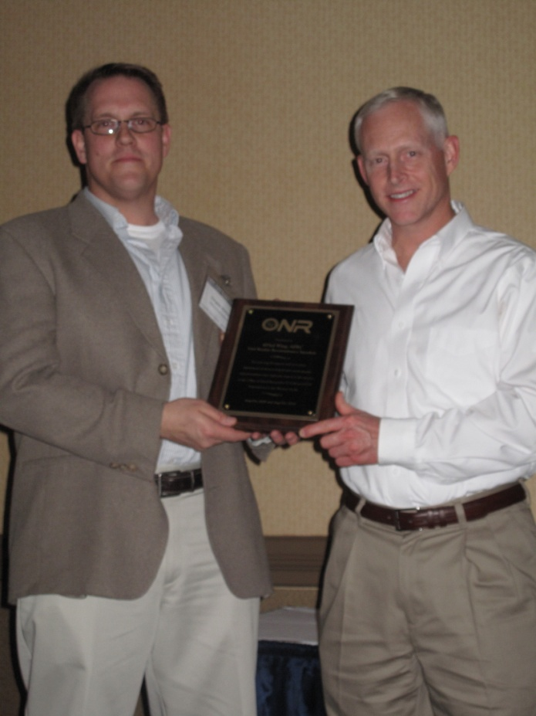
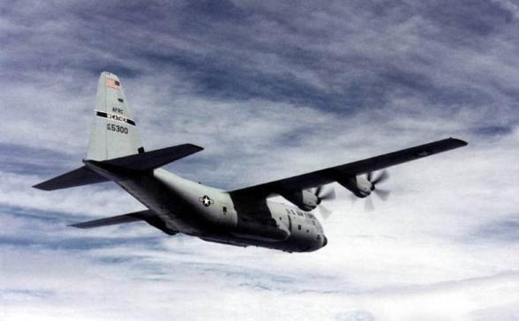
Conference Highlights
Special Award
Congratulations to the 53rd Weather Reconnaissance Squadron

Slide 16
Next Steps
Update the National Hurricane Operations Plan, reflecting changes accepted by the Working Group for Hurricane and Winter Storms Operations and Research, by May 1, 2011
Chapter 5 revisions!
Utilize interagency coordination and collaboration through WG/TCR to continue to focus R&D on #1 operational priority—intensity change
Important note: Track is still important!

Slide 17
Next Steps
Continue to stress the importance of transitioning research to operations
Facilitate and support availability of the data sets resulting from the four 2010 major field experiments
Support and promote efforts underway to assimilate new and existing inner core TC observations into operational models to evaluate their impact on TC forecasting capabilities

Slide 18
Next Steps
The WG/Tropical Cyclone Research will continue to:
Keep operational priorities up to date
Assess and evaluate how research is contributing to those priorities
Provide information to support decisions on future investments
Coordinate and collaborate with NSF to explore using the Science, Engineering and Education for Sustainability (SEES) and Creating a More Disaster Resilient America (CaMRA) programs to advance TC research

Slide 19
Next Steps
Integrating Social Sciences into Meteorological Operations and Services
Possible Ways Forward
Explore partnerships to address the weather needs of the traveling public.
Perform a prototype field study, led by an interdisciplinary team to document the flow of weather information, identify gaps in communication, how people understand weather information and actions taken.
Identify a regular and realistic means to engage agencies—with social scientists, emergency managers and others—on issues related on ways to safeguard the public.

Slide 20
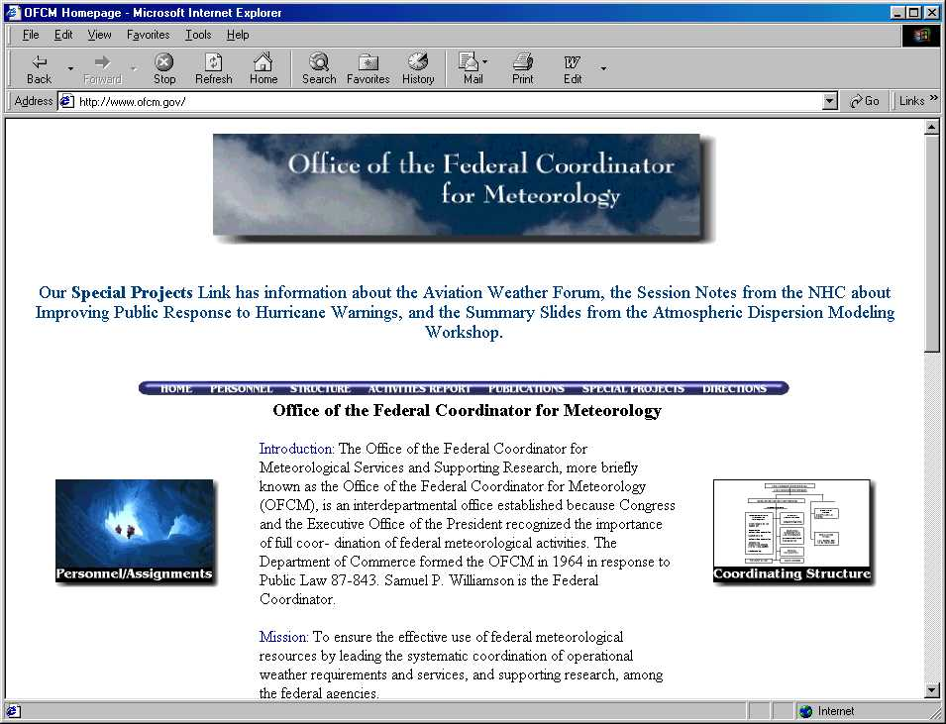
Conference Materials Available
Presentations and other material will be available on the OFCM web site shortly after the IHC.
Click on “Special Projects” and navigate to the 65th IHC.
http://www.ofcm.gov/

Slide 21
Special Recognition
WG/Tropical Cyclone Research WG/Hurricane & Winter Storms Ops and Research
Bill Read, Director, NHC
Dennis Feltgen, NHC Public Affairs
Speakers, Session Leaders, Moderators, and Panelists
OFCM and STC Staff
NMR Audiovisual Services
Vicki Babcock and Pat Welshinger
GA1 and PSA
DoubleTree Hotel
Miami-Dade County
Ms. Alina Hudak, Asst. County Manager
Ms. Marie Bertot, Communications Office

Slide 22
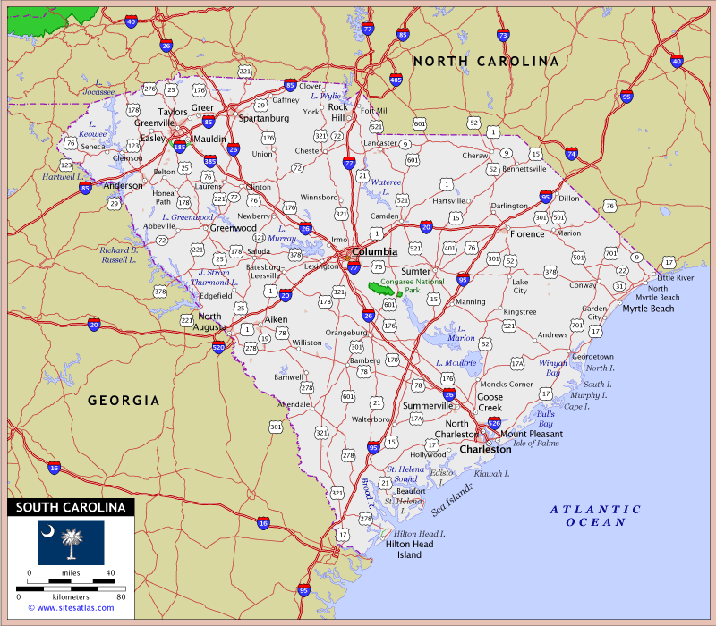
Next IHC
66th IHC – Charleston, SC
67th IHC – New Orleans, LA
68th IHC – Miami, FL area

Slide 23
The 65th IHC is adjourned
Thank you for attending and participating in the 65th Interdepartmental Hurricane Conference!
On behalf of the Office of the Federal Coordinator for Meteorology,
Have a safe trip home!

Slide 24
Notes:
24

