Slide 1
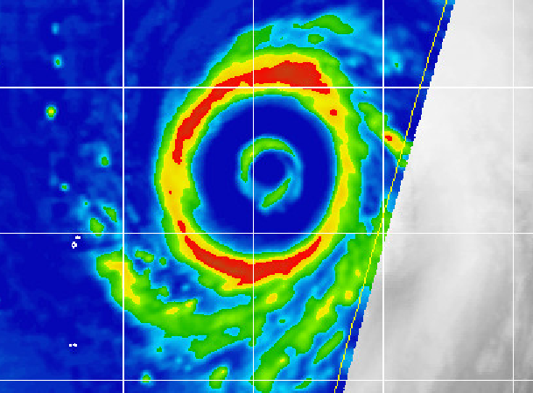



A New Secondary Eyewall Formation Index;
Transition to Operations and Quantification of Associated Hurricane Intensity and Structure Changes
A Joint Hurricane Testbed Project
Jim Kossin
NOAA’s National Climatic Data Center, Asheville, NC
CIMSS/University of Wisconsin, Madison, WI
james.kossin@noaa.gov
65th Interdepartmental Hurricane Conference
3 March 2011
Miami, FL

Slide 2
CIMSS / UW-AOS personnel:
  Matt Sitkowski
  Chris Rozoff
NOAA-RAMMB / CIRA collaborators:
  Mark DeMaria
  John Knaff
NHC operations advisors:
  Robbie Berg
  Eric Blake
  Jack Beven
  John Cangialosi
  James Franklin
  Todd Kimberlain
  Chris Landsea
  Chris Sisko
  Neal Dorst (HRD)
  Shirley Murillo (HRD)

Slide 3
JHT project goals:
Transition a new model to operations that provides probabilistic forecasts of eyewall replacement cycle events in hurricanes.
Utilize low-level aircraft reconnaissance data to construct the first general climatology of intensity and structure changes associated with eyewall replacement cycles.
Apply the new climatology toward constructing new operational tools to forecast intensity changes associated with eyewall replacement cycles.

Slide 4
The PERC model
(Probability of Eyewall Replacement Cycle)
Statistical/empirical model transitioned to operations prior to the start of the 2010 hurricane season.
Executes within SHIPS using environmental and satellite-based features as input.
Provides probability of the onset of an eyewall replacement cycle at lead-times: 0−12h, 12−24h, 24−36h, 36−48h.
*Original model research and development was supported by the Office of Naval Research and the NOAA GOES-R Risk Reduction programs.
Kossin, J. P., and M. Sitkowski, 2009: An objective model for identifying secondary eyewall formation in hurricanes. Mon. Wea. Rev., 137, 876-892.

Slide 5
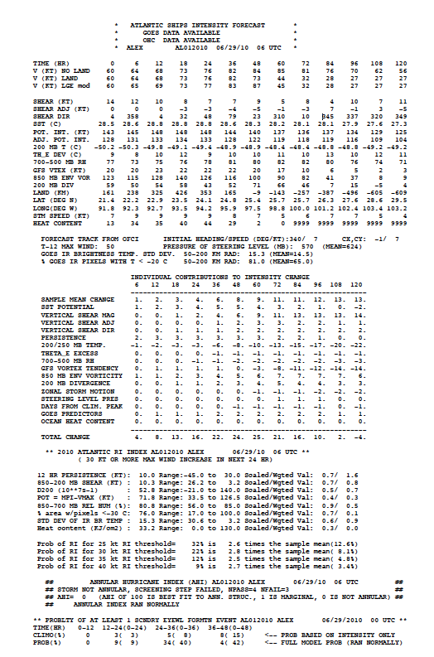
Operational SHIPS text output file
Intensity forecasts
Rapid Intensification Index (RII)
Annular Hurricane Index (AHI)
Probability of Eyewall Replacement Cycle (PERC)

Slide 6
PERC-model verification: Brier Skill Score
“Perfect” intensity/track/environment
1997−2006 leave-one-year-out cross-validated skill:
  Brier Skill Score = +21% (00−12 hr lead-time)
  BSS range among 10 individual years: −23% (1997) to +33% (2003)
Operational Brier Skill Scores
Year | N (ERC) | 00−12 hr | 12−24 hr | 24−36 hr | 36−48 hr
2010 | 9 | +27% | +20% | +0% | −3%
2009 | 3 | −6% | −9% | −2% | +3%
2008 | 4 | +14% | +11% | −9% | +1%
2008−2010 | 16 | +17% | +12% | −3% | −1%
Year | N (ERC) | 00−12 hr | 12−24 hr | 24−36 hr | 36−48 hr
2010 | 9 | +27% | +20% | +0% | −3%

Slide 7
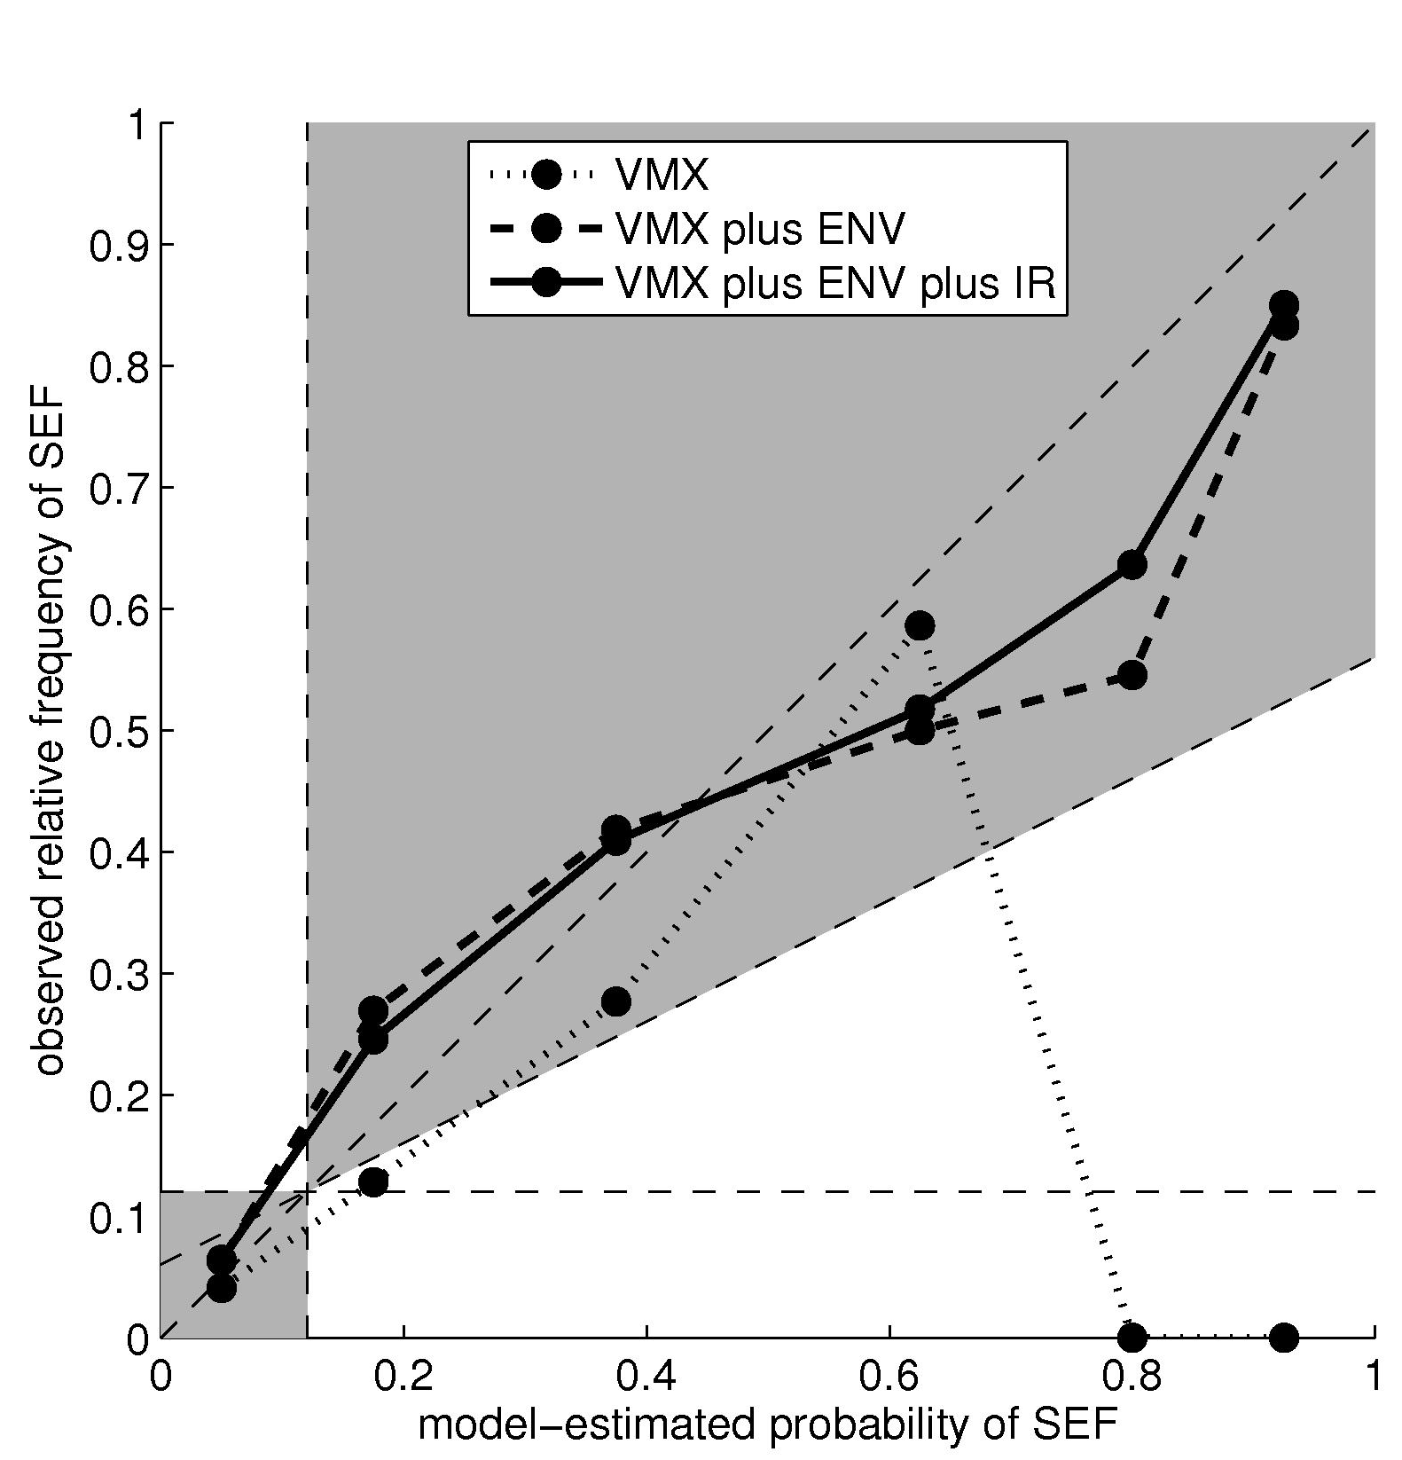
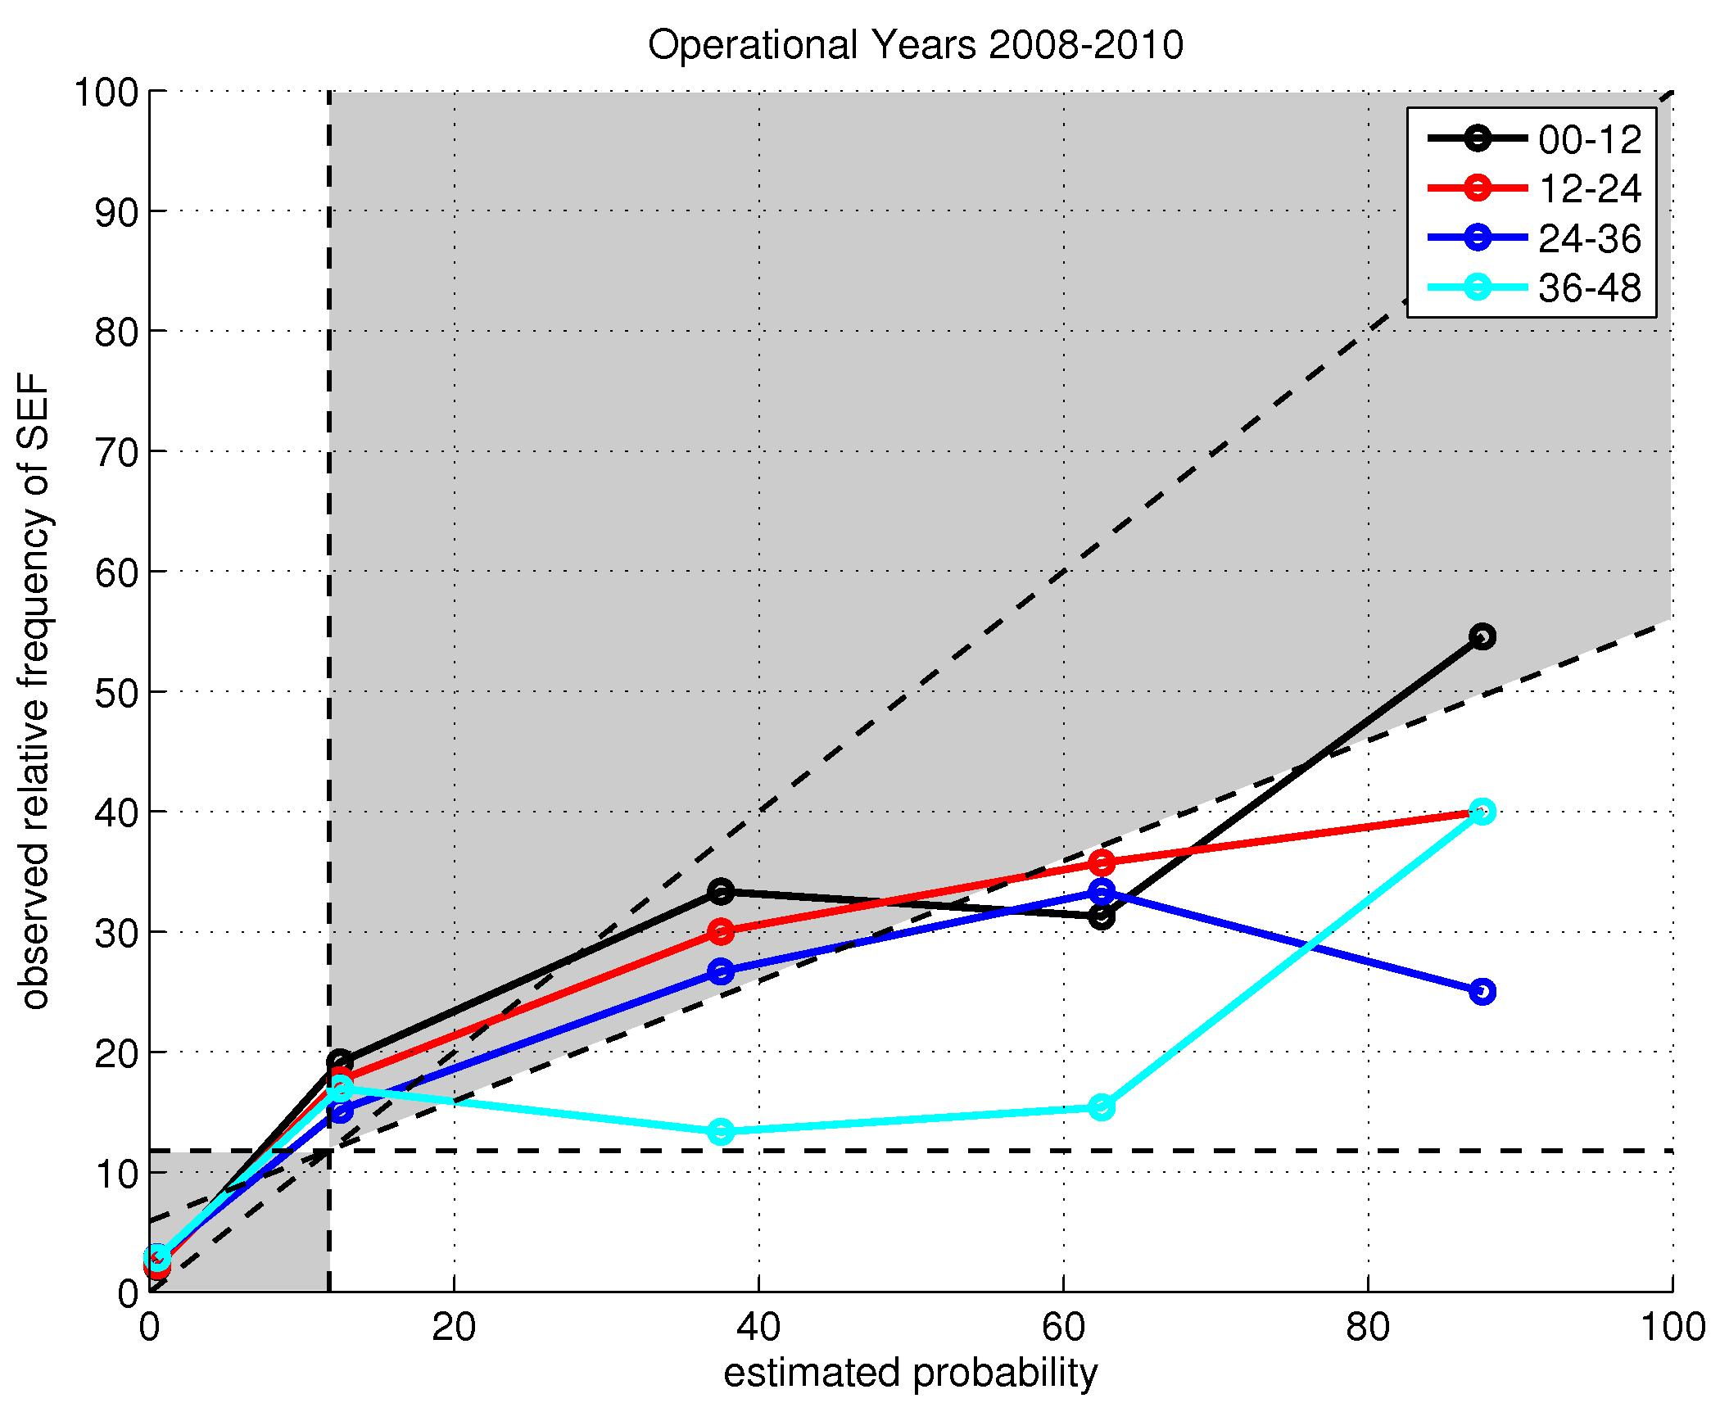
PERC-model verification: Reliability
“Perfect” int/trk/env
(1997−2006 cross-validated)
2008−2010 Operational verification
~15
~15
~15
~60
~800

Slide 8
Ongoing Year-2 Goal:
Construct a climatology of intensity and structure changes associated with eyewall replacement cycles (ERC)
An ERC is forecast to occur or is underway. The forecast questions:
  How long will it last?
  How much weakening will occur? Over what period of time?
  How much re-strengthening? When will it re-strengthen?
Subjective expectation during ERC:
  Intensification rate decreases or weakening occurs
  Re-intensification
  Wind field expands significantly outwards
We want to better quantify these effects and ultimately build forecast tools from them. Best track intensity data are too smoothed in time to capture the transient effects, so a large archive of flight-level data was constructed.
}
transient effect
permanent effect

Slide 9
The 3 Phases of an Eyewall Replacement Cycle
expected intensity evolution without ERC
Coherent secondary wind maximum appears
intensity
intensity forecast adjustment
I
II
III
well-defined secondary convective
ring appears in microwave imagery
time

Slide 10
Building new forecast tools
 | Phase I (intensification) | Phase II (weakening) | Phase III (re-intensification) | Mean Total
ΔV (kt) (intensity change) | μ = +14 σ = 17 | μ = −21 σ = 12 | μ = +6 σ = 8 | −1
Δt (hr) (duration) | μ = 9 σ = 9 | μ = 17 σ = 9 | μ = 11 σ = 13 | 37
Goal: Form tools to reduce large variance
ΔV’ , Δt ~ f (environment, satellite, etc)
ΔV’ is deviation from SHIPS forecast
Note: We are also determining structure changes (e.g. R50)

Slide 11
Summary
The PERC-model was successfully transitioned into NHC operations and performed skillfully during the 2010 season.
Flight-level data have revealed a rich spectrum of behaviors associated with eyewall replacement cycles and have identified 3 distinct phases that are highly relevant to intensity forecasting.
Remaining Goals: Complete the flight-level climatologies and exploit toward building new intensity forecast tools.

Slide 13
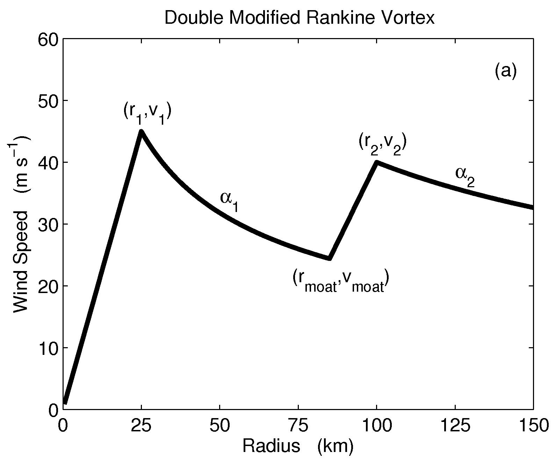
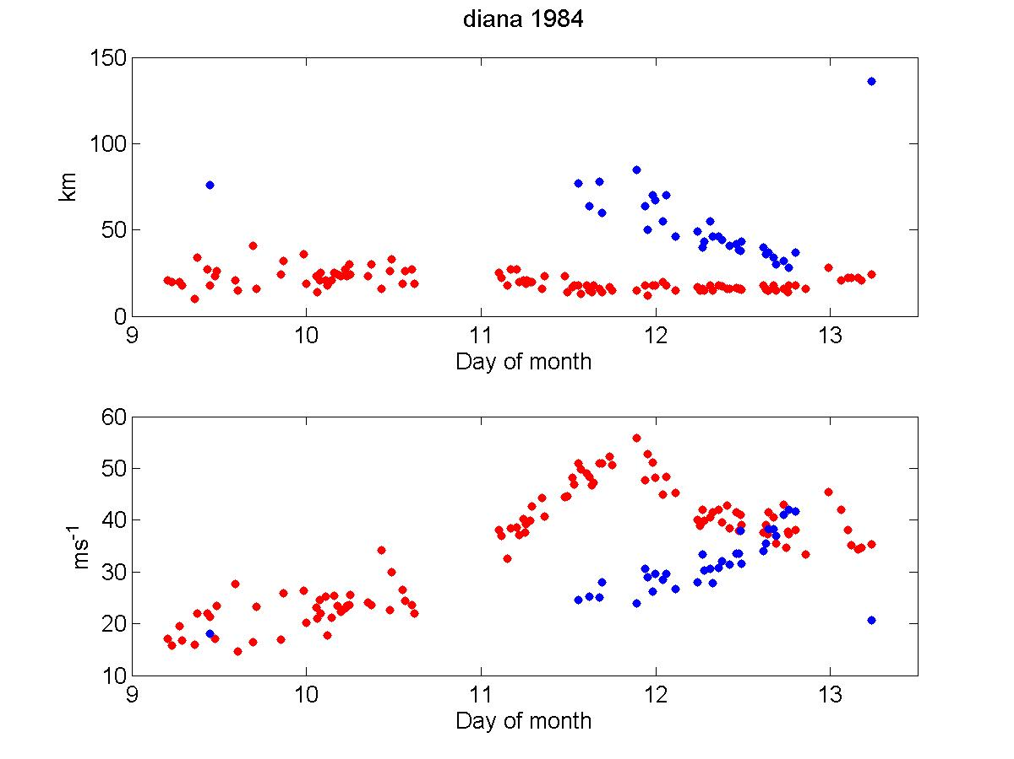
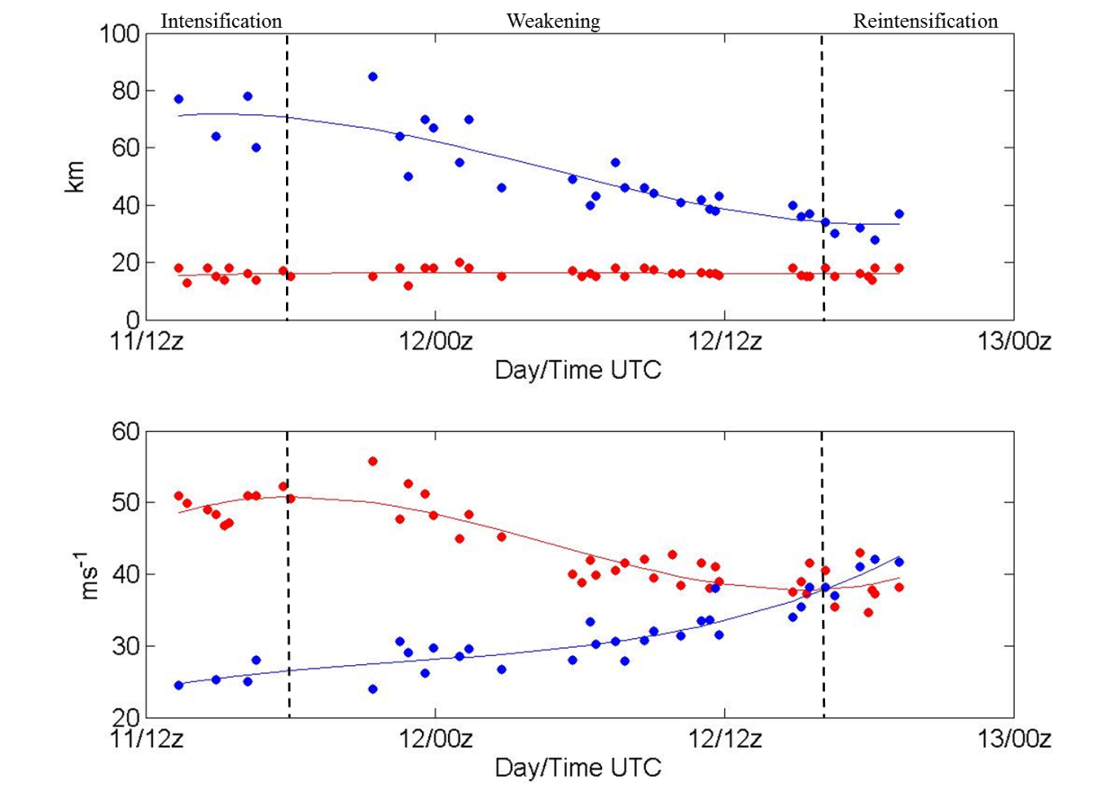
r₂
r₁
v₁
v₁

