Slide 1

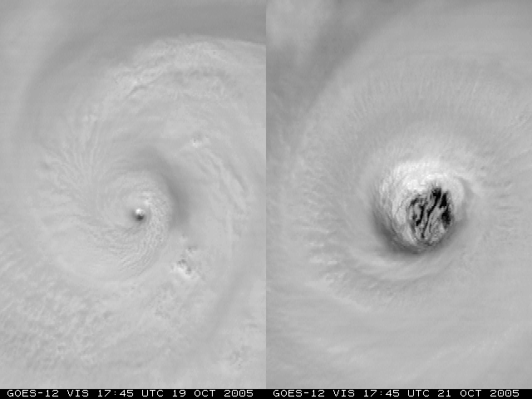

Advanced Applications of the Monte Carlo Wind Probability Model:
A Year 2 Joint Hurricane Testbed Project Update
Mark DeMaria¹, Robert DeMaria², Andrea Schumacher²,
Daniel Brown³, Michael Brennan³, Richard Knabb⁴, Pablo Santos⁵,
David Sharp⁶, John Knaff¹ and Stan Kidder²
¹NOAA/NESDIS, Fort Collins, CO
²CIRA, Colorado State University, Fort Collins, CO
³NCEP National Hurricane Center, Miami, FL
⁴The Weather Channel, Atlanta, GA
⁵NOAA/National Weather Service, Miami, FL
⁶NOAA/National Weather Service, Melbourne, FL
Interdepartmental Hurricane Conference
March 2011

Slide 2
Outline
Brief overview of the MC model
Model computational improvements
Hurricane Landfall Probability Applications
  Input for WFO products
  HuLPA program for NHC

Slide 3
Monte Carlo Wind Probability Model
Estimates probability of 34, 50 and 64 kt wind to 5 days
1000 track realizations from random sampling of NHC/CPHC or JTWC track error distributions
Intensity of realizations from random sampling of NHC/CPHC or JTWC intensity error distributions
  Special treatment near land
Wind radii of realizations from radii CLIPER model and its radii error distributions
Serial correlation of errors included
Probability at a point from counting number of realizations passing within the wind radii of interest
Replaced NHC strike probability program in 2006

Slide 4
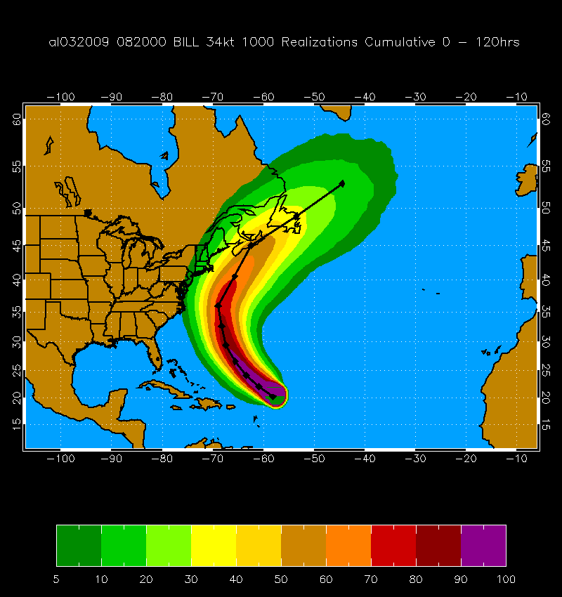
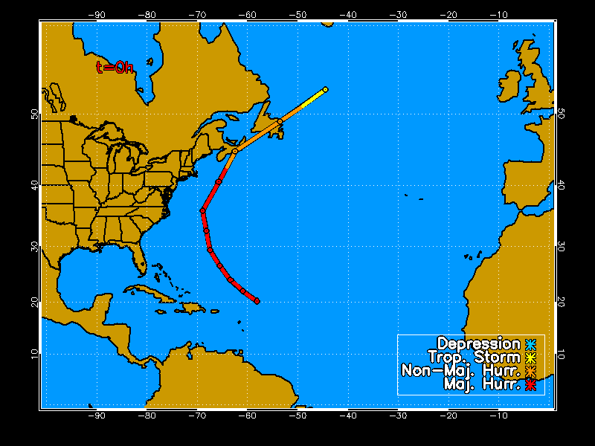
MC Probability Example
Hurricane Bill 20 Aug 2009 00 UTC
1000 Track Realizations 34 kt 0-120 h Cumulative Probabilities

Slide 5
Forecast Dependent Track Errors
Use GPCE input as a measure of track uncertainty
  GPCE = Goerss Predicted Consensus Error
Divide NHC/JTWC track errors into three groups based on GPCE values
  Low, Medium and High
  Reduces or increases probabilities ~10%
Evaluation in 2009 showed improved skill in all basins
GPCE version implemented in 2010

Slide 6
Current JHT Project Tasks
Model Improvements
  Adjust time step for small/fast storms
  Improve azimuthal interpolation of wind radii
  Improve spatial interpolation for text/grid product consistency
  Evaluate wind radii model
Advanced Applications
  Application to WFO local products
  Landfall timing and intensity distributions
  Probabilities integrated over coastal segments
  Automated guidance for watch/warnings

Slide 7
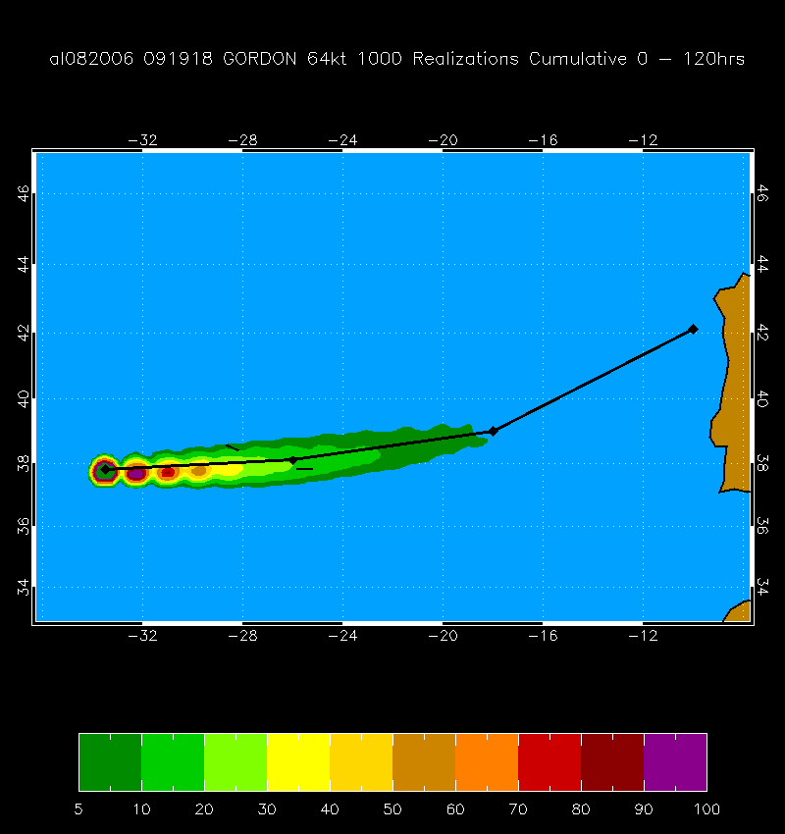
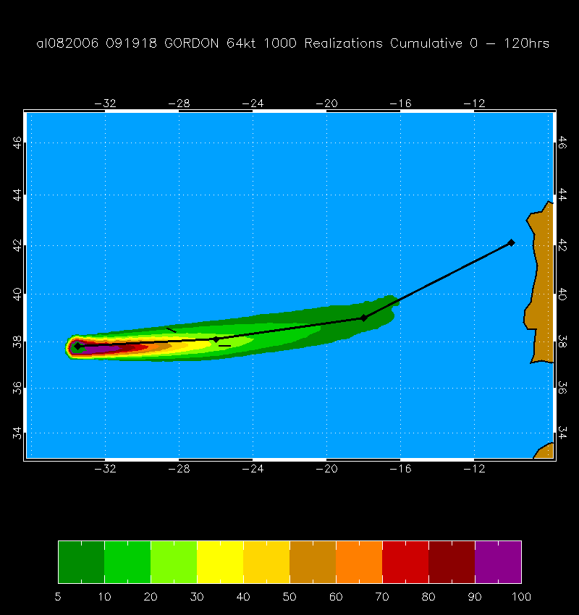
M1. Time Step Adjustment
Completed and Implemented in 2010
Example: Hurricane Gordon, 19 Sept 2006 18 UTC
R₆₄ ~ 25 nmi, c = 28 kt
∆t = 2 hr ∆t = 1 hr

Slide 8
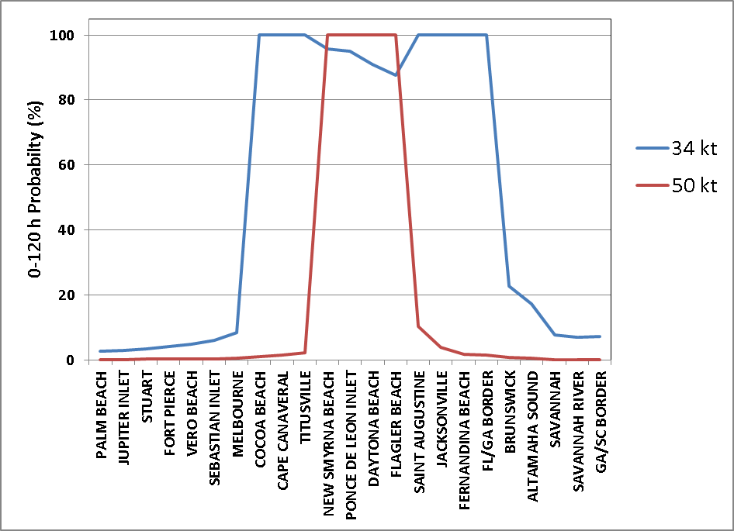
M2. Improve Azimuthal Interpolation
0-120 hr Cumulative
Probabilities for TS Fay
18 UTC 20 Aug 2008
Special conditions
  Slow moving, large storm
  Max winds near 50 or 65 kt
  Initial wind radii = 0 in some quadrants
Azimuthal interpolation of wind threshold radii can be smaller than next lower threshold

Slide 9
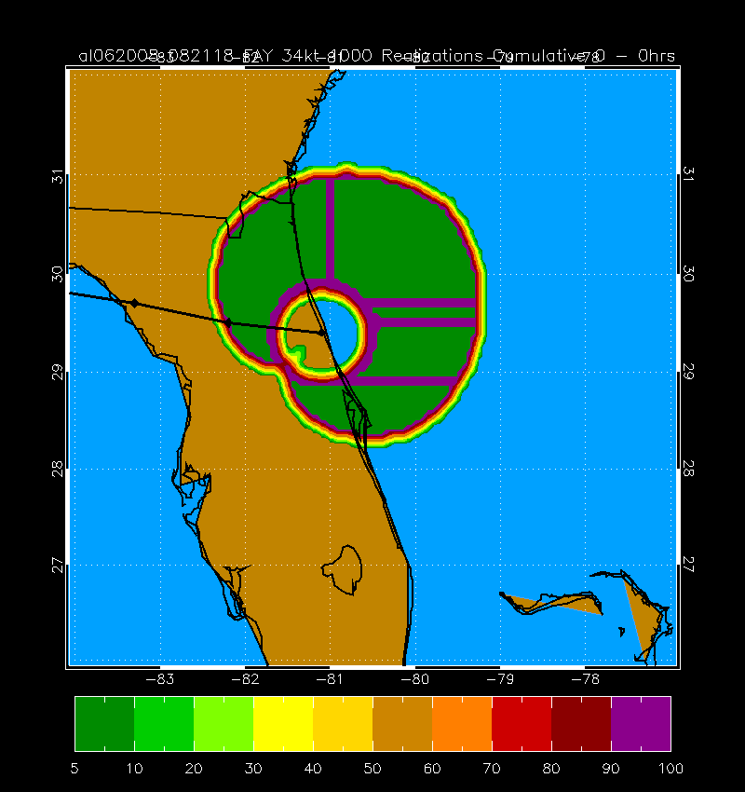
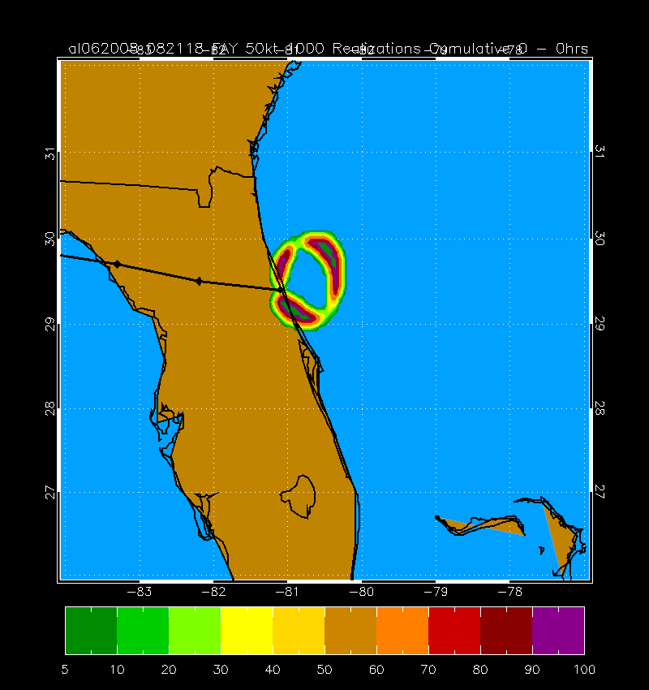
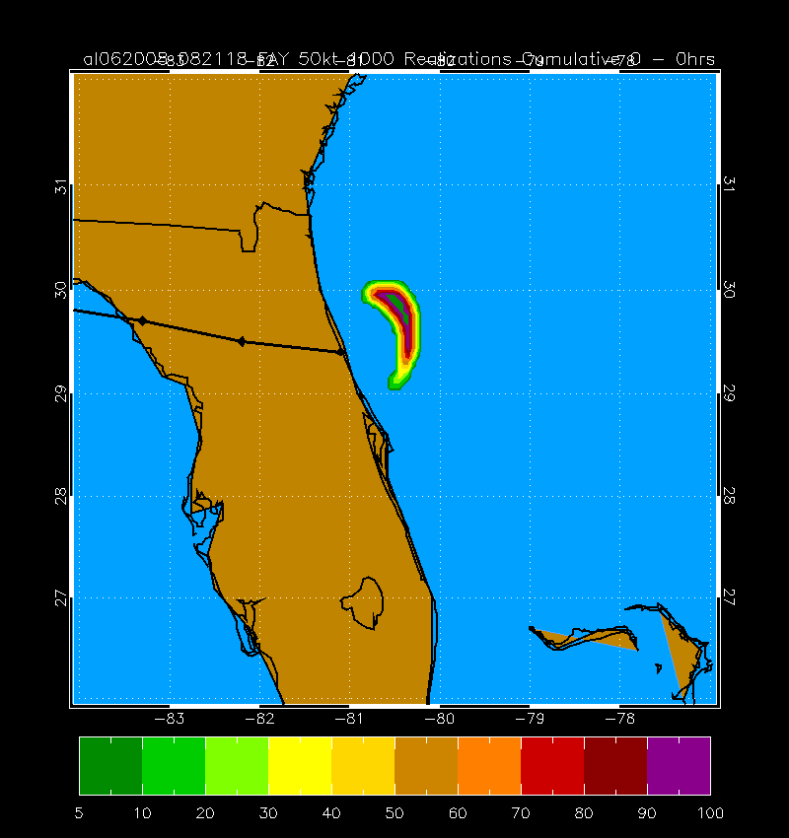
M2. Improve Azimuthal Interpolation
t=0 hr probabilities for TS Fay 18 UTC 20 Aug 2008
34 kt 50 kt 50 kt (corrected)
Solution: Impose radius of max wind as lower bound on outer wind radii interpolation
Ready for implementation in 2011

Slide 10
M3. Improve spatial interpolation
Graphical Products
  Probabilities generated on 0.5 deg lat/lon grid
  Interpolated to 5 km grid for NDFD
Text Product
  Probabilities calculated at specified coastal points
NDFD and text values sometimes disagree
Test higher resolution gridded product
Hurricane Charley (2004) and Ike (2008) test cases

Slide 11
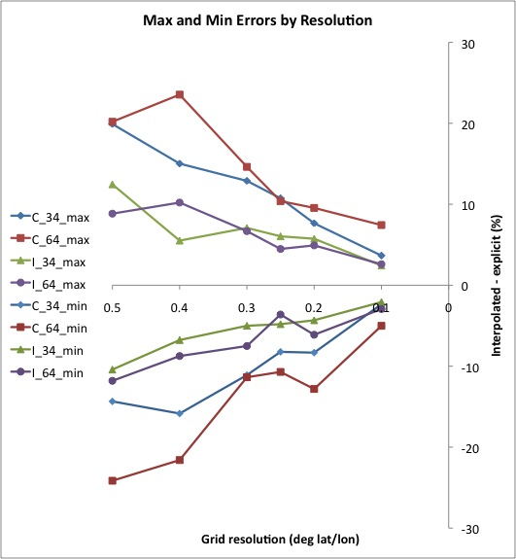
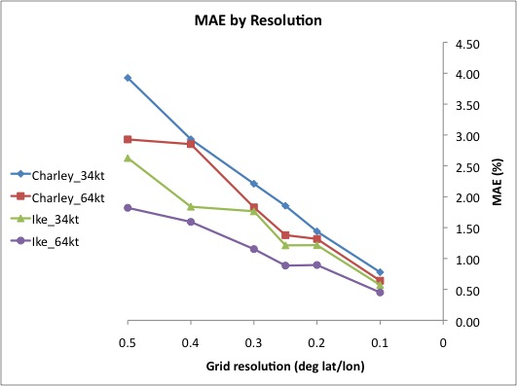
M3. Improve spatial interpolation:
Convergence Tests
Comparison of direct and
interpolated probabilities at
coastal points

Slide 12
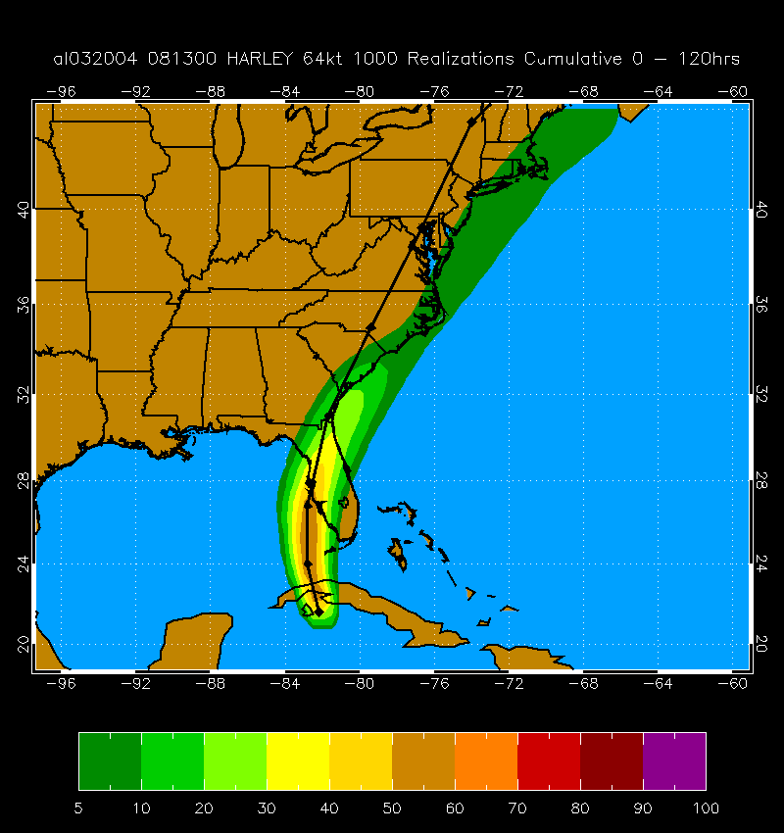
0.5 deg grid
Max Error = 20.1% @ Marquesas Key, FL
Min Error = -24.1% @ N Marquesas Key, FL
Reduced to ~10%
with 0.25 deg grid
Recommend running
at 0.25 deg grid in 2011

Slide 13
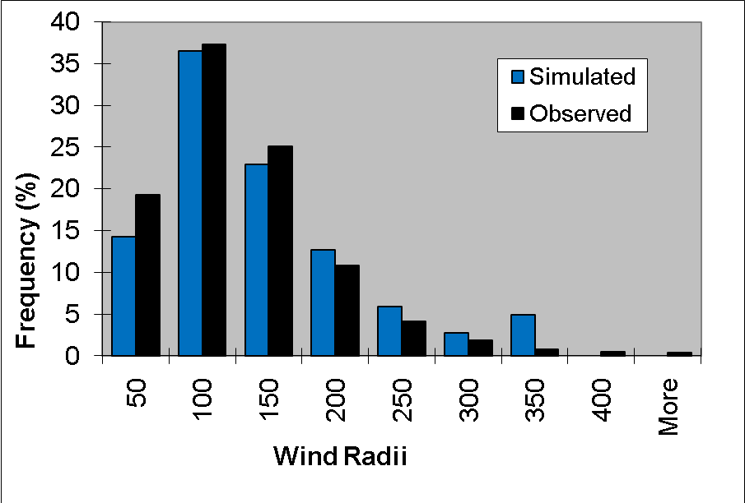
M4. Evaluation of Wind Radii Model
MC model (t=72 hr) and observed distributions of 34 kt wind radii
Conclusion: MC radii adequate
Few alternatives given limited input (track, max wind)

Slide 14
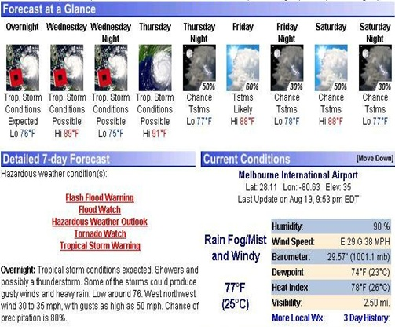
A1. WFO Local Products
Extensive verification (2003-2010) completed for P. Santos
and D. Sharp to guide probability threshold selection

Slide 15
A2-A4. Landfall Applications
User interface written for product testing
  Hurricane Landfall Probability Applications (HuLPA)
  Java program as ATCF prototype
Applications
  Landfall timing/intensity distributions
  Time of arrival/departure distributions of 34, 50 and 64 kt winds
  Integrated coastal probabilities
  Automated guidance for watches/warnings
  Plots of all 1000 realizations

Slide 16
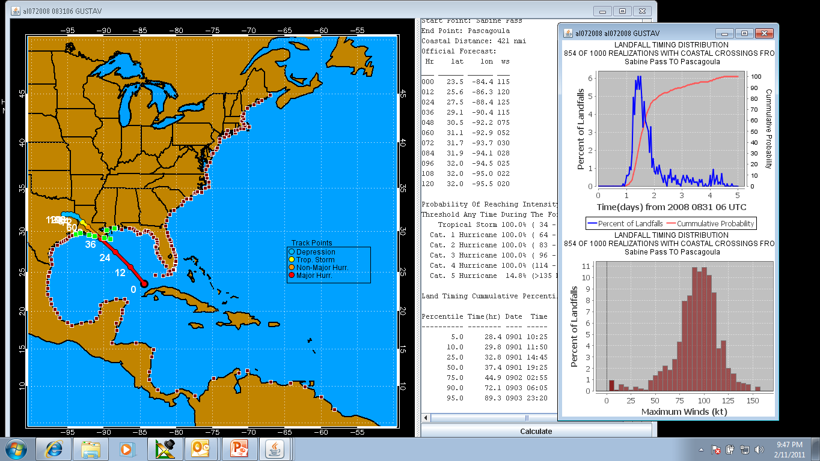
HuLPA: Landfall Timing/Intensity Distributions

Slide 17
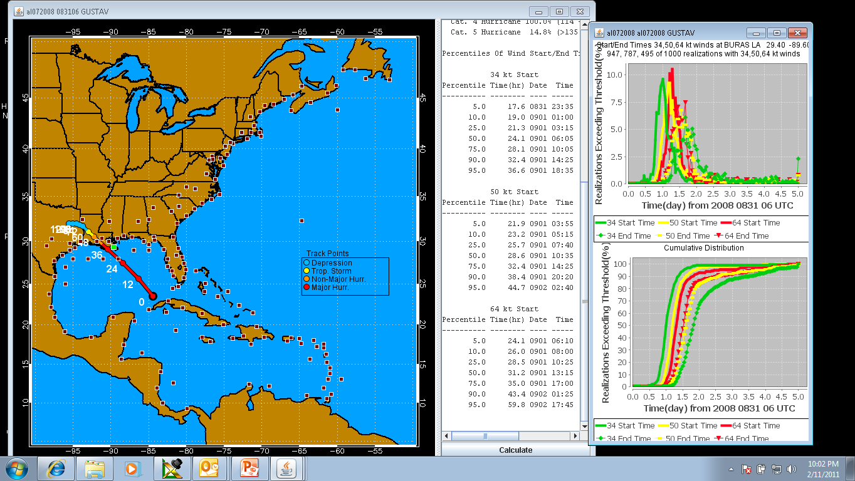
HuLPA: Arrival/Departure of 34, 50, 64 kt winds

Slide 18
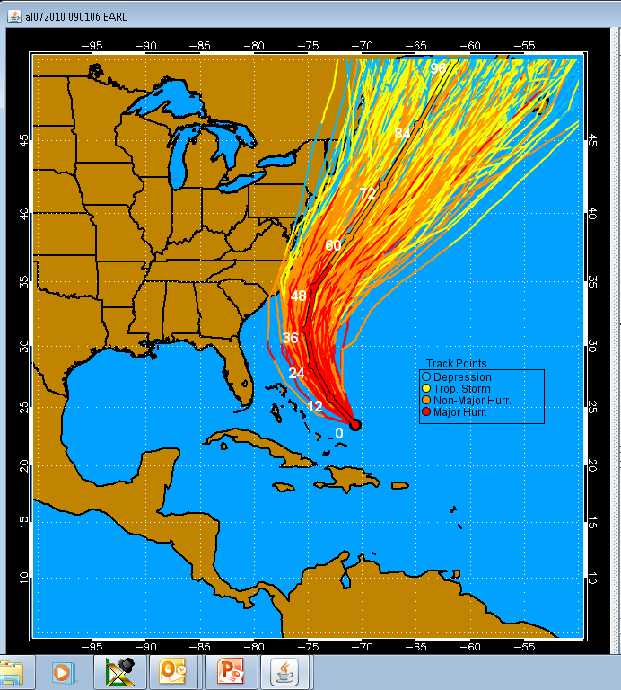
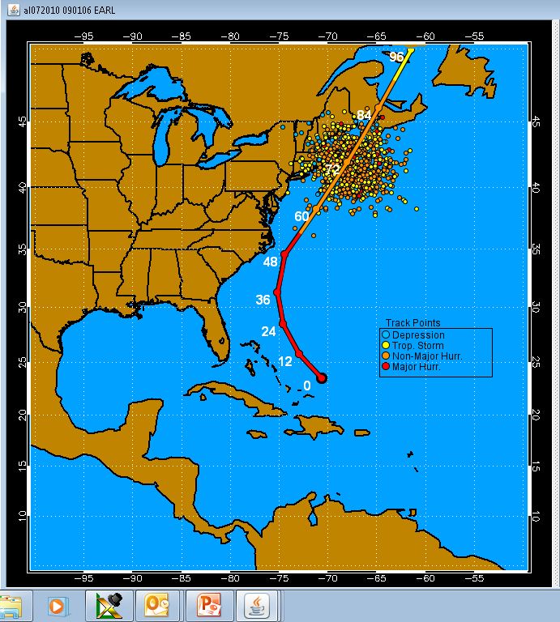
HuLPA: Plotting 1000 Realizations
Full Tracks Single Time (72 hr)
Hurricane Earl 06 UTC 01 Sept 2010

Slide 19
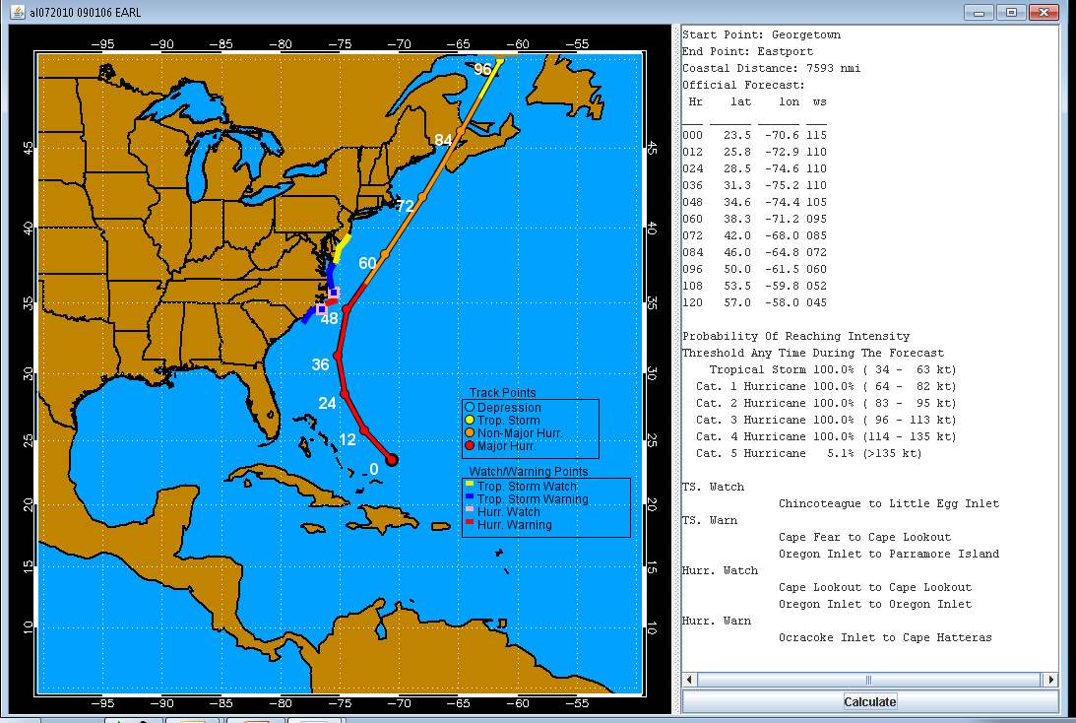
HuLPA: Automated Watch/Warning Guidance

Slide 20
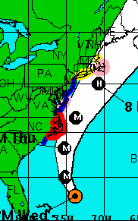
Hurricane Earl 9/1 11pm EDT
NHC
GPCE
No GPCE
Impact of GPCE Input on Automated Watch/Warnings

Slide 21
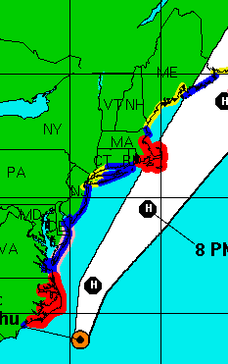
Hurricane Earl 9/2 11pm EDT
NHC
GPCE
No GPCE
Impact of GPCE Input on Automated Watch/Warnings

Slide 22
Model and Application Documentation
Operational Tropical Cyclone Wind Speed Probabilities. Part I: Recent Model Improvements and Verification
Operational Tropical Cyclone Wind Speed Probabilities. Part II: Advanced Applications
  M. DeMaria, J. Knaff, M. Brennan, D. Brown, C. Lauer, R. DeMaria, A. Schumacher, R. Knabb, D. Roberts, C. Sampson, P. Santos, D. Sharp, K. Winters
To be submitted to Weather and Forecasting, March 2011

Slide 23
Future Plans
Possible 2011 Modifications
  New radii interpolation
    Prevents inconsistent 34, 50, 64 kt probabilities
  Increase grid resolution from 0.5º to 0.25º
    Reduces inconsistency between gridded and text products
    Requires modification of NHC driver programs
Test HuLPA in real time in 2011

