Slide 1
Improvements to Statistical Intensity Forecasts
John A. Knaff, NOAA/NESDIS/STAR, Fort Collins, Colorado,
Mark DeMaria, NOAA/NESDIS/STAR, Fort Collins, Colorado,
Kate Musgrave, CIRA/CSU, Fort Collins, Colorado
John Kaplan, NOAA/HRD, Miami, Florida
Christopher M. Rozoff, CIMSS/UW, Madison, Wisconsin,
James P. Kossin, NOAA/NESDIS/NCDC, Madison, Wisconsin
Christopher S. Velden, CIMSS/UW, Madison, Wisconsin

Slide 2
Recent/Ongoing Efforts
Funding Source | Effort
GOES I/M Product Assurance Plan (CIRA,CIMSS) | Rapid Weakening (CIRA) Extra-Tropical Transition (CIRA) New statistical techniques (CIMSS)
GOES-R Risk Reduction (CIRA,CIMSS,AOML) | Improvements to SHIPS and RII with lightning and TPW Improvements to RII using Microwave Imagery (MI) Improvements to RII using infrared (IR) principle components
GOES-R Proving Ground NHC (CIRA) | Demonstrating improvements to RII using lightning
Joint Hurricane Testbed (CIRA, AOML) | RII improvements using TPW, IR principle components and inner core heat /moisture fluxes
Hurricane Forecast Improvement Project (CIRA) | Providing SHIPS and LGEM models for use with other models and in other basins.

Slide 3
Specific Questions
What is the relationship between lightning and TC intensity changes?
Can using different statistical techniques improve results?
Can infrared (IR) imagery be better utilized for forecasting intensity changes?
Can information from microwave imagery (MI) be used to better anticipate rapid intensification?
MI channels?
TPW?

Slide 4
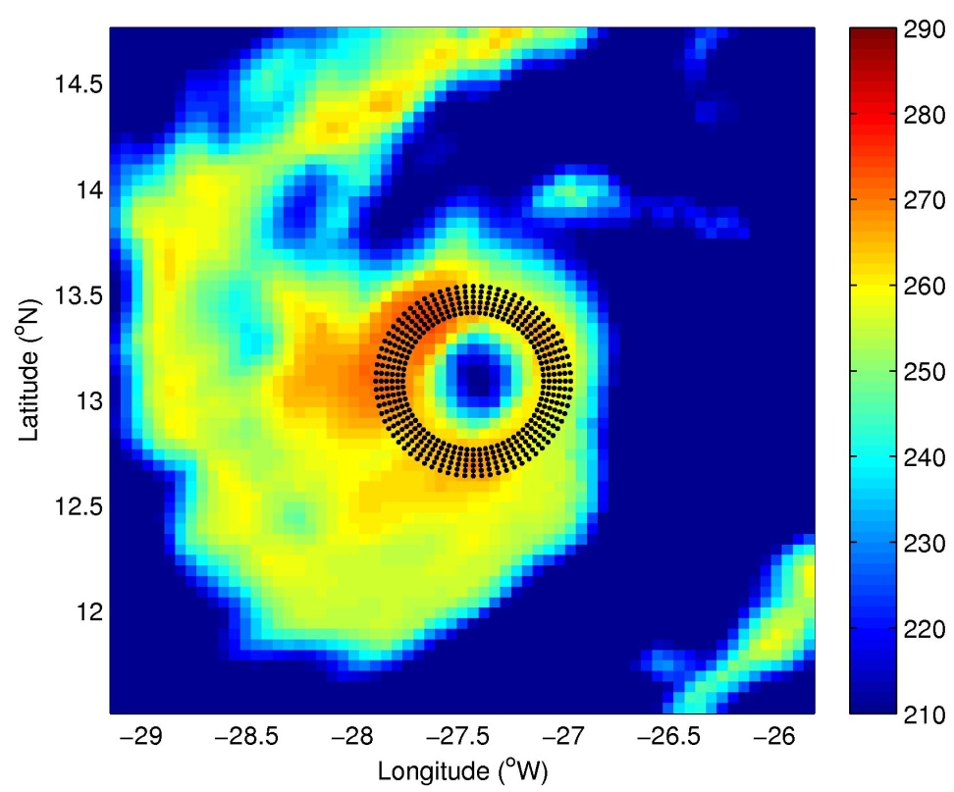
RII Efforts (CIMSS)
Advertisement for Chris Rozoff --- NEXT TALK
Ring averages and standard deviations, based on automated center locations, of 37GHz Brightness temperatures improve probabilistic RII estimates
Results of different statistical techniques are somewhat independent and can be combined to further improve RII forecasts
Horizontally polarized T_{b} and objective ring [TMI; Danielle (2004)]

Slide 5
RII Efforts (AOML/HRD)
Advertisement for John Kaplan --- JHT session
TPW, inner core moisture/heat fluxes and IR principle components information improve the Atlantic and E. Pacific RII re-runs 2008-10.
Statistical treatment of predictors is also found important.
Capability to run these in real-time demonstrated in 2010.

Slide 6
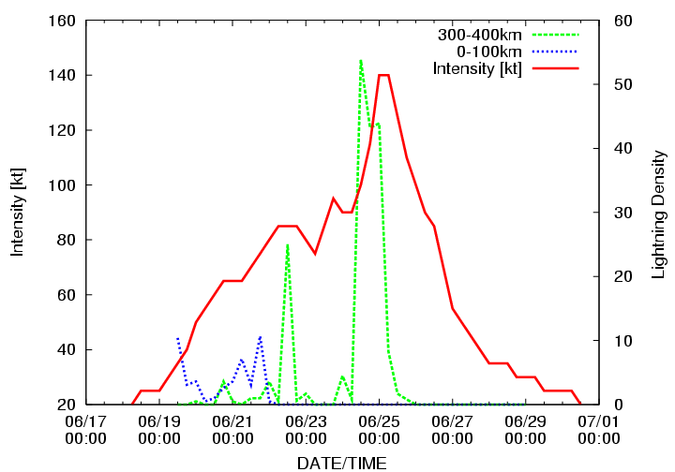
RII Efforts (CIRA/NHC)
Revisit results presented by Jack Beven’s --- GOES-R Proving Ground
Lightning information (inner region vs. rainband region) generally improves RI anticipation in the Atlantic and East Pacific.
More evidence that rainband lightning coincides with intensification.
Other statistical techniques were evaluated and showed similar results

Slide 7
Rapid Weakening Efforts (CIRA)
Atlantic Predictors (7)
East Pacific Predictors (10)
Potential Intensity
500-850 vertical wind shear
200 hPa V wind magnitude
0-500 km precipitable water
0-200 km IR Tb variability
100-300 km IR Tb variability
IR principle component 4
12-hour Intensity trend
Potential Intensity
200-850 vertical wind shear
200 hPa zonal wind
200 hPa meridional wind
0-500 km precipitable water
0-200 km IR Tb variability
100-300 km IR Tb variability
IR principle component #2
IR principle component #4
Most important predictors indicated in Bold Face

Slide 8
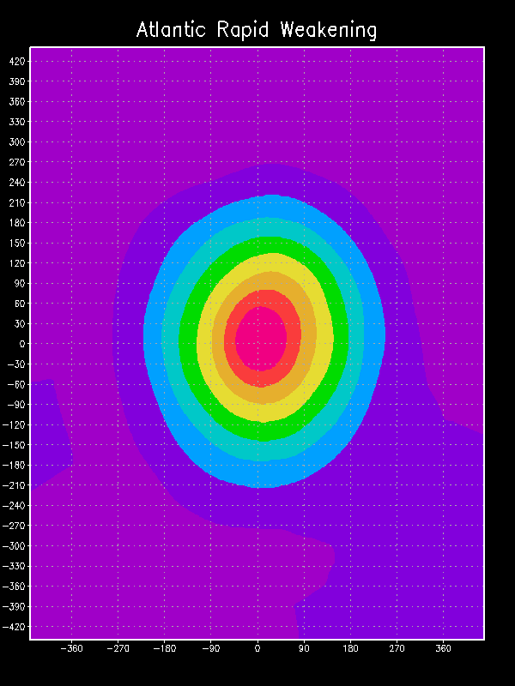
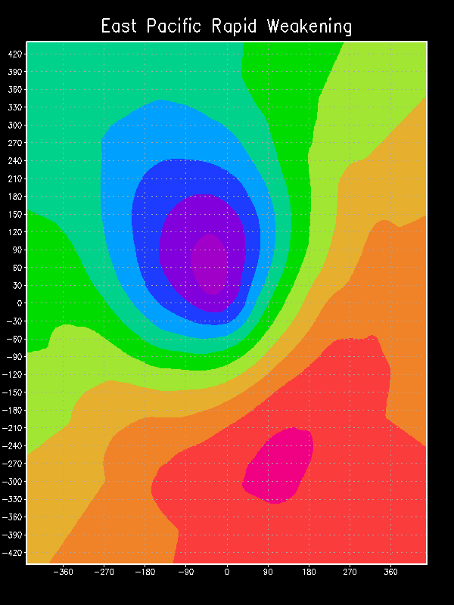
Infrared PC Patterns
Atlantic
East Pacific

Slide 9
Independent Results (2009-2010) (logistic regression)
Atlantic
East Pacific

Slide 10
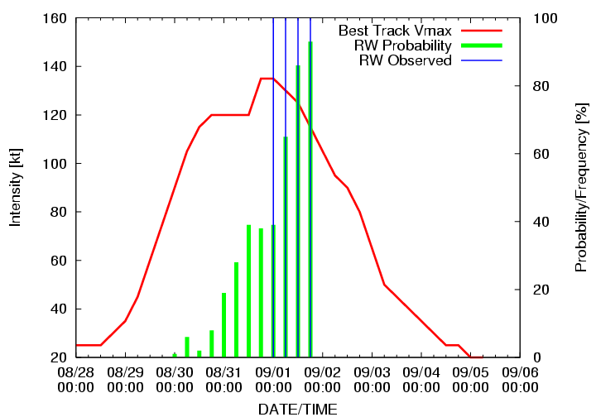
RW Example, EP1309 - Jimena

Slide 11
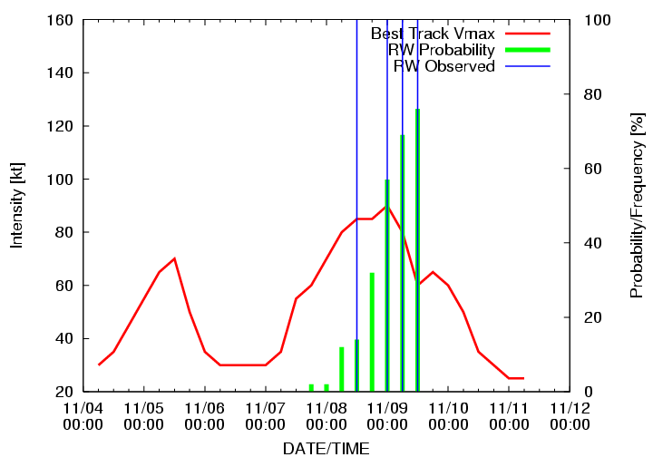
RW Example, AL1109 - Ida

Slide 12
Extra-Tropical Transition (ET)
Factors
Storm speed
Potential Intensity
500-850 hPa vertical wind shear
200 hPa zonal wind
200 hPa meridional wind
200 hPa divergence
0-500 km precipitable water
Infrared pixels 0- 200 km colder than -30 C
Infrared principle component #1
Infrared principle component #3
Most important predictors indicated in Bold Face

Slide 13
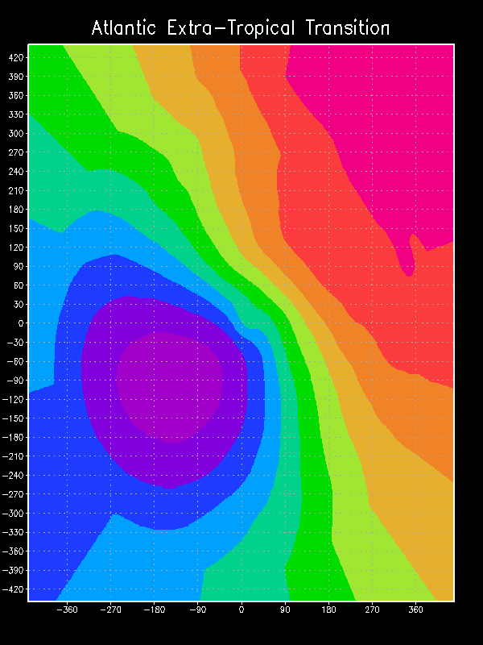
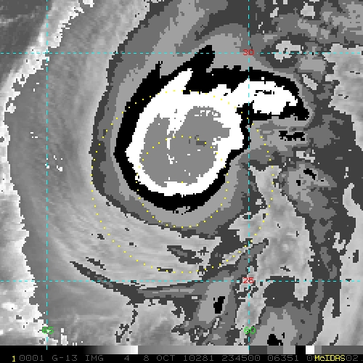
Infrared PC Patterns
Pre-ET pattern
Hurricane Otto Example
Hurricane Otto 9 Oct 00 UTC

Slide 14
Independent Tests (2009-2010)
Linear Discriminant Analysis
Logistic Regression

Slide 15
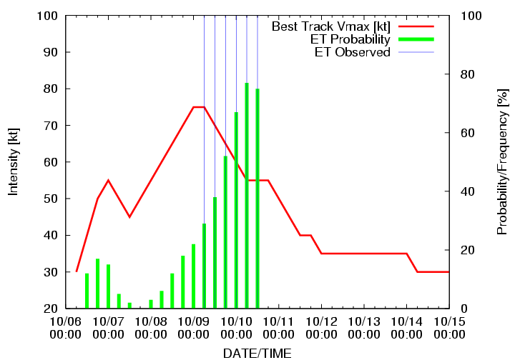
ET Example – Otto – Linear Discriminant Analysis

Slide 16
RW/ET Questions & Future Plans
Questions:
Future Plans
How to display ET information
Every forecast time?
Deterministic?
Probabilistic?
Is 24 h an adequate lead for rapid weakening?
What is ideal
Thresholds based on current intensities?
ET at all the forecast times
Experimental versions possible for 2011 hurricane seasons.

Slide 17
Looking Forward
7-day version of LGEM, where the persistence component is separated from the other predictors
LGEM for the western North Pacific
Version of LGEM where the growth rate is fit using the adjoint model instead of multiple regression
Testing of new ocean predictors using the NCODA fields (SHIPS and LGEM)
Multi-model ensemble of LGEM/SHIPS forecasts (HFIP project).

Slide 18
Improving SHIPS with Lightning and TPW Information
Both TPW and lightning information improve SHIPS forecast (dependent)
Combined results show steady improvements
lightning near the storm center appears to be a generally negative indicator of intensification
Knaff et al. (2010) – AMS tropical meeting

