Slide 1
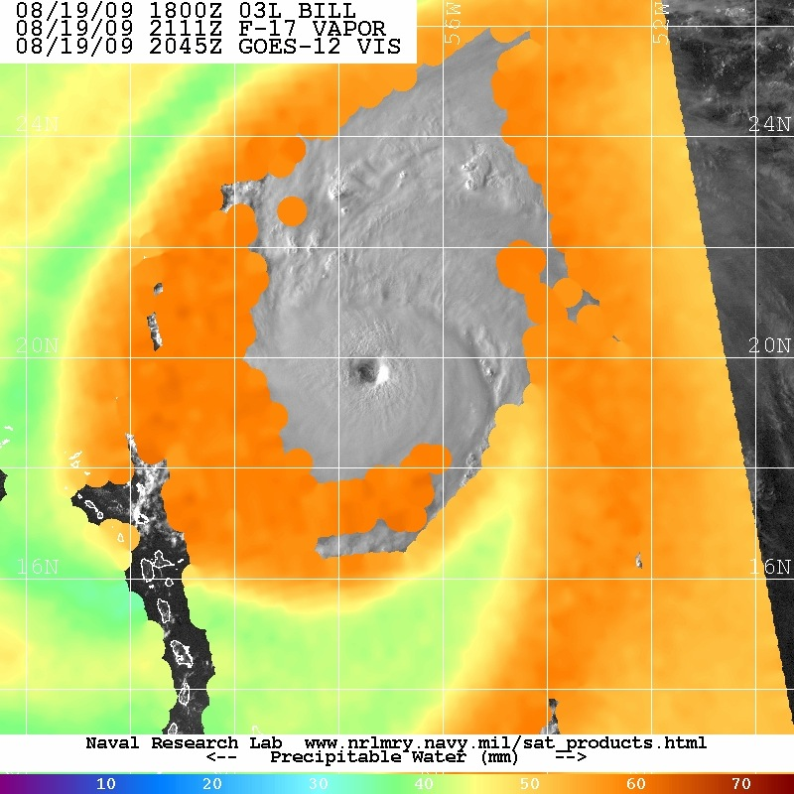
Dry Air in the Tropical Cyclone Environment
Jason Dunion¹ & Greg Tripoli²
1 University of Miami/RSMAS-NOAA/AOML/HRD
2 University of Wisconsin-Madison

Slide 2
Discussion Outline
Motivation:
-improved understanding of the interactions between dry air and TCs (~600-800 mb)
Background
-arc clouds & low to mid-level dry air
Dry Air & AEWs/TCs: The Big Picture
-low to mid-level dry air pathways
Dry Air & AEWs/TCs: The Smaller Picture
    -a tale of 2 TCs & dry air intrusions
Conclusions & Future Work

Slide 3
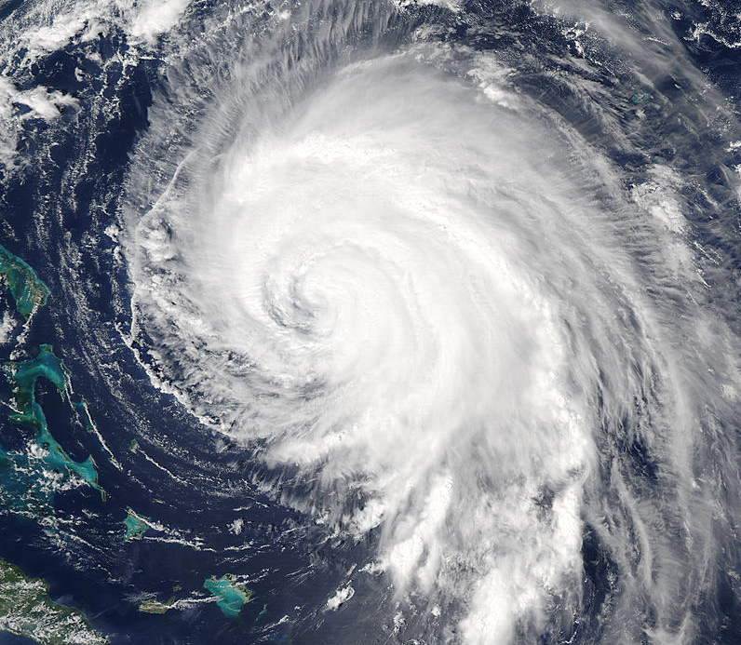
Arc Clouds
Hypotheses
1. Null Hypothesis: Arc clouds: ubiquitous to the tropics…nice pictures…no TC/AEW impact;
2.The moist tropical sounding (Dunion JCLIM 2011) is insufficiently dry in the low to mid-levels (i.e. below the freezing level) to form substantial arc clouds;
3.Arc cloud formation is associated with inhibited TC development in the short term:
a) bringing cool, dry air down into the boundary layer;
b) promoting low to mid-level outflow;

Slide 4
Arc Clouds (NHC Discussions)
JOYCE (28 SEP 2000):
HOWEVER...THERE ARE ARC CLOUDS MOVING AWAY FROM THE SYSTEM WHILE THE OVERALL PATTERN REMAINS NONDESCRIPT. THIS IN GENERAL MEANS THAT THE TROPICAL CYCLONE IS NOT EXPECTED TO STRENGTHEN THROUGH THE NEXT 6 TO 12 HOURS.
ERIN (04 SEP 2001):
...DEEP CONVECTION HAS BEEN INTERMITTENT AND ARC CLOUDS ARE MOVING AWAY FROM THE STORM.
ROSA (09 NOV 2006):
...AND THE PRESENCE OF ARC CLOUDS IMPLIES THAT DRY AIR IS NOW AFFECTING THE CYCLONE.
CHRIS (02 AUG 2006):
...AND ANIMATION OF VISIBLE SATELLITE IMAGERY SHOWS ARC CLOUDS EMANATING NORTHWESTWARD FROM THE STORM. ALL OF THE ABOVE SUGGEST THAT LITTLE INCREASE IN STRENGTH IS LIKELY IN THE SHORT TERM.
INGRID (16 SEP 2007):
MOREOVER...A NUMBER OF ARC CLOUDS...IMPLYING LOW-LEVEL DIVERGENCE...ARE SEEN EMANATING FROM THE WESTERN PORTION OF THE SYSTEM.
JOSPEHINE (03 SEP 2008):
ADDITIONALLY...THE PRESENCE OF ARC CLOUDS EMANATING FROM THE CLOUD CANOPY SUGGEST THAT SOME DRY AIR MIGHT BE AFFECTING JOSEPHINE.
BILL (20 AUG 2009):
IN FACT...SOME ARC CLOUDS ARE MOVING AWAY FROM THE HURRICANE SUGGESTING THAT BILL IS NOT STRENGTHENING AT THIS TIME.
LINDA (07 SEP 2009):
VISIBLE IMAGERY SHOWS THAT LINDA IS INGESTING DRIER AND MORE STABLE AIR FROM THE NORTH INTO THE WESTERN SIDE OF ITS CIRCULATION...AND THE CYCLONE HAS BEEN PRODUCING SOME ARC CLOUDS TO ITS SOUTH.
DANIELLE (25 AUG 2010):
...AND SEVERAL ARC CLOUDS HAVE BEEN SEEN JUST OUTSIDE THE CENTRAL CONVECTION IN THE SOUTHWESTERN QUADRANT.
TOMAS (01 NOV 2010):
VISIBLE SATELLITE IMAGES SHOW A SERIES OF ARC CLOUDS PROPAGATING AWAY FROM THE CONVECTIVE MASS...INDICATIVE OF DRY AIR NEAR THE CORE.
*Courtesy of the Frank Marks PPT Institute

Slide 5
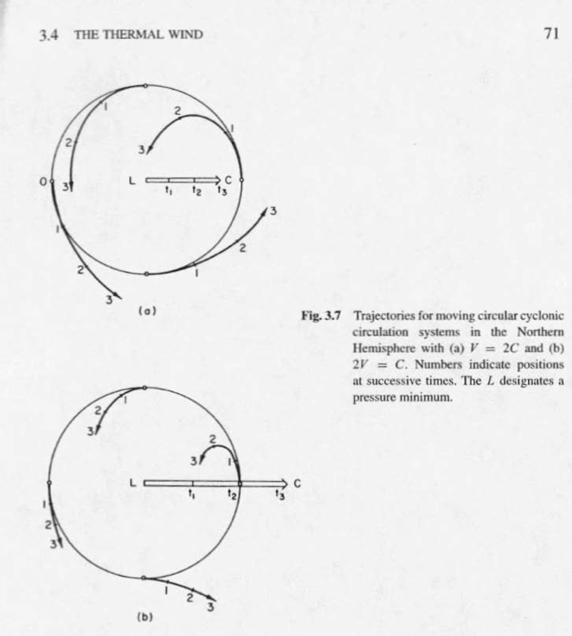
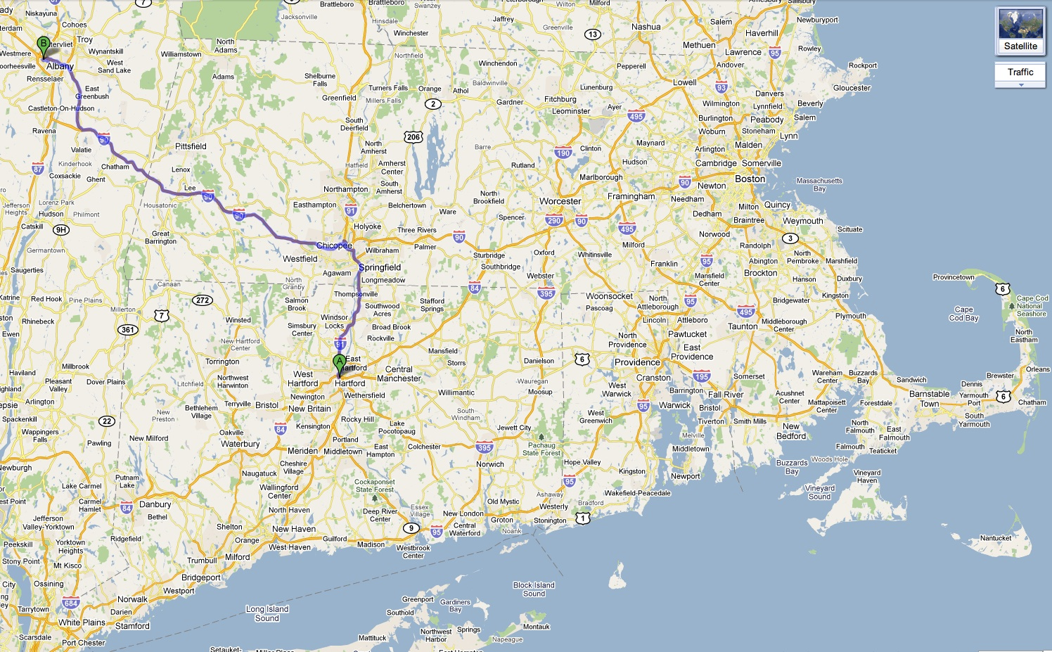
Dry Air Trajectories
Mile Marker 10,250
R_{t}=radius of curvature (trajectories)
R_{s}=radius of curvature (streamlines)
C=motion of height contours
Υ=angle between streamlines
V=WSpd

Slide 6

Dry Air Trajectories
No wind field asymmetries
C=V/2 (slow mover)
C=2V (fast mover)
Notes:
Emphasize house-window analogy…maybe even with a top view picture of a house

Slide 7
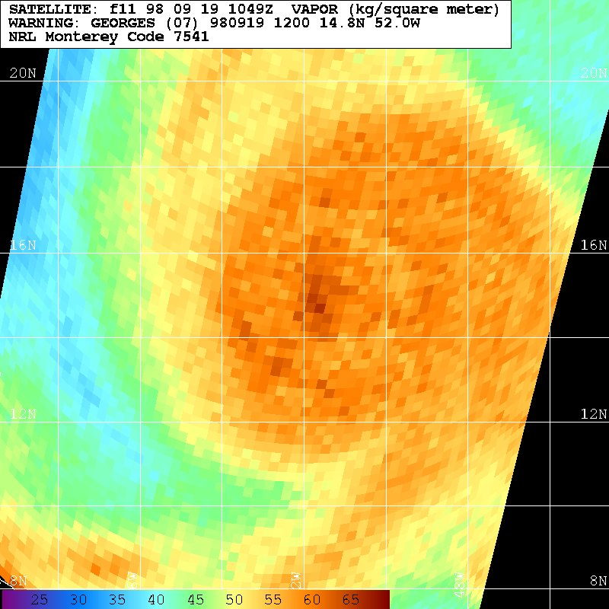
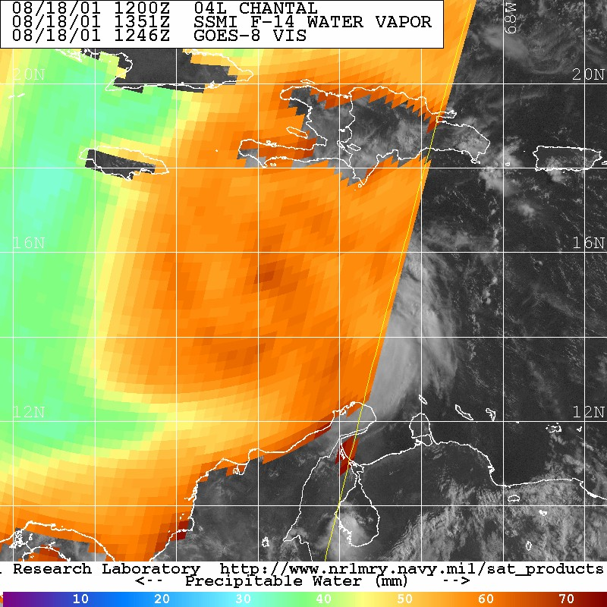
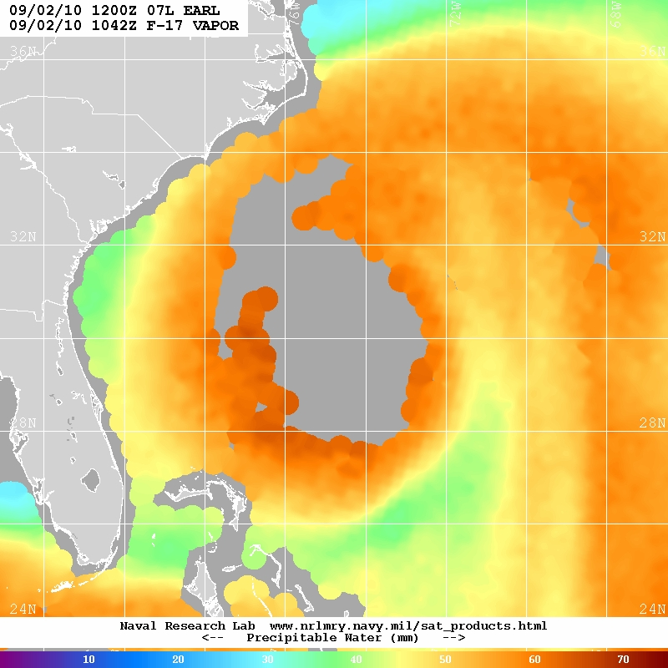
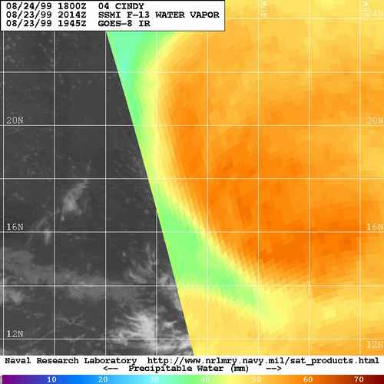
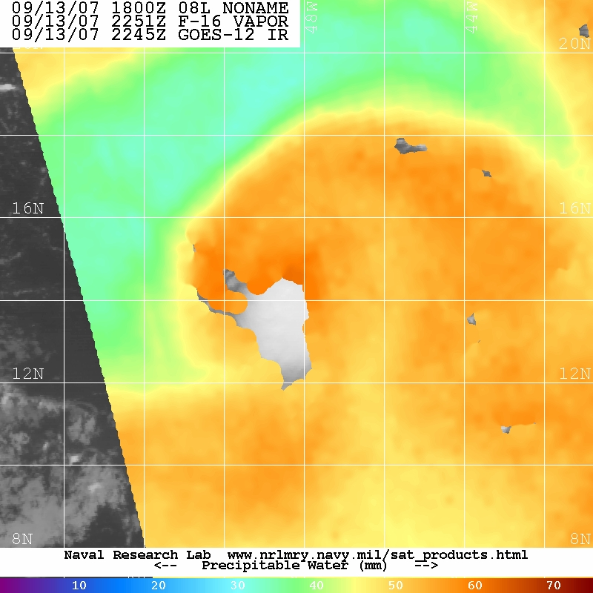
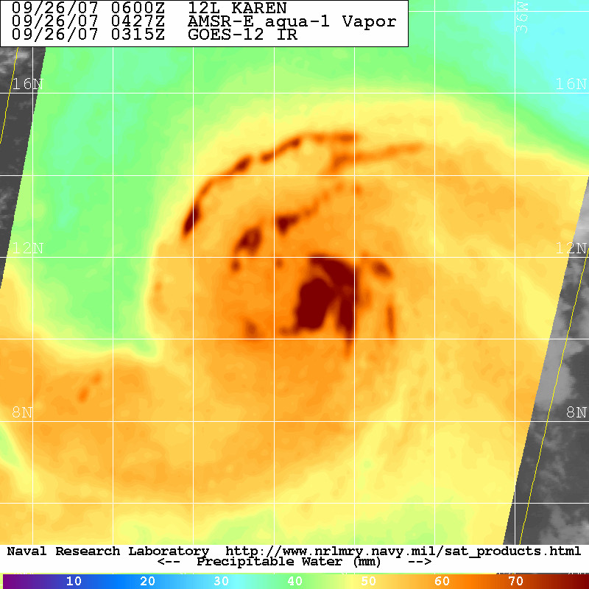
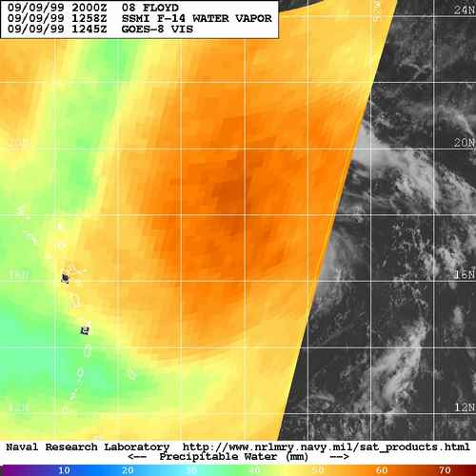
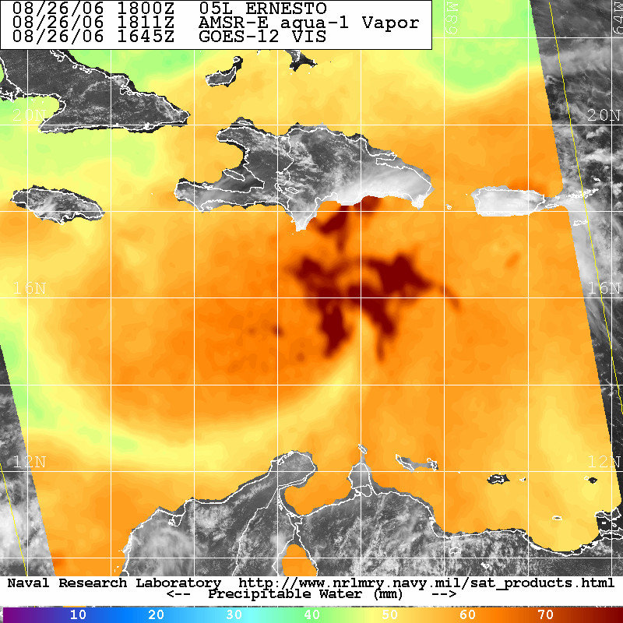
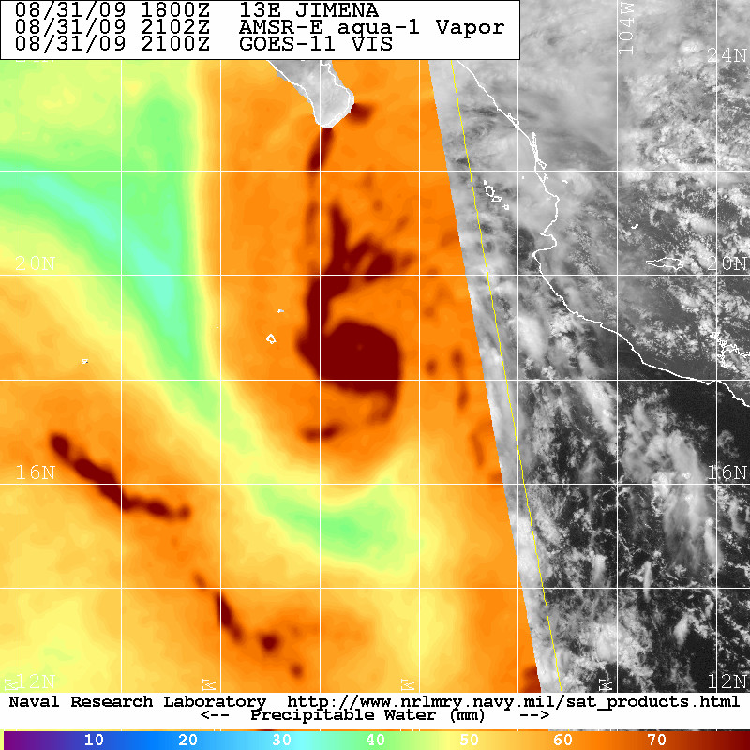
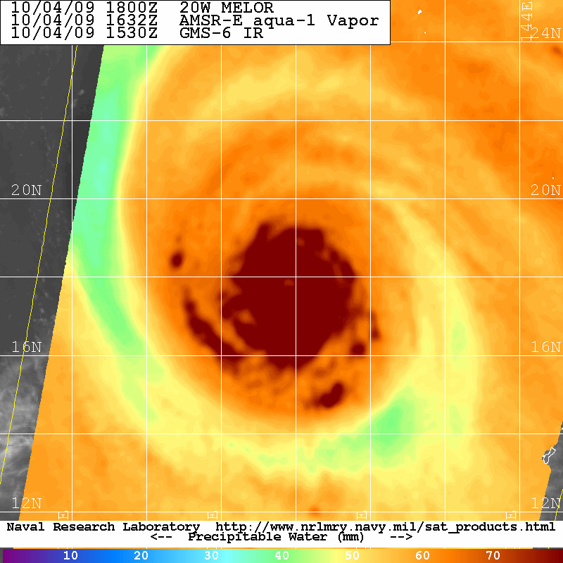
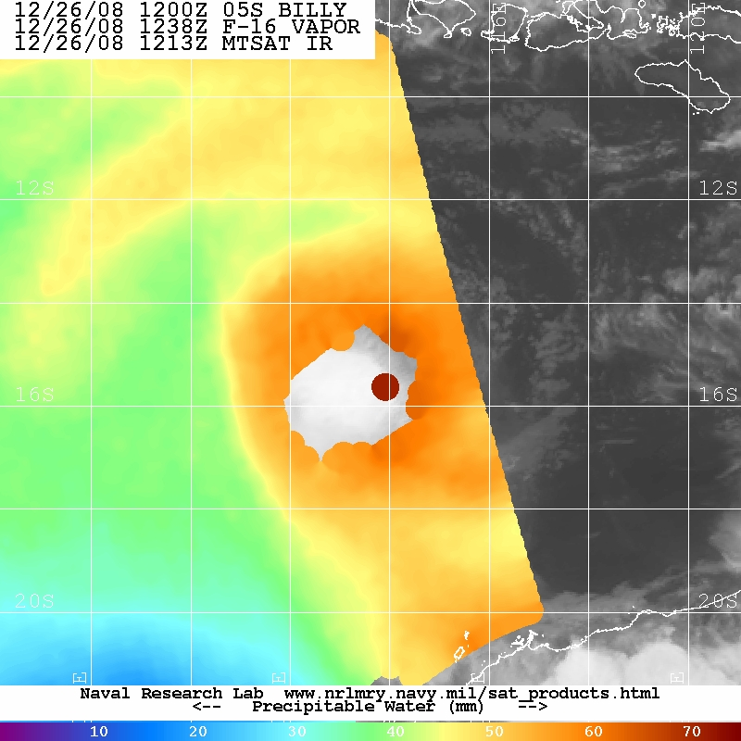
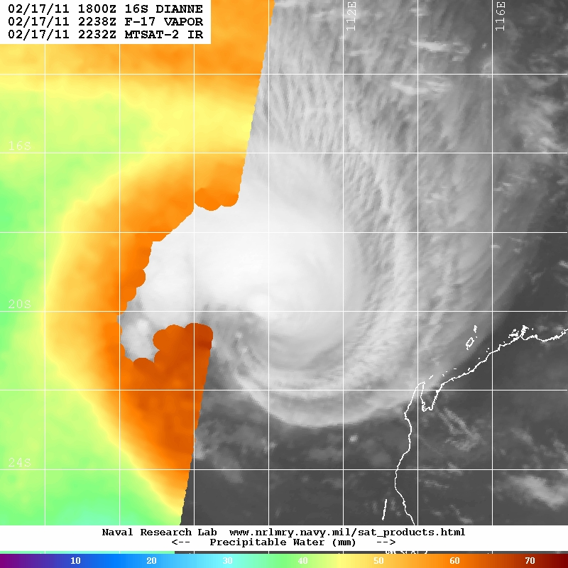

Slide 8
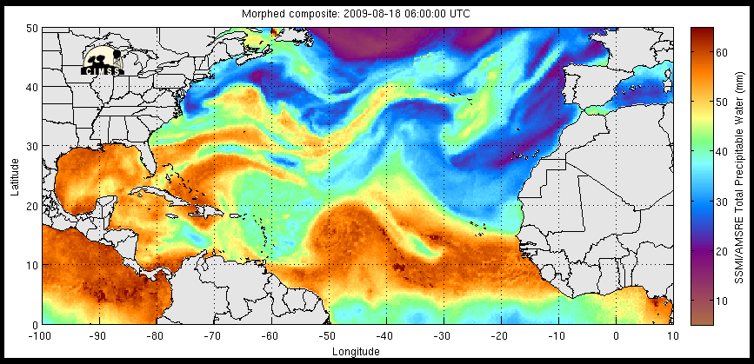
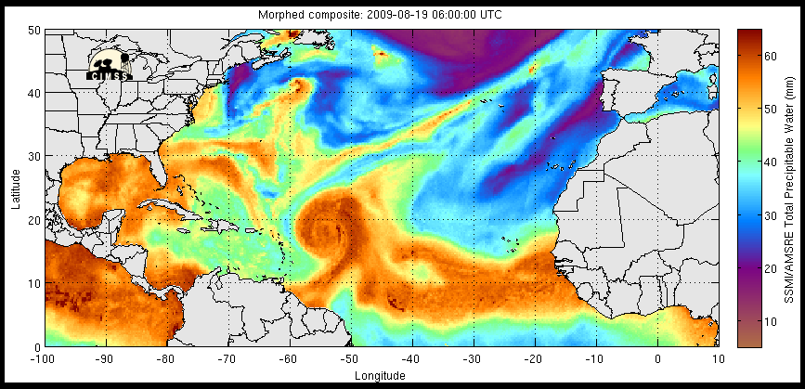
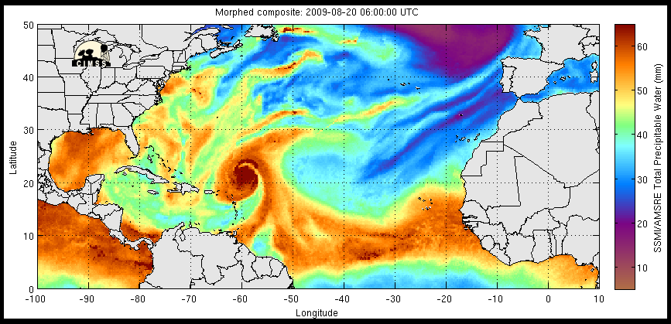
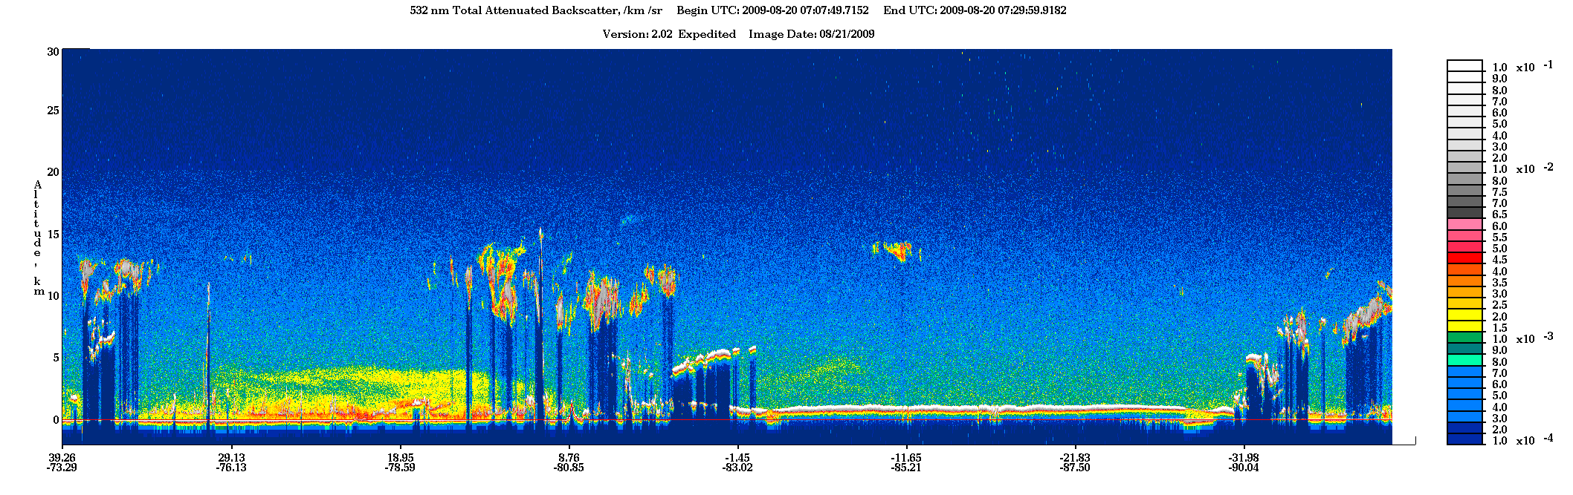
A
SAL &
mid-lat
subsid above
SAL
SAL &
mid-lat
subsid above
SAL
SAL &
mid-lat
subsid above
SAL
B
A
B
Saharan Dust
Notes:
Top: TPW showing large SAL outbreaks W and E of Bill. Note the large dry air intrusion wrapping around the storm at this time
Bottom: coincident CALIPSO overpass (A-B) showing that the dry air wrapping into the storm on the SW side was indeed a dusty SAL outbreak. Dust extends up to ~4.5-5 km in this outbreak…fairly typical for SAL outbreaks in the NATL

Slide 9
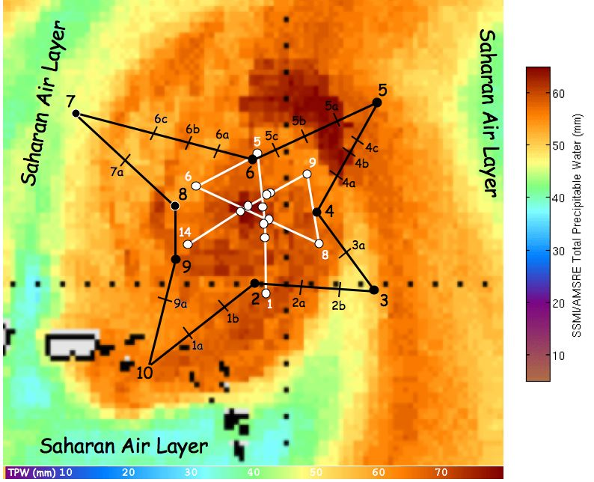
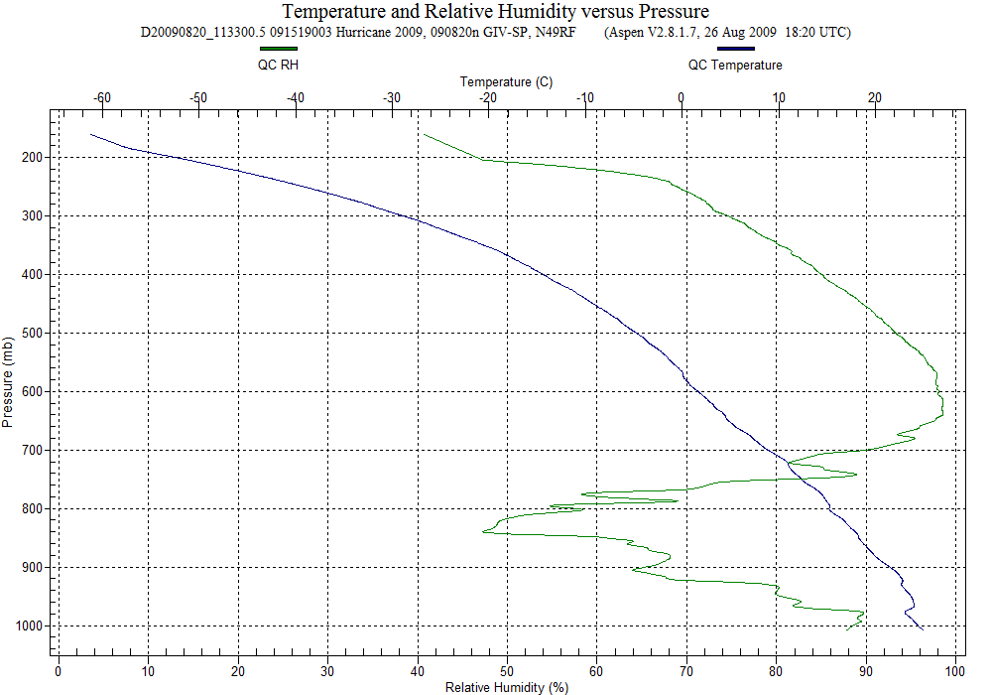
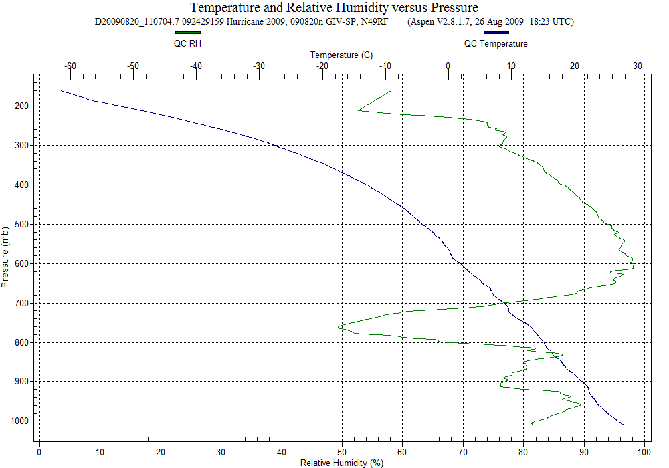
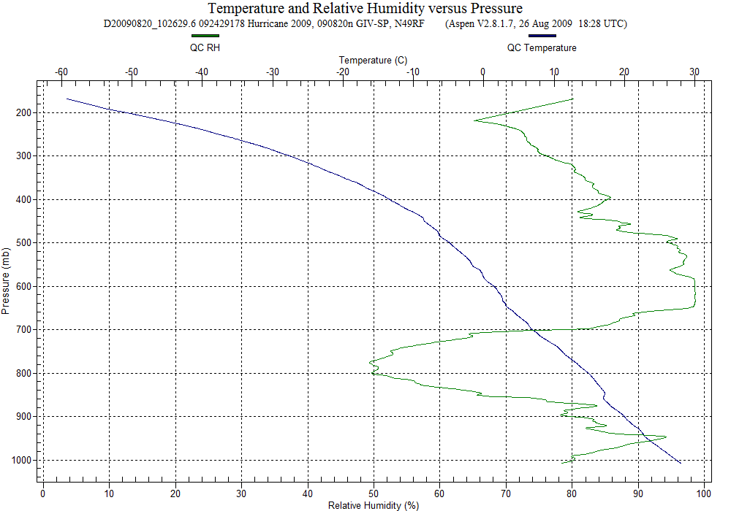
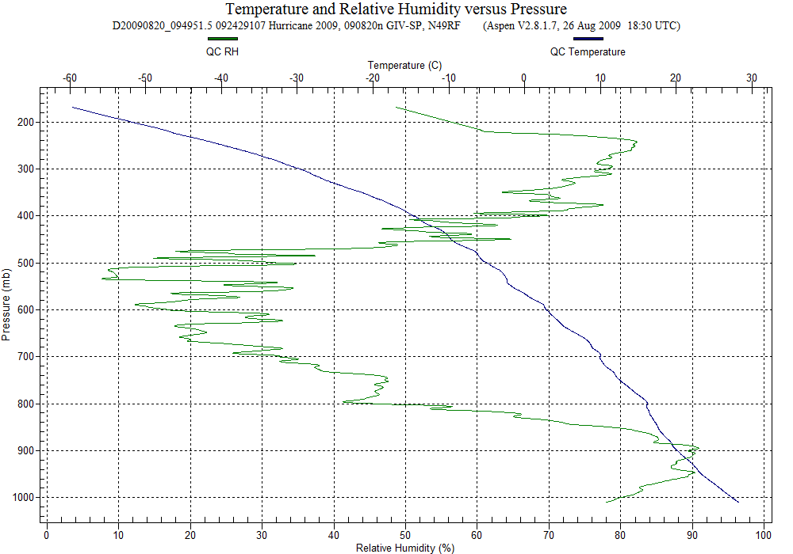
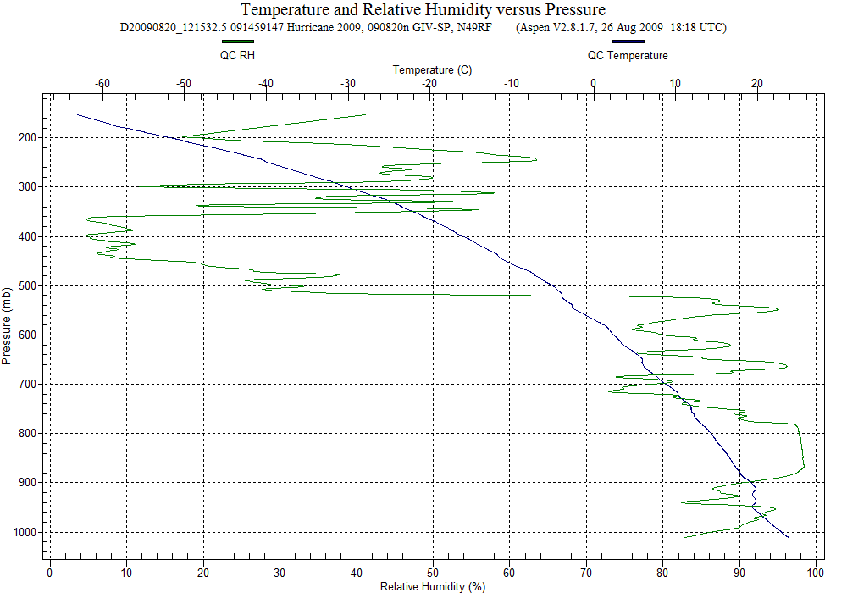
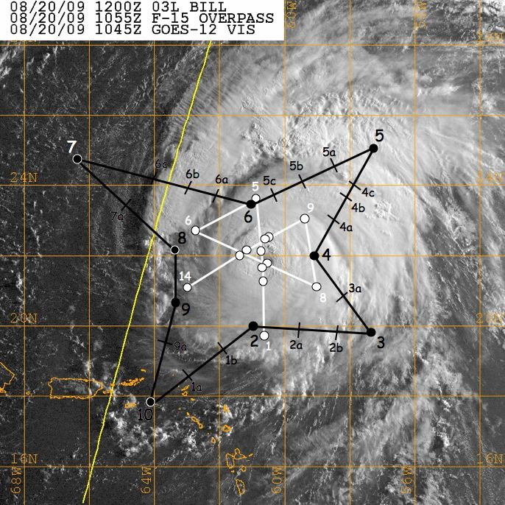
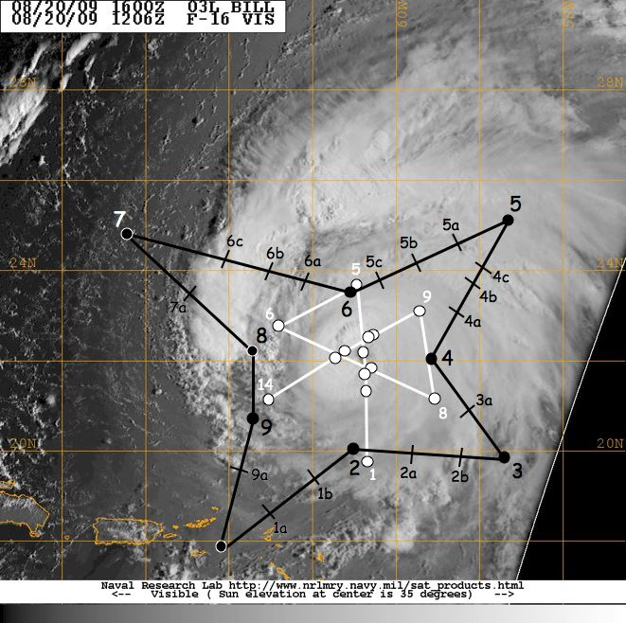
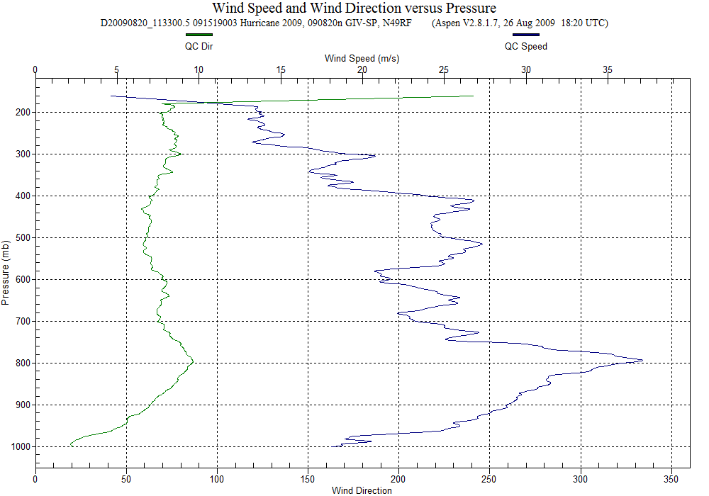
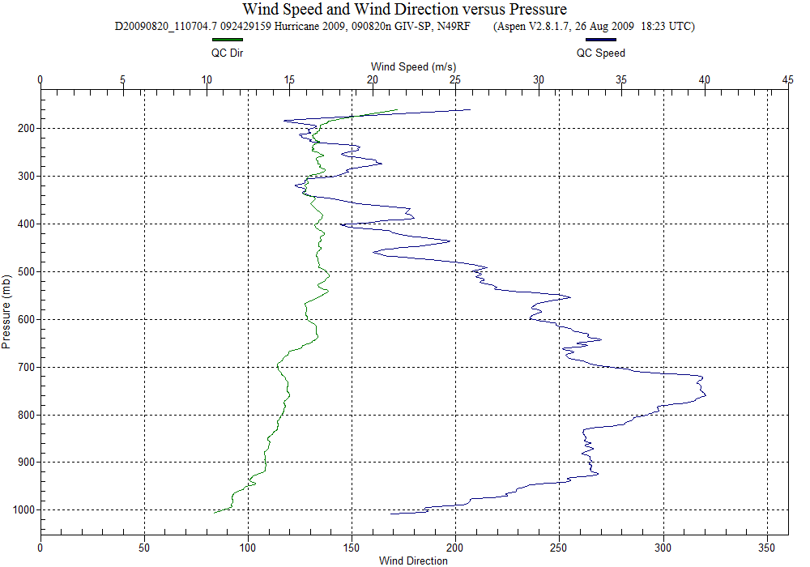
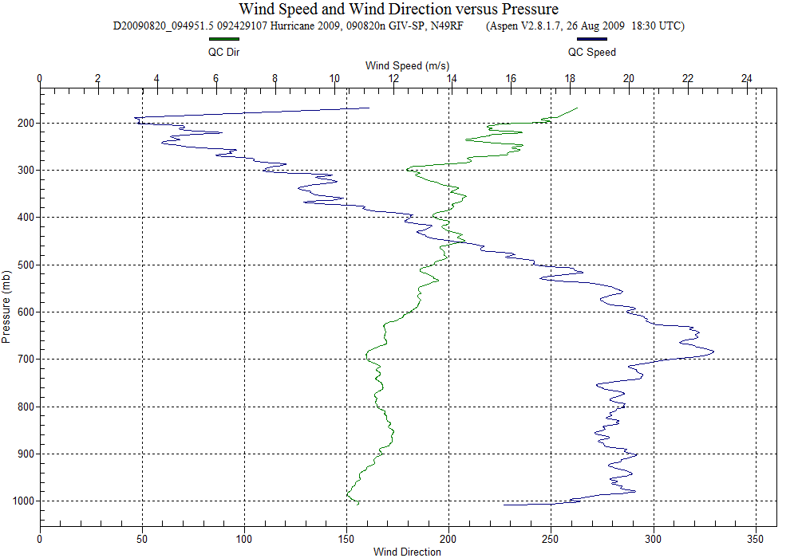
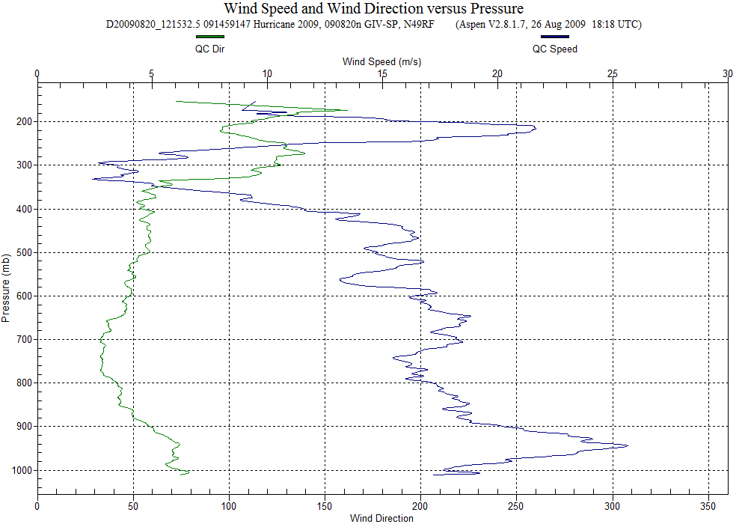
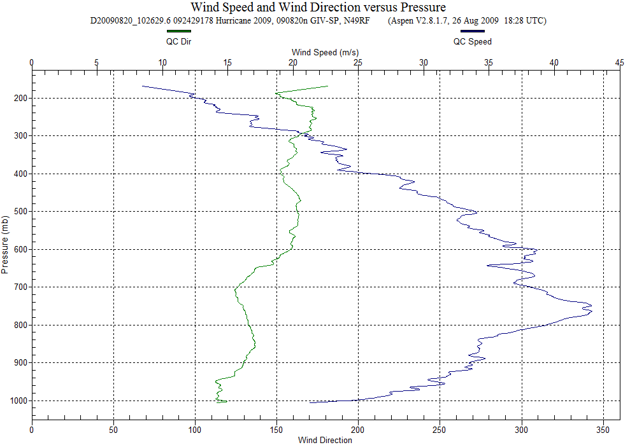
mid-latitude/subsidence
SAL intrusion
SAL intrusion?
(collocated with jet)
SAL intrusion
SAL intrusion >
Downdraft?
46 kt SSE jet
86 kt SE jet
80 kt ESE jet
76 kt ENE jet
52 kt ENE jet

Slide 10
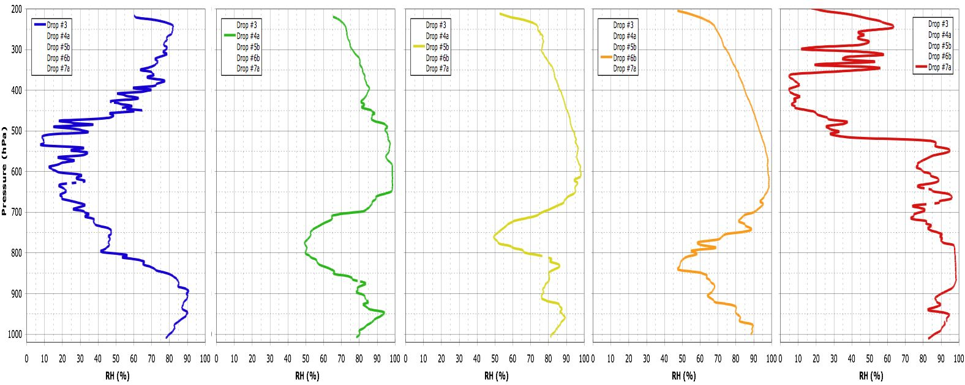
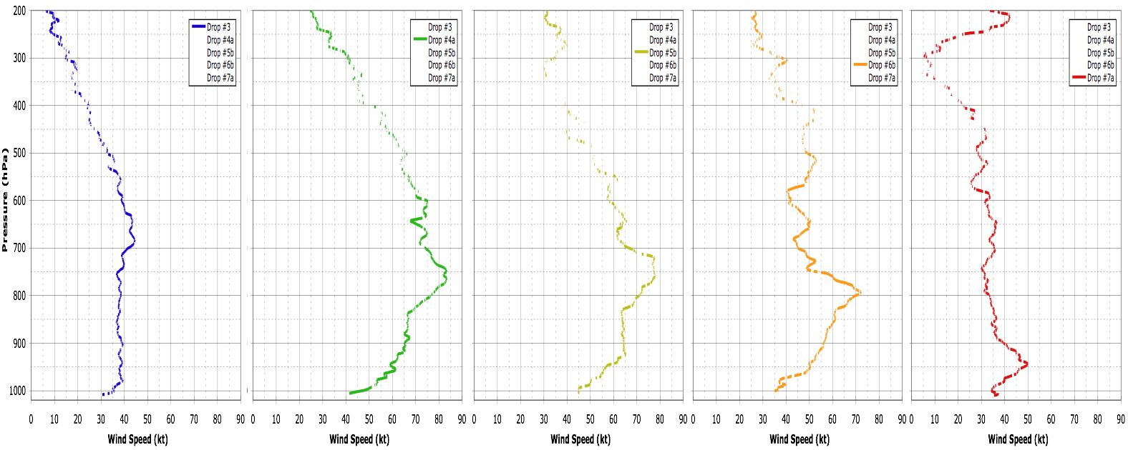
Hurricane Bill 20 August 2009
SE
NW
18.7 g/kg
18.9 g/kg
19.2 g/kg
20.2 g/kg
15.5 g/kg

Slide 11
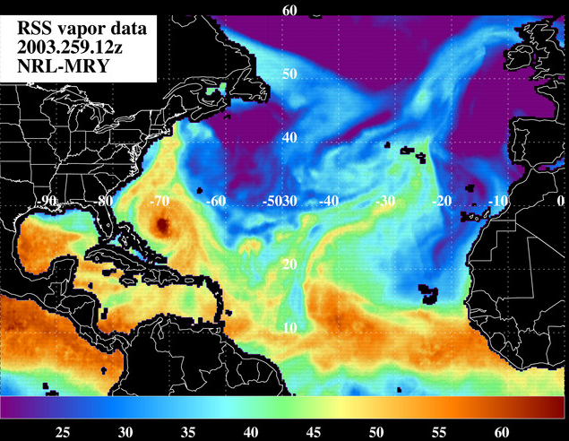
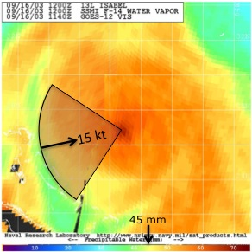
Total Precipitable Water Rapid Intensity Index Predictor
21 Atlantic TPW predictors tested & identified
%TPW pixels <45 mm; r=0-500 km,
90 deg quad centered upshear)
replaces old 700-850 hPa RH predictor

Slide 12
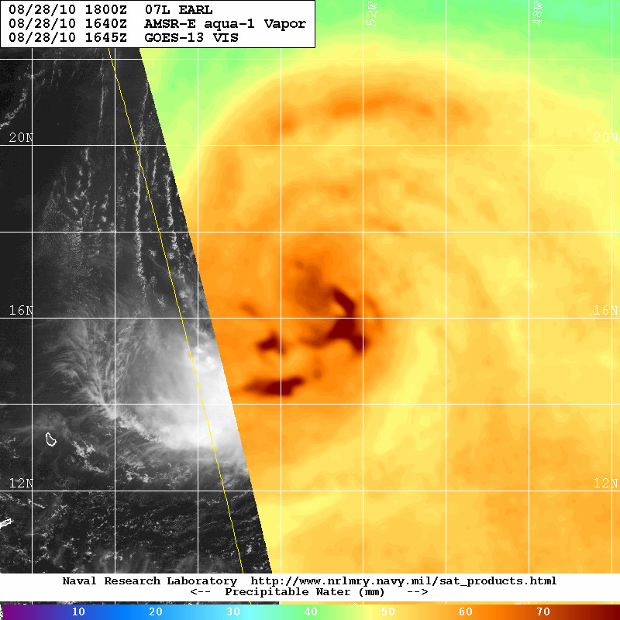
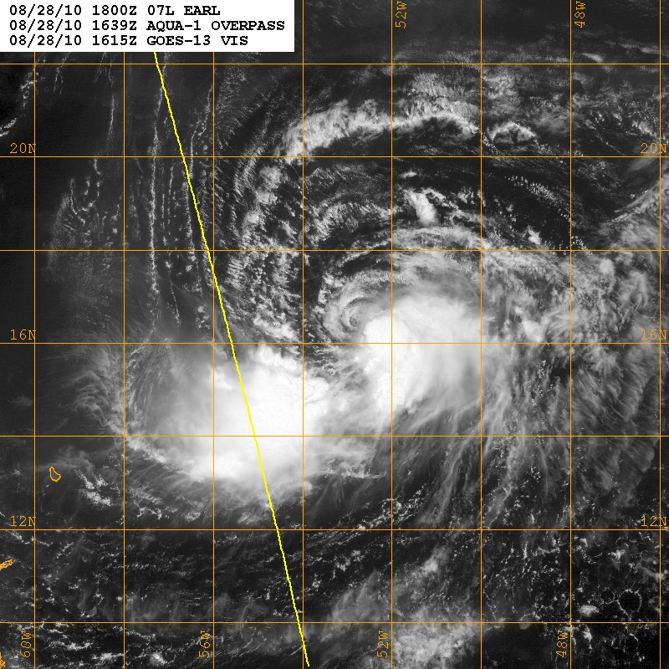
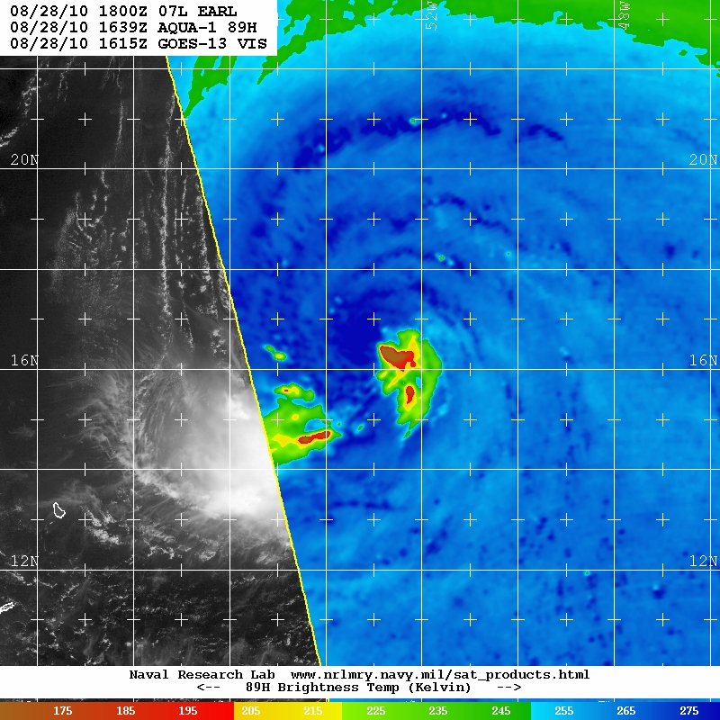
2010 Hurricane Earl
28 August – 01 September
28 Aug 1640z
SHIPS Deep Layer Shear:
t +24 hr: 10 kt @52 deg
t +48 hr: 4 kt @33 deg
t +72 hr: 15 kt @237 deg

Slide 13
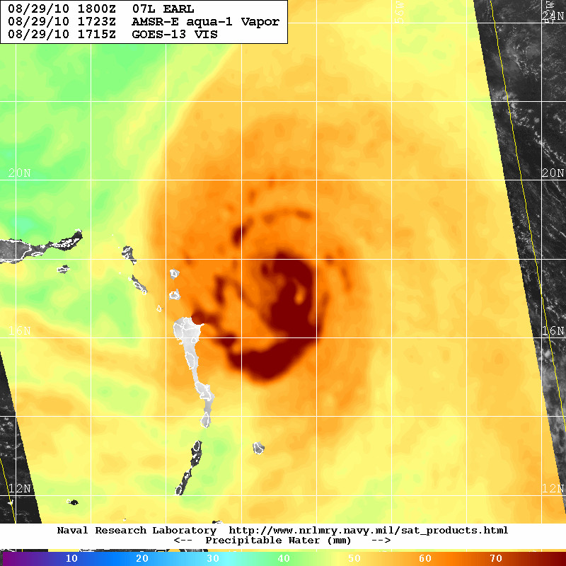
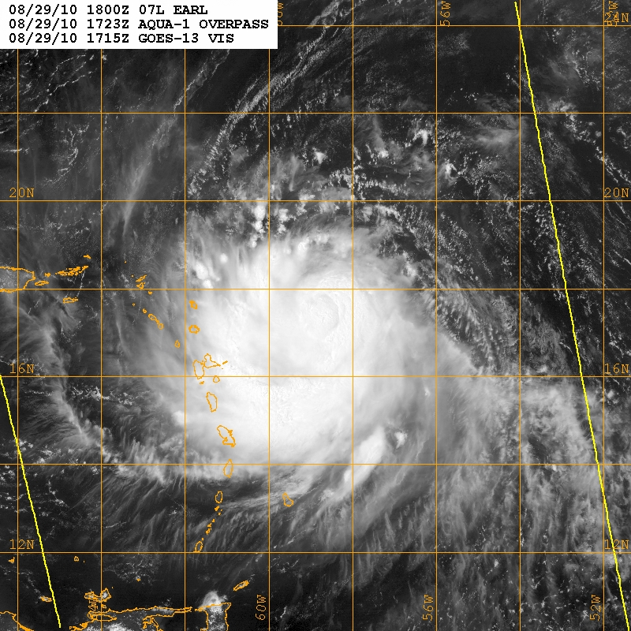
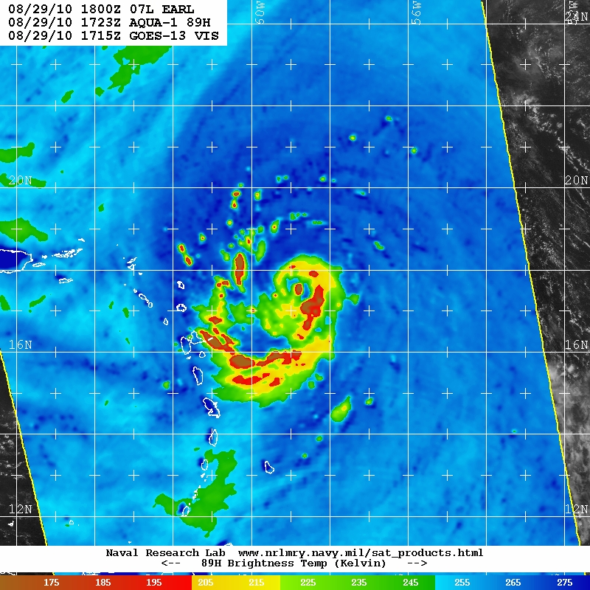
2010 Hurricane Earl
28 August – 01 September
29 Aug 1723z
SHIPS Deep Layer Shear:
t +24 hr: 2 kt @308 deg
t +48 hr: 11 kt @191 deg
t +72 hr: 13 kt @172 deg

Slide 14
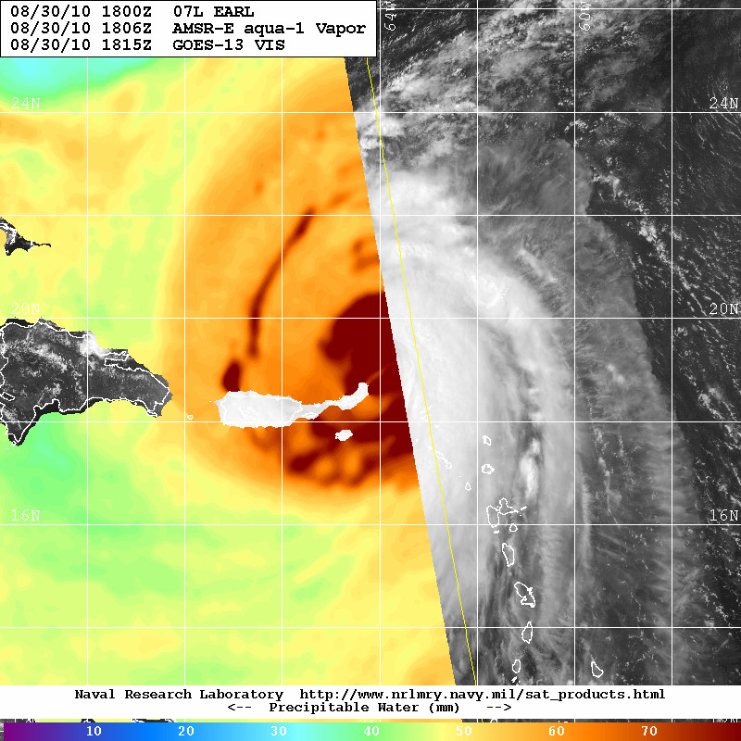
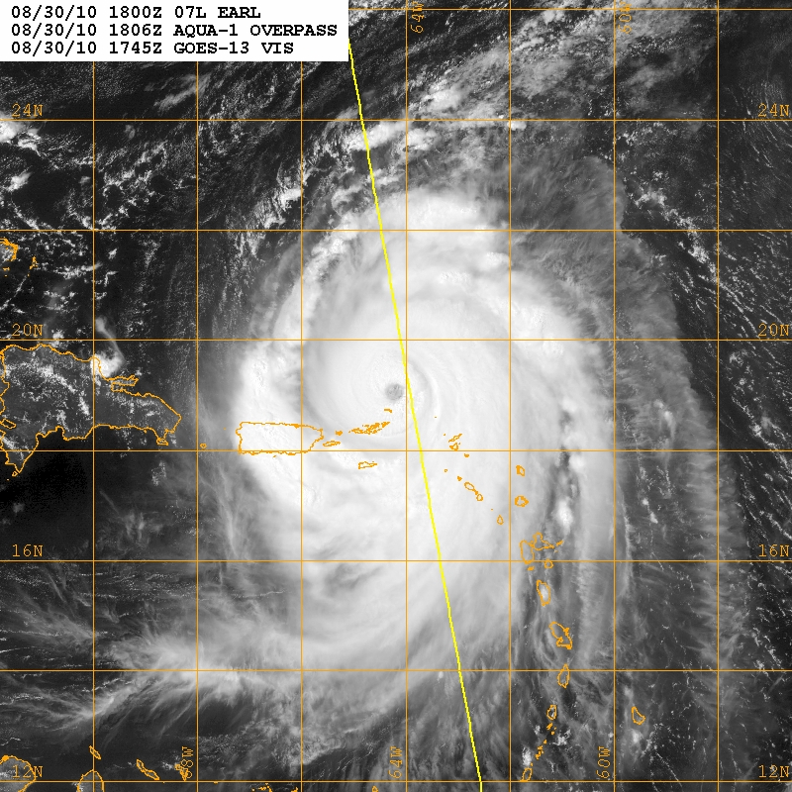
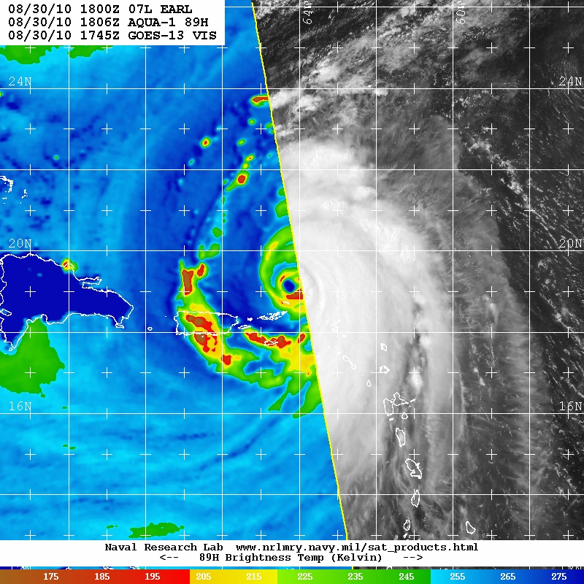
2010 Hurricane Earl
28 August – 01 September
29 Aug 1723z
SHIPS Deep Layer Shear:
t +24 hr: 15 kt @191 deg
t +48 hr: 22 kt @177 deg
t +72 hr: 14 kt @174 deg

Slide 15
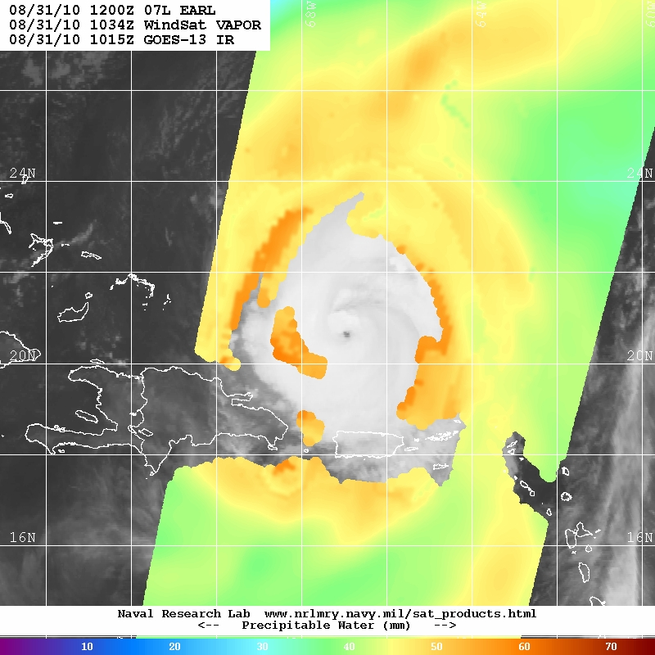
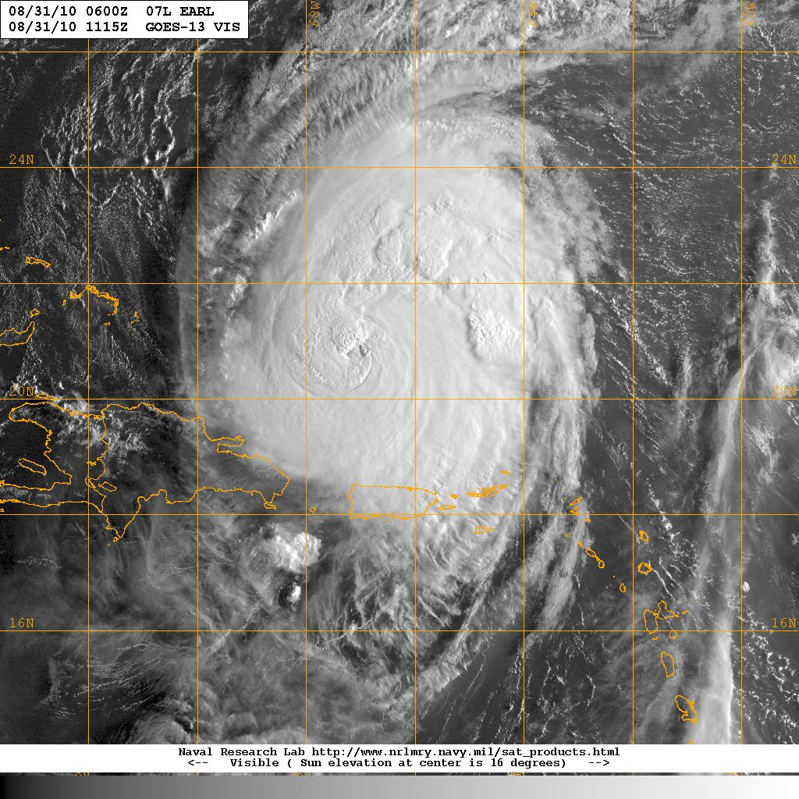
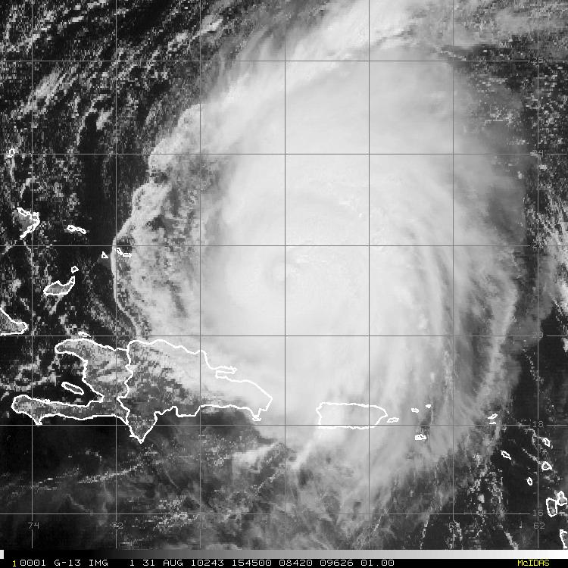
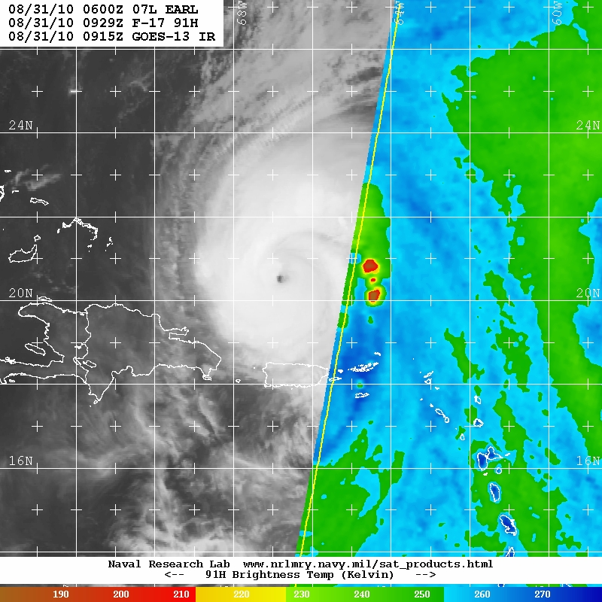
2010 Hurricane Earl
28 August – 01 September
31 Aug 1034z
SHIPS Deep Layer Shear:
t +24 hr: 18 kt @187 deg
t +48 hr: 2 kt @113 deg
t +72 hr: 13 kt @214 deg

Slide 16




2010 Hurricane Earl
28 August – 01 September
01 Sep 1056z
SHIPS Deep Layer Shear:
t +24 hr: 13 kt @190 deg
t +48 hr: 24 kt @198 deg
t +72 hr: 22 kt @216 deg

Slide 17




















Hurricane Earl 31 Aug – 01 Sept 2010
VIS IR 6-hr BT Difference
31 Aug 0045z
31 Aug 0345z
31 Aug 0645z
31 Aug 0945z
31 Aug 1245z
31 Aug 1545z
31 Aug 1845z

Slide 18
















































Hurricane Fabian 01-03 September 2003
VIS IR 6-hr BT Difference
01 Sep 0645z
01 Sep 0945z
01 Sep 1245z
01 Sep 1545z
01 Sep 1845z
01 Sep 2145z
02 Sep 0045z
02 Sep 0345z
02 Sep 0645z
02 Sep 0945z
02 Sep 1245z
02 Sep 1545z
02 Sep 1845z
02 Sep 2145z
03 Sep 0045z
03 Sep 0345z

Slide 19
Conclusions
Arc Clouds
1) Hypothesis: moist tropical sounding- not dry enough to form substantial arc clouds (Dunion JCLIM 2011)
2) Disruption of TCs/AEWs via:
a) bringing cool, dry air down into the boundary layer;
b) promoting low to mid-level outflow;
Dry Air & AEWs/TCs Pathways: Big Picture
-favored “big picture” pathways
-resistance of the vortex to intrusion: can’t be ignored
Dry Air & AEWs/TCs Pathways: Smaller Picture
-dry air entrainment & collated jets (Bill)
-dry air + shear (shear vector alignment may be important)
-storm motion relative to arc clouds…may be important
-6-hr GOES IR BT differences….food for thought

Slide 20
Future Work
Down the Road:
Test TPW in SHIPS (especially genesis cases)
Idealized modeling of arc clouds
UL BT cooling rings
-hmmm…that’s interesting (Zipser IHC 2011)
-Predictability?
-relationship to EWCs?
HRD Hurricane Field Program
-Use TPW & SHIPS (swinging shear vector) to target arc cloud events/better understand BT ring
-Aircraft data: P-3 Doppler; P3/G-IV GPS dropsondes

