Slide 1
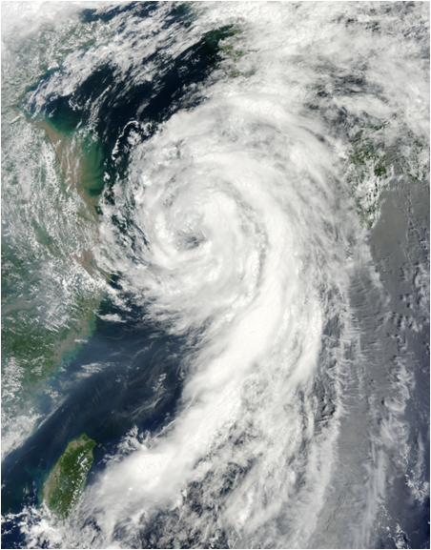
Intraseasonal to Seasonal Prediction of
Tropical Cyclogenesis:
A Statistical-Dynamical Forecast System
Tom Murphree and David Meyer
Naval Postgraduate School
murphree@nps.edu and dwmeyer@nps.edu
NPS Contributors:
Bryan Mundhenk
Chad Raynak
Stephanie Johnson
Bob Creasey
Coordination / Collaboration:
DOD: FNMOC, JTWC, AFWA
NOAA: CPC
Funding:
DOD: USN, USAF
05W (Dianmu)
approaches South Korea
10 August 2010
Presented at the 2011 Interdepartmental Hurricane Conference
Miami, FL, 28 February – 03 March 2011
1
IHC, Mar11, murphree@nps.edu
Notes:
1

Slide 2
Long Range Forecasting of Tropical Cyclones
05W (Dianmu) 05-12 August 2010
05W formation on
05 Aug 2010
A great deal of operational planning requires long range forecasts (LRFs) of TC activity with lead times out to several seasons.
We have developed an experimental system for providing LRFs of TC formations.
Our system is a first step toward LRFs of TC tracks and intensites.
Western North Pacific first, then N Atlantic, then other basins.
2
IHC, Mar11, murphree@nps.edu

Slide 3
Long Range Forecasting of Tropical Cyclone Formations
90 Day Lead
Valid 05 Aug 10
NPS TC Formation Probability Forecasts
Forecasts based on NPS statistical-dynamical forecast system.
Contours: ensemble mean forecasted probabilities.
Minimum contours indicate threshold for formation, with very little chance of a TC forming outside this contour.
All plotted contours are greater than maximum observed probabilities.
Hit: formation (JTWC 1st position) occurs on valid date inside or within 2.5º of threshold contour.
Red dot northeast of Luzon: formation of 05W (Dianmu) on 05 Aug 10.
Note forecast consistency with lead time, and highest probabilities outside main formation region.
60 Day Lead
Valid 05 Aug 10
30 Day Lead
Valid 05 Aug 10
3
IHC, Mar11, murphree@nps.edu
Notes:
A hit for a TC formation is scored if the JTWC first position for a TC shows formation inside or within 2.5o of the forecasted threshold contour on the forecast valid date.

Slide 4
Long Range Forecasting of Tropical Cyclogenesis in the Western North Pacific
NPS Statistical-Dynamical Forecast System: Development and Operation
1. Build logistic regression model based on relationships between TC formations and LSEFs**
(use JTWC best track and NCEP R2 reanalysis data)
3. Create NPS statistical-dynamical forecast system with parameterized TC formations.
4. Produce statistical-dynamical, ensemble based long range forecasts of TC formation probabilities
(NPS TC LRFs, 4-90 day lead times)
2. Force statistical model with dynamical, ensemble-based, long range forecasts of LSEFs**
(use NCEP Climate Forecast System v1)
** LSEFs = large scale environmental factors: SST, ζ₈₅₀, shear₂₀₀₋₈₅₀, div₂₀₀, f
Inputs and outputs are all on a daily, 2.5° scale (high resolution for LRFs).
Extensive ensembling based on multiple initial conditions and multiple lead times (e.g., 184 members for 90 day lead LRFs).
Statistical model verified via hindcasting of 1980-2006, with very good results (e.g., reliability, BSS, ROC).
4
IHC, Mar11, murphree@nps.edu
Notes:
In 2005 NCEP presented an award to a group of its employees for developing the CFS. This model led to “the first time in history numerical seasonal predictions were on par with empirical methods.”
Bias corrected field = (raw field – model climo) + observed climo
4

Slide 5
Long Range Forecasting of Tropical Cyclogenesis in the Western North Pacific
4 Day Lead TC Formation Probability Forecast
Valid 06 August 2009, Issued 02 August 2009
Formation of 10W (Etau) on 06 Aug 2009
Daily forecasts issued at leads of 0, 4, 7, 14, 21, 30, 60, and 90 days.*
Weekly and monthly forecasts issued at leads of 1 week to 3 months.
Forecasts have skill at all leads, including high apparent reliability.
NPS 1 and 2 week forecasts provided to CPC/NCEP for use in producing CPC forecasts (GTBH 1 and 2 week outlooks).
5
5
5
* Maximum lead: 30 days for 2009; 90 days for 2010
IHC, Mar11, murphree@nps.edu
Notes:
5

Slide 6
Long Range Forecasting of Tropical Cyclogenesis in the Western North Pacific
30 Day Lead TC Formation Probability Forecast
Valid 11 September 2009, Issued 12 August 2009
Formation of 16W (Koppu) on 11 Sep 2009
Formation of 15W (Choi-Wan) on 11 Sep 2009
Number of ensemble members used increases with lead time.
Extensive ensembling is critical for skill and temporal consistency.
No other forecasts available with comparable resolutions, lead times, and verification.
6
6
6
IHC, Mar11, murphree@nps.edu
Notes:
6

Slide 7
Skill of TC Formation Forecasts for Western North Pacific: 30 Day Lead, 2009
Skill in Predicting Formation of TCs
Skill in Predicting Non-Formation of TCs
PC: proportion correct. POD: probability of detection. FAR: false alarm ratio. HSS: Heidke Skill Score.
Non-formation forecasts requested by long range operational planners.
Forecasts of TC formation and non-formation have good skill at 30-day leads.
Formation POD of 0.81 is very good, but FAR of 0.46 is higher than we’d like.
Additional indicator of good skill: positive Brier skill score (BSS).
7
IHC, Mar11, murphree@nps.edu
Notes:
A hit for a TC formation is scored if the JTWC first position for a TC shows formation inside or within 2.5o of the forecasted threshold contour on the forecast valid date.

Slide 8
Skill of TC Formation Forecasts for Western North Pacific: 30-90 Day Leads, 2010
Preliminary Results | 30 Day Lead | 60 Day Lead | 90 Day Lead
Probability of Detection | 0.72 | 0.82 | 0.82
Heidke Skill Score | 0.14 | 0.24 | 0.30
Final skill results for 2010 forecasts will be calculated after 2010 JTWC best track data set is released.
Preliminary results are encouraging.
Increased skill at longer leads related to greater ensembling at longer leads (e.g., 184 members for 90 day lead forecasts).
8
IHC, Mar11, murphree@nps.edu

Slide 9
Long Range TC Formation Forecasts:
Climate Variations
Modeled TC Formation Probabilities, Jul-Oct
El Nino
x10⁻³
Southeastward shift in high probabilities during El Niño years.
La Nina
x10⁻³
Northwestward shift in high probabilities during La Nina years.
Regression model based probabilities for EN and LN conditions:
Consistent with prior observational studies ⇒ model verification
Useful products for long range planning
IHC, Mar11, murphree@nps.edu
Notes:
9
More qualitative verification now…
ENLN based on Oceanic Nino Index.
Probabilities are in daily time steps.
El Niño (non-Modoki): 1982, 1987, 1991, and 1997
La Niña: 1985, 1988, 1999, and 2000
9

Slide 10
TC Formations in Western North Pacific: 2009 and 2010
TC Formation Locations, Jan – Dec 2009
28 TC formations in 2009*, with moderate-strong El Nino conditions during the most active TC period, Jul-Oct 2009
Note NW-ward shift in formation locations from 2009 to 2010.
* Approximate locations
IHC, Mar11, murphree@nps.edu

Slide 11
TC Formations in Western North Pacific: 2009 and 2010
TC Formation Locations, Jan – Dec 2010
19 TC formations in 2010*, with strong La Nina conditions during the most active TC period, Jul-Oct 2010. Lowest number of formations in last 41 years.
Note NW-ward shift in formation locations from 2009 to 2010.
* Approximate locations; will be updated after release of 2010 best track data
11
IHC, Mar11, murphree@nps.edu

Slide 12
90 Day Lead Forecasts: Early Indications of TC Formation Anomalies in 2010
90 Day Lead
Issued 17Mar10
Valid 15Jun10
NPS 90 day lead forecasts issued in Mar-May 2010 and valid in Jun-Aug 2010 consistently showed:
Probabilities much lower than for 2009, indicating 2010 would have a relatively few TCs.
Probabilities highest to north and west of main formation region.
These forecasts were consistent with expectations for La Nina periods --- but were issued up to three (five) months prior to the first La Nina watch (advisory) issued by CPC/NCEP.
Good overall correspondence between these forecasts and observed TC formations in 2010.
90 Day Lead
Issued 16Apr10
Valid 15Jul10
90 Day Lead
Issued 17May10
Valid 15Aug10
IHC, Mar11, murphree@nps.edu

Slide 13
Forecast Consistency: Same Lead Times and Consecutive Valid Dates
4 Day Lead, Valid 31 Jul 2010
Notes From a Forecasting Perspective
The most likely location for TC formation is E of Taiwan.
13
IHC, Mar11, murphree@nps.edu

Slide 14
Forecast Consistency: Same Lead Times and Consecutive Valid Dates
4 Day Lead, Valid 01 Aug 2010
Notes From a Forecasting Perspective
Increase in probabilities E of Taiwan merits attention.
14
IHC, Mar11, murphree@nps.edu

Slide 15
Forecast Consistency: Same Lead Times and Consecutive Valid Dates
4 Day Lead, Valid 02 Aug 2010
Notes From a Forecasting Perspective
Stability of probabilities E of Taiwan merits continued attention.
15
IHC, Mar11, murphree@nps.edu

Slide 16
Forecast Consistency: Same Lead Times and Consecutive Valid Dates
4 Day Lead, Valid 03 Aug 2010
Notes From a Forecasting Perspective
Sharp increase in probabilities E of Taiwan merits extra attention.
High do not guarantee formation but are reliable indicators.
Conversely, a formation outside a contoured region would be unusual.
16
IHC, Mar11, murphree@nps.edu

Slide 17
Forecast Consistency: Same Lead Times and Consecutive Valid Dates
4 Day Lead, Valid 04 Aug 2010
Notes From a Forecasting Perspective
Area E of Taiwan merits continued extra attention, especially given the persistent indications in the prior 4 forecasts.
17
IHC, Mar11, murphree@nps.edu

Slide 18
Forecast Consistency: Same Lead Times and Consecutive Valid Dates
4 Day Lead, Valid 05 Aug 2010
05W (Dianmu) forms
05 Aug 2010
Notes From a Forecasting Perspective
05W forms in area that was consistently forecasted as favorable in six consecutive 4 day lead forecasts, and especially in the immediate three prior 4 day lead forecasts.
System appears capable of capturing evolution of TC favorable and unfavorable conditions, and providing temporally consistent forecasts.
18
IHC, Mar11, murphree@nps.edu

Slide 19
Forecast Consistency: Different Lead Times But Same Valid Date
90 Day Lead Forecast, Valid 06 Sep 2010
11W (Meranti) forms 06 Sep 2010
Notes From a Forecasting Perspective
At 90 day lead: area just S of Taiwan merits attention.
Meranti formed just outside this area 90 days later.
19
IHC, Mar11, murphree@nps.edu

Slide 20
Forecast Consistency: Different Lead Times But Same Valid Date
30 Day Lead Forecast, Valid 06 Sep 2010
11W (Meranti) forms 06 Sep 2010
Notes From a Forecasting Perspective
At 30 day lead: area just S and E of Taiwan merits attention.
Meranti formed inside this area 30 days later.
20
IHC, Mar11, murphree@nps.edu

Slide 21
Forecast Consistency: Different Lead Times But Same Valid Date
21 Day Lead Forecast, Valid 06 Sep 2010
11W (Meranti) forms 06 Sep 2010
Notes From a Forecasting Perspective
At 21 day lead: area just S and E of Taiwan merits continued attention.
Meranti formed just inside this area 21 days later.
21
IHC, Mar11, murphree@nps.edu

Slide 22
Forecast Consistency: Different Lead Times But Same Valid Date
07 Day Lead Forecast, Valid 06 Sep 2010
11W (Meranti) forms 06 Sep 2010
Notes From a Forecasting Perspective
At 7 day lead: broadened area centered near Taiwan merits attention.
Meranti formed near the center of this area 7 days later.
22
IHC, Mar11, murphree@nps.edu

Slide 23
Forecast Consistency: Different Lead Times But Same Valid Date
04 Day Lead Forecast, Valid 06 Sep 2010
11W (Meranti) forms 06 Sep 2010
Notes From a Forecasting Perspective
At 4 day lead: area S and E of Taiwan merits continued attention.
Meranti formed in the center of this area 4 days later.
Forecasts show evidence of temporal consistency and reliability [i.e., more (less) formations in high (low) probability areas].
23
IHC, Mar11, murphree@nps.edu

Slide 24
NPS TC Long Range Forecasting System: Summary and Future Work
Statistical-dynamical system with extensive ensembling provides long range forecast (LRF) products for which there are few or no alternatives:
Daily, 2.5 degree resolution
Skill at leads of 4 to 90 days
Consistent, reliable
On-going and planned R&D:
Upgrade system using CFSR and CFSv2
Extend verification (e.g., consistency, reliability, BSS, false alarms compared to invests/TCFAs/OLRA)
Increase leads to 6 months. Increase ensembling at all leads.
Continue / extend system to:
North Atlantic and other basins
Track and intensity
Extend climate variation assessments (e.g., ENLN, MJO, IOD)
Consider alternate dynamical model for short-medium leads
Continue & expand coordination / collaboration: CPC, FNMOC, JTWC, NHC.
Continue and expand interactions with forecast customers.
On-Going Questions
Who are the customers for operational TC LRFs, and what do they need?
Who will produce operational TC LRFs?
24
24
IHC, Mar11, murphree@nps.edu
Notes:
24

Slide 25
Long Range Forecasting of Tropical Cyclones: Contact Information
Tom Murphree, Ph.D.
Research Associate Professor
Department of Meteorology
Naval Postgraduate School
254 Root Hall
589 Dyer Road
Monterey, CA 93943-5114
831-656-2723 office
831-402-9603 cell
831-656-3061 fax
murphree@nps.edu
David Meyer
Operations Research Analyst
Department of Meteorology
Naval Postgraduate School
Monterey, CA 93943-5114
831-233-8438 cell/office
dwmeyer@nps.edu
25
IHC, Mar11, murphree@nps.edu
Notes:
25
25

Slide 26
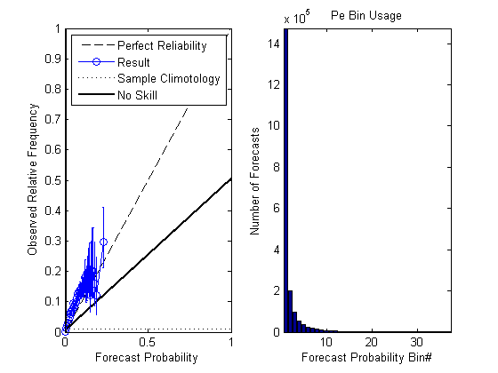
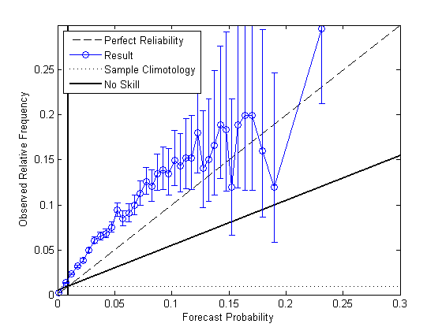
Prediction of Tropical Cyclogenesis in the Western North Pacific: Statistical Model Skill
Reliability Diagrams and Bin Histogram
Reasonably reliable and skillful hindcasts.
Model overwhelmingly predicts very small probabilities, which aligns well with the rarity of TCs
Skillful, but slightly underpredictive.
26
IHC, Mar11, murphree@nps.edu
Notes:
Reliability 0.0000657, resolution of 0.000329, and uncertainty of 0.00922

Slide 27
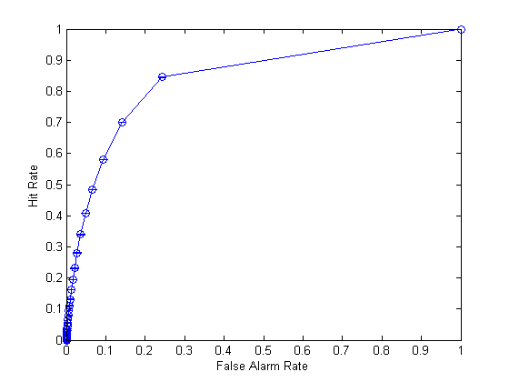
Prediction of Tropical Cyclogenesis in the Western North Pacific: Statistical Model Skill
Relative Operating Characteristic (ROC) Curve
Diagonal represents zero resolution (no discrimination).
Fair discrimination and potential utility to the user.
ROC skill score of 0.68; “1” is a perfect forecast and “<0” is worse than the sample climatology
27
IHC, Mar11, murphree@nps.edu

Slide 28
Forecast Verification Methods
Verification done for both formation and non-formation forecasts.
Standard 2 x 2 contingency table verification metrics (e.g., Wilks 2006) used to allow ready interpretation and comparison with other forecasts (e.g., CPC one and two week forecasts).
Also calculate Brier skill score.
Observed
 | Yes | No
Yes | a | b
No | c | d
Forecasted
Proportion correct (PC) = (a+d)/(a+b+c+d)
Basic proportion correct (BPC) = a/(a+b)
Hit rate (HR) = probability of detection (POD) = a/(a+c)
False alarm ratio (FAR) = b/(a+b)
False alarm rate (FAR) = b/(b+d)
Threat score (TS) = critical success index (CSI) = a/(a+b+c)
Heidke skill score (HSS) = [2(ad-bc)] / [(a+c)(c+d) + (a+b)(b+d)]
28
IHC, Mar11, murphree@nps.edu

Slide 29
TC Formations in Western North Pacific: 2009 and 2010
2009 TC Origins
2010 ~ TC Origins
28 TC formations in 2009, with moderate-strong El Nino conditions during the most active TC period, Jul-Oct 2009
19 TC formations in 2010, with strong La Nina conditions during the most active TC period, Jul-Oct 2010
Note NW-ward shift in formation locations from 2009 to 2010.
29
Note: 2010 TC formation locations are approximations pending release of JTWC best track data for 2010
IHC, Mar11, murphree@nps.edu

Slide 30
TC Formations: Long Term Mean Patterns
Red dots: TC formations from JTWC best track data set,
Jan 1970 – Dec 2007.
30
IHC, Mar11, murphree@nps.edu

Slide 31
TC Formations: LTM Patterns
Red dots: TC formations from JTWC best track data set,
Jan 1970 – Dec 2007.
Region of highest long term mean probability of TC formation
31
IHC, Mar11, murphree@nps.edu

