Slide 1
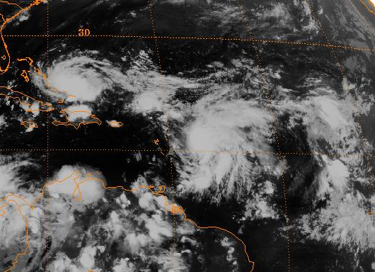

Estimating Tropical Cyclone Intensity and Genesis
from Infrared Image Data
Elizabeth A. Ritchie
Miguel F. Piñeros
J. Scott Tyo
Scott Galvin
Gen Valliere-Kelley
Acknowledgments:
ONR NOPP program
HFIP program
ONR Marine Meteorology Program

Slide 2
2. Data
Atlantic and Gulf of Mexico: Infrared Imagery (GOES-E)
2004-2010
Spatial resolution: 5 km/pixel
Temporal resolution: 30 min
10.7 μm
remove overland samples and cases outside the analysis region.
Use the Deviation-Angle Variance (DAV) Technique to extract the genesis and intensity estimation signal
Notes:
The most work has been done in the North Atlantic Basin, and these results are what we will concentrate on here. Some preliminary work has been done in the eastern North Pacific – have calculated the DAV series for 2005-2006 to train with. The western North Pacific is in very early stages.

Slide 3
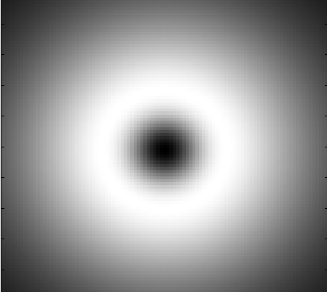
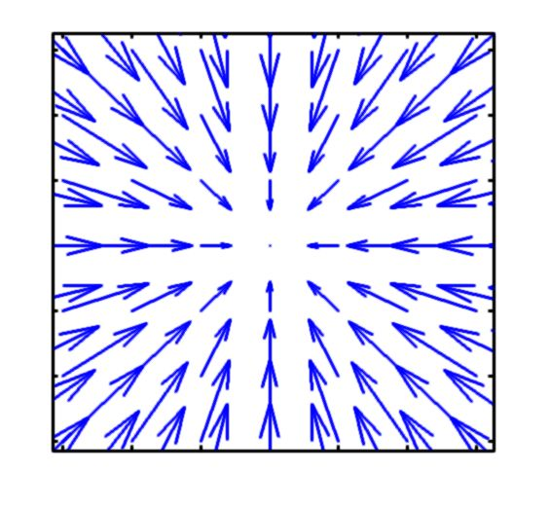
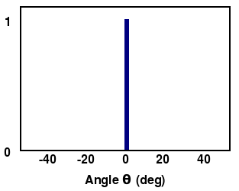
3. Methodology
Artificial Hurricane
B_{T} gradient field
Variance = 0 deg²
Map the DAV back to the reference pixel
Notes:
Example of the gradient calculation:
Start off with an IR image – here we have the brightness temperature image of an ideal vortex – this is what the “perfect” hurricane IR cloud signature might look like.
Calculate the gradient of the IR image at every pixel. Here we show inside the red box of the IR image.
Second line is a real example of a disorganised cloud.

Slide 4
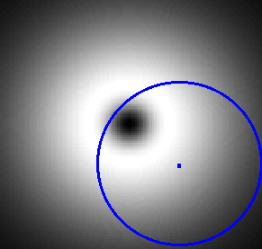
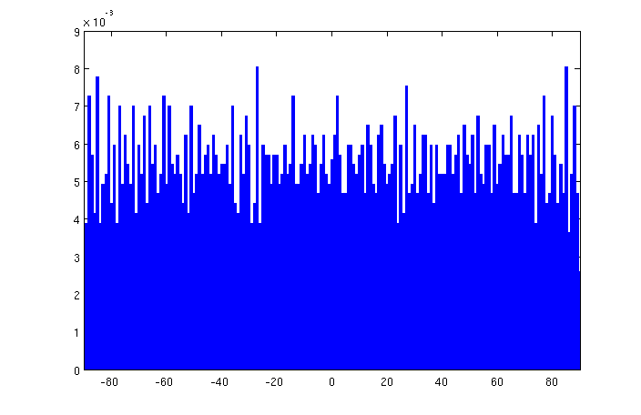
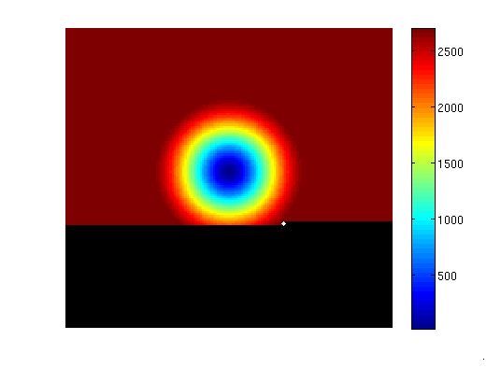
3. Methodology
Choose a different reference pixel and calculate the DAV
Notes:
Example of the gradient calculation:
Start off with an IR image – here we have the brightness temperature image of an ideal vortex – this is what the “perfect” hurricane IR cloud signature might look like.
Calculate the gradient of the IR image at every pixel. Here we show inside the red box of the IR image.
Second line is a real example of a disorganised cloud.

Slide 5
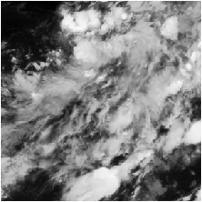
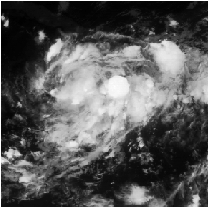
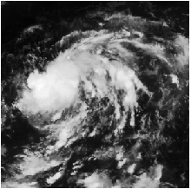
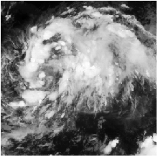
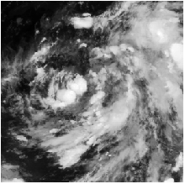
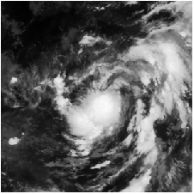
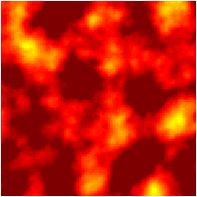
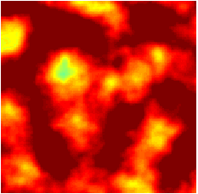
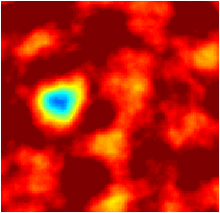
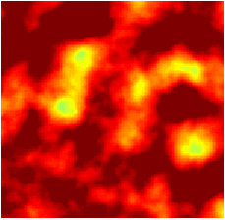
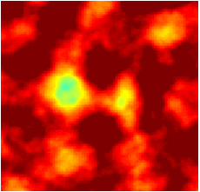
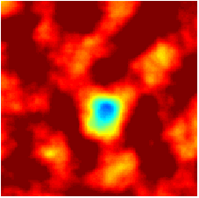

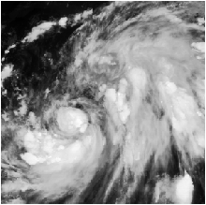
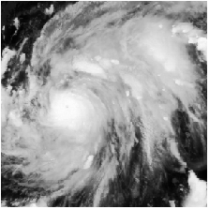
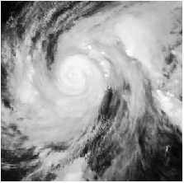
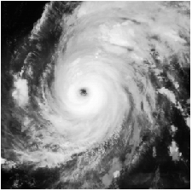
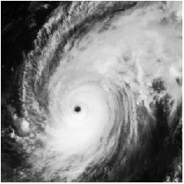
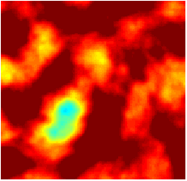
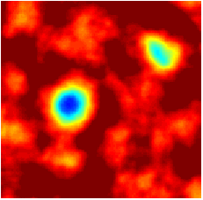
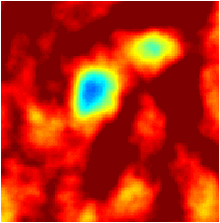
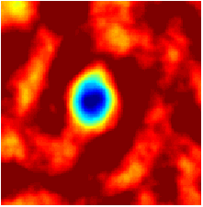
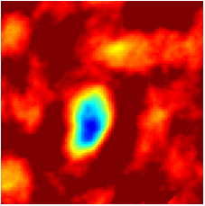
3. Map of Variances
Hurricane Wilma (October 2005)
14 - 00UTC 15 – 00UTC 15 - 1345UTC 16 – 00UTC 25kt 17 – 00UTC 30kt 17 – 06UTC 35kt
18 – 00UTC 55kt 19 - 00UTC 130kt 20 - 00UTC 135kt 21 - 00UTC 130kt 22 - 00UTC 120kt
Extract the minimum value – constrained by the cloud mass

Slide 6
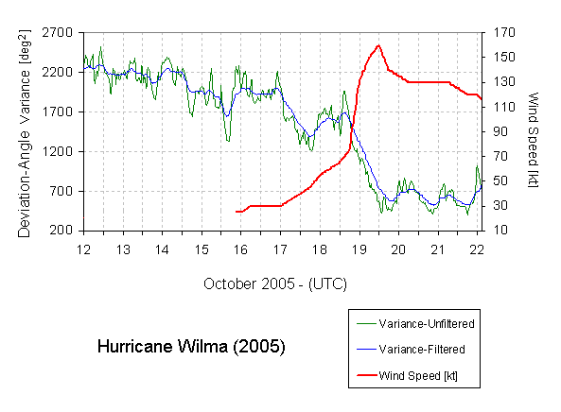
3. DAV time series
Genesis
Intensity
Correlation: - 0.93
34 kt
NHC first best-track input
Hurricane Wilma 2005

Slide 7
3. DAV time series
Genesis
Intensity
Correlation: - 0.93
Low points in the DAV signal
Intensity: Map DAV values to BT intensities for all cases
2004-2009 → training set (36TS 42H)
Genesis: Accumulate statistics on cloud cluster positive detection versus false alarms for thresholds of DAV (every 50 deg²)
2004-2005 → training set (3TD 1ST 17TS 20H 134NDCC)
NHC first best-track input
34 kt

Slide 8
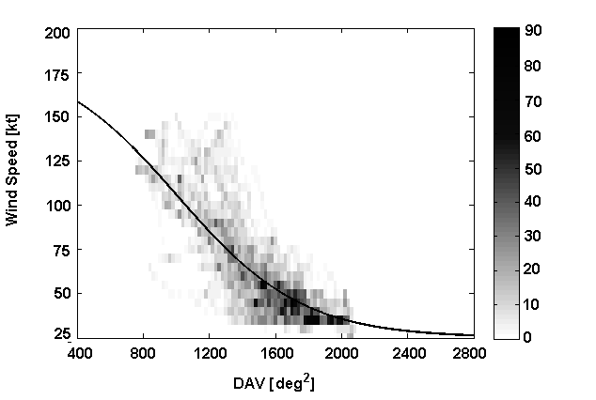
4. DAV Intensity estimation
Fit is a sigmoid constrained at both ends
Training: 2004-2009
Two tests:
1. Train using 2004-2008. Test with 2009 (8 cases)
2. Train using 2004-2009. Test with 2010
(14 cases)
Notes:
Data scatter plot. The values have been binned into DAV values of 20 “DAV-units” along the x-axis and 5-kt bins along the y-axis, which is why they look “blocky”. The black curve is the best-fit sigmoid of the median values.
The sigmoid is used because it is bounded at both ends – we do not end up with unrealistically high intensities such as we would if we fit with a quadratic or cubic spline.
You can certainly the spread of the data points around the “best-fit” curve.
Note the cut-off at 35 kt. We are not currently processing below this wind speed. Will talk about the issues and our plans to solve these issues at the end.

Slide 9
4. DAV Intensity estimation
Fit is a sigmoid constrained at both ends
Training: 2004-2009
Two tests:
1. Train using 2004-2008. Test with 2009 RSME = 24.8 kt (8 cases)
2. Train using 2004-2009. Test with 2010 RSME = 13.8 kt
(14 cases)
Notes:
Data scatter plot. The values have been binned into DAV values of 20 “DAV-units” along the x-axis and 5-kt bins along the y-axis, which is why they look “blocky”. The black curve is the best-fit sigmoid of the median values.
The sigmoid is used because it is bounded at both ends – we do not end up with unrealistically high intensities such as we would if we fit with a quadratic or cubic spline.
You can certainly the spread of the data points around the “best-fit” curve.
Note the cut-off at 35 kt. We are not currently processing below this wind speed. Will talk about the issues and our plans to solve these issues at the end.

Slide 10
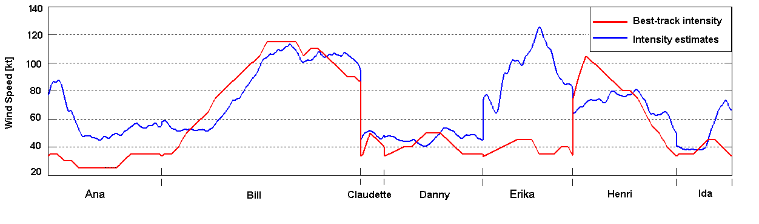
4. DAV Intensity estimation
Training 2004-2008 Testing 2009: RMSE = 24.8kt !!
Notes:
2nd test. Train with 2004-2009. Test with 2010.
Result, High RMSE …

Slide 11
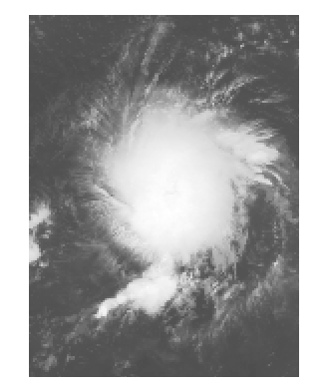
4. DAV Intensity estimation
Training 2004-2008 Testing 2009: RMSE = 24.8kt !!
Remove these 2 cases: RMSE = 12.9 kt!!
** Over-estimate of sheared systems with very circular, offset CDOs
Erika
Notes:
2nd test. Train with 2004-2009. Test with 2010.
Result, High RMSE …

Slide 12
5. Laundry list
1. Fix “shear issue”:
constrain the DAV value using operational center fixes:
2010 test: RMSE = 13.04 kt.
2. Fit only to periods when USAF recon is available
3. Other Basins: processing ePac (UA) and wPac (NRL):
(in progress)
4. Low wind speeds: limited BT intensity estimates:
- use mesoscale model to build simulated “best track” archive
(in progress)
- query USAF recon database for low wind speed observations
and “fit” to those
5. Put “confidence” on estimates:
- bin by “cloud scene type”
- bin by intensity intervals
- bin by environmental conditions

Slide 13
6. DAV Genesis Prediction
Genesis
Intensity
Low points in the DAV signal
NHC first best-track input
Genesis: Accumulate statistics on cloud cluster positive detection versus false alarms for thresholds of DAV (every 50 deg²)
2004-2005 → training set (3TD 1ST 17TS 20H 134NDCC)

Slide 14
6. DAV Genesis Prediction
ROC curve for IR imagery (2004-2005)
1650
1700
1800
1850
1900
1950
2000
1750
1600
1550
1500
Variance Thresholds
True Positive Rate
1400/1450
1350
False Alarm Rate
Notes:
2nd test. Train with 2004-2009. Test with 2010.
Result, High RMSE …

Slide 15
6. DAV Genesis Prediction
TPR = 93%
FAR = 22%
TPR = 96%
FAR = 40%
Time [h]
Mean = -0.6 h
Mean = -12 h
Variance Threshold [deg²]
Bottom Line:
* Right now can make a deterministic “Yes/No” prediction
* Turning into a “probability of TD in 24-, 48-, and 72-h” prediction
* Developed a user interface GUI that automatically tracks and labels with DAV thresholds when they are met.

Slide 16
7. Summary
● A completely objective and independent technique to
estimate TC intensity and predict genesis.
● Currently uses only IR 10.7 μm channel
● Intensity: testing gives results between RMSE 13-14 kt
● Intensity: gave the laundry list of future development
  - also to test 3.9, 6.7, 12 μm channels and polar-orbiting MW
  channels – presents its own unique challenge
  ● Genesis: there is also a laundry list.
  - developing for ePac and wPac
  - have already tested 6.7 water vapor μm channel and not found
  new/additional information to improve FAR and “time to detection”
  - plan to test 3.9, 12 μm channels and MW channels

Slide 17
Thank you
Piñeros, M. F., E. A. Ritchie, and J. S. Tyo 2008: Objective measures of tropical cyclone structure and intensity change from remotely-sensed infrared image data. IEEE Trans. Geosciences and remote sensing. 46, 3574-3580.
Piñeros, M. F., E. A. Ritchie, and J. S. Tyo 2010: Detecting tropical cyclone genesis from remotely-sensed infrared image data. IEEE Trans. Geosciences and Remote Sensing Letters, 7, 826-830.
Piñeros, M. F., E. A. Ritchie, and J. S. Tyo 2011: Estimating tropical cyclone intensity from infrared image data. Wea. Forecasting, (In review).
Valliere-Kelley, G., E. A. Ritchie, M. F. Pineros, and J. S. Tyo: Tropical cyclone intensity estimates using the Deviation-Angle Variance Technique: Part I. Statistics for the 2009-2011 seasons based on intensity bins. Wea. And Forecasting, (In Preparation).

Slide 18
4. DAV Intensity estimation
Training 2004-2009 Testing 2010: RMSE = 13.8kt !!
Notes:
2nd test. Train with 2004-2009. Test with 2010.
Result, High RMSE …

