Slide 1
HS3: A Multi-Year Investigation of Hurricane Formation and Intensity Change
PI: Scott Braun
Deputy PI: Paul Newman
PM: Marilyn Vasques
PS: Ramesh Kakar

Slide 2
Overall Science Objective
To provide measurements to address key science questions related to storm formation and intensity change, including whether it is primarily a function of the storm environment or storm internal processes

Slide 3
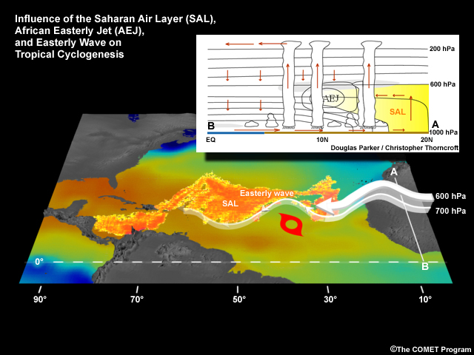
Science Questions—Environment
What aspects of the environment most impact the ability of a tropical storm to form and intensify?
Is the Saharan Air Layer positive or negative influence on storm formation and evolution? Both?

Slide 4
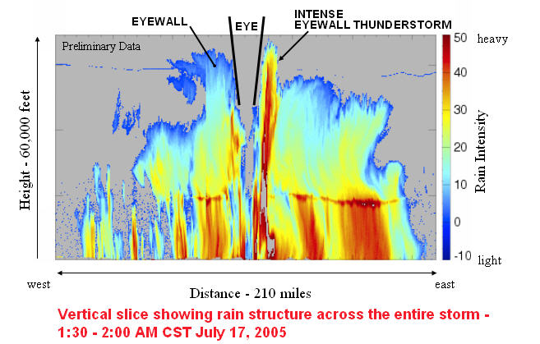
Science Questions—Inner-core
Are convective hot towers actively contributing to storm intensification beyond merely contributing to the total mass flux required for intensification?
Do specific transformations of convective structure occur prior to genesis and rapid intensification?

Slide 5
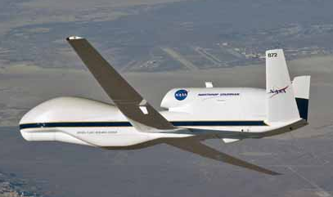
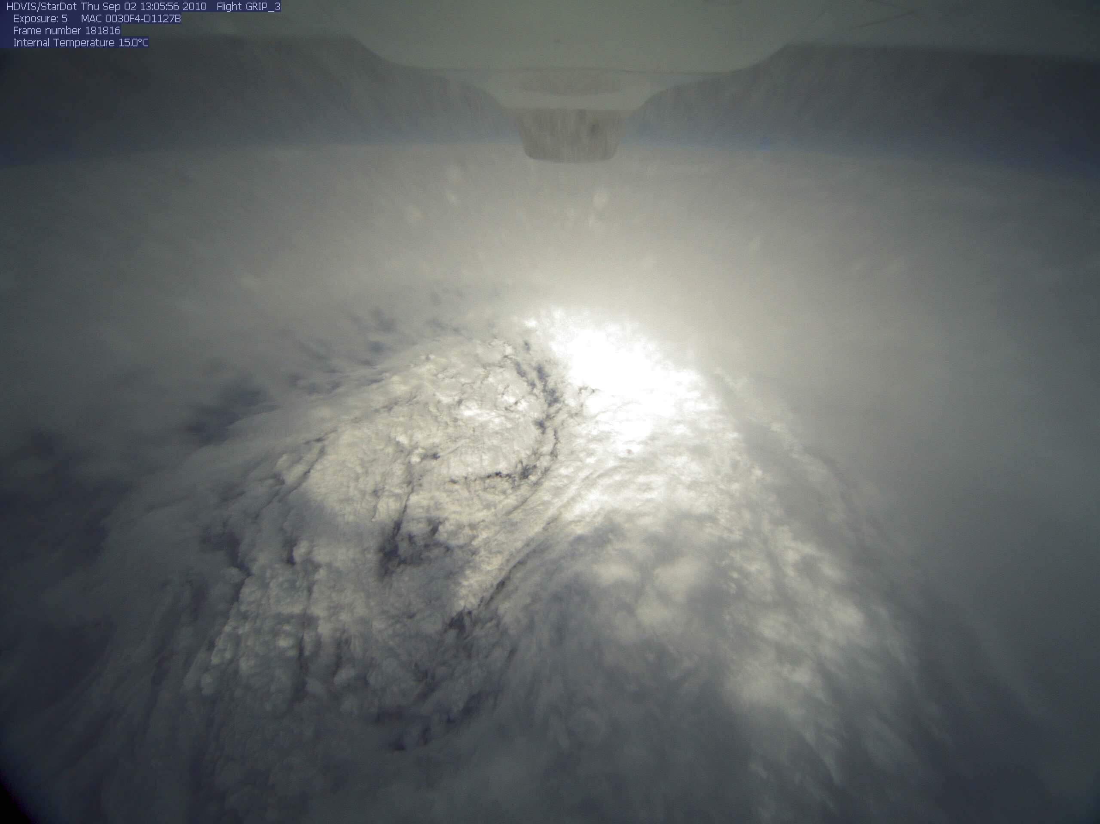
NASA’s Global Hawk Unmanned Airborne System
Hurricane Earl’s eye as seen from the GH
Cruise Climb from 56-65K ft
(max takeoff weight)

Slide 6
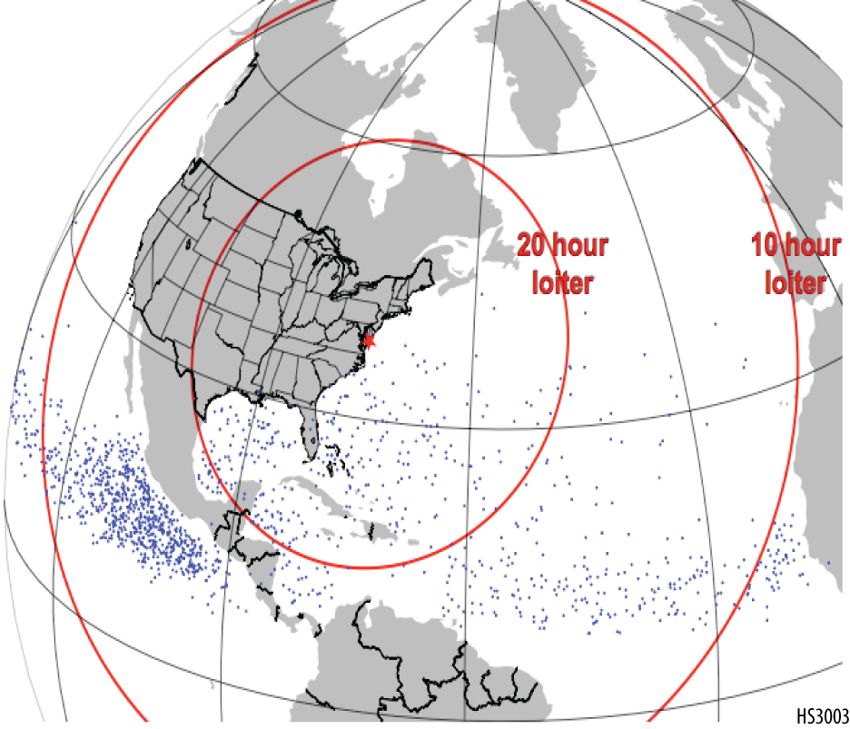
HS3 Mission Overview
• Two aircraft, one equipped for the storm environment, one for over-storm flights
• Deployments of GHs from the East Coast, likely Wallops Flight Facility in VA
• One-month deployments in 2012, 2013, and 2014
• 3-year mission ensures adequate sampling of a wide variety of conditions
Dots indicate genesis locations. Range rings assume 30-h flights.

Slide 7
Environmental Payload

Slide 8
Instruments: Cloud Physics Lidar
Cloud/aerosol lidar (CALIPSO simulator)
Instrument PI: Matt McGill, NASA/GSFC
Data: Profiles of atten. backscatter, cloud/aerosol boundaries, optical depth, extinction, depolarization
Horiz., vertical resolution=200 m, 30 m

Slide 9
Instruments: Dropsondes (AVAPS)
Instrument PI: Gary Wick, NOAA
Data: High-resolution vertical profiles of temperature, humidity, pressure, winds
Potentially up to 70-90 drops per flight
New design has flown on GH
Test flights (low, mid, high alt.) completed 2/4/11
NOAA science flights ongoing

Slide 10
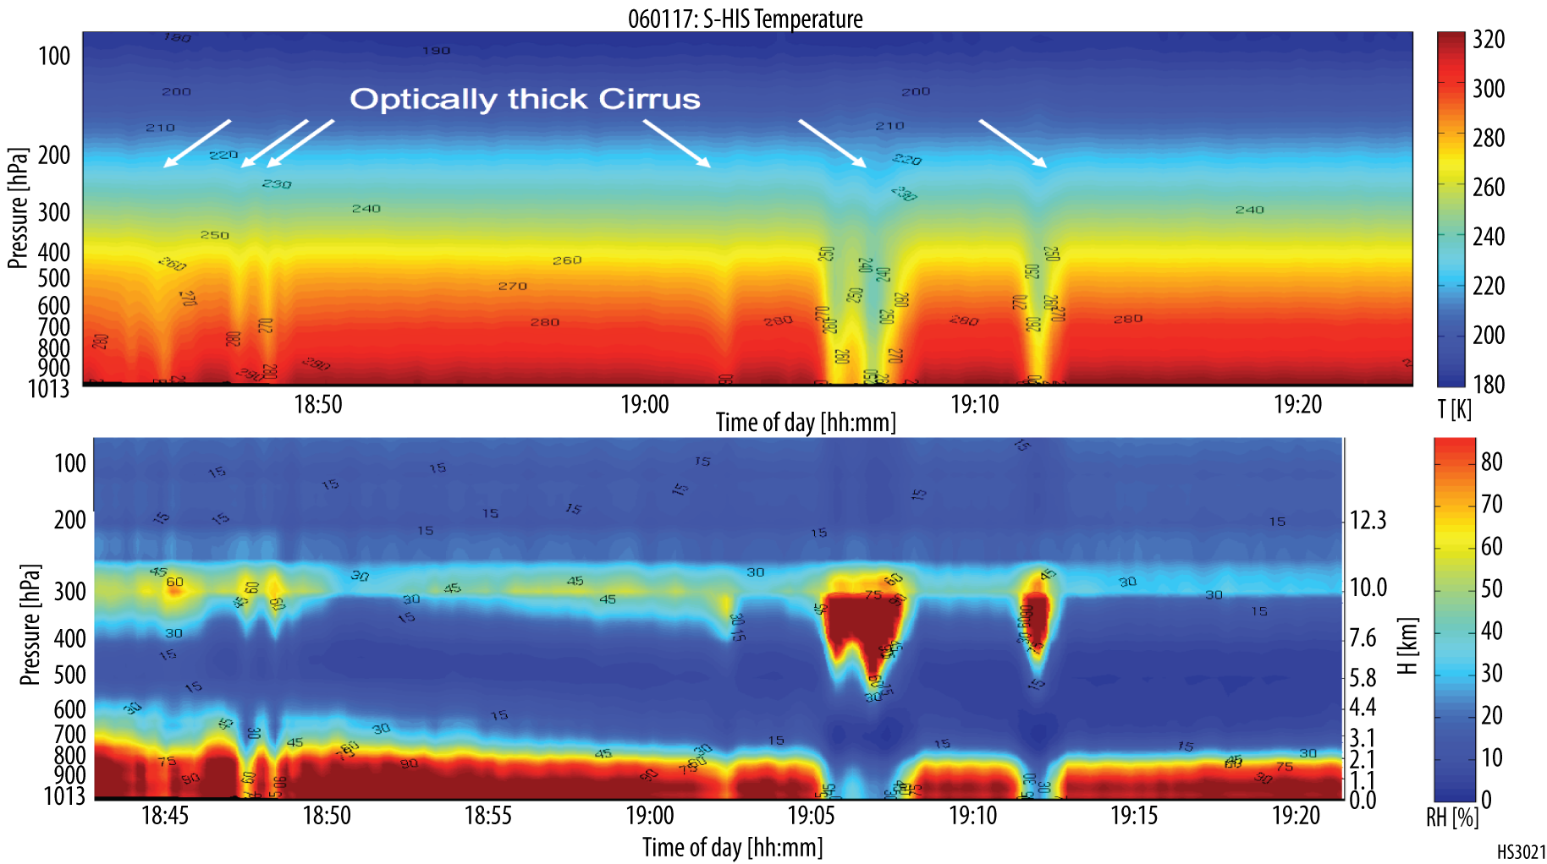
Instruments: Scanning High-resolution Interferometer Sounder
Instrument PI: Hank Revercomb, Univ. Wisconsin
Data: IR TB spectra; Cloud-top temperature, height; sfc skin temperature; profiles of temperature and water vapor in clear-sky conditions
Horiz., vertical resolution=2 km, 1-3 km

Slide 11
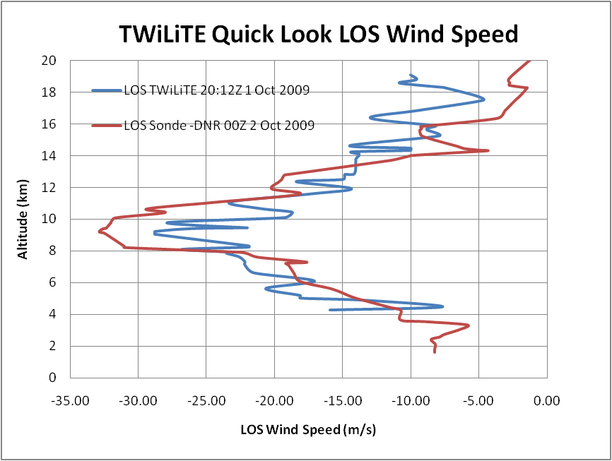
Instruments: TWiLiTE Wind Lidar
Instrument PI: Bruce Gentry, NASA/GSFC
Data: Profiles of backscatter intensity, Doppler velocity, horizontal winds in clear-sky conditions
Will fly as part of HS3 in 2013-14 only due to NGC schedule, wind pod availability
Horiz., vertical resolution=~2 km radial winds, 8 km for retrieved horizontal winds, 250 m

Slide 12
Over-Storm Payload

Slide 13
Instruments: High-Altitude MMIC Sounding Radiometer (HAMSR)
Instrument PI: Bjorn Lambrigtsen, JPL
Data: Calibrated brightness temperature; vertical profiles of temperature and water vapor and liquid water; precipitation structure
Horiz., vertical resolution=2km, 1-3 km
3D reflectivity, Hurricane Emily (2005)
15 km
14 km
13 km
12 km
11 km
10 km
9 km
8 km
7 km
6 km
5 km
4 km
3 km
2 km

Slide 14
Instruments: High-altitude Imaging Wind and Rain Airborne Profiler (HIWRAP)
Instrument PI: Gerald Heymsfield, NASA/GSFC
Data: Calibrated reflectivity, Doppler velocity, 3D reflectivity and horizontal winds, ocean surface winds in precipitation free areas
Horiz., vertical resolution=
1 km, 200 m for dBZ, Doppler velocity
1 km, 500 m for horiz. winds
2 km for surface winds

Slide 15
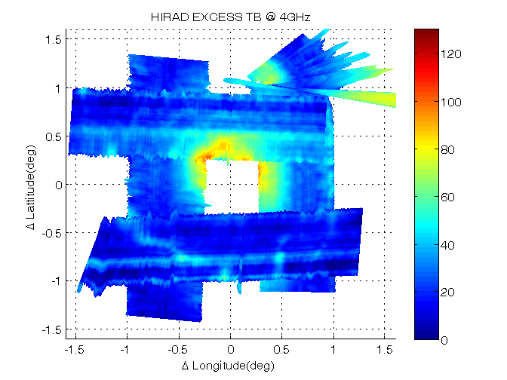
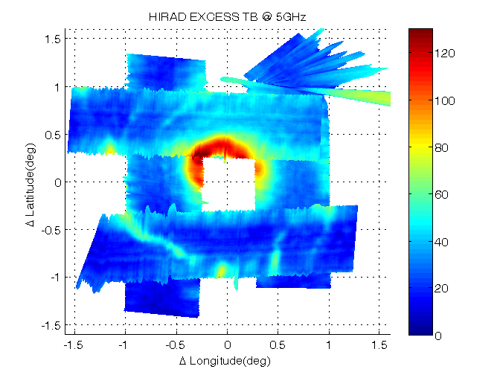
Instruments: Hurricane Imaging Radiometer (HIRAD)
Instrument PI: Tim Miller, NASA/MSFC
Data: Surface wind speed, rain rate, and temperature; brightness temperature fields at 4 frequencies
Technology similar to NOAA’s SFMR, but scans cross track instead of just nadir
Horiz. resolution=~1.5-2.5 km
Example from Hurricane Earl flight during GRIP

Slide 16
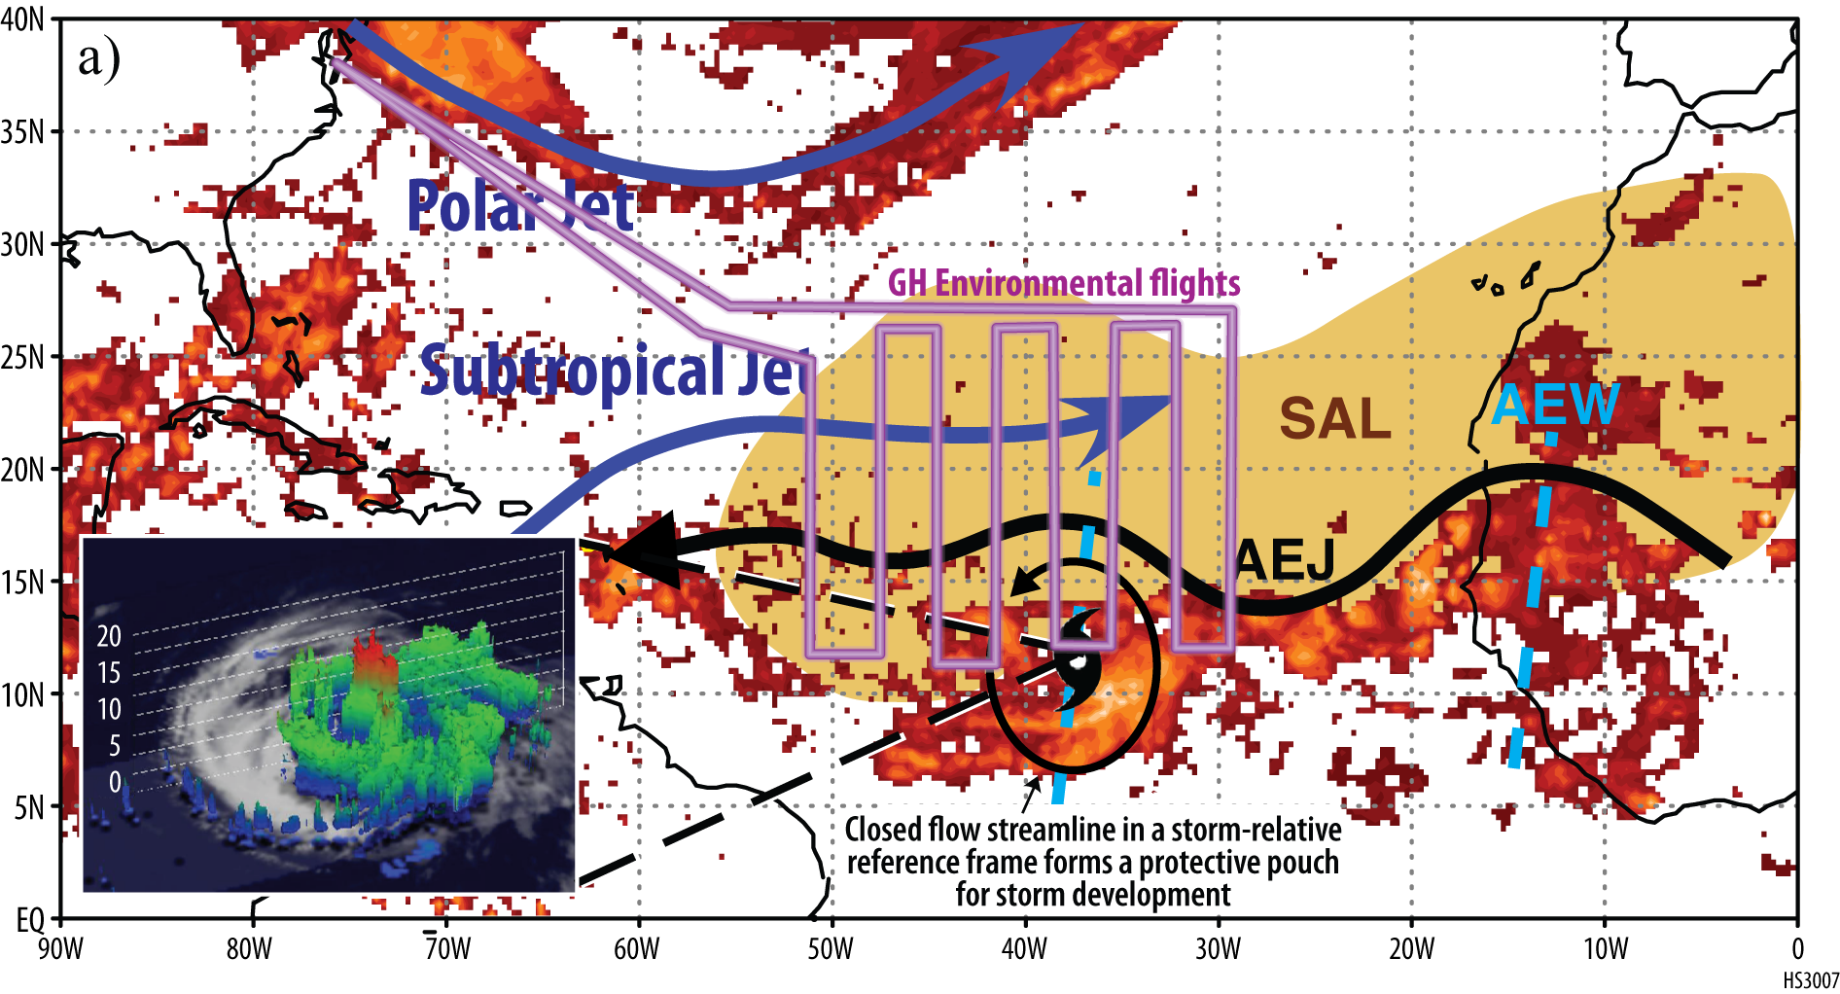
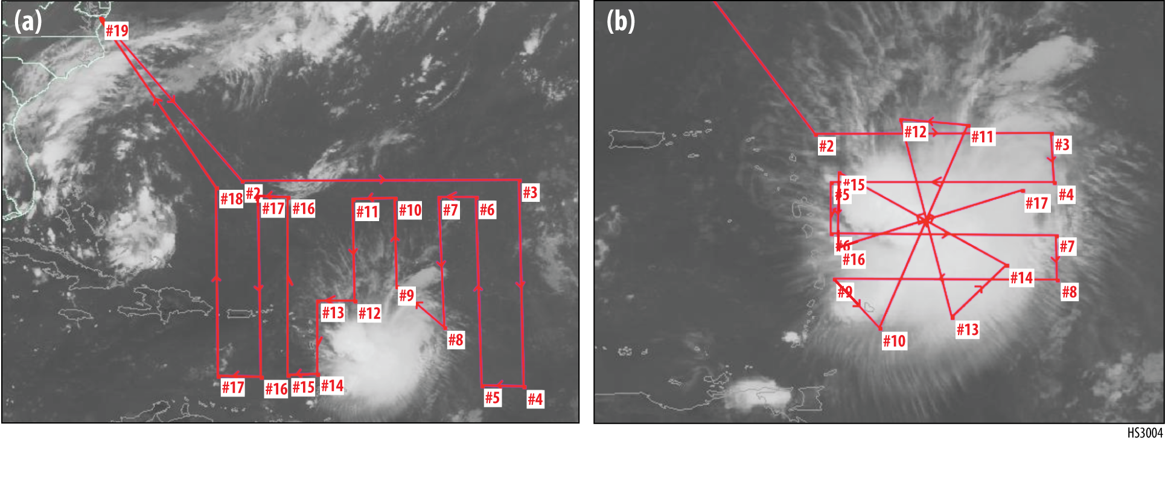
HS3 Science Operations Concept
Operations to be closely coordinated with other available aircraft (e.g., NOAA P-3s, G4) to maximize data coverage and continuity, similar to GRIP
Will occasionally fly east of operational aircraft
Orange shading is 24-h precipitation

Slide 17
Mission Operations Concept
• Initial concept is to fly GHs serially if desired to alternate environment and over-storm sampling
• Manpower, cost, potential FAA issues make simultaneous flights unlikely
• Can have one GH coming back while the other is going out
• Turn-around time for either GH (landing to next takeoff ~24-48 h
• 300 total science flight hours per deployment Division between the aircraft will depend on science goals and weather

Slide 18
HS3 Applications
Goal: To make data widely available for
Hurricane research
Satellite calibration/validation activities (GPM, NPP, GOES-R)
Model improvement research (DA, microphysics)
Collaboration with HFIP
Would like to collaborate with NHC to develop useful real-time products

Slide 19
HS3 Data Plan
All data to be publically available
Some data products to be made available in real time
Following each deployment, ~6-9 months for data QC, processing
Links to data, as well as all mission information, at www.espo.nasa.gov/hs3/

Slide 20
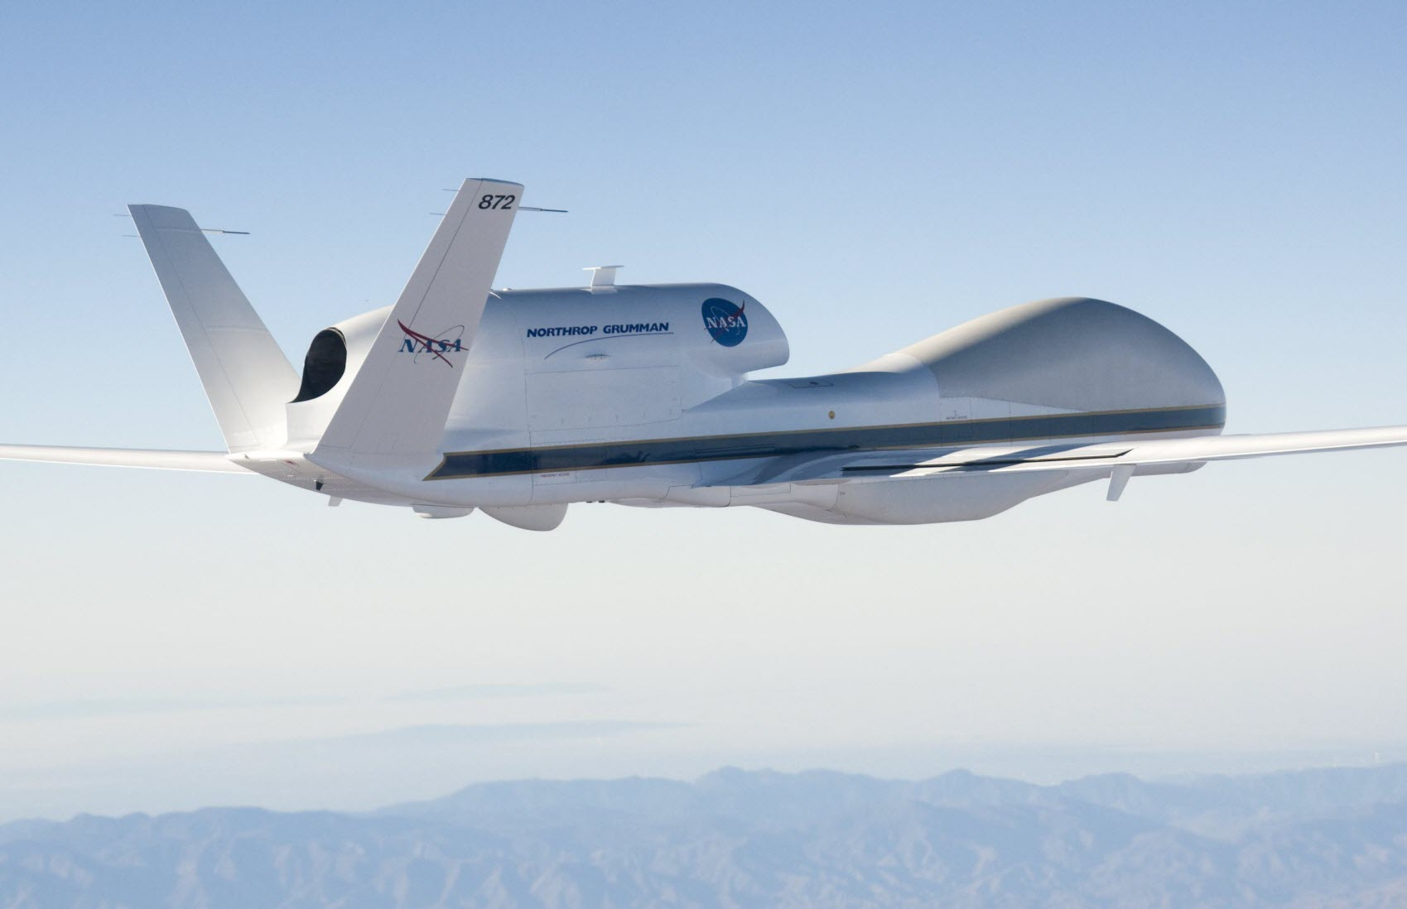
Questions?
www.espo.nasa.gov/hs3/

Slide 21
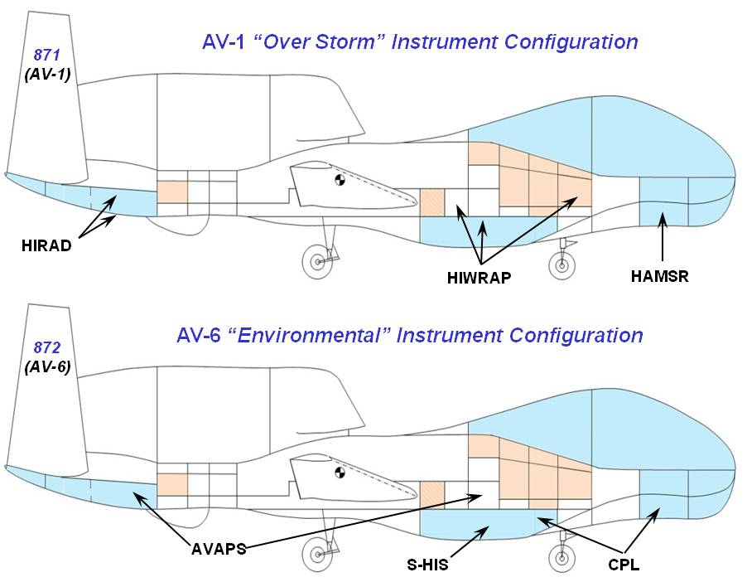
Over-Storm Payload

Slide 22
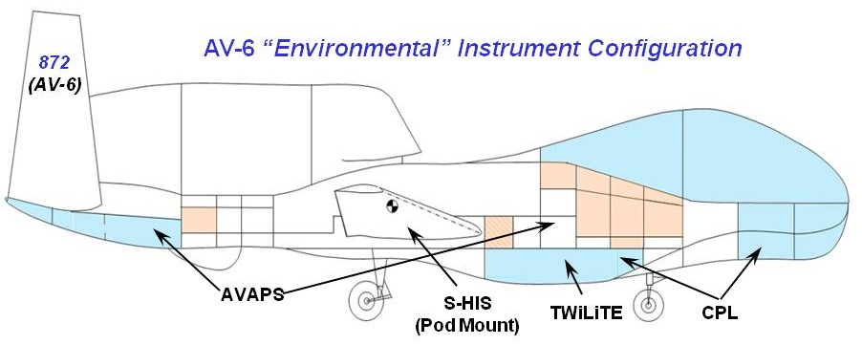
Environmental Payload
2012
2013-2014

