Slide 1
Multi-model Coupled Air-Sea Forecasts of Typhoons during ITOP
Brandon Kerns*, Shuyi S. Chen, Chiaying Lee, and Falko Judt
RSMAS/University of Miami
*bkerns@rsmas.miami.edu
Interdepartmental Hurricane Conference Miami, Florida 28 February – 3 March 2011
Notes:
Acknowledge support from ONR.

Slide 2
Outline
UM/RSMAS Realtime coupled modeling system
Coupled Model Forecast verification
Track and intensity
Combined track & Intensity: Cross-Along Track Intensity Error (CATIE)
Beyond track and intensity: structure (e.g., size, asymmetry, etc.)
Notes:
A brief outline of this talk… Conventionally model verification is done in terms of track and intensity. We’re looking at ways to go beyond track and intensity verification of high resolution coupled models.

Slide 3
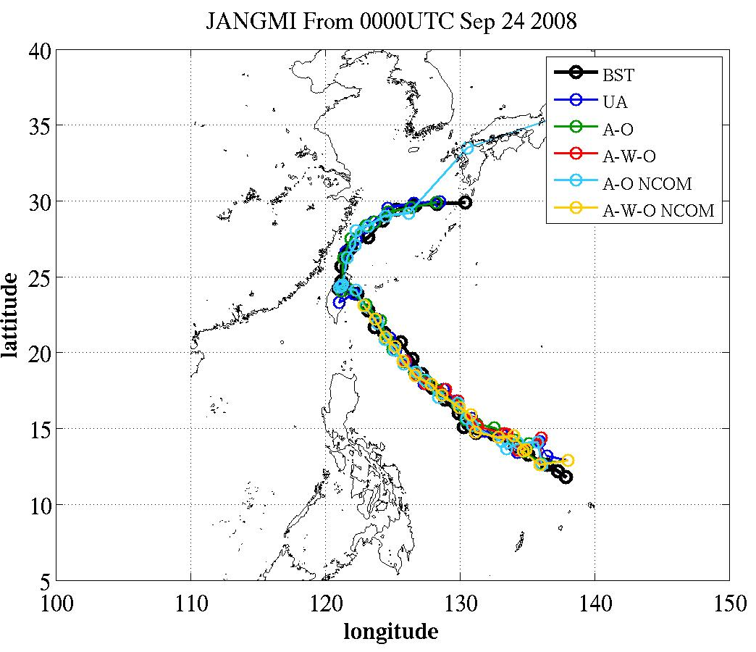
U.Miami Real Time Coupled Multi-Model System
 | Atmosphere | Ocean | Waves | Initlal/Boundary Conditions
UMCM | MM5 | 3DPWP* | WW3 | GFS, NOGAPS, JMA, ECMWF
CWRF | WRF-ARW | 3DPWP*
12 km
12 km
0Z 5-day Forecast Cycle: UMCM-gfs
~ 06 Z | Model and analysis begin
~ 14 Z | Forecast/analysis finished
~ 21 Z | ITOP Forecast Briefing
4 km
4 km
1.3 km
1.3 km
*Price et al. (1986)
Notes:
Multi model, multi model, multi model. Real-time, real-time, real-time. These forecasts were used for mission planning during ITOP.

Slide 4
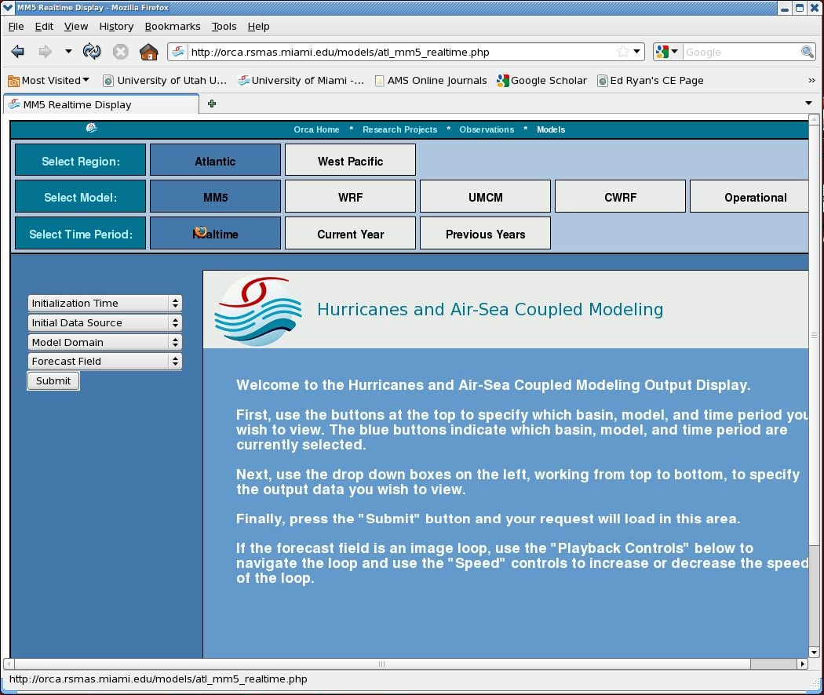
Atmosphere
Ocean
Waves
Notes:
Example of plots available in real-time as the model is running. available on website

Slide 5
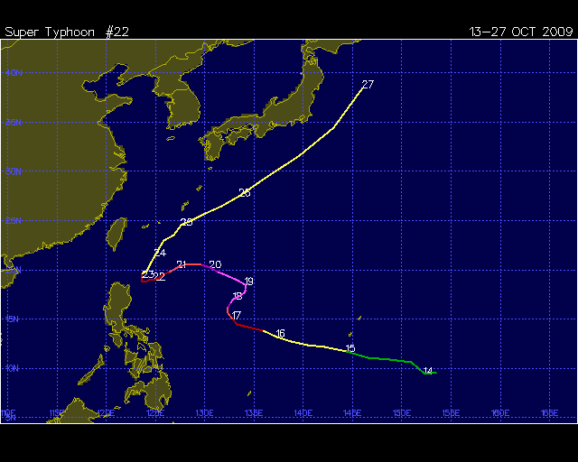
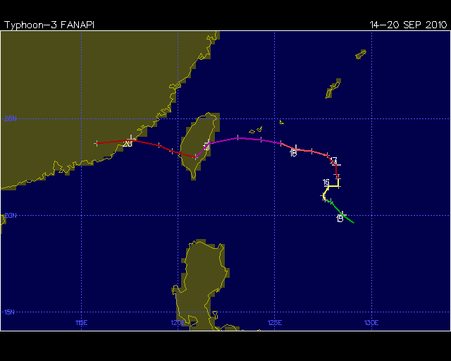
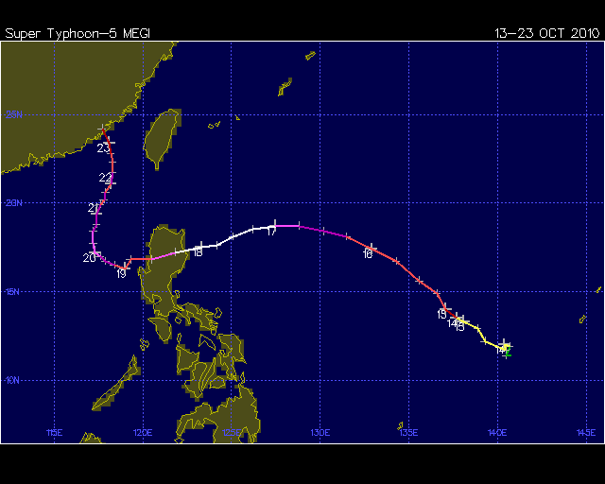
Verification: ITOP Cases
Storm | Dates | Number of Forecasts*
Lupit (2009) | 15-18 Oct. 2009 | 4
Fanapi (2010) | 15-18 Sept. 2010 | 4
Megi (2010) | 13-18 Oct. 2010 | 6
 | TOTAL: | 14
*Once per day
while storm is
in area of
interest.
S-curve
S-curve
A record-breaking Cat-5
super typhoon
These were CHALENGING cases!
Notes:
Focus of ITOP dry run and field phase.

Slide 6
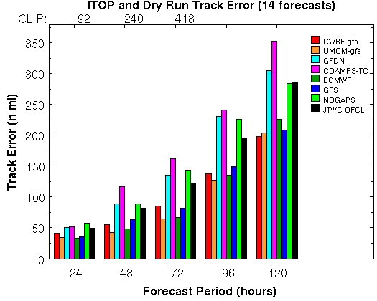
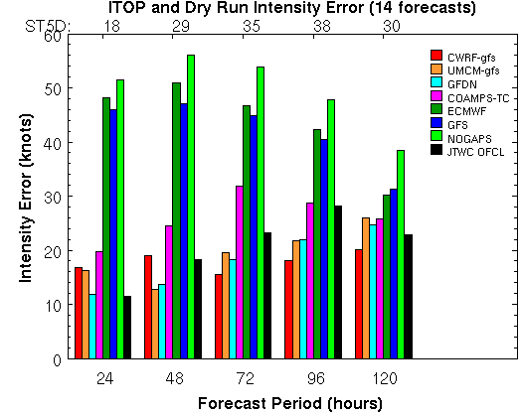
Track Intensity
High-resolution (1.3 km) coupled models (UMCM and CWRF) improve intensity forecast significantly
GFDN and COAMPS-TC have smaller intensity error, but larger track error compared to that of global models
Notes:
High resolution coupled models are red and brown. JTWC official forecast in black.

Slide 7
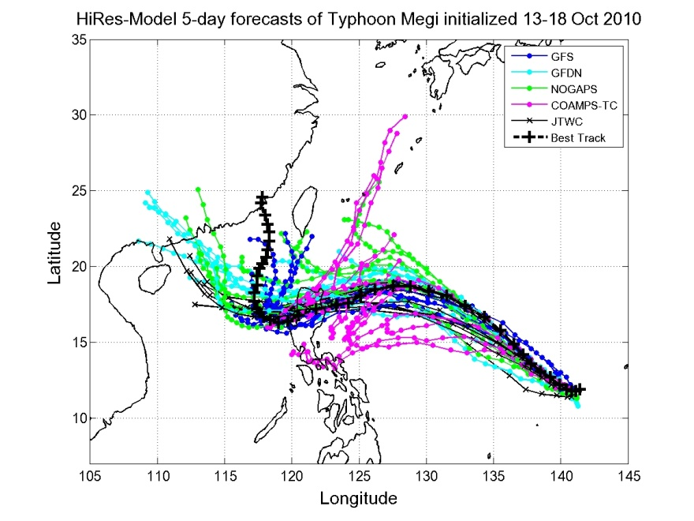
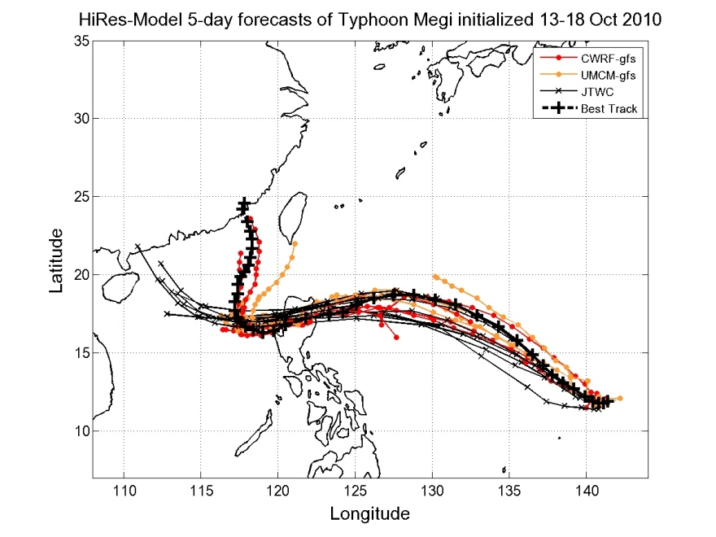
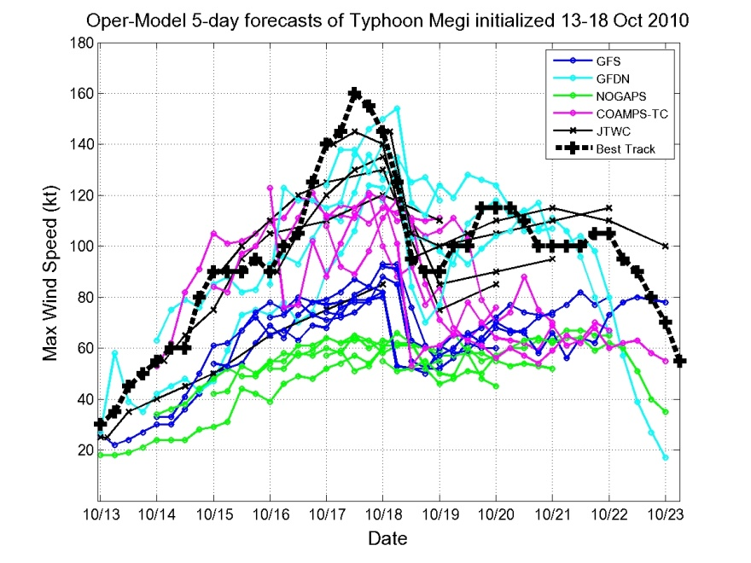
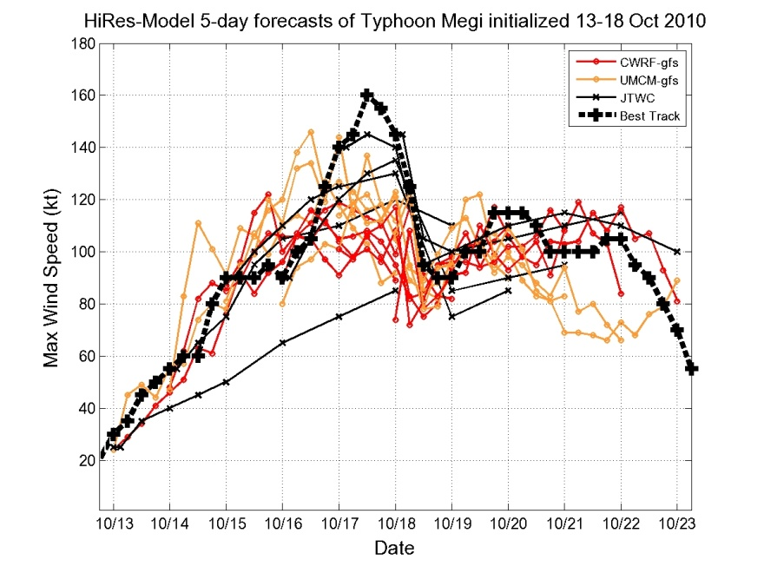
Track and Intensity
OPERATIONAL High-res UMCM & CWRF
GFDN big track error
Megi
Megi
INTENSITY TRACK
Megi
GFDN great intensity forecast
Megi
Notes:
Here is an example where the intensity error can be small, but the track error large at the same time. You’re looking at …

Slide 8
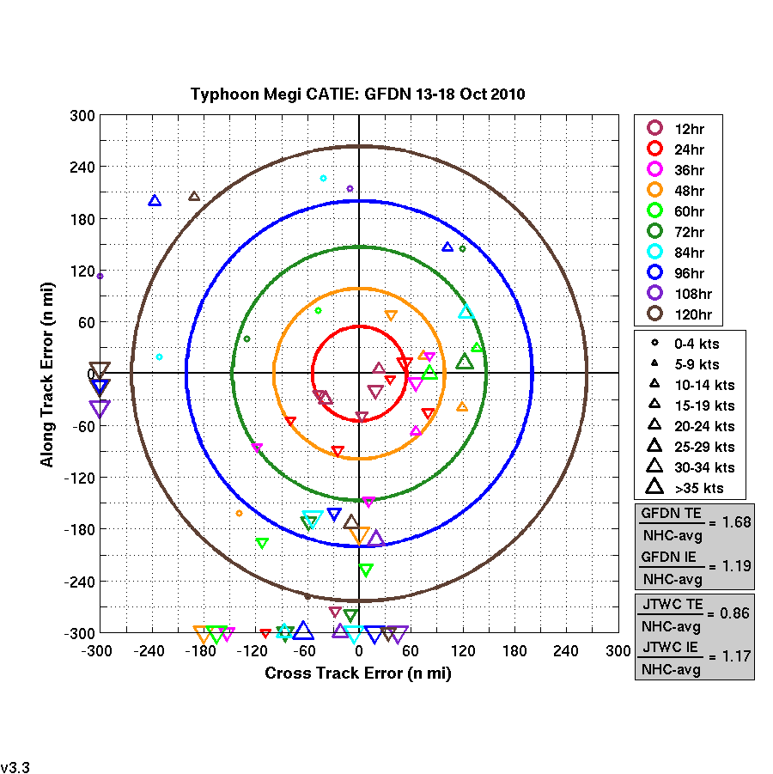
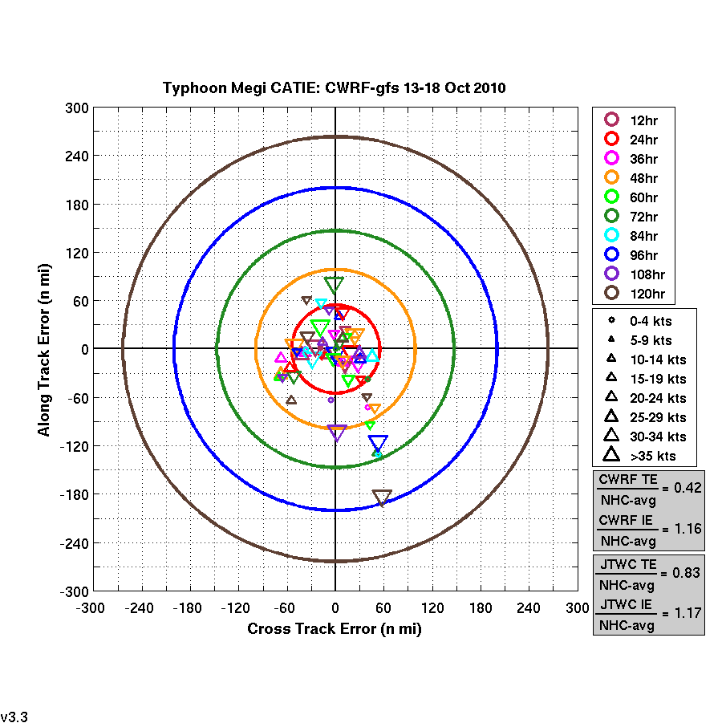
Cross/Along Track Intensity Error “CATIE”
GFDN
CWRF-gfs
24 hr
48 hr
72 hr
96 hr
120hr
Along Track Error
Along Track Error
Cross Track Error
Cross Track Error
Notes:
To visualize the combination of track and intensity error, together we can use the so-called “CATIE” diagram. There is a lot of information on these diagrams, but what you can immediately tell, is that the GFDN forecast, on the left, was very different than the high resolution coupled forecast, on the right. Think of these diagrams as dart boards, and each forecast is a dart that you want to hit the center with.

Slide 9
Cross/Along Track Intensity Error “CATIE”
GFDN
CWRF-gfs
Notes:
I also want to point out how the cases with good intensity verification but large track errors show up.

Slide 10
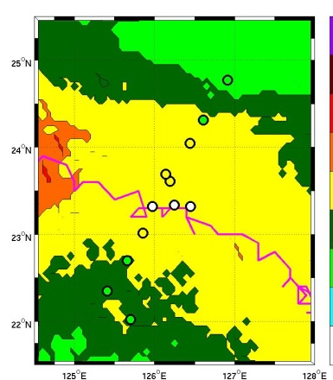
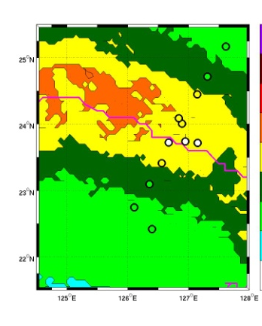
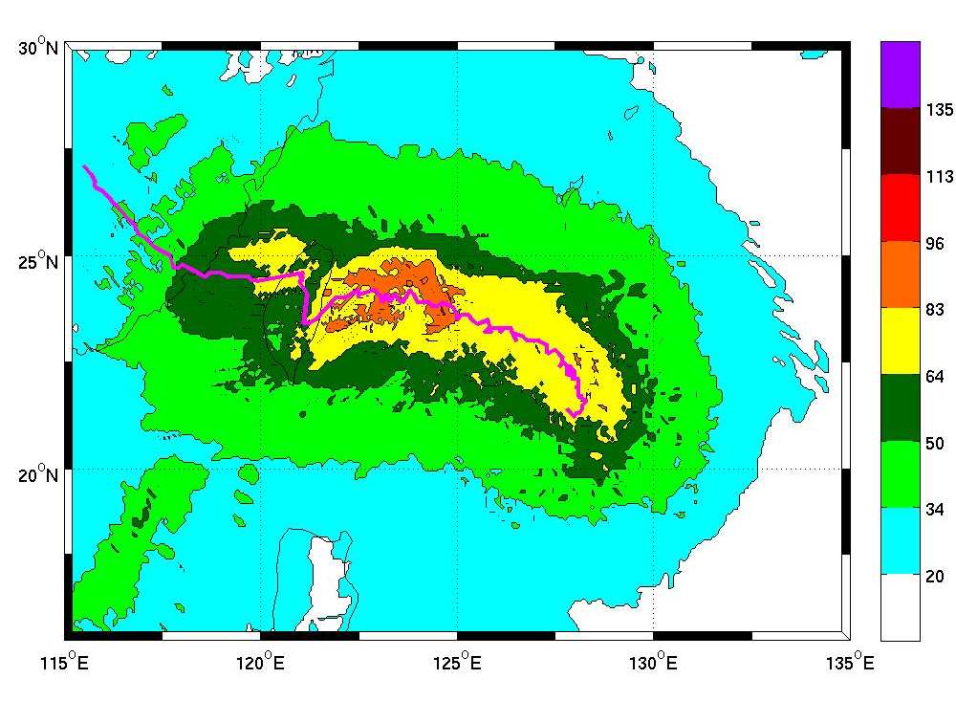
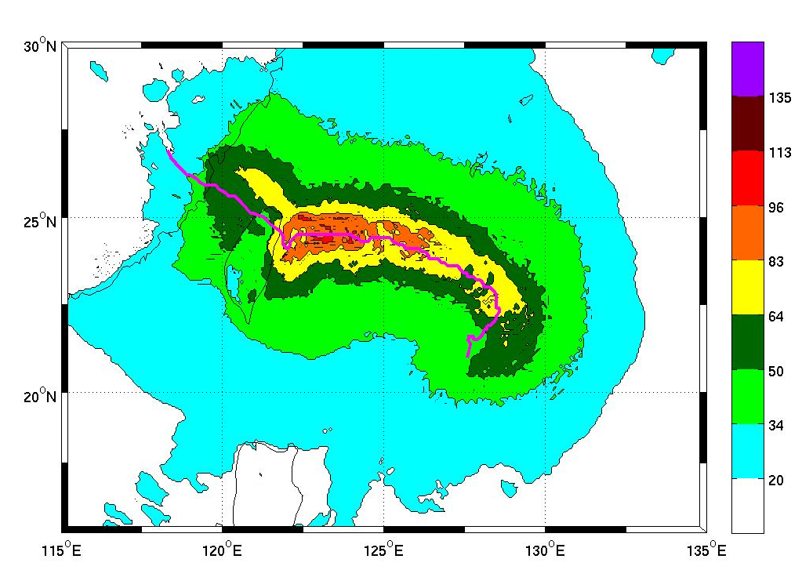
TC Structure: Size and Asymmetry
Comparison of dropsondes and model wind swath.
Fanapi
Fanapi
UMCM-gfs
CWRF-gfs
Notes:
Going beyond track and intensity, the high resolution models provide information about the wind radii and asymmetry of the storm.

Slide 11
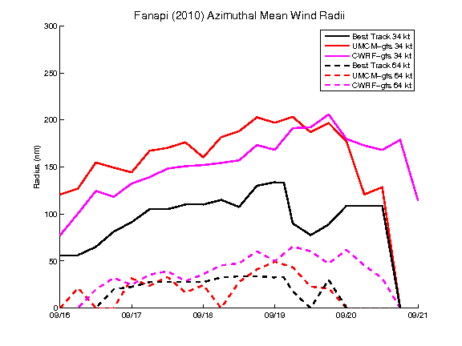
Verification of Structure: Size
Fanapi
200
UMCM-gfs
Radius (nm)
UMCM-gfs
100
BEST
9/16
9/17
9/18
9/19
9/20
9/21
Hurricane wind radii are near the best track estimates, but not gale radii.
Details of the wind field can affect ocean response.
Notes:
Looking at the storm size another way, this plot compares the best track wind radii with the model wind radii. The oval is the time that the cold wake was being produced.

Slide 12
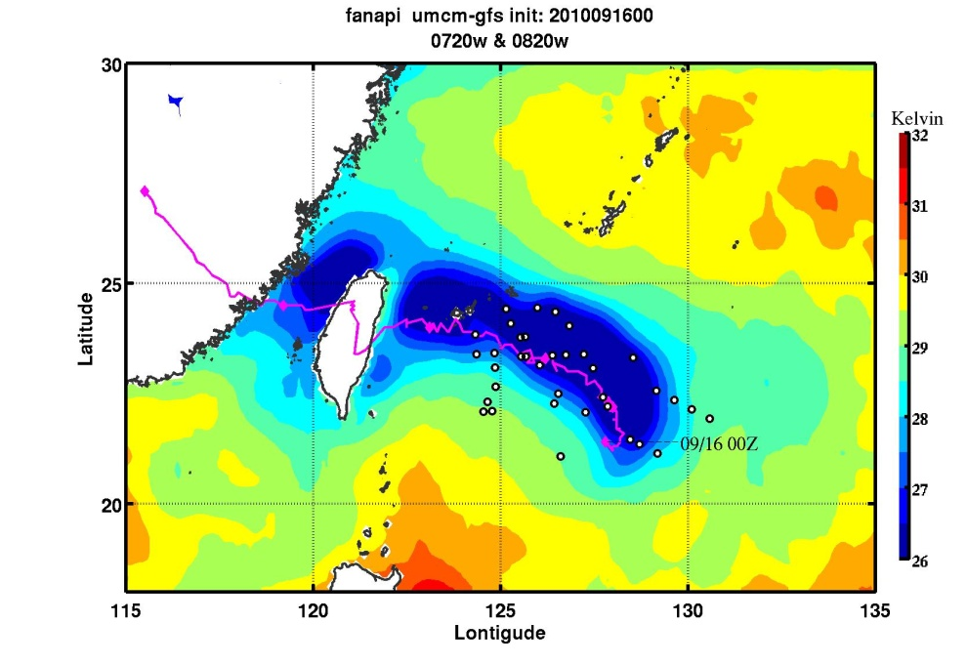
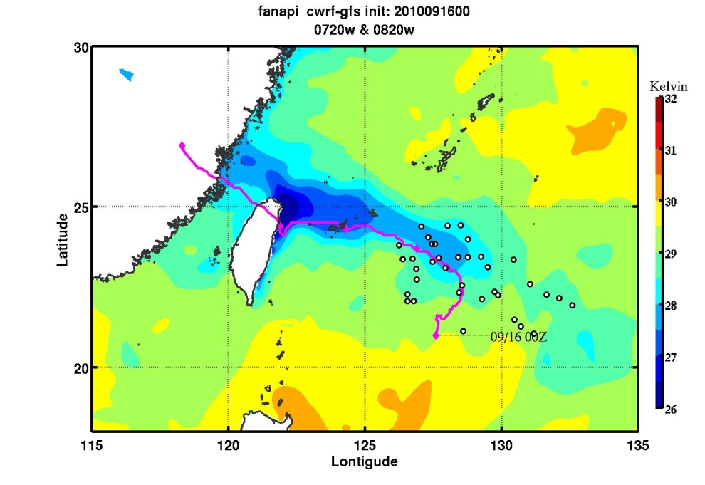
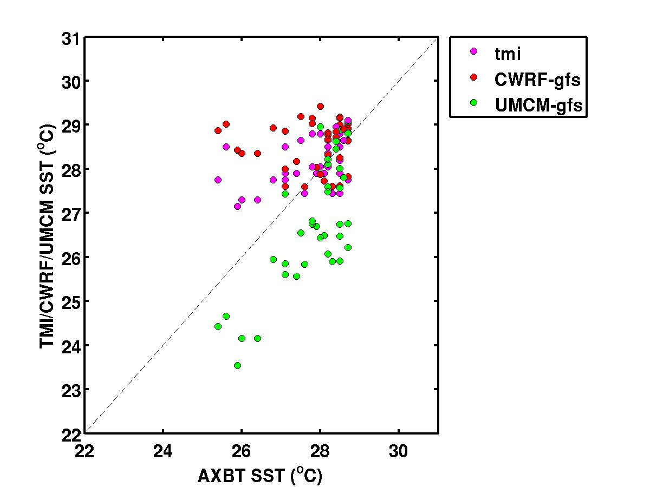
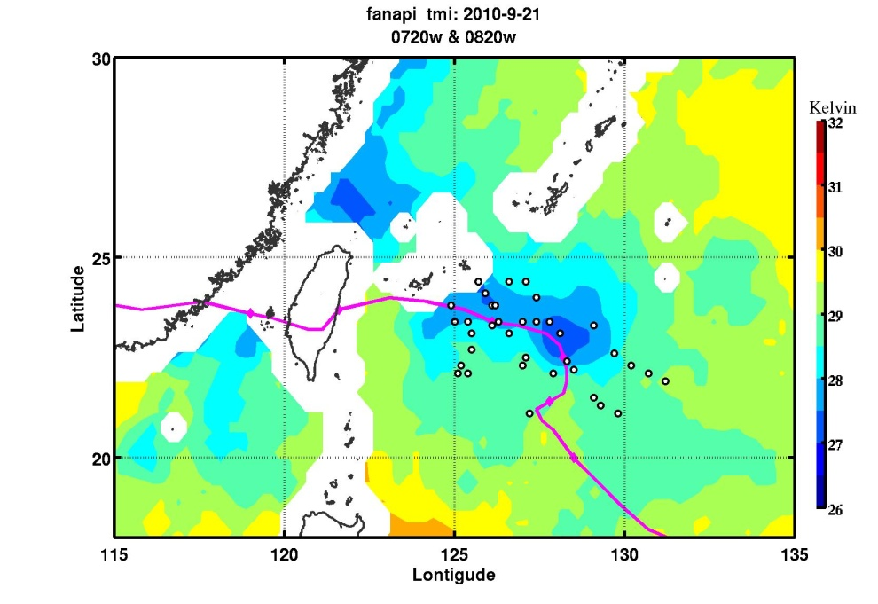
Verification: (Cold Wake)
UMCM-gfs
CWRF-gfs
Satellite SST
SATSST
Notes:
Finally, the coupled model provides information about the cold wake. These plots of SST show the model-produced cold wake on top and SST cold wake on the lower left. UMCM-gfs too strong.

Slide 13
Summary
High-resolution coupled atmosphere-ocean-wave model forecasts were made in real-time in support of the ITOP field campaign.
Track and intensity errors of the high-res coupled models for the 3 typhoons compare favorably with the operational models and the official JTWC forecast.
The “CATIE” diagram is used to visualize/verify track and intensity errors concurrently.
ITOP provides a unique, coupled data set for evaluation and verification of the high-res coupled model forecasts of TC structure, air-sea fluxes, and upper ocean properties.

