Slide 1
NASA GRIP 2010
Brief status report
Ed Zipser, Univ. of Utah, Salt Lake City, UT
on behalf of the GRIP Science Team

Slide 2
What did we do during hurricane season 2010?
NSF/NCAR PREDICT (PRE-Depression
Investigation of Cloud Systems of the Tropics)
NASA GRIP (Genesis and Rapid Intensification
Processes)
NOAA IFEX (Intensity Forecasting Experiment)
GOALS: Remarkably Similar…..Not a coincidence!

Slide 3
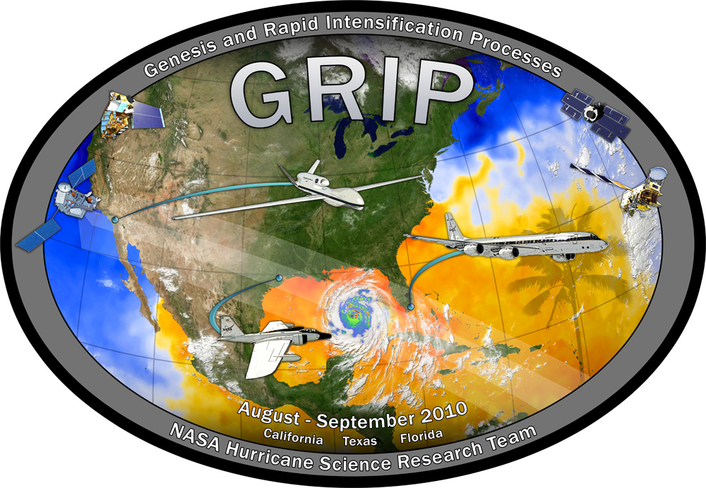
Mission and Science Overview: Summary of GRIP Science Objectives
Genesis: Distinguish the role of the larger-scale environment vs. meso-convective processes near the putative developing center.
Rapid Intensification: Relative role of environmental vs. inner core processes? Is RI predictable?
Test-bed: Evaluate candidate technologies for remote sensing from aircraft and from satellites. Wind lidar, high frequency passive microwave, dual-frequency radars, Global Hawk itself.

Slide 4
Scientific Accomplishments
Tropical cyclone genesis
Tropical Storm Gaston—null case for development
Hurricane Karl—unprecedented multiday coverage from first detection through genesis
Rapid Intensification
Hurricane Earl—documentation of rapid intensification as well as weakening of a large Category 5 storm
Hurricane Karl—observations of rapid intensification from storm stage to Category 3 and landfall

Slide 5
Technical Accomplishments
In Hurricane Earl
First Global Hawk flight over a hurricane
In Hurricane Karl
20 crossings of eye of Hurricane Karl by Global Hawk
Close flight coordination of Global Hawk, DC-8, WB-57, NOAA G-IV & P-3, NCAR G-V, and AF C-130s

Slide 6
Coordinated flight legs through Category 3 Hurricane Karl, Sept 16, 2010

Slide 7
Aircraft Hours in GRIP
Storm | GH | DC-8 | WB-57 | NOAA | NSF | AF
Frank | 15.3 | 0 | 0 | N | N | N
Earl | 24.2 | 39.3 | 10.9 | Y | Y | Y
Gaston | 0 | 14.5 | 0 | N | Y | N
Karl | 48.5 | 40.2 | 17.5 | Y | Y | Y
Matthew | 25.1 | 17.8 | 0 | Y | Y | Y
Other Sci | 0 | 12.2 | 0 | NA | NA | NA
Transit/test flights | 8.6 | 14.9 | 0 | NA | NA | NA
TOTAL | 121.7 | 138.9 | 28.4

Slide 8
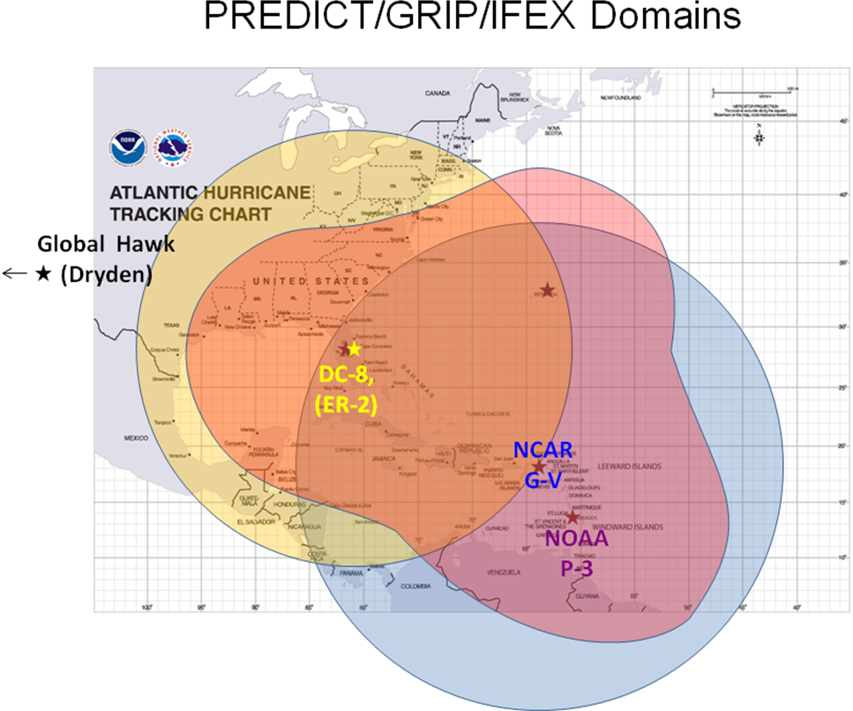
WB-57
P-3
DC-8

Slide 9
PREDICT planning meeting, Nov 2009 at HRD, together with IFEX and GRIP people

Slide 10
GRIP Conference Room, Fort Lauderdale Airport (between Customs and Homeland Security)

Slide 11
PREDICT conference room, at hotel, St. Croix

Slide 12
All flights into Earl during rapid intensification, 29-31 August 2010

Slide 13
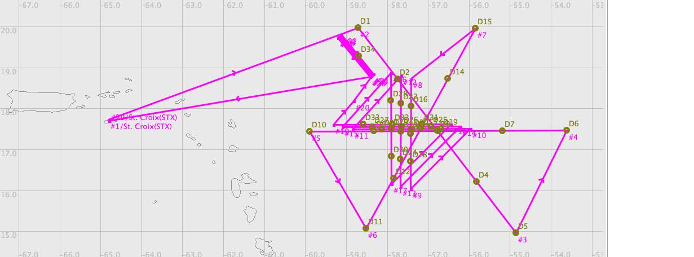
Hurricane Earl Flights August 29-30
August 29
St. Croix
August 30

Slide 14
All flights into Hurricane Earl, 1-3 September 2010

Slide 15
First Global Hawk flight over a hurricane eye (Earl, Sept 2, 2010)

Slide 16
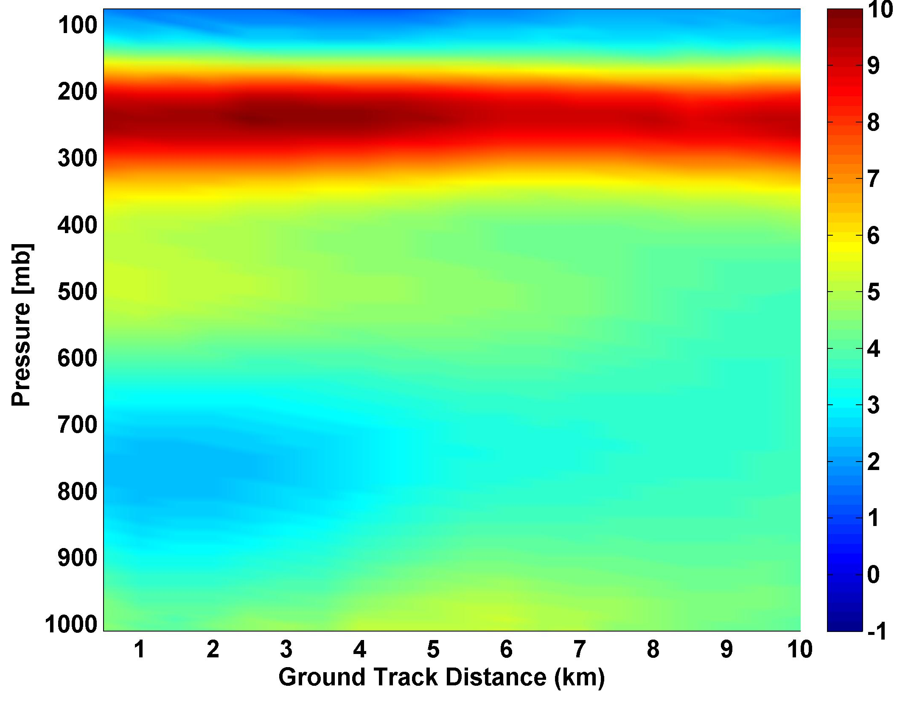
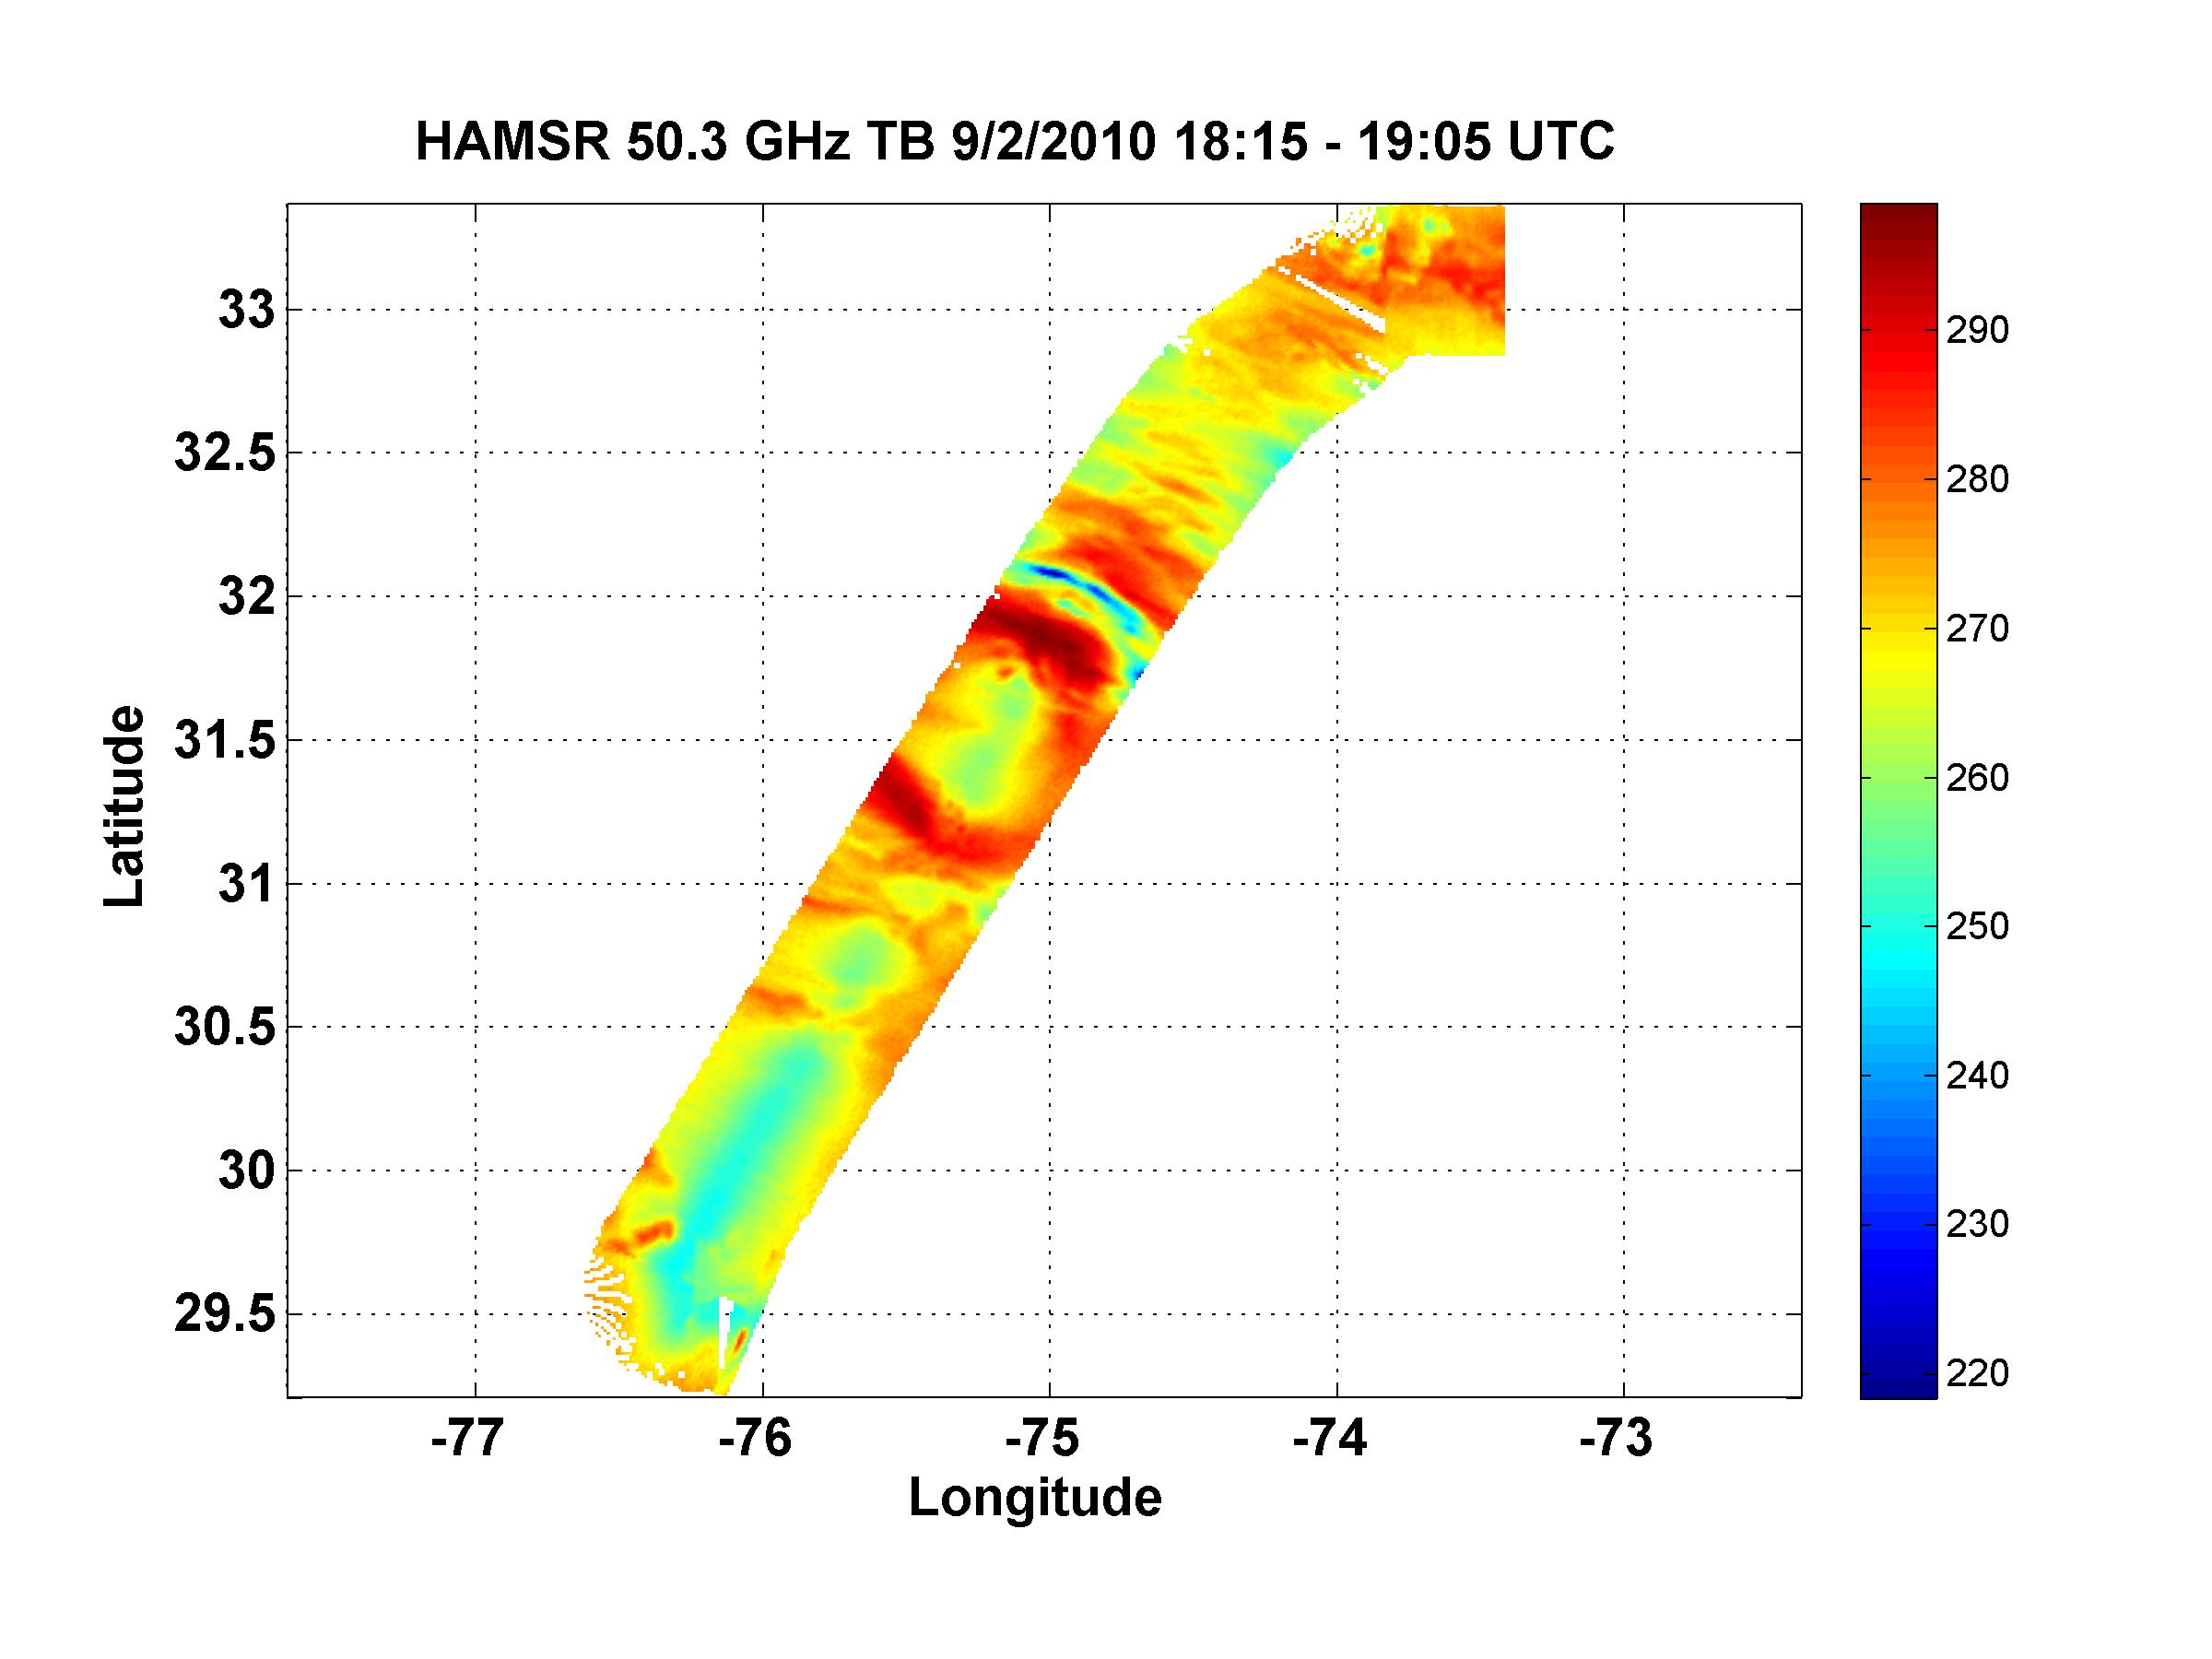
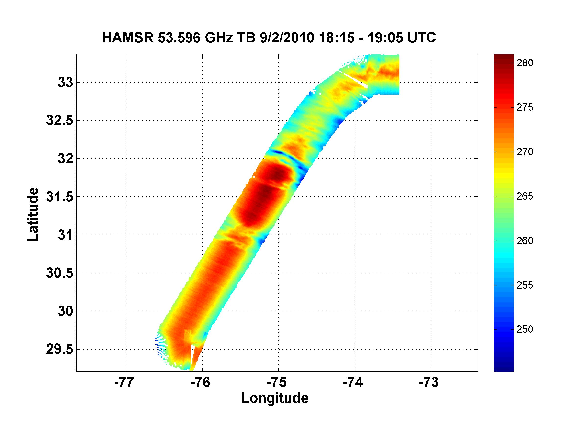
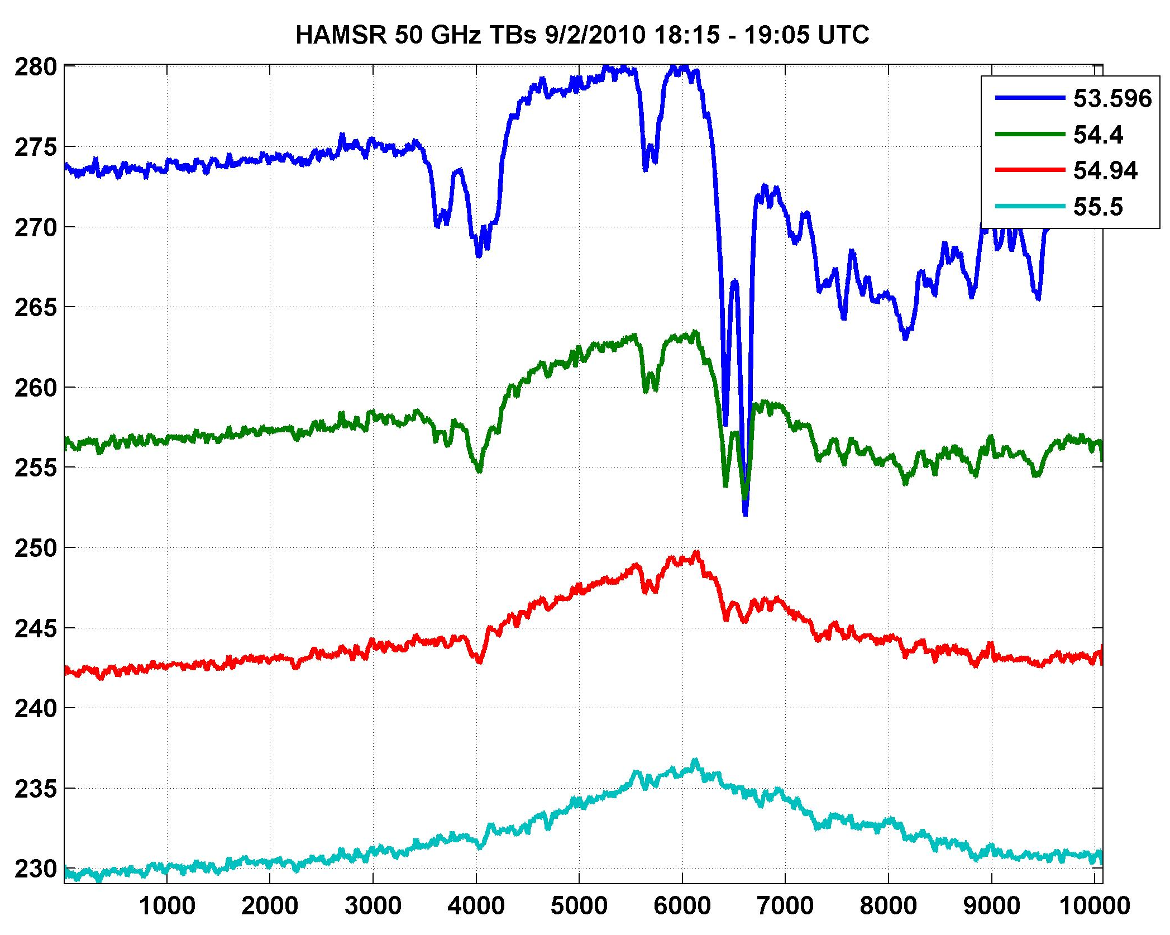
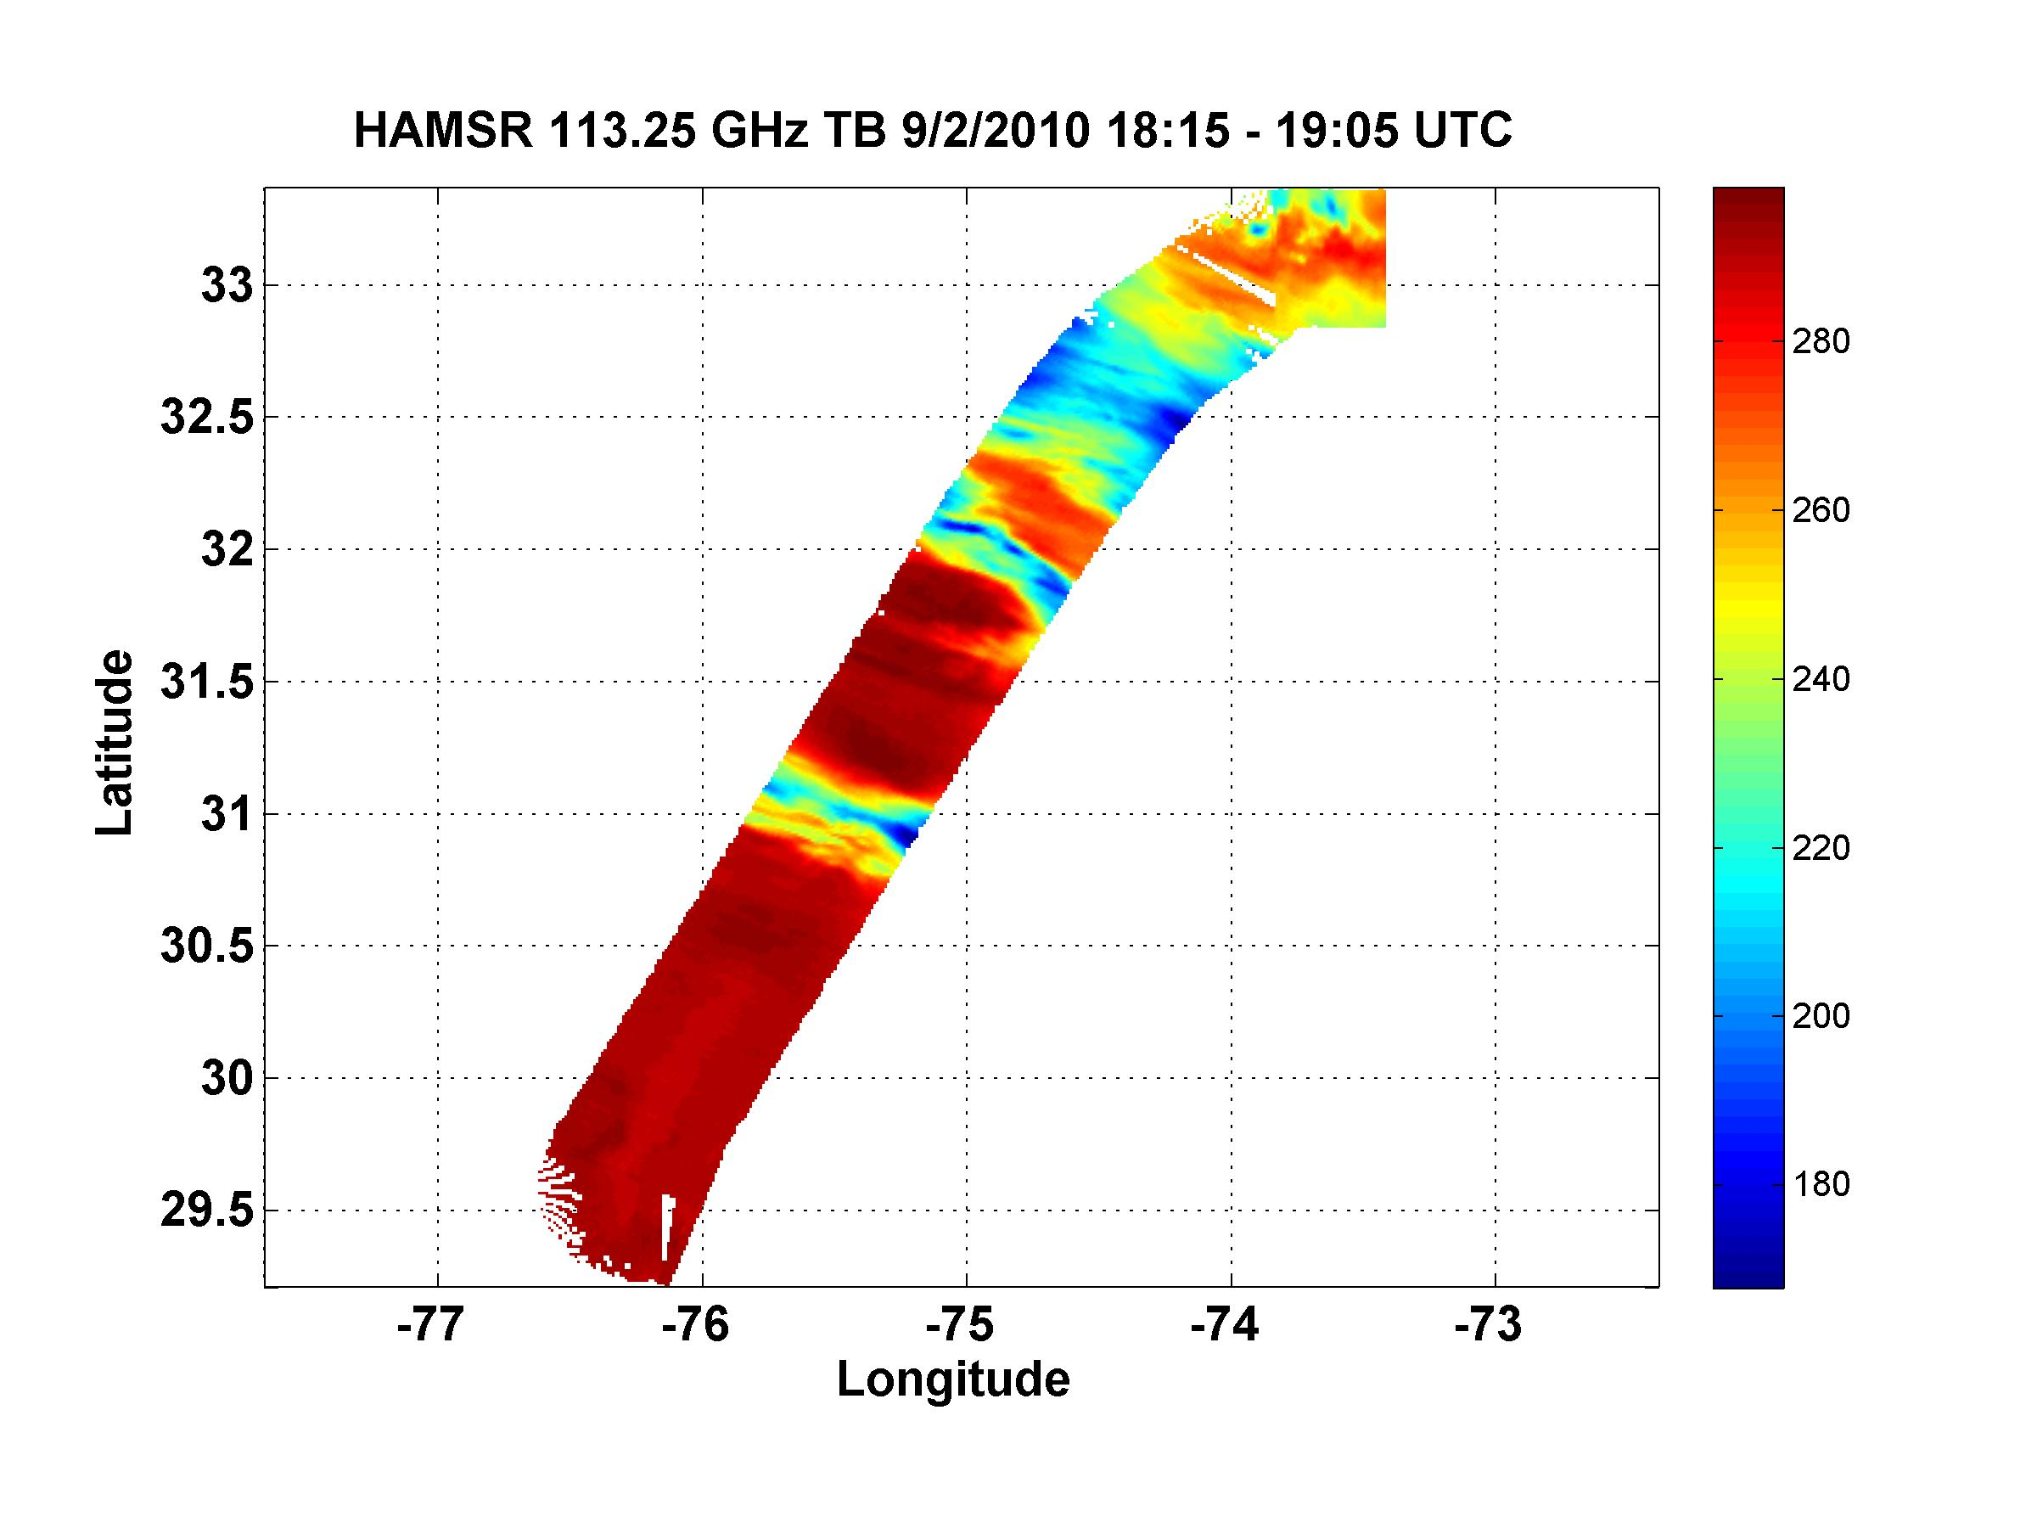
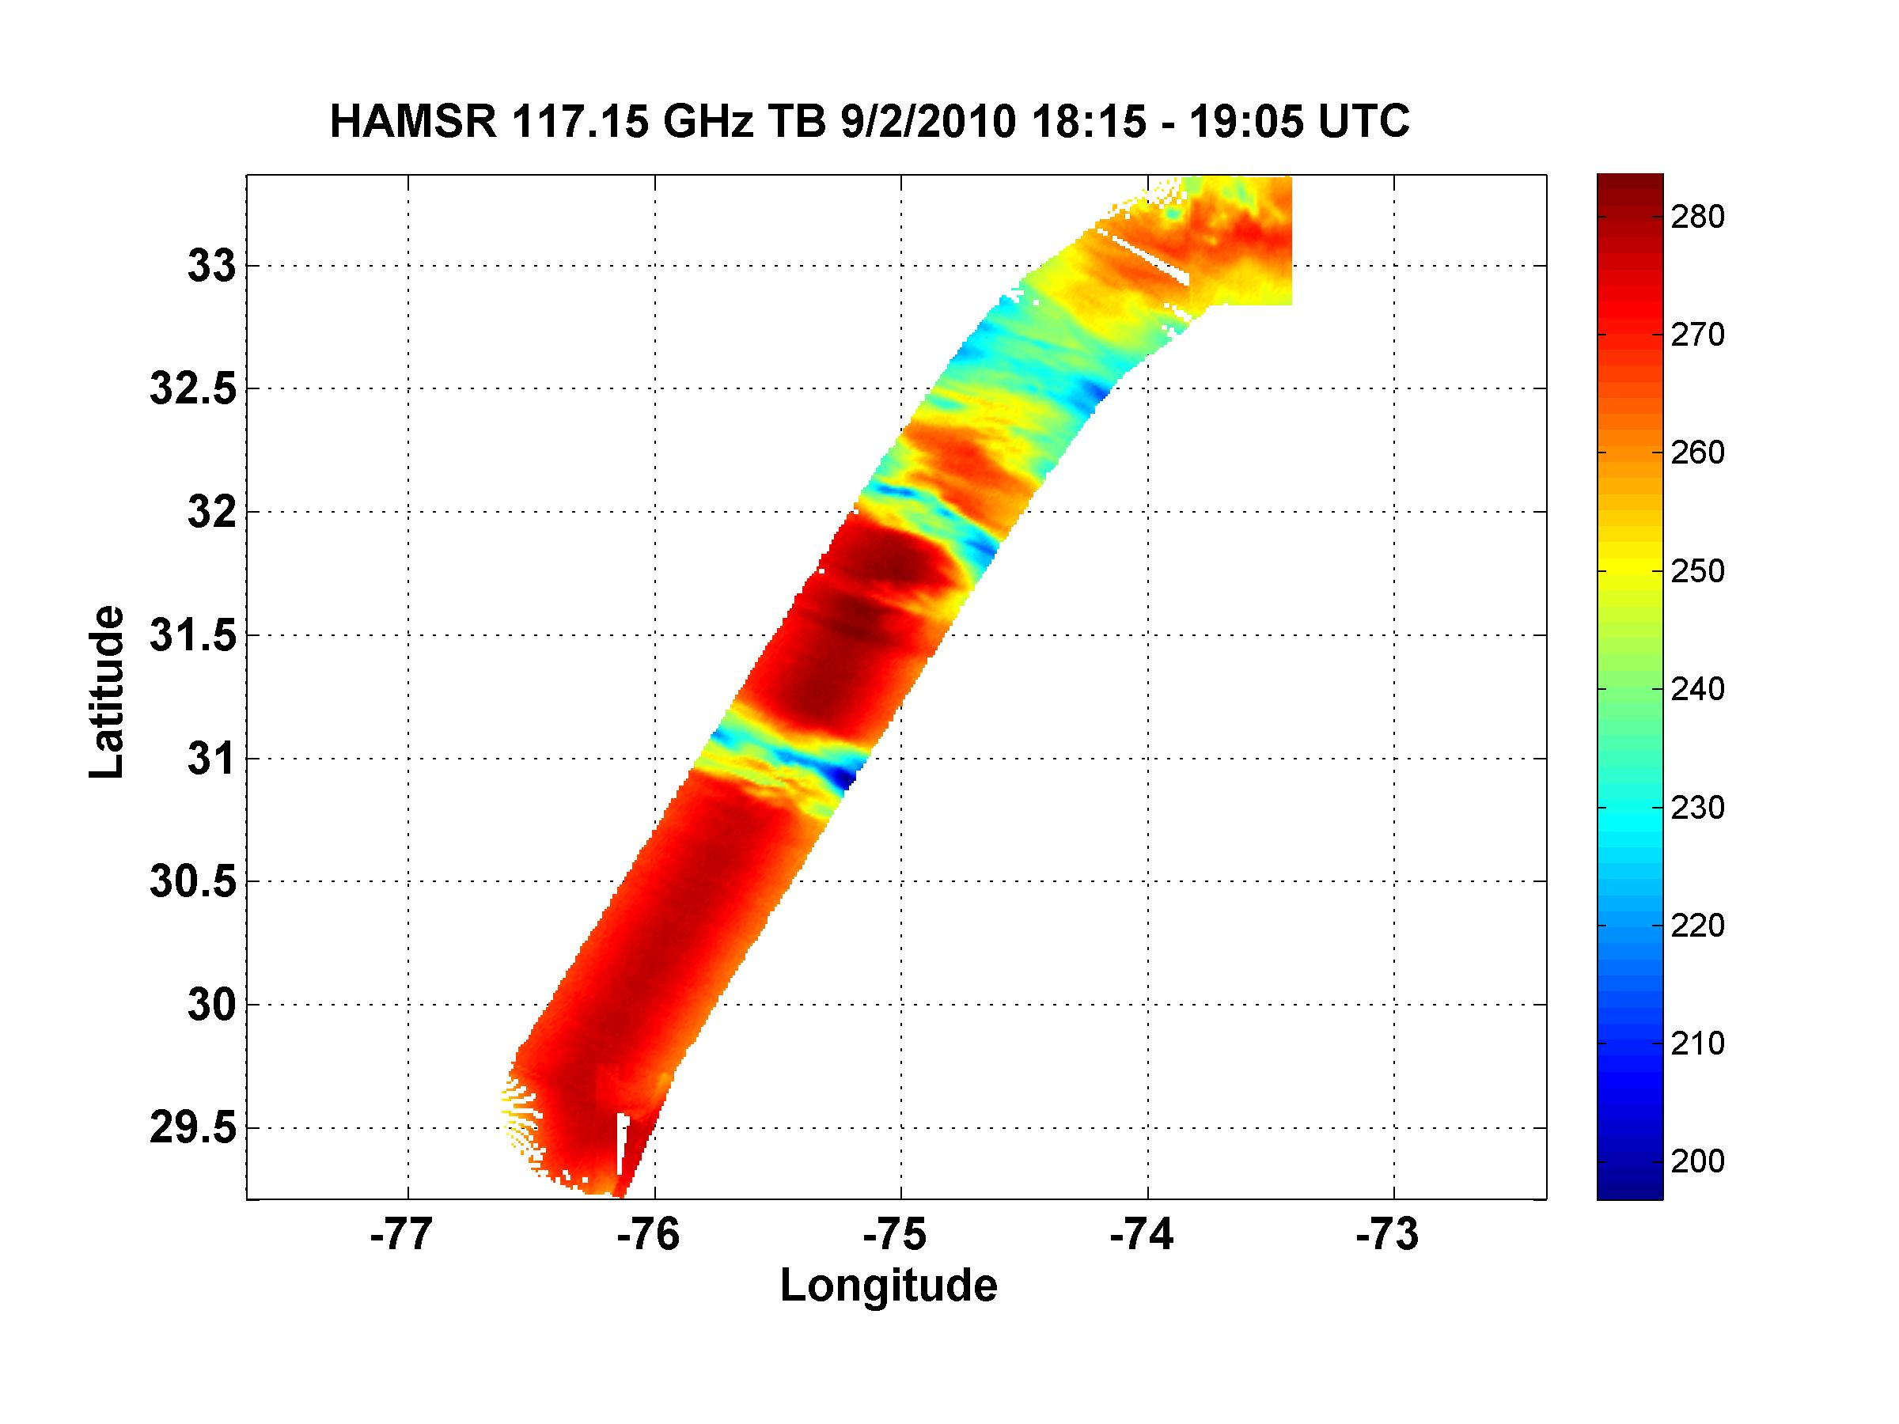
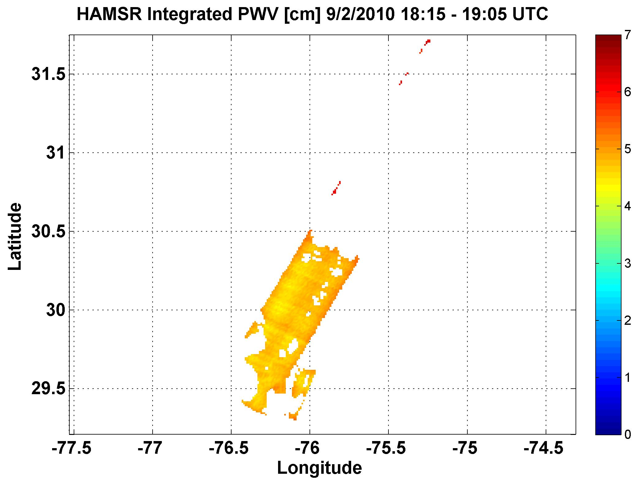
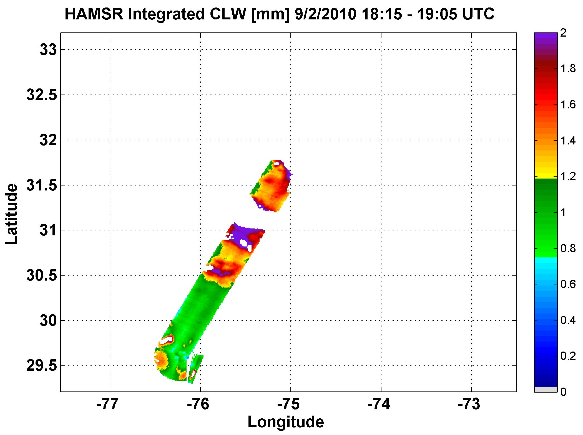
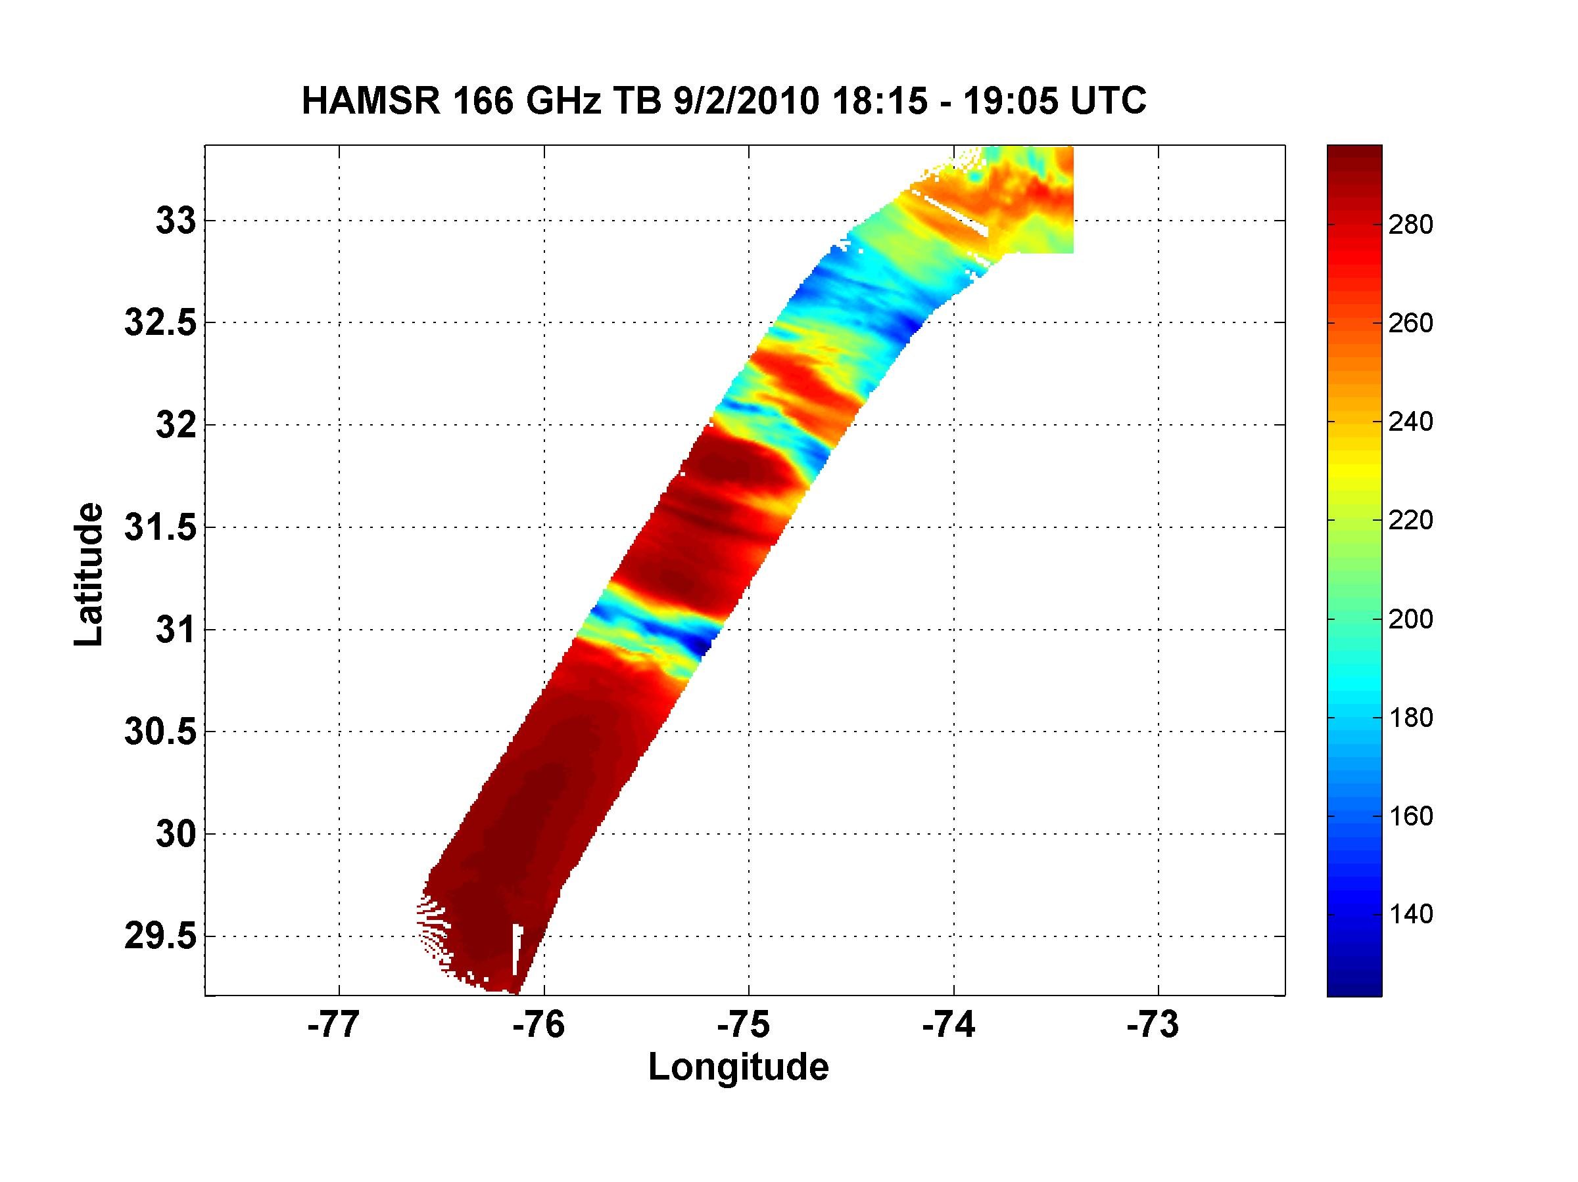
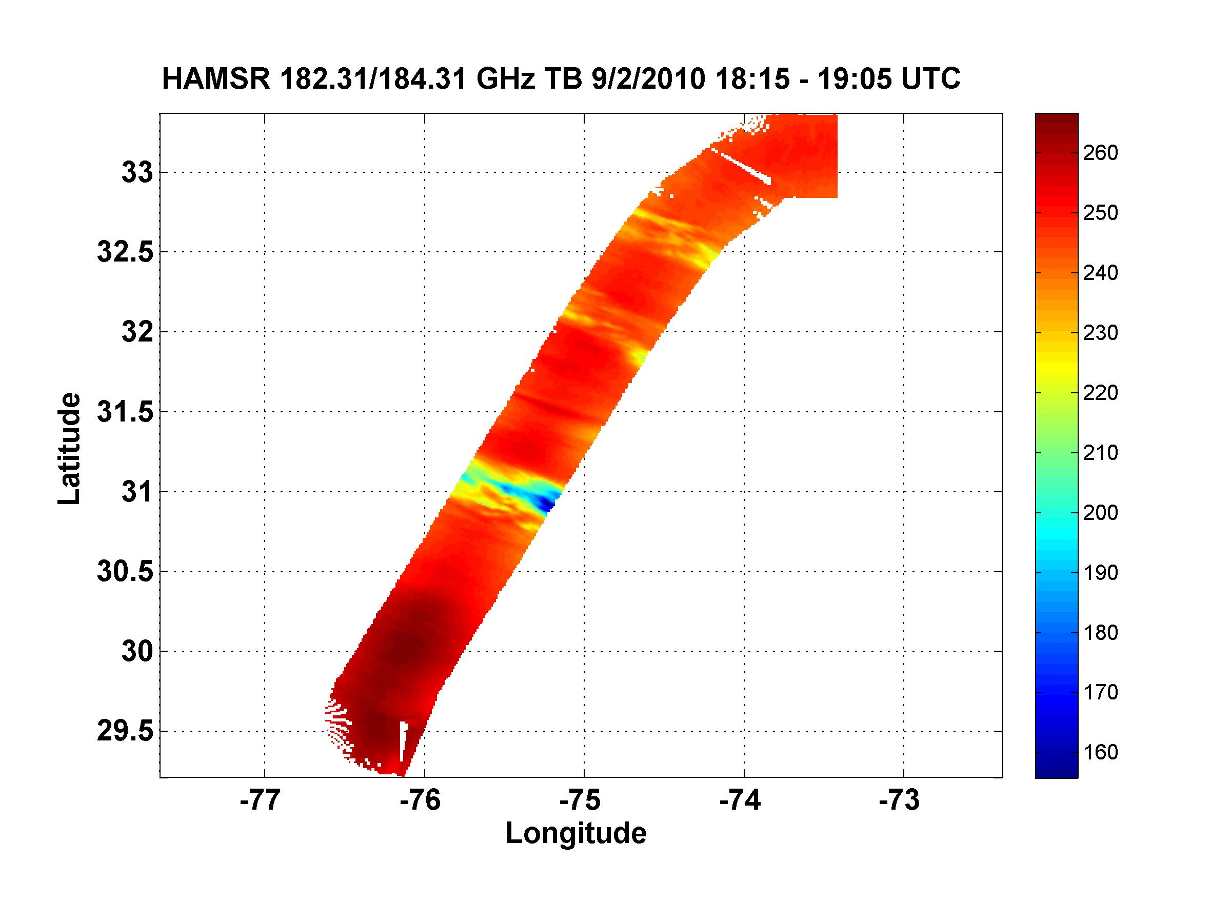
HAMSR @ Earl, 9/2/2010, 1815-1905 UTC
(All retrievals are preliminary)
Temperature
Brightness temperatures
Reflectivity (experimental)
10 km
Ch. 01
Ch. 04
Up to 10 K
warm core anomaly
7 km
5 km
Tb anomaly
Ch. 09
Ch. 13
Precipitable water
4-5 cm TPW
3 km
Significant
convection &
precipitation
Cloud liquid water
Up to 2 mm LWC
Ch. 19
Ch. 25
Nadir (0-15 km altitude)
Courtesy Bjorn Lambrigtsen
Notes:
This pass went right across the eye of Earl, which shows up quite clearly in the channel 1 (50.3 GHz) Tb image. There is an arch of thunderstorms NE of the eye, with very cold Tb’s.
We have done preliminary temperature retrievals in the eye and determined the warm core anomaly. It peaks at about 10 K at 250 mb (UL panel). Just below that plot we show line plots of brightness temperature anomalies across the eye (at nadir).
We have also done water vapor retrievals. The next image down shows total precipitable water in benign areas only (no precip, etc.). The value is generally around 4-5 cm. We have also retrieved cloud liquid water, and the last plot to the left shows total liquid water in non-convective regions. Peak value is 2 mm, but it is possible that the retrieval is biased just there (we need to work on that).
On the right side we show retrieved reflectivity, using a new experimental algorithm we have developed. At the bottom is a nadir curtain plot, with color coded reflectivity plotted vs. height (0-15 km) on the vertical axis and along-track distance on the horizontal axis. Of note is a convective area SW of the eye that does not extend to the surface and a strong convective area NE of the eye that corresponds to a band of lightning. The plots above are horizontal slices at 4 different altitudes. Also of note is that according to this, convective cells reached 15 km altitude in some areas.

Slide 17
Gerry Heymsfield Ed Zipser Liz Ritchie Mike Black
…a cooperative effort!...

Slide 18
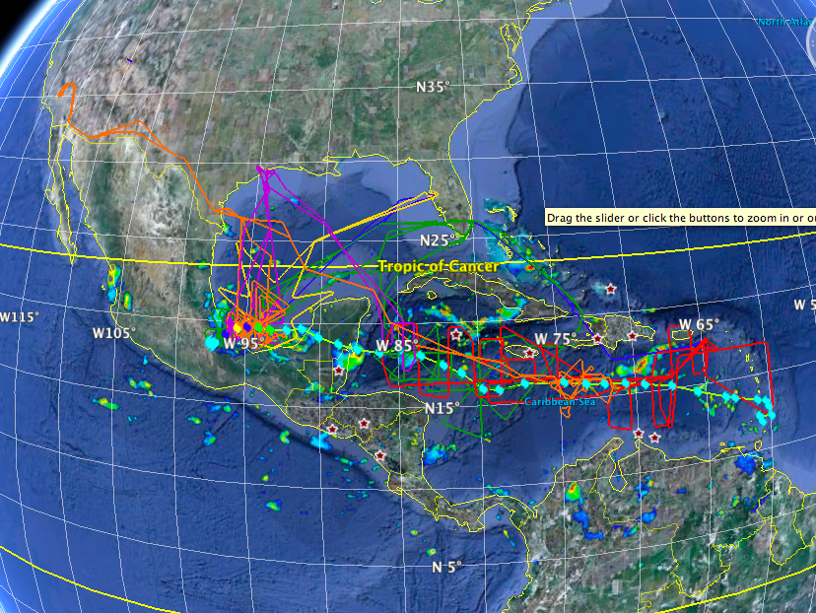
This made all the planning worthwhile! Karl 2010: All Flight tracks (almost) Sept 11-17 Courtesy Scott Braun

Slide 19
All flights into pre-Karl, 11 – 13 September 2010

Slide 20
All flights into pre-Karl and TS Karl, 13 – 14 September 2010

Slide 21
All flights into Hurricane Karl, 16 – 17 September 2010

Slide 22
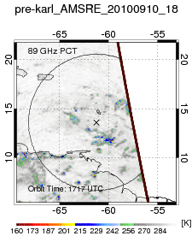
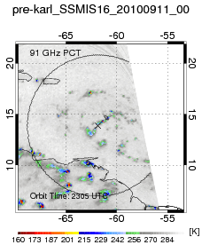
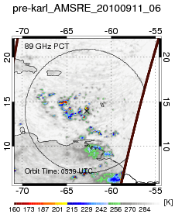
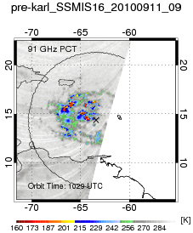
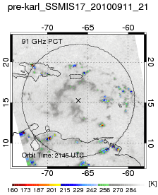
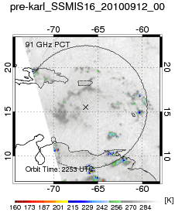
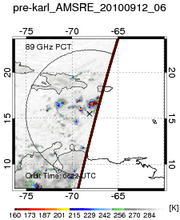
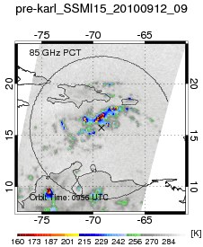
Major Science Questions: Why did Karl take so long to form?
What was the time evolution of inner core moistening? Did the convective bursts help?
Courtesy Jon Zawislak

Slide 23
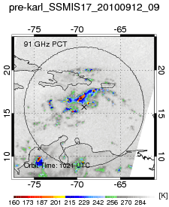
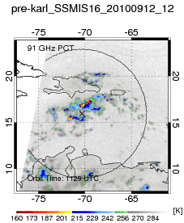
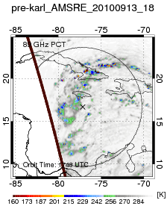
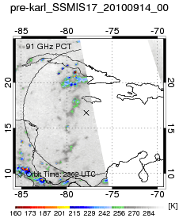
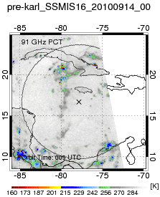
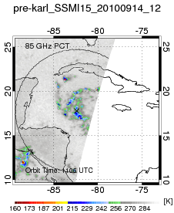
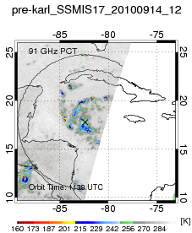
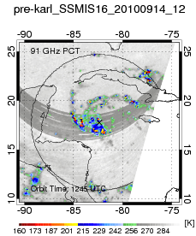
TD
Courtesy Jon Zawislak

Slide 24
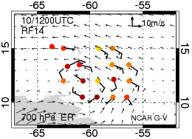
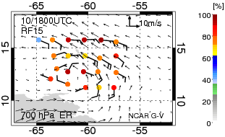
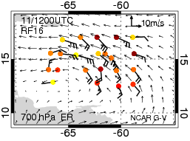
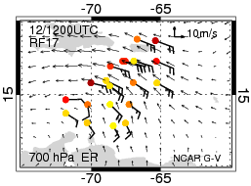
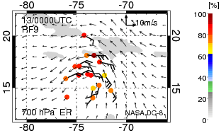
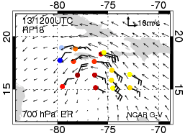
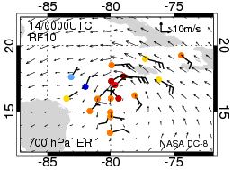
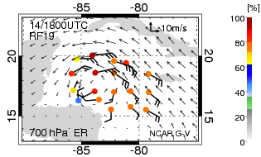
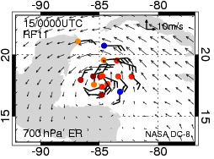
Courtesy Jon Zawislak

Slide 25
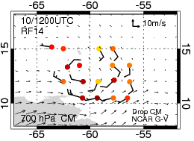
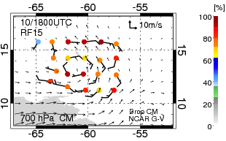
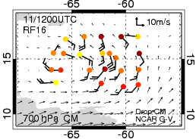
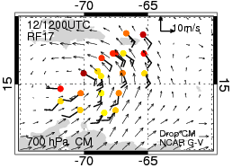
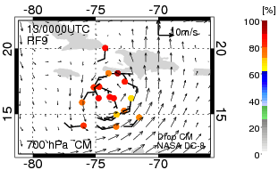
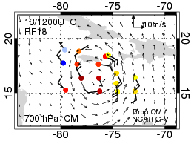
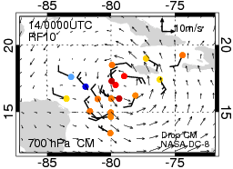
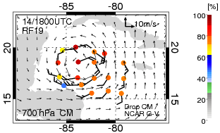
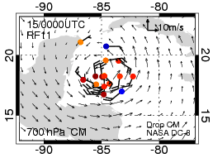
Courtesy Jon Zawislak

Slide 26
Major Science Questions: Why did Karl take so long to form?
What was the time evolution of inner core moistening? Did the convective bursts help?
STAY TUNED: WORK IS JUST GETTING STARTED

Slide 27
Example of great data obtained by APR-2 when the DC-8 pilot preferred penetration
of an active thunderstorm/MCS complex over Haiti to entering Cuban air space
Courtesy Simone Tanelli and APR-2 team from JPL
(Cuban air
Space here)

Slide 28
….Frank Marks can bring anyone to his knees….

Slide 30
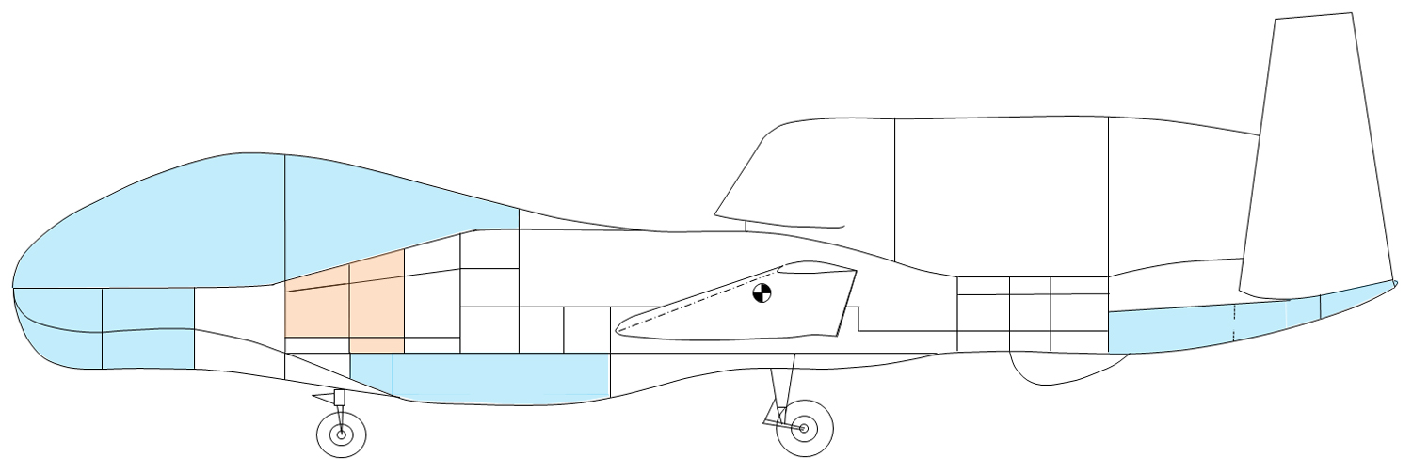
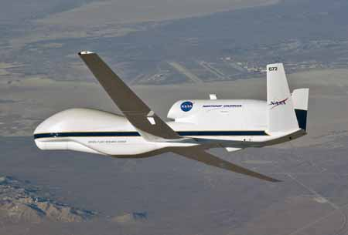
GLOBAL HAWK
7
27
1
3
11
13
61
HAMSR
25
51
HIWRAP
LIP
HDVis
Dropsondes

Slide 31
DC-8 AIRCRAFT
WB-57 AIRCRAFT

