Slide 1
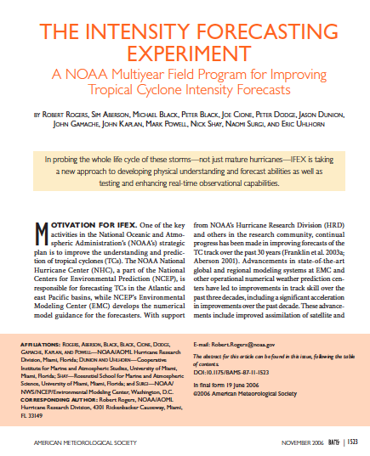
NOAA Hurricane Intensity Forecast Experiment (IFEX)
Background:
Joint effort between HRD & NESDIS hurricane research and NHC & EMC needs for data sets over storm life cycle to support forecast guidance, initialization and evaluation of HWRF model system.
2005 was 1st attempt to merge research interests & capabilities with operational needs.
Rogers et al (2006, BAMS)

Slide 2
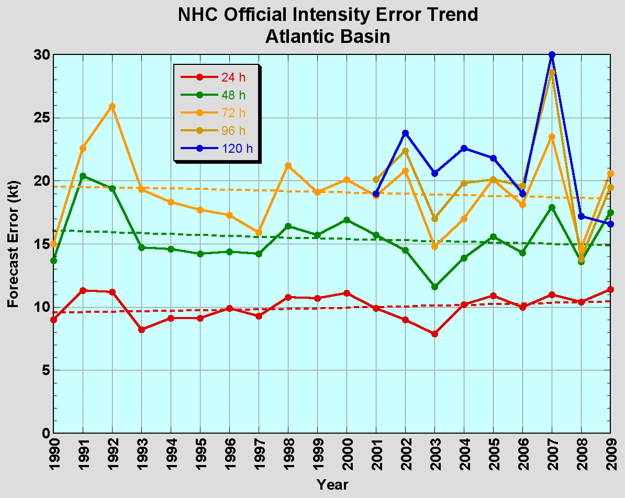
The Good – track forecast improvements
Current Capabilities
The Bad - intensity minor gains
Little progress in last 15-20 years
Errors cut in half over past 15 years
10-year improvement - As accurate at 48 h as we were at 24 h in 1999
24-48h intensity forecast off by 1 category
Off by 2 categories 5-10% of time

Slide 3
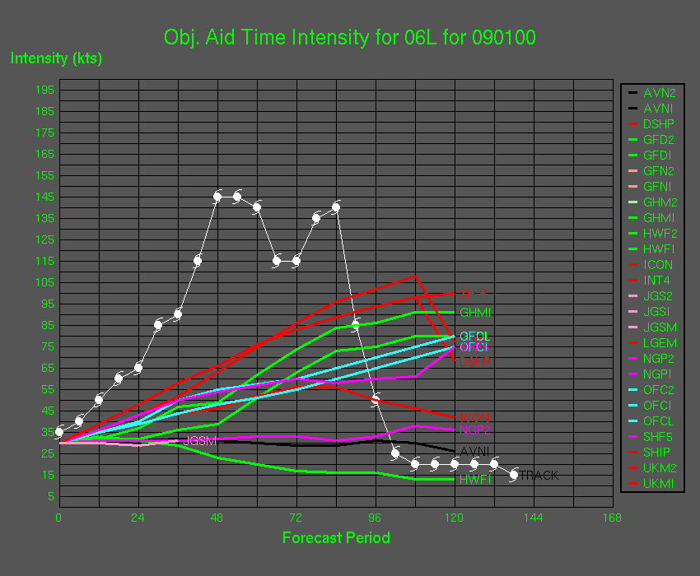
The Ugly - Rapid intensity change Current models have little or no skill

Slide 4
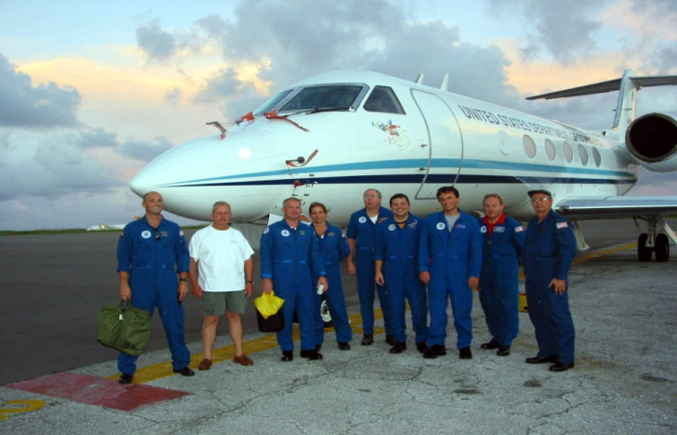
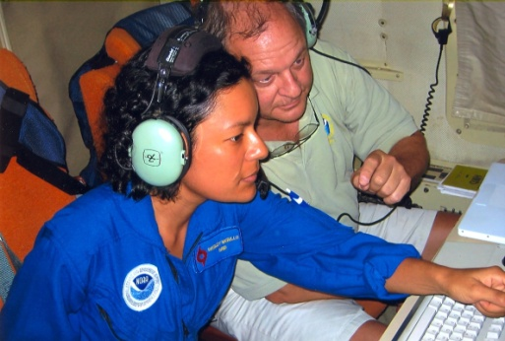
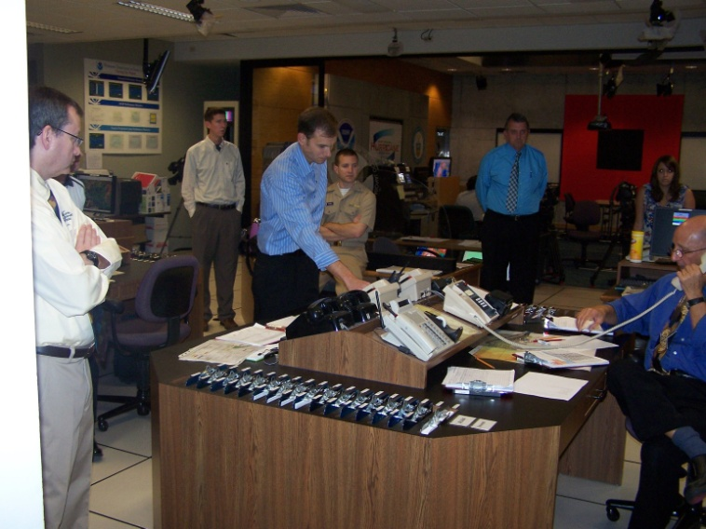
Intensity Forecast Experiment (IFEX)
NOAA Partnership to utilize NOAA’s hurricane expertise in operations and research
Improve hurricane intensity forecast
Refine measurement technologies
Increase understanding
Notes:
Improving hurricane intensity predictions, a major goal for NOAA’s Hurricane Forecast Improvement Project (HFIP)
collect observations that span hurricane life cycle
develop and refine measurement technologies
improve understanding of intensity change at all stages of a hurricane’s life cycle

Slide 5
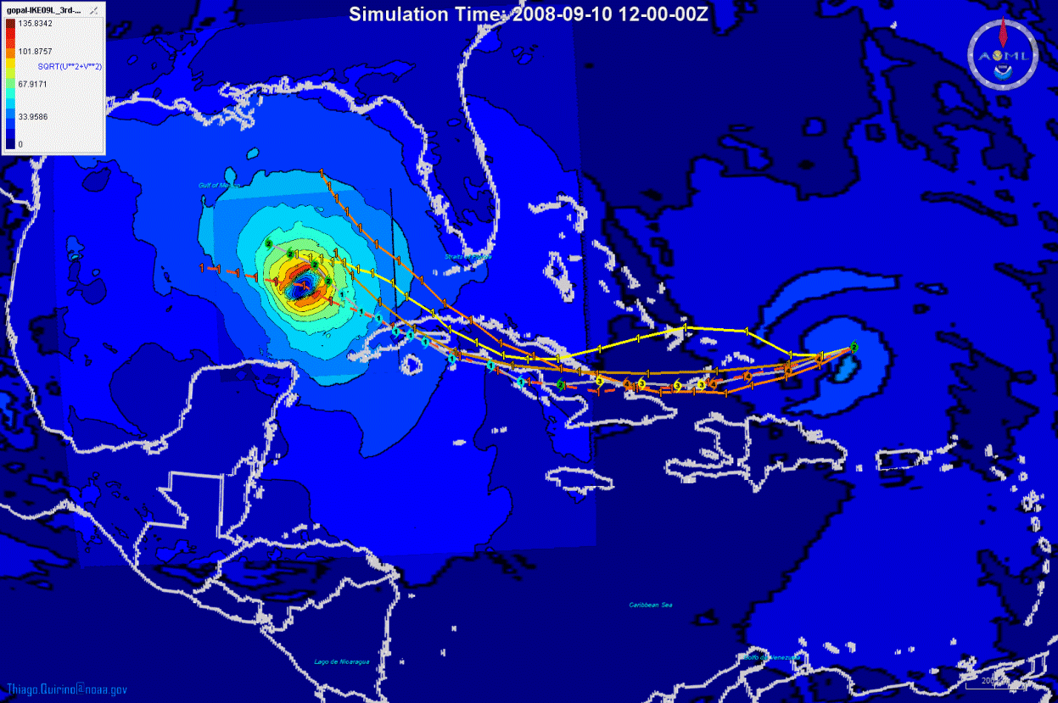
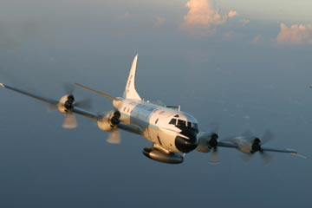
Collecting aircraft data from the hurricanes inner core and large scale hurricane environment…
Improve Hurricane Intensity Forecasts
… and getting it into the next generation high resolution models.

Slide 6
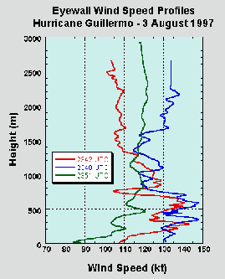
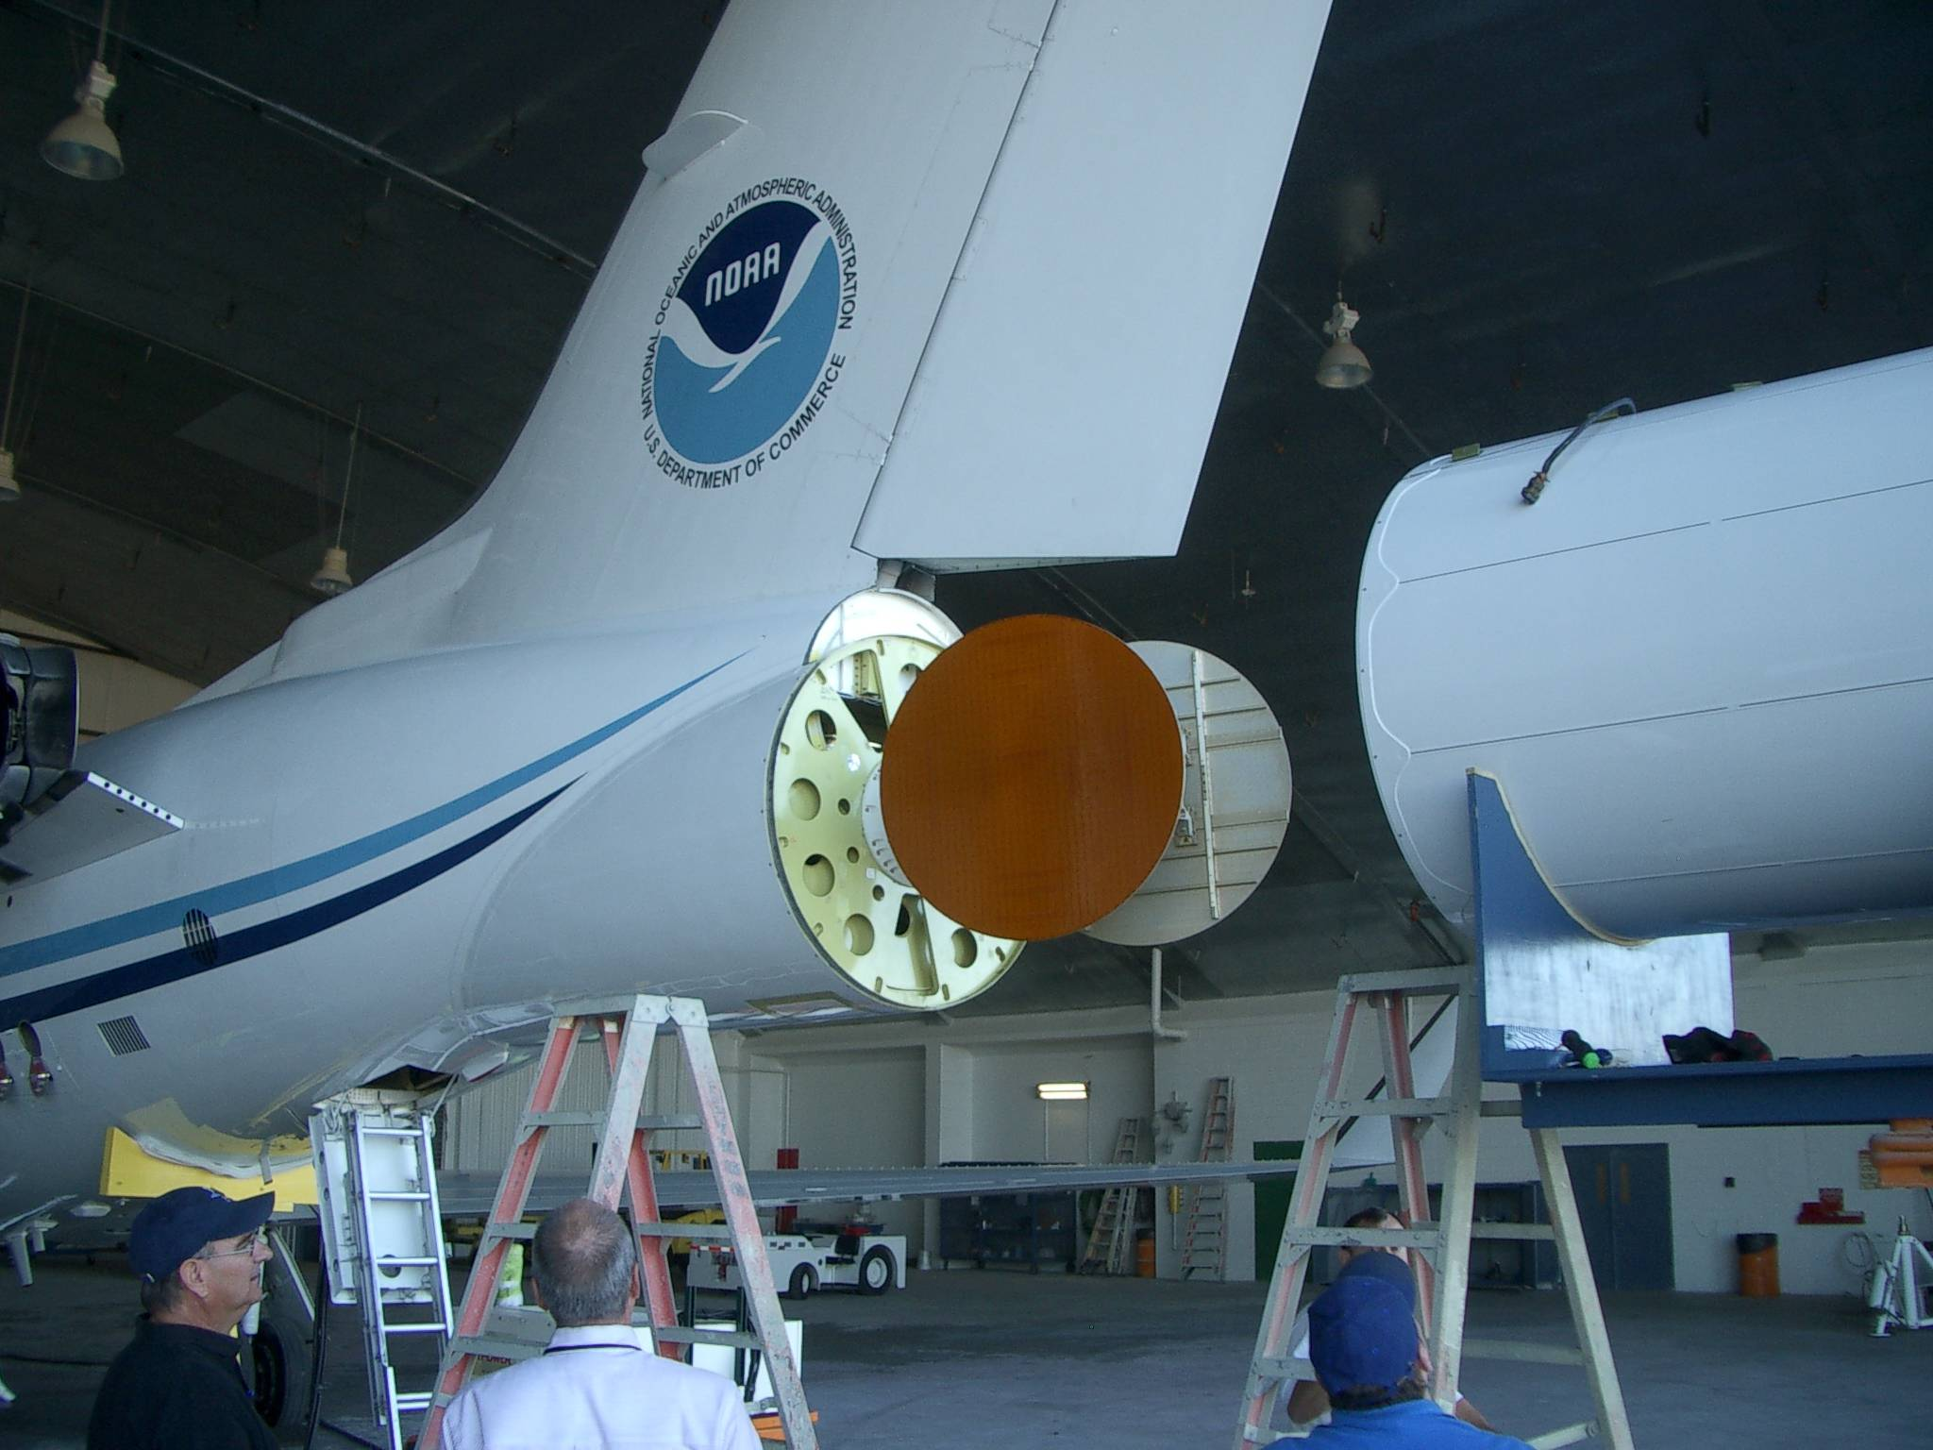
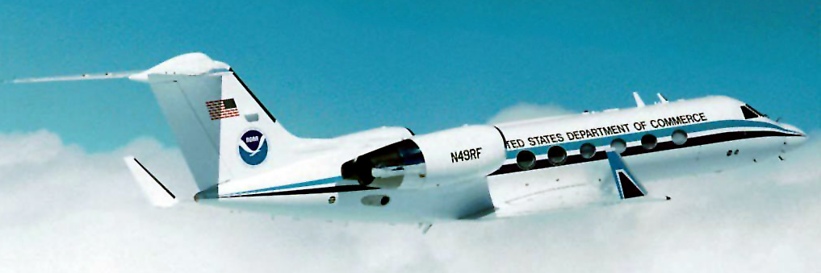
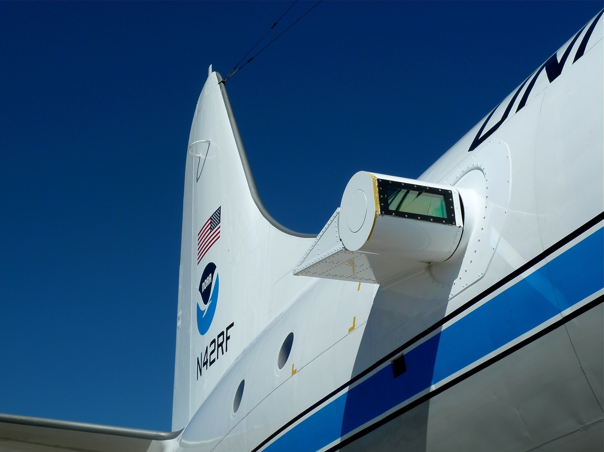
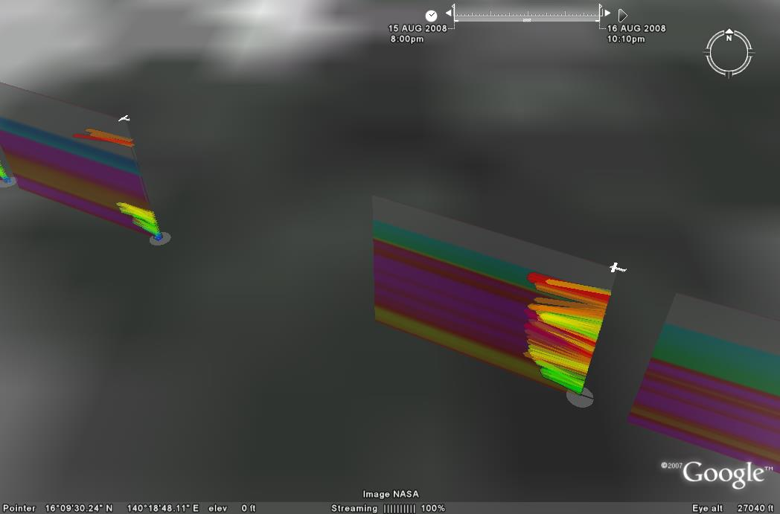
Refine Measurement Technologies
In-situ
Wind, press., temp.
Expendables
Dropsondes
AXBT, AXCP, buoy
Remote Sensors
Doppler Radar
SFMR/HIRAD
WSRA
Scatterometer/profiler
UAS
Global Hawk UAS
G-IV Tail Doppler Radar
ONR DWL
Notes:
UR image depicts dropsonde profiles in eyewall of Hurricane Guillermo (1997)
LR image is Doppler Wind Lidar profiles from TCS-08

Slide 7
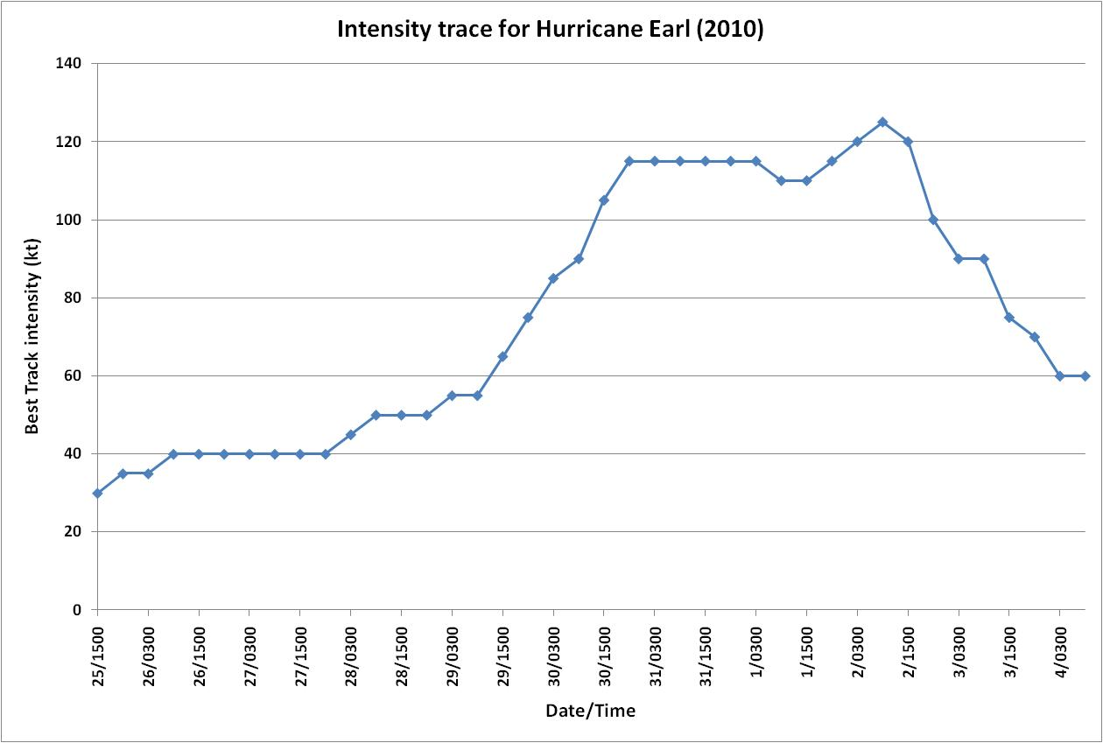
Increase Understanding Particularly Rapid intensity
Number one forecast problem for NHC: hard to forecast – to understand
86% of all hurricanes go through rapid intensification at some point in their lifecycle
P-3 missions
G-IV missions

Slide 8
Multi-Agency Collaborations
NASA TCSP (2005), NAMMA (2006), GRIP (2010)
(Rainfall, Microphysics/Aerosol, Genesis, and Rapid Intensification)
DC-8
ER-2
Global Hawk
NSF RAINEX (2005), Upper-ocean Sampling (2005-2008), PREDICT (2010)
(Rainbands, Ocean mixed-layer interaction, and Genesis
NRL P-3
G-V
Notes:
NASA’s Genesis and Intensification Processes (GRIP).
This field campaign has the primary focus of addressing the fundamental science
leading to tropical cyclogeneis and rapid intensification of tropical cyclones. The focus
area of investigation is the Western Atlantic, Caribbean Sea, Gulf of Mexico and Eastern
Pacific. The NASA DC-8 and Global Hawk will investigate tropical cyclones. GRIP
will run from August 15-September 30
Key measurements for GRIP: 3-dimensional winds (dropsondes and wind lidar) and
thermodynamic field (insitu and microwave), Surface winds, precipitation intensity
and rain-rates (dual-frequency radars on DC-8 and Global Hawk), cloud
microphysics, aerosol content (insitu and Lidar)

Slide 9
NOAA Hurricane Intensity Forecast Experiment (IFEX)
Lessons learned:
Coordination insures WP-3D and G-IV aircraft serve NOAA’s research and operational interests.
Optimum use of hurricane flight hours & expendables.
Provide capacity to support NOAA HFIP.
Provides opportunity to engage and educate outside research community in use of aircraft observations.
Provides capacity to train future hurricane researchers utilizing NOAA tools to improve operations and promote research

Slide 10
Questions?

Slide 11
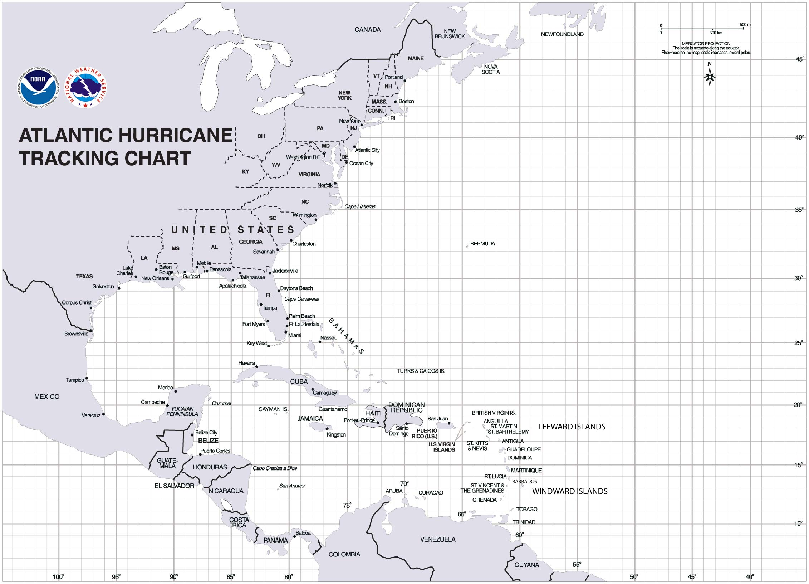
IFEX Flight Domains
NOAA G-IV
NOAA P-3

Slide 12
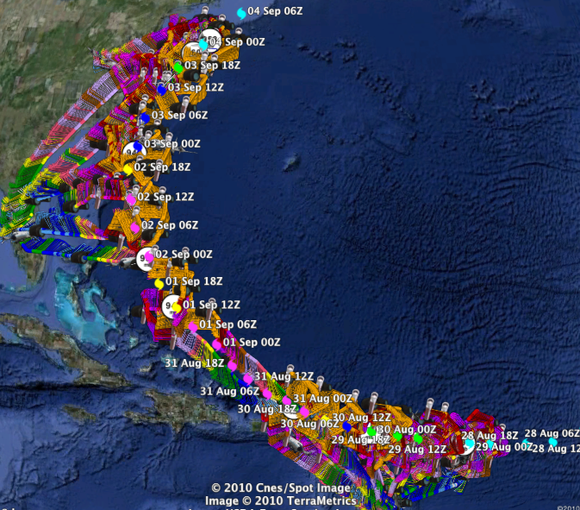
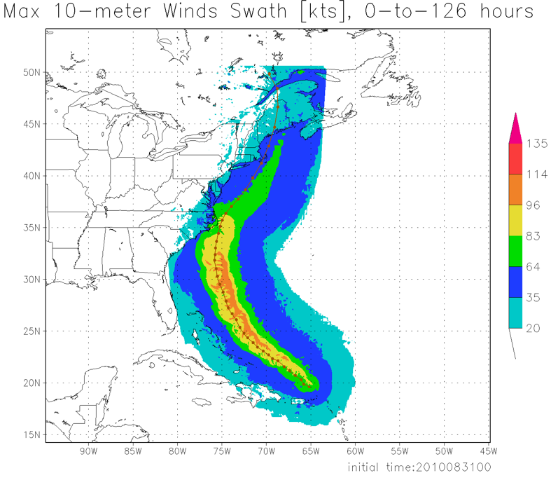
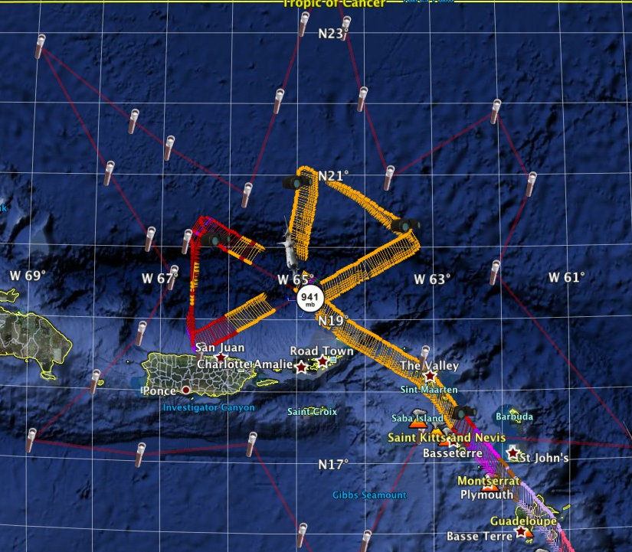
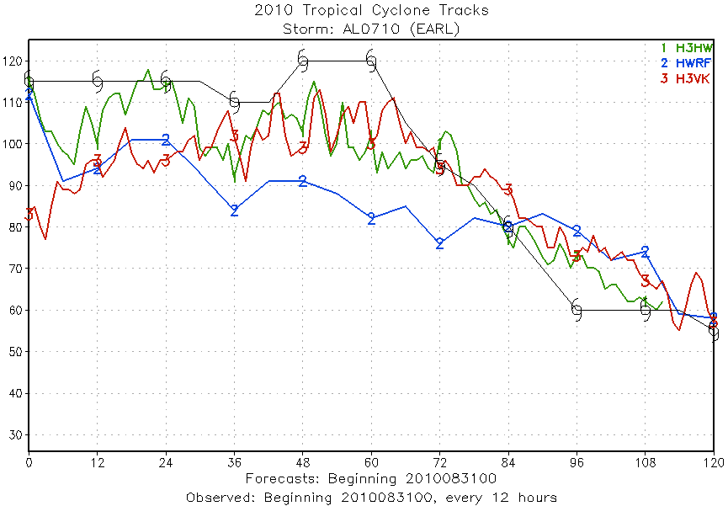
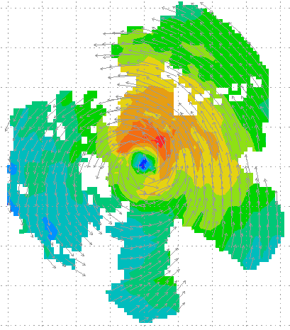
Improved Use of Observations: HFIP 2010 Demo: Earl
11 P-3 Flights
28 August – 3 September 2010
HWRFx/HEDAS
20100831 00UTC
Doppler SO (EnKF) transmitted in real-time to HRD for assimilation into HWRFx model
20100830I1
2126-0229 UTC
5 missions at 12-h intervals
00Z 28 – 12Z 30 August, 6 missions at 12-h intervals 00Z 1 September – 00Z 3 September collecting Doppler SO (HEDAS)
HWRFx/HEDAS
20100831 00UTC
J. Gamache, A. Aksoy, T. Vukicevic, Gopal (AOML/HRD)
Notes:
Left hand image - Flight pattern for 11 P-3 Doppler mission For Earl beginning 00Z 28 August 2010, ending at 12Z 3 September 2010
middle image – show real-time Doppler analyses for three legs mission centered on 00Z 30 August used to generate Sos
Right images – HWRFx forecasts track and maximum wind swath (top), and intensity (bottom) initialized at 00Z 30 August
IFEX 2010: Hurricane Earl WP-3D (11 missions: 5 missions at 12-h intervals, 00Z 28 – 12Z 30 August, & 6 missions at 12-h intervals, 00Z 1 September – 00Z 3 September collecting Doppler SO (HEDAS)
Deployed 756 dropwindsondes and 238 AXBTs. 55 real-time TDR analyses transmitted to NHC and Doppler radial files transmitted to EMC. TDR superobs transmitted in Paloma, Bill and Danny provided real-time assimilation of TDR data into ARW model at TACC. 60 real-time H*Wind surface analyses

