Slide 1
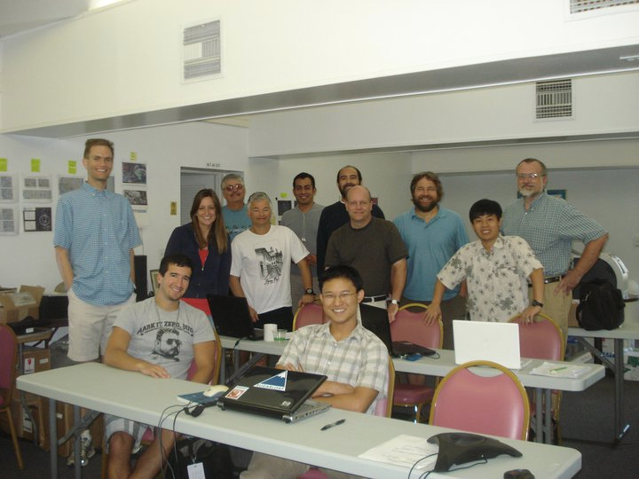
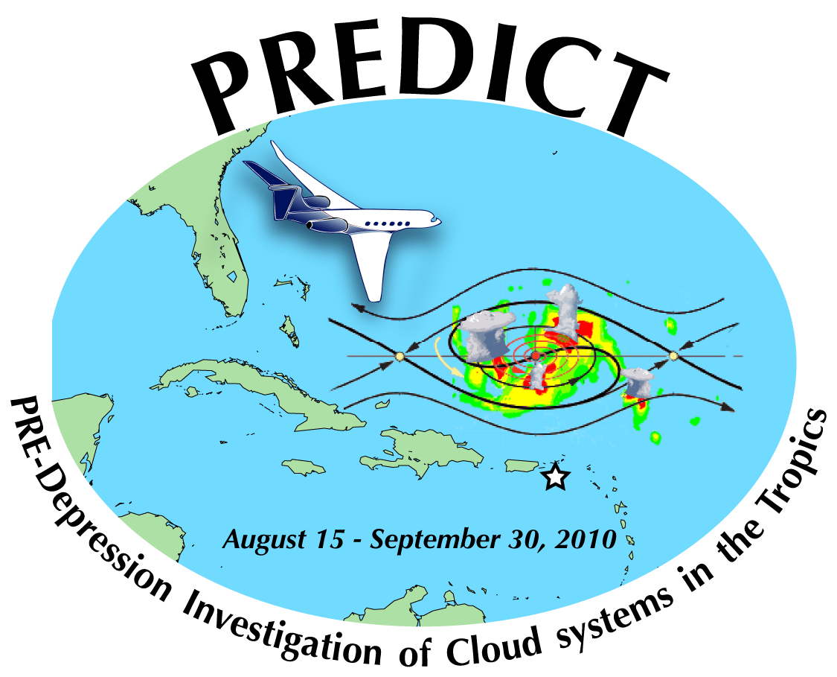
Pre-Depression Investigation of Cloud-systems in the Tropics (PREDICT): An NSF perspective
Michael C. Morgan
National Science Foundation

Slide 2
Outline
Pre-PREDICT
Why PREDICT?
PREDICT: Science Objectives
PREDICT: Measurement Objectives
PREDICT Observations
Future NSF opportunities

Slide 3
Pre-PREDICT
Tropical Experiment in Mexico (TEXMEX), 1991 (genesis)
Hurricane Rainband and Intensity Change Experiment (RAINEX), 2005 (intensity)

Slide 4
Why PREDICT?
Despite analyses from prior field campaigns and recent modeling activities, the processes associated with tropical cyclogenesis remain unresolved.
Prior field campaigns (e.g. FASTEX, T-PARC) had multiple targets . . . Where do you go? Follow the wave? Which part??
PREDICT offered a practical, focused means to target observations to challenge the hypotheses put forward by Dunkerton et. al (2009)
PREDICT offered a means to study other potential genesis pathways
In addition, the opportunity existed to work cooperatively with two other field activities (IFEX and GRIP)

Slide 5
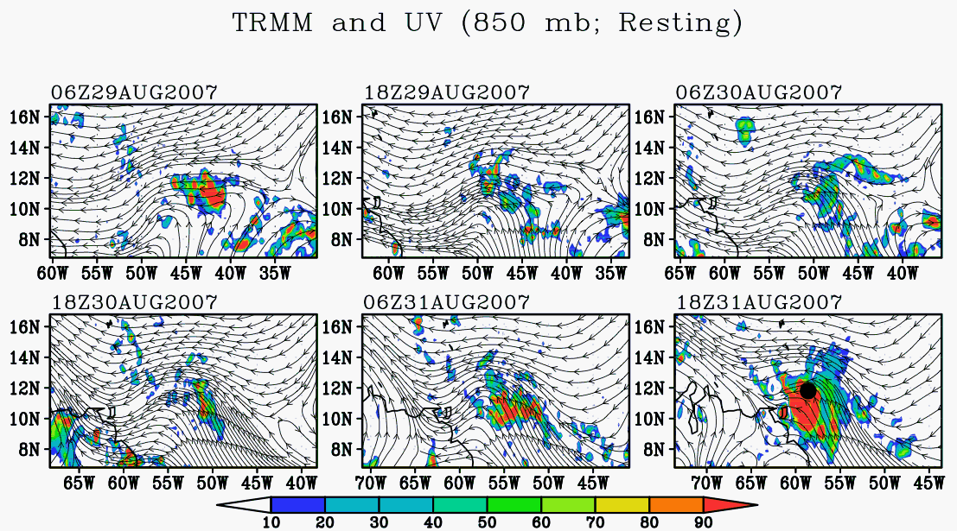
2007 Felix TRMM and ground-relative 850 hPa streamlines
Wang et al. (2010)

Slide 6
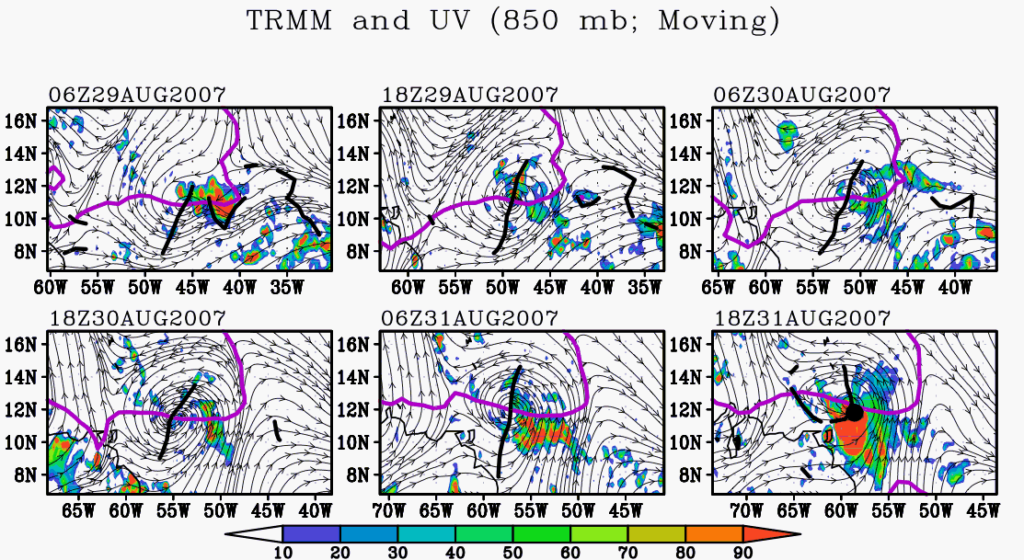
2007 Felix TRMM and translated 850 hPa streamlines

Slide 7
PREDICT: Science Objectives
Testing of the DMW “marsupial hypotheses”
Investigating other genesis pathways: Are the mesoscale processes relatively universal among the different synoptic-scale precursors?
Understanding the dynamics of upper-tropospheric circulation on development of developing TCs and relationship to critical layer convective dynamics.
Assessing the vorticity and thermodynamic budget of TEWs
Characterizing TC genesis using special remotely sensed observations and products
Advancing our understanding of the processes and predictability associated with TC genesis via ensembles
Creatiing a dataset from satellite-based sensors that would complement the airborne observations from PREDICT IOPs that will be compared and integrated with aircraft observations.
Using real-time support from modeling efforts and satellite-based analyses
Conducting ensemble-based data assimilation and assessment of predictability and sensitivity of genesis forecasts to observations

Slide 8
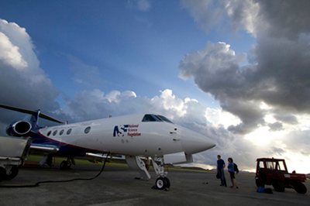
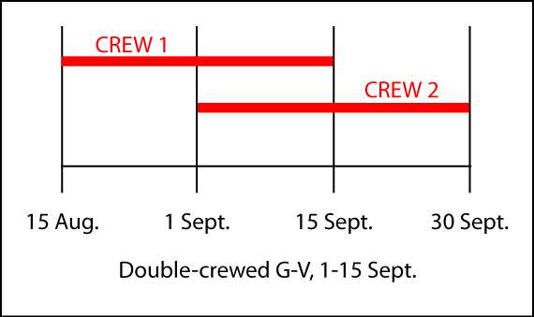
PREDICT: Observations
Maximum range: 6500 nm
Maximum cruise altitude: 51,000 ft (15.5km)
Anticipated 200 research hours
Anticipated use of 500 GPS dropsondes
Other instruments
Microwave temperature profiler
Differential GPS
Small ice detector
counterflow virtual impactor
2-D imaging probes
Tunable Diode Laser hygrometer
The NSF/NCAR G- V research aircraft on St. Croix, U.S. Virgin Islands.
Photo credit: NPS

Slide 9
PREDICT: Measurement objectives
Mapping the structure of tropical waves and identifying the “sweet spots”, emphasizing mesoscale variations of convection, humidity and rotational features. Determine horizontal and vertical characteristics of the critical layer.
Observing the vertical structure of the temperature, pressure-gradient, and wind fields in candidate pouch regions
Measuring the water vapor field at several altitudes to assess column humidity and mesoscale variations of water vapor near convective features
Examining the aerosol and thermodynamic properties of Saharan Air Layers. In particular, measuring concentrations and radiative forcing within regions of dust.
Conducting hierarchies of numerical simulations of genesis, tested with field observations, to further test genesis hypotheses, and deduce key limiting factors in predicting genesis, including observations needed to improve genesis prediction and limitations of model physical processes

Slide 10
Future NSF opportunities
The President’s request for the FY2012 Budget for the AGS Division calls for a 10.2% increase in support over the FY2010 enacted level.
Essentially all of this funding is targeted to three initiatives:
SEES: Science, Engineering and Education for Sustainability (SRNs and SEPs)
CIF21: Cyberinfrastructure Framework for the 21st Century Science and Engineering
CaMRA: Creating a more Disaster Resilient America

