Slide 1
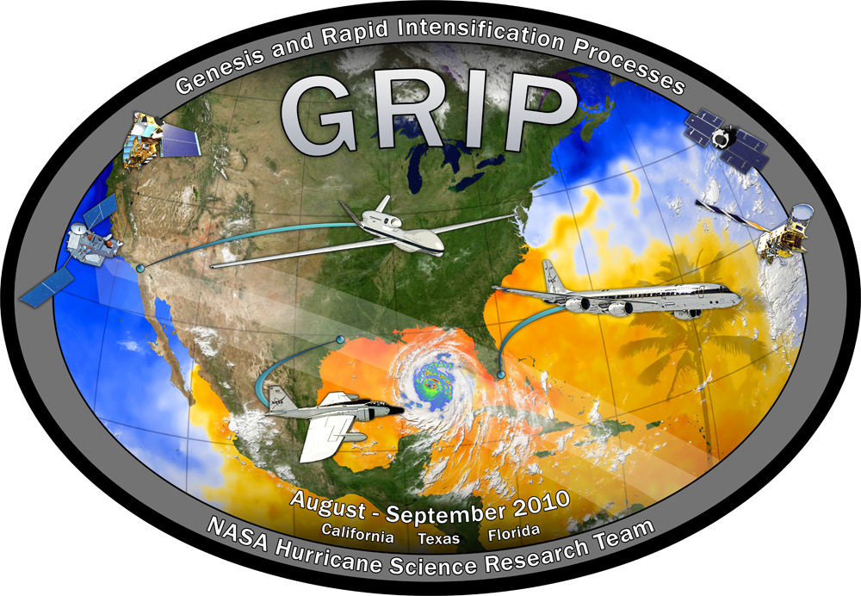
Genesis and Rapid Intensification Processes ( GRIP ) Field Experiment
Ramesh Kakar
Earth Science Division
NASA Headquarters
October 13, 2010

Slide 2

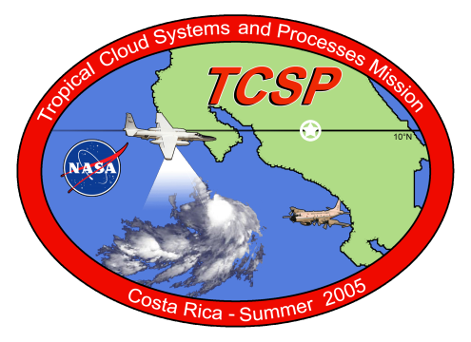
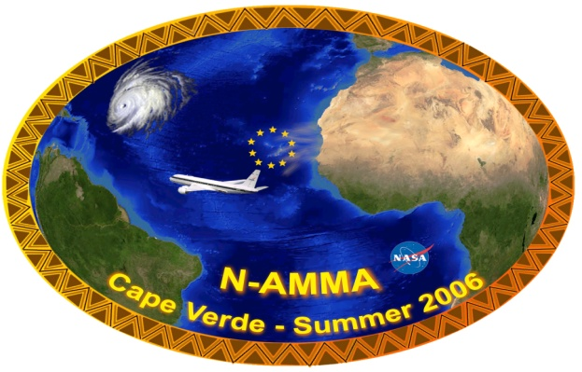
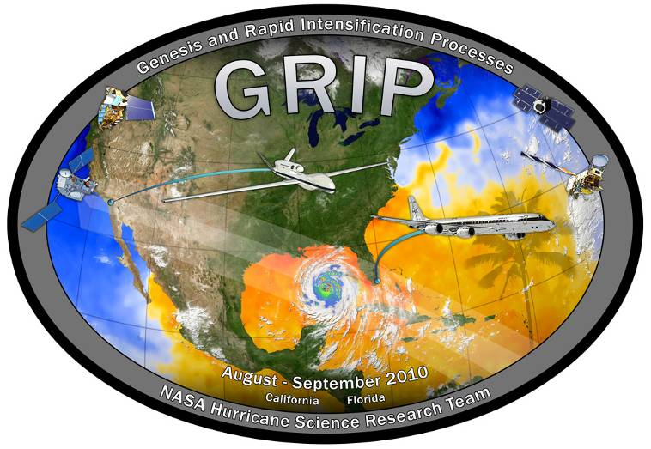
NASA Hurricane Field Experiments
Field programs coordinated with other Federal Agencies
1998
2001
2005
2006
2010 GRIP
NASA sponsored field campaigns have helped us develop a better understanding of many hurricane properties including inner core dynamics, rapid intensification and genesis
We do field experiments to accomplish:
- calibration/validation of satellite sensors
- evaluation of new sensor concepts
- process studies
Notes:
2

Slide 3
Mission and Science Overview:
Summary of GRIP Science Objectives
Genesis: Distinguish the role of the larger-scale environment vs. meso-convective processes near the putative developing center.
Rapid Intensification: Relative role of environmental vs. inner core processes? Is RI predictable?
Test-bed: Evaluate candidate technologies for remote sensing from aircraft and from satellites. Wind lidar, high frequency passive microwave, dual-frequency radars, Global Hawk itself.

Slide 4
NASA Hurricane Research Science Team
(selected competitively)
ROSES 08 (Science Team) ROSES 09 (Field/Instrument Team)
Scott Braun NASA GSFC Richard Blakeslee NASA MSFC
Shu-Hua Chen U. of California, Davis Paul Bui NASA ARC
William Cotton Colorado State U. Stephen Durden NASA JPL
Robert Hart Florida State U. Michael Goodman NASA MSFC &
Gerald Heymsfield NASA GSFC Svetla Hristova-Veleva NASA JPL
Robert Houze U. of Washington Jeffrey Halverson UMBC/JCET
Haiyan Jiang U. of Utah (to FIU) Andrew Heymsfield NCAR
Tiruvalam Krishnamurti Florida State U. Gerald Heymsfield NASA GSFC
Greg McFarquhar U. of Illinois Syed Ismail NASA LARC
John Molinari U. of Albany Michael Kavaya NASA LARC
Michael Montgomery Naval Postgrad School Tiruvalam Krishnamurti Florida State U.
Elizabeth Ritchie U. of Arizona Bjorn Lambrigtsen NASA JPL
Robert Rogers NOAA/AOML
Nick Shay U of Miami
Eric Smith NASA GSFC
Christopher Thorncroft U. of Albany
Edward Zipser U. of Utah

Slide 5
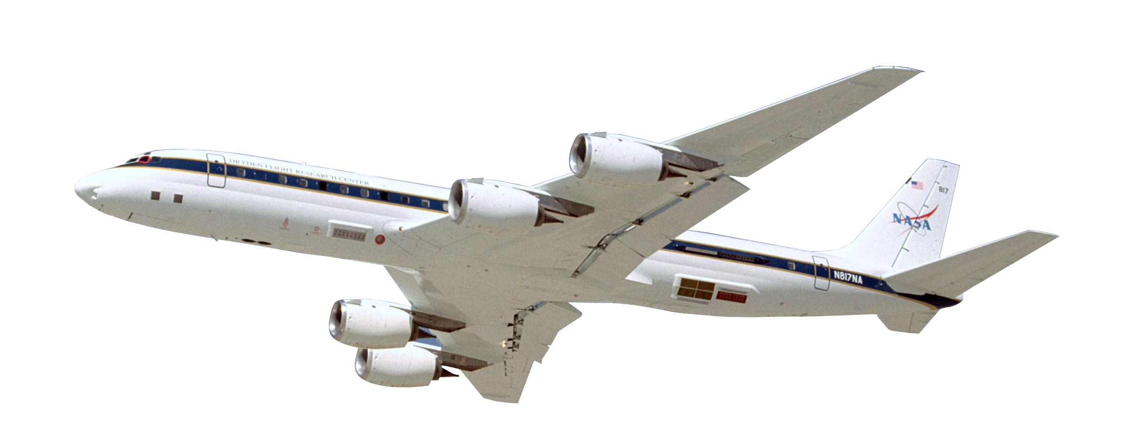
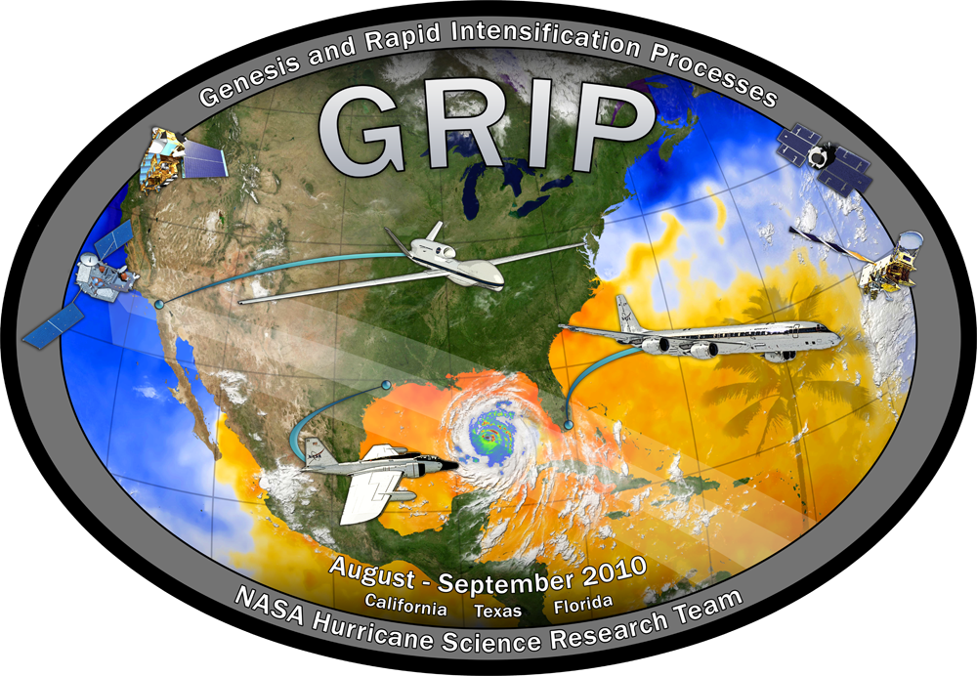
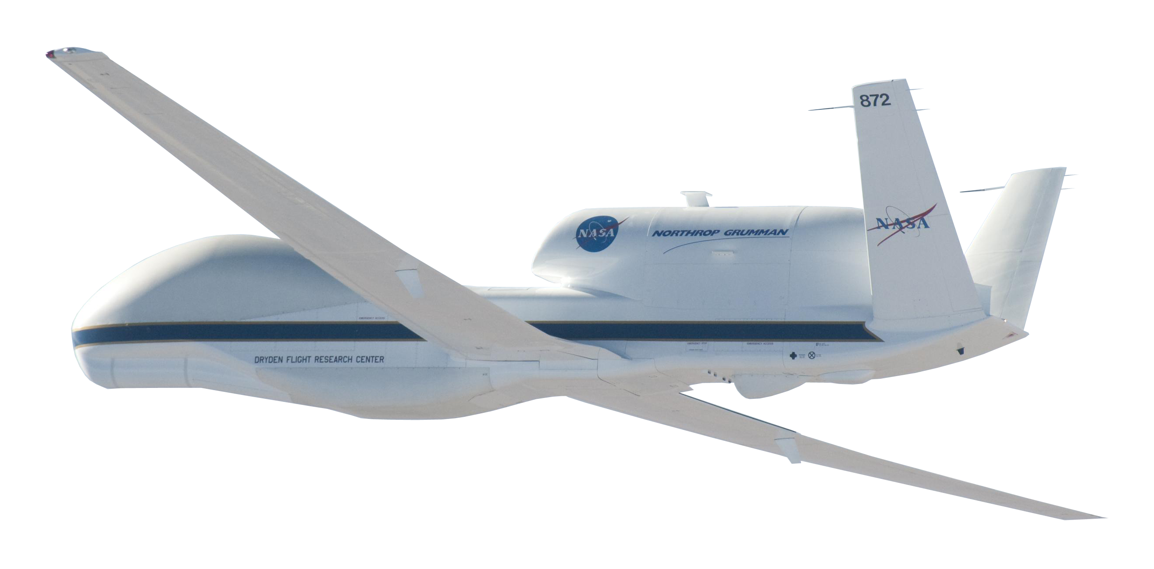
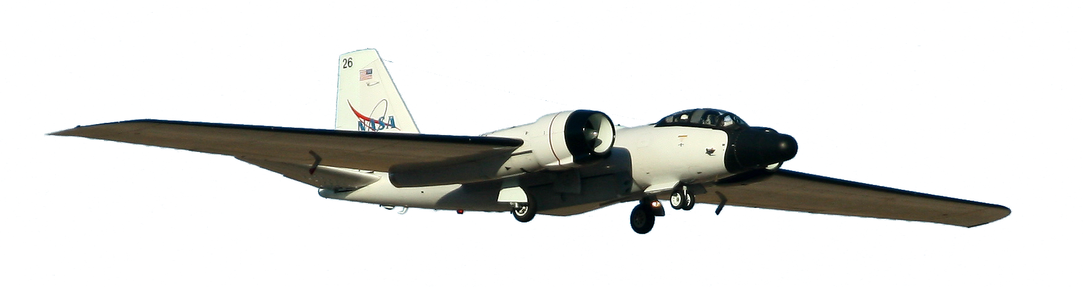
Several Advanced Technologies To Support the 2010 GRIP Campaign
DC-8
- The Doppler Aerosol WiNd lidar (DAWN) is a 2-micron Doppler lidar that can take vertical profiles of vectored horizontal winds.
(Principal Investigator: Michael Kavaya, NASA LaRC, IIP-04/IIP-07)
- The Airborne Second Generation Precipitation Radar (APR-2) is
an advanced radar system that obtained the first-ever simultaneous
measurements of rain intensity and fall velocity profiles during the
4th Convection and Moisture Experiment (CAMEX-4) in 2001.
(Principal Investigator: Eastwood Im, JPL, IIP-98)
Global Hawk
WB-57
The High-Altitude MMIC Sounding Radiometer (HAMSR) is a microwave atmospheric sounder that provides measurements that can be used to infer the 3-D distribution of temperature, water vapor, and liquid water in the atmosphere, even in the presence of clouds. (Principal Investigator: Bjorn Lambrigsten, JPL, IIP-98)
- The High-Altitude Imaging Wind and Rain Airborne Profiler
(HIWRAP) is a dual-frequency Doppler radar capable of measuring tropospheric winds within precipitation regions as well as ocean surface winds in rain-free to light rain regions.
(Principal Investigator: Gerald Heymsfield, NASA GSFC, IIP-07)
- The Hurricane Imaging Radiometer (HIRAD) instrument on board the WB-57 includes an ESTO-funded Agile Digital Detector (ADD) for Radio Frequency Interference (RFI) Detection and Mitigation system that can produce clearer microwave measurements, particularly over populated areas where wireless communications can crowd the spectrum. (Principal Investigator: Chris Ruf, University of Michigan, IIP-04)
Support
- The Real Time Mission Monitor (RTMM) is a situational awareness tool that integrates satellite, airborne and surface data sets; weather information; model and forecast outputs; and vehicle state data (e.g., aircraft navigation, satellite tracks and instrument field-of-views) for field experiment management. RTMM will optimize science and logistic decision-making during the GRIP campaign by presenting timely data, graphics and visualizations that improve real time situational awareness of the experiment’s assets. (Principal Investigator: Michael Goodman, Marshall Space Flight Center, AIST-08)

Slide 6
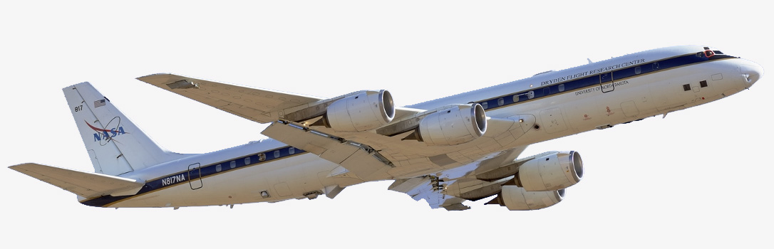
NASA DC-8 Payload
GRIP DC-8 Payload
Dropsondes
(Vertical Profiles of Temp, Press, Humidity and Winds)
DAWN
Doppler Aerosol Wind Lidar
(Vertical Profiles of Vectored Horizontal Winds)
MMS
Meteorological Measurement System
(Insitu Press, Temp, 3D Winds and Turbulence)
CAPS, CVI, PIP
(Cloud Particle Size distributions, Precip Rate, Rain & Ice water content)
LASE
Lidar Atmospheric Sensing Experiment
(H2Ov, Aerosol profiles and Cloud distributions)
APR-2
Airborne Precipitation Radar Dual Frequency
(Vertical Structure Rain Reflectivity and Cross Winds)

Slide 7
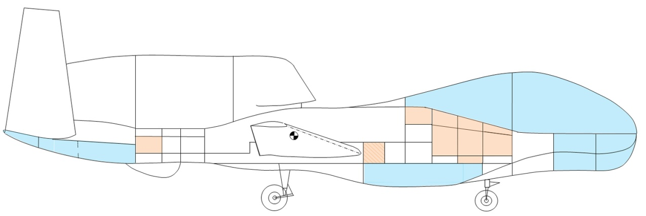
GRIP Global Hawk Instrument Payload
LIP (1,2)
Turbulence
Sensors
LIP (3,4)
2-Cameras, and
Storm Scope
27
7
65
46
16
13
12
1
61
22
3
LIP (5)
HDVis
25
HAMSR
DropSonde
LIP (6)
HIWRAP
HIWRAP
DropSonde
HAMSR
LIP
3 Cameras
Storm Scope
Accelerometers
High Altitude Imaging Wind and Rain Profiler (GSFC)
NOAA DropSonde System (incl. 75 dropsondes) (NCAR)
High Altitude MMIC Sounding Radiometer (JPL)
Lightning (and Electric Field Meas.) Instrument Package (MSFC)
Visual (including IR) Situational Awareness to Pilot
Lightning Detection Display in Flt. Op’s Area
Real-time Turbulence Time-history Display in Flt. Op’s Area

Slide 8
Flight Tracks in Hurricane Earl
Green-NASA DC-8
Purple-NASA WB57
Orange-NASA Global Hawk
Yellow-NOAA G-IV
Blue-NOAA P-3

Slide 9
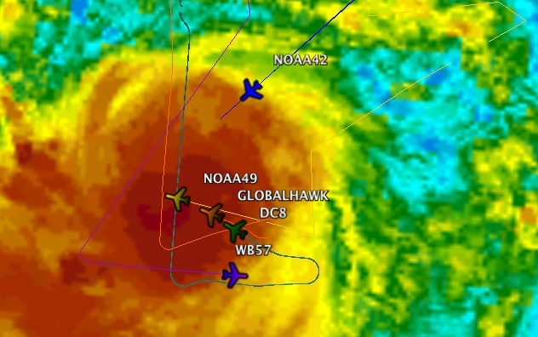
Flight Tracks Into Hurricane Karl
Green-NASA DC-8
Purple-NASA WB57
Orange-NASA Global Hawk
Red-PREDICT G-V
Yellow-NOAA G-IV
Blue-NOAA P-3

Slide 10

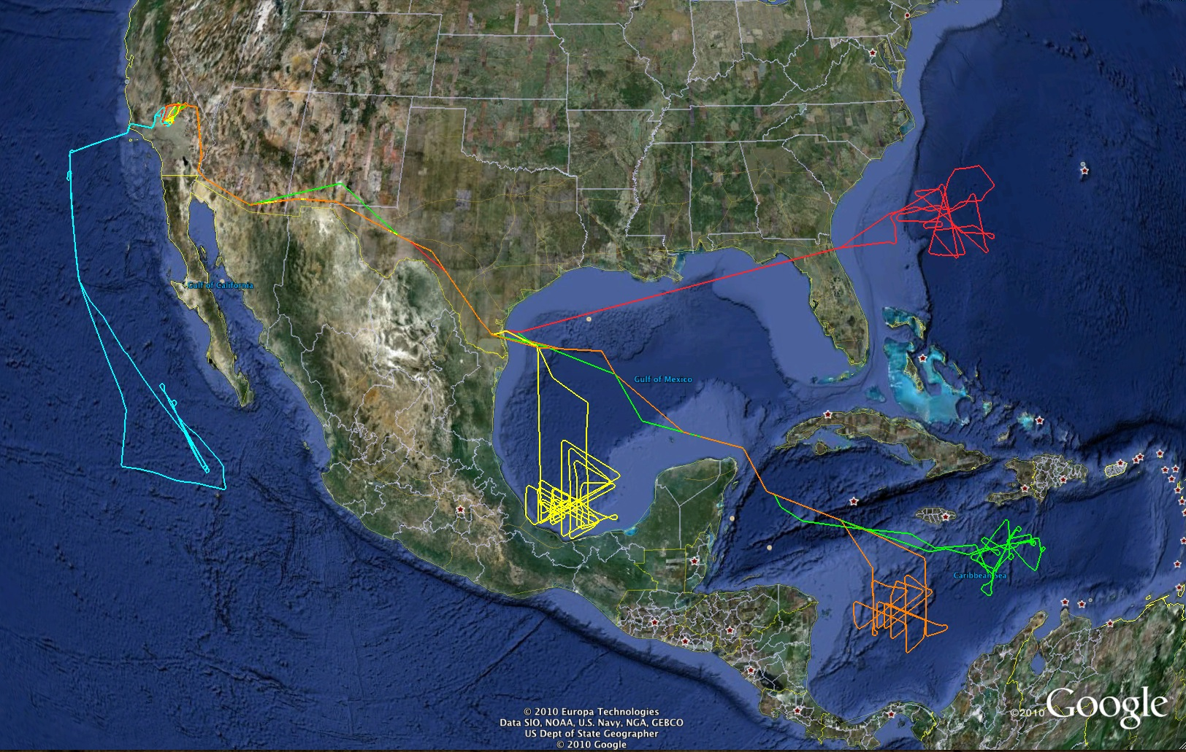
GRIP: Genesis and Rapid Intensification Processes Field Experiment
Storm | GH | DC-8 | WB-57 | NOAA | NSF | AF
Frank | 15.3 | 0 | 0 | N | N | N
Earl | 24.2 | 39.3 | 10.9 | Y | Y | Y
Gaston | 0 | 14.5 | 0 | N | Y | N
Karl | 48.5 | 40.2 | 17.5 | Y | Y | Y
Matthew | 25.1 | 17.8 | 0 | Y | Y | Y
Other Sci | 0 | 12.2 | 0 | NA | NA | NA
Transit/test flights | 8.6 | 14.9 | 0 | NA | NA | NA
TOTAL | 121.7 | 138.9 | 28.4
Hurricane
Earl
TS Frank
Hurricane Karl
Pre-Karl
TS Matthew
  GRIP accomplishments:
  • Two case of storm genesis (Karl and Matthew)
  • Two cases of RI (Earl and Karl)
  Global Hawk accomplishments:
  • Easily overflew intense hurricanes
  • ~14 h on-station over Karl
  • 20 eye overpasses during Karl
10

Slide 12
NASA Aircraft Hours and GRIP Coordination
Storm | GH | DC-8 | WB-57 | NOAA | NSF | AF
Frank | 15.3 | 0 | 0 | N | N | N
Earl | 24.2 | 39.3 | 10.9 | Y | Y | Y
Gaston | 0 | 14.5 | 0 | N | Y | N
Karl | 48.5 | 40.2 | 17.5 | Y | Y | Y
Matthew | 25.1 | 17.8 | 0 | Y | Y | Y
Other Sci | 0 | 12.2 | 0 | NA | NA | NA
Transit/test flights | 8.6 | 14.9 | 0 | NA | NA | NA
TOTAL | 121.7 | 138.9 | 28.4
Coordination of a combined 5 NASA and NOAA aircraft in Hurricane Karl on 16 September 2010 at ~1955 UTC

Slide 13

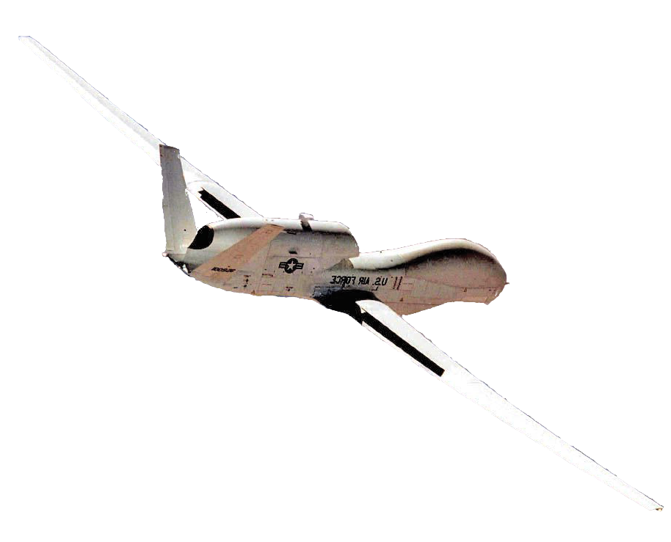
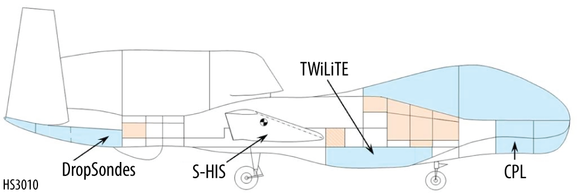
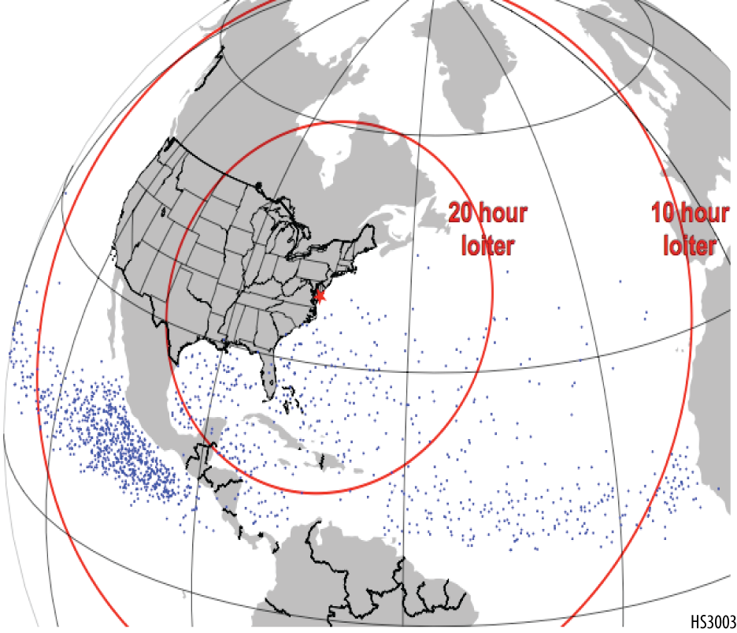
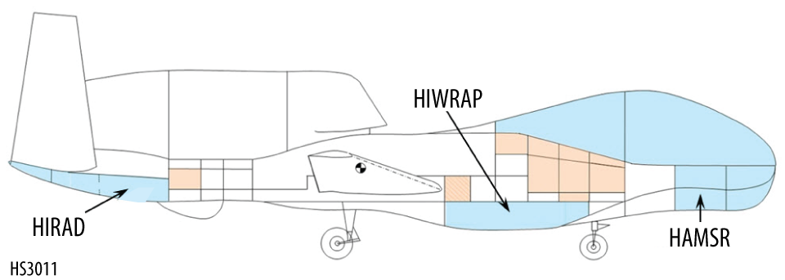
Hurricane and Severe Storm Sentinel (HS3)
Hurricane and Severe Storm Sentinel
HS³
Future NASA Hurricane Research
PI: Scott A. Braun (GSFC)
Science Goal:
To understand hurricane genesis and intensification.
Key Science Questions:
How do hurricanes form?
What causes rapid intensity changes?
How are intensity changes after formation related to upper-tropospheric flow features?
What’s the role of the Saharan Air Layer?
Two Global Hawk (GH) aircraft
Environment GH instrumentation
TWiLiTE (direct detection wind lidar)
CPL (cloud & aerosol lidar)
Scanning HIS (T, RH)
Dropsondes (wind, T, RH)
Over-storm GH instrumentation
HIWRAP (3-D winds plus sfc winds)
HIRAD (sfc winds and rain)
HAMSR (T, RH)
Key Elements:
Part of NASA’s Earth Venture program
Two Global Hawk aircraft, one to sample the environment, the other over storm
Three one-month deployments in 2012-2014
Deployment from the East Coast (likely Wallops Flight Facility)
Environment GH
Genesis Locations and Loiter Times
Over-storm GH

Slide 14
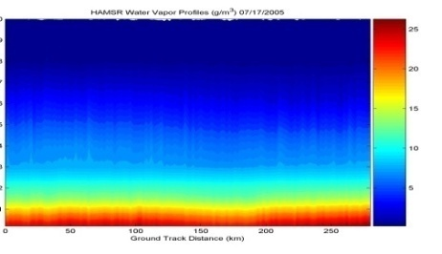
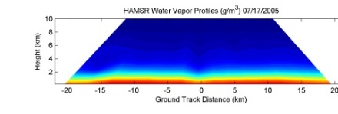
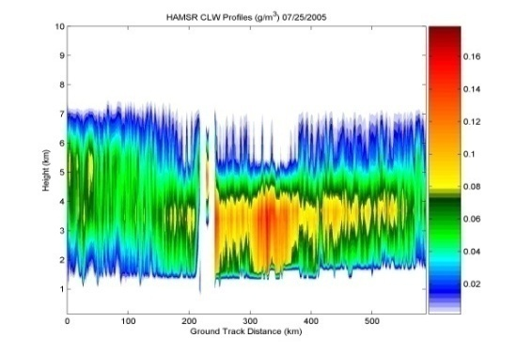
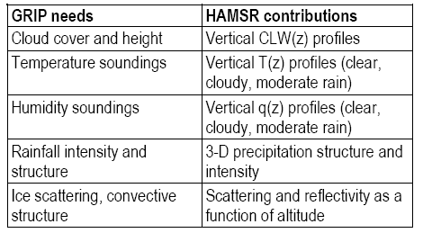
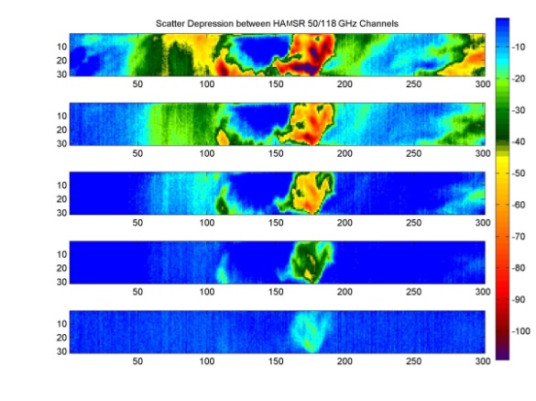
JPL High Altitude MMIC Sounding Radiometer (HAMSR)
JPL High Altitude MMIC Sounding Radiometer (HAMSR)
  Microwave radiometer for 3-D all-weather temperature and water vapor sounding, similar to AMSU on NOAA platform
  25 sounding channels in three bands:
  50-60 GHz, 118 GHz, 183 GHz
Cross track scanning
  + 45º off nadir
  40 km swath at 20 km
  2 km resolution
Flew in CAMEX-4, TCSP and NAMMA
Flight path
q(z): Cross-track
q(z): Along-track
CLW(z):
Along-track
Precipitation Structure/Imagery
Notes:
14

Slide 15
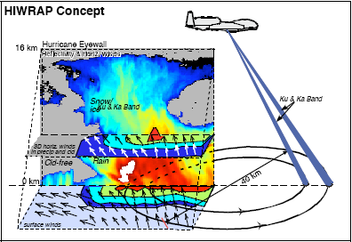
High-Altitude Imaging Wind and Rain Airborne Profiler (HIWRAP)
MEASUREMENTS GOALS:
Map the 3-dimensional winds and precipitation within hurricanes and other severe weather events.
Map ocean surface winds in clear to light rain regions using scatterometry.
NASA Global Hawk:
  19 km altitude, 30 hours
HIWRAP Characteristics:
  Conically scanning.
  Simultaneous Ku/Ka-band & two beams @30 and 40 deg
  Winds using precipitation & clouds as tracers.
  Ocean vector wind scatter-ometry similar to QuikScat.
Notes:
15

Slide 16
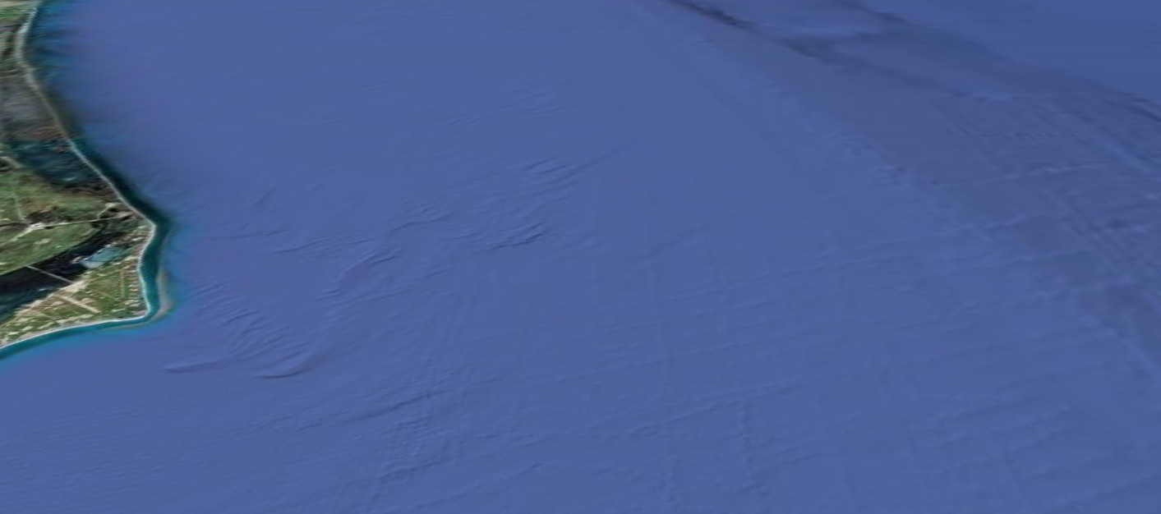

GRIP
Coherent Pulsed Doppler Wind Profiling Lidar System
Nominal Parameters
Laser beam nadir angle = 45 degrees (unchangeable)
Laser beam azimuth angle = 45, 135, 225, and 315 degrees
60 laser shots per LOS wind profile (12 sec)
LOS wind profiles 8.8 km from track
Aft LOS profile begins 71 s after Fore began
Fore and Aft LOS wind profile = 1 horizontal wind profile (83 s measurement time)
Left and Right of track horizontal wind profiles = 1 scan pattern
Pattern repeat = horizontal resolution = 12.5 km (50 sec)
Vertical profile of horizontal wind magnitude and direction
“= balloonsonde launch or very tall anemometer tower”
DC-8: 425 – 490 knots True Air Speed (cruise) = 218 - 252 m/s (250). 41,000 ft = 12.5 km

Slide 17
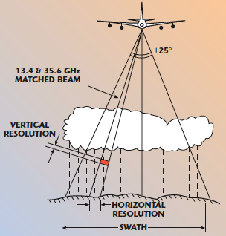
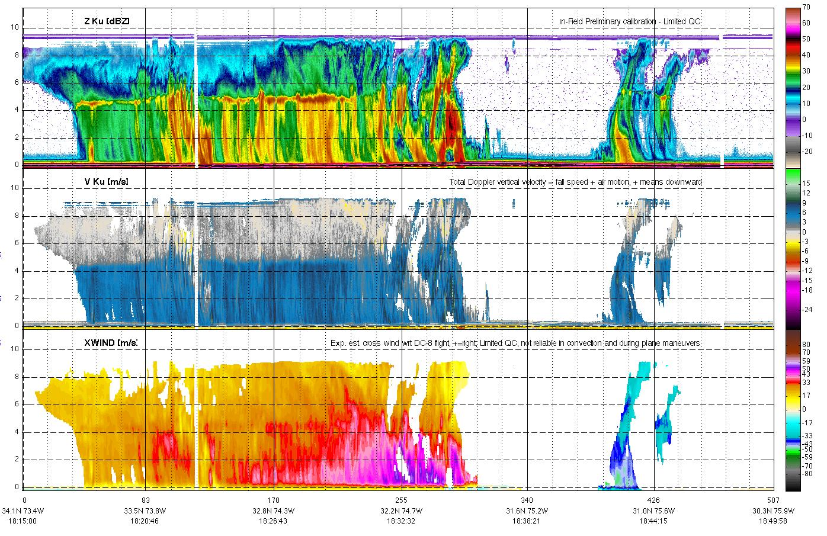
Airborne Precipitation Radar (APR-2)
APR-2 is a dual-frequency, dual-polarization, Doppler radar that operates on the NASA DC-8 aircraft
Below is vertical slice through Earl on Sep 2 from NNE to SSW (1815 UTC); southern eyewall was decaying
13 GHz reflectivity
eye
Vertical motion of precipitation (fall speed + air motion)
Updraft of 5 m/s
Max 58 m/s
out of page
Horizontal wind speed
Max 49 m/s
into page

Slide 18
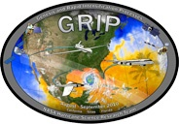


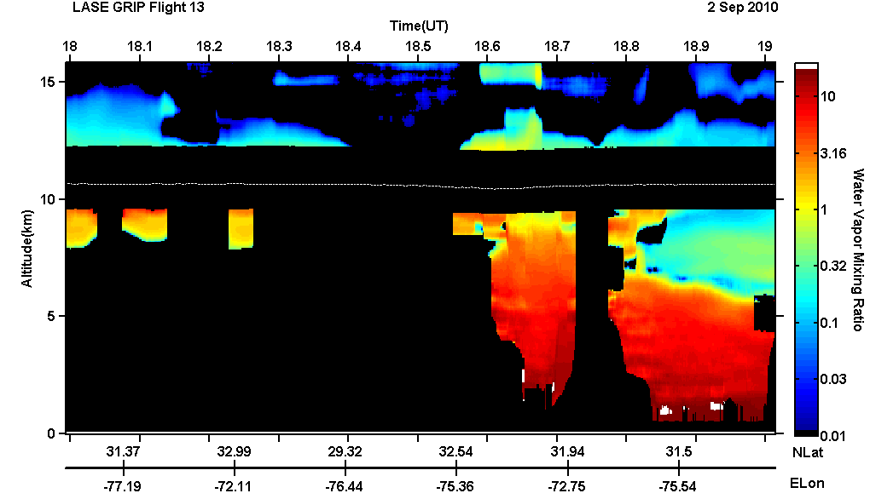
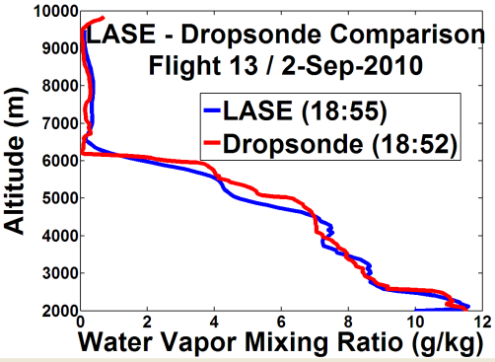
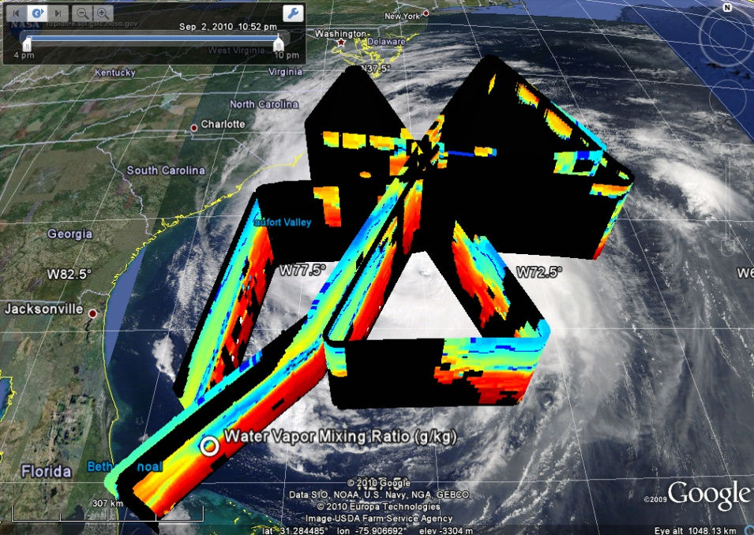
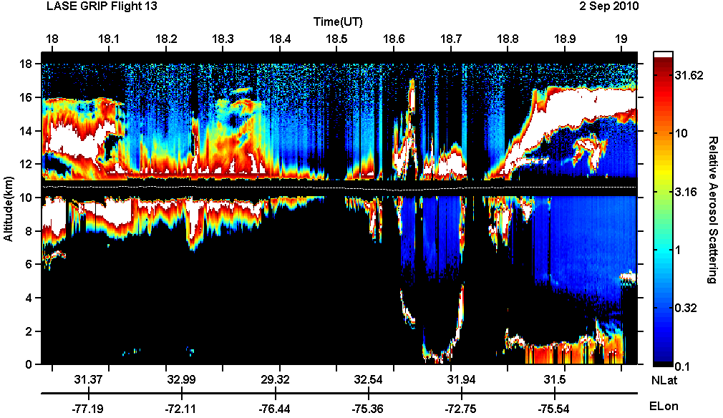
NASA Langley LASE measurements over Hurricane Earl
DC-8 GRIP Flight 13 - September 2, 2010
LASE measured water vapor, aerosol, and cloud distributions during flights over Hurricane Earl
LASE and dropsonde measurements of water vapor just outside eyewall show good agreement
Flight Segment across Earl between 18 – 19 UT
Water Vapor Mixing Ratio
Eye
Water Vapor Mixing Ratio
cirrus clouds
(outflow)
water clouds
(eyewall)
Relative Aerosol
And Cloud Scattering
Notes:
This slide shows preliminary LASE (Lidar Atmospheric Sensing Experiment) measurements acquired on September 2, 2010 when the DC-8 flew around Hurricane Earl. LASE measures profiles of water vapor mixing ratio and aerosol and cloud scattering. The map on the lower left shows LASE water vapor measurements acquired during the entire flight (~8 hours) on September 2 (DC-8 flight 13). The MODIS image in the background shows clouds associated with Hurricane Earl. This image shows LASE water vapor profiles between the surface and 10 km. The image on the top right shows the LASE water vapor profiles acquired during a pass from northeast and southwest (18-19 UT) over Earl when the Global Hawk was also flying over Earl. The LASE and DC-8 measurements during this pass included measurements over the eye of Earl as indicated in the image. (The color bar to the right of the image also applies to the image in the bottom left.) The LASE profile measurements show the high amount of water vapor over the eye decreasing away from the eye. The graph in the inset shows a comparison between the LASE and dropsonde water vapor profiles acquired just outside the eye at the location indicated by the vertical dashed line. This comparison shows excellent agreement between the LASE and dropsonde water vapor profiles. The black areas in these images are regions where the LASE lidar beam is attenuated by clouds. The image on the bottom right shows the LASE measurements of aerosol and clouds during this 18-19 UT pass over Earl. During the first part of the image, the DC-8 was flying in clouds and so the LASE lidar beam was heavily attenuated. The latter part of this image shows the locations of clouds above the eye and mostly cloud free skies, except for low clouds and aerosols near the surface and cirrus clouds above the aircraft.
Additional information about these measurements can be obtained from Syed Ismail (syed.ismail-1@nasa.gov), Richard Ferrare (richard.a.ferrare@nasa.gov), or Johnathan Hair (johnathan.w.hair@nasa.gov).

Slide 19
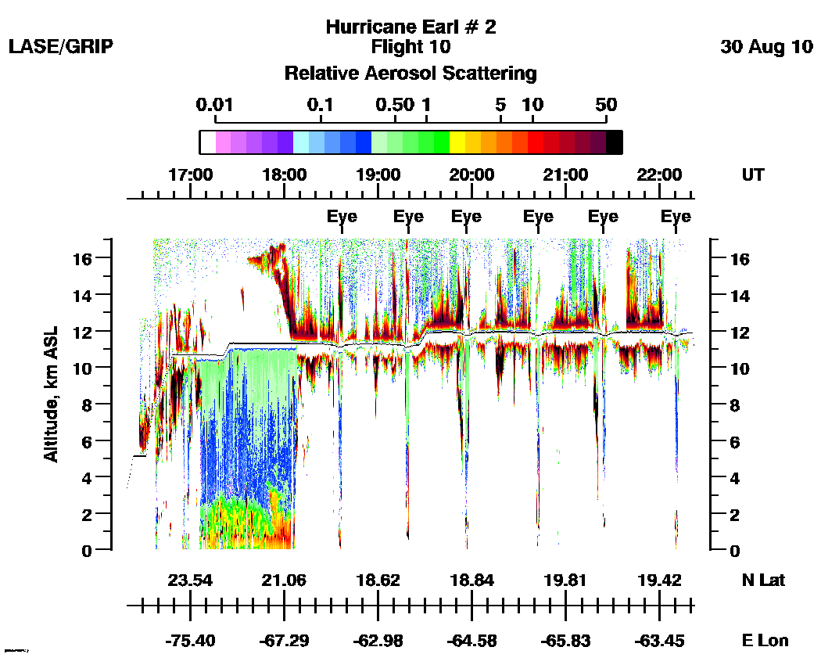
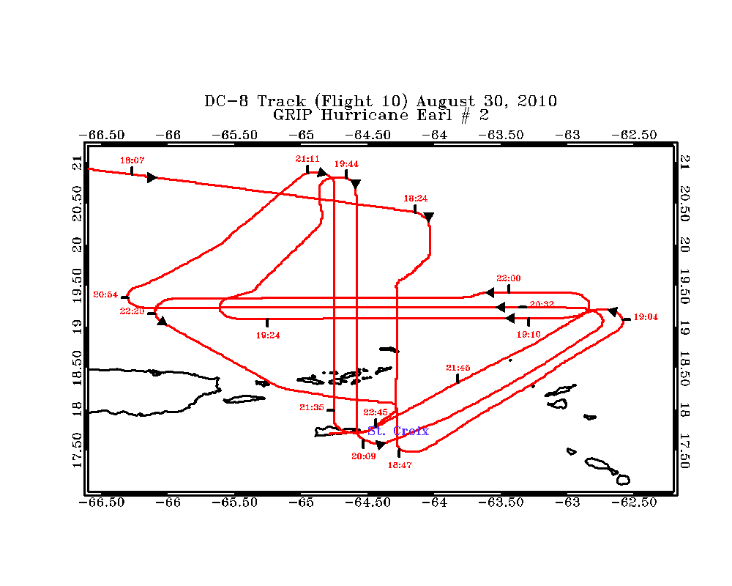
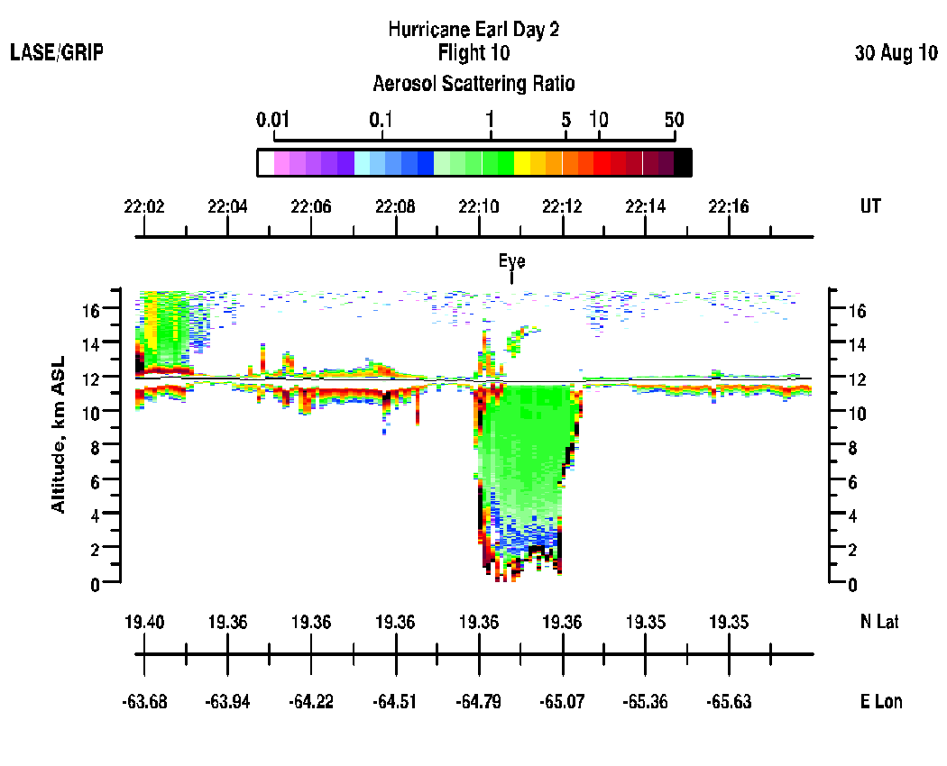
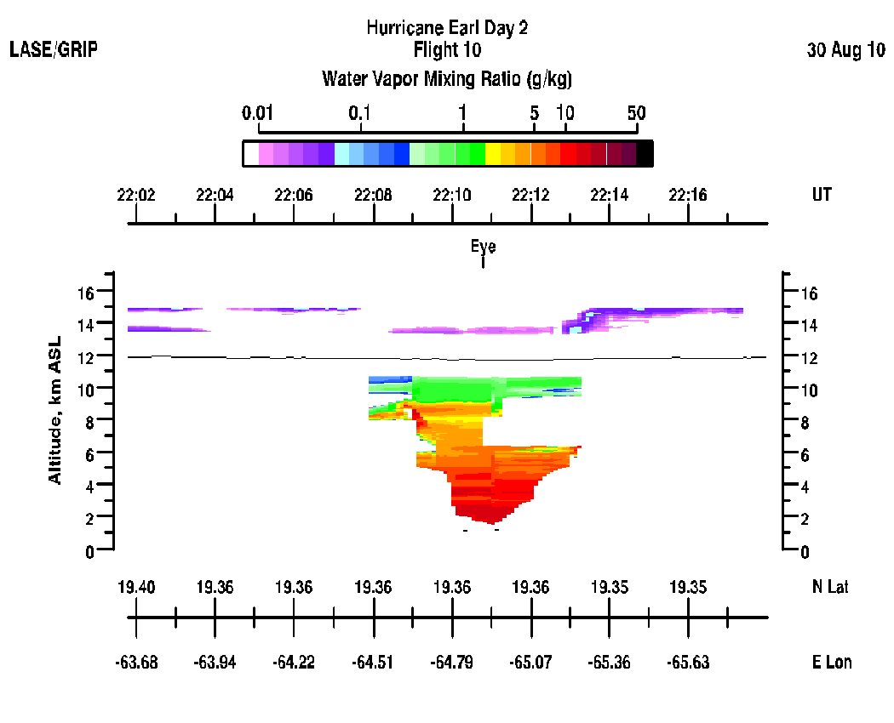
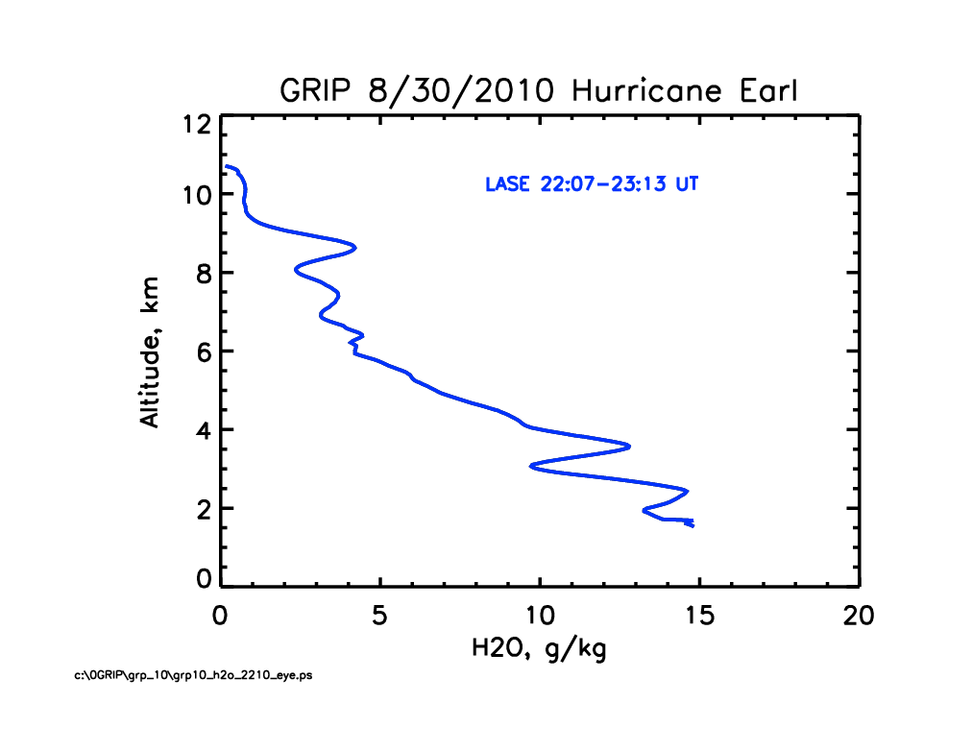
NASA Langley LASE Samples Evolution of the Eye of
Hurricane Earl on August 30, 2010
RELATIVE AEROSOL SCATTERING
FLIGHT TRACK ACROSS THE ‘EYE’
Dust
Dust
H₂O PROFILE IN THE ‘EYE’
Relative Aerosol Scattering
Water Vapor
Mixing Ratio
Notes:
LASE measurements of relative aerosol scattering and water mixing ratio are shown in this slide. The DC-8 flew over the Hurricane Earl as it was intensifying and a clear ‘eye’ was forming on Aug. 30. Relative aerosol scattering profiles from nadir and zenith are shown on the top left hand side panel. The DC-8 altitude profile is shown as a dark line in this image and white regions indicate absence of lidar data mostly due to cloud attenuation. The ‘eye’ was crossed several times and as clear eye formation towards the end permitted measurements to the surface. Bottom panels show: 1) the eye wall and structure of the eye from the relative aerosol scattering, 2) water vapor distributions within the eye (highest near bottom ~15 g/kg (red) and lowest <<0.1 g/kg in the zenith (purple)), 3) and water vapor profile in the eye.

Slide 20
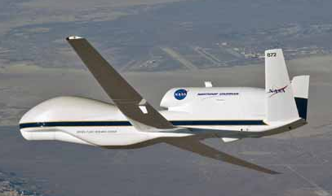
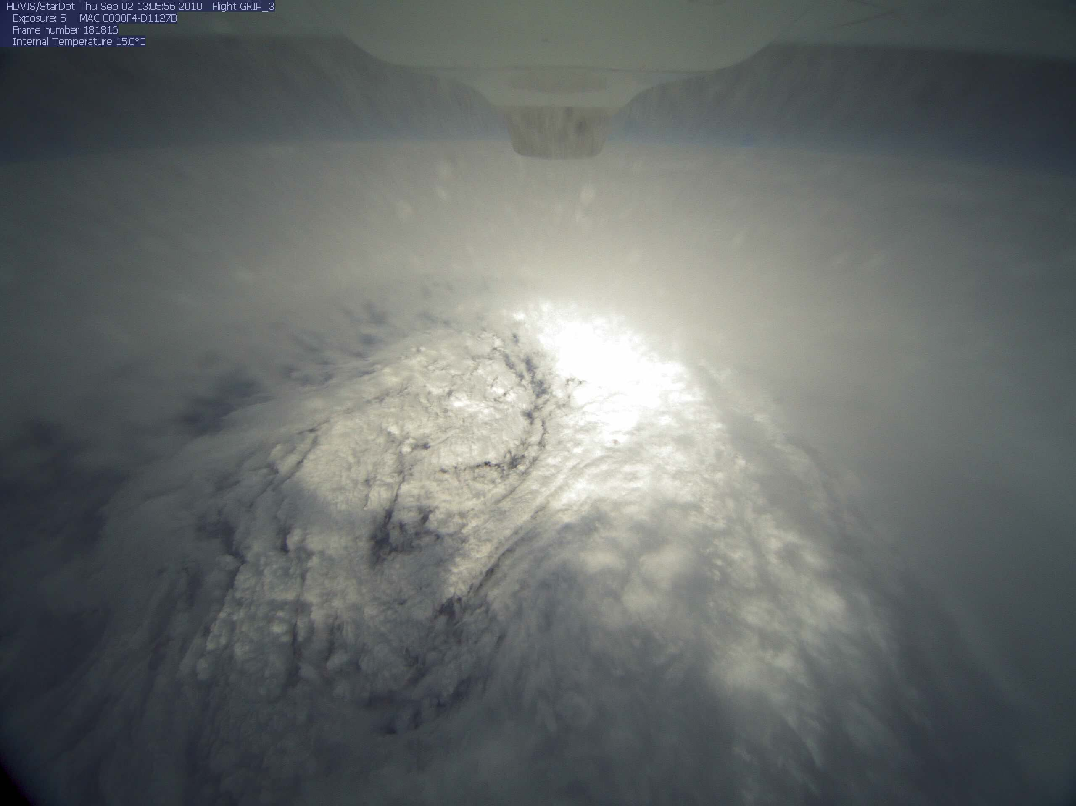
NASA’s Global Hawk UAS
Hurricane Earl’s eye as seen from the GH
Cruise Climb from 56-65K ft
(max takeoff weight)

Slide 21
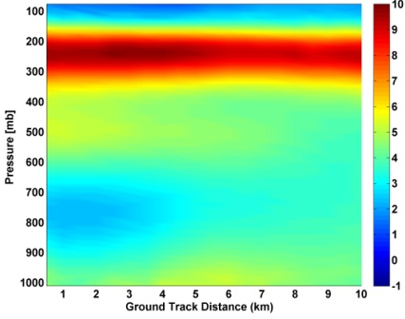
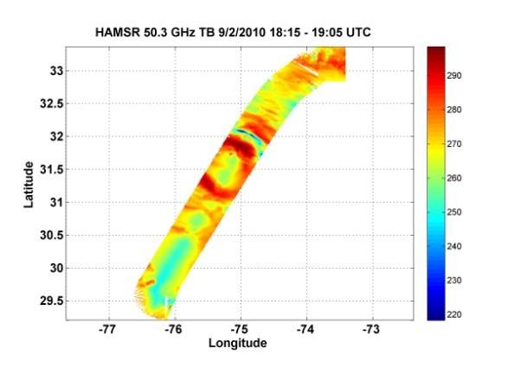
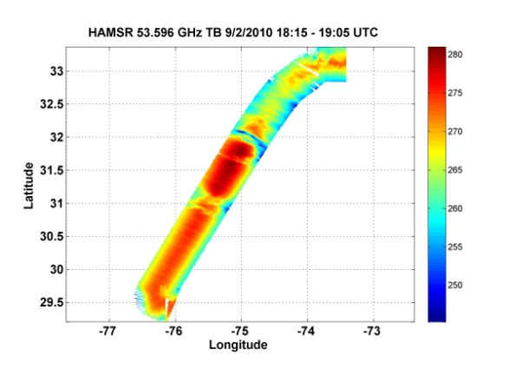
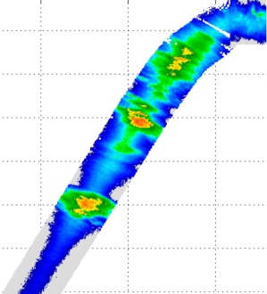
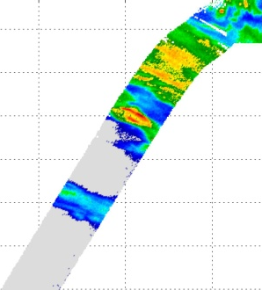
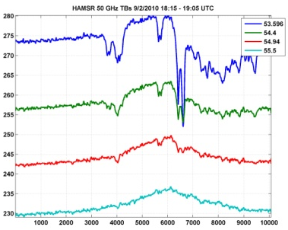
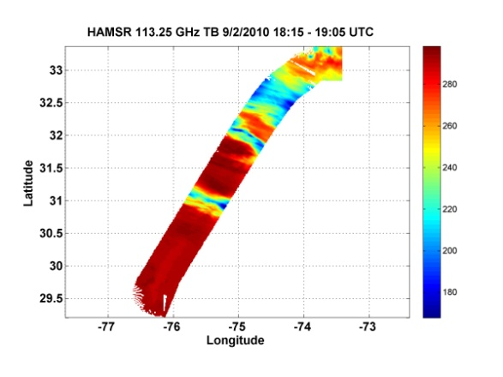
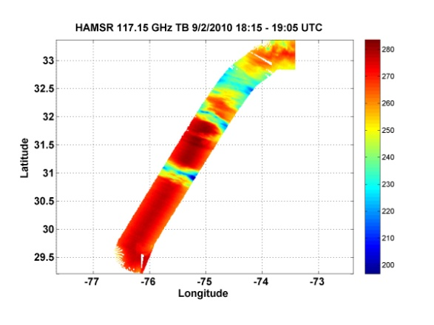
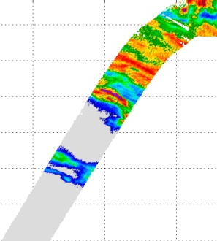
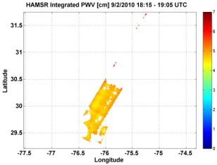

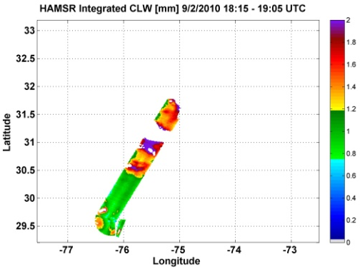
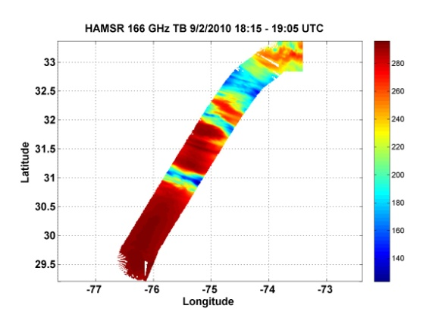
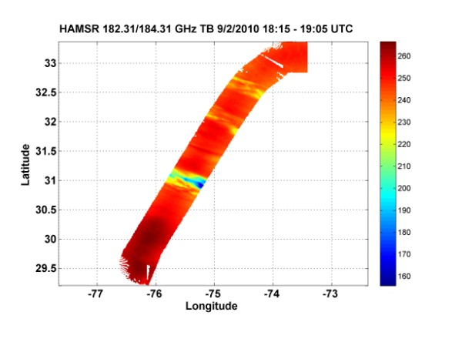

HAMSR @ Earl, 9/2/2010, 1815-1905 UTC
(All retrievals are preliminary)
Temperature
Brightness temperatures
Reflectivity (experimental)
10 km
Ch. 01
Ch. 04
Up to 10 K
warm core anomaly
7 km
5 km
Tb anomaly
Ch. 09
Ch. 13
Precipitable water
4-5 cm TPW
3 km
Significant
convection &
precipitation
Cloud liquid water
Up to 2 mm LWC
Ch. 19
Ch. 25
Nadir (0-15 km altitude)
Notes:
This pass went right across the eye of Earl, which shows up quite clearly in the channel 1 (50.3 GHz) Tb image. There is an arch of thunderstorms NE of the eye, with very cold Tb’s.
We have done preliminary temperature retrievals in the eye and determined the warm core anomaly. It peaks at about 10 K at 250 mb (UL panel). Just below that plot we show line plots of brightness temperature anomalies across the eye (at nadir).
We have also done water vapor retrievals. The next image down shows total precipitable water in benign areas only (no precip, etc.). The value is generally around 4-5 cm. We have also retrieved cloud liquid water, and the last plot to the left shows total liquid water in non-convective regions. Peak value is 2 mm, but it is possible that the retrieval is biased just there (we need to work on that).
On the right side we show retrieved reflectivity, using a new experimental algorithm we have developed. At the bottom is a nadir curtain plot, with color coded reflectivity plotted vs. height (0-15 km) on the vertical axis and along-track distance on the horizontal axis. Of note is a convective area SW of the eye that does not extend to the surface and a strong convective area NE of the eye that corresponds to a band of lightning. The plots above are horizontal slices at 4 different altitudes. Also of note is that according to this, convective cells reached 15 km altitude in some areas.

Slide 22
Summary
NASA satellite sensors are helping to expand weather/hurricane research frontiers
Columbia and Pleiades supercomputers support high resolution hurricane modeling
NASA sponsored field campaigns have helped us develop a better understanding of many hurricane properties including inner core dynamics, rapid intensification and genesis
NASA satellite sensor data is being under utilized in hurricane research (assimilation of satellite data has a much greater potential impact on the track and intensity forecasts)

