Slide 1
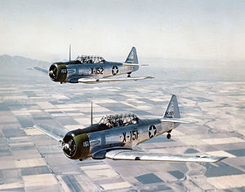
First Hurricane Flights in 1943…
"As we broke into the 'eye' of the storm we... could see the sun and the ground. Apparently the 'eye' was like a leaning cone as observation of the ground showed a considerable ground wind.... On the whole, neither flight through the hurricane was as uncomfortable as a good, rough thunderstorm. “ – Army Air Force Colonel Joseph Duckworth– July 26th, 1943 – Aboard an AT-6C

Slide 2
…Hurricane Flights in 2010

