Slide 1
Objective Evaluation of 2010 HFIP Stream 1.5 Candidates
Louisa Nance, Christopher Williams, Michelle Harrold, Kathryn Newman, Paul Kucera, and Barb Brown
National Center for Atmospheric Research (NCAR)
Research Applications Laboratory (RAL)
Joint Numerical Testbed (JNT)
Tropical Cyclone Modeling Team (TCMT)
Acknowledgements:
National Hurricane Center – case selection and verification metrics
HFIP Verification Team – verification metrics
Participating Modeling Groups – retrospective forecasts

Slide 2
HFIP Stream 1.5 Concept
Stream 1: Yearly upgrades to operational numerical weather prediction capabilities
Stream 2: Enhancements to operations that require multiple year applied research, development and transition-to-operations work
Stream 1.5: Improved models (mainly) that the NHC, based on prior assessments, wants to access in real-time during a particular hurricane season, but which can’t be made available to the NHC by the operational modeling center in conventional “production” mode (typically due to limits in computing capability and/or programmer time)

Slide 3
2010 Stream 1.5 Retrospective Cases
Eastern Pacific:
2008 – 5 storms
2009 – 6 storms
Atlantic:
2008 – 8 storms
2009 – 9 storms

Slide 4
2010 Stream 1.5 Participants
Participants
Organization | GFDL | NCAR/MMM | NRL | FSU
Model | GFDL* | AHW | COAMPS-TC | ARW
ATCF ID | GFD5 | AHW1 | COTC | ARFS
Resolution | 1/12 deg | 1.3 km | 5 km | 4 km
Basins | Atlantic & Eastern Pacific | Atlantic | Atlantic & Eastern Pacific | Atlantic
Initialization times | 00, 06, 12, 18 | 00, 12 | 00, 06, 12, 18 | 00, 12

Slide 5
Data Inventory
% Expected
Storms & time periods
Planned basins & # of runs/day

Slide 6
Methodology
Stream 1.5 Candidate
Operational Baseline
forecast
…….
forecast
forecast
…….
forecast
NHC Vx
…….
NHC Vx
NHC Vx
…….
NHC Vx
…….
Track & Intensity (along- & cross- track too)
errors
errors
errors
…….
errors
matching – homogeneous sample
pairwise differences
error distribution properties
median, mean, interquartile range, 95% CI, outliers
Graphics
SS tables
Median ± 95%CI does not include zero

Slide 7
Baseline Comparisons
Operational Baseline | Stream 1.5 configuration | Lead times evaluated
GFDL | Stream 1.5 | Every 6 h out to 120 h
Consensus (at least 2 available) - Track: GFS, UKMET, NOGAPS, GFDL, HWRF Intensity: DSHP, LGEM, GFDL, HWRF | Consensus + Stream 1.5 | Every 6 h out to 120 h
GFS (track) DSHP (intensity) | Stream 1.5 | Official forecast times: 00, 12, 24, 36, 48, 72, 96, 120 h
Homogeneous average of previous year’s top flight models – Track: GFS, UKMET, GFDL Intensity: GFDL, HWRF, DSHP, LGEM | Stream 1.5 | Official forecast times: 00, 12, 24, 36, 48, 72, 96, 120 h

Slide 8
Error Distributions
Absolute Intensity Error
GFDL vs GFD5
Atlantic Basin
Difference Distributions
GFDL-GFD5
Atlantic Basin

Slide 9
Statistically Significant Differences
GFDL Baseline
Consensus Baseline
Track
Intensity

Slide 10
NHC’s 2010 Stream 1.5 Decision
Accepted
GFD5
Accepted prior to TCMT evaluation
AHW1
Statistically significant improvements at numerous time periods when added to the operational consensus with no statistically significant degradations
Substantial improvements over the consensus at 96 and 120 h (not statistically significant)
Note: Sample provided smaller than desired
Not accepted
ARFS
Largely neutral impact on the consensus and limited sample size.
COTC
Not sufficiently strong or consistent enough to warrant inclusion
Note: Provided a significant sample size

Slide 11
Sample Size Impact Full COTC sample vs sample consistent w/AHW1
GFDL Baseline
Consensus Baseline
Track
Intensity

Slide 12
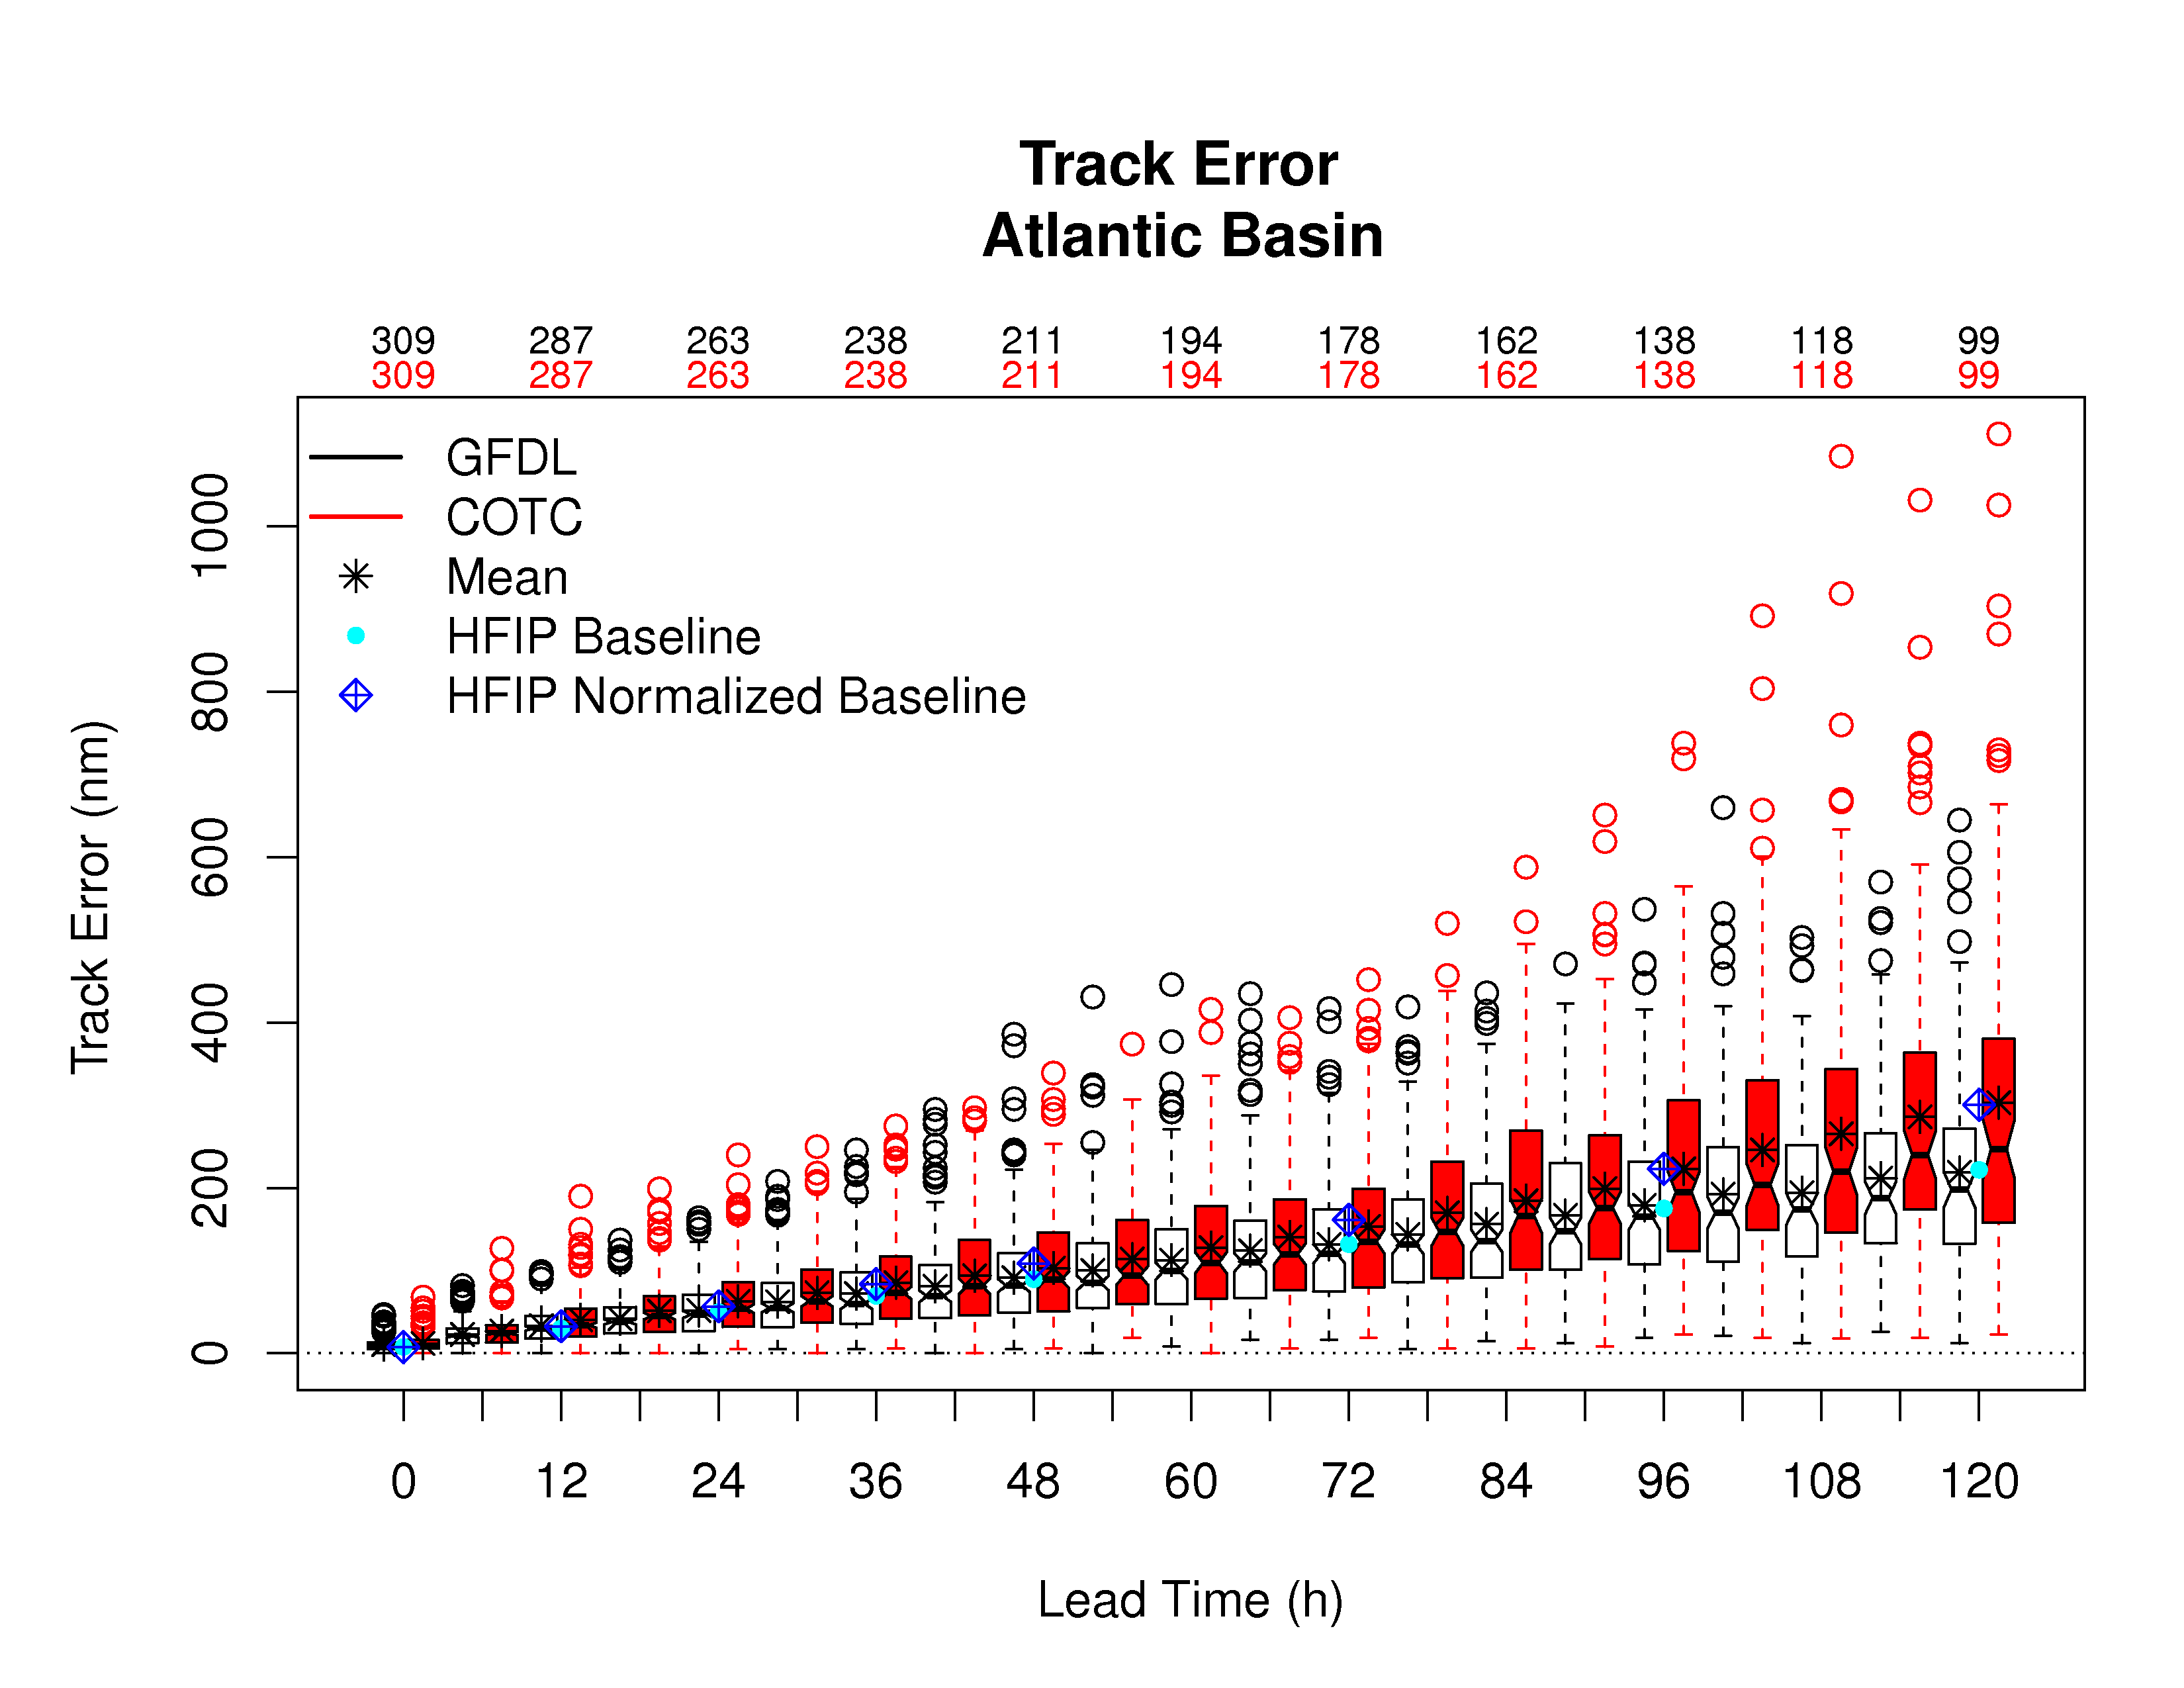
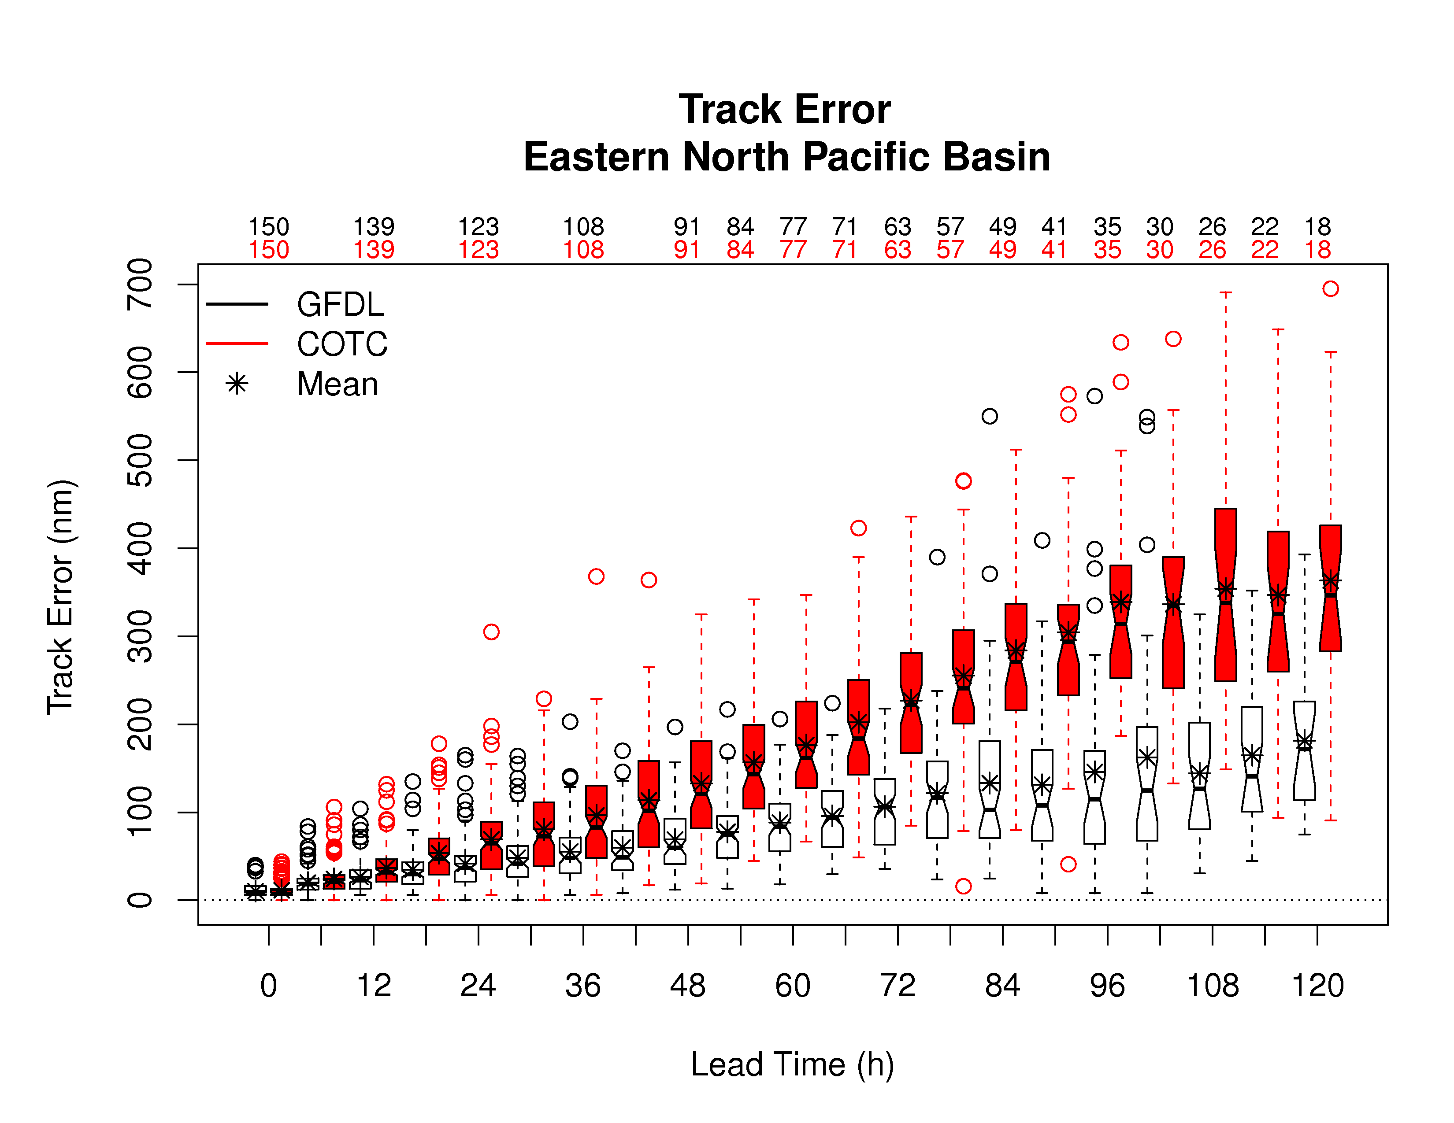
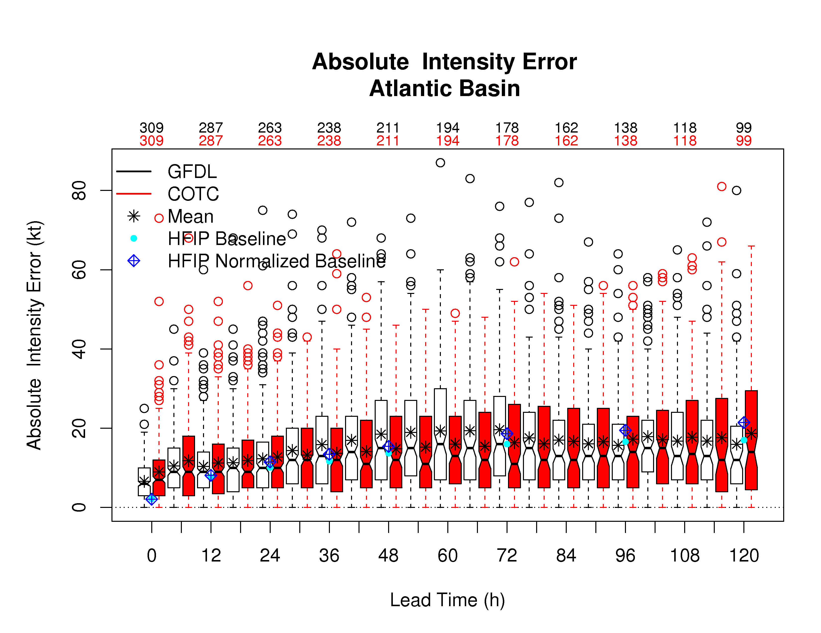
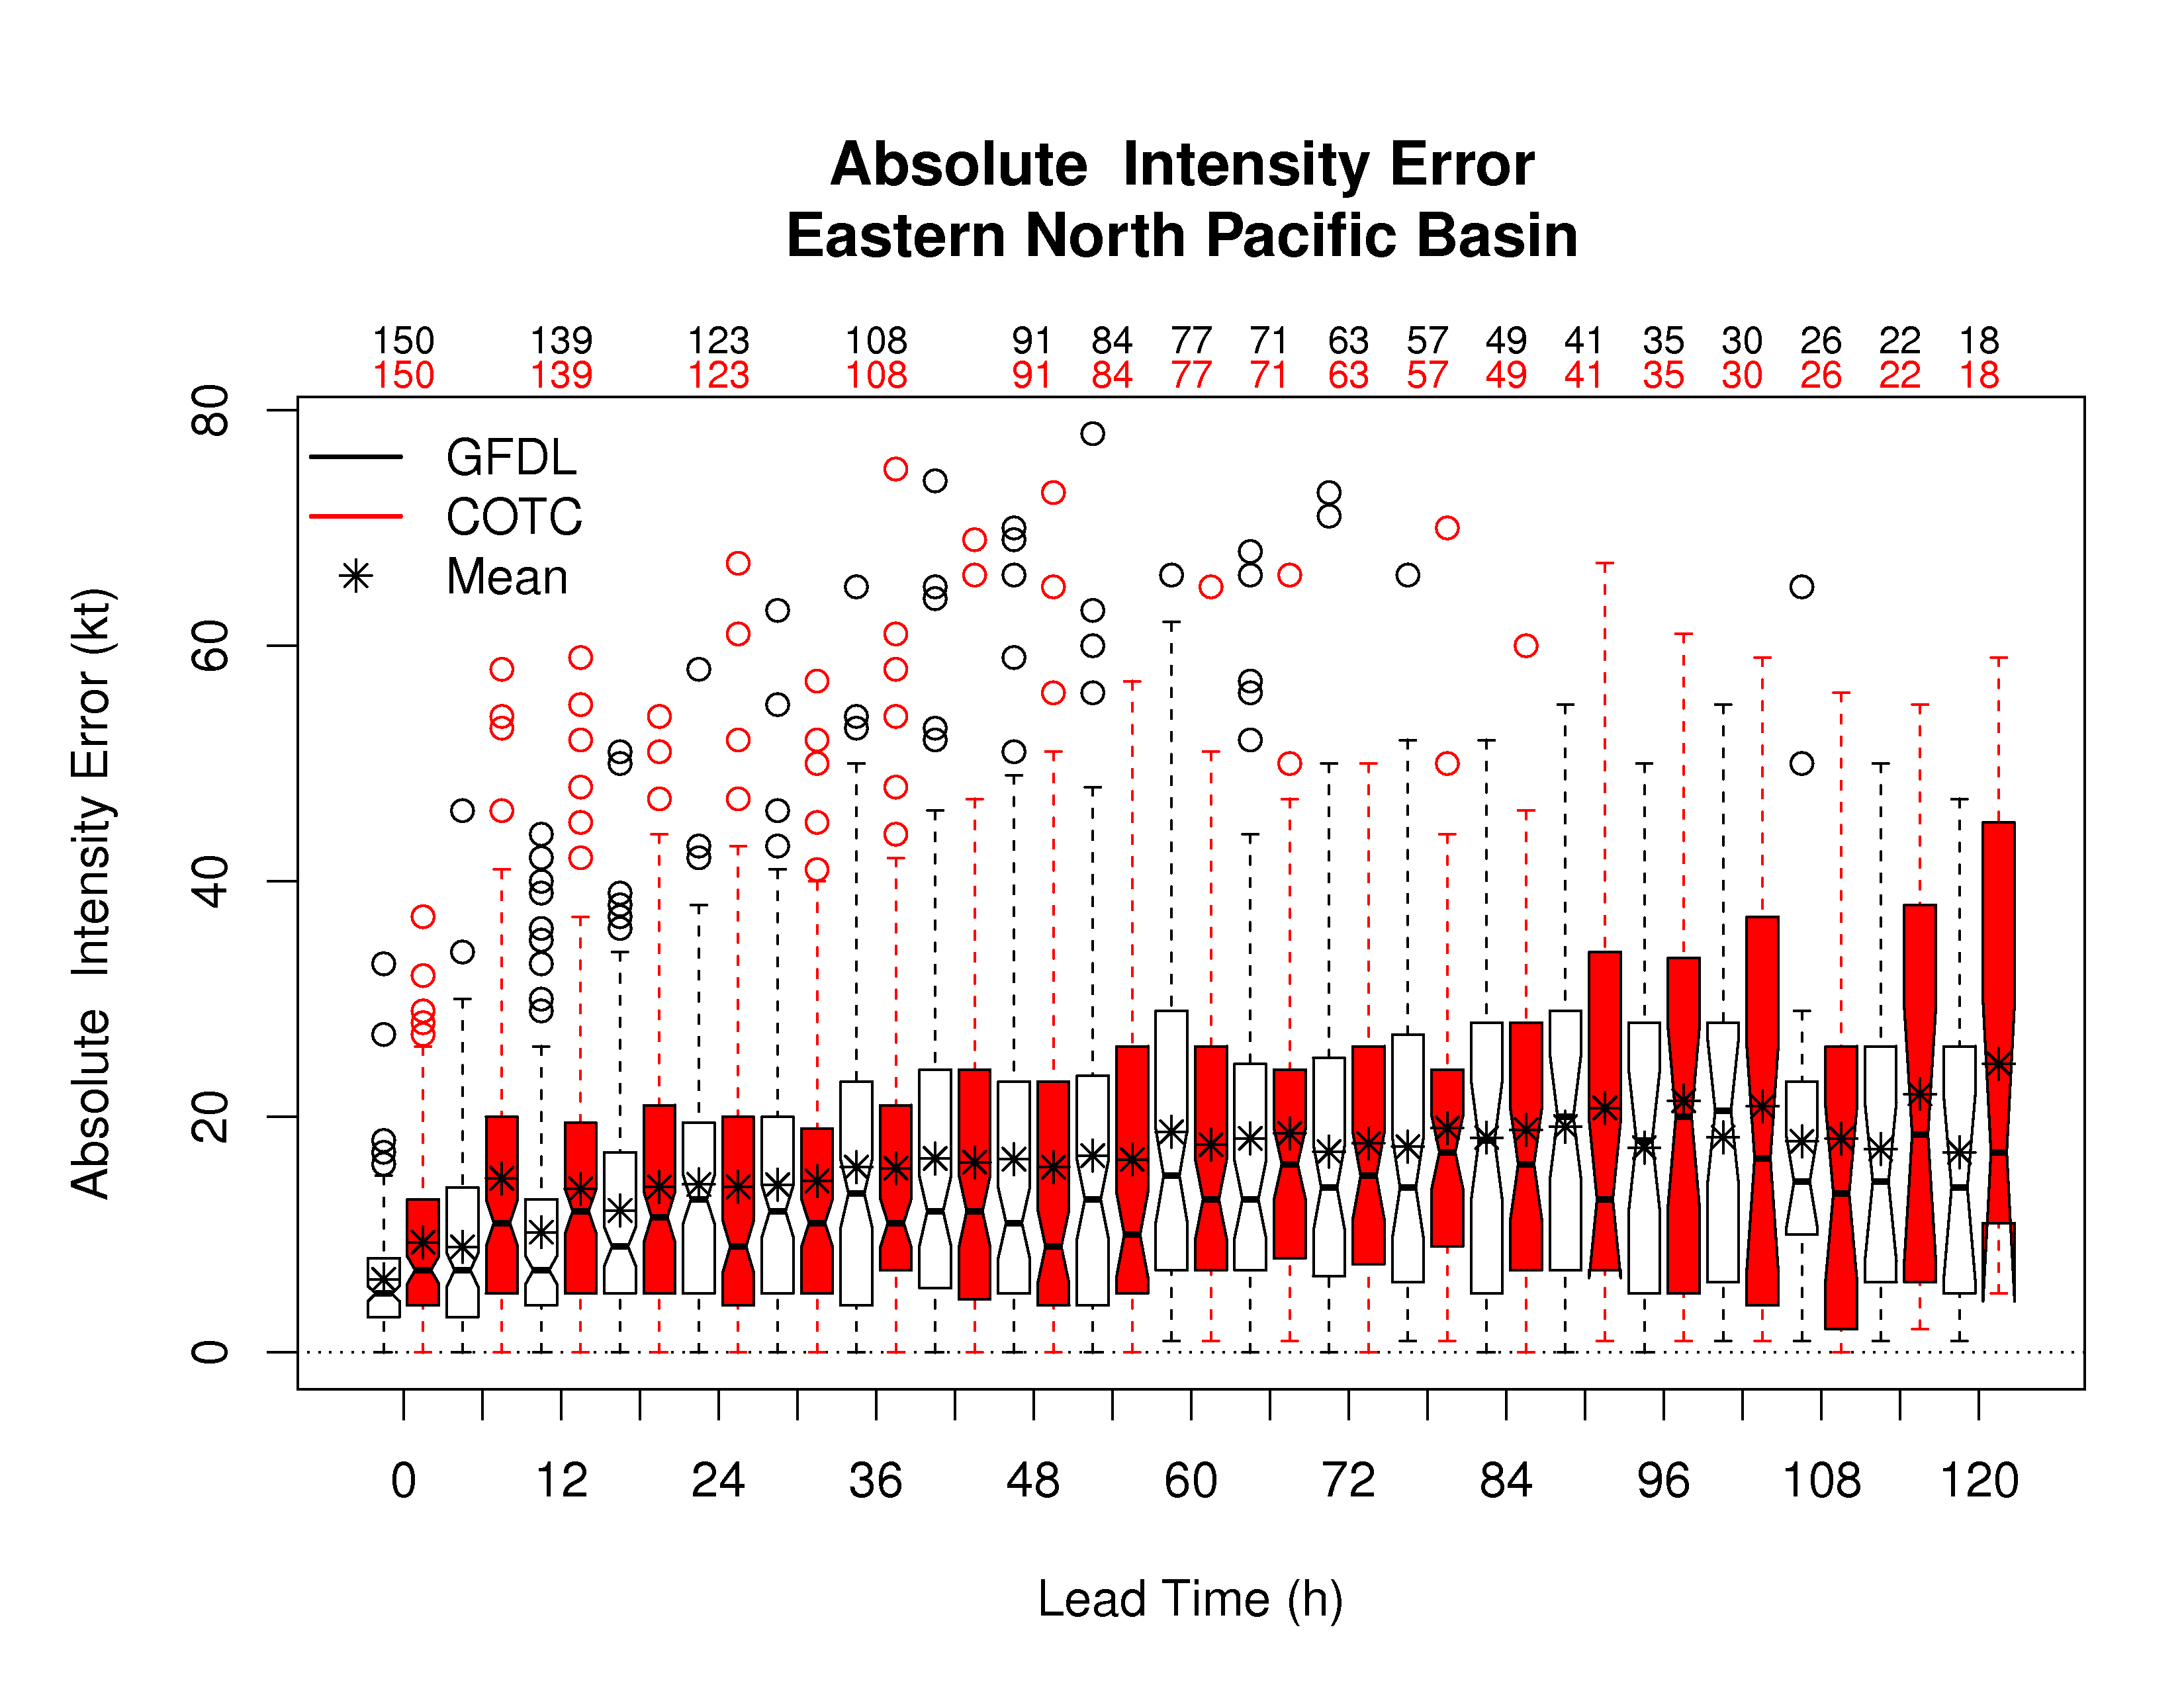
Basin Sensitivity
Atlantic
Eastern Pacific

Slide 13
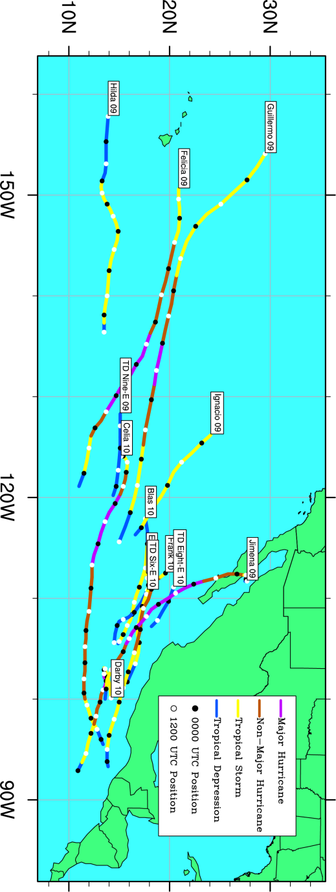
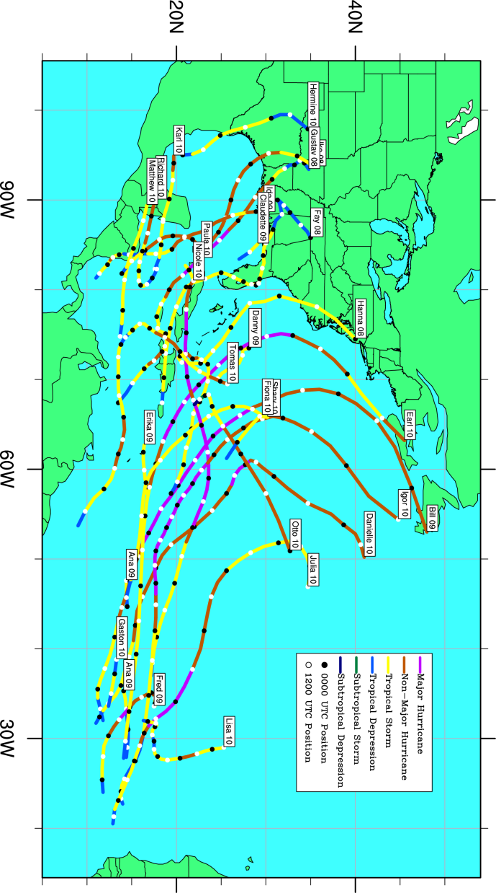
2011 Stream 1.5 Retrospective Cases
Eastern Pacific:
2009 – 6 storms
2010 – 7 storms
Atlantic:
2008 – 4 storms
2009 – 7 storms
2010 – 16 storms

