Slide 1

Technology Transfer in Tropical Cyclone Numerical Modeling – The Role of the DTC
Ligia Bernardet, S. Bao, C. Harrop, D. Stark, T. Brown, and L. Carson
External collaborators:
NOAA Environmental Modeling Center
NOAA Geophysical Fluid Dynamics Laboratory
NOAA Atlantic Oceanographic and Meteorological Laboratory
NCAR Mesoscale and Microscale Meteorology Division
University of Rhode Island
65th IHC, March 02, 2011

Slide 2
Goal: Increase Tech Transfer to Operations
Current focus in HWRF
Code Management
  Create a framework for NCEP and the research community to collaborate
Testing and Evaluation
  Perform tests to assure integrity of community code and evaluate new developments for potential operational implementation
  Develop and maintain a hurricane testing and evaluation infrastructure at DTC
User Support
  Support the community in using an operational hurricane model

Slide 3
HWRF Overview

Slide 4
HWRF Code Management
Goal: maintain a single code base for research and operation
Components with existing community code repository in 2009 | Components without existing community code repository in 2009
WRF, WPS, GSI, WPP | Vortex, POM, coupler, tracker
DTC established operational capability with community repository | DTC created community code repositories
DTC keeps community code updated with operational developments
Code for 2011 operations taken from community repository

Slide 5
HWRF Code Management: Atmospheric Model
Tutorial,HWRF release
04/2011
WRF V3.3
HWRF for operations (2011)
Contributions from EMC and NOAA Research to HWRF
(initial 3rd nest development, new nest motion)
02/2011
WRF V3.2.1+
09/2010
WRF V3.2.1+
08/2010
WRF V3.2.1
2011 Baseline
Tutorial, HWRF Beta release
03/2010
WRF V3.2
2010 Baseline
07/2009
WRF V3.1.1
(…)
05/2004
WRF V2
(…)
oper HWRF
2009
oper HWRF
2010 “R2”
Notes:
Main change since November 2010: 2011 Baseline now in repository and tested.
Emphasize that this slides only covers the atmospheric component of HWRF (WRF)
The vertical blue boxes represent the evolution of the WRF Community Code. The orange boxes along the bottom of the slide represent evolution of the WRF code within HWRF. For years, HWRF code was developed at EMC separately from the community effort. The orange arrows represent work done by EMC and DTC of putting HWRF capabilities into community code. After each code transfer, a multi-storm test was conducted. DTC is currently conducting a comprehensive test of the 2011 Operational Baseline. The previous test conducted by DTC was dubbed R2prime (a test of V3.2.1+ containing the R2 capabilities). The results of those runs were compared against an equivalent run using the current operational WRF V2. The “prime” refers to the fact that in this test community code was used not only for WRF (V3.2.1+ with R2 capabilities) but also for the vortex initialization and ocean. The community vortex initialization and ocean are basically the same ones used in operations, but several bugs were fixed and corrections were made to have the code work in multiple platforms.

Slide 6
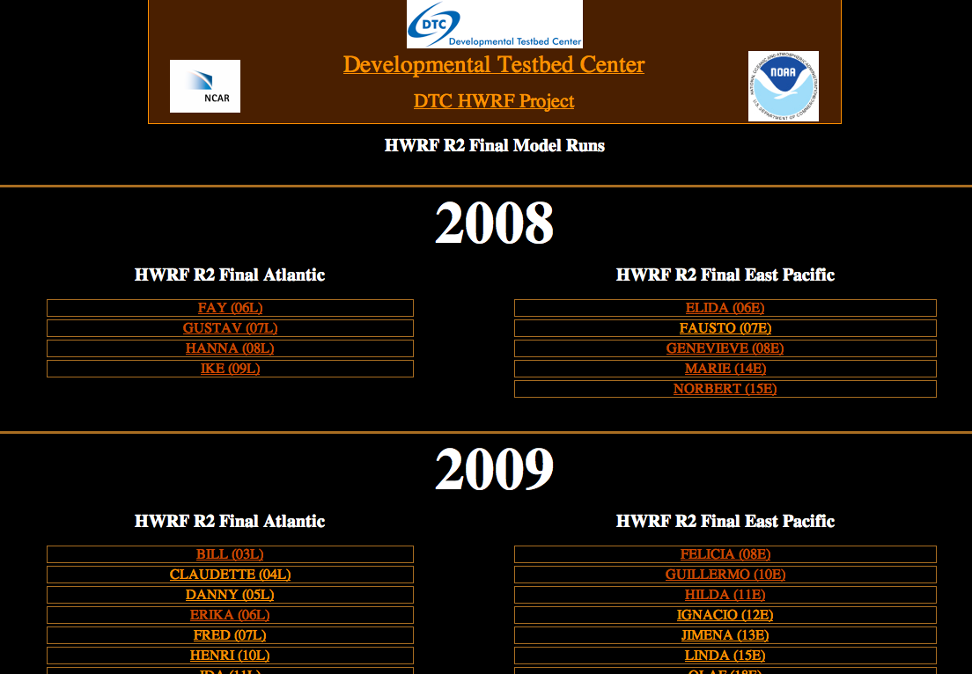
Functionally-Equivalent T&E Suite
Pre-processing (including ability to read binary GFS in spectral coordinates)
Cycled HWRF vortex initialization and relocation
GSI Data Assimilation
Coupled (POM + WRF) model
Post-processing
Tracking
NHC Verification, confidence intervals
Display
Archival
The Developmental Testbed Center
HWRF 2011 Baseline Test Plan
Point of Contact: Ligia Bernardet
December 15, 2010
Introduction
The DTC will be performing testing and evaluation for the Hurricane WRF system, known as HWRF (Gopalakrishnan et al. 2010). HWRF will be configured as close as possible to the operational HWRF model, employing the same domains, physics, coupling, and initialization procedures as the model used at the NOAA NCEP Central Operations and by the model developers at NCEP EMC. The configuration to be tested matches the 2011 HWRF Baseline, which is the configuration that served as control for all developments at EMC geared towards the 2011 operational implementation.

Slide 7
HWRF 2011 Operational Baseline
Goals
  Benchmark the community code
  Compare average skill against similar test done by EMC to qualify DTC’s testing suite (exact match not expected)
DTC (HNR2) | EMC (HR20)
Linux (HFIP machine) | IBM (NCEP)
Community tracker | Operational Tracker
NetCDF I/O format | Binary I/O format
DTC ran 1190 cases, 53 storms, over 3 seasons, Atl and EP

Slide 8
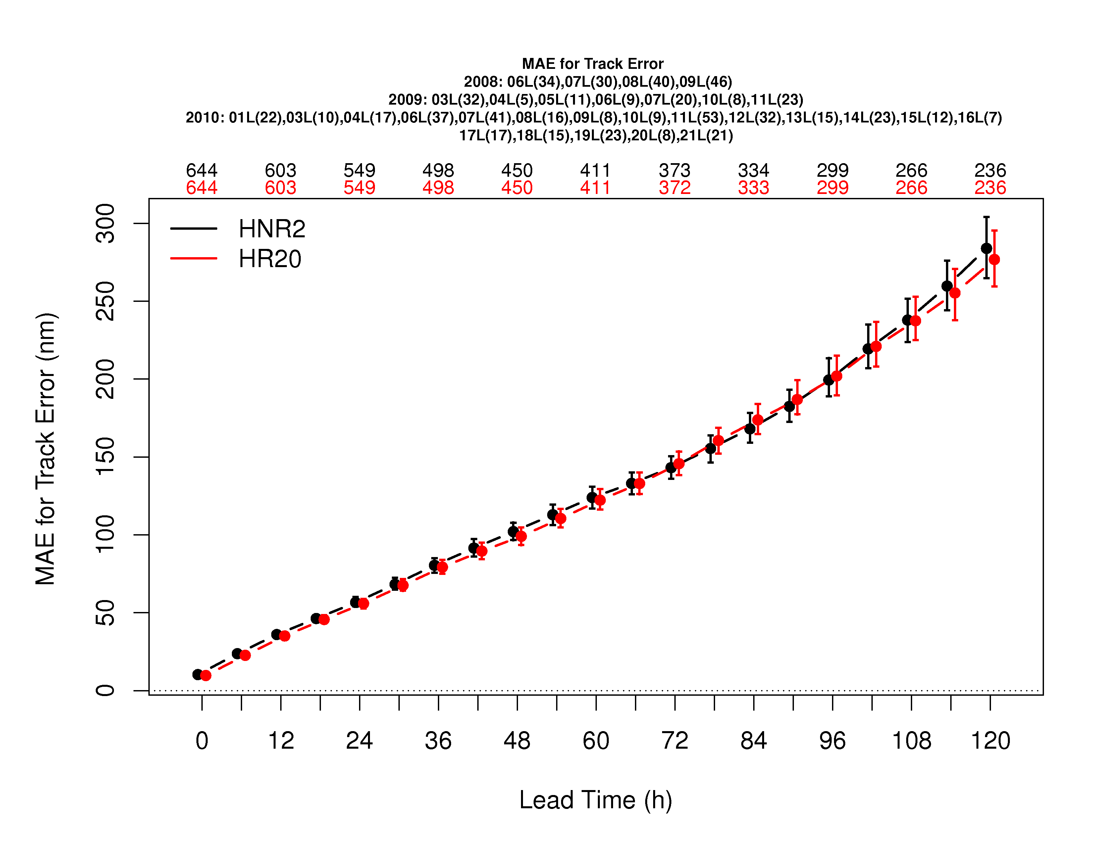
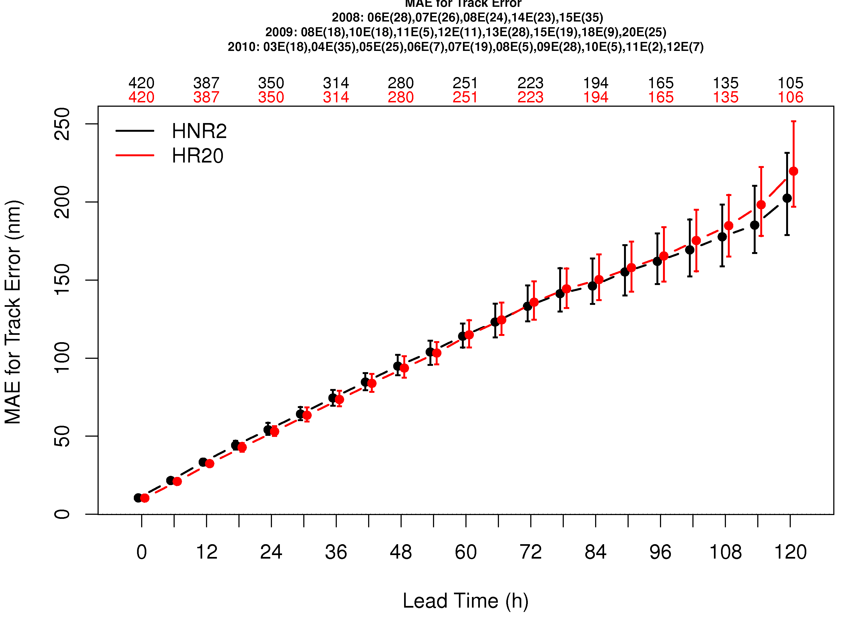
Track Errors – 2011 Baseline
DTC run
EMC run
Atlantic
Pacific
Community code benchmarked
Errors similar to equivalent runs performed at EMC
DTC testing suite qualified

Slide 9
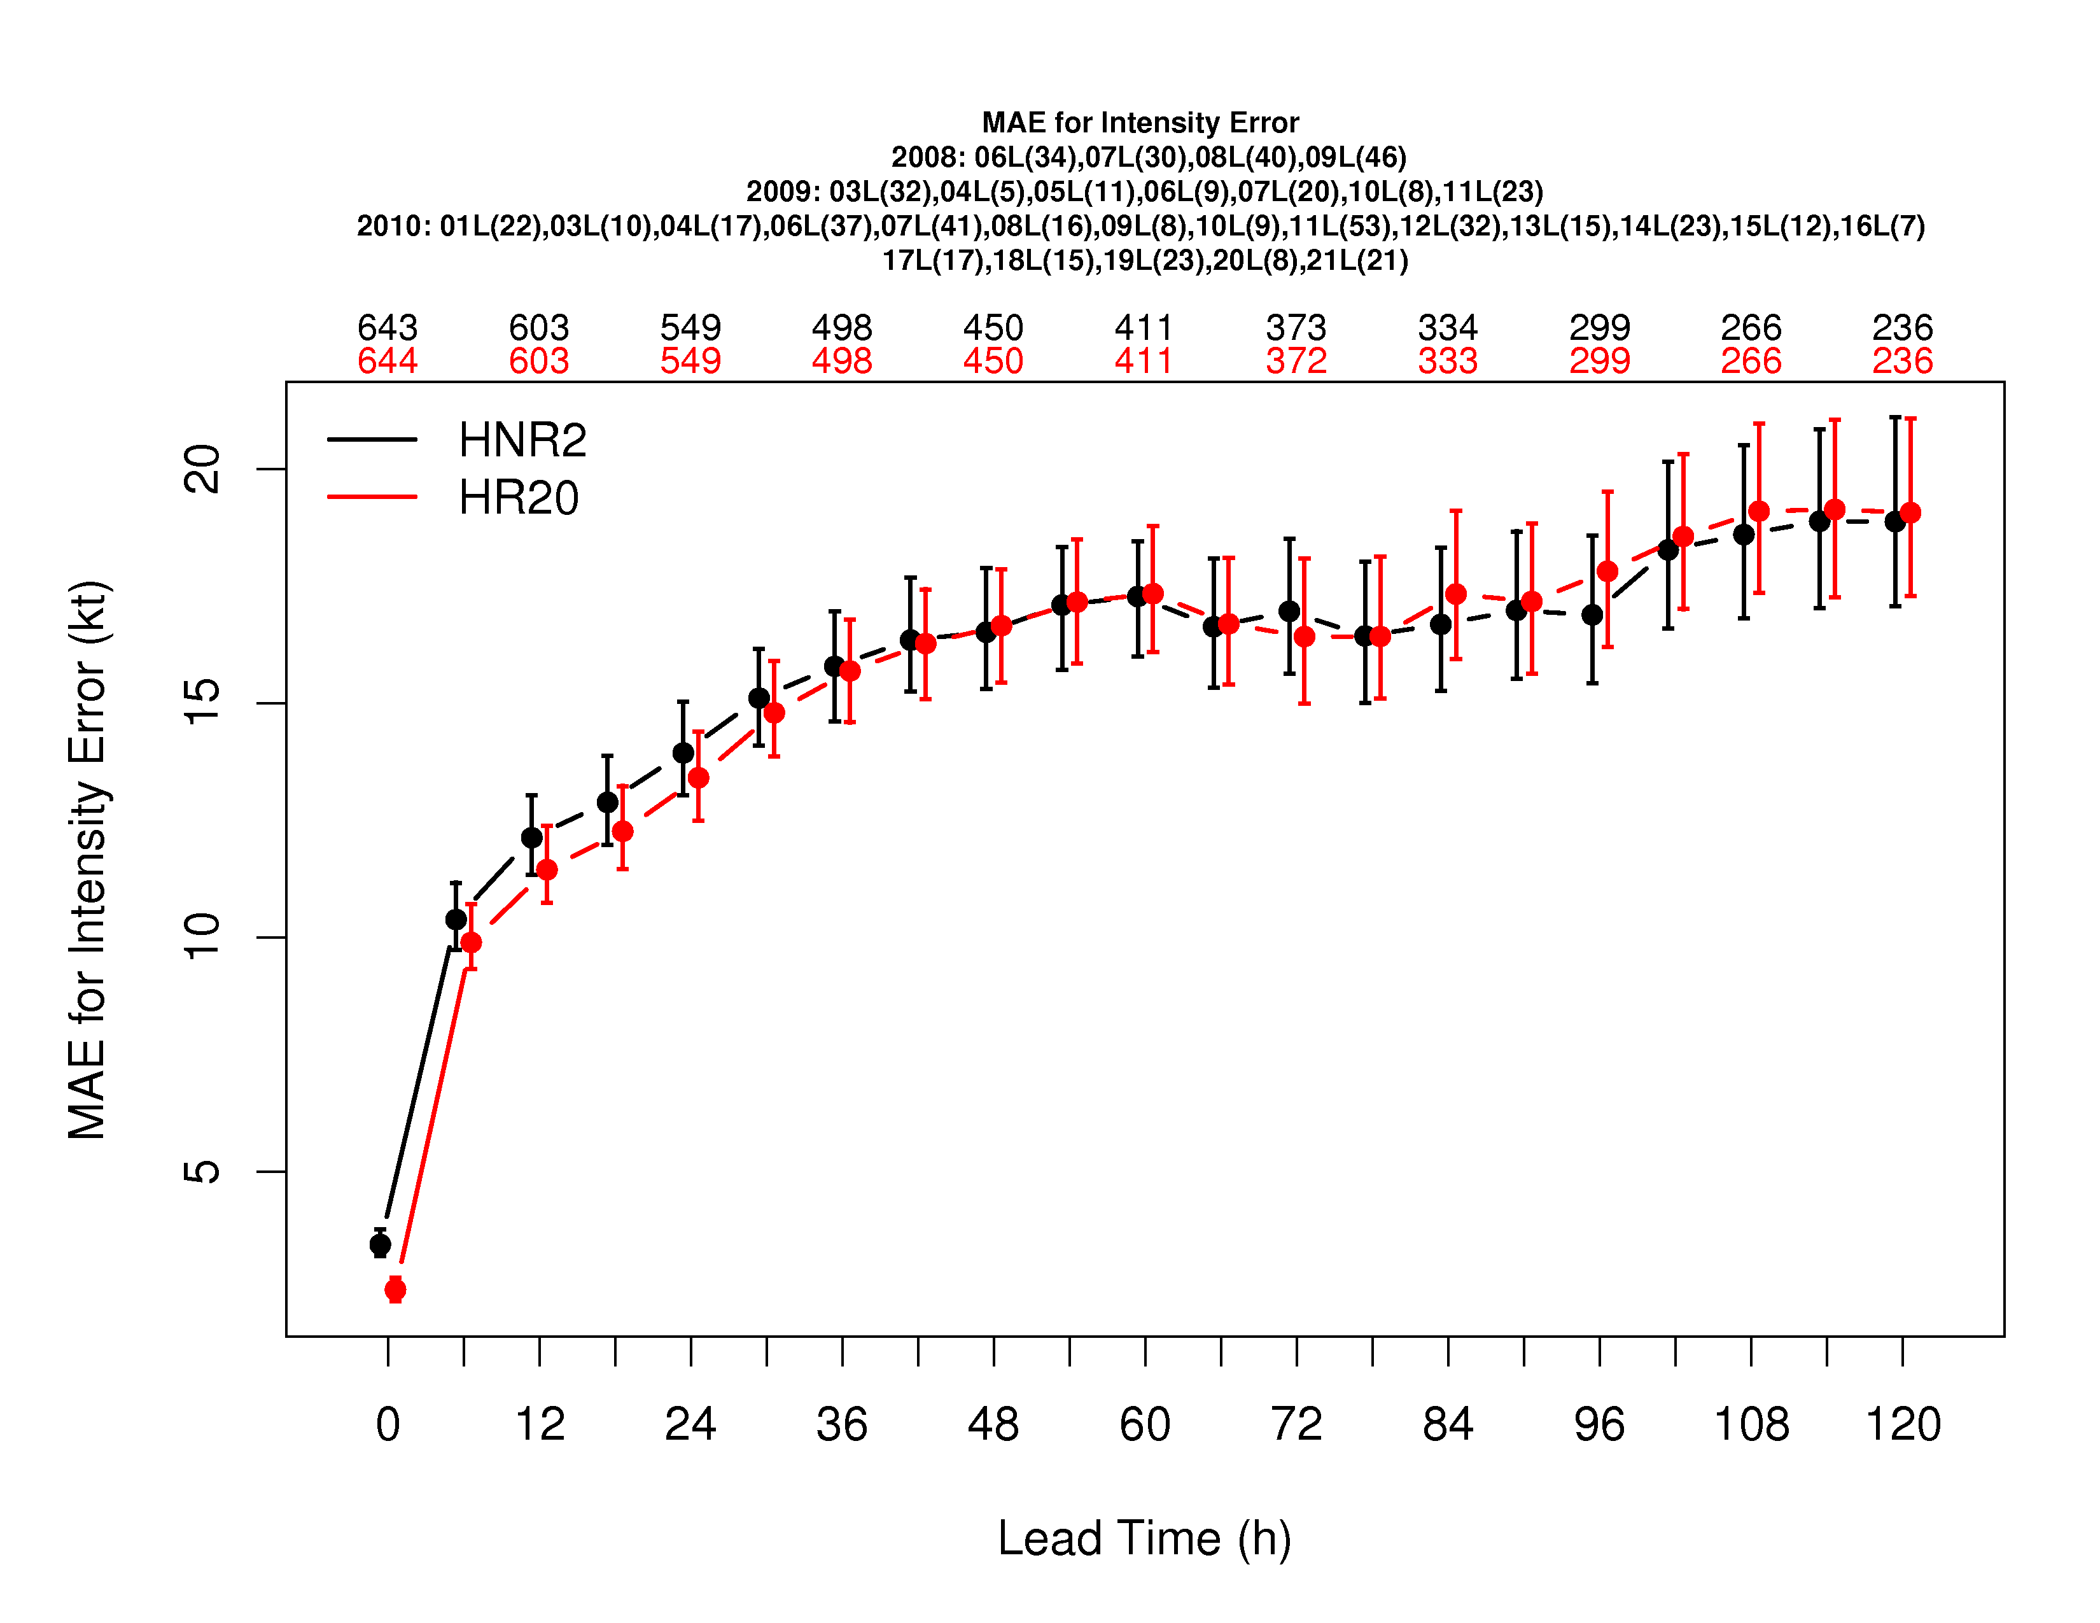
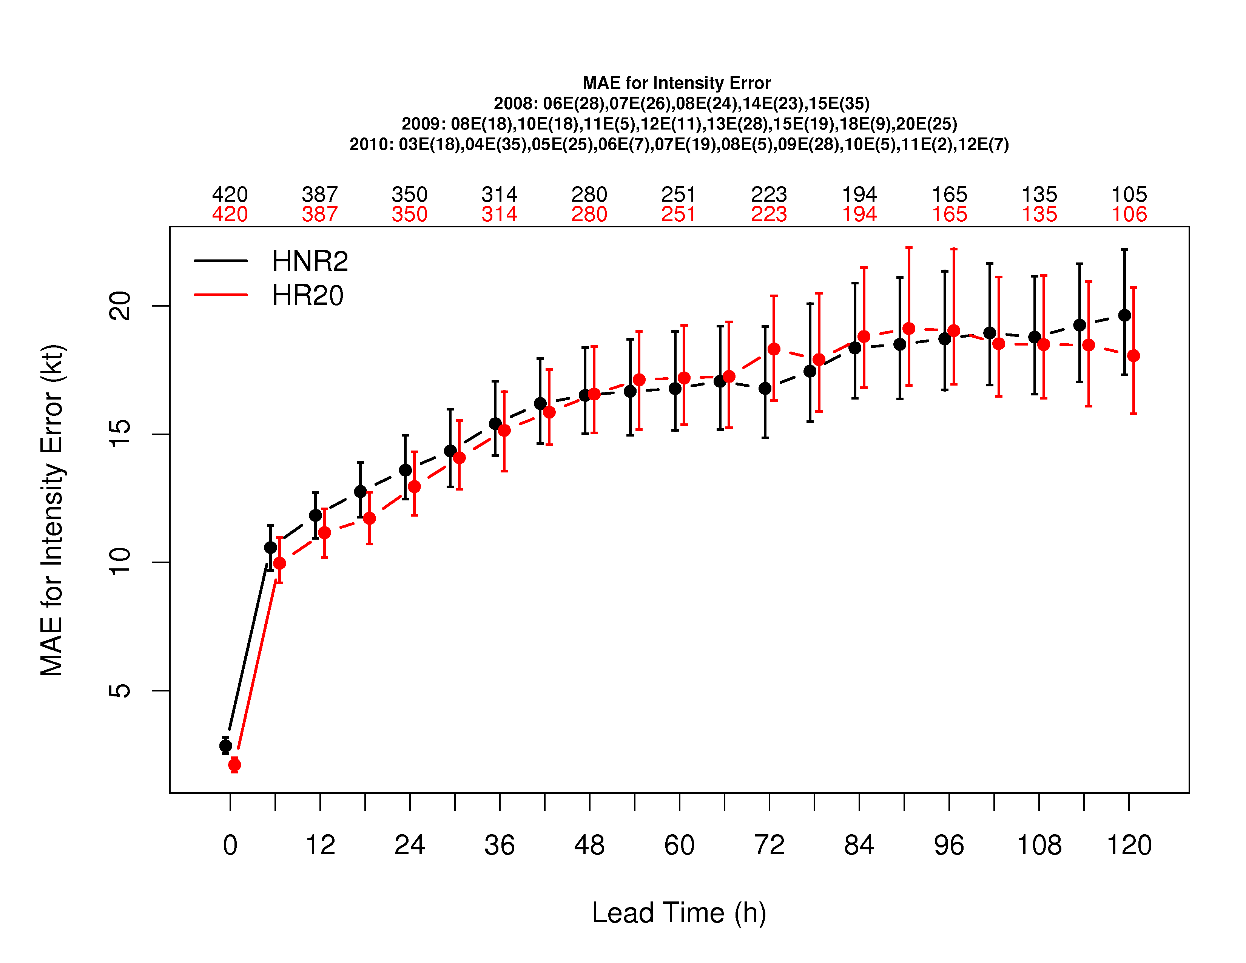
Intensity Errors – 2011 Baseline
DTC run
EMC run
Atlantic
Errors similar to equivalent runs performed at EMC
Only statistical significant difference is at initial time
Pacific

Slide 10
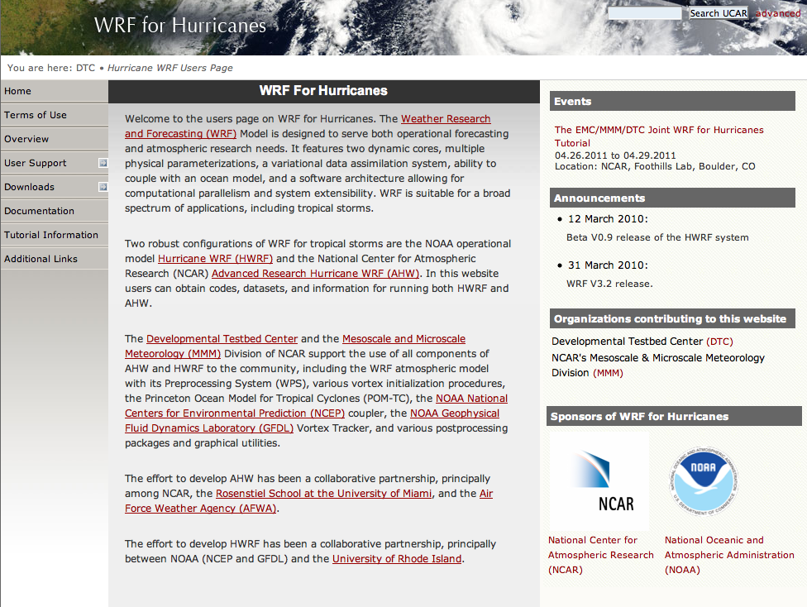
HWRF User Support
www.dtcenter.org/HurrWRF/users
Code downloads, datasets, documentation, email helpdesk
160 registered users
Register for April 2011 Tutorial

Slide 11
Future Work: Code Management
Work with community members to transition new capabilities onto HWRF system
  2011 operational capability
  Idealized simulation capability
  Three-nest capability
  Ocean model choice (POM and HYCOM)
  JHT AO projects
  HFIP AO projects
Work with research and operational communities to maintain a single code base
Ascertain that non-HWRF changes to the community code do not affect HWRF answer

Slide 12
Future Work: Testing and Evaluation
Test plan for 2011
  Alternate physics
  Higher resolution
  Reference Configuration for the 2011 operational model
Diagnostic activities
  Identifying tools available in the community for use in DTC
    Visualization of model output
    Computation of derived quantities
    Comparison of model forecasts and observations/analyses
  Support diagnostic tools to the community

