Slide 1
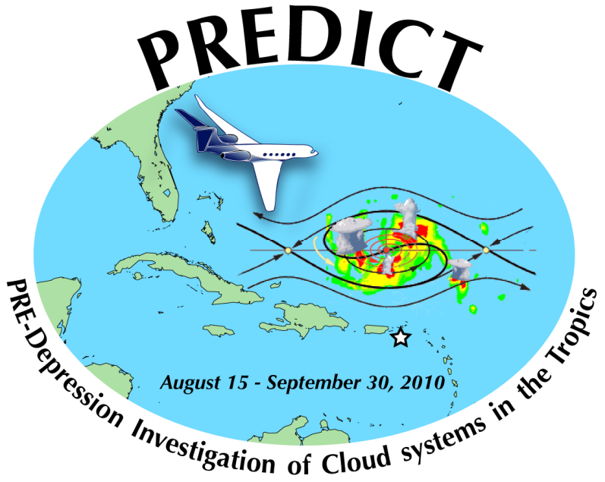
Ensemble-based prediction and diagnostics during the PREDICT field experiment
Sharan Majumdar (RSMAS / U. Miami)
Ryan Torn (SUNY at Albany)
Fuqing Zhang (Penn State)
Acknowledgments: all PREDICT PIs and Forecasters
65th IHC, Miami, FL. 03/01/11

Slide 2
The problem
Only ~20% of tropical waves develop into depressions.
Need to advance understanding of the physical differences between developing and non-developing systems.
Tropical cyclone formation is a multi-scale process, which depends on
Large-scale environment in which it is embedded
Wave’s structure (low-level vorticity, mid-level moisture)
Convective-scale processes: hot towers etc.
Seek to investigate utility of ensemble forecasts
Global; Regional; Convective-scale

Slide 3
Offer a longer-term outlook (>1 week) on the potential for a tropical disturbance to develop.
Scatter of forecasts depicting critical values of
Area-averaged vorticity
Geopotential thickness anomaly
Okubo-Weiss parameter
Probabilities of exceedance of critical values of
Vertical wind shear
Lower-tropospheric relative humidity
Upper level divergence / lower-level convergence
Offer hypotheses on processes that lead to errors in large-scale conditioning (and thereby inaccurate representations of smaller-scale processes)

Slide 4
Example: Genesis of Karl (AL13; PGI44L)
Monsoon-like trough predicted to meander northward from the northern coast of South America into the southern Caribbean.
ECMWF ensemble forecasts of
(TOP) 700-850 hPa relative vorticity averaged over disk of radius 300 km
(BOTTOM) 200-850 hPa thickness anomaly: Z(r=250 km) – Z(r=1000 km)
All initialized on 00 UTC, 8 Sept 2010
7 days prior to genesis

Slide 5
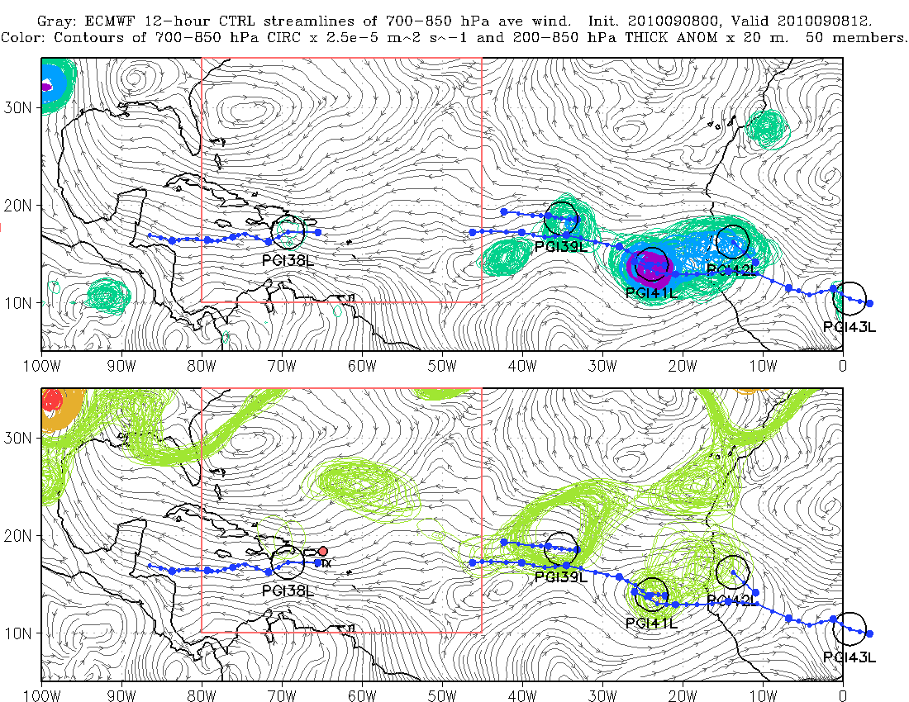
average rel. vort. (x 10⁻⁵ s⁻¹)

Slide 6
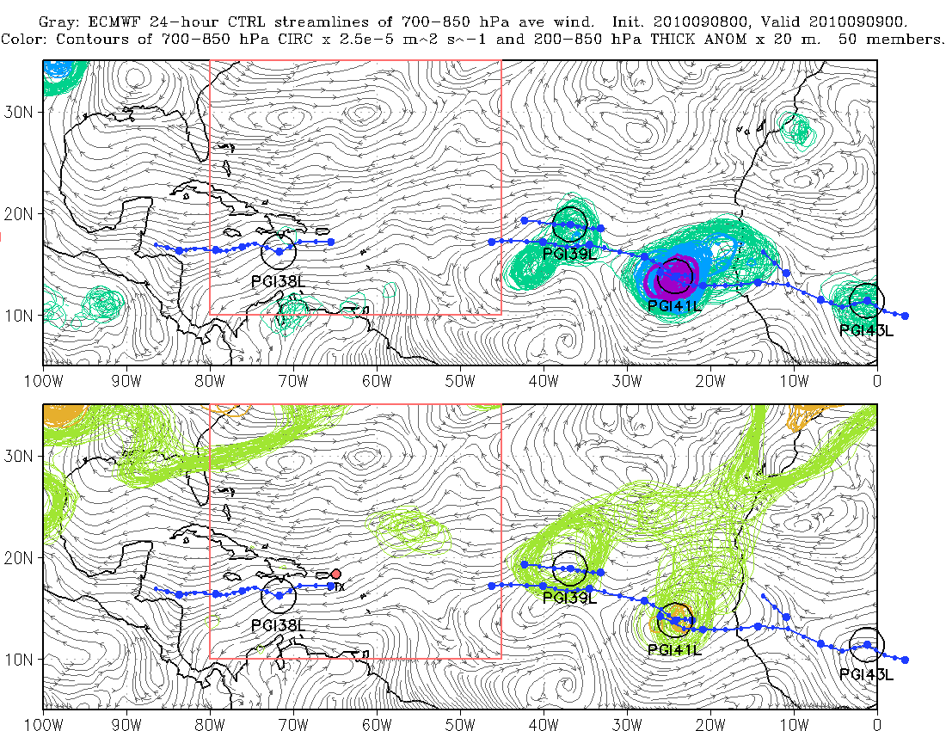
average rel. vort. (x 10⁻⁵ s⁻¹)

Slide 7
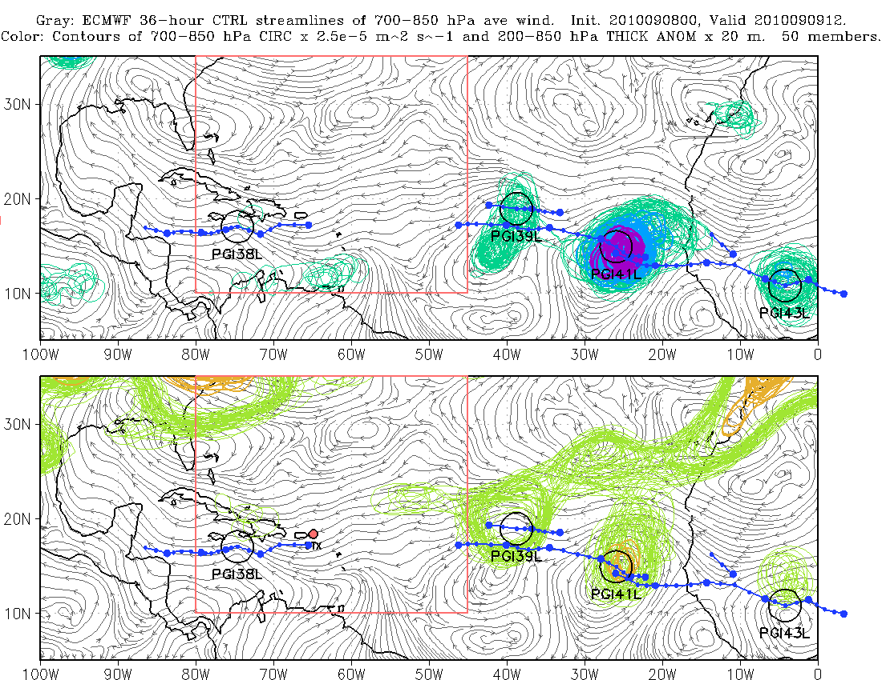
average rel. vort. (x 10⁻⁵ s⁻¹)

Slide 8
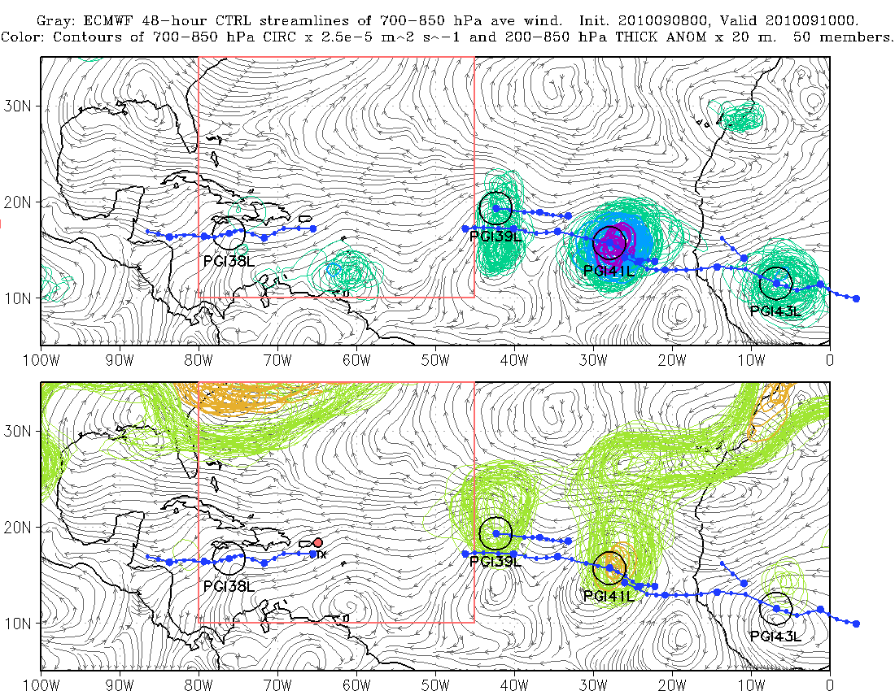
average rel. vort. (x 10⁻⁵ s⁻¹)

Slide 9
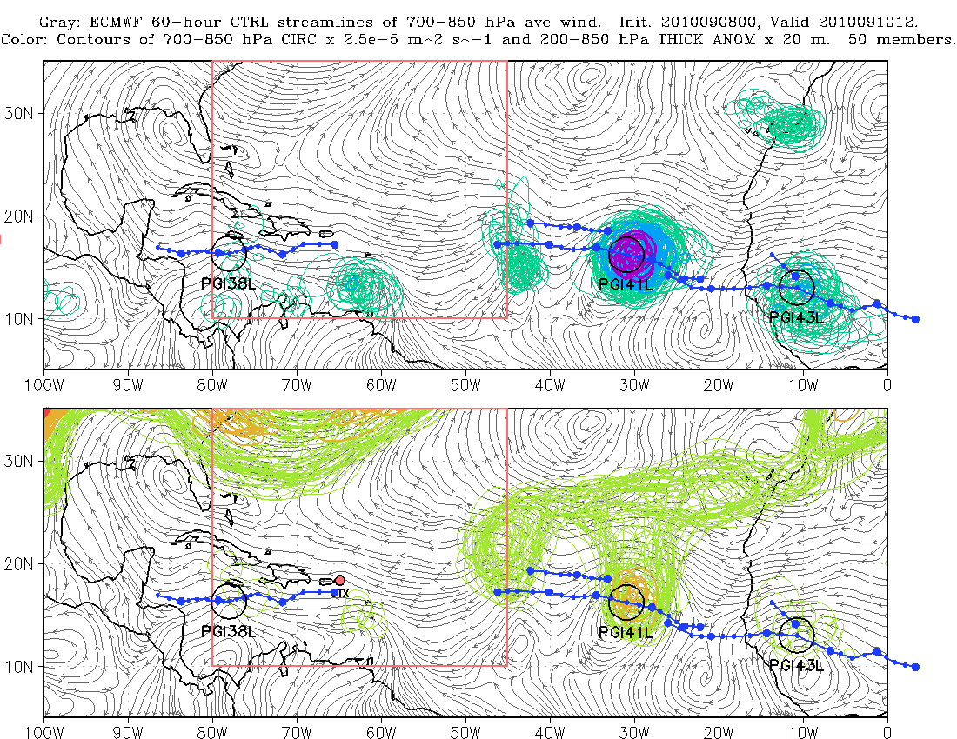
average rel. vort. (x 10⁻⁵ s⁻¹)

Slide 10
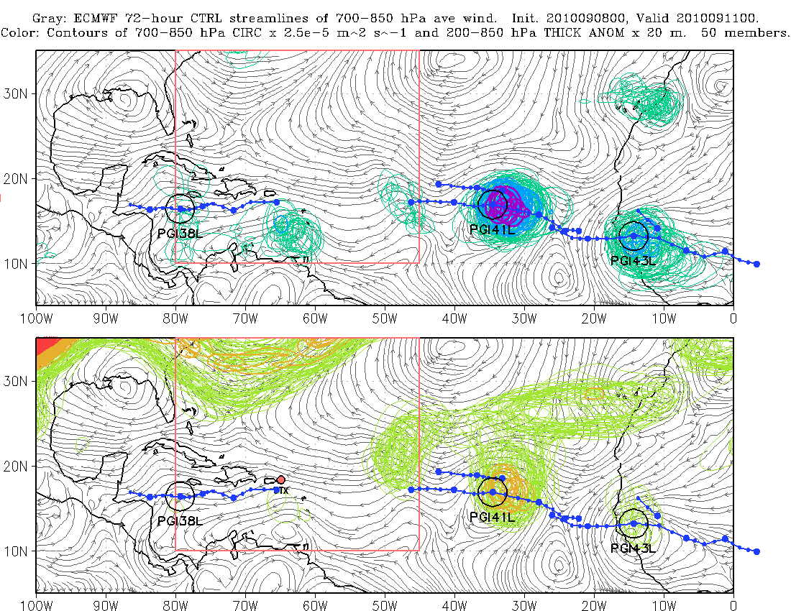
average rel. vort. (x 10⁻⁵ s⁻¹)

Slide 11
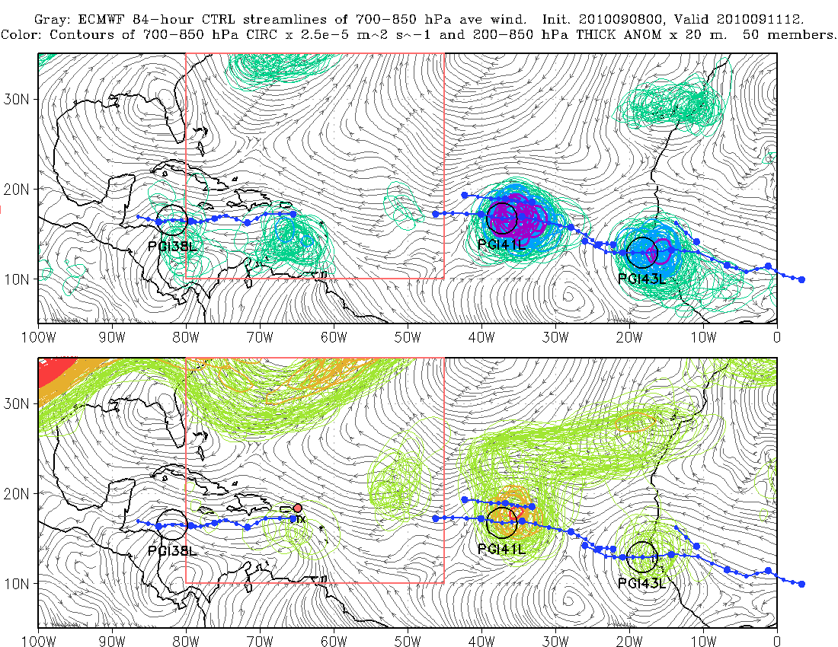
average rel. vort. (x 10⁻⁵ s⁻¹)

Slide 12
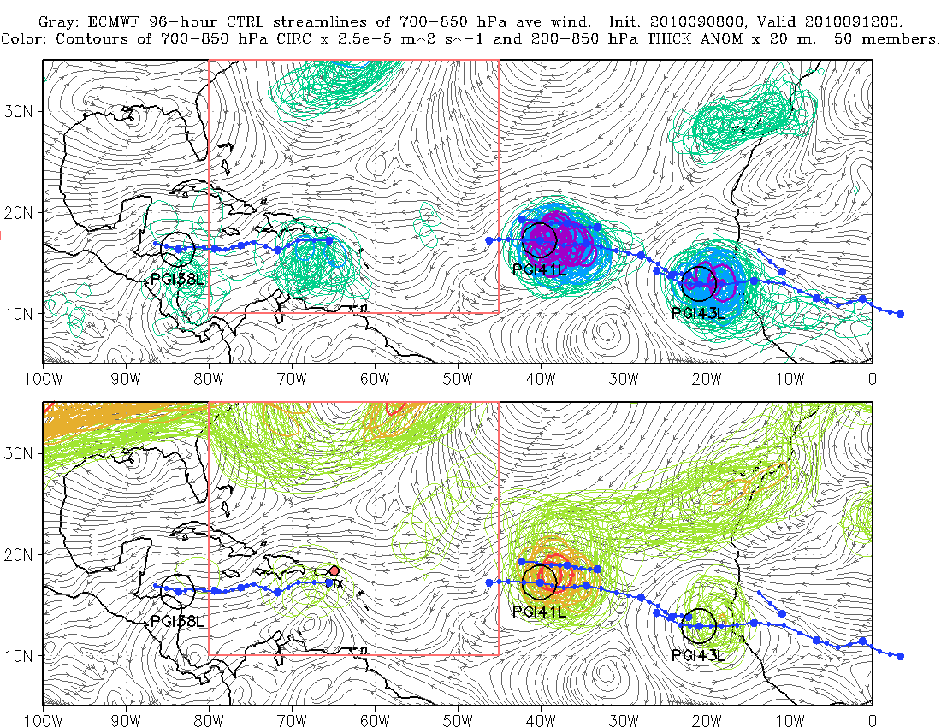
average rel. vort. (x 10⁻⁵ s⁻¹)

Slide 13
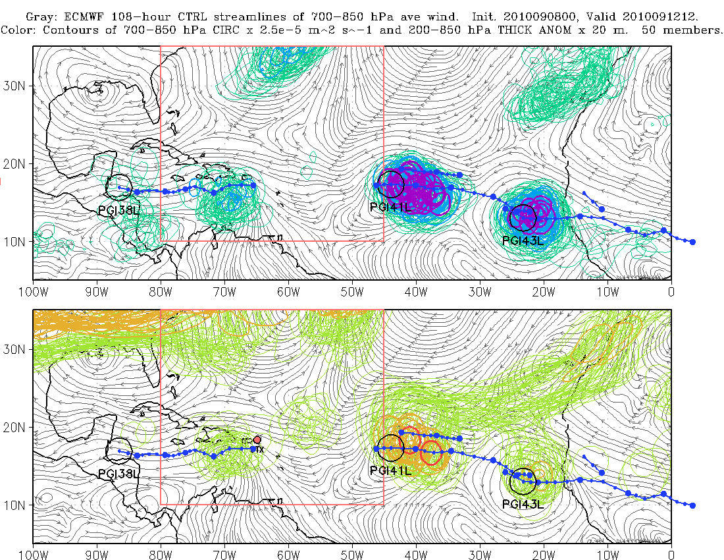
average rel. vort. (x 10⁻⁵ s⁻¹)

Slide 14
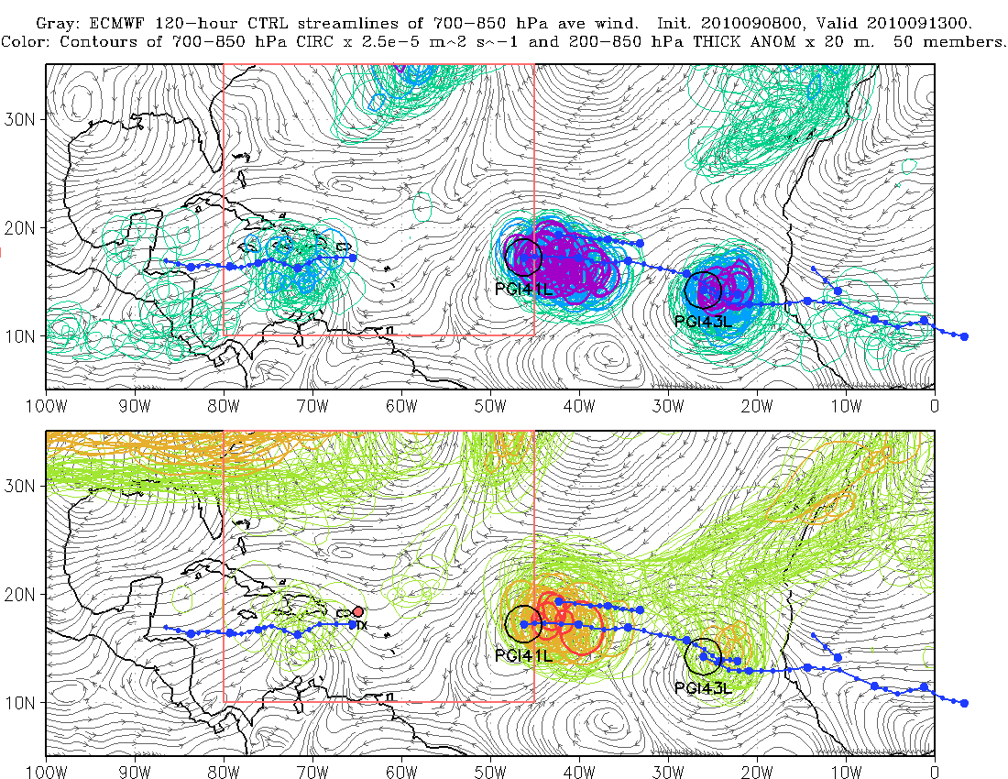
average rel. vort. (x 10⁻⁵ s⁻¹)

Slide 15
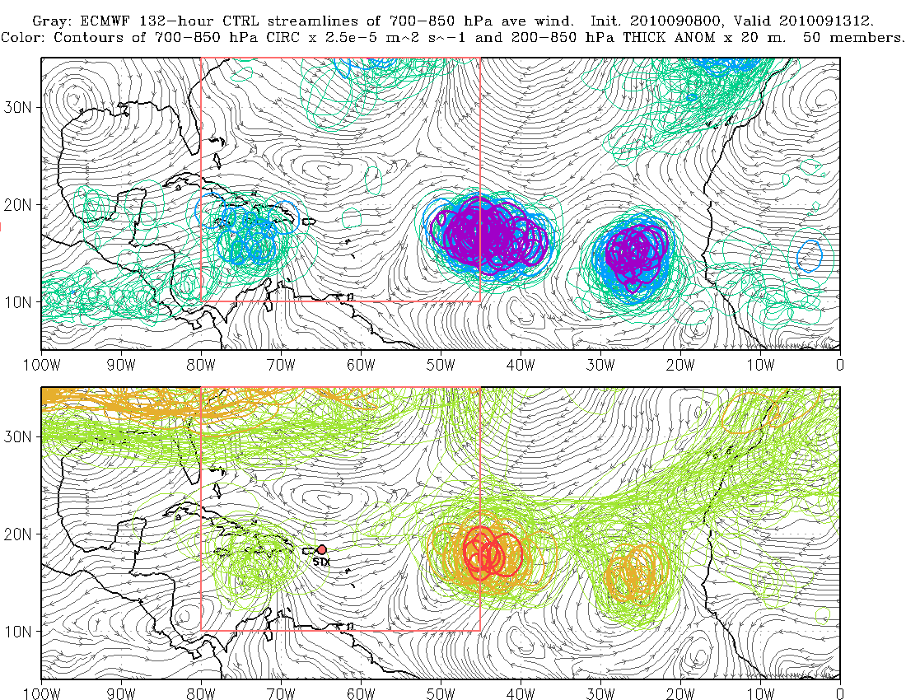
average rel. vort. (x 10⁻⁵ s⁻¹)

Slide 16
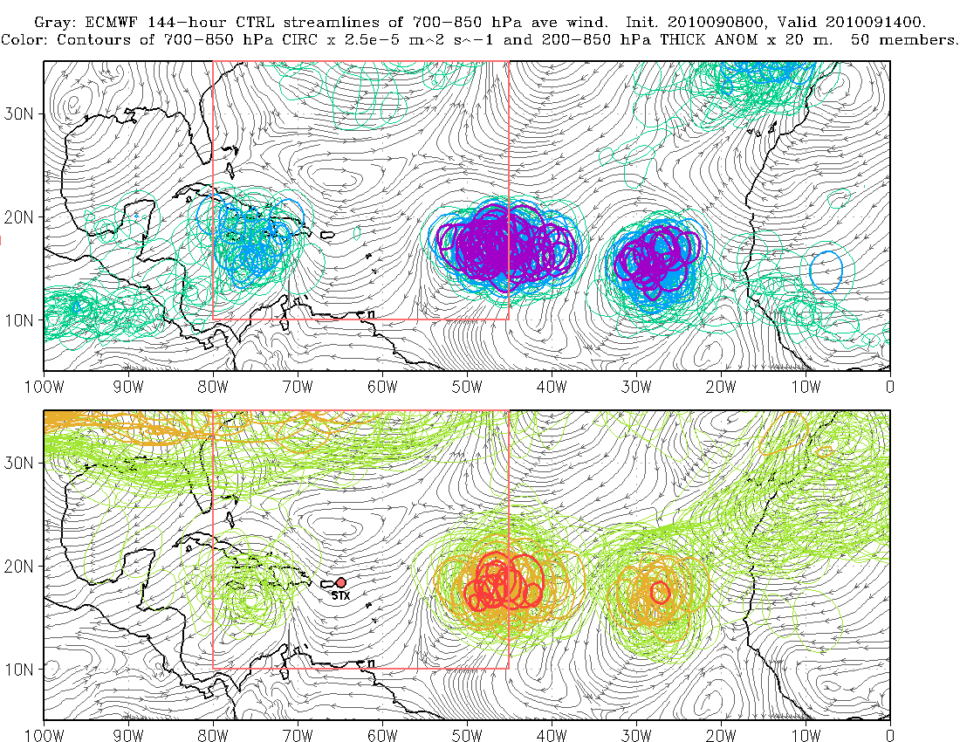
average rel. vort. (x 10⁻⁵ s⁻¹)

Slide 17
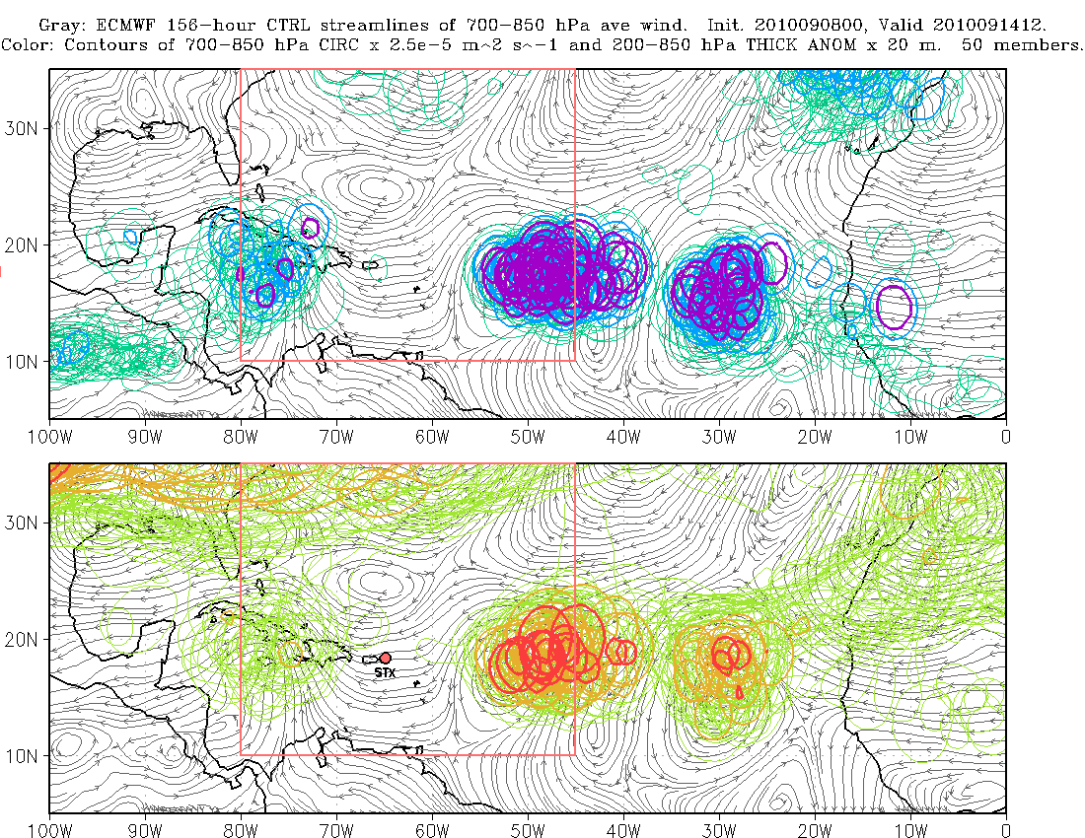
average rel. vort. (x 10⁻⁵ s⁻¹)

Slide 18
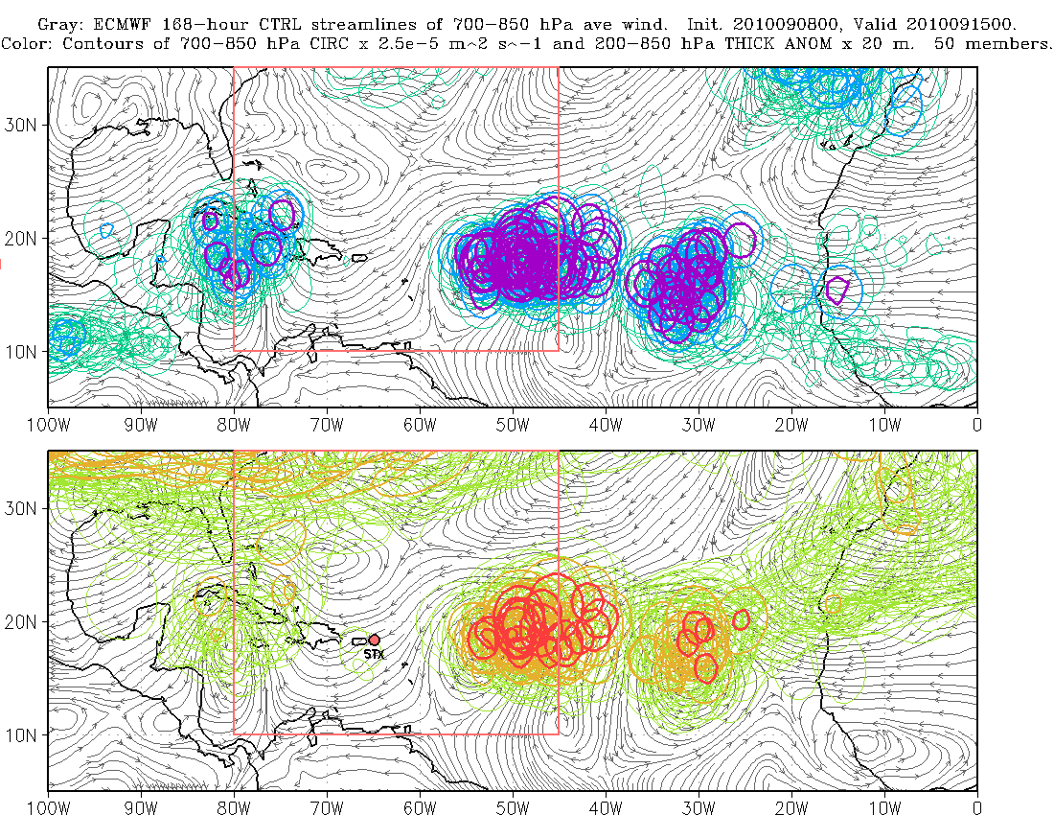
average rel. vort. (x 10⁻⁵ s⁻¹)
X
X

Slide 19
Example: Genesis of Karl (AL13; PGI44L)
7-day forecasts of
Probability that 700 hPa RH > 70%
Okubo-Weiss parameter (vorticity^2 – strain rate^2): indicator of strongly curved flow with minimum horizontal shearing deformation

Slide 20
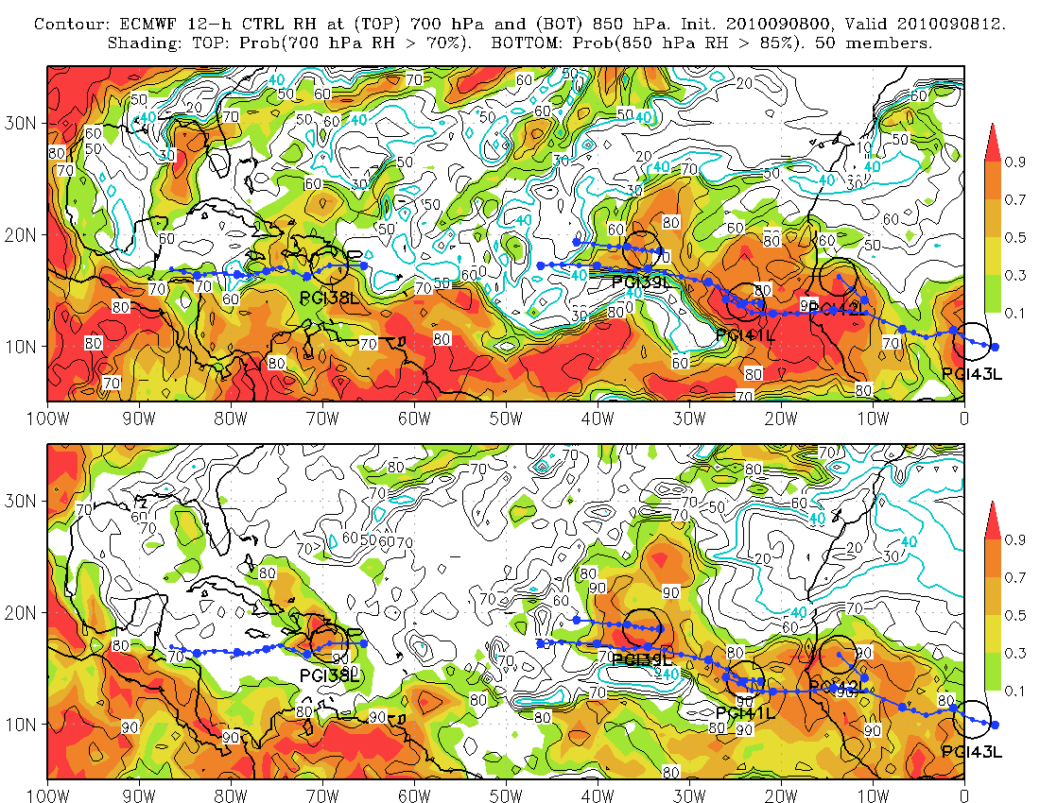
Contours of O-W: 2 x 10⁻⁹ s⁻²

Slide 21
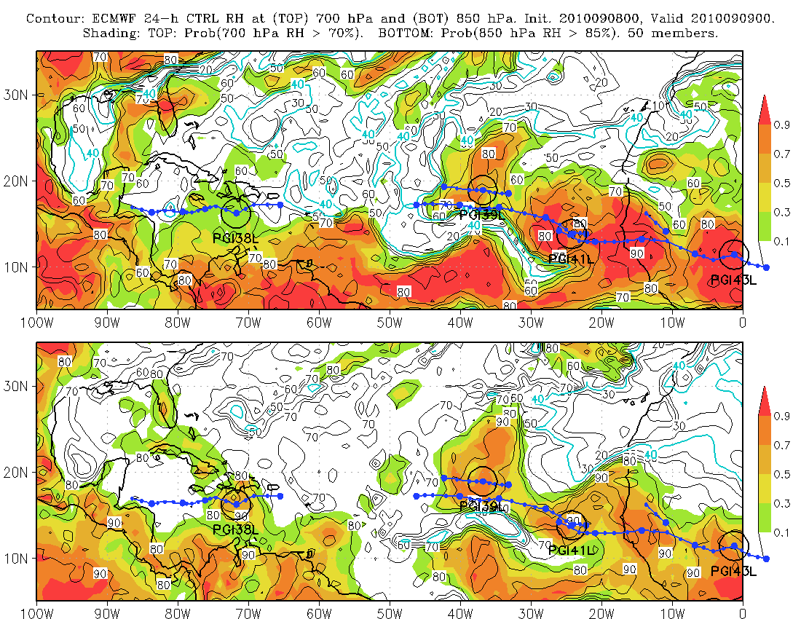
Contours of O-W: 2 x 10⁻⁹ s⁻²

Slide 22
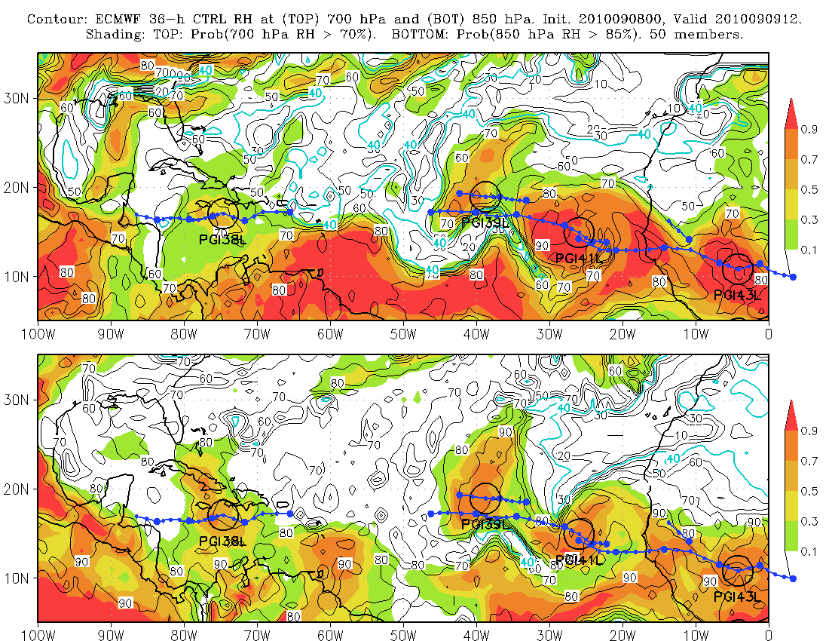
Contours of O-W: 2 x 10⁻⁹ s⁻²

Slide 23
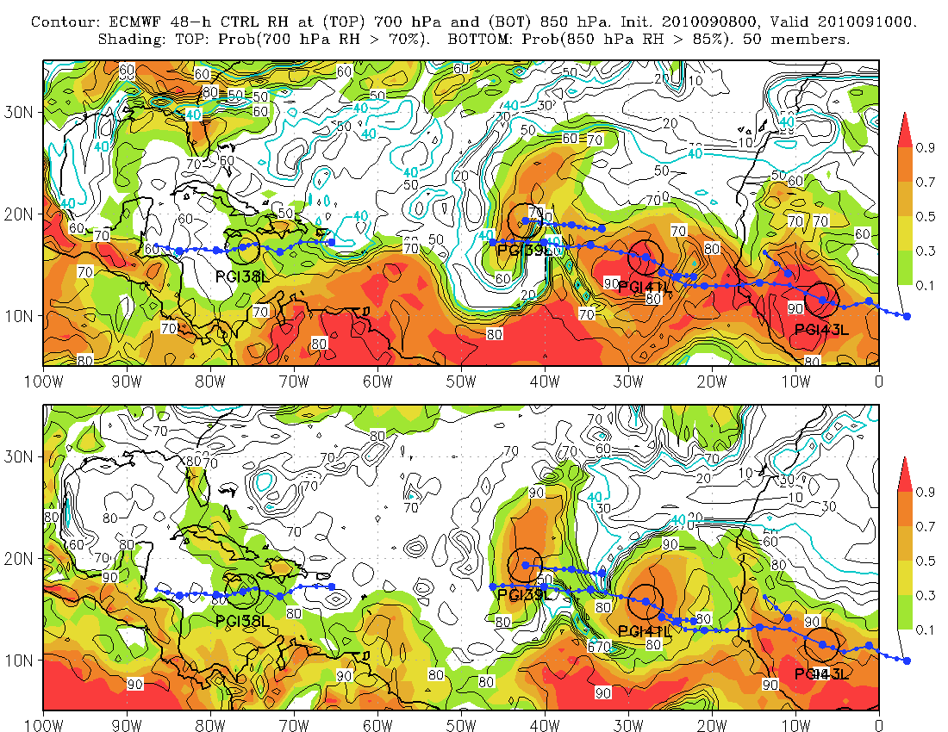
Contours of O-W: 2 x 10⁻⁹ s⁻²

Slide 24
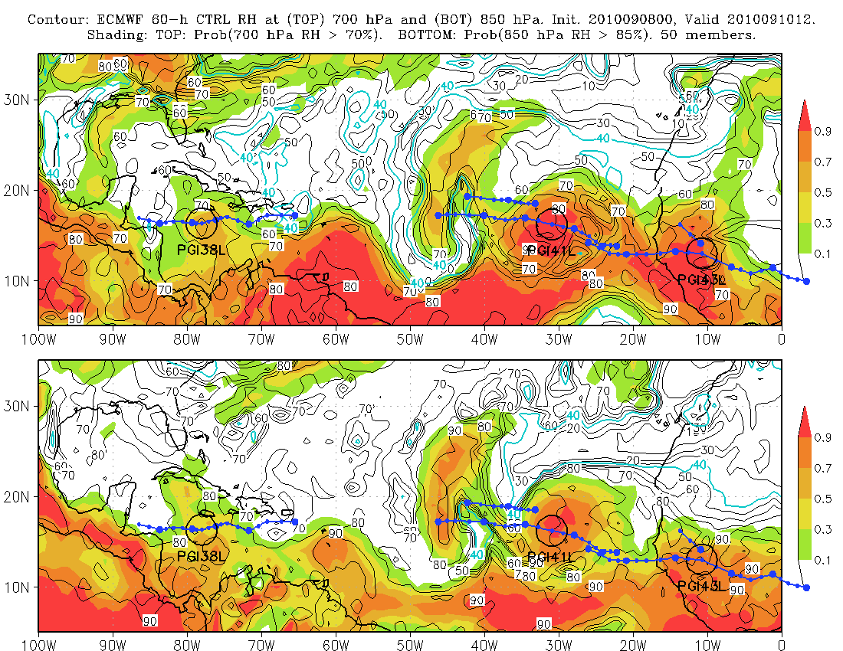
Contours of O-W: 2 x 10⁻⁹ s⁻²

Slide 25
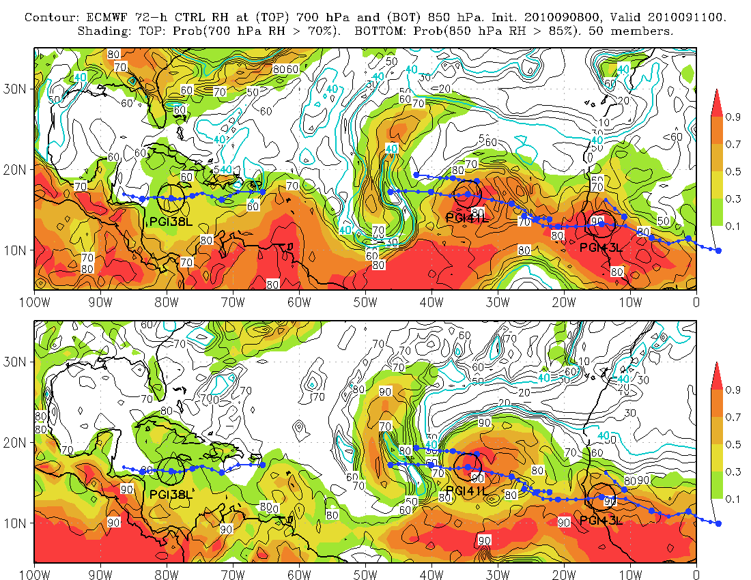
Contours of O-W: 2 x 10⁻⁹ s⁻²

Slide 26
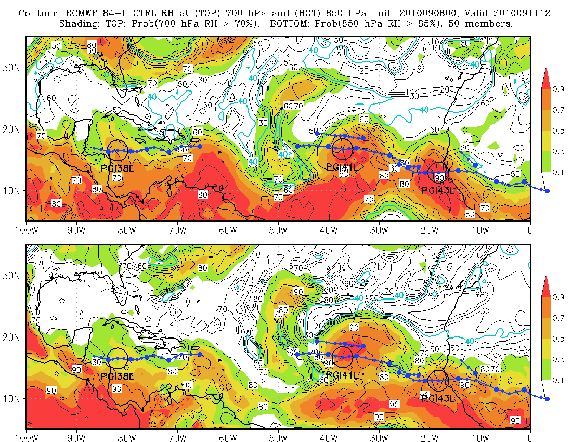
Contours of O-W: 2 x 10⁻⁹ s⁻²

Slide 27
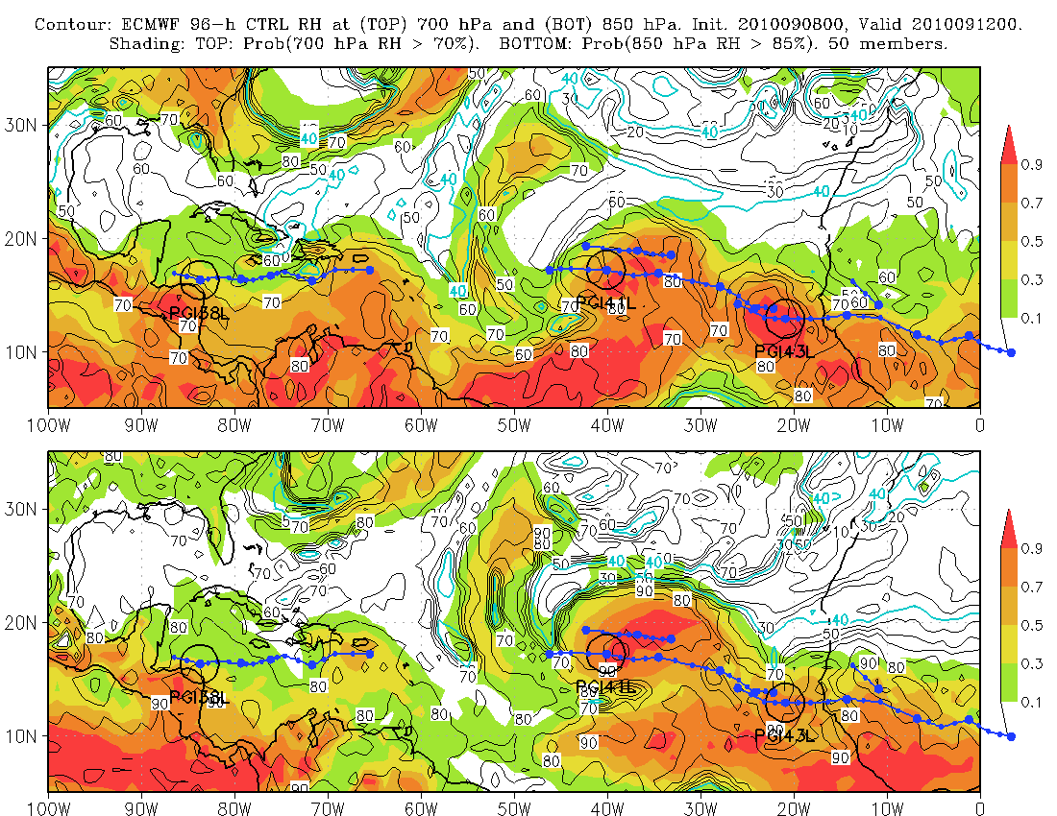
Contours of O-W: 2 x 10⁻⁹ s⁻²

Slide 28
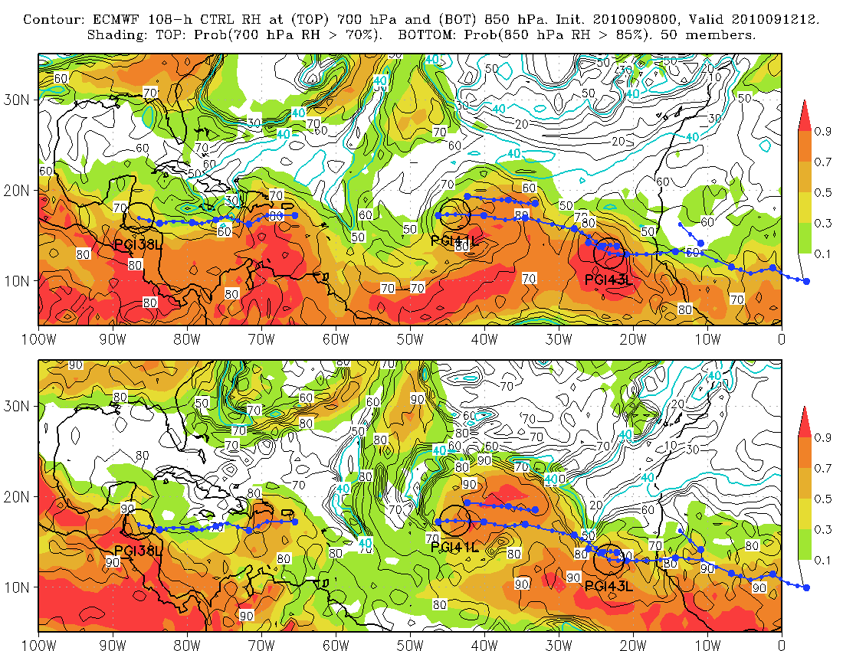
Contours of O-W: 2 x 10⁻⁹ s⁻²

Slide 29
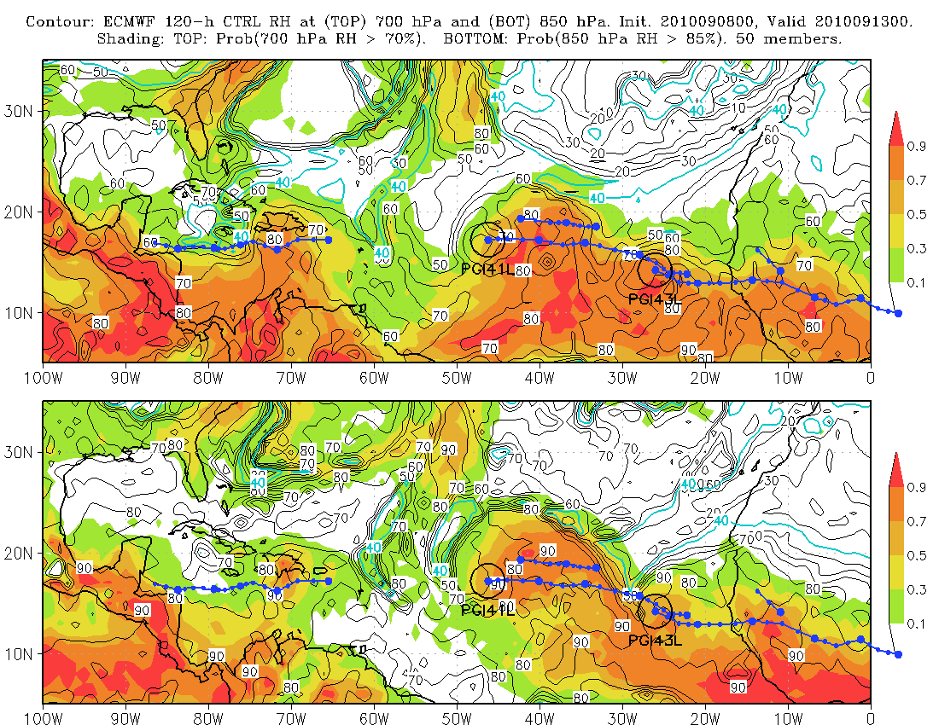
Contours of O-W: 2 x 10⁻⁹ s⁻²

Slide 30
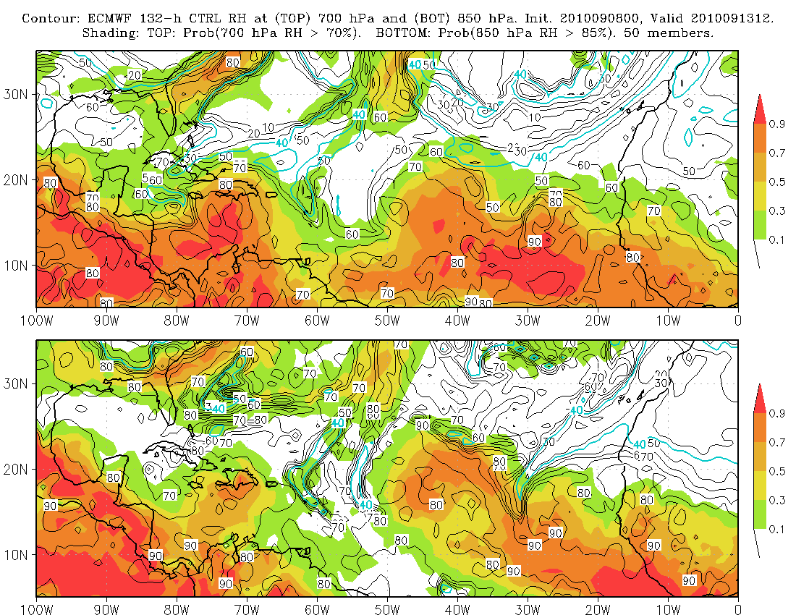
Contours of O-W: 2 x 10⁻⁹ s⁻²

Slide 31
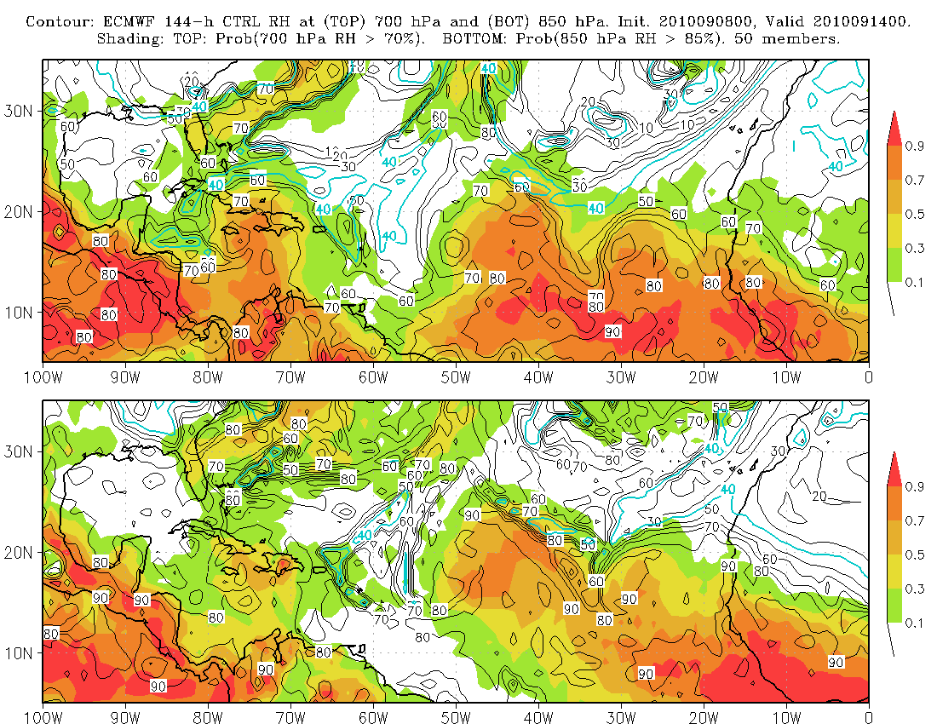
Contours of O-W: 2 x 10⁻⁹ s⁻²

Slide 32
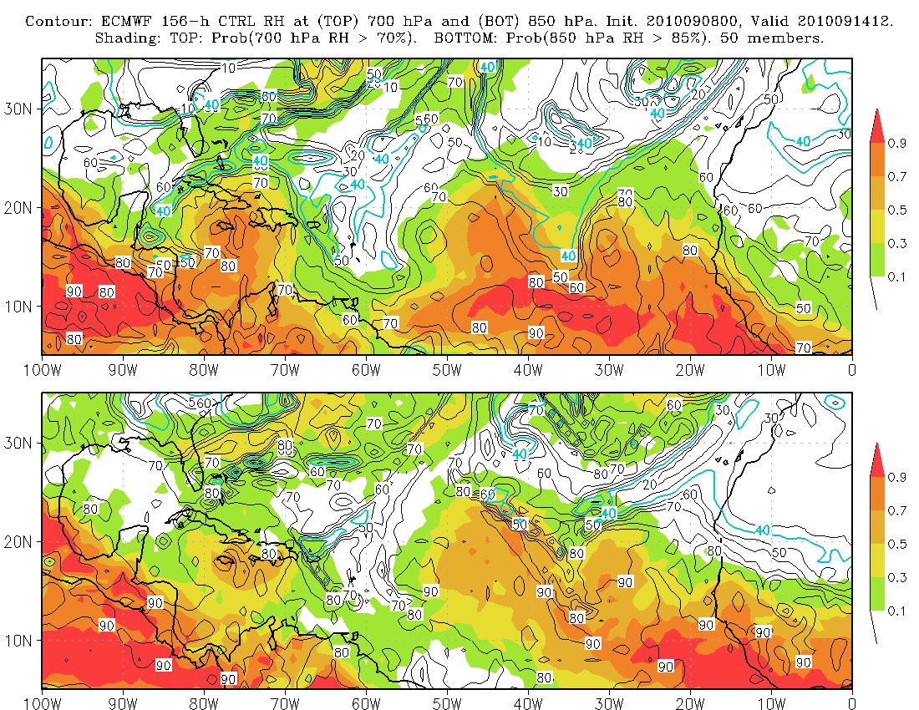
Contours of O-W: 2 x 10⁻⁹ s⁻²

Slide 33
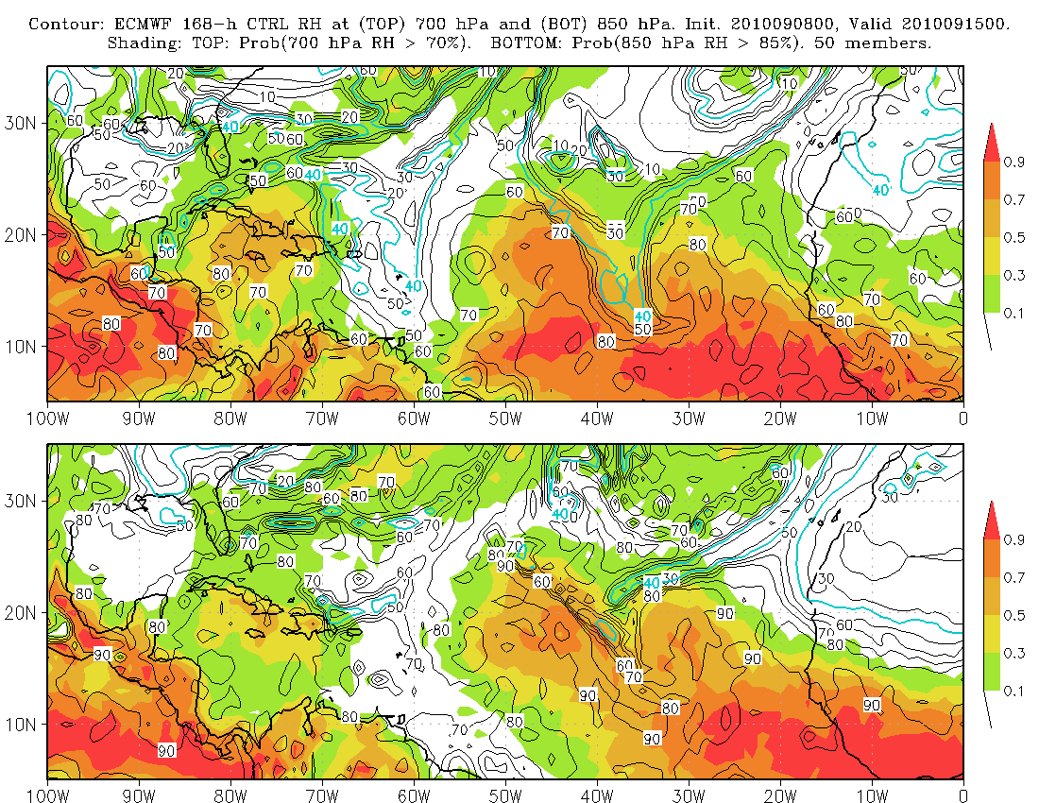
Contours of O-W: 2 x 10⁻⁹ s⁻²
X
X
X
X

Slide 34
Example: Genesis of Karl (AL13; PGI44L)
Genesis occurred just before 00 UTC, 15 Sep
Next two “loops”
9- through 0- day ensemble forecasts of area-averaged relative vorticity valid at genesis time
Same but displayed as PDFs

Slide 35
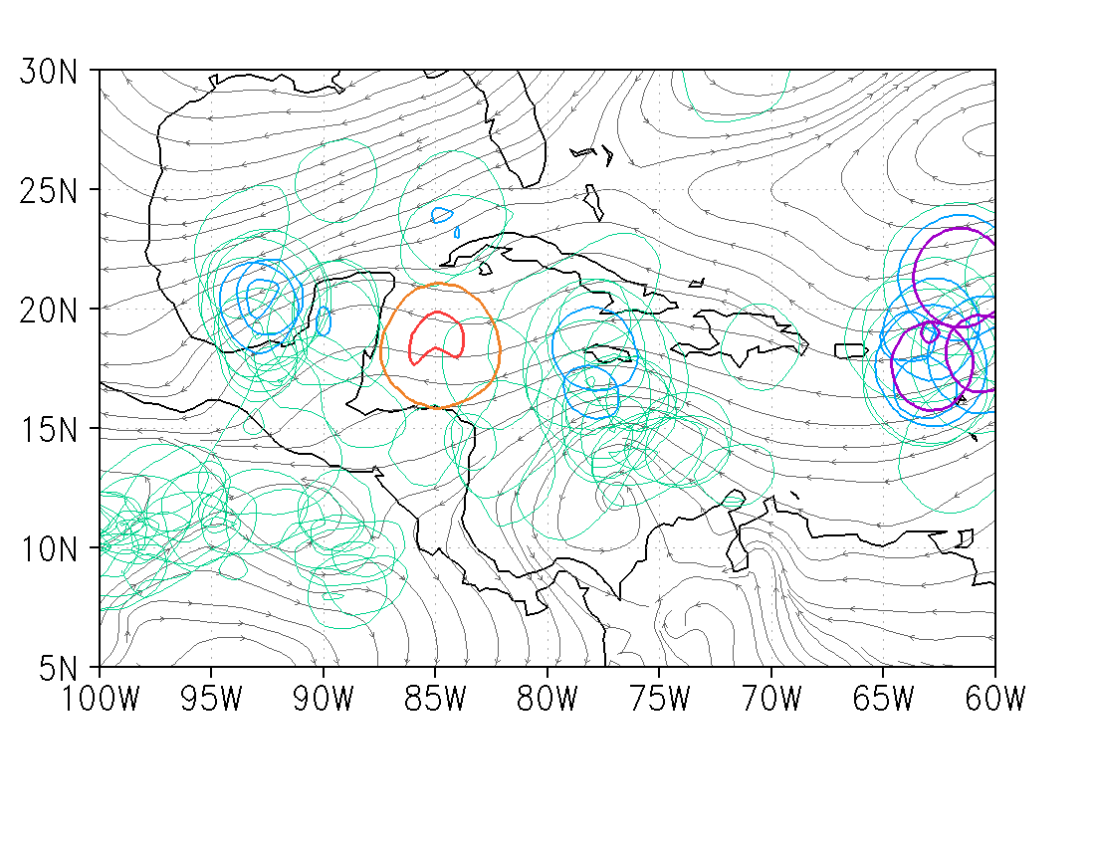
9-day forecast for 00 UTC 15 Sep

Slide 36
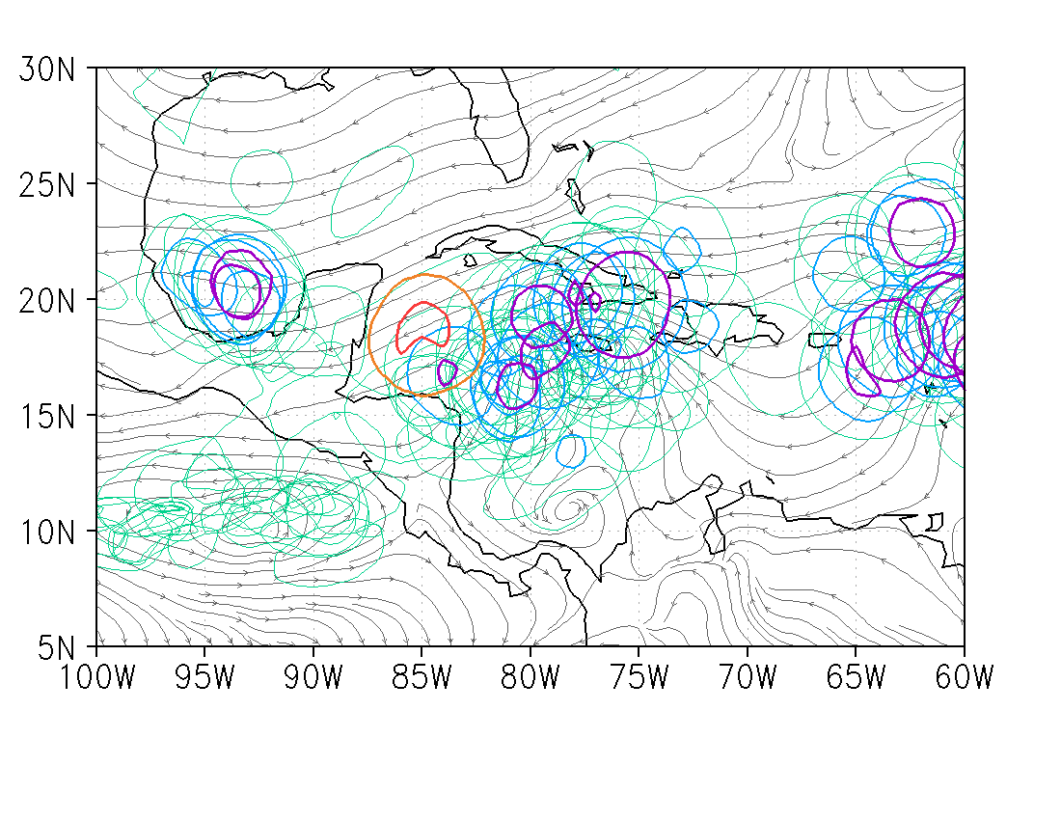
8-day forecast for 00 UTC 15 Sep

Slide 37
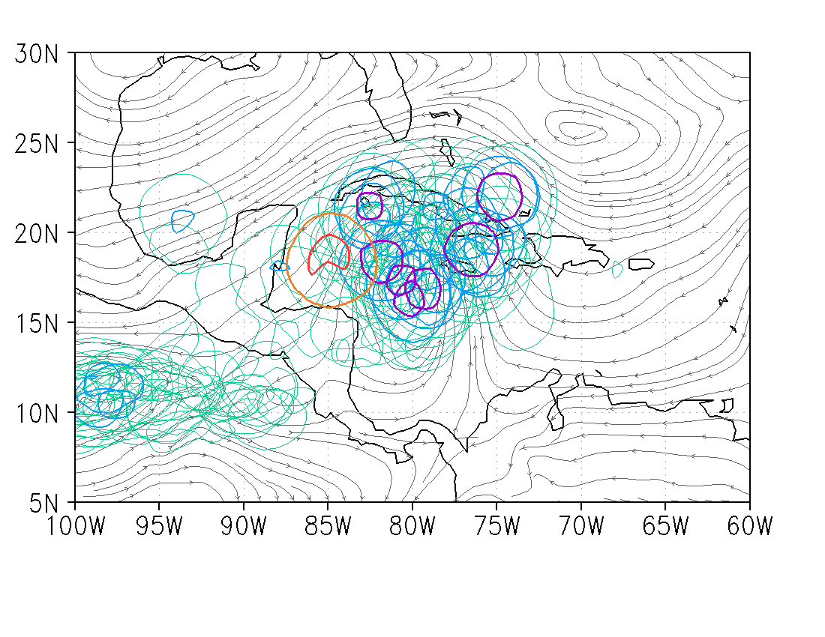
7-day forecast for 00 UTC 15 Sep

Slide 38
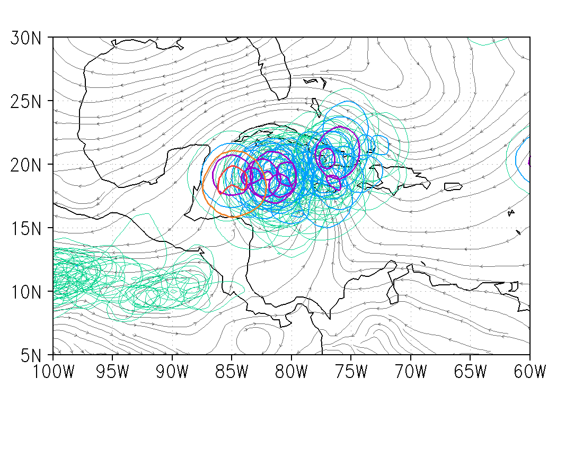
6-day forecast for 00 UTC 15 Sep

Slide 39
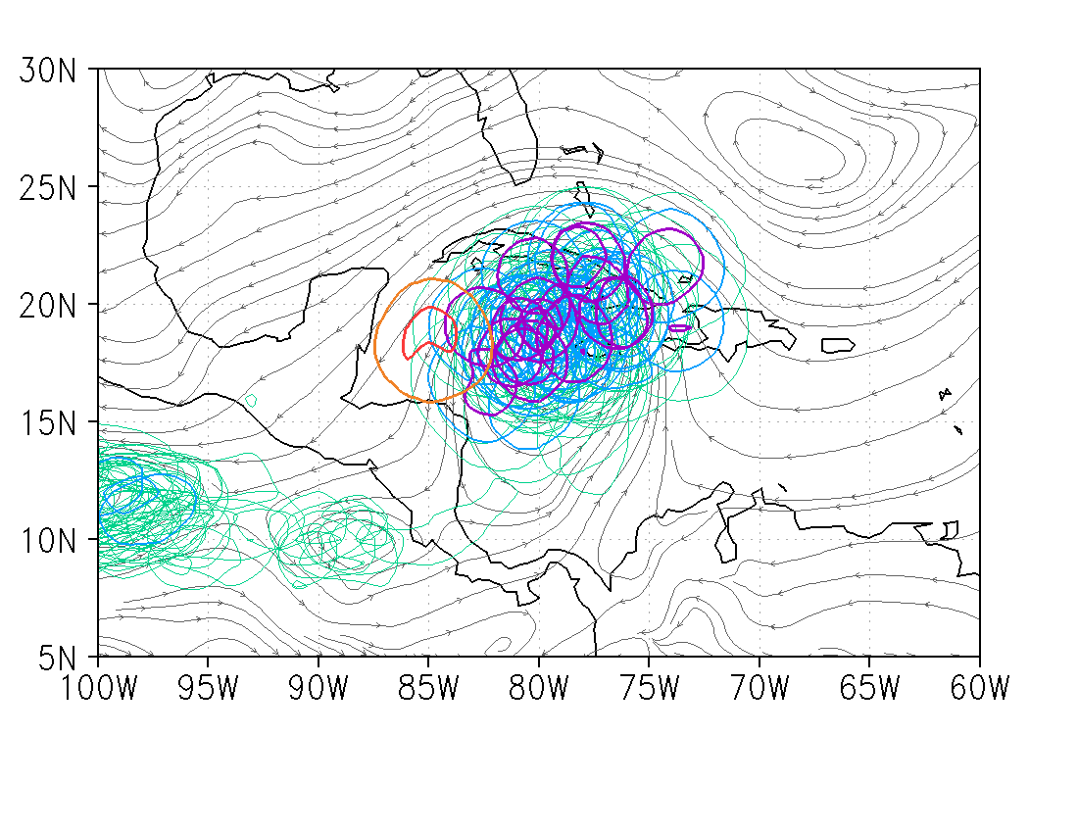
5-day forecast for 00 UTC 15 Sep

Slide 40
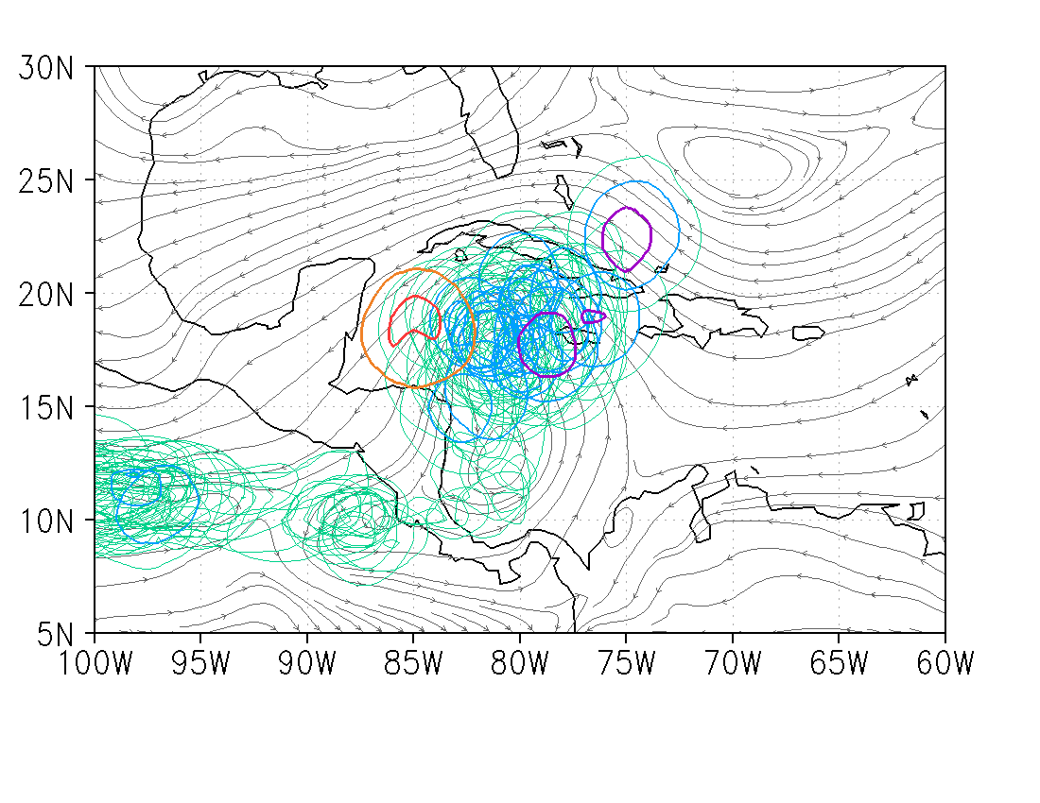
4-day forecast for 00 UTC 15 Sep

Slide 41
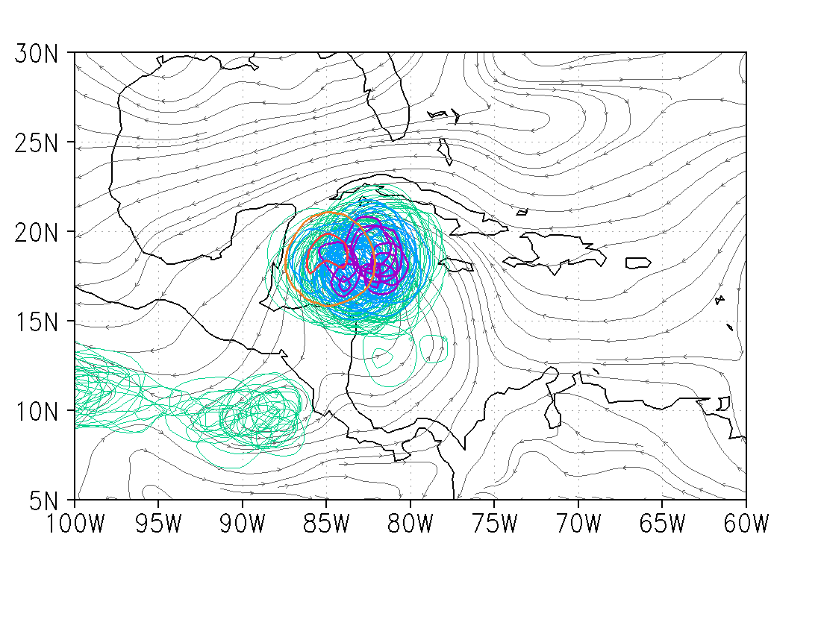
3-day forecast for 00 UTC 15 Sep

Slide 42
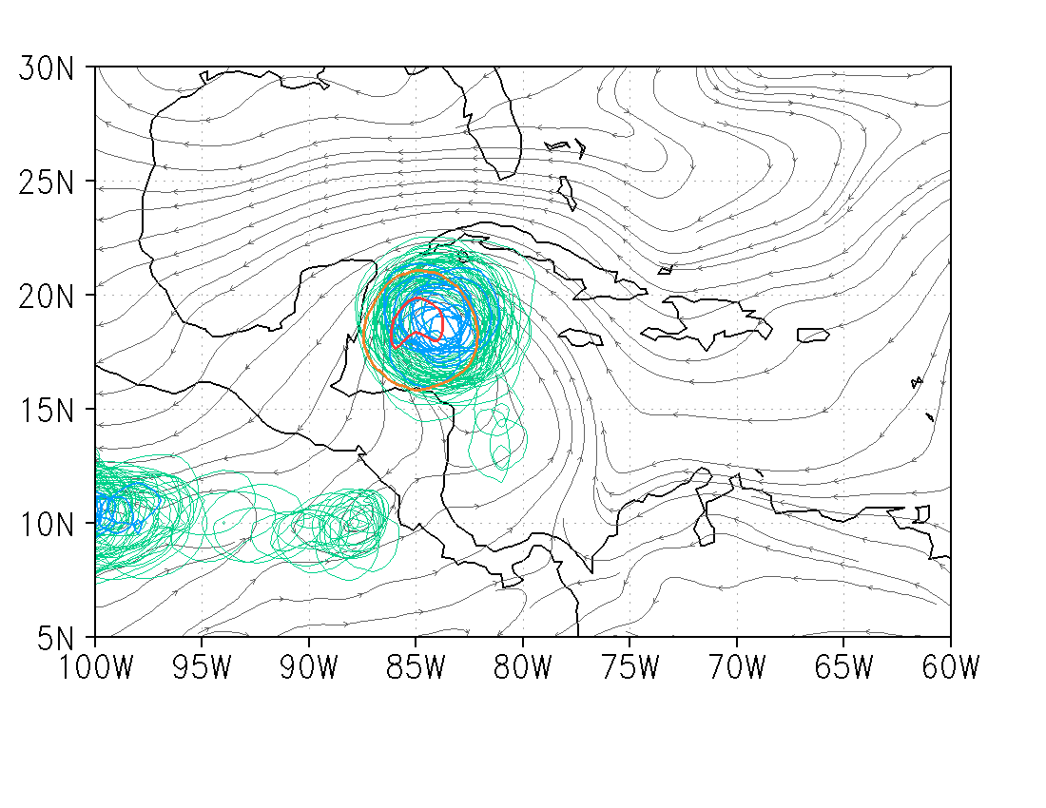
2-day forecast for 00 UTC 15 Sep

Slide 43
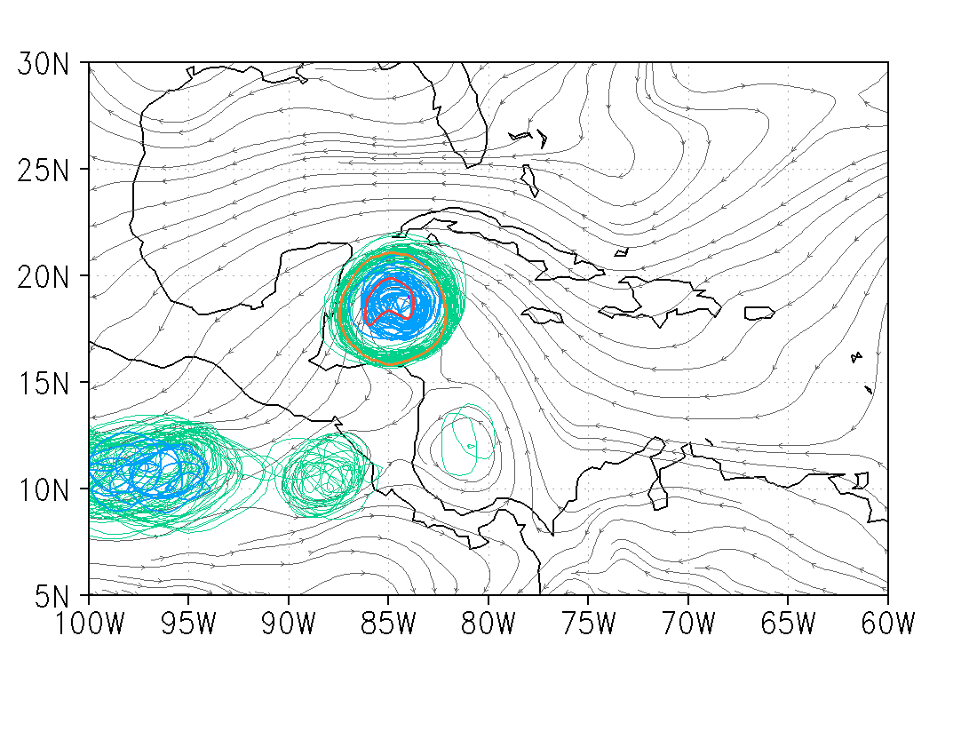
1-day forecast for 00 UTC 15 Sep

Slide 44
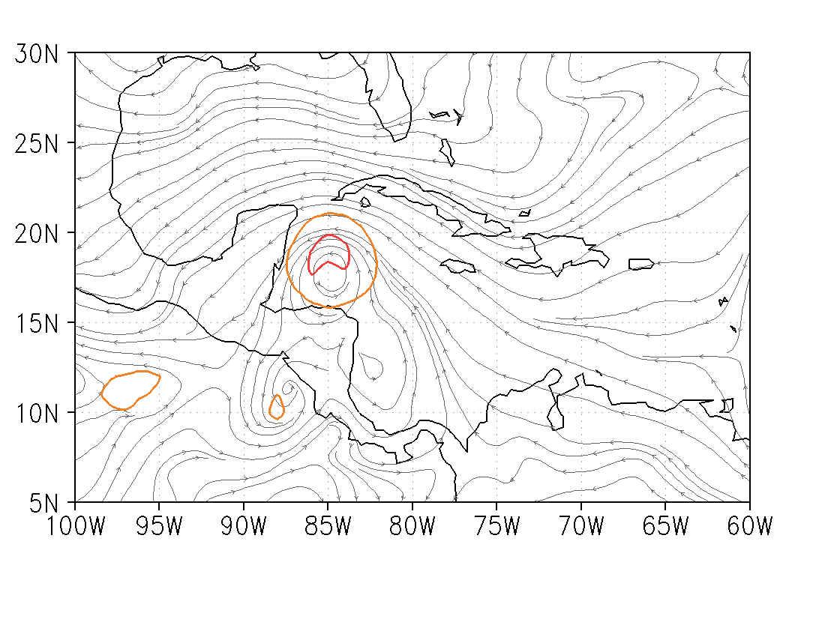
0-day forecast for 00 UTC 15 Sep

Slide 45
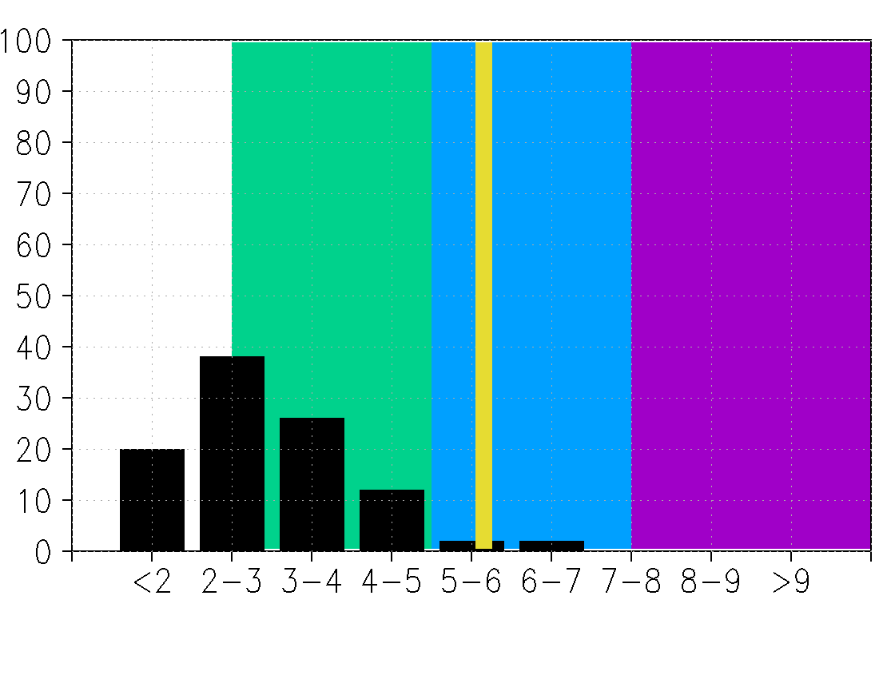
9-day forecast for 00 UTC 15 Sep

Slide 46
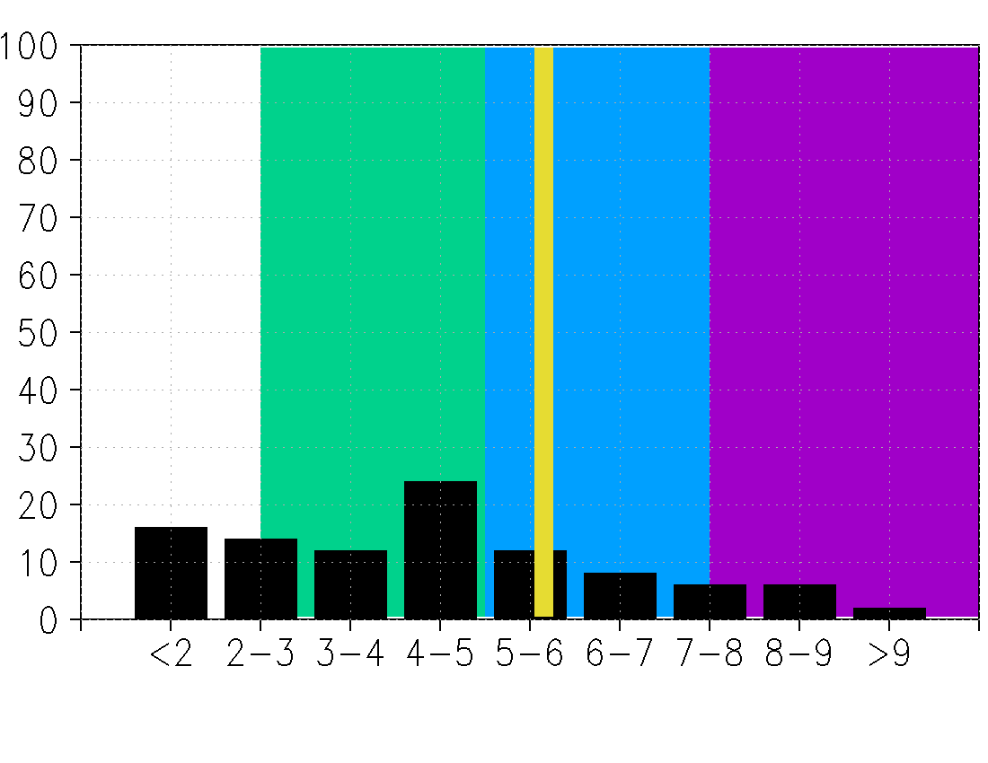
8-day forecast for 00 UTC 15 Sep

Slide 47
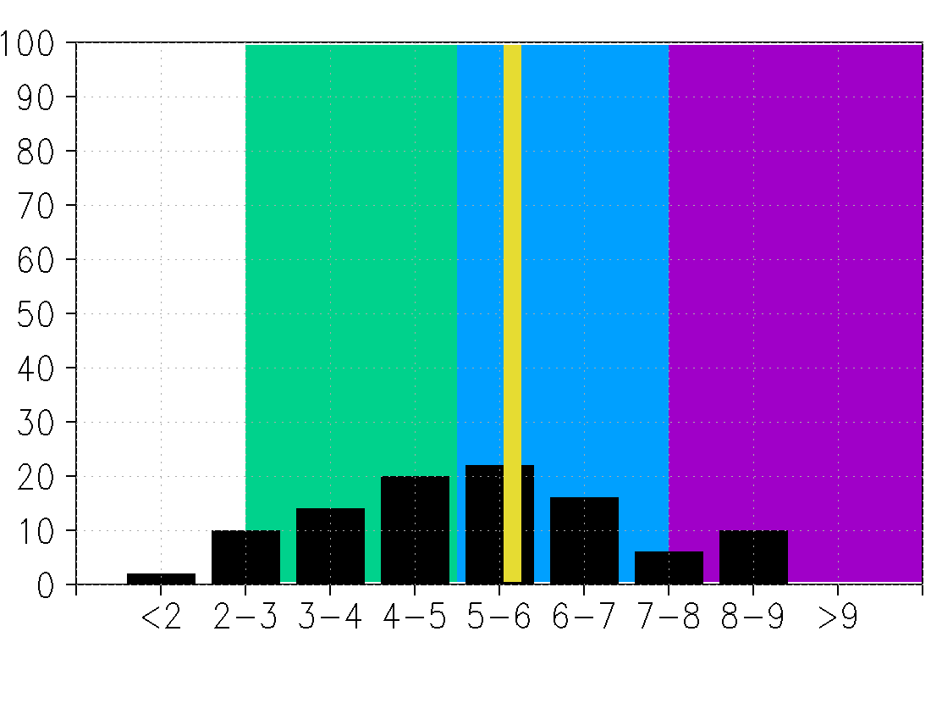
7-day forecast for 00 UTC 15 Sep

Slide 48
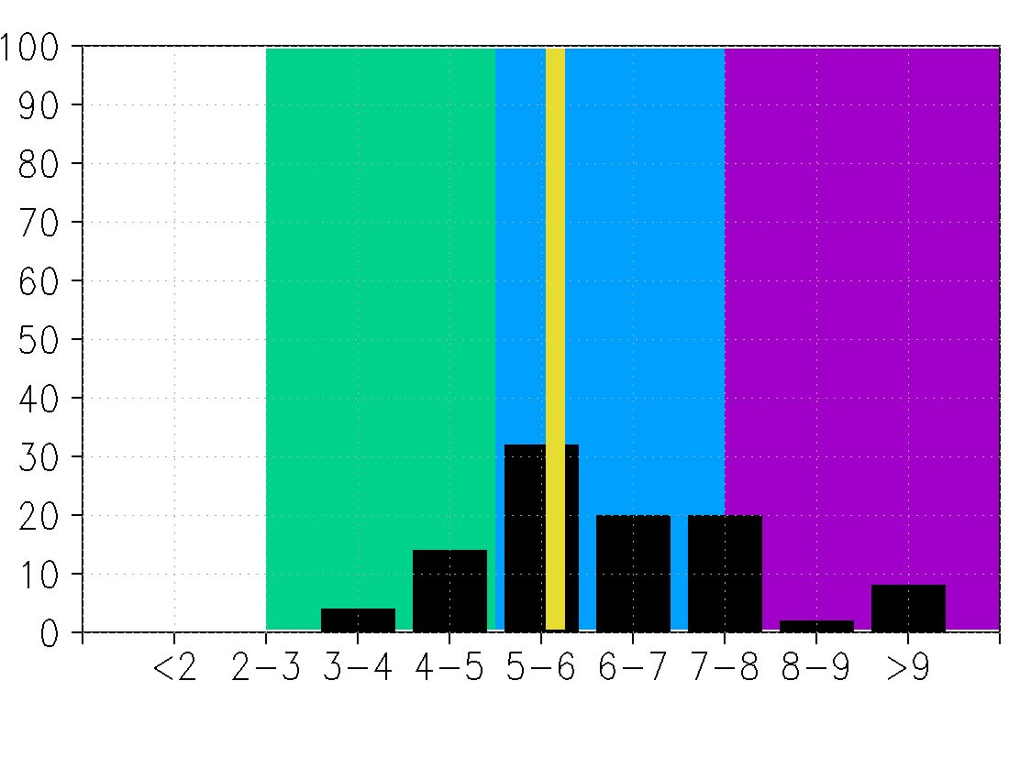
6-day forecast for 00 UTC 15 Sep

Slide 49
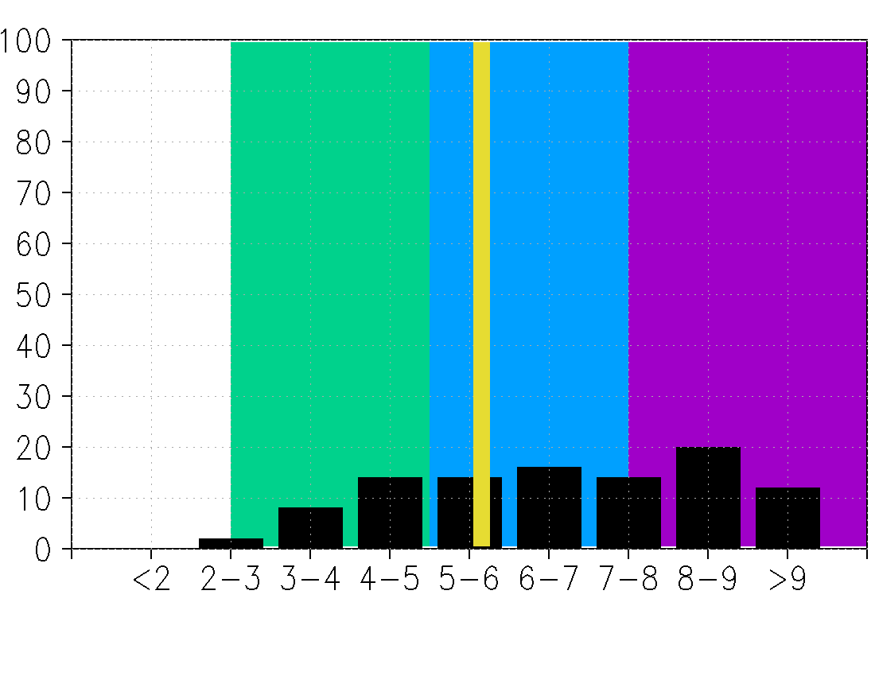
5-day forecast for 00 UTC 15 Sep

Slide 50
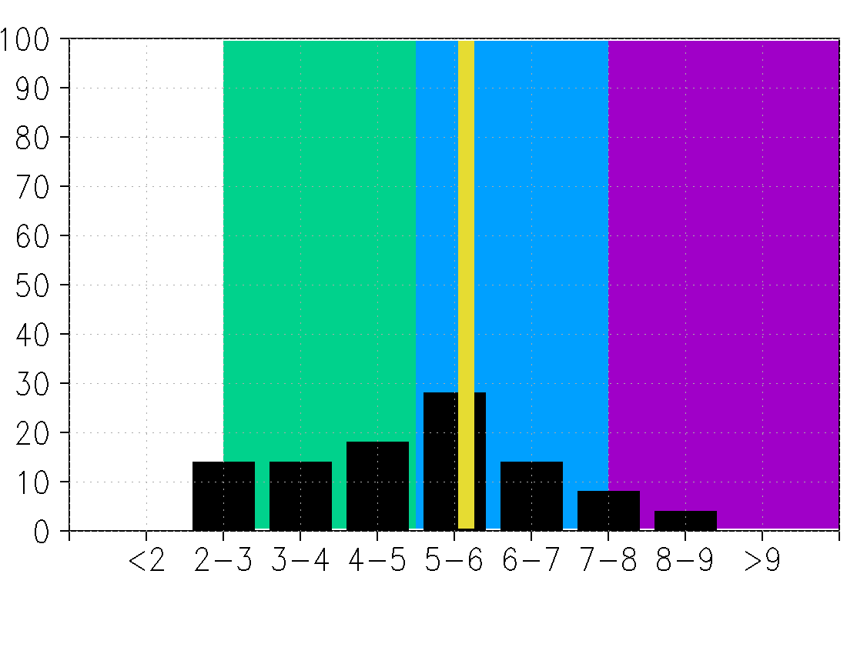
4-day forecast for 00 UTC 15 Sep

Slide 51
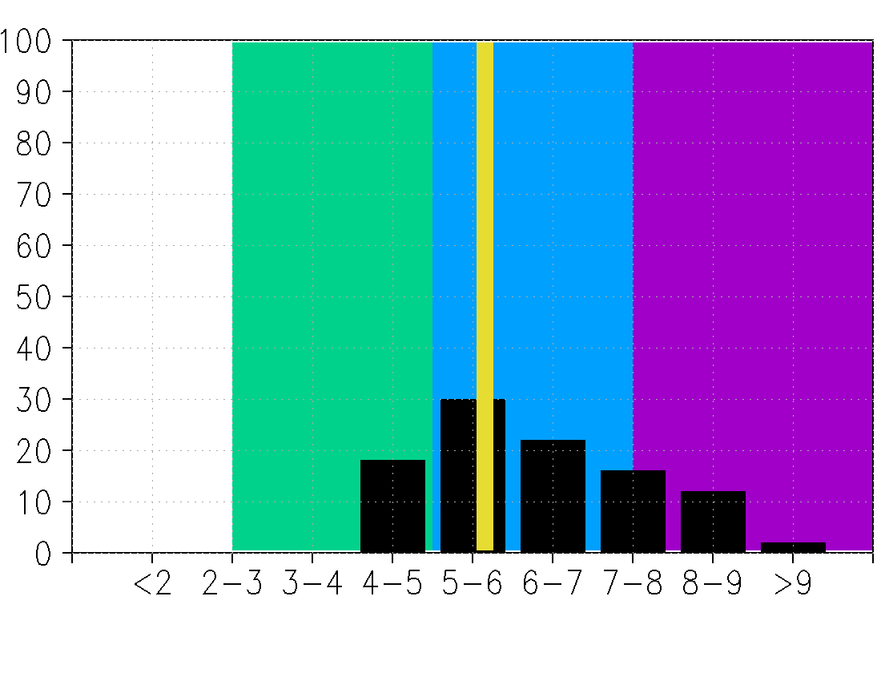
3-day forecast for 00 UTC 15 Sep

Slide 52
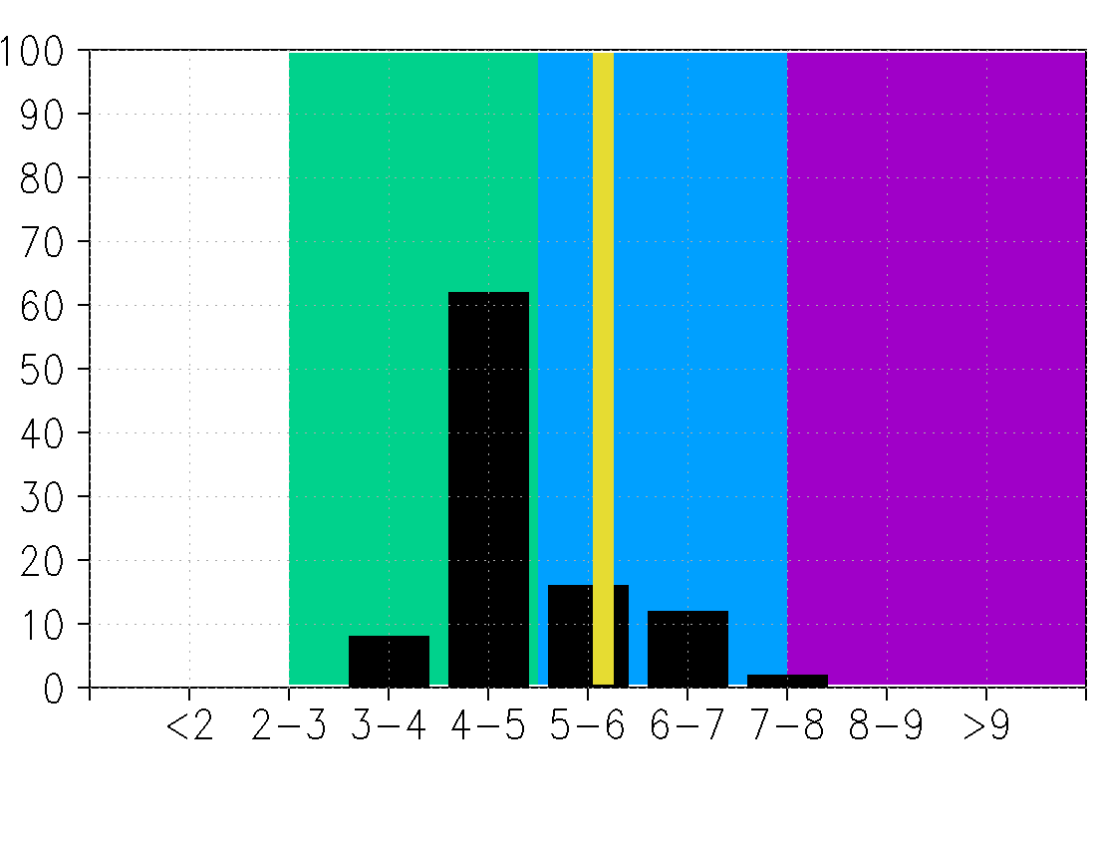
2-day forecast for 00 UTC 15 Sep

Slide 53
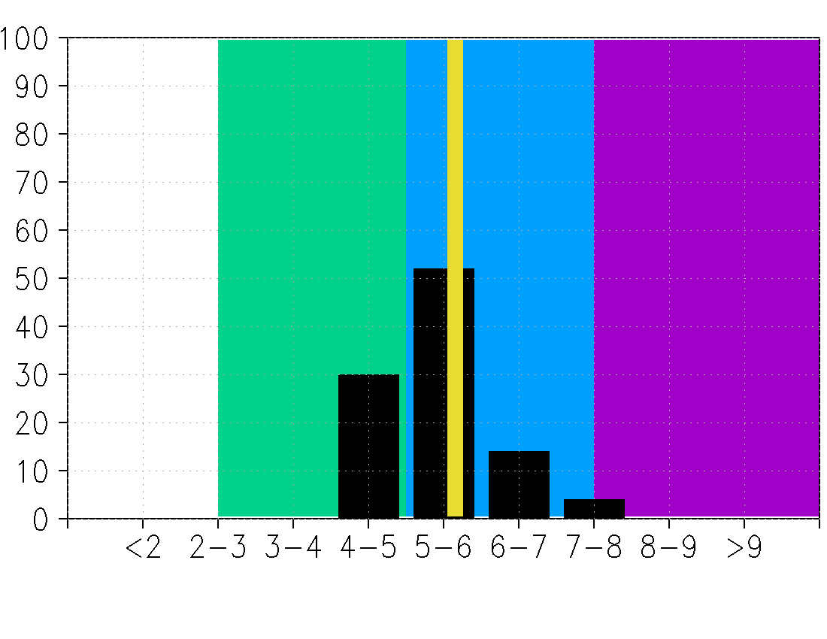
1-day forecast for 00 UTC 15 Sep

Slide 54
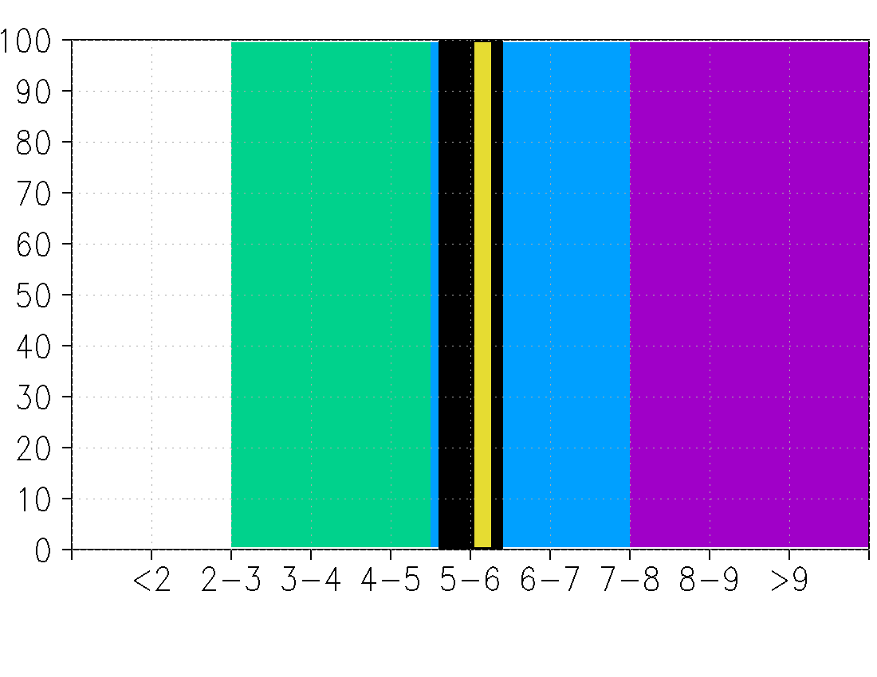
0-day forecast for 00 UTC 15 Sep

Slide 55
How to verify ensemble forecasts?
Verify each ensemble member individually to determine whether they meet some threshold criteria for genesis.
Could examine area-averaged vorticity and thickness anomaly exceeding a critical value

Slide 56
Regional ensembles: WRF/EnKF

Slide 57
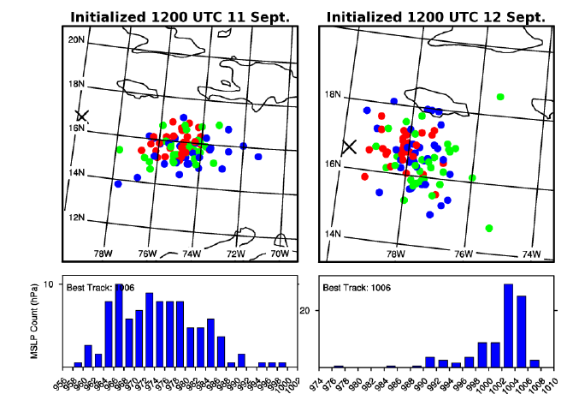
WRF-ARW / EnKF
36/12 km
96 mem
Larger variance in position and minimum SLP
Tighter PDF, closer to verification values
Min SLP
lowest 1/3
middle 1/3
highest 1/3
R. Torn

Slide 58
WRF-ARW / EnKF
40.5/13.5/4.5 km
60 mem DA
30 mem fcst
Earlier forecasts developed Karl too soon; error reduced in subsequent cycles.
F. Zhang

Slide 59
Future Work
Produce community real-time ensemble products in 2011 from NCEP GEFS (+ others?)
Determine viable objective criteria for genesis; explore tracking mechanisms
Evaluate TIGGE ensemble predictions versus their own respective analyses
Comparison with Torn ensemble sensitivity (WRF)
Detailed investigation of processes that are adequately / inadequately captured in ensemble members: what are the key limitations?

Slide 60
NCEP GFS Analyses 2007-9: TD
200-850 hPa Thickness Anomaly
700-850 hPa Area-averaged Vorticity

Slide 61
TIGGE: considerably different quantitative values of all fields relevant to genesis.

