Slide 1
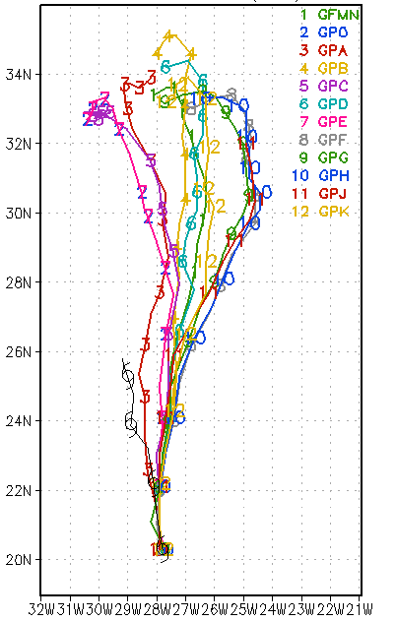
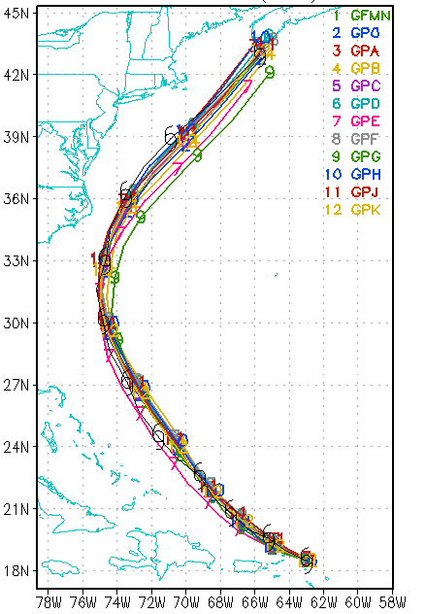
GFDL Hurricane Model Ensemble Performance during the 2010 Atlantic Season
Tim Marchok
Morris Bender
NOAA / GFDL
65th IHC
Miami, FL
01 March 2011
Acknowledgments: HFIP Program, Bob Tuleya, James Franklin, Richard Pasch

Slide 2
Design of the system
Focus on intensity
Given time constraints, must be simple to implement
Development began in mid / late July
Several members created by modifying the structure-related data from the NHC storm warning message in order to perturb the axisymmetric vortex
ROCI
NHC 12L KATRINA 20050829 0000 272N 0891W 335 046 0904 1006 0649 72 037 0371 0334 0278 0334 D 0204 0185 0139 0185 72 410N 815W 0167 0167 0093 0167
Radii of 34- and 50-kt winds

Slide 3
Defining the ensemble members
11-member ensemble: 10 perturbed members and a control forecast
GP0: Control forecast (GFD5 run on Jet)
GPA: Unbogussed forecast
GPB: Control, but with no asymmetries included
GPC: Control, but with the use of old environmental filter
GPD: Increase storm size (ROCI-based) by 25%
GPE: Decrease storm size (ROCI-based) by 25%
GPF: Increase wind radii 25%, increase storm size 25%
GPG: Decrease wind radii 25%, decrease storm size 25%
GPH: Old filter (GPC), plus both size increases from GPF
GPJ: Old filter (GPC), plus both size decreases from GPG
GPK: Set Rmax minimum to 45 km (GFD5 control uses 25 km)
Size
Members

Slide 4
Running the ensemble
All 11 members run on FSL / HFIP Jet system at operational resolution (1/2º, 1/6º, 1/12º)
Each member’s 126-h forecast ran in 90 minutes using 31 cpus.
Full forecast cycle in under 2 hours, allowing for up to 3 storms 4x per day.
Automatic cycling of the system began on 21 September

Slide 5
Cases
195 cases
Alex (12 cases)
Danielle (16)
Earl (20)
Igor (24)
Julia (15)
Lisa (15)
Matthew (11)
Nicole (2)
Otto (9)
Paula (15)
Richard (19)
Shary (4)
Tomas (33)

Slide 6
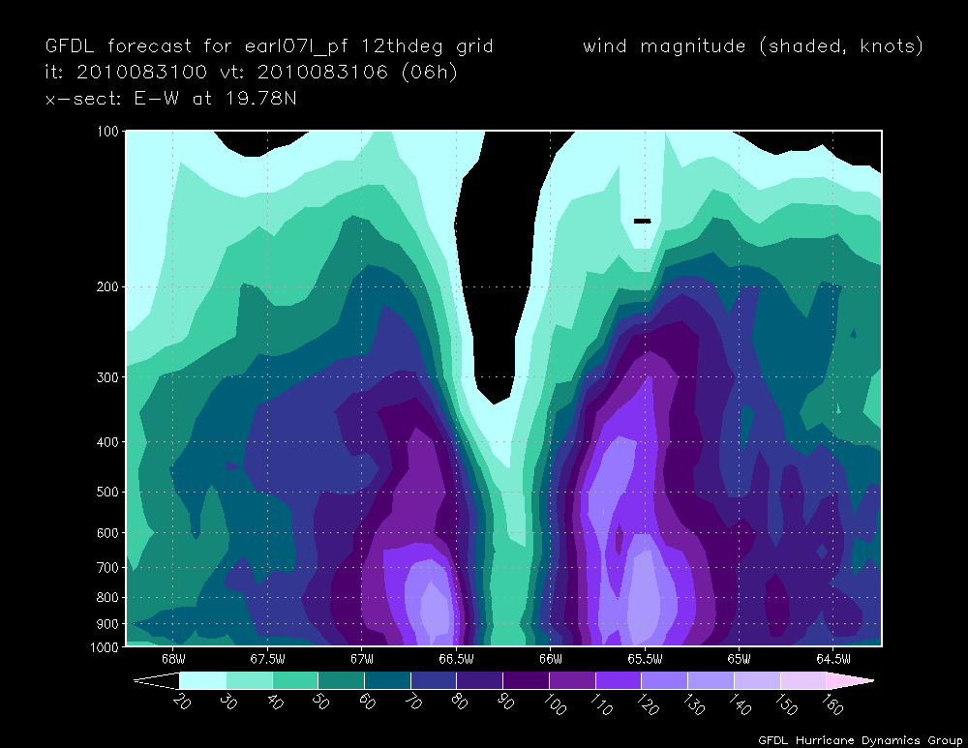
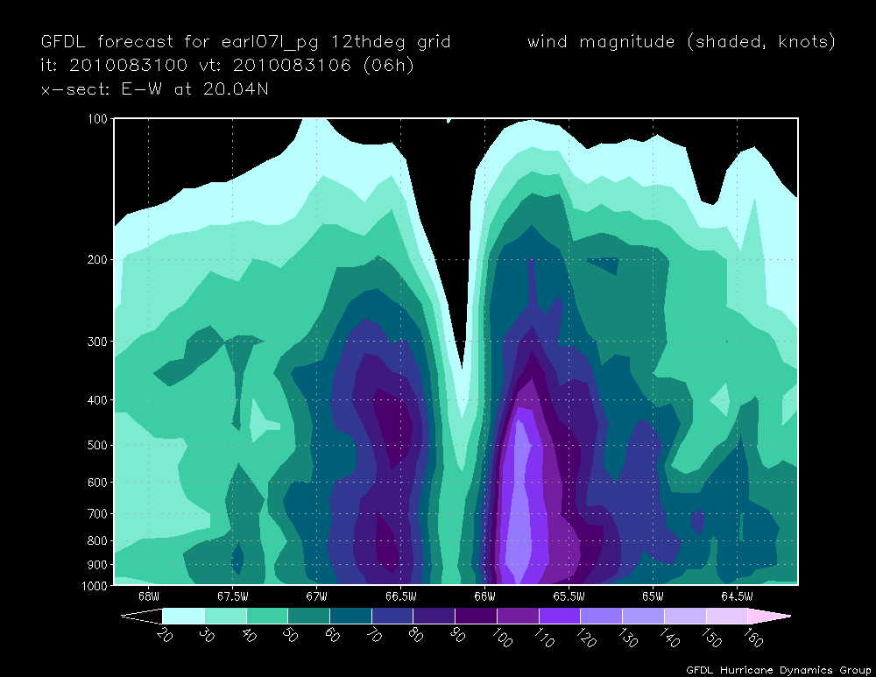
Earl 2010083100
Modifications to the observed storm size data that are input into the axisymmetric spinup lead to noticeable changes in the model storm structure
GPF: Increase all wind radii and storm size (ROCI) by 25%
GPG: Decrease all wind radii and storm size (ROCI) by 25%

Slide 7
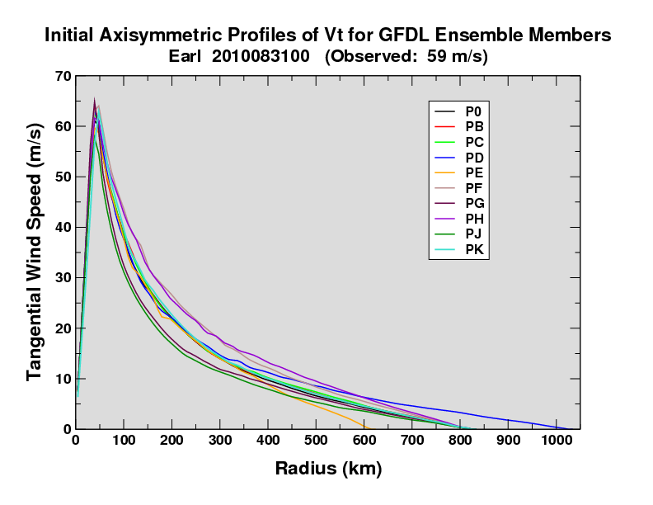
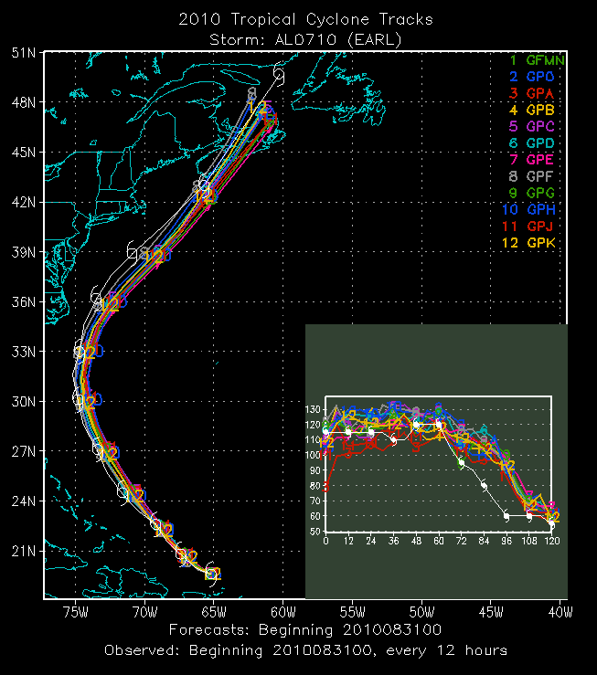
Earl 2010083100
Spread evident in the V_{T} profiles from the vortex spinup leads to noticeable spread in the Vmax forecast, but very little spread in the tracks.

Slide 8
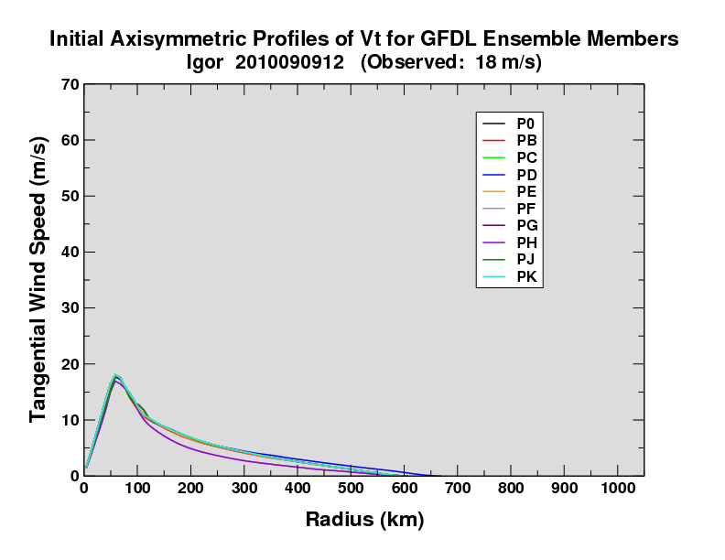
Igor 2010090912
As a weak tropical storm (35 kts), there is little in the way of structure to manipulate for this case of Igor.

Slide 9
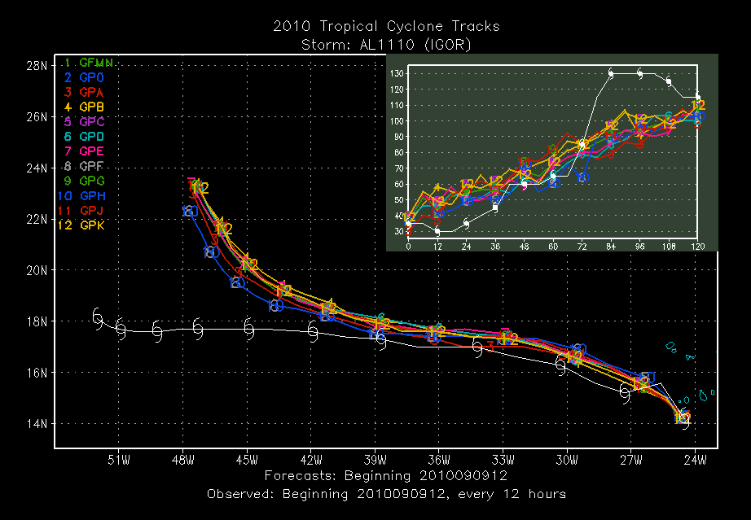
Igor 2010090912
Small spread is seen throughout this case for both track and intensity

Slide 10
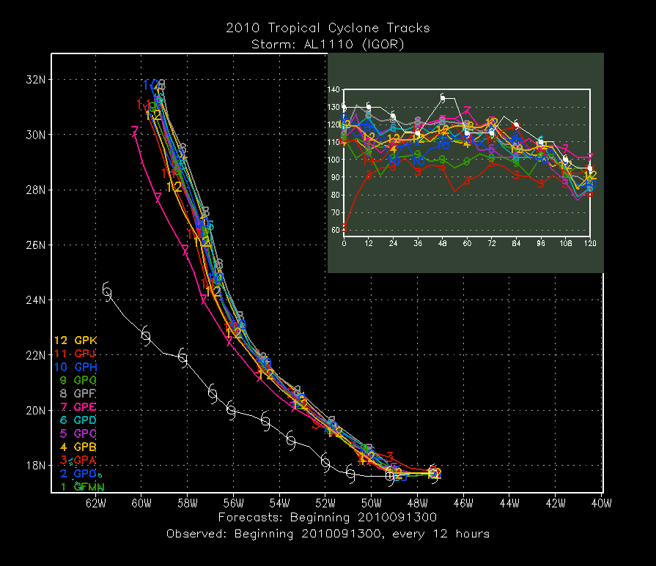
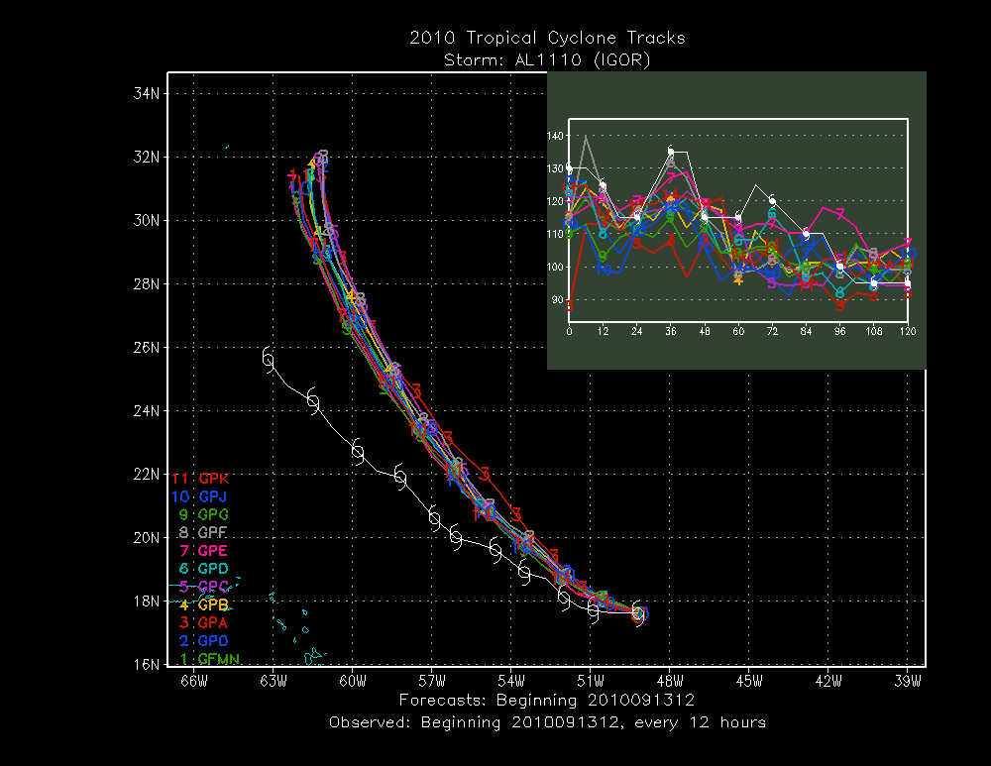
Igor
2010091300 (130 kts)
2010091312 (130 kts)
Later cases of Igor – when more intense – exhibited more spread, at least for the intensity forecasts.

Slide 11
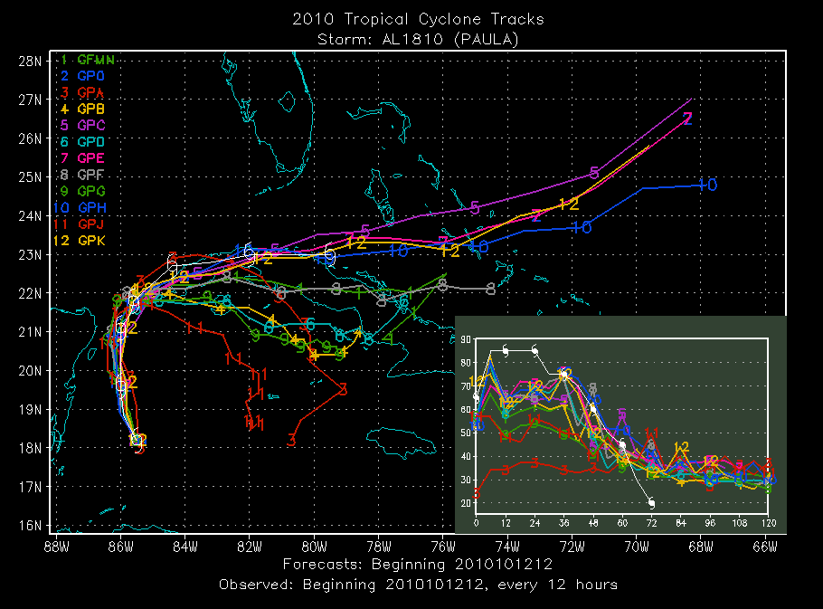
Paula
Cases of Paula exhibited some of the most spread for track forecasts

Slide 12
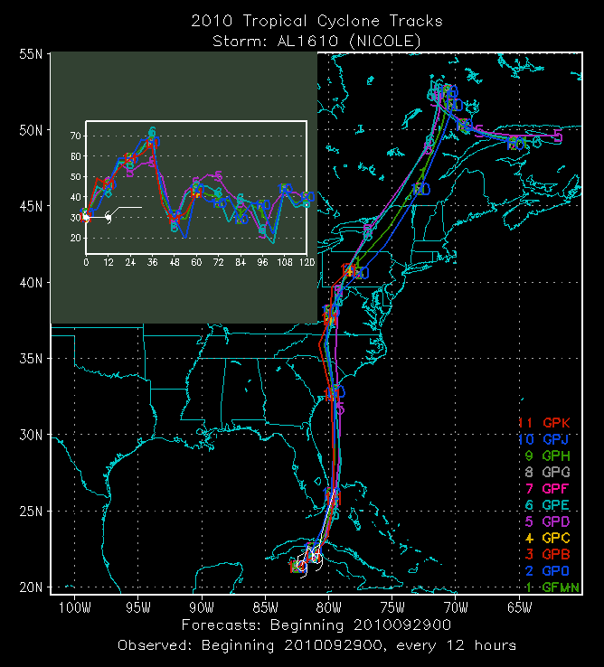
Nicole
A problem that occasionally occurred with very weak storms is shown here for Nicole in which several identical forecasts were produced.

Slide 13
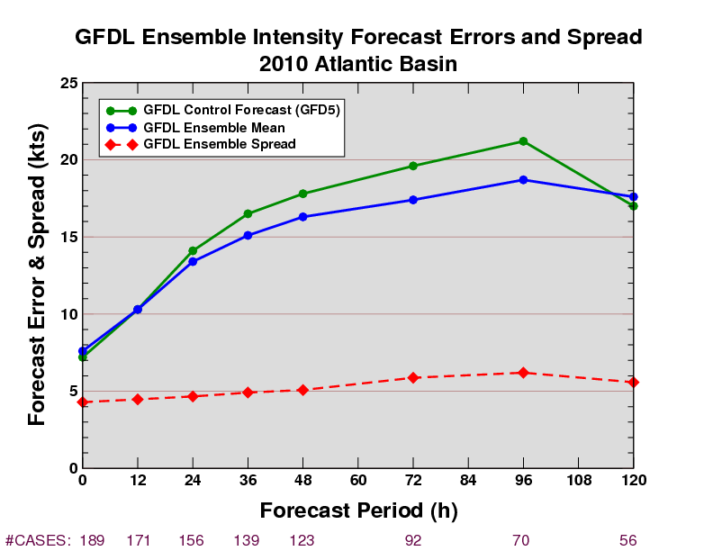
Intensity Results
Statistically significant improvements of the ensemble mean over the control are seen through the middle of the forecast period.
11.8%
11.2%
8.3%
8.4%
4.4%
However, the spread results indicate an underdispersive ensemble

Slide 14
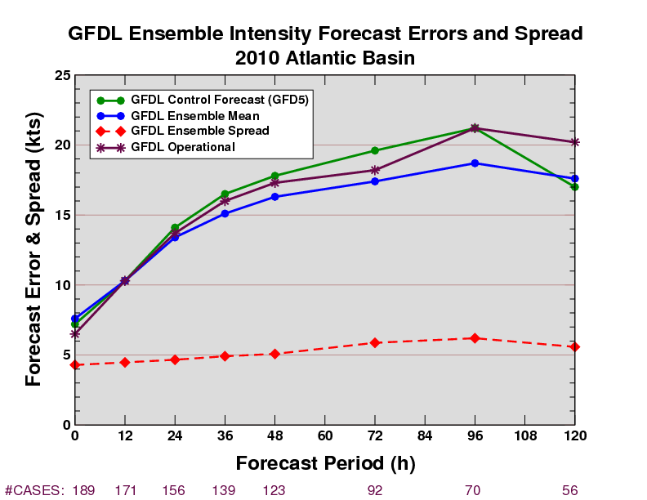
Intensity Results
Improvements over the operational GFDL are also seen, especially at 4 and 5 days.
11.8%
11.2%
8.3%
8.4%
4.4%

Slide 15
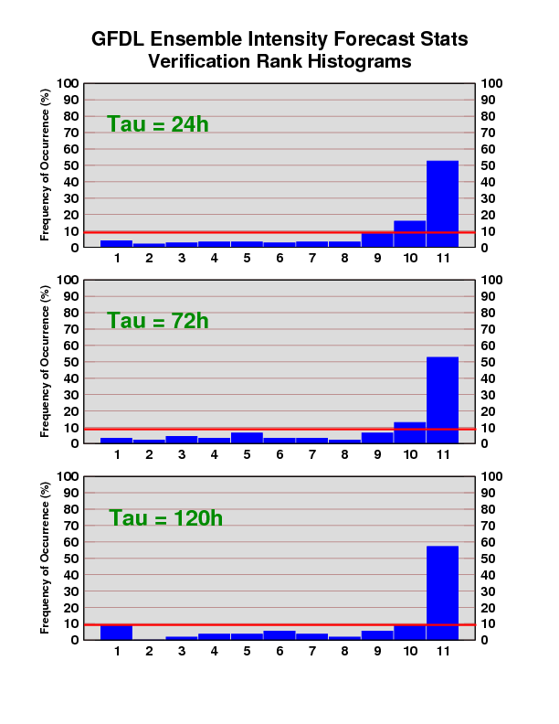
Intensity Results
Verification rank histograms also indicate an underdispersive ensemble.

Slide 16
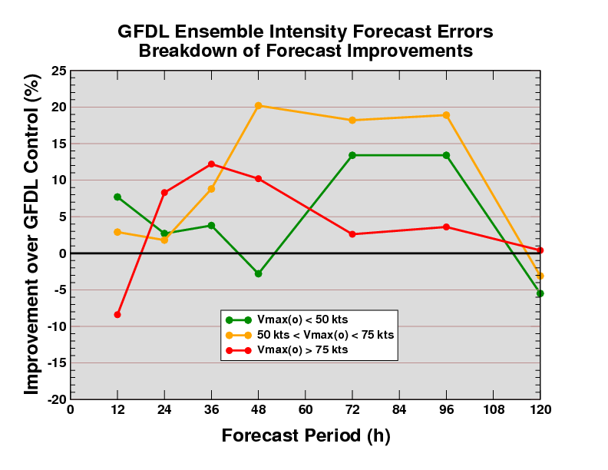
Intensity Improvement Stratified by Vmax₍₀₎
Forecasts for weak storms see very little improvement from the GFDL ensemble mean until 3 days, while stronger storms see improvements at earlier lead times.

Slide 17
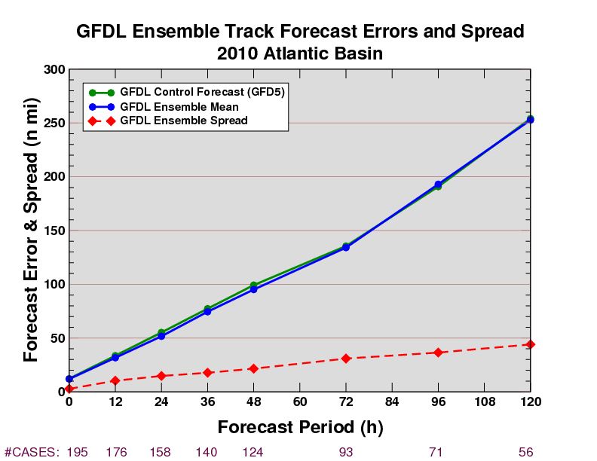
Track Results
Improvements for track are smaller than for intensity, but still significant from 12-48h .
However, the spread in the track forecasts is extremely low.
1.0%
4.1%
3.6%
6.3%
5.5%

Slide 18
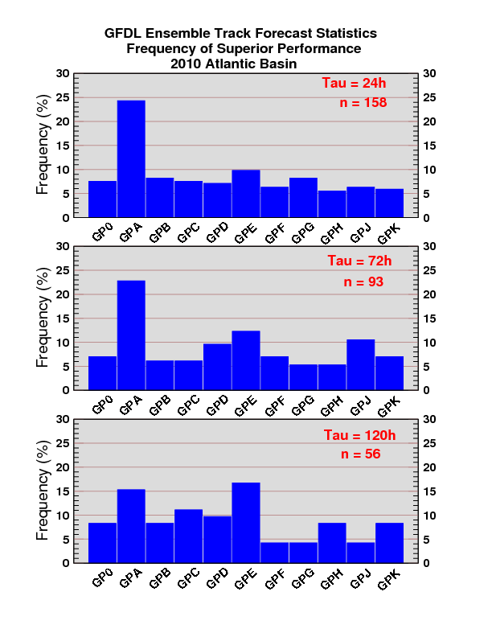
Performance of the unbogussed forecast
Frequency of Superior Performance: Track
An interesting result was how well the unbogussed forecast performed, both for track and intensity.
Track: Unbogussed forecast had smallest error at 24, 36, 48 and 96h.

Slide 19
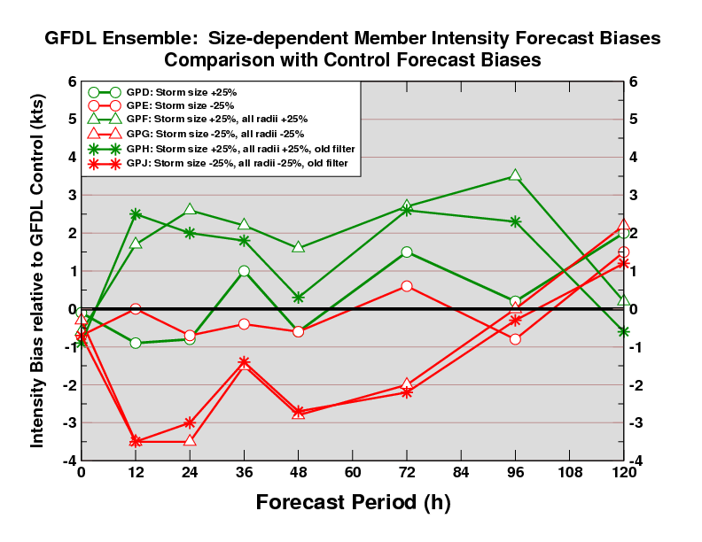
Comparison of Intensity Forecast Biases
Modifying the wind radii and storm size together has more of an impact on intensity bias than just modifying storm size alone.

Slide 20
Testing a modified ensemble membership for 2011
13-member ensemble: 12 perturbed members and a control forecast
0: Control forecast (Proposed 2011 operational GFDL)
A: Unbogussed forecast
B: Increase Vmax₍₀₎ +10%
C: Decrease Vmax₍₀₎ -10%
D: Increase 34R (+25%), 50R (+40%), ROCI (+25%)
E: Decrease 34R (-25%), 50R (-40%), ROCI (-25%)
F: Increase Rmax +25%
G: Decrease Rmax -25%
H: GFDL ensemble control from 2010 (“GFD5”)
J: Allow greater % of dissipation to go into heating
K: Decrease the amount of vertical momentum transport
L: Turn off shallow convection
M: Reduce the penetration of downdrafts into the boundary layer
Size
Members
Convective Param
Members

Slide 21
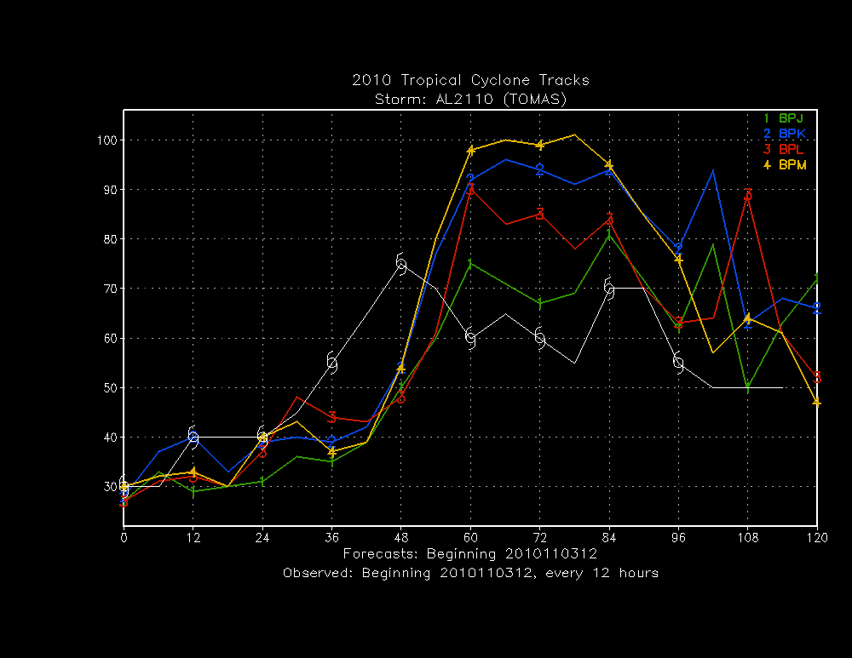
Differences with convective perts: Tomas example
Considerable spread in the intensity forecast is seen from the 4 convective parameterization members for this case of Tomas.

Slide 22
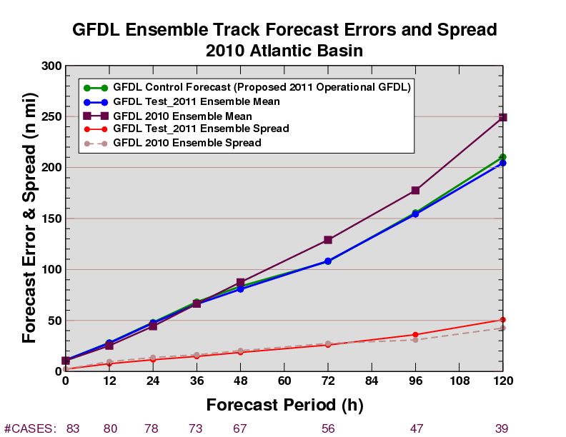
Preliminary Results: Track
2011 ensemble mean better than 2011 control and significantly better than 2010 ensemble mean at 3-5 days lead time.
Ensemble only marginally more dispersive than 2010 ensemble.

Slide 23
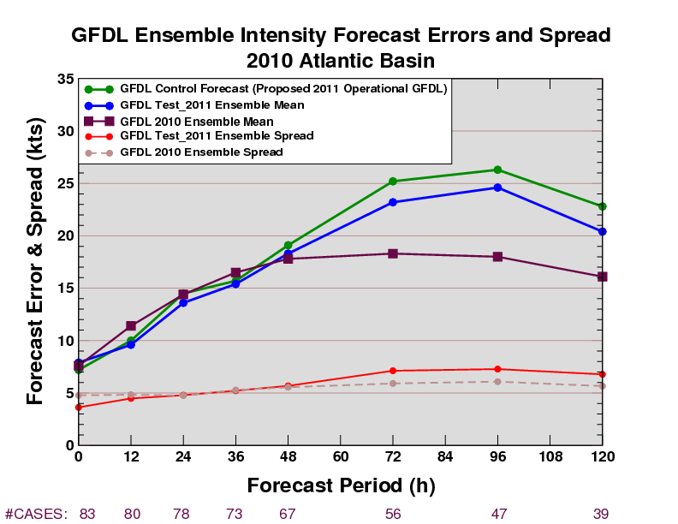
Preliminary Results: Intensity
2011 ensemble mean better than control but significantly worse than 2010 ensemble mean at 3-5 days lead time.

Slide 24
Conclusions
Modest improvements over control run seen for 2010 ensemble mean intensity forecasts, somewhat less for track.
Modifying the vortex structure shows promise for perturbing forecasts (although not as well for weak storms, given the perturbation method we used).
The ensemble shows low dispersion for intensity and especially track, and it may benefit from increased spread.
Modifying the wind radii and the ROCI has more of an impact on intensity bias than just modifying ROCI alone.
The unbogussed forecast performed surprisingly well for track, and even for intensity at later lead times.

