Slide 1
Large Ensemble Tropical Cyclone Forecasting
K. Emanuel¹ and Ross N. Hoffman², S. Hopsch²,
D. Gombos², and T. Nehrkorn²
¹ Massachusetts Institute of Technology
² Atmospheric and Environmental Research, Inc.
Tuesday March 1st, 2011
Kerry A. Emanuel
Massachusetts Institute of Technology emanuel@mit.edu

Slide 2
Technique
Begin with ECMWF global 51-member ensemble
Calculate ensemble mean TC track velocity vectors and covariances among them
Calculate mean and covariances among global wind components at 250 and 850 hPa
Synthesize track velocity vectors, using track velocity vectors at early lead times giving way to beta-and-advection model at long lead times
Run CHIPS model along each track
Easy and fast to generate thousands of tracks in real time

Slide 3
Data
ECMWF Deterministic and Ensemble forecasts (51 ensemble members at 00 and 12 UTC)
Track data from all ensemble members
Spatial resolution: 2° latitude/longitude grid
  17 vertical levels from deterministic forecast
  850 and 250 hPa winds from the ensemble forecasts
Temporal resolution: 12 hourly time steps
Filter ECMWF wind fields to remove model TCs
Notes:
Not all storms in all members.
12 h data for tracks and grids

Slide 4
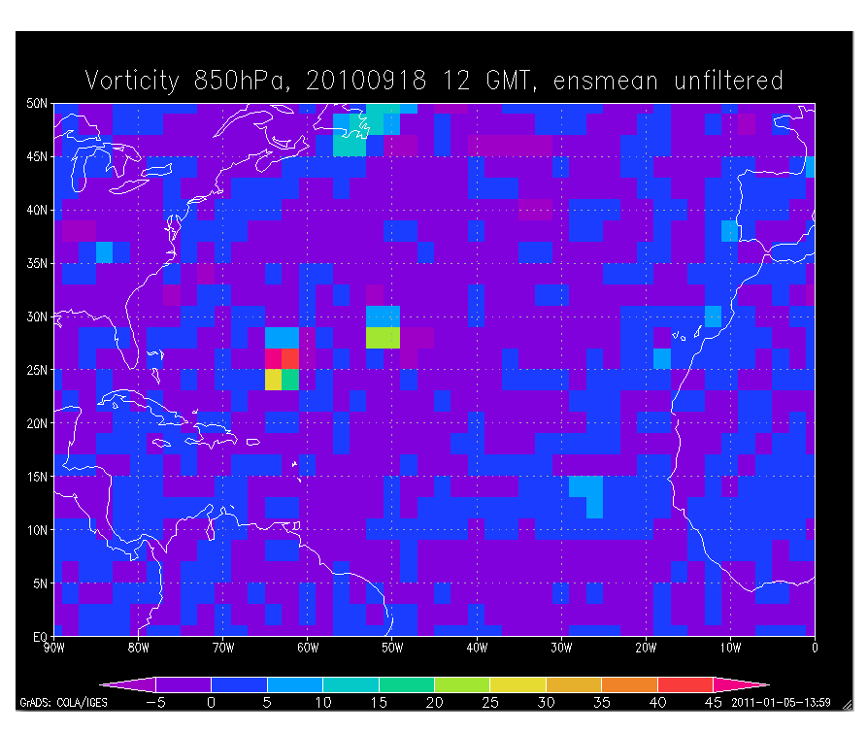
Relative Vorticity Igor (AL11), 2010 09 18 12 GMT
unfiltered relative vorticity
Julia (AL 12)
Igor (AL 11)

Slide 5
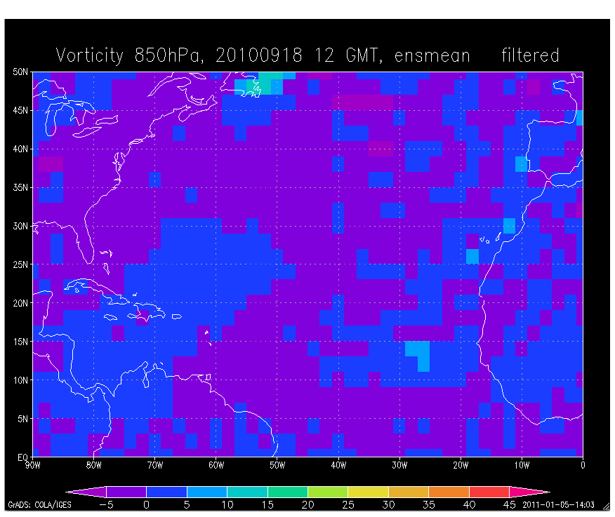
After vorticity surgery
filtered relative vorticity

Slide 6
Example: Hurricane Igor, 2010 09 17 12 GMT

Slide 7
With Best Track

Slide 8
With NHC Forecast

Slide 9
With ECMWF Track Ensembles

Slide 10
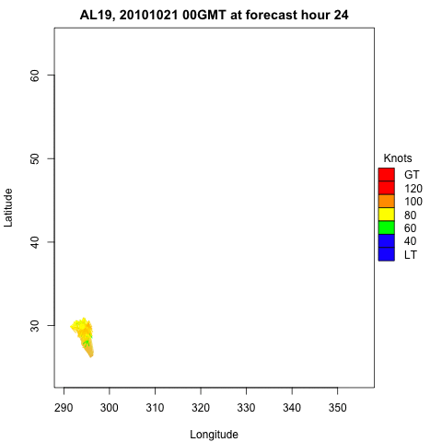

Slide 11
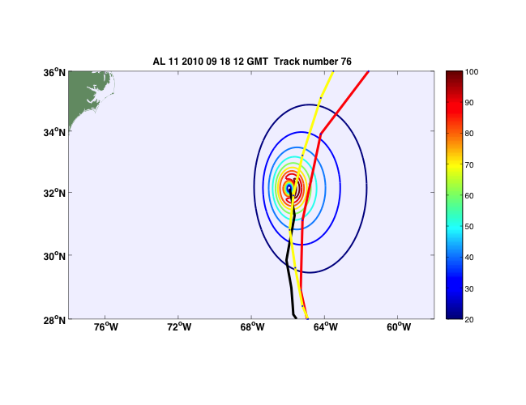
Wind field for one (very good) sample track (T+36 h)
NHC Forecast & Best track
NHC official forecast
Best track
Notes:
Yellow = best track, red = official NHC forecast track, FYI the metar special obs with the days maximum windspeed and gust is given below. It occurred on Sep. 20th at 2:22GMT - i.e. this particular track is in good agreement with the observations.
Metar from TXKF: SPECI TXKF 200222Z 15059G81KT 0800 R30///// R12///// -RA BLPY BKN012 OVC050 26/25 Q0965 RMK R30///// R12///// PRESFR

Slide 12
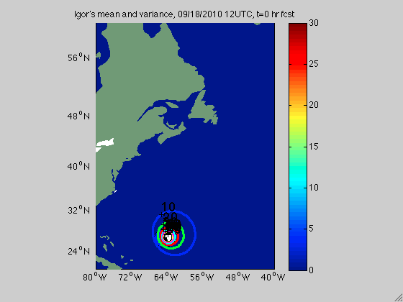

Slide 13
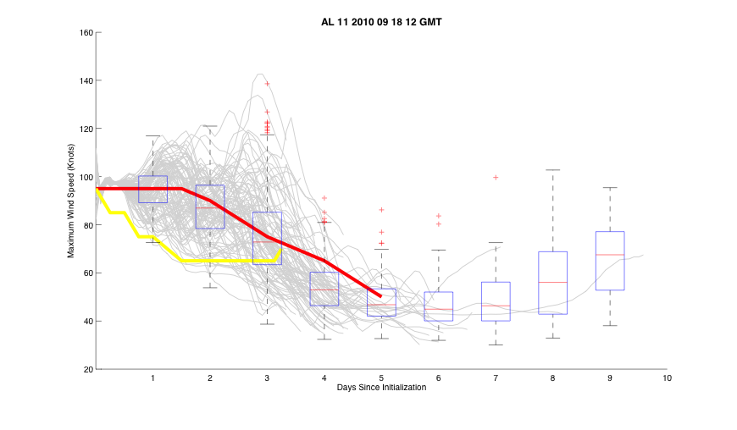
Intensity forecast
Gray = downscaled ensemble
based on 100 tracks
NHC official forecast
final best track
Boxplot based on 1000 tracks
Notes:
Intensity is for 100 ensemble tracks data from Kerry, boxplot is based on data with 1000 tracks, the number of tracks in the second half of the timeseries gets smaller and smaller… something that the boxplot can’t convey by itself.
When the lines and the boxplot are not referencing the same data source, I find this figure a little confusing. There appears to be a disconnect between the intensity of the individual tracks and the boxplot, particularly towards the second half of the timeseries.

Slide 14
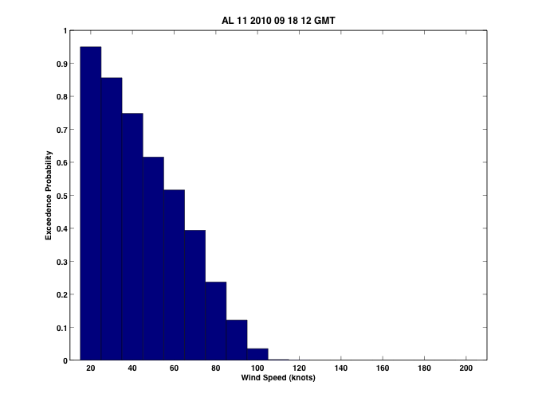
Wind exceedence probabilities for Bermuda (32.4N, 64.7W)
Sample size:
1000 tracks
Observed at airport (TXKF):
59kts
(81kts gusts)

Slide 15
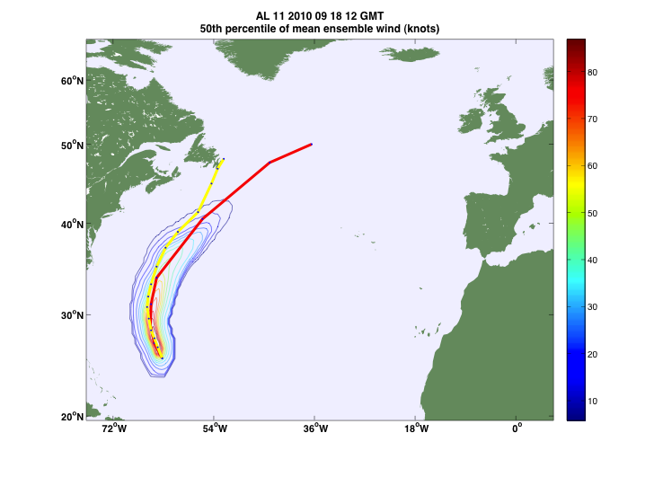
50 % peak wind exceedence (knots)
NHC official forecast
Best track
Notes:
The following are still experimental maps - showing probabilities of winds exceeding the contoured wind speeds… These maps are based on the 1000 track ensemble members.

Slide 16
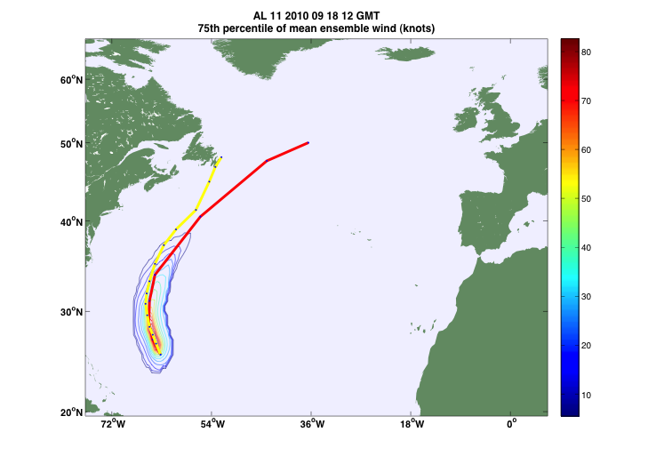
75 % peak wind exceedence (knots)
NHC official forecast
Best track

Slide 17

90 % peak wind exceedence (knots)
NHC official forecast
Best track

Slide 18
Discussion
Capability to generate hundreds or thousands of TC intensity forecasts for individual storms.
Must develop efficient methods to communicate the results for:
  Ease of understanding, and
  For use in decision-making.
Problem in communicating uncertainty in many dimensions; both the
  Probabilistic forecasts, and the
  Skill metrics of these forecasts.
Many potential approaches.
  Methods shown are just a start, and were restricted to non-interactive images or animations.

