Slide 1
2011 operational HWRF model upgrades
EMC/NCEP/NWS/NOAA
Young C. Kwon, V. Tallapragada, R. Tuleya, Q. Liu, K. Yeh*, S. Gopal*, Z. Zhang, S. Trahan and J. O’connor
*: HRD/AOML

Slide 2
Main components of 2011 upgrades
Use WRF-NMM3.2 dynamic core
Upgrade the vortex initialization scheme
Upgrades of Simplified Arakawa-Schubert (SAS) deep convection scheme to 2010 GFS
Modified air-sea enthalpy exchange coefficient (Ch) at high wind speeds
Several bug-fixes in radiation and Micro-physics scheme
2

Slide 3
Experiments
► HR20: Baseline HWRFV3.2
► HR21: HR20 + New GFS deep convection
► HRDI: New Vortex initialization
► HR28: New Init + New SFC + New deep convection
► H211: GFS convection + New SFC + New init
+ bug fixes + new 2011 GFS :: To be run soon

Slide 4
Modified initialization
Vortex size correction
- Instead of matching only RMW but also matching outer radii such as ROCI or R34kt
Less use of the composite storms for weak storms
- Preventing the rapid spin-up of weak storms
Matching the maximum 10m wind speed but not forcing the minimum SLP
- With more balanced vortex, rapid spin-down of strong storm is much reduced
* Modified initialization significantly improve the intensity skill of HWRF model (especially 0-48hr)

Slide 5
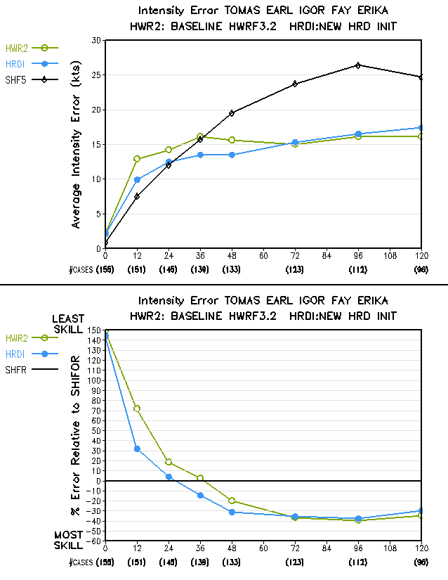
Modified initialization improves the intensity skill over 20% at the early time (0-48hr)
Baseline
New INIT

Slide 6
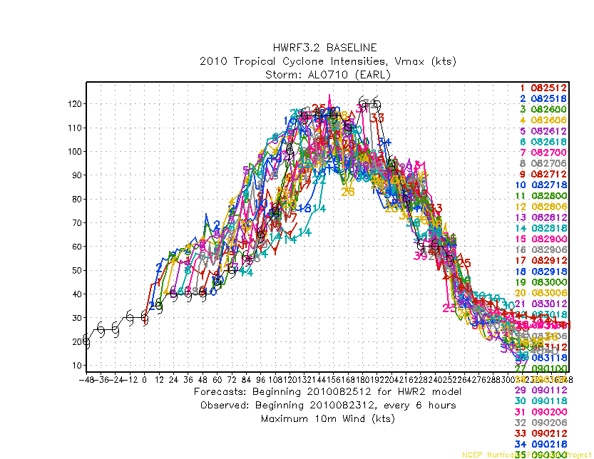
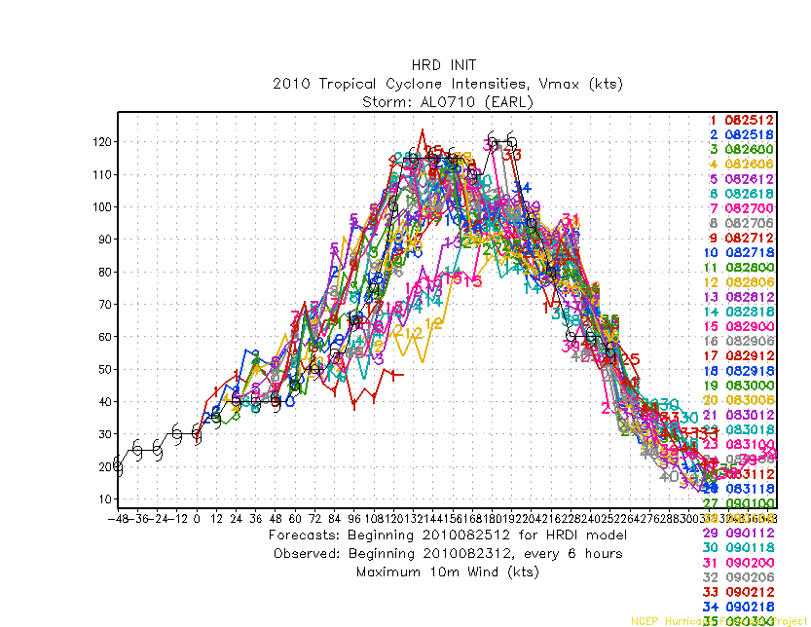
New initialization
Initial spin-up for weak storms
Much reduced spin-up

Slide 7
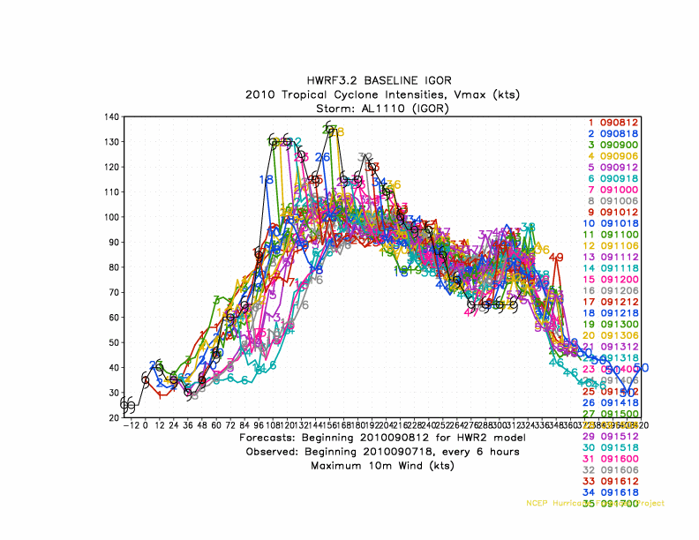
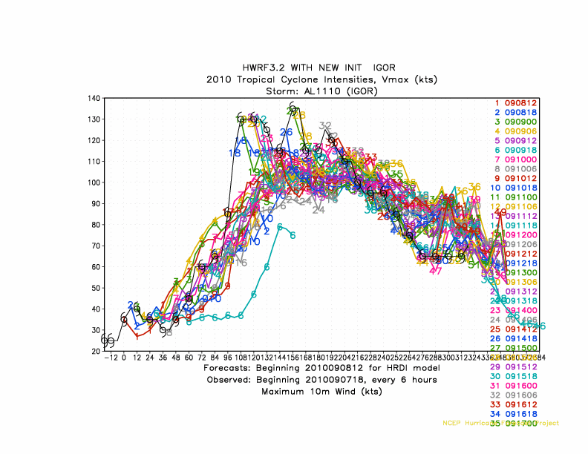
New initialization
Initial spin-down for strong storms
Much reduced spin-down

Slide 8
IGOR 2010091300
HR20: PARENT
HRDI: PARENT
GFDL: PARENT
HR20: NEST
HRDI: NEST
GFDL: NEST
8

Slide 9
Major changes in deep convection scheme
Random cloud top is replaced by a single deep cloud. In sub-cloud layer, entrainment rate is given to be inversely proportional to height and the detrainment rate is set to be a constant as entrainment rate at the cloud base. Above cloud base, an organized entrainment is added, which is a function of environmental relative humidity.
Convective overshoot is parameterized in terms of the cloud work function (CWF) (negative energy above neutral buoyancy level is set to be 10% of the CWF).
Maximum cloud base mass flux [currently 0.1 kg/(m²s)] is defined for the local Courant-Friedrichs-Lewy (CFL) criterion to be satisfied, but less than 0.5 kg/(m²s).
4. The effect of convection-induced pressure gradient force on cumulus momentum transport is included, which reduce the convective momentum mixing.

Slide 10
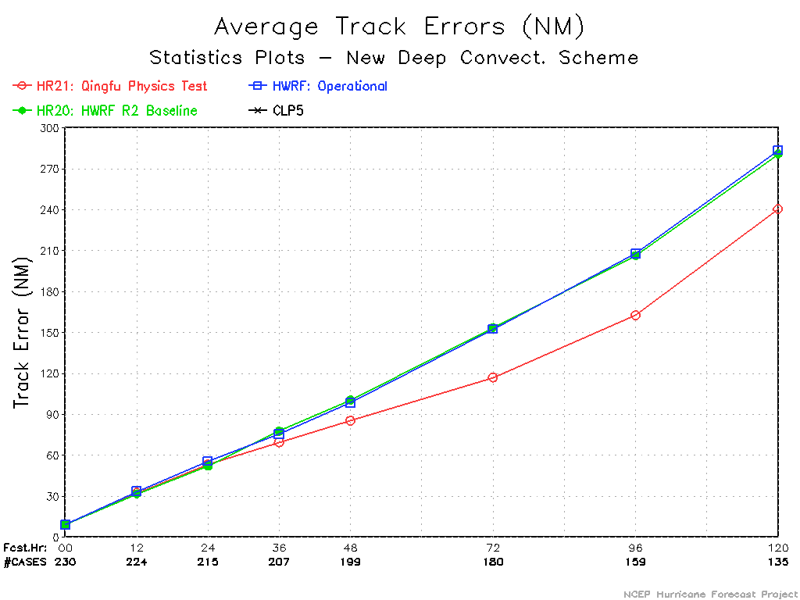
Track improved significantly with new GFS convection
baseline
New convection

Slide 11
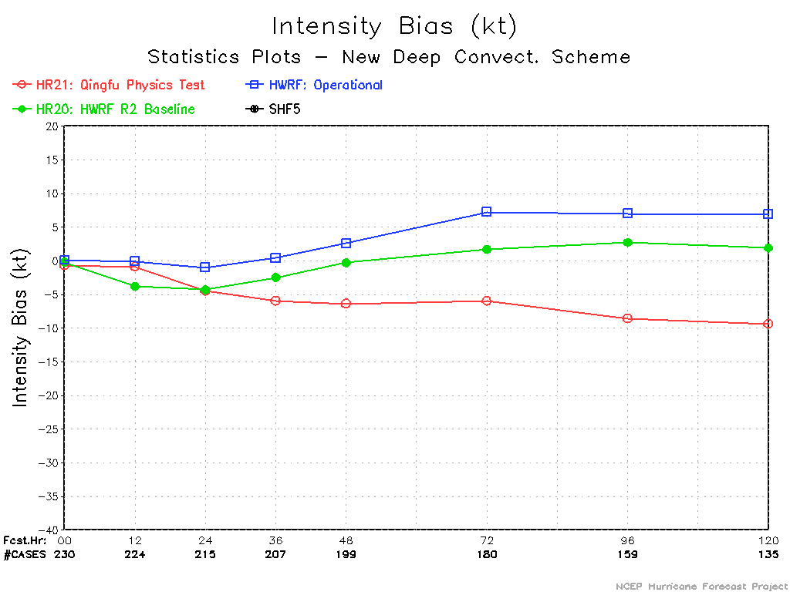
New convection
However, intensity is too weak with new convection

Slide 12
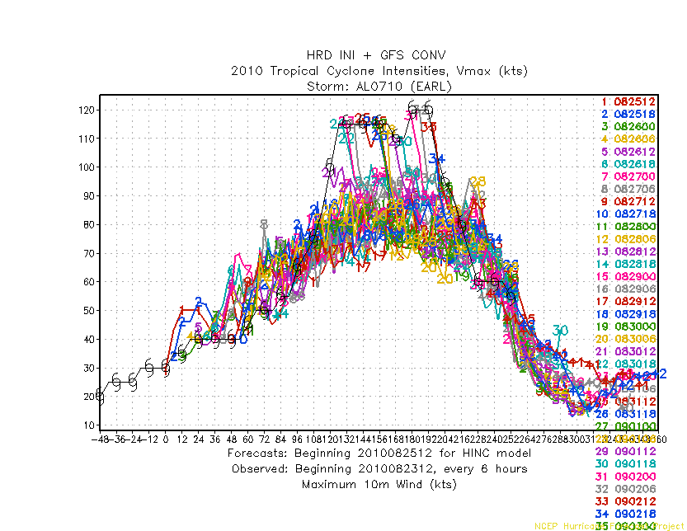
New init +
New init with GFS convection show large negative bias : increase of Ch
12

Slide 13
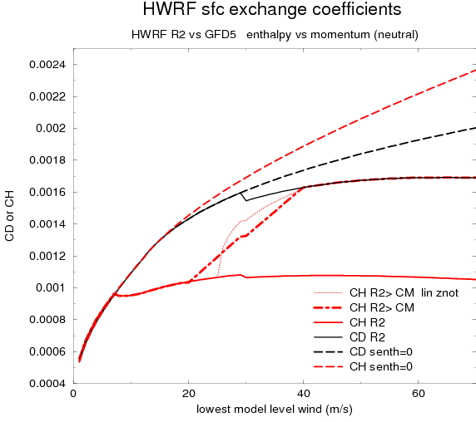
New Ch for 2011
13

Slide 14
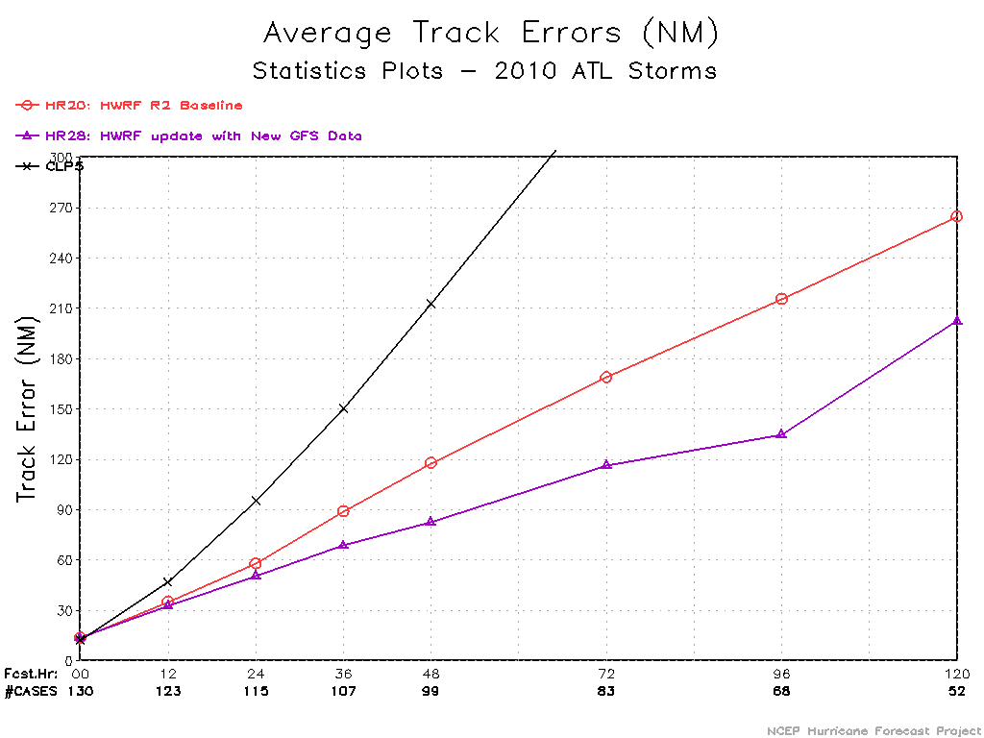
baseline
HR28

Slide 15
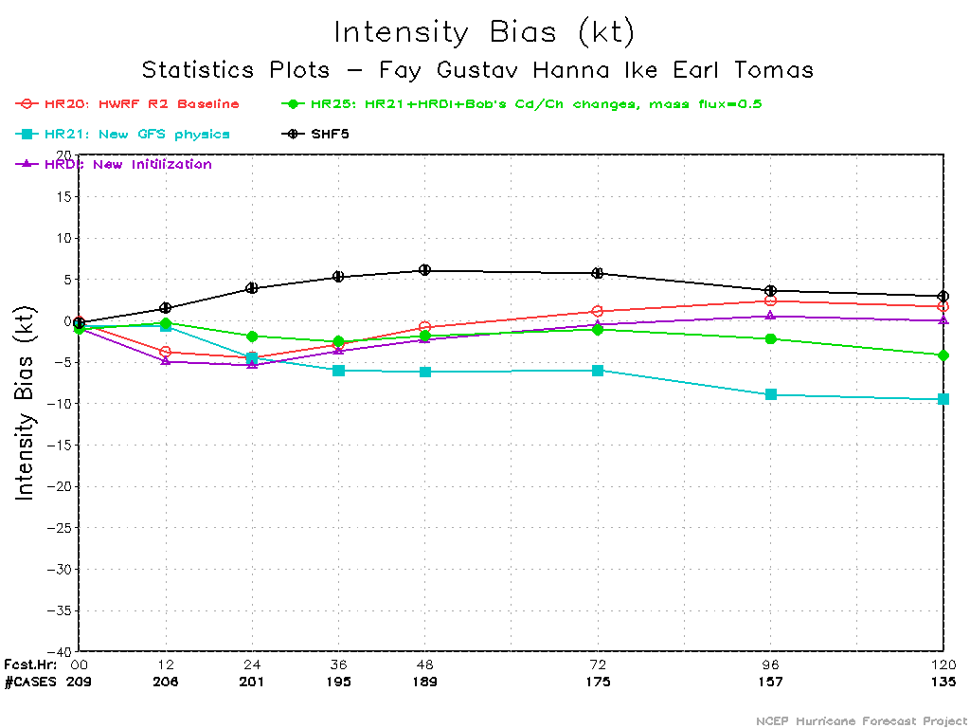
Original Ch
New Ch

Slide 16
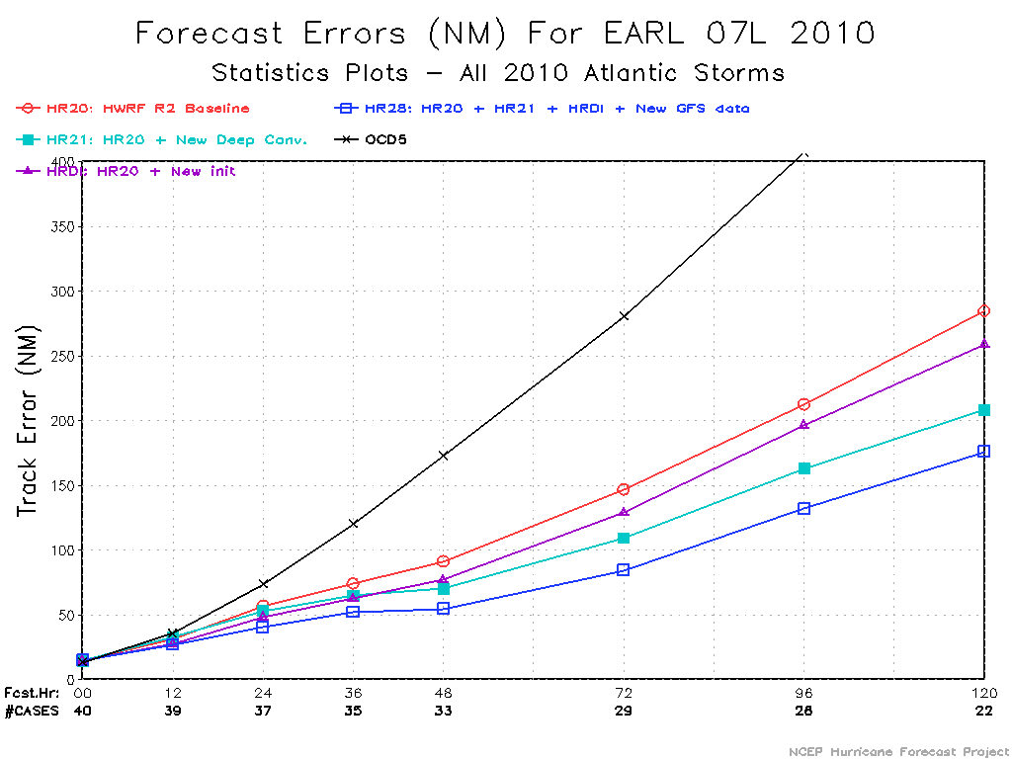
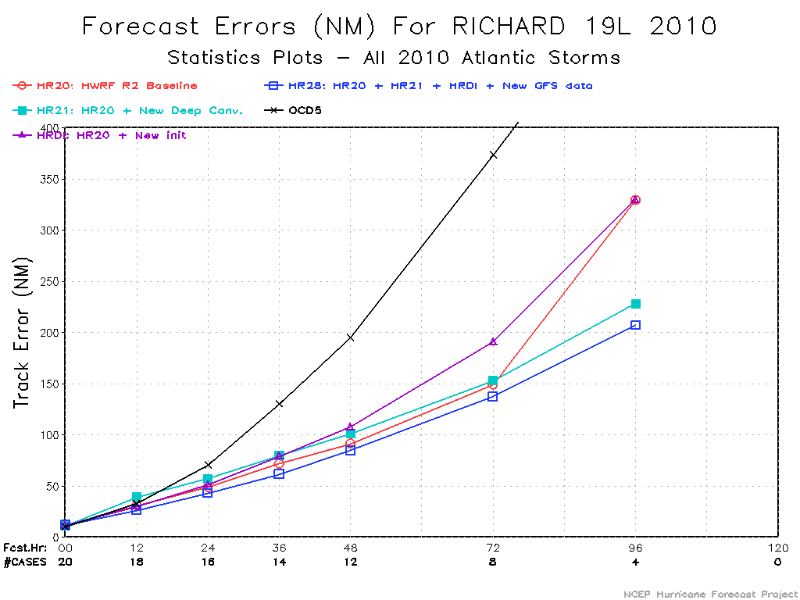
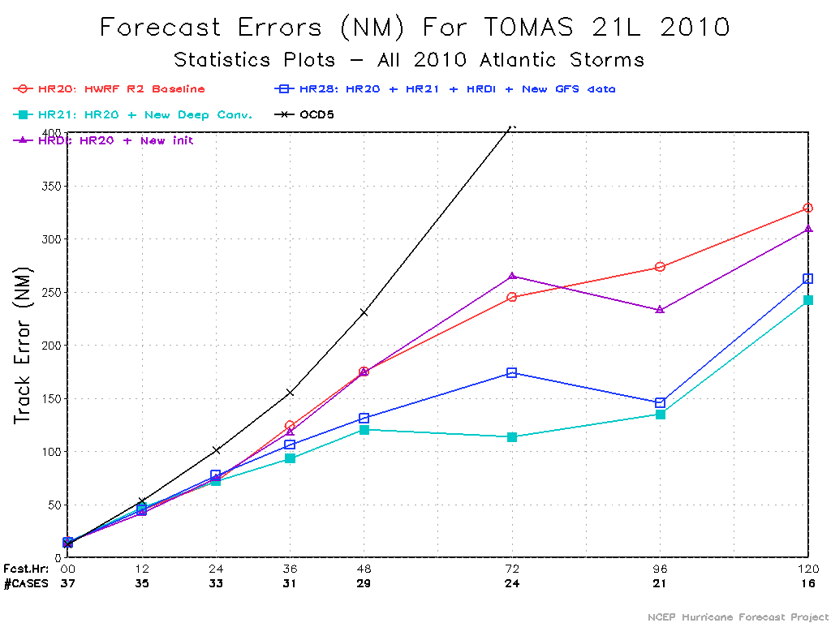
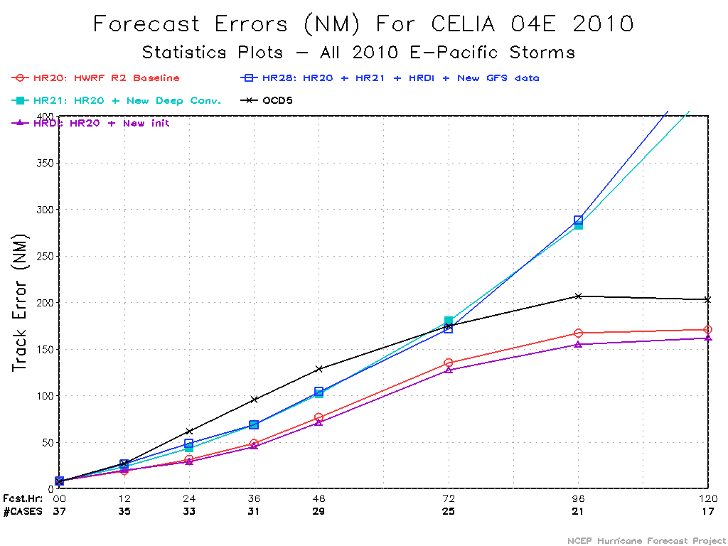
Earl
Richard
BASELINE
~ 35% improvement
HR28
Tomas
Celia
Track degraded

Slide 17
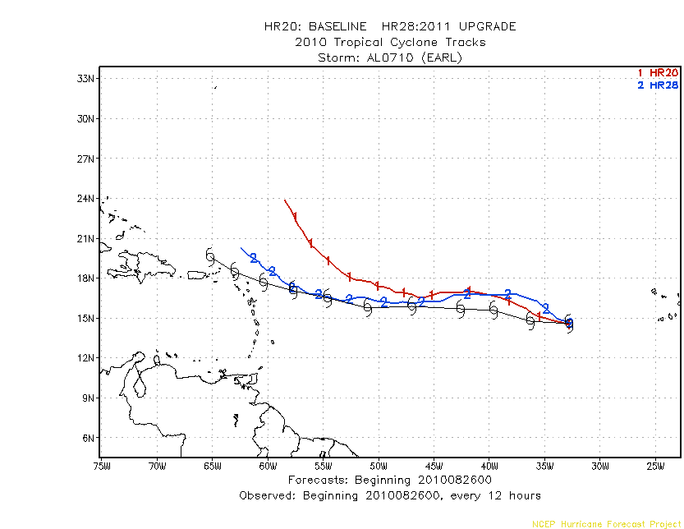
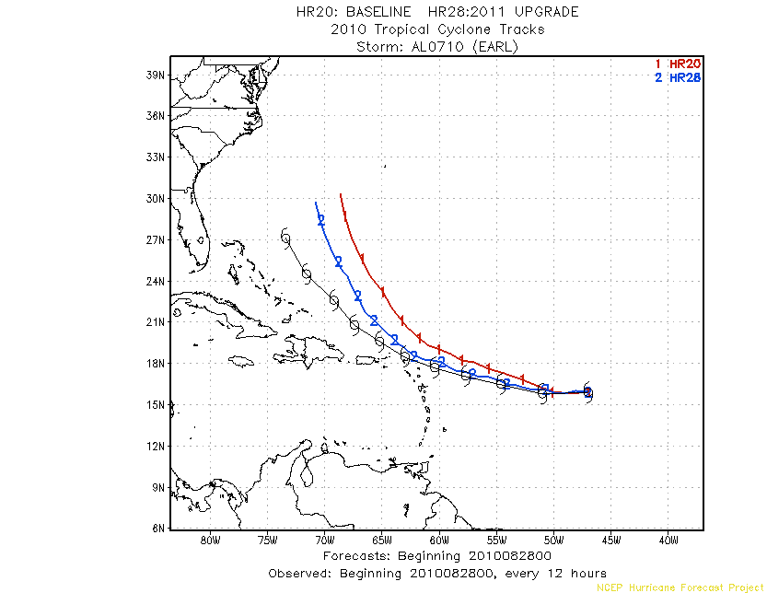
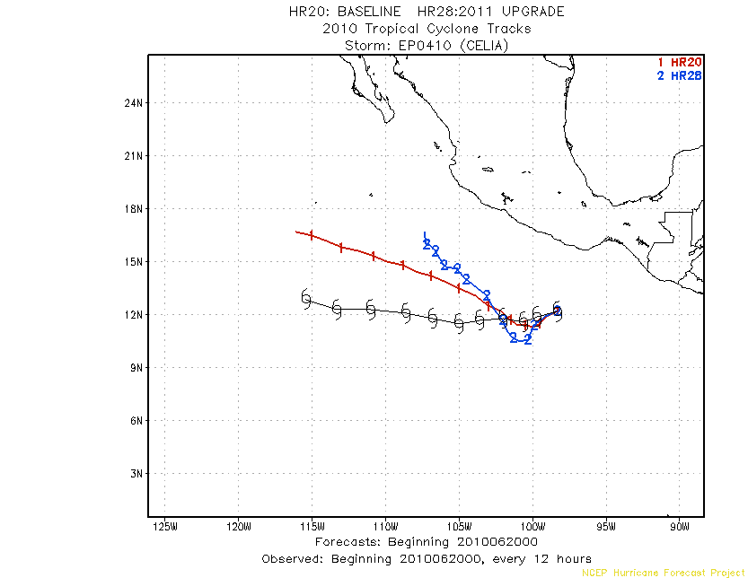
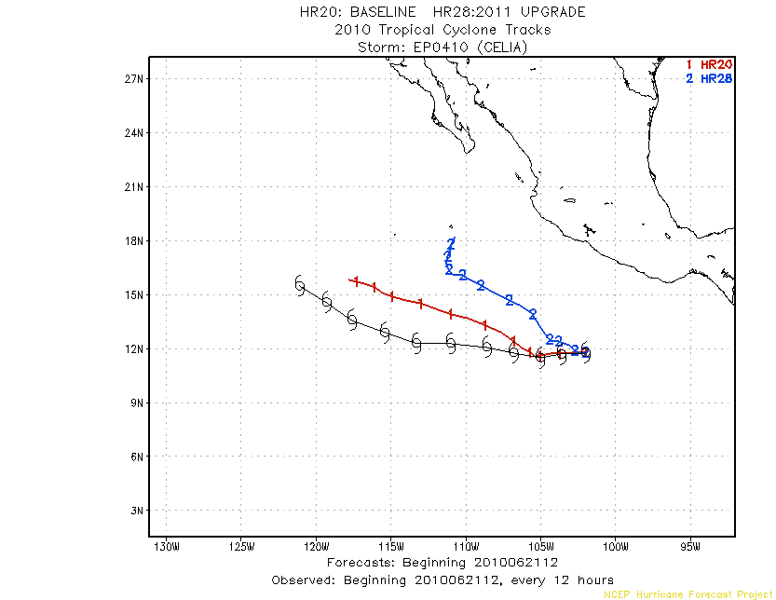
Earl:082800
Earl:082600
Red:baseline
Blue:2011 HWRF
Celia:062000
Celia:062112

Slide 18
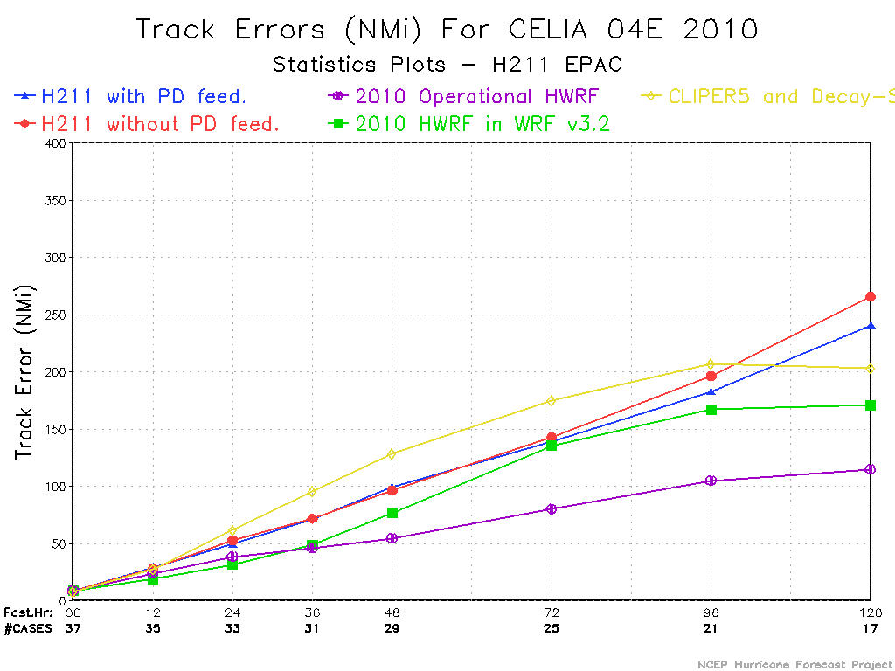
HR28
H211

Slide 19
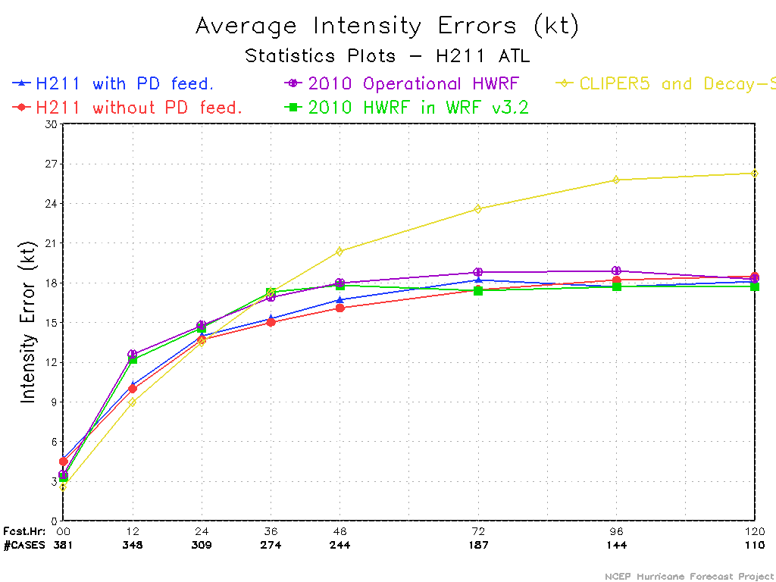
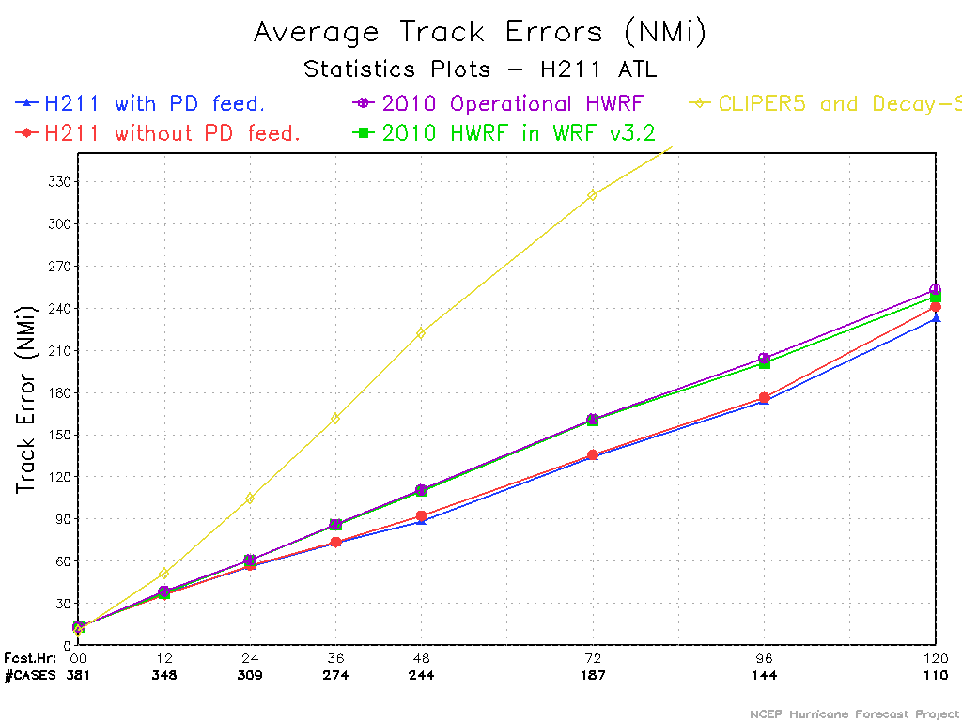
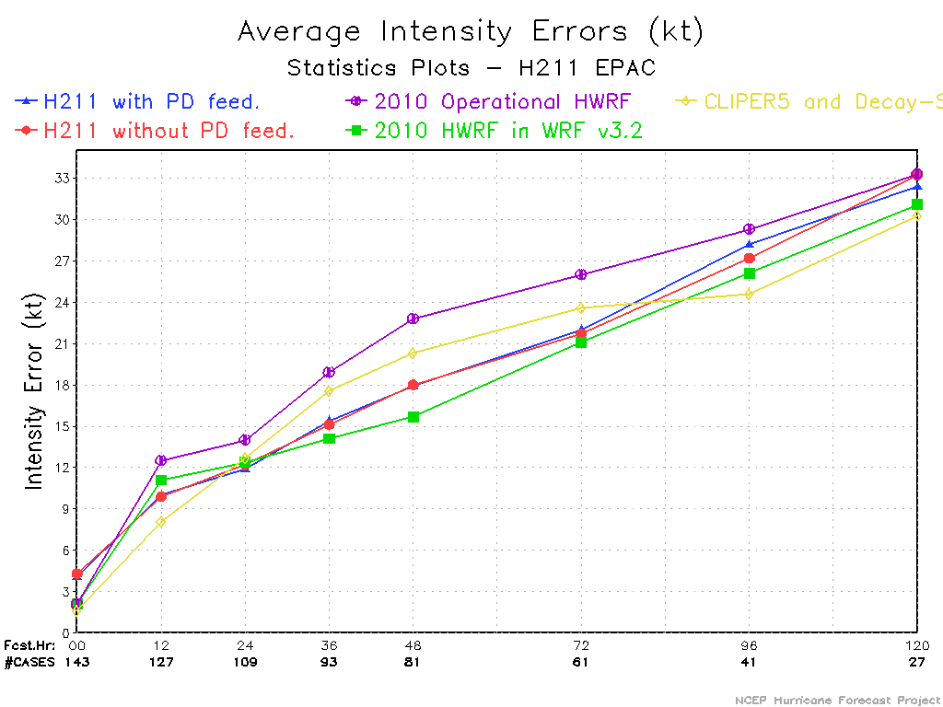
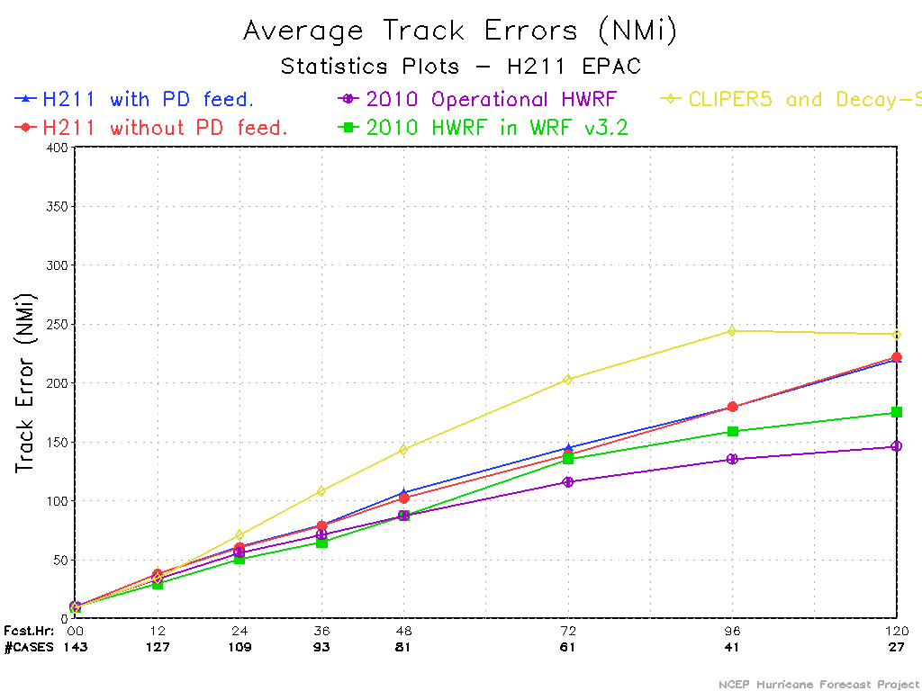
Red:H211
Purple:2010 opr

