Slide 1
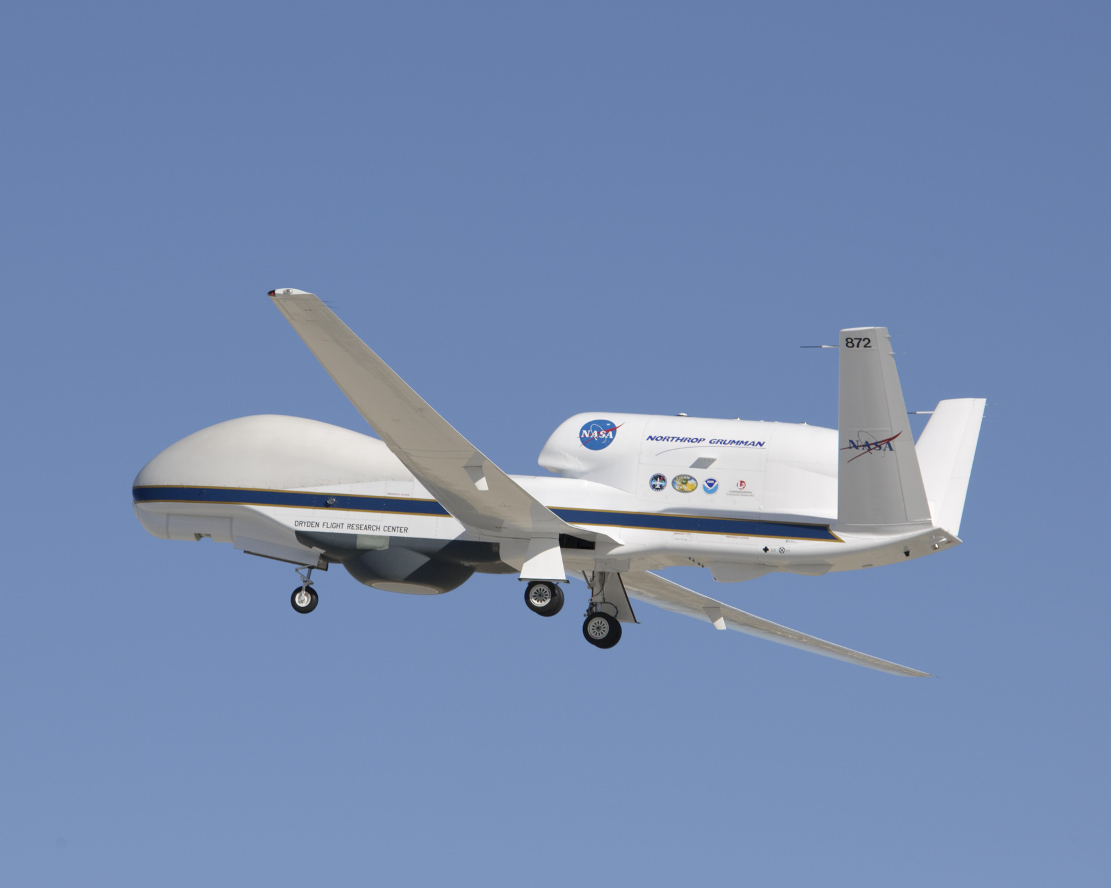
First Flights of High-Altitude Imaging Wind and Rain Airborne Profiler (HIWRAP) During GRIP
Gerry Heymsfield NASA/Goddard Space Flight Center
Lihua Li, Matt Mclinden, Martin Perrine, Lin Tian, Steve Guimond/ NASA/GSFC
James Carswell / Remote Sensing Solutions
Dan Schaubert & Justin Creticos / U. Mass. CASCA

Slide 2
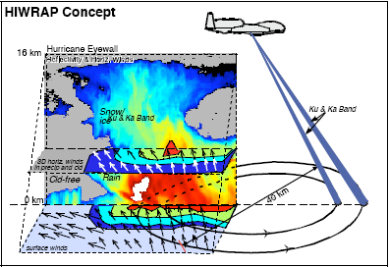
High-Altitude Imaging Wind and Rain Airborne Profiler (HIWRAP)
MEASUREMENTS GOALS:
Map the 3-dimensional winds and precipitation in precipitation regions associated with tropical storms.
Map ocean surface winds in clear to light rain regions using scatterometry.
NASA Global Hawk:
19 km altitude, ~30 hour flight
HIWRAP Characteristics:
Conically scanning.
Simultaneous Ku/Ka-band & two beams @ 30 and 40 deg
New technologies in radar: low power solid state transmitters with pulse compression, single antenna
GPM radar frequencies.
Notes:
Increased sampling of storm temporally needed to capture RI and other events
Fills gaps in coverage from orbiting satellites.
Global Hawk new plane for science

Slide 3
HIWRAP System Parameters
Parameters | Specifications
 | Ku-band | Ka-band
RF Frequency (GHz) | Inner Beam: 13.91 | Inner Beam: 35.56
 | Outer Beam: 13.47 | Outer Beam: 33.72
Peak Transmit Power (W) | 25 | 4
3 dB Beamwidth (º) | 2.9 | 1.2
Polarization | H (inner beam), V (outer beam)
Dynamic Range (dB) | > 65
Min. Detect. Reflectivity (dBZe,60m res. 10 km range and 3 km chirp pulse) | 0 | -5
Doppler Velocity (ms⁻¹) | 0-150 (Accuracy < 1.5 ms⁻¹ for SNR>10)
Scanning | Conical scan 10-30 RPM (nom. 16 RPM)

Slide 4
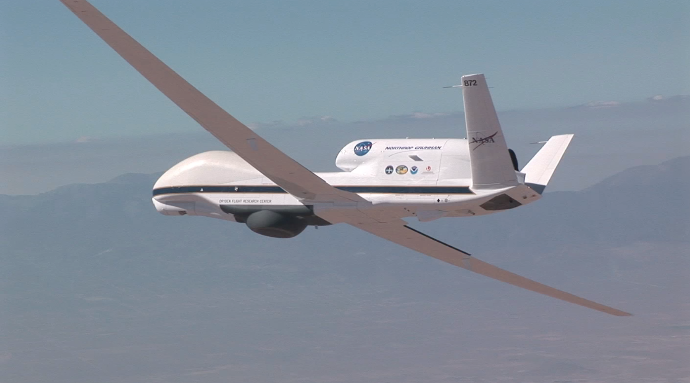
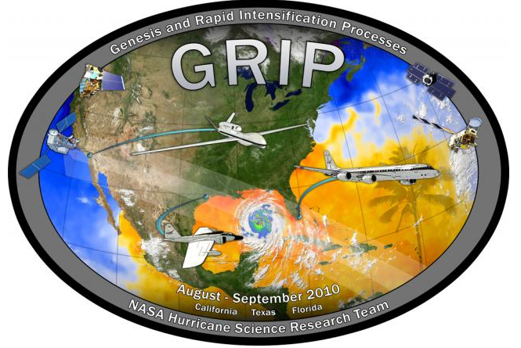
HIWRAP Development
Instrument development funded by NASA Instrument Incubator Program (IIP) and NASA Weather Focus Area funded GRIP Global Hawk activity.
Test flights conducted in March 2010 on WB-57.
GRIP Global Hawk installation June 2010 and campaign Aug-Sept 2010.
GRIP
15 August 2010 – 25 Sept 2010
3 Test Flights & 5 Science Flights
Notes:
4

Slide 5
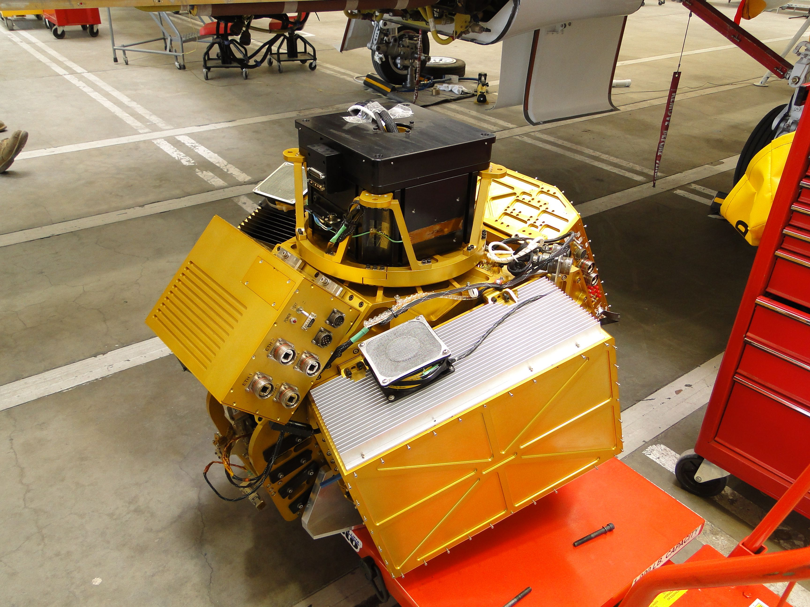
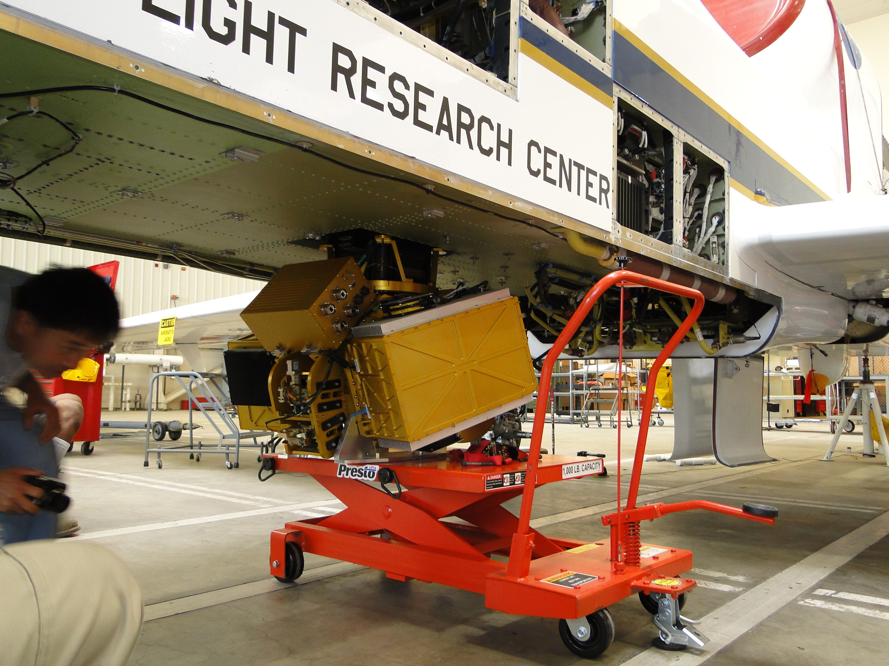
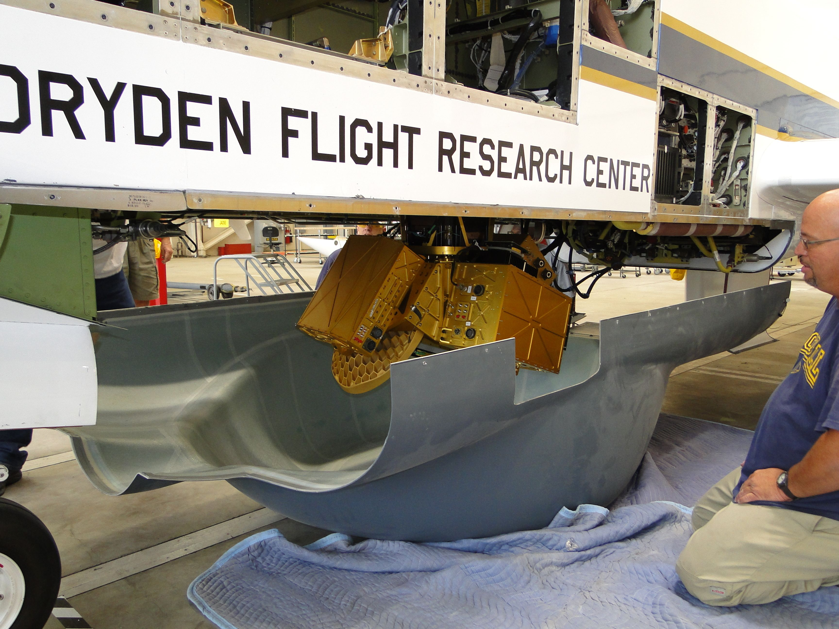
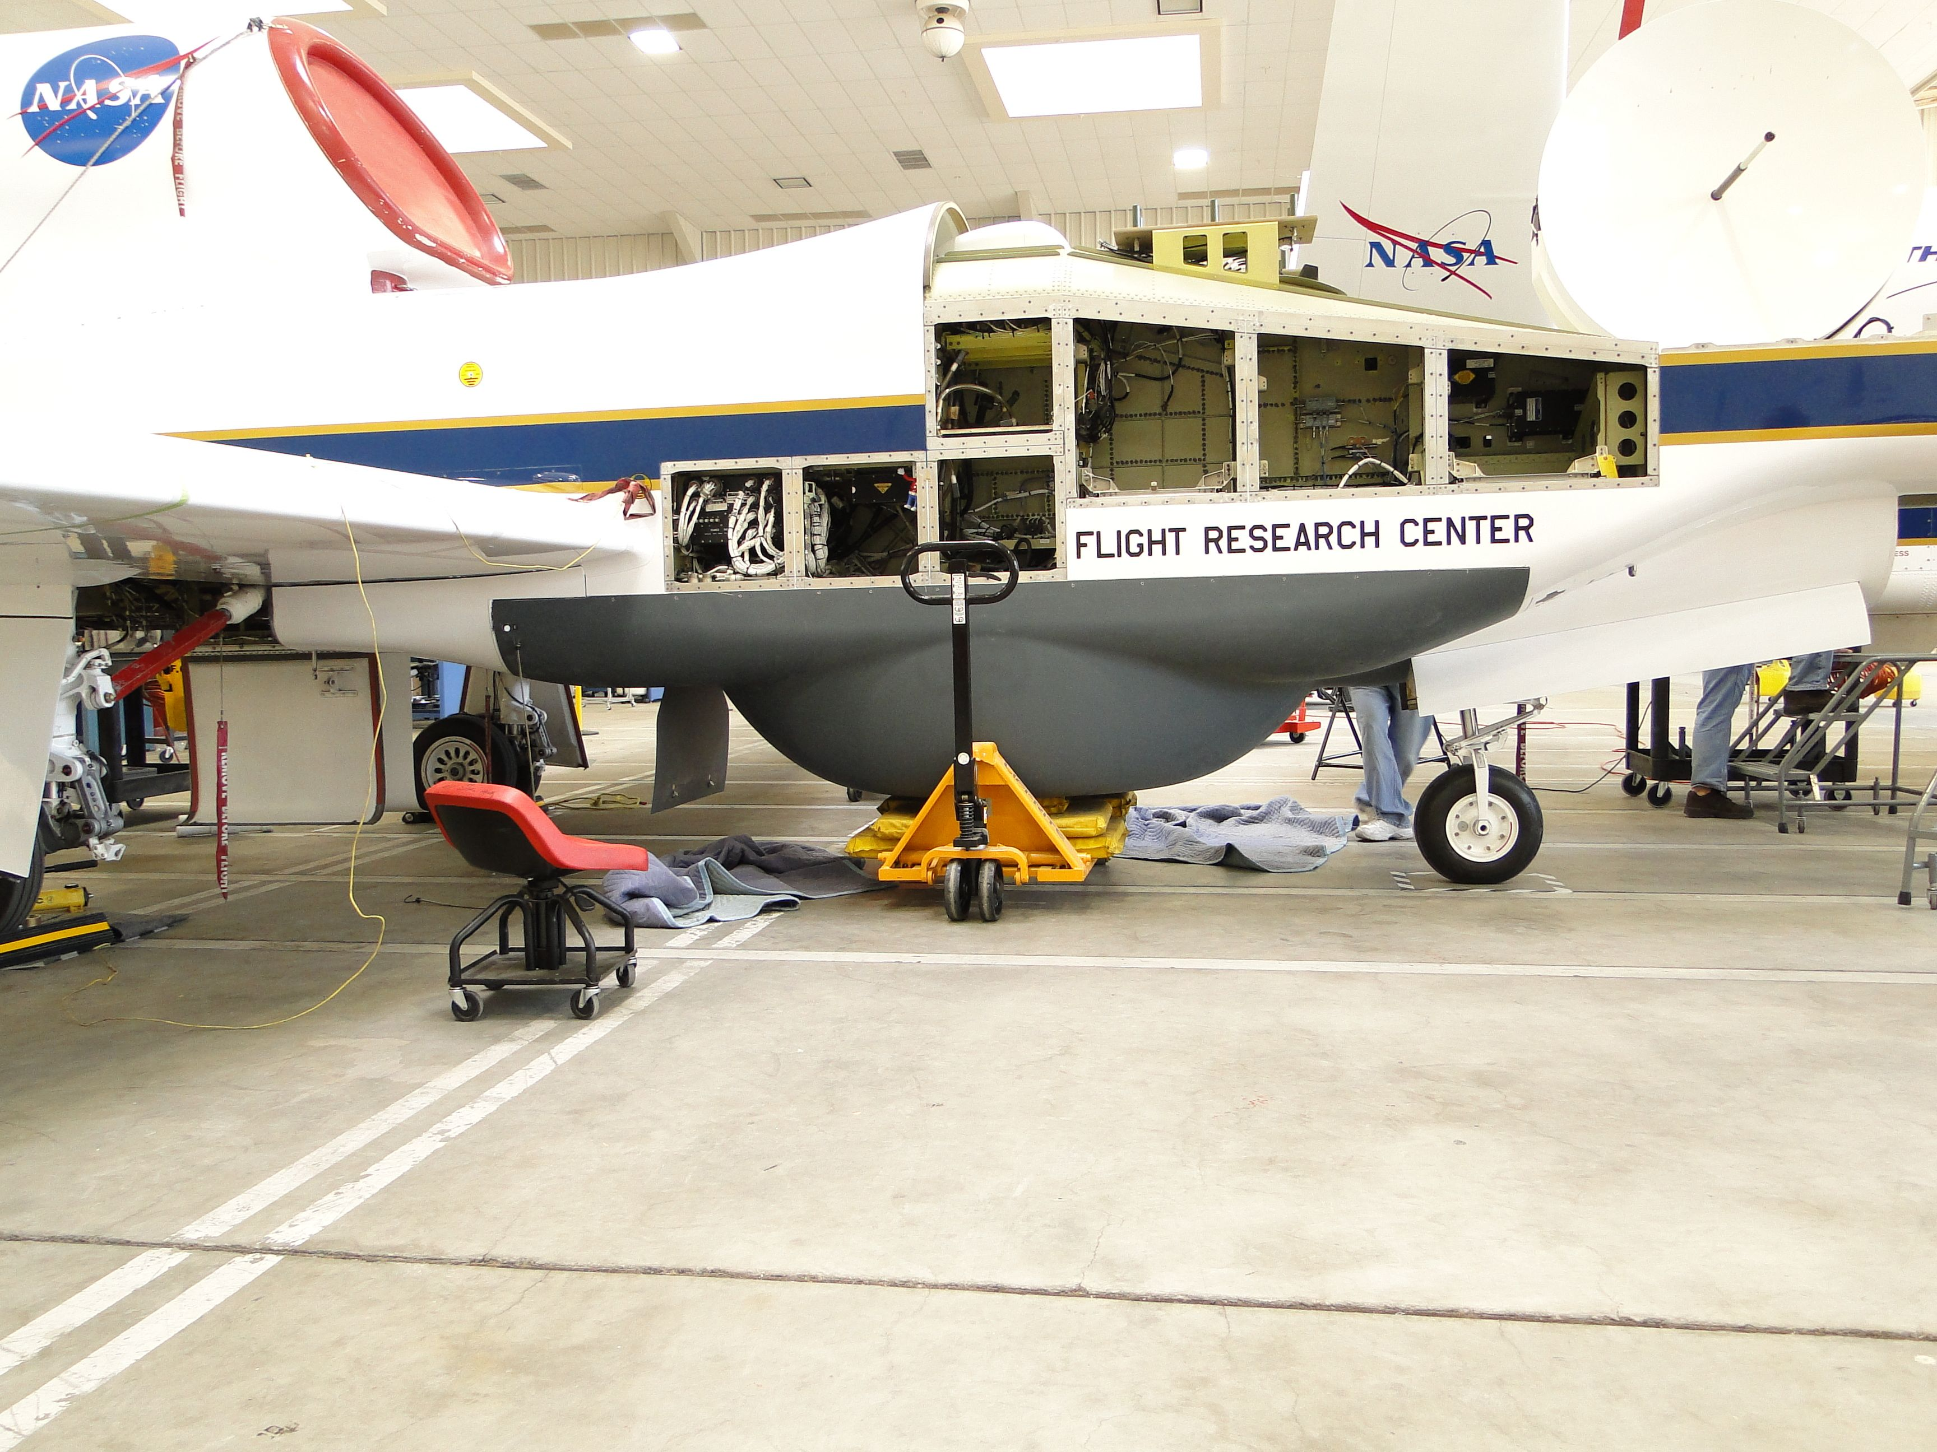

Slide 7
Processing & Analysis
GRIP processing in progress.
Doppler processing (pulse pair) from I, Q.
Antenna pointing and navigation evaluation.
Data editing (cleaning up, unfolding,..)
Reflectivity calibration
Software in progress for 3D mapping, ocean surface wind analysis.

Slide 8
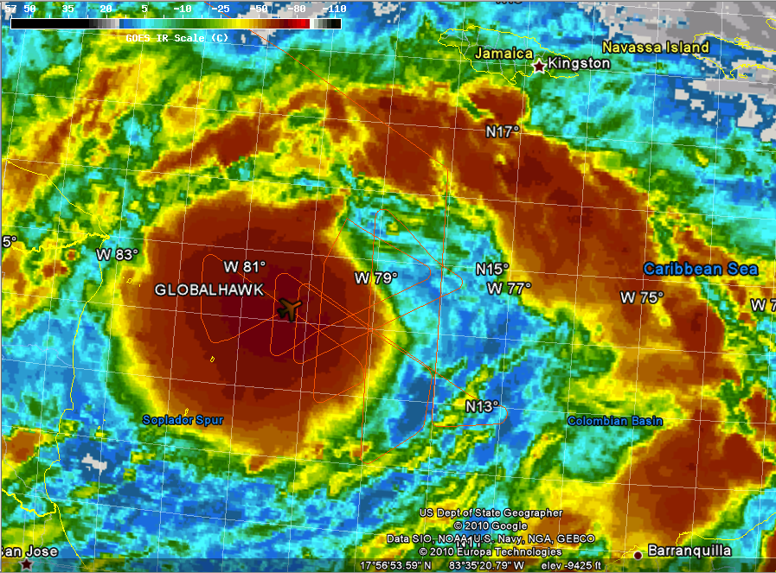
Tropical Storm Matthew 23-24 Sept 2010
Last GRIP Global Hawk flight but best (cleanest) data of campaign.
Convective burst (CB) began just prior to the GH getting on station, but was sustained throughout the flight.
Mathew intensified by 5 to 10 kts during the flight, max winds ~40kt.
Storm was unable to intensify beyond 50 kt winds but it went on to produce >16” of rain in parts of Yucatan, Mexico.

Slide 9
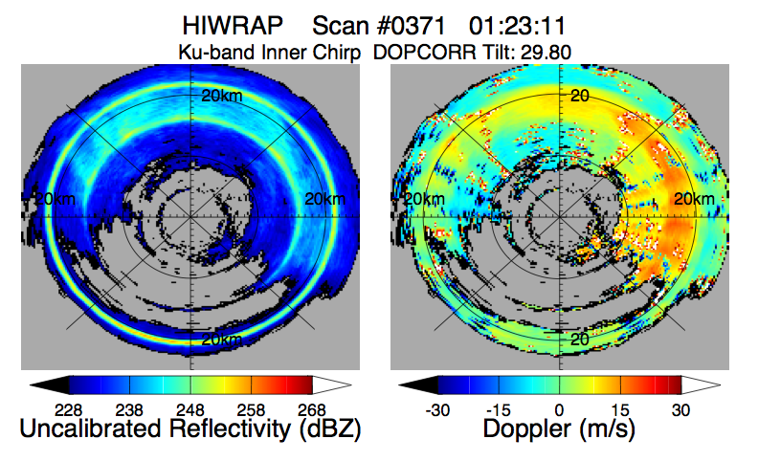
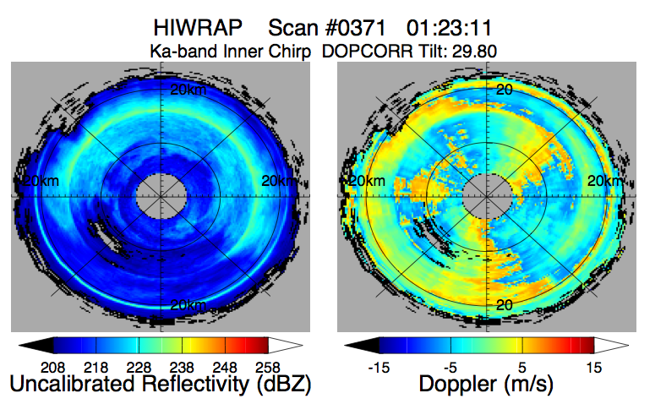
Polar Plots
One Scan – Polar Plot
Uncalib. Reflectivity
Doppler (air+fallspd)
< Ku-Band
Inner Beam (30ºH)
< Ka-Band
Inner Beam (30ºH)
2010 GRIP Flights
Ran at reduced resolution (150 m range; 2 deg azimuth)
< Ka-band Doppler partial unfolding

Slide 10
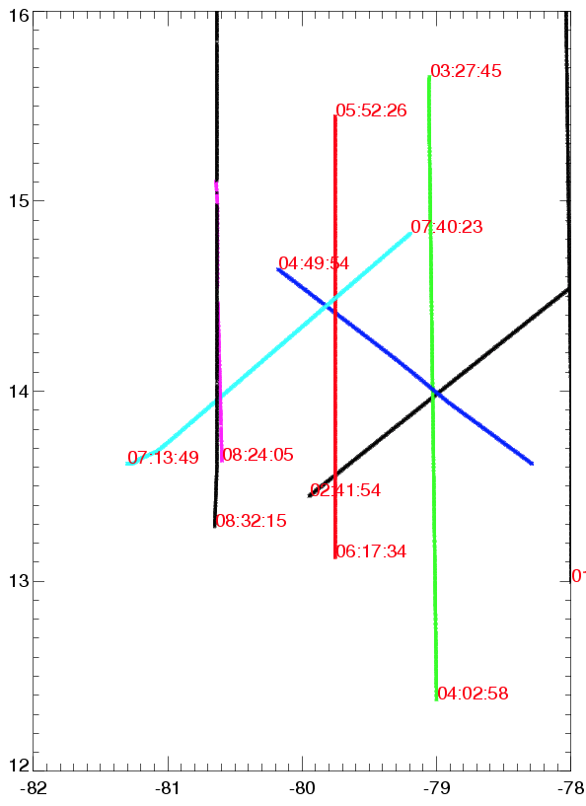
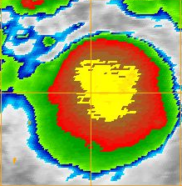
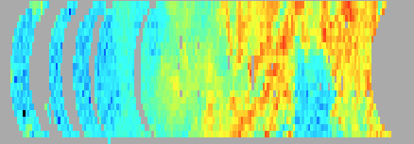
TS Matthew 23/24 Sept 2010
Low level Flight Track Mosaic 03:27 to 08:32 UTC
1
9
A
B
3
5
D
8
2
7
C
4
6
Uncalibrated backward looking (half-circle) HIWRAP reflectivity on GOES IR image.

Slide 11
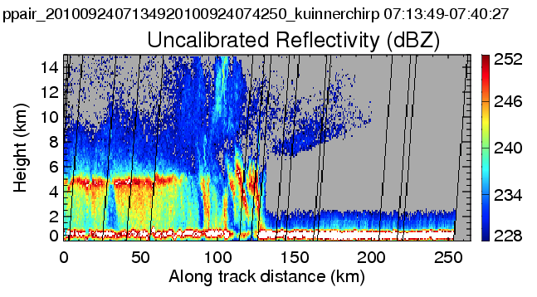
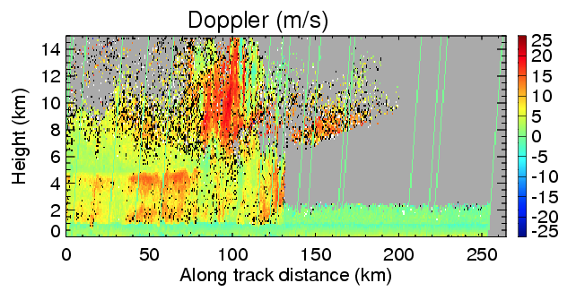
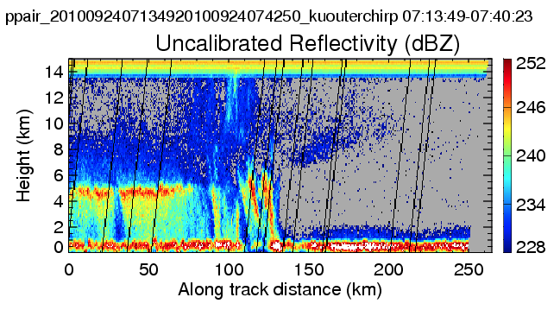
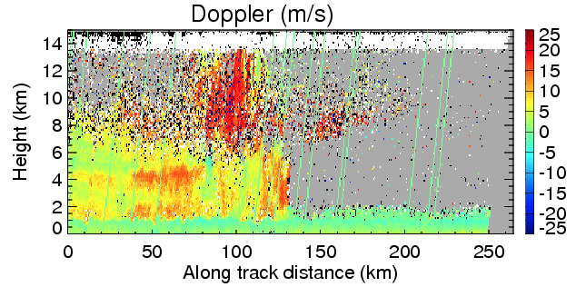
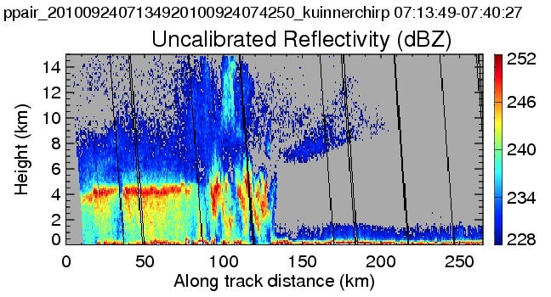
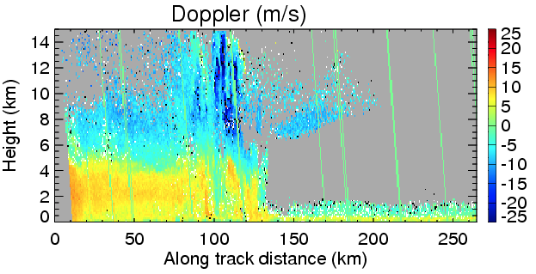
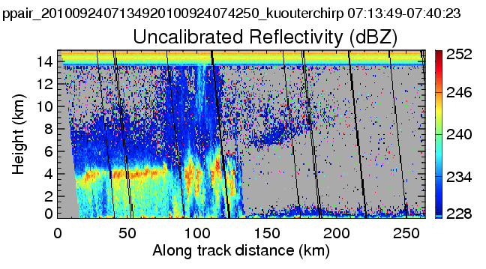
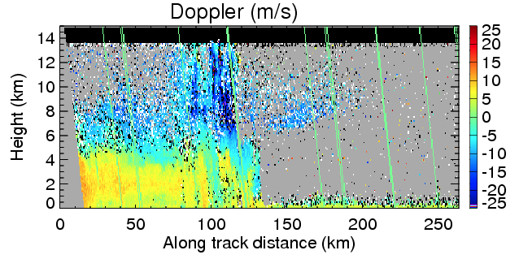
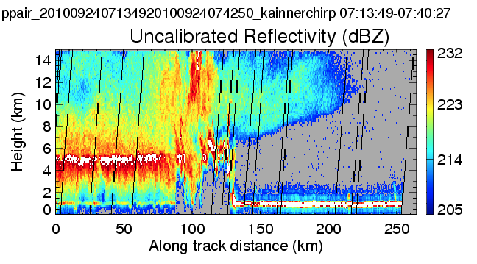
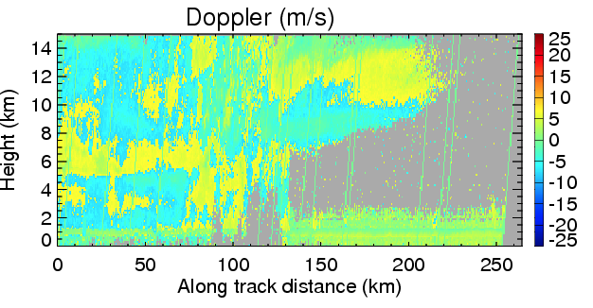
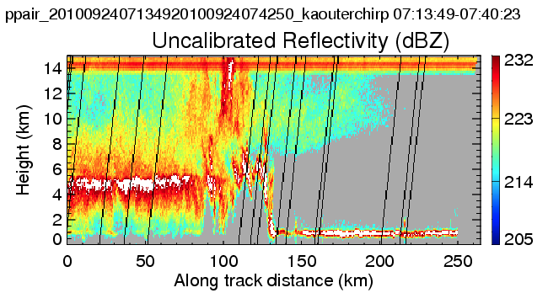
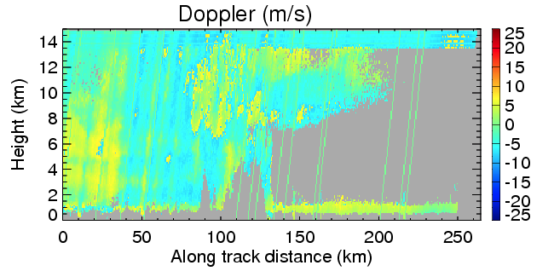
Reconstructed Vertical Along-Track Cross Section
Ku inner chirp (30º beam, H)
Ku outer chirp (40º beam, V)
Rear look
Rear look
Forward look
Forward look
Ka inner chirp (30º beam, H)
Rear look
Ka outer chirp (30º beam, V)
Rear look

Slide 12
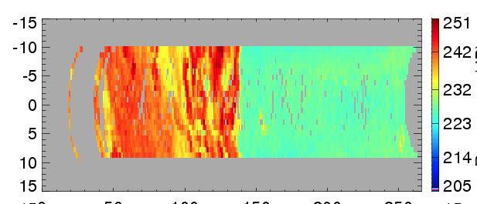
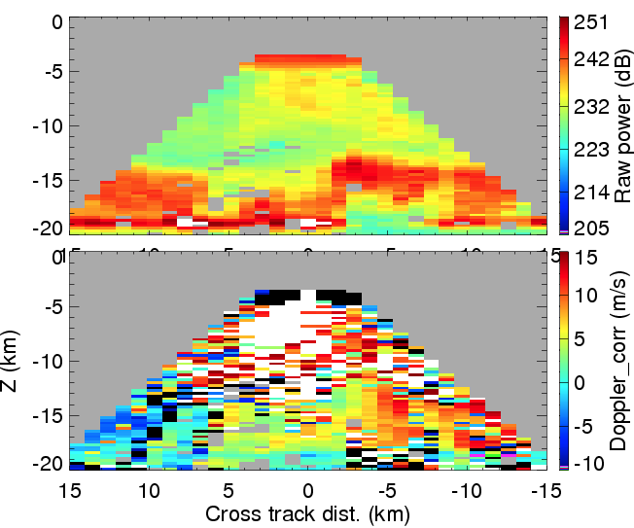
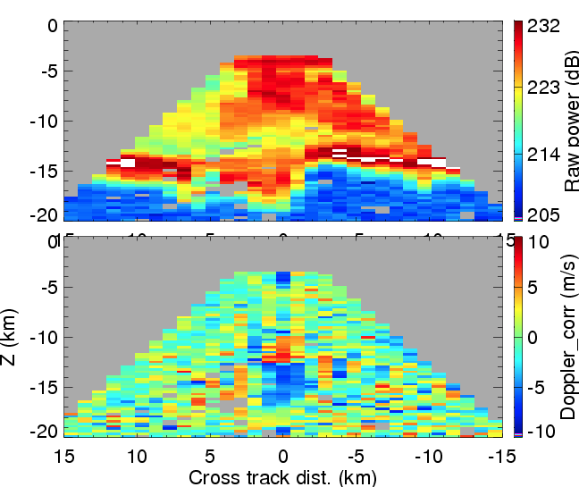
3D Gridded Data
1.0 x 1.0 x0.25 km grid interval with Yt along flight track.
Weighted (by distance from the center point) average or nearest point.
Gridded with forward/backward half circle of the scan separately.
Example: 2 km altitude cross-section.
Y = 100 km
X= 5km
Yt
X= -5km
Xt
Ku band, V,
outer beam
Y = 100 km
Ka band, V,
outer beam
100 km
(folded)

Slide 13
HIWRAP Future Development & Flights
Hardware improvements:
Pulse pair processing (Doppler velocity, reflectivity).
Improved receiver performance.
FFT processing to aid in boundary layer wind retrievals.
Downlink real-time products.
Flights in April 2011 for GPM algorithms using HIWRAP on ER-2 in nadir pointing mode.
Hurricane Severe Storm Sentinel (HS3) Global Hawk hurricane flights 2012-2014.
Notes:
I,Q very voluminous

Slide 14
Questions?

