Slide 1
Establishing an Improved National Capacity for Collection of Extreme storm and flood data
Robert Mason
USGS
IHC, March 1, 2011
William Birkemeier, Dan Catlett, William Coulbourne, Bob Holmes, Will Shaffer, Tony Ramirez, Phil Turnipseed, Forest Masters, and many others

Slide 2
National Plan for Disaster Impact Assessments: Weather and Water Data
Motivation
Partners
Capabilities
The National Plan
Next steps
Notes:
Thank you for the opportunity to speak with you. Here is an outline of my talk: I will speak briefly to the motivation for the Nat;l plan, ID the partners, tell you a little bit about their capabilities, briefly review the National Plan, and the next steps for our effort

Slide 3
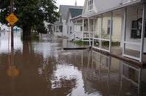
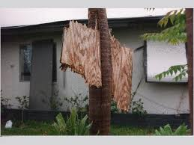
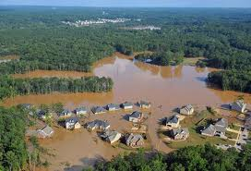
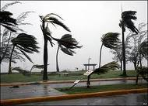
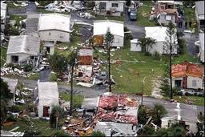
“Disasters Can Be Informative.”
Notes:
The national Plan is about 30 pages in length plus about the same number of pages in the appendices. This is our first sentence: “Disasters can be informative”.
But only if we pay attention to them. They inform our science, our models, our forecasts, our building codes, and landuse decisions. The medium of opportunity consists of Careful and detailed observations, broadly shared and widely used. One of the lessons of Hurricane Katrina is that our existing observation networks are highly vulnerable. We lost 35 tide and streamgages for all or part of he Katrina and its aftermath. Those losses really hampered our ability to understand that storm. We have to do more ensure that we learn from future disasters and that is what our effort is all about.
Past efforts focused on derivation of the scope and strength of natural hazards phenomena by forensic analysis of debris, and HWM. New, mobile, and highly mobile technologies permit detailed, resolution observations where impacts can be understood in terms of the temporal histories wind and water observation.

Slide 4
Observing and Learning
Augment and densify existing networks
Collect data throughout the storm
Focus on boundary layers (wind-water; water-roughness)
Wind: speed, direction, direction, and damages
Water: highwater marks , water-level hydrographs
Create complementary datasets
Wind fields, water levels
Evaluate and assess
Model performance
Construction and landuse practices
Notes:
The scope of the endeavor is focused on small-scale measurement, wind and water observations and development of complementary datasets that we hope will be of use to the modeling and forecasting community. The effort really focuses on the boundary layer.
The evaluation of models, damages, etc. is an important component of a full program, but is outside of the scope of the work that we are now doing.

Slide 5
Partners
-Oversight and Management by the Working Group
-Feds
DOT, FEMA, NOAA NOS, NOAA NWS, NIST, USACE, USGS (Chair), coordinated by OFCM
-Affiliate members
Digital Hurricane Consortium
American Association of Wind Engineering
Coasts, Oceans, Ports and Rivers Institute (COPRI) of American Society of Civil Engineers (ASCE
Notes:
The effort is a partnership between FEDs and Universities over seen by OFCM.

Slide 6
Collection Platforms
 | Doppler Radars | ≥ 10 m Wind Obs. | < 10 m Wind Obs. | Surge/Wave Sensors
Center for Severe Weather Research | 3 | 3 | 15
Florida Coastal Monitoring Program (UF, CU, FIU) |  | 6
LSU |  | 2
Notre Dame |  |  |  | 24
University of Oklahoma | 1
Texas Tech Sticknet |  |  | 24
Texas Tech Radars | 1
University of Alabama at Huntsville | 2 | 2 | 2
U.S. Geological Survey |  |  |  | 200
Subtotal | 7 | 13 | 41 | 24
 | 285 Observational Platforms

Slide 7
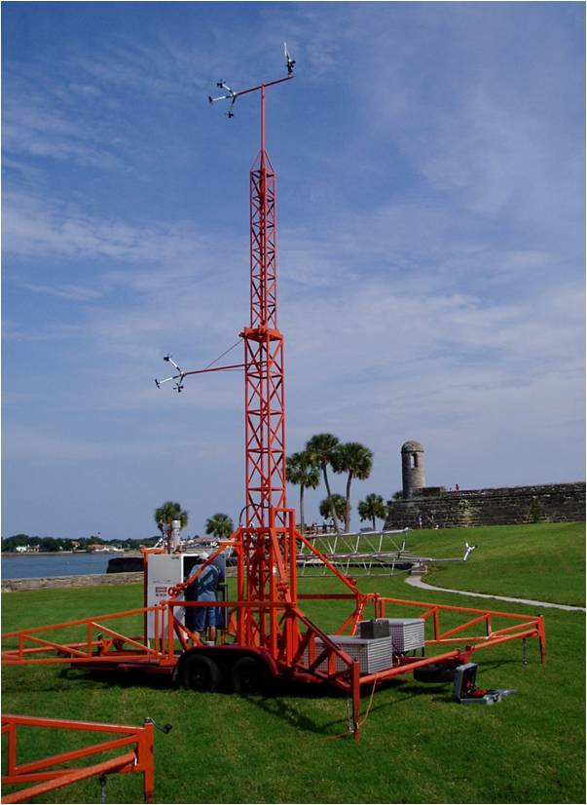
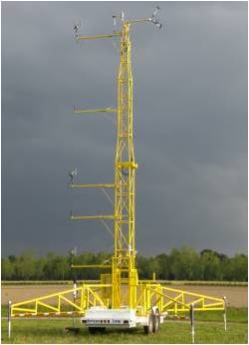
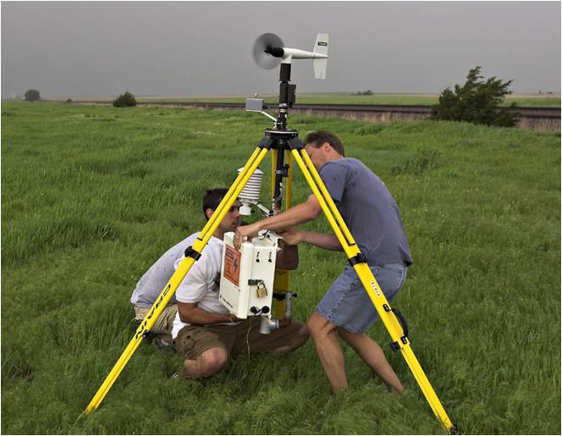
Portable Weather Stations
FCMP
LSU
TTU/UNF
www.atmo.ttu.edu/TTUHRT
Notes:
Let’s talk about toys: The partners, particularly the university partners have some very useful toys. These include
13 portable weather stations tower units set up in 30 minutes
Withstand 200 MPH winds and debris
40 Tripod systems take about 3 minutes
Long version from Brian Hirth (Tx Tech)
The WEMITE towers are trailer mounted ruggedized platform instrumented at multiple levels up to 10 m (WEM ITE 1) and 15 m (WEMITE 2), sampling at 10 Hz. These towers were towed to the coast for tropical cyclone landfalls between 1998 - 2005. When deployed, the trailer was dropped, the tower was wrenched to its full height, and guy wires and mobile home earth screws anchored the system. StickNet was developed to bring more observations to coast, and we are currently developing real-time capabilities for these platforms as well. Each StickNet probe begins with a standard surveying tripod that has been fabricated to support a standard meteorological sensor suite. Currently the complete fleet consists of 24 probes, which are towed in two separate covered trailers. The size of these platforms allows us to place them in more precarious locations, including sand dunes, barrier islands, etc. A marine battery is attached to the platform, and the dead weight of the tower plus anchoring makes the platform very durable in high winds. It is anticipated that these platforms can withstand a 3-second gust in excess of 130 mph. The highest gust recorded was 115 mph during Hurricane Ike. We have yet to have a platform topple or fail in a hurricane deployment yet. These platforms also sample at 10 Hz

Slide 8
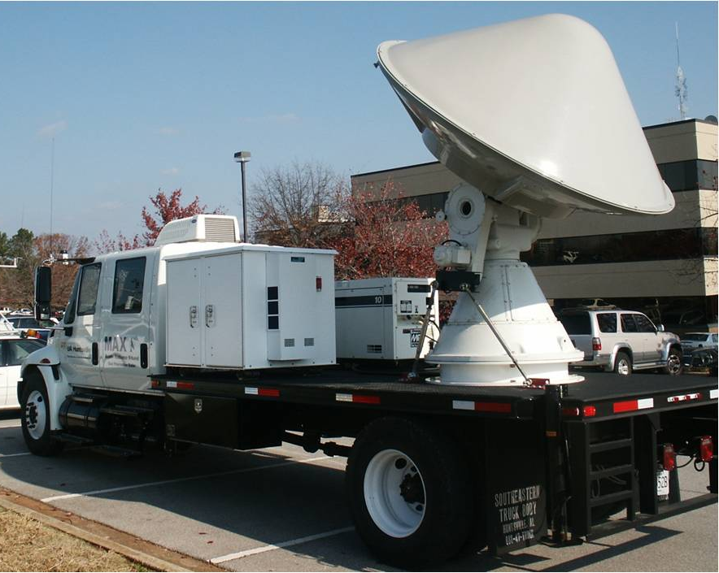
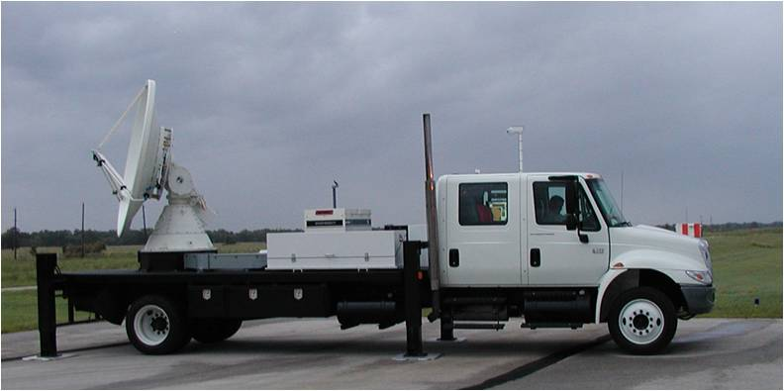
Portable Doppler Radars
Long range radars
(C-Band)
Short Range Radars
(K- and X-band)
CSWR, TTU, UAH,
Notes:
7 mobile Doppler radars for tracking wind speeds
Short Range Radars (k- and x-band)
CSWR, TTU, UAH,
Long range radars (C-Band)

Slide 9
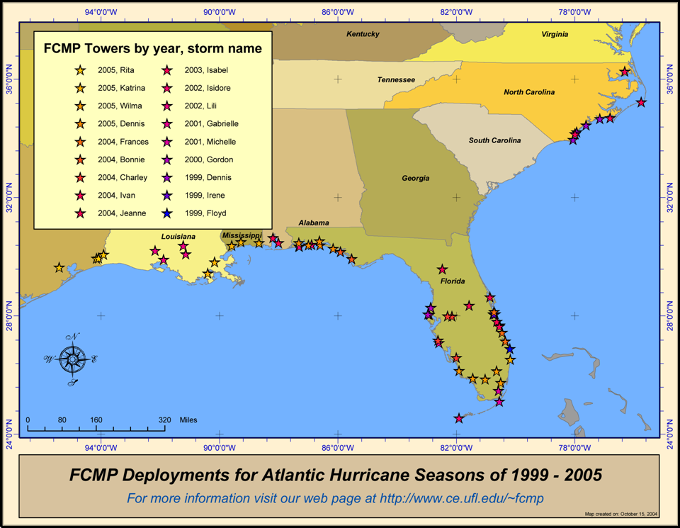
Wind Tower Deployments(1999-2005)

Slide 10
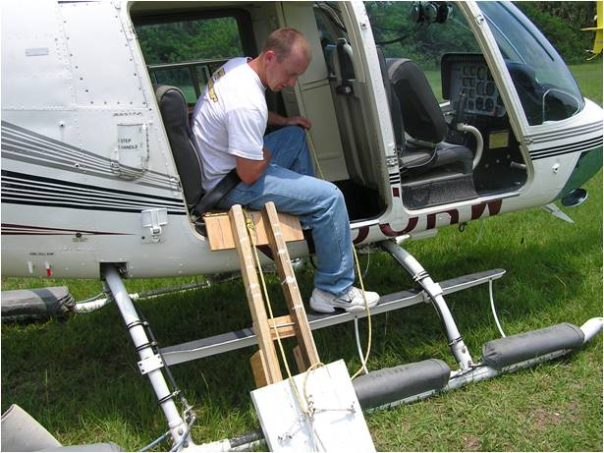
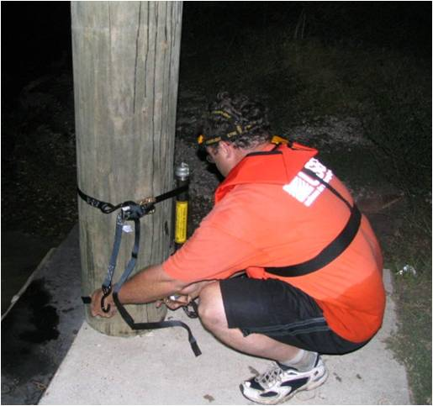
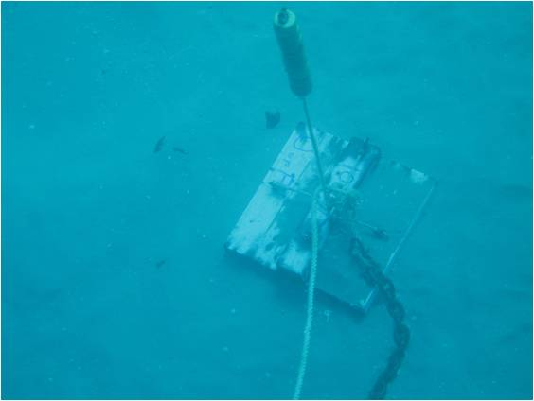
Surge and Wave Sensors
Notre Dame and USGS
Notes:
Water data consists of two measurements, water levels, waves, we are considering, but do not have funding for other parameters such as velocity.
Nota Dame
USGS

Slide 11
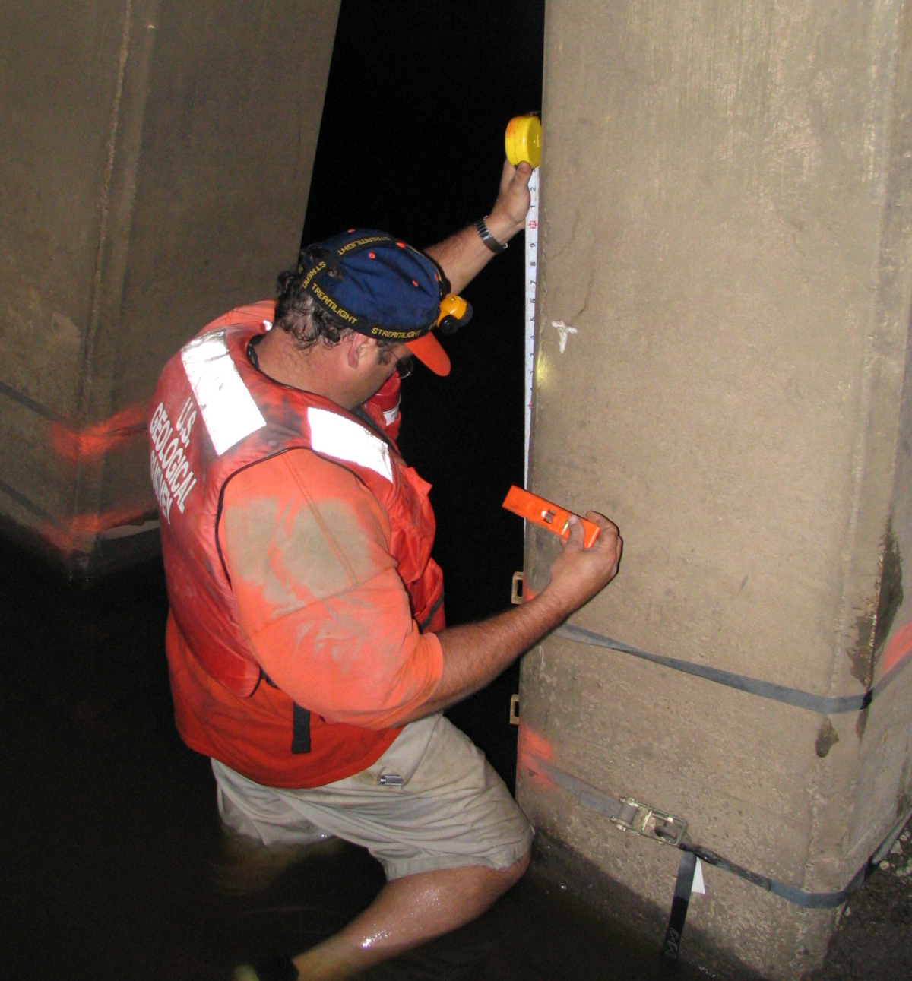
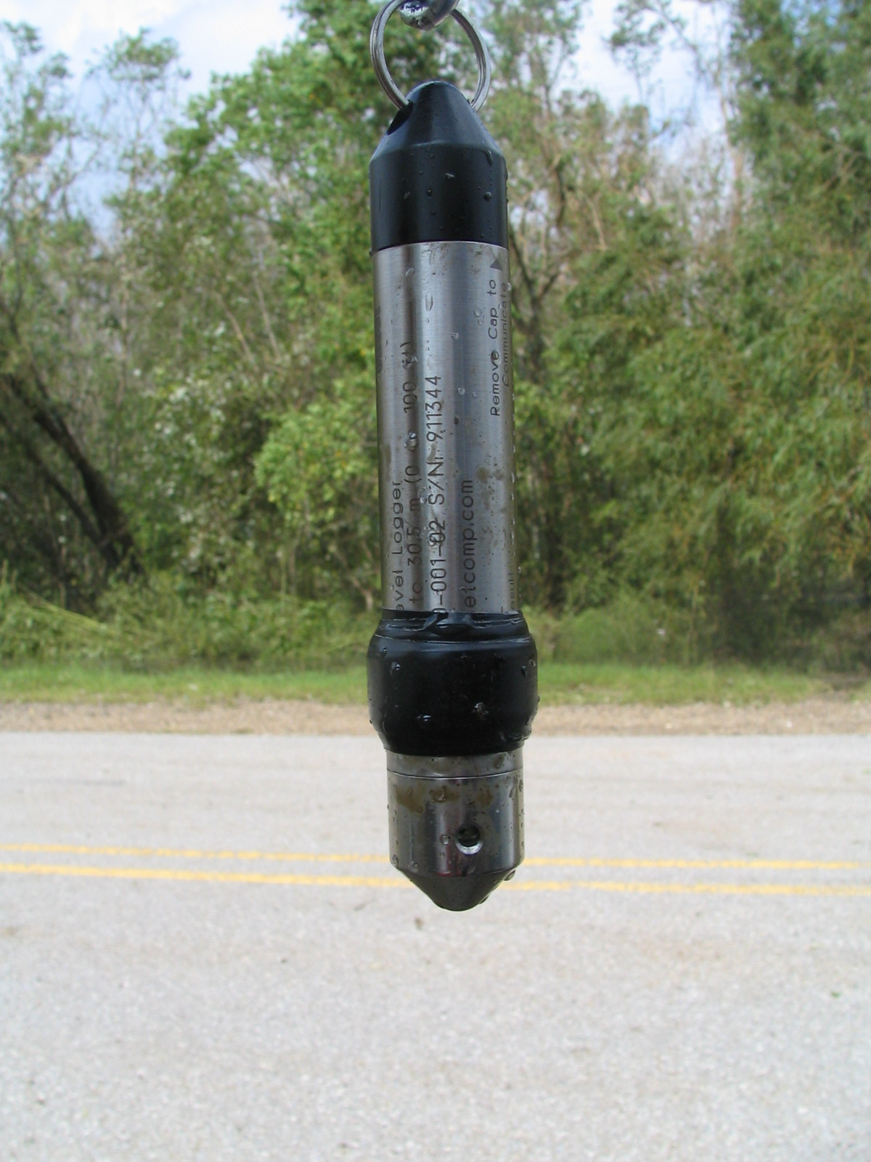
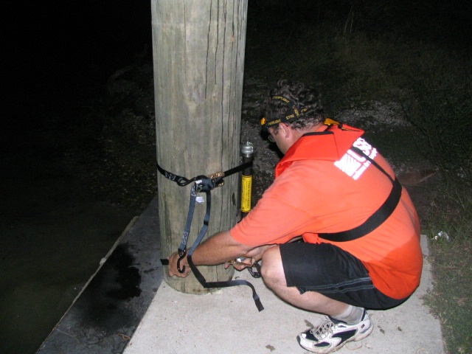
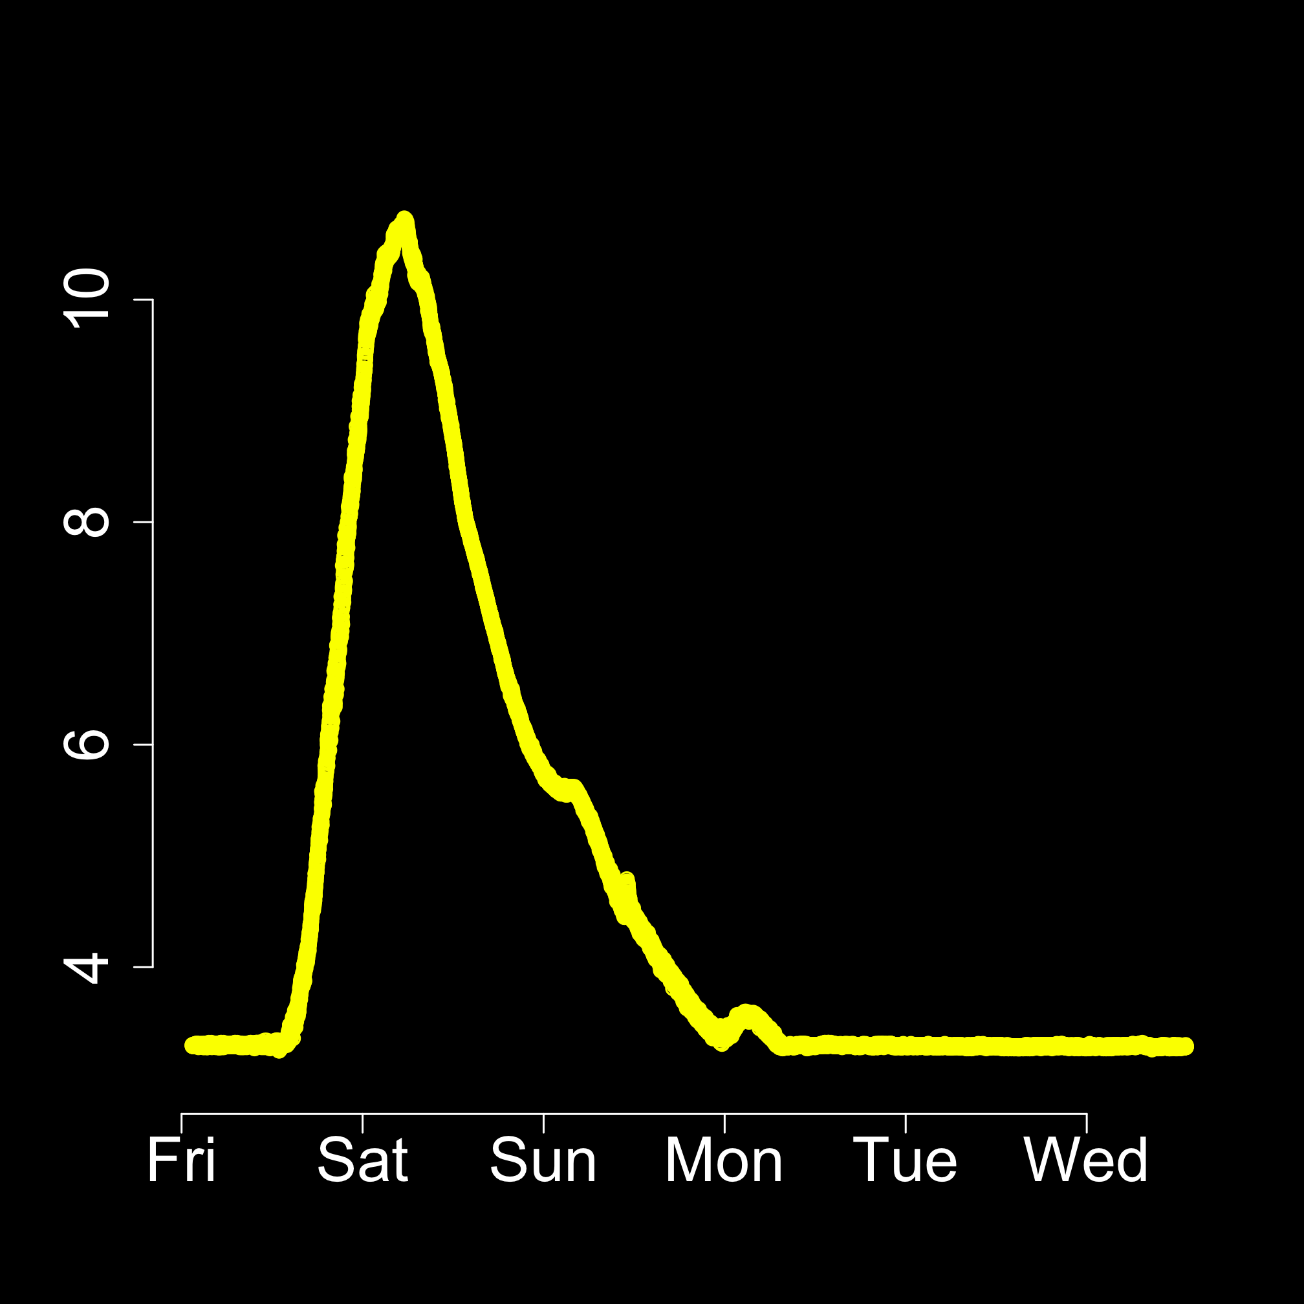
USGS
Storm-Tide
Deployments
Hurricane Rita
storm-surge
water levels
at Pecan
Island, LA
Notes:
In the past storm-surge was documented by HWMs. Those data were often unreliable and never provided info about the relative timing of surge or rates of inundation. Now the USGS has developed mobile storm-surge network that provides and information. Low cost, self-contained water loggers are deployed a large number 40-105 locations, strapped to fixed structures, and record data as frequent as every 0.5 second yielding flood hydrographs like that shown.
The U.S. Geological Survey (USGS) deployed a temporary monitoring network of 117 pressure transducers (sensors) at 65 sites over an area of about 5,000 square miles to record the timing, areal extent, and magnitude of inland hurricane storm surge and coastal flooding generated by Hurricane Ike, which struck southeastern Texas and southwestern Louisiana September 12–13, 2008. Fifty-six sites were in Texas and nine were in Louisiana. Sites were categorized as surge, riverine, or beach/wave on the basis of proximity to the Gulf Coast. One-hundred five sensors from 59 sites (fig. 1) were recovered; 12 sensors from six sites either were lost during the storm or were not retrieved. All 59 sites (41 surge, 10 riverine, 8 beach/wave) had sensors to record water pressure (fig. 2), which is expressed as water level in feet above North American Vertical Datum of 1988 (NAVD88), and 46 sites had an additional sensor to record barometric pressure, expressed in pounds per square inch. Figure 3 shows an example of water level and barometric pressure over time recorded by sensors during the storm.

Slide 12
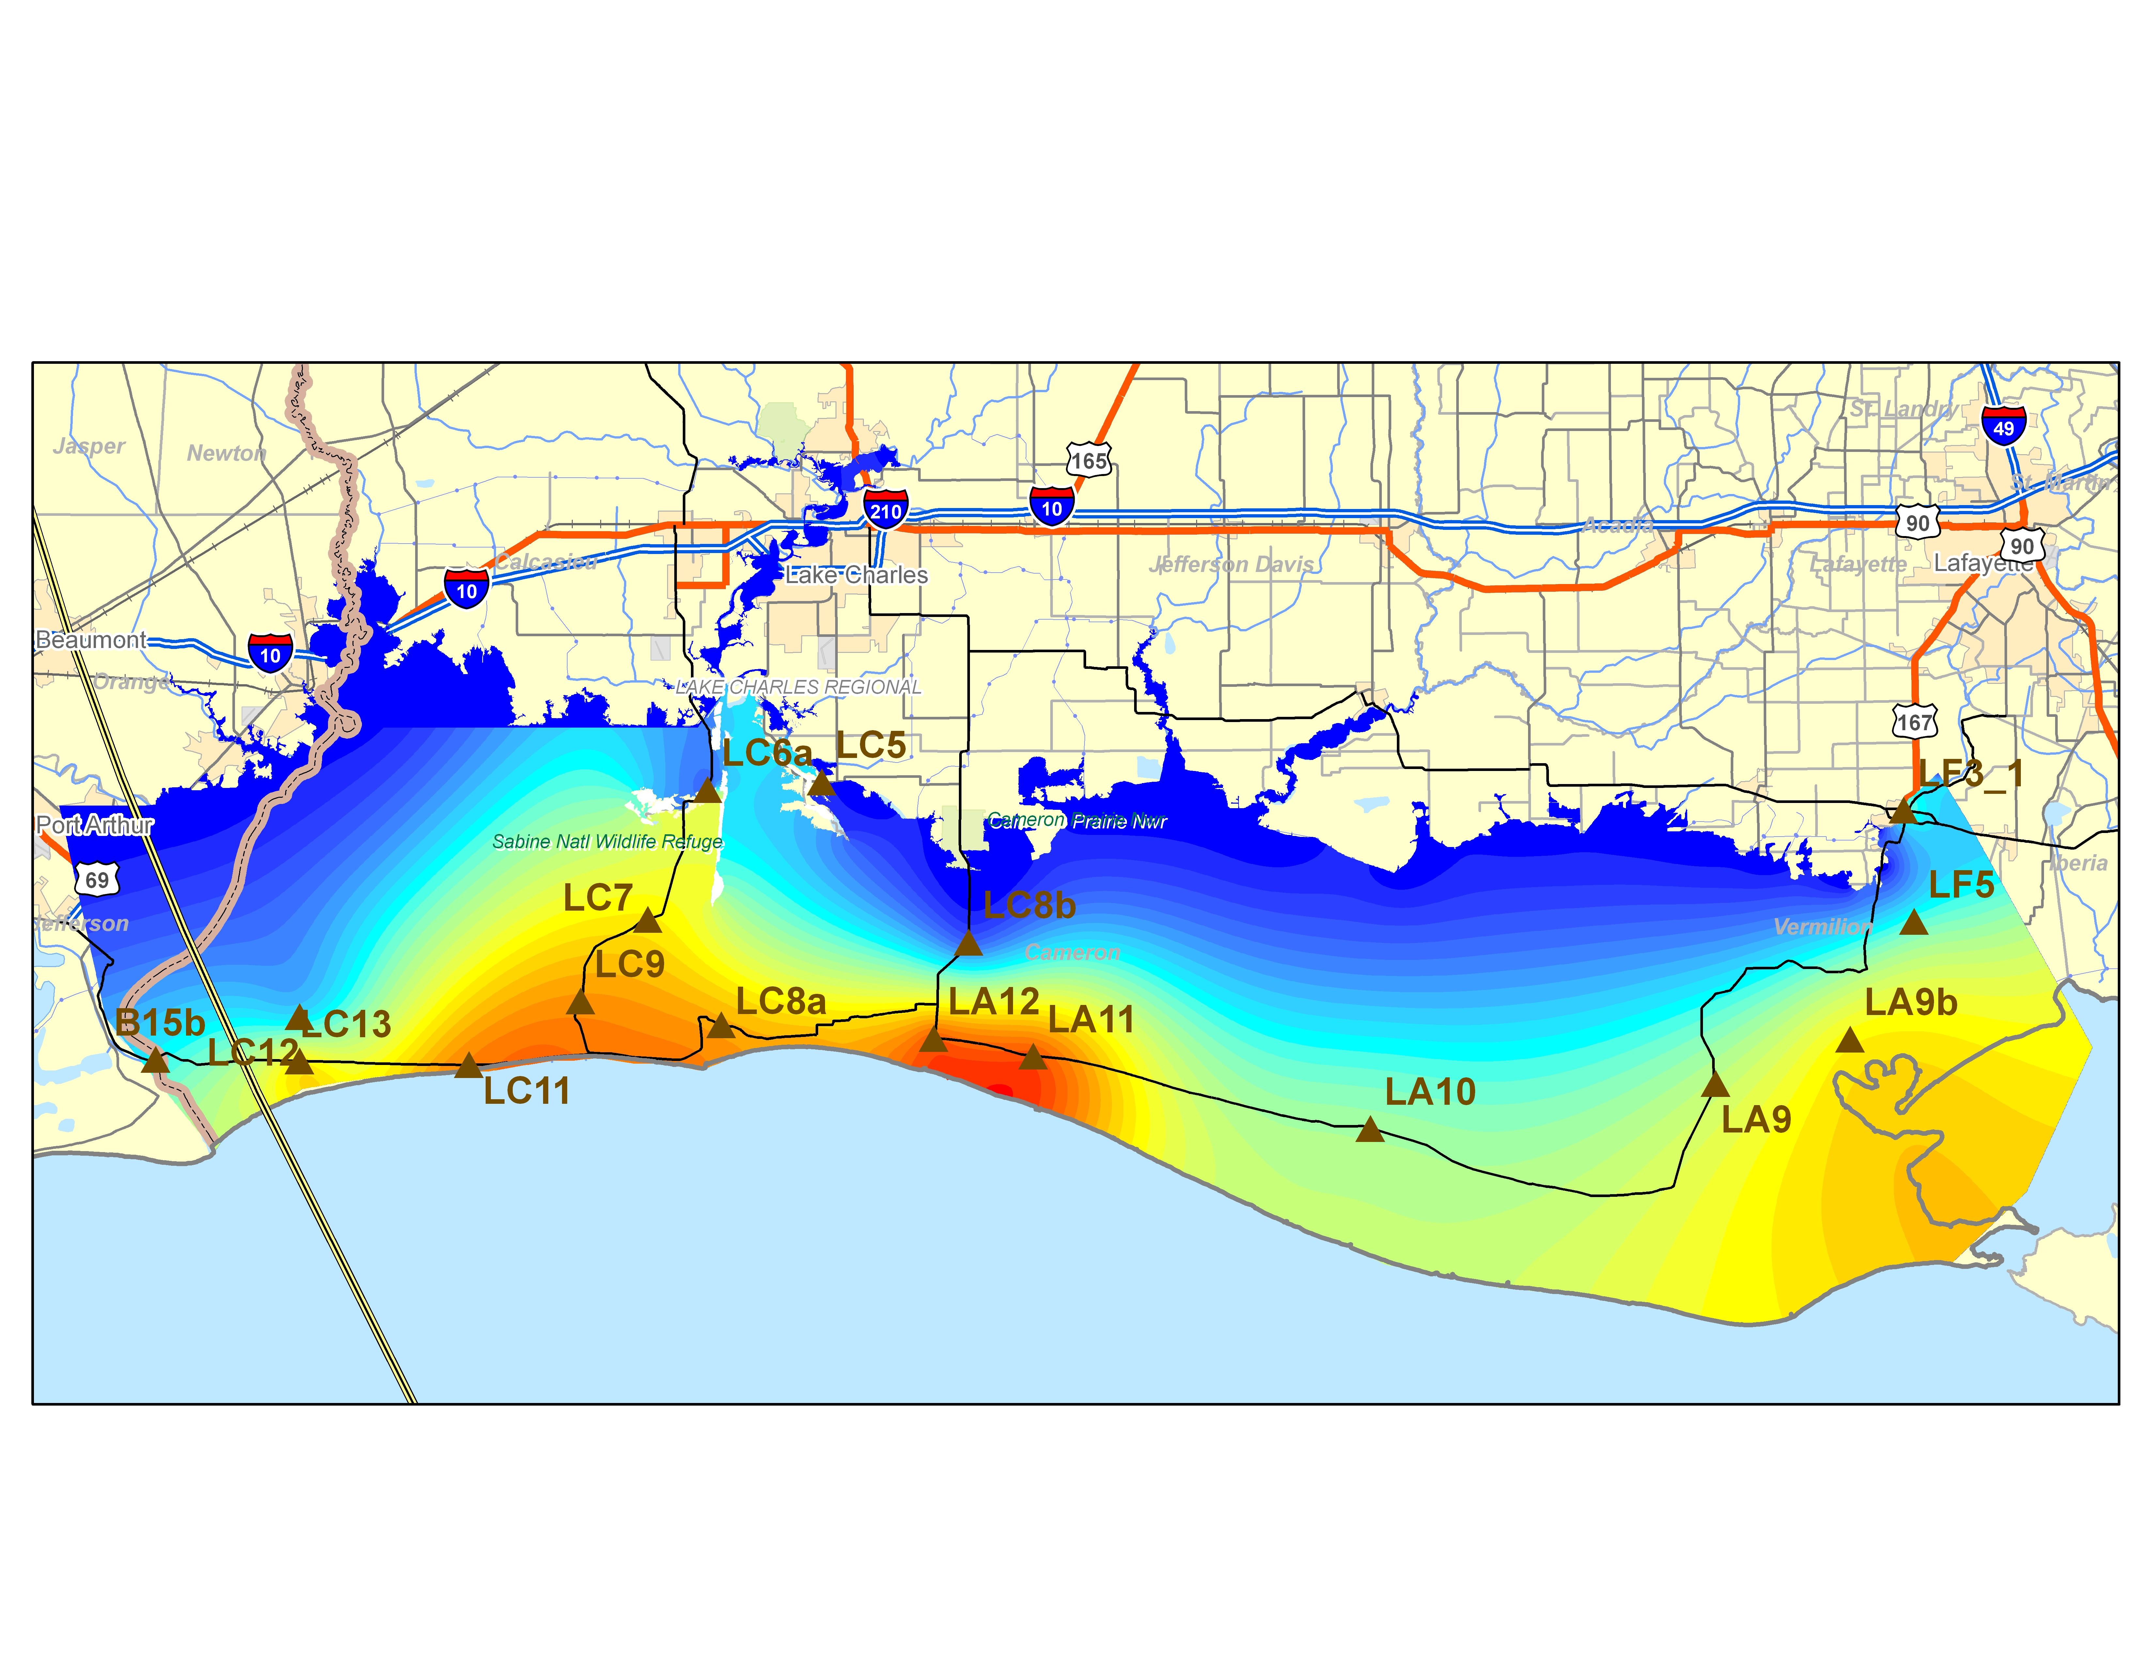
Minute by minute mapping possible for model calibration (3:00 am 9/24/05)
Canal
Calcasieu
River
Bluffs
27
27
Calcasieu
Lake
82
Constance
Beach
Rutherford’s
Beach
82
Roads
Gulf of Mexico
Explanation
Storm-tide elevation, in feet above NAVD88
Hurricane Rita
September 24, 2005
3:00 am
USGS Storm surge sensor
LC11
Notes:
When connect the hydrographs via GIS spline fits, these are the surface depictions that we can develop. They can be quite detailed and if we are smart with te deployment, reveal the influence of roads, culverts, dunes, and other topography and some landuse effects.
The neat thing about this for modelers is that the surge levels can be compared to model outputs moment. We can see the effects as winds increase and shift in direction.

Slide 13
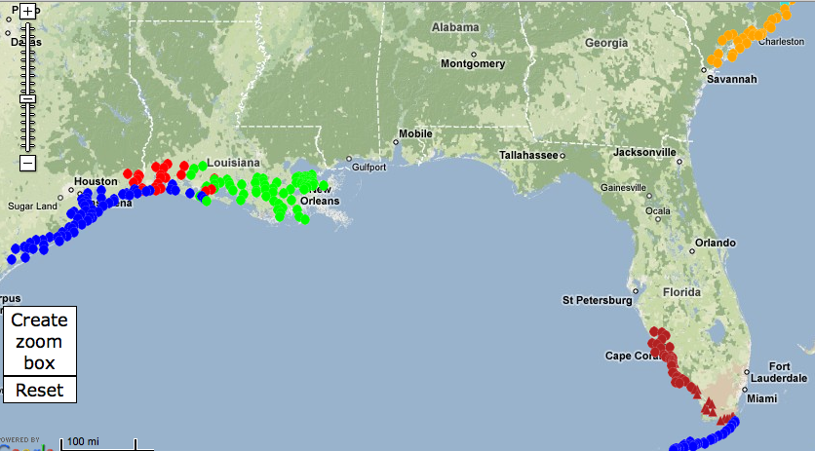
Hurricane Storm-Tide Network Coverages
Rita http://pubs.usgs.gov/ds/2006/220
Wilma http://pubs.usgs.gov/ds/2007/294/
Ike http://pubs.usgs.gov/of/2008/1365/
Gustav http://pubs.usgs.gov/of/2008/1373
Ernesto -Unpublished

Slide 14
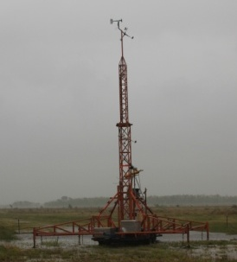
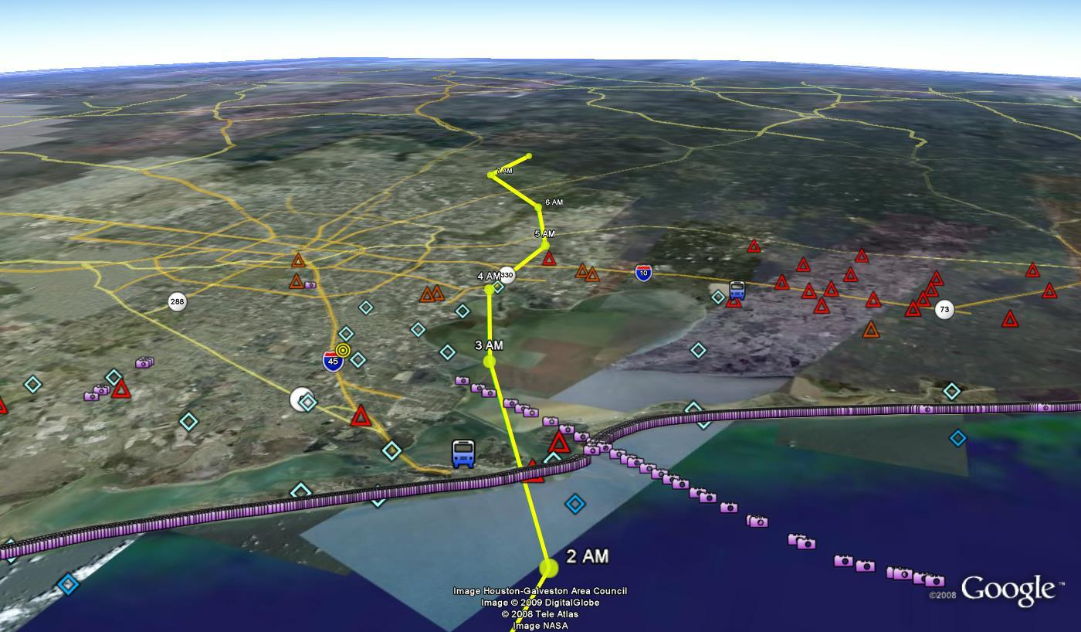
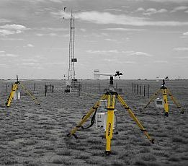
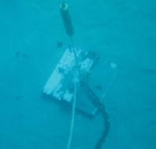
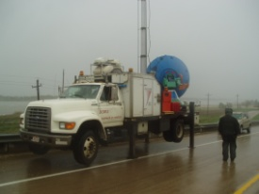
Hurricane Ike – Successful deployment… …but not optimally placed or coordinated
Notes:
So, when a storm lands, what do we do. In the past we deployed our assests without a great deal of coordinatiuon. No ONE agency or person calls the shots and we don’t get in leveraging of one another’s efforts.

Slide 15
Lessons Learned
Storms change direction even to the last minute; a broad, dispersed network needed
For water-level instruments surveying to common datum is most time consuming challenge
Need coordination leverage efforts and develop complementary datasets

Slide 16
OFCM National Plan
Published in November 2011
Identifies Partners
Inventories capabilities
Wind (Anemometers, Doppler)
Water (Highwater marks, Surge, Waves)
Establishes communications and coordination process
Calls for event data-documentation reports
No dedicated funding –Katrina funding ends
Notes:
Most partners focused on coasts
Feds: DOT, FEMA, NOAA NOS, NOAA NWS, NIST,
USACE, USGS (Chair), coordinated by OFCM
Digital Hurricane Consortium, American Association of Wind Engineering,
Coasts, Oceans, Ports and Rivers Institute (COPRI) of American Society of Civil Engineers (ASCE)

Slide 17
Implications
Real-time observations for emergency management
More and better data for model development (wind sheer, water drag, characterization of roughness)
Closer association of structural impacts with wind and water phenomena (strength, speed, depth time histories)

Slide 18
Implications for Surge Modeling
Dense and quick-interval water-level observations
Access to real-time wind field production
New coordination with offshore/onshore sensor deployments
Increased observation density
Shear stress estimates for short fetch lengths in bays, estuaries…
Pressure gradient fields
Sea-to-land-to-bay/river/etc: internal boundary layer formation; changes in force balance (friction, coriolis and centrifugal forces)
Anemometric estimates of drag coefficients (C_{D} → z₀)

Slide 19
Implications for Forecasting
Real-time monitoring of decaying weather conditions at hurricane landfall
Verification of intensity forecasts
Observe small-scale features (e.g. MCV, BL rolls, tornadoes, etc.)
Tracking storm features may allow for 5-10 minute nowcasting

Slide 20
End Users
Risk Modeling
Local and State: State of Florida Public Hurricane Loss Model, Florida DEP, Texas General Land Office, FL Inlet Management Districts, County Engineers
Federal : FEMA HAZUS-MH, Army Corps of Engineers Coastal Hydraulics Lab and District Offices
Industry: AIR Worldwide Corporation, Applied Research Associates, EQECAT, Risk Management Solutions, Coastal Planning and Engineering…
Damage Assessment and Recovery
Local and State: Building Officials Association of Florida, LA Recovery Authority, County Emergency Management Programs
Federal: WFO Office of Response and Restoration, FEMA, NIST Building and Fire Research Laboratory
Industry: Institute for Business and Home Safety, Federal Alliance for Safe Homes, Roofing Industry Committee On Weather Issues, Utilities

Slide 21
Next Steps
Improve coordination
Develop real-time capabilities
Link datasets
Establish funding mechanisms
Work with emergency management community
Pending legislation to develop insurance arbitration panels for wind versus water damages
Draft “pre-scripted” mission assignment for FEMA (Hurricane Program) to activate the group

Slide 22
Questions?

