Slide 1




New Tools for Tropical Cyclone Radar Rainfall Estimation
Dan Berkowitz
Radar Operations Center
Norman, Oklahoma
Notes:
This presentation is designed to bring you up to date on the current and near future methods to estimate rainfall amounts from radar data.

Slide 2
Overview
Short review of past methods to convert radar information to rainfall estimates
NSSL’s National Mosaic & Multi-Sensor Quantitative Precipitation Estimation (NMQ/Q2), New
Dual Polarization rainfall estimation, New

Slide 3
1. Past Methods: Reflectivity-to-rainfall (Z-R) relationship
  Default (Z = 300R^{1.4}) (starting in 1991)
  Tropical (Z = 250R^{1.2}) (starting in 1997)
  Hail contamination mitigated by Maximum Precipitation Rate Allowed
  Corrective gauge-to-radar bias application
Notes:
Traditionally, rainfall estimates came from a reflectivity-to-rainfall empirical relationship. The WSR-88D system has a default convective relationship that was supplemented in 1997 by a tropical relationship. Shortly afterward, cool season relationships were authorized. The parameters for these relationships could be set at the office controlling each WSR-88D system.

Slide 4
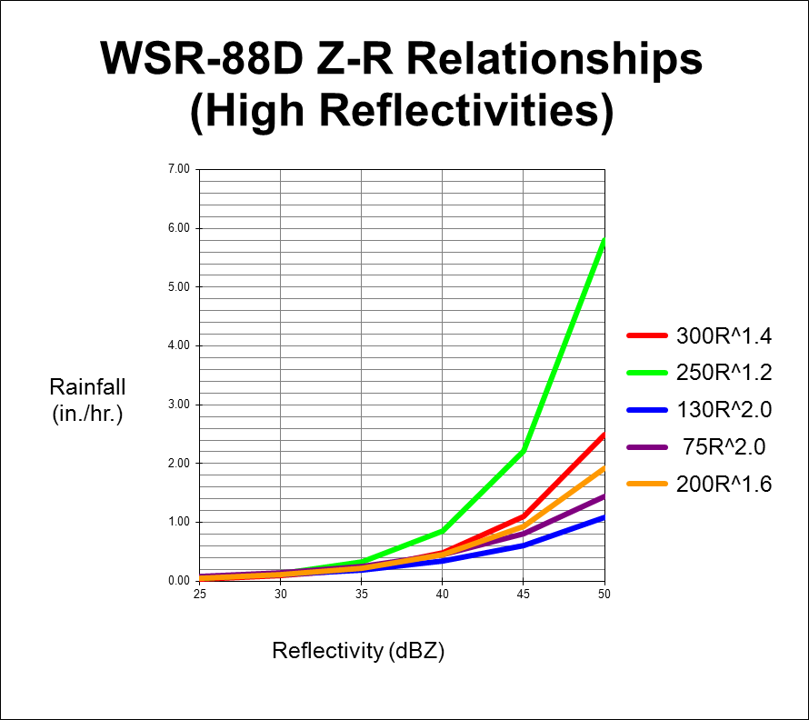
Tropical
Default convective
Tropical
Default
Notes:
This graph shows the impact on estimated rainfall rates of various Z-R relationships. The default/convective relationship yields significantly less rainfall than the tropical relationship at very high reflectivities.

Slide 5
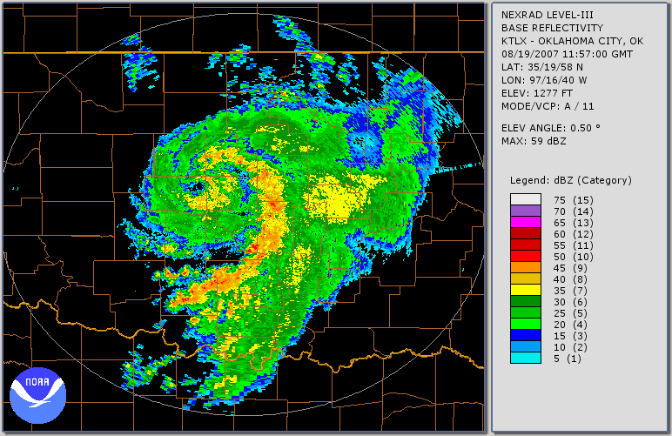
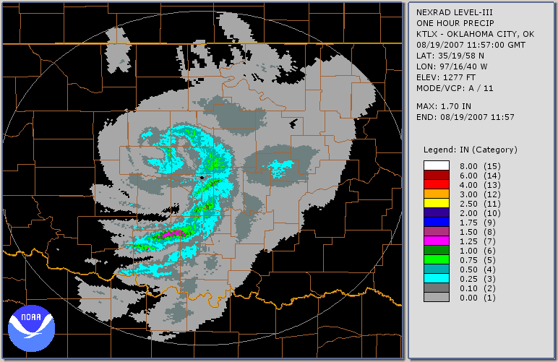
Reflectivity & One-Hour Rainfall Accumulation
0.5 R
11:57Z
19 Aug 07
0.5 OHA
10:57-11:57Z
19 Aug 07
Notes:
These are 0.5 reflectivity & one hour precip. totals for remnants of Tropical Storm Erin over Oklahoma at 11:57 UTC on 08/19.

Slide 6
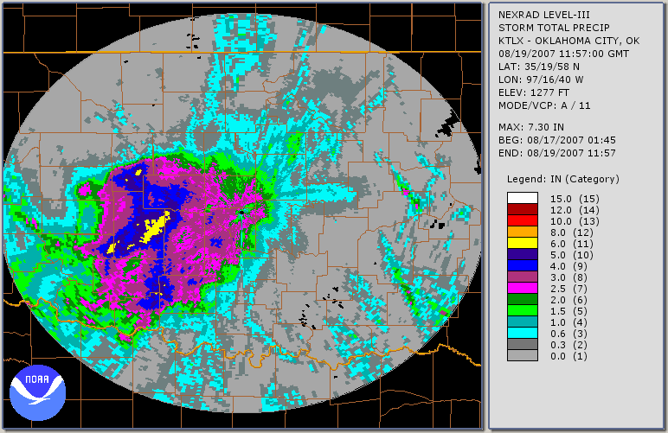
Storm Total Rainfall Ending 11:57 UTC
Notes:
This is an estimate of storm total rainfall (in inches) from remnants of Tropical Storm Erin over Oklahoma as of 11:57 UTC on 08/19.

Slide 7
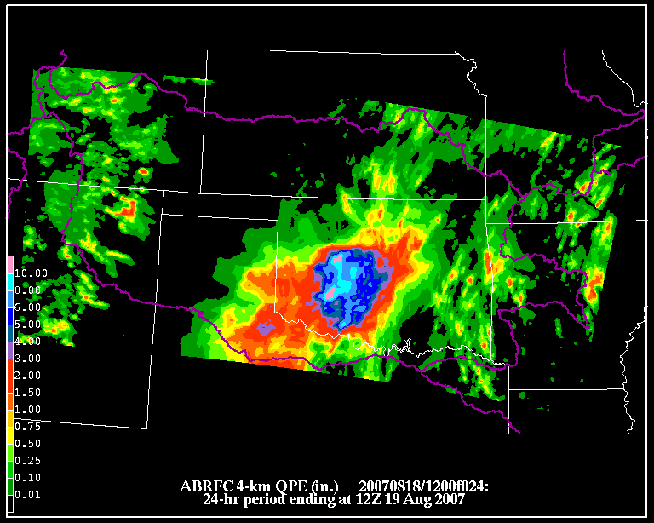
24-hour RFC Rainfall Estimates
(using rain gauge adjustment)
Notes:
Arkansas-Red Basin River Forecast Center rainfall estimation from remnants of Tropical Storm Erin for the 24-hour period ending 12:00 UTC on 08/19. Note that this is a mosaic of data from all WSR-88D radars covering this region. Furthermore, radar rainfall estimates have been adjusted by applying a bias factor from rain gauge data.

Slide 8
2. NSSL’s NMQ/Q2
Inputs for Q2 Precipitation Type:
Radar reflectivity
  Base reflectivity for each radar’s coverage
  Vertical Profile of Reflectivity (VPR)
Environmental data (updated from RUC)
  Surface temperature
  Surface wet bulb temperature
Notes:
These are the primary inputs for the National Mosaic & Multi-Sensor Quantitative Precipitation Estimate (NMQ) version 2 (Q2) developed by the National Severe Storms Laboratory.

Slide 9
Conceptual Model of a VPR with a Bright Band (Melting Layer)
Notes:
The “nose” in the vertical profile of reflectivity comes from the melting layer, a layer of enhanced reflectivity due to water-coated snow flakes as the snow is melting.

Slide 10
NSSL’s Q2 (continued)
Precipitation Types:
Convective rain (from VPR)
Stratiform rain (from VPR)
Tropical rain (from VPR)
Hail (from environmental data)
Snow (from environmental data)
Final Q2 Estimate Adjustments:
Quality Control
Rain Gauge Data
Notes:
This is a summary of the precipitation types identified by Q2 and the final adjustments made when producing Q2 precipitation estimates.

Slide 11
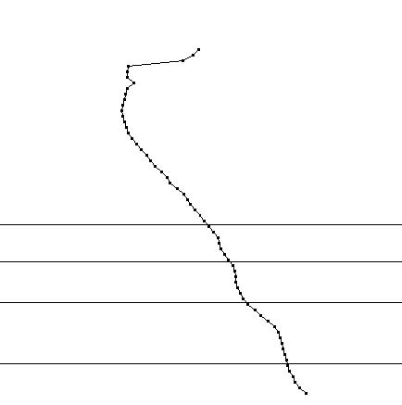
Q2 Precipitation Types Identified by VPR
Convective
Tropical
Stratiform
Notes:
Models of VPRs for the three precipitation types: convective (red), stratiform (blue), and tropical (black). Typically, heaviest tropical rainfall reflectivity is near 30 dBZ (but less than 40 dBZ) near the surface. The tropical VPR usually has a gradual decrease in reflectivity with height. Note that both the convective and stratiform VPRs indicate a melting layer, which very rarely occurs near the center of a tropical cyclone (even though it may be present distant from the center of the cyclone).

Slide 12
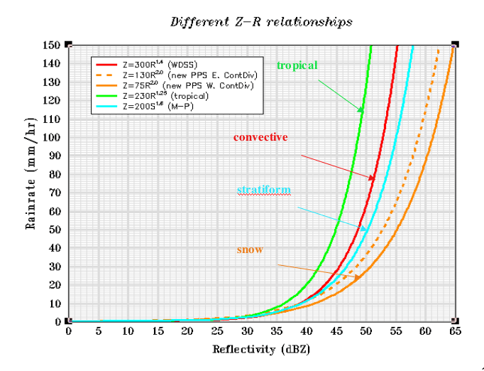
(Illustration from http://www.nssl.noaa.gov/projects/q2/tutorial/q2.php )
Notes:
These are Z-R relationships used by the Q2 system after the VPR, temperature, and other information have identified the precipitation type classification. Note that the tropical relationship is slightly different than the one in slide #4.

Slide 13
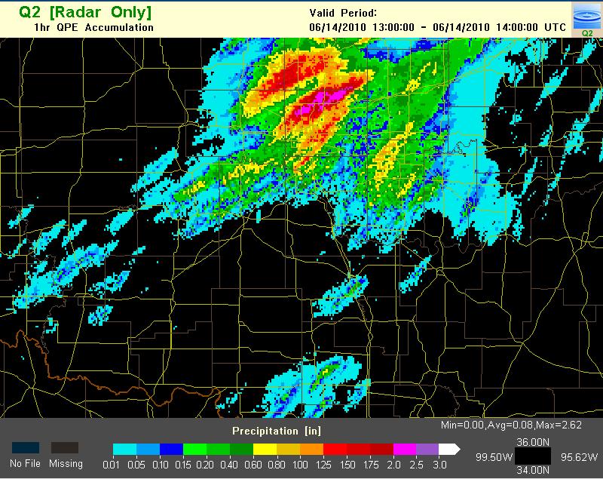
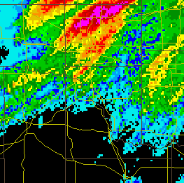
24-hour Q2 Rainfall Estimates
Notes:
NMQ/Q2 rainfall estimation from heavy rainfall event in central Oklahoma, a 1-hour period ending 14:00 UTC on 06/14. Note that this is a mosaic of data from all WSR-88D radars covering this region, although most of this estimate came from the KTLX radar site adjusted by Oklahoma Mesonet gauges.

Slide 14
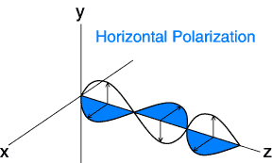
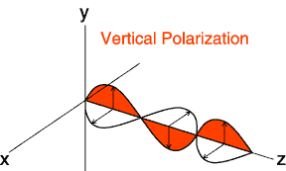
3. Dual Polarization
Notes:
Dual polarization refers to how electromagnetic radiation is processed at a receiver after it was transmitted with a 45-degree orientation. Conventional weather radars (Doppler and otherwise) transmit and receive with horizontal polarization.

Slide 15
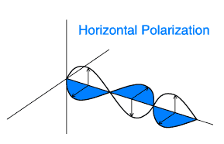
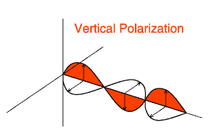
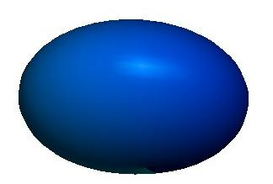



Dual Polarization Overview
Oblong drop
Spherical drop
Hail stone
Ice needle
Notes:
Animation of this slide illustrates how polarization determines the shapes of targets.

Slide 16
Dual Polarization Variables
Differential Reflectivity (ZDR): determines hydro-meteor shape.
  Values (in dB) >> 0 indicate large (hamburger-shaped) droplets, hail, snow flakes, biological targets, etc.;
  Values near 0 indicate spherical shapes, such as drizzle, aggregated or granular snow, small hail
  Values < 0 are usually vertically-oriented ice crystals.
Notes:
This is a description of differential reflectivity and how it determines the shape of a target.

Slide 17
Dual Polarization Variables (cont.)
Correlation Coefficient (CC): indicates consistency or similarity of hydro-meteors
  Values near 1 indicate very uniform targets (e.g., all rain)
  Values << 1 or near 0 are various types of targets (diverse shapes, orientations, and sizes), such as biological targets, ground clutter, melting snow, etc.
Specific Differential Phase (KDP): determines the amount of liquid water causing phase change in radar pulses, particularly the change in phase with distance
  Heavy rain causes largest values of Kdp.
Notes:
These are brief descriptions of correlation coefficient (also called RhoHV) and specific differential phase and how they determine the consistency of and amount of liquid in a target volume within the radar beam.

Slide 18
Quantitative Precipitation Estimate (QPE) Algorithm:
High Level Data Flow
Data Acquisition
Process Base Data (ZDR, KDP, CC, etc.)
Hydrometeor Classification
Algorithm
Melting
Layer
Detection
Algorithm
Hydro Class, Mltg Lyr, & DP variables
DP variable products plus QPE and other DP algorithm products
Environmental
data
Notes:
Radar energy received at the radar antenna is processed to produce dual polarimetric variables along with base data (reflectivity, velocity, and spectrum width). These data are then passed to a set of algorithms: the Hydrometeor Classification Algorithm (HCA), the Melting Layer Detection Algorithm (MLDA), and, finally, the Quantitative Precipitation Estimation (QPE) algorithm. Environmental data from soundings or from the Rapid Update (RUC) model are used to help the MLDA determine the freezing level.

Slide 19
QPE Algorithm Relationship to Hydrometeor Classification Algorithm
Conditions | R method (mm/hr)
Classification is Ground Clutter or Unknown | Not computed
Classification is No Echo or Biological | 0
Light/Moderate Rain is classified | R(Z, ZDR)
Heavy Rain or Big Drops are classified | R(Z, ZDR)
Rain/Hail is classified and echo is below the top of the melting layer | R(KDP)
Rain/Hail is classified and echo is above the top of the melting layer | 0.8*R(Z)
Graupel is classified | 0.8*R(Z)
Wet Snow is classified | 0.6*R(Z)
Dry Snow is classified and echo is in or below the top of the melting layer | R(Z)
Dry Snow classified and is echo above the top of the melting layer | 2.8*R(Z)
Ice Crystals are classified | 2.8*R(Z)
Notes:
Depending upon the classification identified by the Hydrometeor Classification Algorithm (HCA), a relationship is selected to compute a rainfall estimate. Note that the bottom six lines in this table only use reflectivity, where the Z-R relationship (called R(Z) in this table) is the default convective relationship that has been used in the WSR-88D since its first deployment. Three of the relationships make use of dual polarization variables.

Slide 20
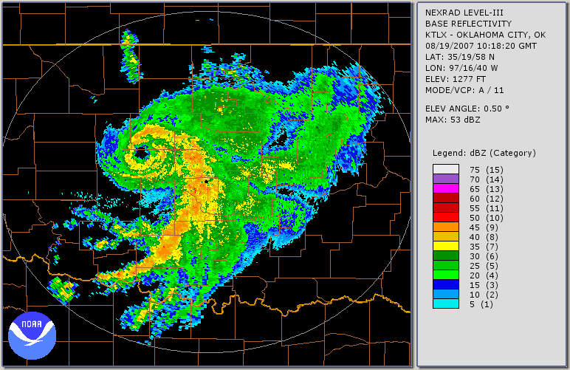
Erin - Base Reflectivity
Notes:
Here is reflectivity during the remnants of Tropical Storm Erin over Oklahoma at 10:18 UTC on August 19th. The red box indicates the focus region for the next few slides.

Slide 21
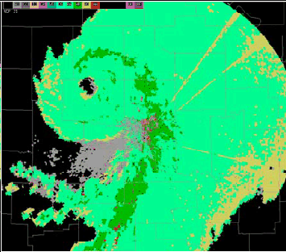
Erin - Hydrometeor Classification
Heavy
Rain
Light or
Moderate
Rain
Biological
Big Drops
Notes:
Here are the classifications from the HCA at approximately 10:18 UTC (corresponding to the reflectivity in the previous slide).

Slide 22
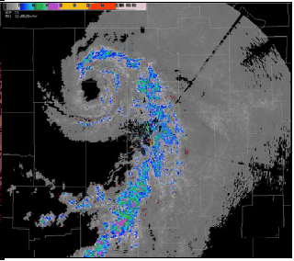
Erin - Polarimetric Rainfall Rate (DPR)
1-2 in/hr
2-3 in/hr
3-4 in/hr
Notes:
This slide is instantaneous rainfall rate (in inches per hour), which is an intermediate step to computing rainfall accumulations for selected periods (e.g., one hour and storm total).

Slide 23
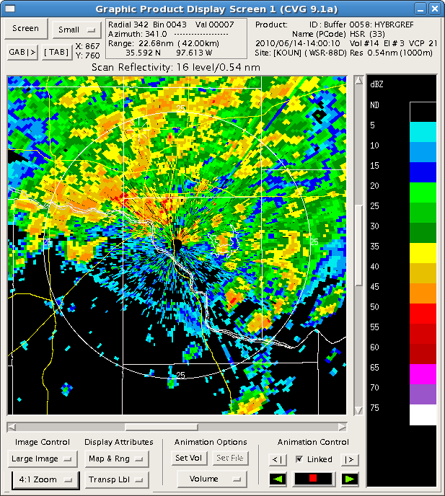
0.5 degree Reflectivity at 1400Z
Notes:
This is 0.5 degree reflectivity at 14:00 UTC on June 14th, 2010, over central Oklahoma. The rainfall event developed early that morning. Pay particular attention to the regions circled in yellow and in orange.

Slide 24
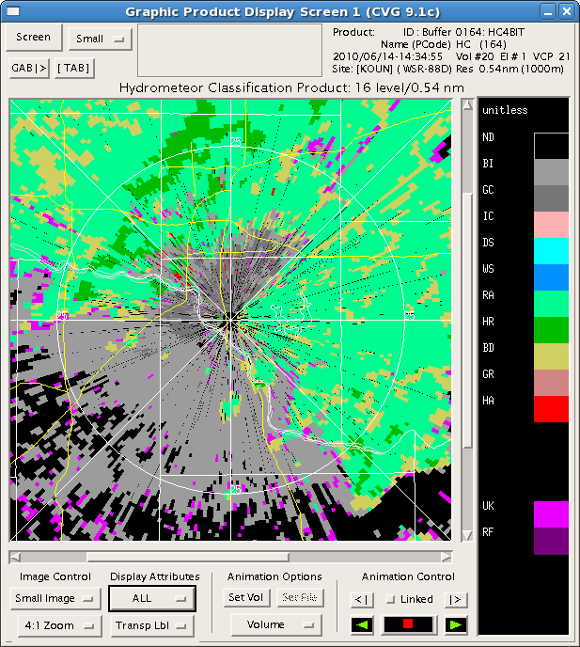
Biological
Ground Clutter
0.5 degree Hydrometeor Classification
at 1434Z
Rain
Heavy Rain
Big Drops
Rain-Hail
Mixture
Unknown
Notes:
The yellow circle includes identification of ground clutter and even some pixels suggesting a rain-hail mixture (even though they are strong clutter targets). The orange oval covers a large amount of biological returns (from birds and insects).

Slide 25
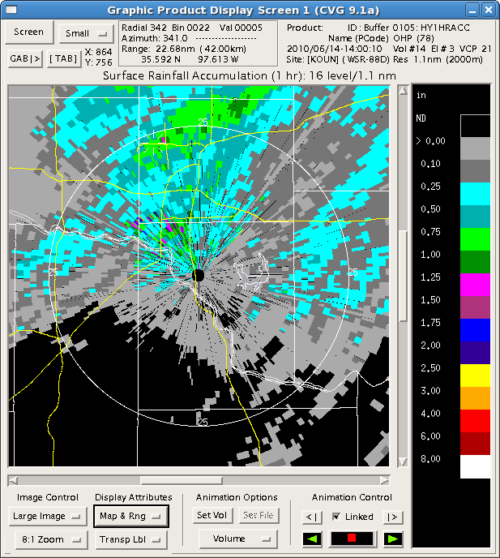
One-Hour Precipi-tation (Legacy Algorithm) at 1400Z
Notes:
The legacy precipitation algorithm computed rainfall from both ground clutter and biological returns.

Slide 26
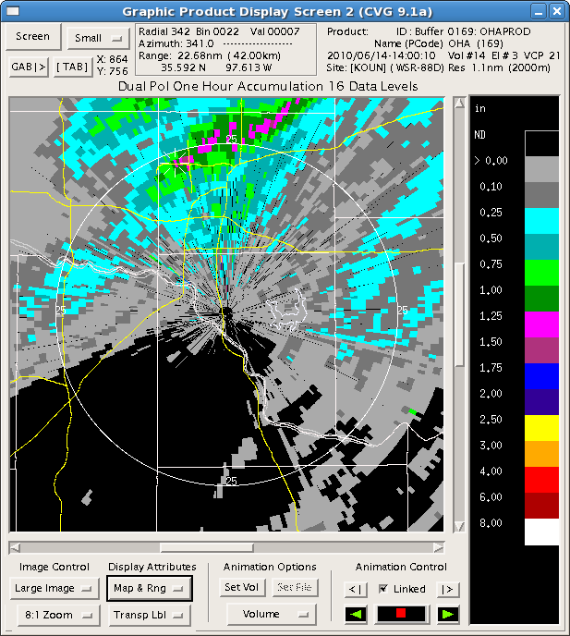
One-Hour Precipi-tation (Dual Pol. Algorithm) at 1400Z
Notes:
The dual polarization algorithms eliminated the ground clutter and biological returns from the rainfall computation. They also appeared to give higher estimates from the band of convection to the north, where heavy rainfall was reported (even though there were no rain gauges there).

Slide 27
Summary
Rainfall estimates originally based on reflectivity alone
  One Z-R relationship chosen by operator, applied to all reflectivity
  Maximum rate “cap” used to mitigate hail contamination
  Estimate can be adjusted by a rain gauge bias factor
NSSL’s NMQ/Q2 applies VPR to determine which conversion relationship to use
  Uses temperature, humidity, and rain gauge data to make adjustments….this is a mosaic product.
Dual Pol. QPE algorithm uses classification data from the HCA to determine what relationship to apply for a given radar echo
  DP data discriminates precipitation from non-precipitation.
  DP can identify hail, removing most hail contamination.
  QPE is no longer limited to only one Z-R relationship for all echoes.

Slide 28
References
Arndt, D. S., J. B. Basara, R. A. McPherson, B. G. Illston, G. D. McManus, and D. B. Demko, 2009: Observations of the Overland Reintensification of Tropical Storm Erin (2007). Bull.Amer. Meteor. Soc., 90, 1079–1093.
Dodson, A., S. Van Cooten, K. Howard, J. Zhang, X. Xu, 2008: Assessing Vertical Profiles of Reflectivity (VPR's) To Detect Extreme Rainfall: Implications for Flash Flood Monitoring and Prediction. Preprints, 22nd Conference on Hydrology- Session 1, Weather To Climate Scale Hydrological Forecasting, New Orleans, LA, USA, AMS, CD-ROM, 1.5.
Moser, H., K. Howard, J. Zhang, and S. Vasiloff, 2010: Improving QPE for Tropical Systems with Environmental Moisture Fields and Vertical Profiles of Reflectivity. In Extended Abstract for the 24th Conf. on Hydrology. Amer. Meteor. Soc.
Saffle, R. E., M. J. Istok, and G. Cate, 2008: NEXRAD product improvement – update 2008. 24th Conference on IIPS, American Meteorological Society Annual Meeting, New Orleans, Louisiana
Xu, X., K. Howard, J. Zhang, 2008: An Automated Radar Technique for the Identification of Tropical Precipitation. J. Hydromet., 9, 885-902.
Zhang, J., K. Howard, S. Vasiloff, C. Langston, B. Kaney, A. Arthur, S. VanCooten, K. Kelleher, D. Kitzmiller, F. Ding, D.-J. Seo, M. Mullusky, E. Wells, T. Schneider, and C. Dempsey, 2009: National Mosaic and QPE (NMQ) System – Description, results and future plans. In Extended Abstract for the 34th Conf. on Radar Meteorology. Amer. Meteor. Soc.
Zhang, J., C. Langston, and K. Howard, 2008: Bright Band Identification Based On Vertical Profiles of Reflectivity from the WSR-88D. J. Atmos. Ocean. Tech., 25, 1859-1872. [ Appendix C (.pdf, 2.0 MB) ]
Notes:
These are references for further information about the topics in this presentation.

